Slide 1
Principled Pragmatism: A Guide to the
Adaptation of Philosophical Disciplines to Conceptual Modeling
David W. Embley, Stephen W. Liddle, & Deryle W. Lonsdale
Brigham Young University, USA
Notes:
Needs a color theme to liven it up.
How long is the presentation supposed to be? (Ans: standard, 30-minute slot: but I’d say that for a workshop, I should try to make the presentation about 20-22 minutes long and leave more time for discussion)

Slide 2
Principled Pragmatism
When adapting ideas
from philosophical disciplines
to conceptual modeling,
find the right balance.
Be neither too dogmatic
(insisting on a discipline-purist point of view)
nor too dismissive
(ignoring contributions other disciplines can make).
Notes:
This assertion is in harmony with the statements on the following three slides.

Slide 3

“What can be explained on fewer principles is explained needlessly by more.”
- William of Ockham, 1288-1343

Slide 4

“I think metaphysics is good if it improves everyday life; otherwise forget it.”
“The solutions all are simple … after you’ve already arrived at them. But they’re simple only when you already know what they are.”
– Pirsig

Slide 5
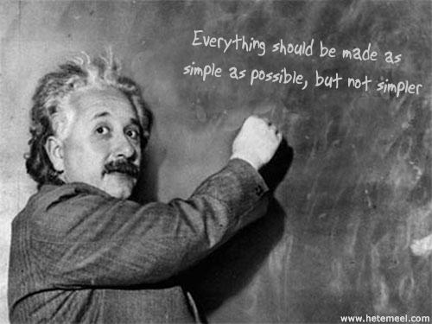

Slide 6
Principled Pragmatism
(by example)
}
Information Extraction
& Finding Facts in Historical Documents
Learning, Prediction, and Analysis
& Conceptual-Modeling Languages
Information Integration
& Multilingual Query Processing
Practical
use
}
Modeling
reality
}
Additional
help
Notes:
Pair 1: applications that focus on essential, practical use of ontology, epistemology, logic, linguistics
Pair 2: focus on applications in which modeling reality is emphasized
Pair 3: focus on applications in which there is a need for additional help from the disciplines
Our pragmatism views ontologies as formal specifications of some domain that are simple enough that users can encode them without extensive experience in knowledge engineering or the truth-maintenance systems typically used for large-scale ontology development. We maintain simplicity by minimally selecting and adapting ideas from each of
the disciplines in a combination that appropriately enhances our application.
To illustrate the principled pragmatism we advocate, we present several case-study examples. For each case study, we explain how the disciplines of ontology, epistemology, logic, and linguistics guide the theoretical conceptual-modeling underpinnings of these applications. We also show that as the applications become more complex, they draw more heavily on philosophical disciplines for support. Thus, the relationship between philosophical disciplines and conceptual-modeling applications becomes blurred so that it is no longer clear whether the artifact produced is a conceptual model or whether it is an ontology drawing heavily on conceptualizations from epistemology, logic, and linguistics. Further, we argue: it does not matter. What matters is that the application is well-served by the artifact and that researchers are able to build serviceable applications by making good synergistic combinations of ideas drawn from the overlapping disciplines of conceptual modeling, ontology, epistemology, logic, and linguistics.

Slide 7
Principled Pragmatism
(by example)
}
Information Extraction
& Finding Facts in Historical Documents
Learning, Prediction, and Analysis
& Conceptual-Modeling Languages
Information Integration
& Multilingual Query Processing
Practical
use
synergistic combinations of ideas drawn from the overlapping disciplines of conceptual modeling, ontology, epistemology, logic, and linguistics
}
Modeling
reality
}
Additional
help
Notes:
Pair 1: applications that focus on essential, practical use of ontology, epistemology, logic, linguistics
Pair 2: focus on applications in which modeling reality is emphasized
Pair 3: focus on applications in which there is a need for additional help from the disciplines
Our pragmatism views ontologies as formal specifications of some domain that are simple enough that users can encode them without extensive experience in knowledge engineering or the truth-maintenance systems typically used for large-scale ontology development. We maintain simplicity by minimally selecting and adapting ideas from each of
the disciplines in a combination that appropriately enhances our application.
To illustrate the principled pragmatism we advocate, we present several case-study examples. For each case study, we explain how the disciplines of ontology, epistemology, logic, and linguistics guide the theoretical conceptual-modeling underpinnings of these applications. We also show that as the applications become more complex, they draw more heavily on philosophical disciplines for support. Thus, the relationship between philosophical disciplines and conceptual-modeling applications becomes blurred so that it is no longer clear whether the artifact produced is a conceptual model or whether it is an ontology drawing heavily on conceptualizations from epistemology, logic, and linguistics. Further, we argue: it does not matter. What matters is that the application is well-served by the artifact and that researchers are able to build serviceable applications by making good synergistic combinations of ideas drawn from the overlapping disciplines of conceptual modeling, ontology, epistemology, logic, and linguistics.

Slide 8
Information Extraction
Toward a Web of Knowledge (WoK)
Philosophical disciplines
  What exists? (Ontology)
  What facts are known? (Epistemology)
  What’s implied by known facts? (Logic)
  How are the facts communicated? (Linguistics)
And their role in WoK development
Notes:
Should add “Cognitive Science” (Antoni’s suggestion): the interdisciplinary scientific study of mind and its processes. It examines what cognition is, what it does and how it works. It includes research on how information is processed (in faculties such as perception, language, memory, reasoning, and emotion), represented, and transformed in behaviour, (human or other animal) nervous system or machine (e.g., computer).
What exists in our domain of interest? (objects and relationships)
What’s known in our domain of interest? (facts)
What’s implied by what’s known? (implied facts)
What’s communicated? (how to we talk/write about objects, relationships, facts, implied facts)
Make point: use of disciplines to solve problem
(should also be able to point out something about principled pragmatism)

Slide 9
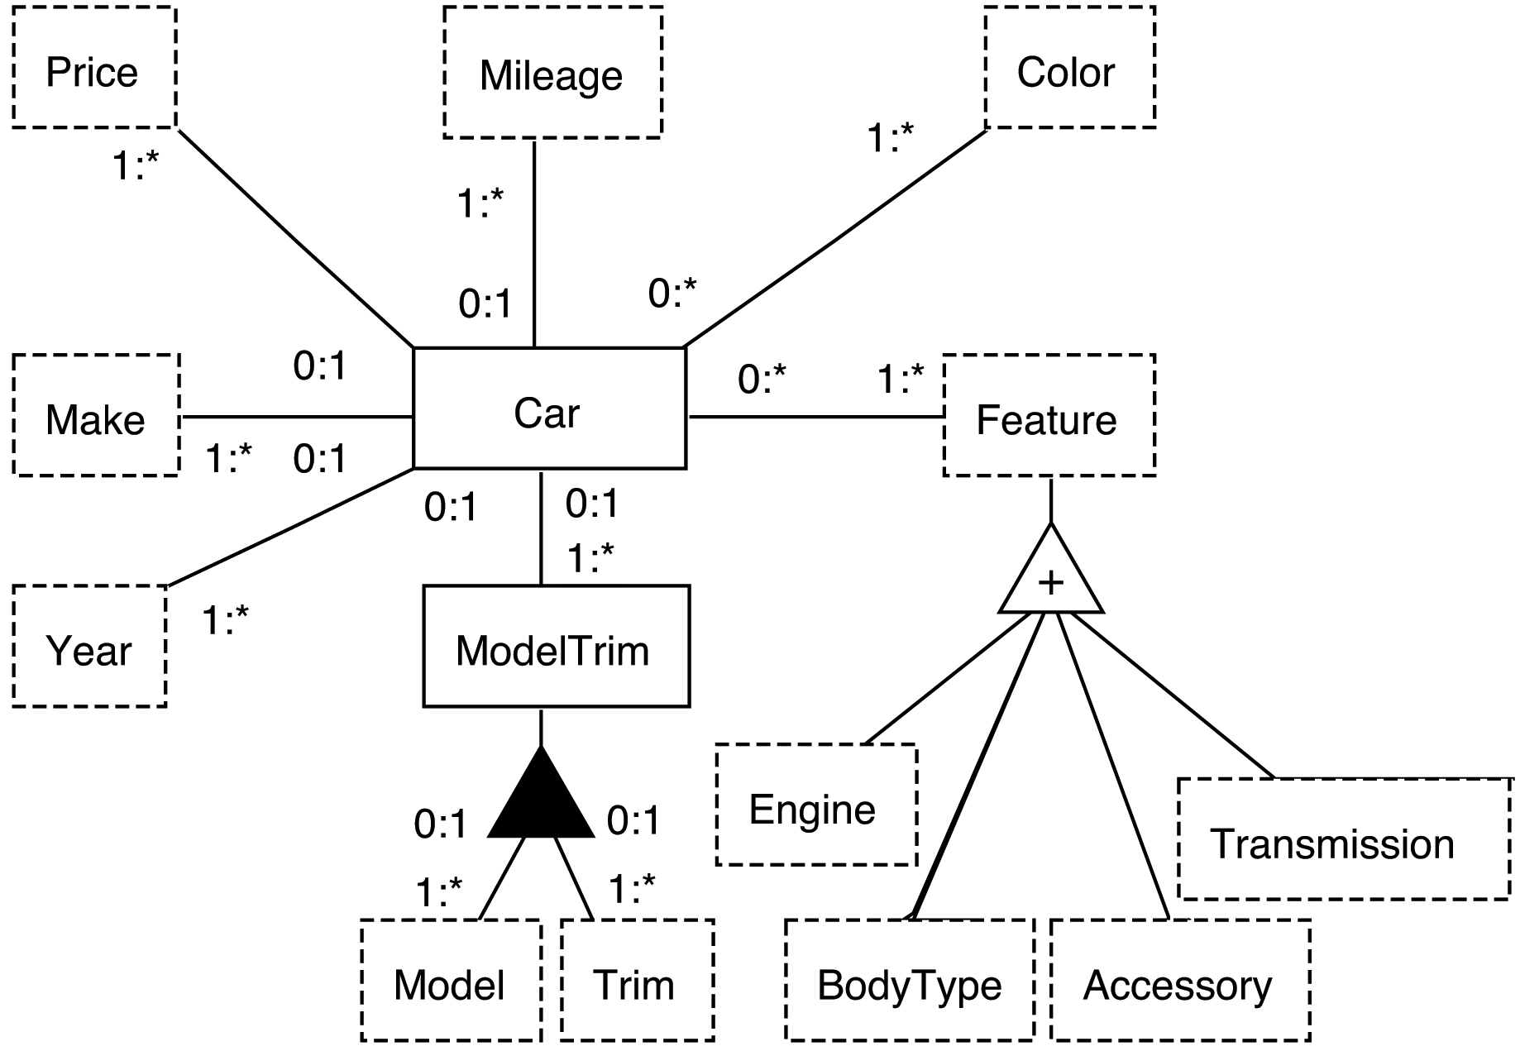
Ontology
Study of Existence ⎯ asks “What exists?”
Concepts, relationships, and constraints
Notes:
Study of being, existence, reality, …

Slide 10
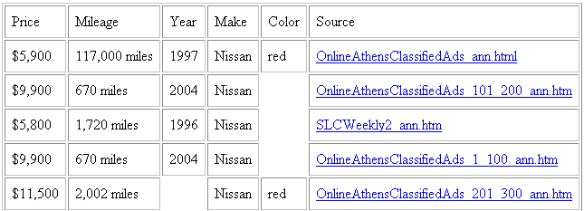
Epistemology
The nature of knowledge ⎯ asks: “What is knowledge?” and “How is knowledge acquired?”
Populated conceptual model

Slide 11
Logic
Principles of valid inference ⎯ asks: “What can be inferred?”
For us, it answers: what can be inferred (in a formal sense) from conceptualized data.
Find price and mileage of red Nissans, 1990 or newer
Notes:
Inferred: facts like how old they are and the fact that they are cars are for sale and can be purchased.
More formally, implied facts based on predicate calculus – will see better later.

Slide 12
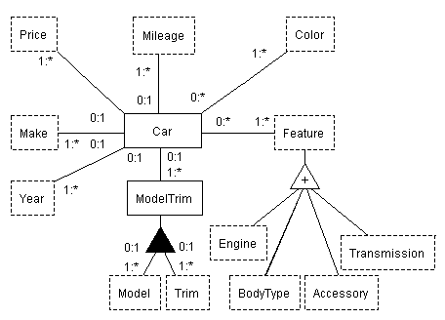
Linguistics: Communication
(Turning Raw Symbols into Knowledge)
Symbols: $ 4,500 117K Nissan CD AC
Data: price($4,500) mileage(117K) make(Nissan)
Conceptualized data:
  Car(C₁₂₃) has Price($11,500)
  Car(C₁₂₃) has Make(Nissan)
Knowledge:
  “Correct” facts
  Provenance

Slide 13
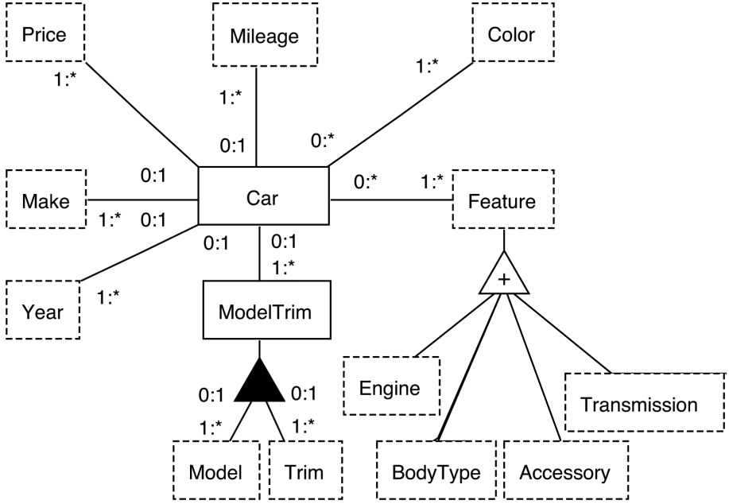
Linguistics: Communication
(Turning Raw Symbols into Knowledge)
Symbols: $ 4,500 117K Nissan CD AC
Data: price($4,500) mileage(117K) make(Nissan)
Conceptualized data:
  Car(C₁₂₃) has Price($4,500)
  Car(C₁₂₃) has Make(Nissan)
Knowledge:
  “Correct” facts
  Provenance

Slide 14
IE Actualization (with Extraction Ontologies)
Find me the price and
mileage of all red Nissans. I want a 1990 or newer.
Notes:
Again, use of linguistics to “understand” query.

Slide 15

IE Actualization (with Extraction Ontologies)
Linguistic “understanding”
of query.
Find me the price and
mileage of all red Nissans. I want a 1990 or newer.
≥ 1990
Notes:
Again, use of linguistics to “understand” query.

Slide 16
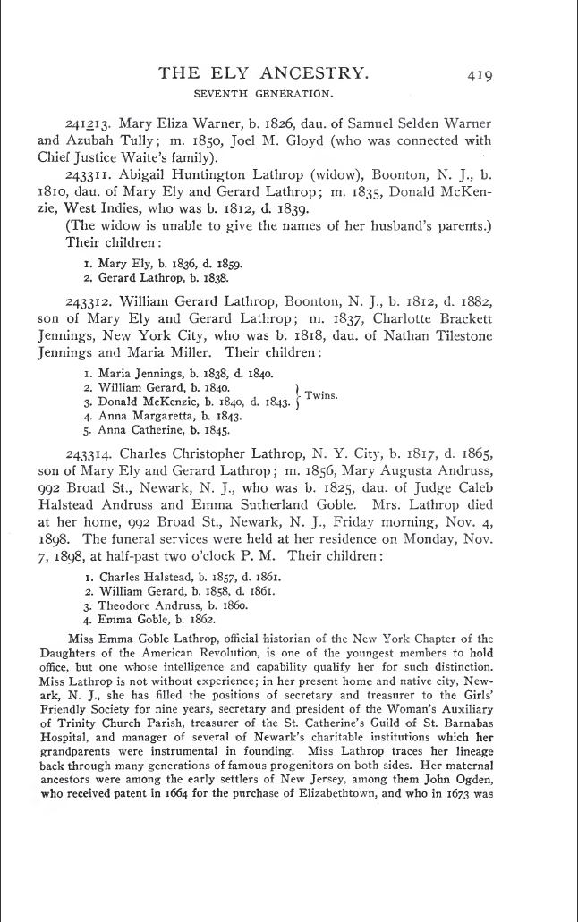
Finding Facts in Historical Documents
(A Web of Knowledge Superimposed over
Historical Documents)
Notes:
Automatic extraction builds links.

Slide 17
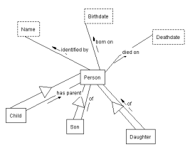
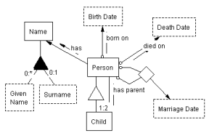
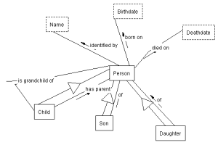
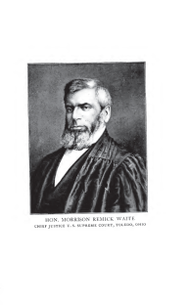

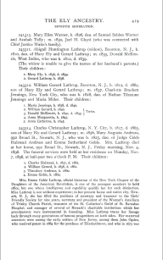
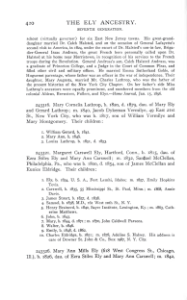
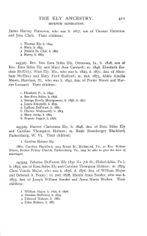
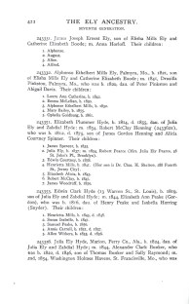
Finding Facts in Historical Documents
(A Web of Knowledge Superimposed over Historical Documents)
…
…
…
…
Notes:
Automatic extraction builds links.

Slide 18
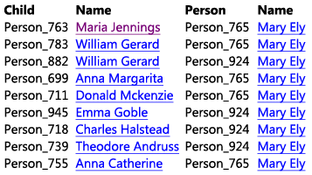
Finding Facts in Historical Documents
(A Web of Knowledge Superimposed over Historical Documents)
grandchildren of Mary Ely
…
…
…
…

Slide 19
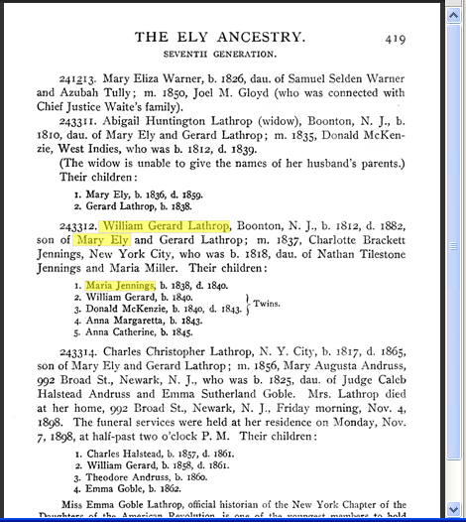
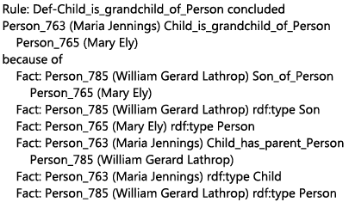
Finding Facts in Historical Documents
(A Web of Knowledge Superimposed over Historical Documents)
grandchildren of Mary Ely
…
…
…
…
Notes:
Mockup as designed. Actual implementation quite close. The differences point to where we need to add finishing touches.

Slide 20
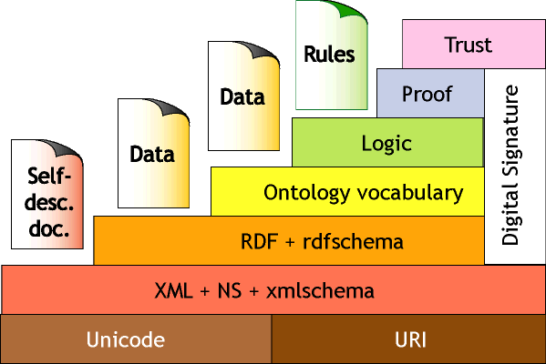
Finding Facts in Historical Documents (Nicely illustrates the Layer Cake of the Semantic Web)
Notes:
Automatic extraction builds links.

Slide 21
Information Extraction & Fact Finding
(& Principled Pragmatism: Upper/Lower Bounds)
Ontology
  Ontological commitment via name in historical book
  But not meta-physical existence of a person
Epistemology:
  Verification via historical document display
  But not a requirement of full community agreement
Logic:
  Implied facts grounded in the ontology
  But only computationally reasonable implied facts
Linguistics:
  Communicated facts of an ontology
  But not full understanding
Notes:
Summary for IE and Finding Facts for Historical Documents
ontological commitment = name in family history book, but not a requirement to understand what constitutes the existence of a person in the meta-physical sense
* epistemology = grounded in “original documents” (actually secondary sources in my example, but in any case provenance is provided), but not full community agreement required to declare something to be known (perhaps wikipedia style in the sense that anyone can edit but …)
* logic = implied facts grounded in the ontology but only computationally “reasonable” implied facts
* linguistics = the communicated facts and implied facts wrt the ontology, and here we would like more: bootstrapping via ListReader (or other semistructured reader) leading to creation of dictionaries and recognizers for further extraction, then tailored Hust patterns … and then more: coreferences, part of speech, …

Slide 22

Learning, Prediction, and Analysis
(Principle: model the real/abstract world the way it is.)
Pastor, et al.,
Handbook of Conceptual Modeling
Notes:
As opposed to modeling the programming world.

Slide 23

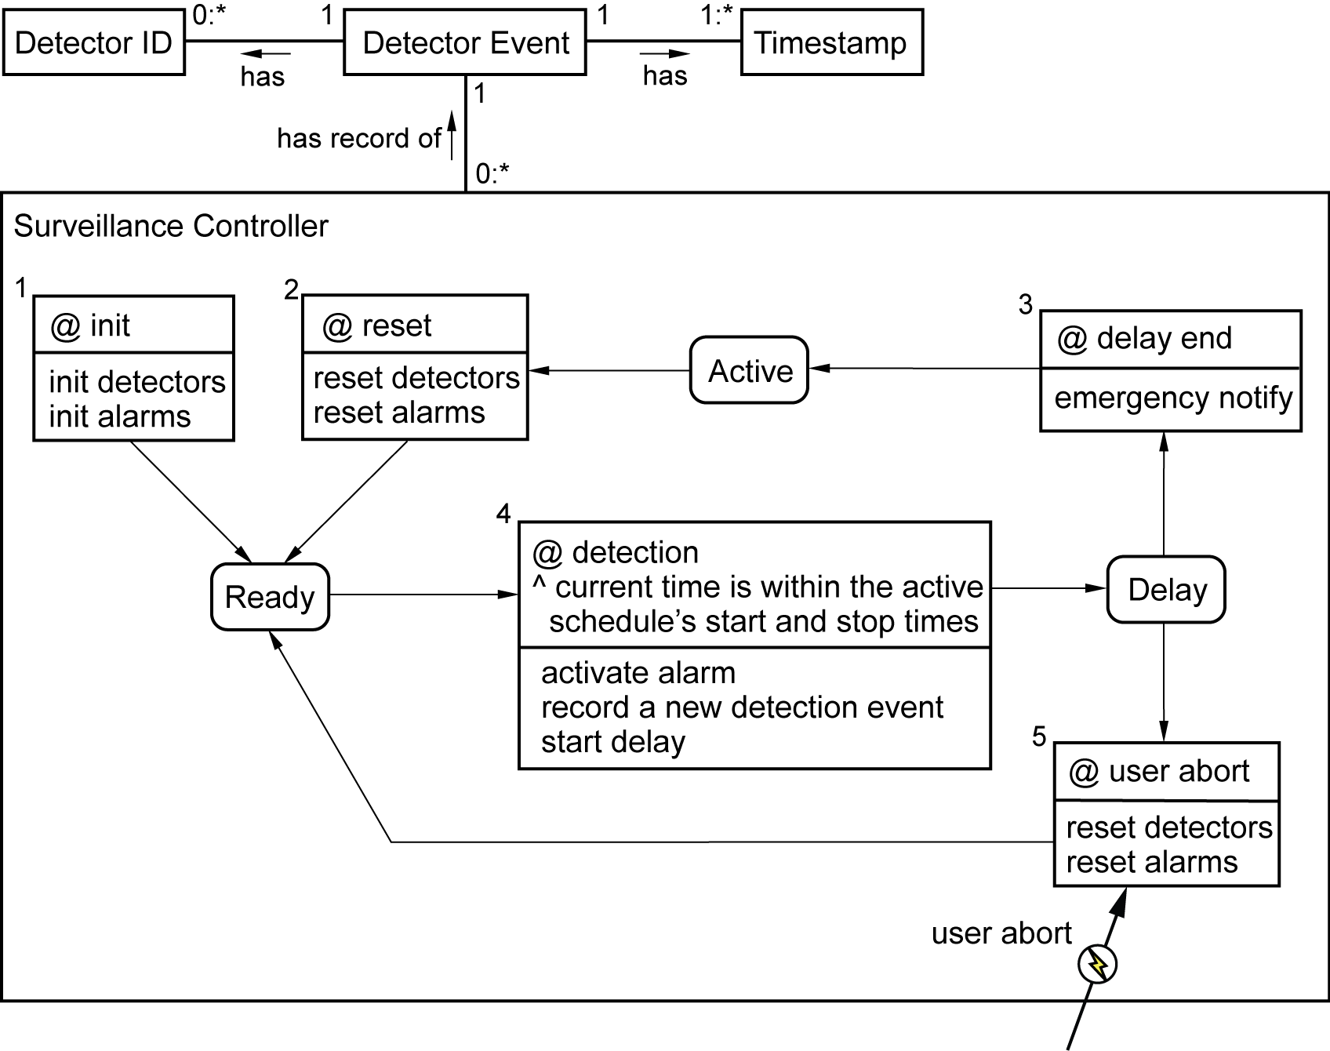


Learning & Prediction Home Security
(Principle: model the real/abstract world the way it is.)
Notes:
Will take as an example to show formalism, fact & metadata creation (extract from newspaper, threats to home ??).
Many conceptual models; many formalizations of conceptual models; many that integrate static models, behavior models, interaction models, … (see references)
Likely important: Objects, Relationships, Behavior, Interaction all modeled together in a conceptual model.
Eventual application (miniscule example wrt to the larger picture, but nonetheless an example): analyze “Detection Event” sequences.
Reference to formalisms (Dori 11, OPM: Object-Process Methodology; EKW, OSM; Thalheim 00, CoDesign)
With both model and meta-model intertwined we have a something like the “tangled hierarchy” described by (Douglas R. Hofstadter in Gödel, Escher, Bach: an Eternal Golden Braid))

Slide 24
Learning & Prediction Home Security
(Principle: model the real/abstract world the way it is.)
Detection Event(x) has Detector ID(y) (t₁, t₂)
Detection Event(x) has Timestamp(y) (t₁, t₂)
Surveillance Controller(x) has record of Detection Event(y) (t₁, t₂)
Surveillance Controller(x) in state Active(t₁, t₂)
Surveillance Controller(x) transition 5 enabled(t1, t2)
user abort(t₁)
Notes:
Will take as an example to show formalism, fact & metadata creation (extract from newspaper, threats to home ??).
Many conceptual models; many formalizations of conceptual models; many that integrate static models, behavior models, interaction models, … (see references)
Likely important: Objects, Relationships, Behavior, Interaction all modeled together in a conceptual model.
Eventual application (miniscule example wrt to the larger picture, but nonetheless an example): analyze “Detection Event” sequences.
Reference to formalisms (Dori 11, OPM: Object-Process Methodology; EKW, OSM; Thalheim 00, CoDesign)
With both model and meta-model intertwined we have a something like the “tangled hierarchy” described by (Douglas R. Hofstadter in Gödel, Escher, Bach: an Eternal Golden Braid))

Slide 25
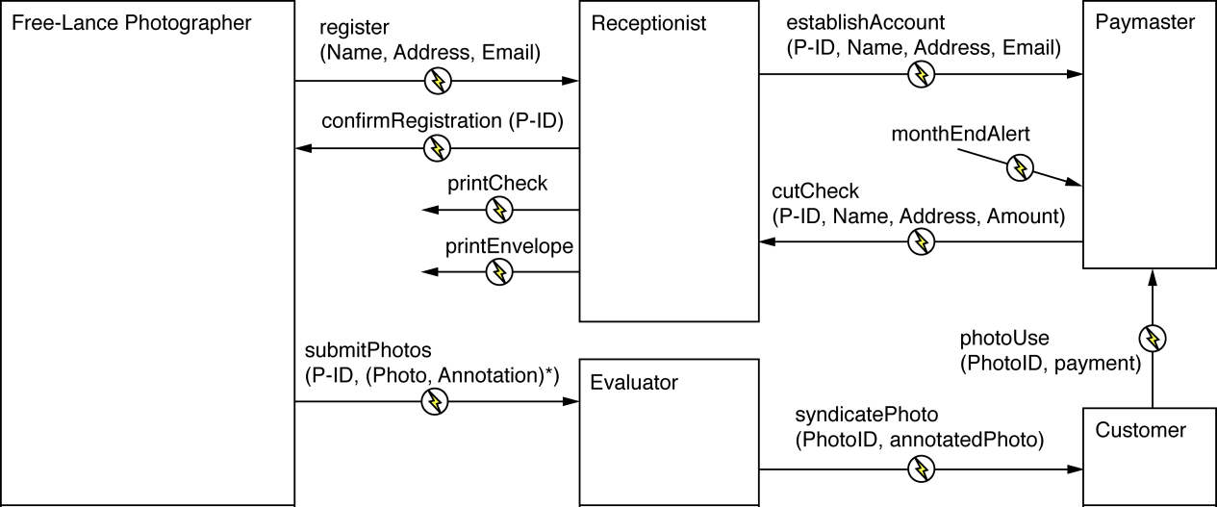
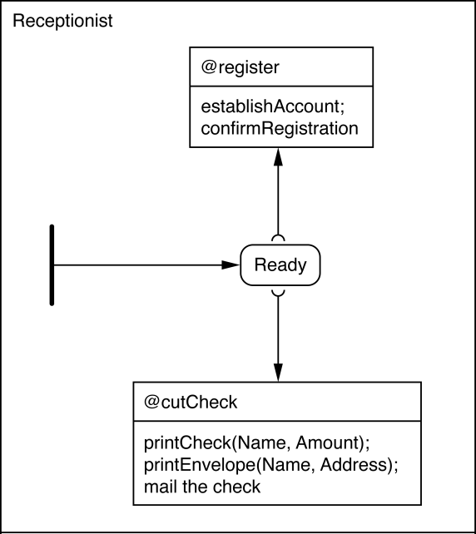
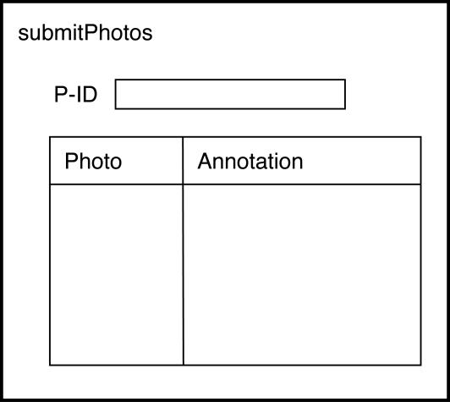
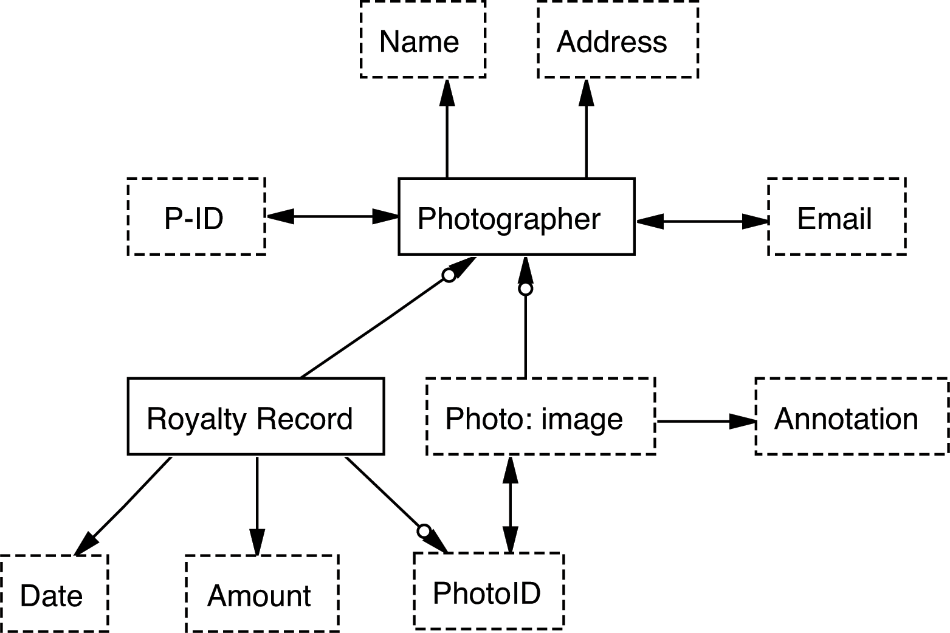
Conceptual Modeling Languages
(Principle: model the real/abstract world the way it is.)
Notes:
Idea: don’t model pgmg, model the real (or abstract) world the way it is
This point of view itself, illustrates, the use of disciplines
Not getting carried away illustrates the point about principled pragmatism
Later we worry about mapping – could show, but even better:
Show that this leads to a new pgmg lang, a model-equivalent lang & the manifesto

Slide 26
Conceptual Modeling Languages
(Principle: model the real/abstract world the way it is.)
@ create then
enter Ready
end;
when Ready
@ register then
new thread;
establishAccount;
confirmRegistration;
kill thread;
end;
when Ready
@ cutCheck then
new thread
printCheck(Name, Amount);
printEnvelope(Name, Address);
kill thread;
end;
Notes:
Idea: don’t model pgmg, model the real (or abstract) world the way it is
This point of view itself, illustrates, the use of disciplines
Not getting carried away illustrates the point about principled pragmatism
Later we worry about mapping – could show, but even better:
Show that this leads to a new pgmg lang, a model-equivalent lang & the manifesto

Slide 27
Conceptual Modeling Languages
(Principle: model the real/abstract world the way it is.)
@ create then
enter Ready
end;
when Ready
@ register then
new thread;
establishAccount;
confirmRegistration;
kill thread;
end;
when Ready
@ cutCheck then
new thread
printCheck(Name, Amount);
printEnvelope(Name, Address);
kill thread;
end;
CMP Manifesto:
“Conceptual Model Programming”
“The model is the code.”
Notes:
Idea: don’t model pgmg, model the real (or abstract) world the way it is
This point of view itself, illustrates, the use of disciplines
Not getting carried away illustrates the point about principled pragmatism
Later we worry about mapping – could show, but even better:
Show that this leads to a new pgmg lang, a model-equivalent lang & the manifesto

Slide 28
Real-World Modeling
& Principled Pragmatism
Capture the abstraction literally,
But don’t go beyond:
  Neither too much like programming languages
    Messages sent are sometimes not received
    Transitions really do take time
    Objects really can do two things at once
  nor too much on meta-physical existence properties
    People have intuition, but program artifacts don’t
    Objects have rigidity properties, but all need not be specified
Notes:
Meta-physical = philosophical
Summary for Learning,

Slide 29
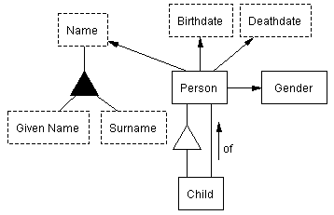
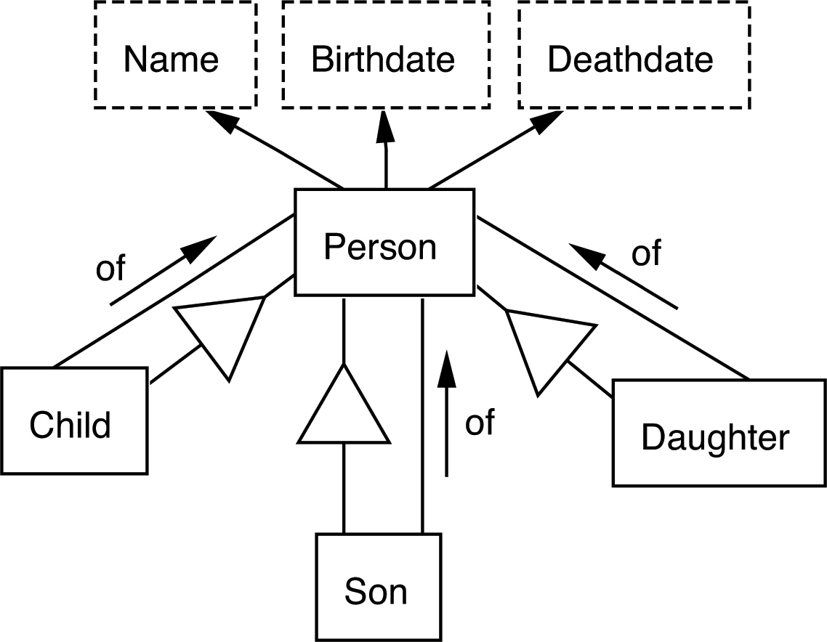
Information Integration
Additional help needed from philosophical disciplines
Notes:
Accurate conceptualizations tend to help in the integration process.
Logic based on localized custom appears to be necessary here – sometimes difficult to capture computationally.

Slide 30
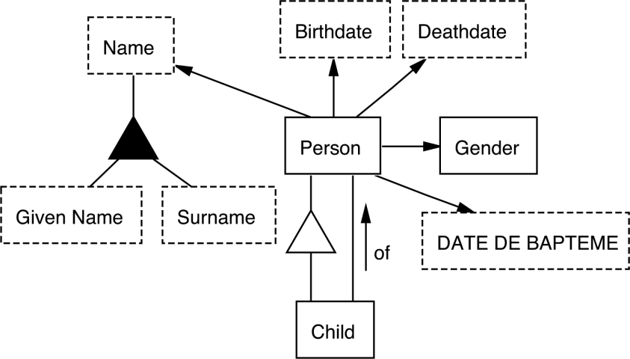
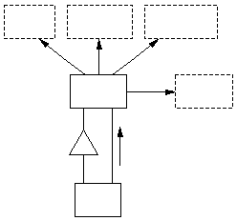
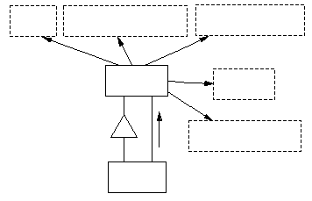
Multilingual Query Processing
Wie alt war Mary Ely als ihr Son William geboren wurde? (die Mary Ely die Maria Jennings Lathrops Oma ist)
이름
생년월일
사망날짜
nom
date de naissance
date de décès
…
사람
성별
individu
sexe
의
Additional help needed from philosophical disciplines
de
date de baptême
자식
enfant
Notes:
It doesn’t matter what language, many app domains are the same
Multilingual ontologies leverages this point – models the world in a
language-independent manner
Language independent model (English, although could use symbols (e.g., man/woman symbols for Gender) and a mixture of languages.

Slide 31
Additional Help Needed: Examples
Ontology
  Issue: ontological commitment distinguishing person, place, & thing
  Solution? reliance on plausible relationships & context
Epistemology
  Issue: trust
  Solution?
    grounding facts in source documents
    evidence-based community agreement
    probabilistic plausibility
Logic
  Issue: tractability
  Solution? detect long-running queries; interactive resolution
Linguistics
  Issue: rapid construction of mappings
  Solution? use of WordNet and other lexical resources
Notes:
Admit that this is rough and speculative. HOWEVER, make the point that even though I may not know the solutions the best, I do know that once I have an issue, I know where to go look for answers—in the philosophical disciplines.
Ontology: accurate conceptualizations should aid in integration; may need more powerful conceptual models and a way to come to community agreement
Epistemology: If anyone can declare a fact, we should make it possible for the fact to be verified (to the extent possible).
Logic: I suspect that users will wish to ask queries that cannot be answered in real time; in an interaction with the user, the system should be able to determine whether it should proceed or not and help the user write a more reasonable query or at least know that it will take a long time to answer the question. Decidability could be much the same: in general, if we allow for logic systems that are undecidable, many queries may nevertheless be decidable.
Linguistics: Linguistic resources should be helpful in quickly generating mappings both for integration and multilingual ontologies.

Slide 32

Summary & Conclusion
Principles from philosophical disciplines
  Can guide CM research
  Can enhance CM applications
Apply principles pragmatically:
  Simplicity
  Sufficiency
  But not overzealously
BYU Data Extraction Research Group
www.deg.byu.edu
Notes:
Take home message: Conceptual-model researchers should draw ideas and seek guidance from the disciplines of ontology, epistemology, logic, and linguistics to enhance conceptual-modeling applications, but should not become distracted from computationally practical solutions by insisting that philosophical tenets should prevail. (Occam’s Razor; Einstein’s maxim)

