Slide 1
Extracting Data Automatically from Scanned Books with OntoSoar
Peter Lindes
Family Search Internship, 2015

Slide 2
Agenda
What we can do
How it is done
Overall results

Slide 3
What we can do …

Slide 4
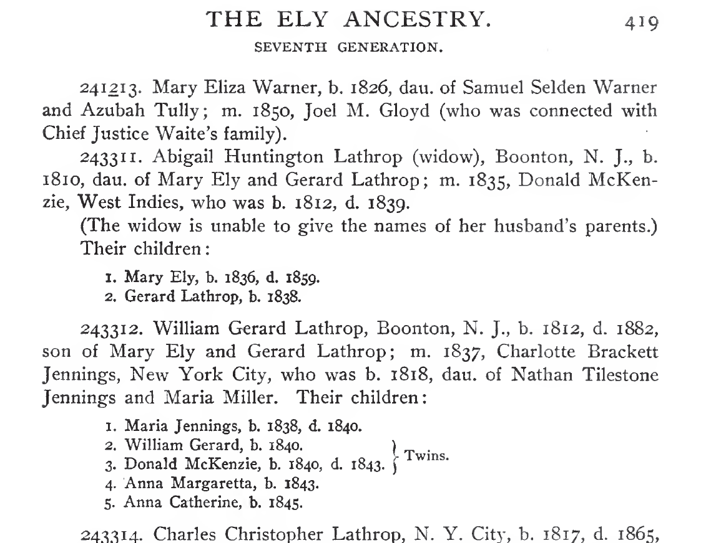
From this …

Slide 5
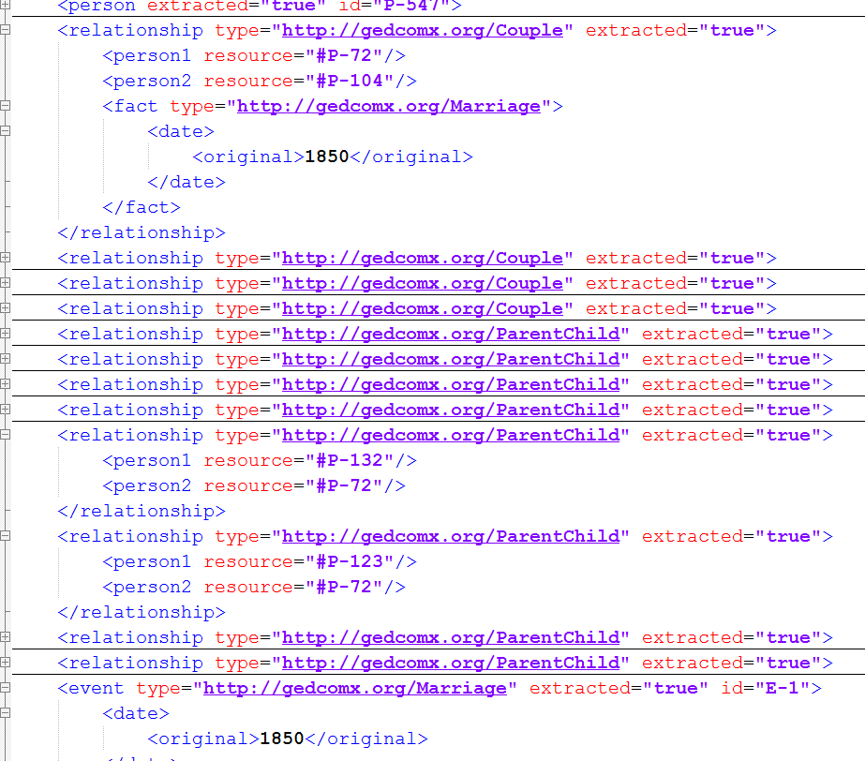
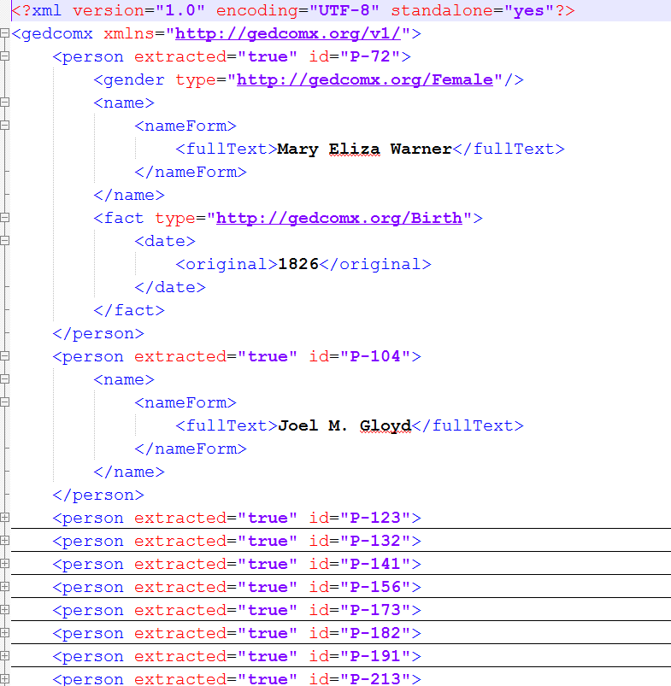
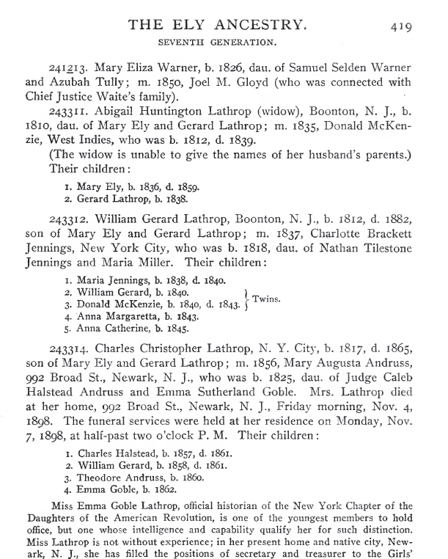
… to this!

Slide 6
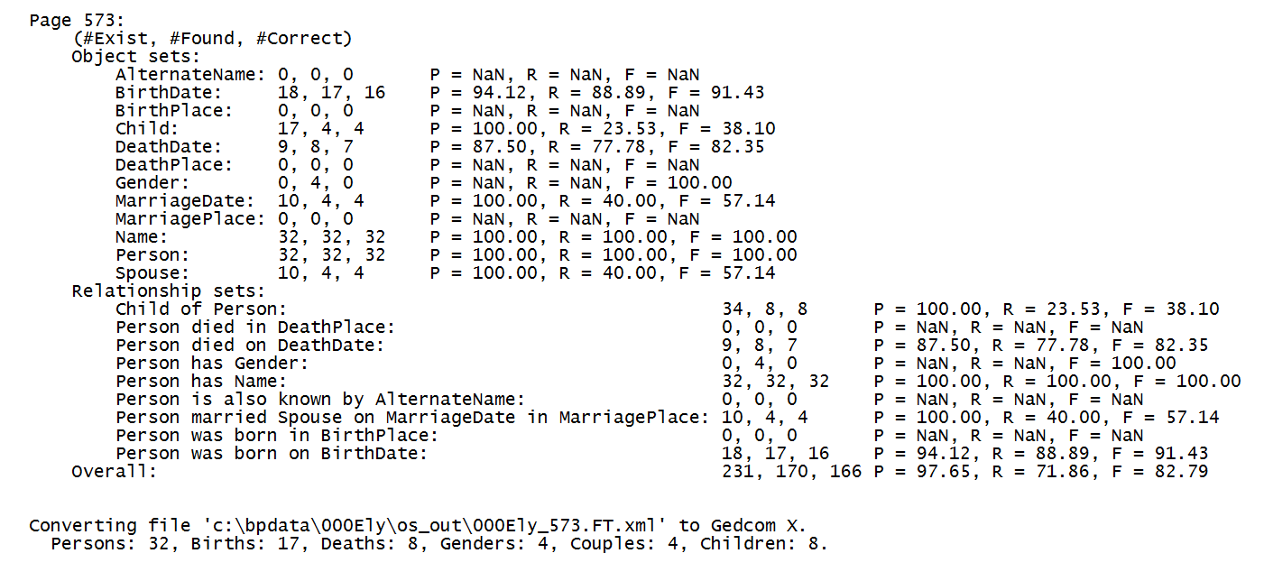
… plus this.

Slide 7
How it is done …

Slide 8
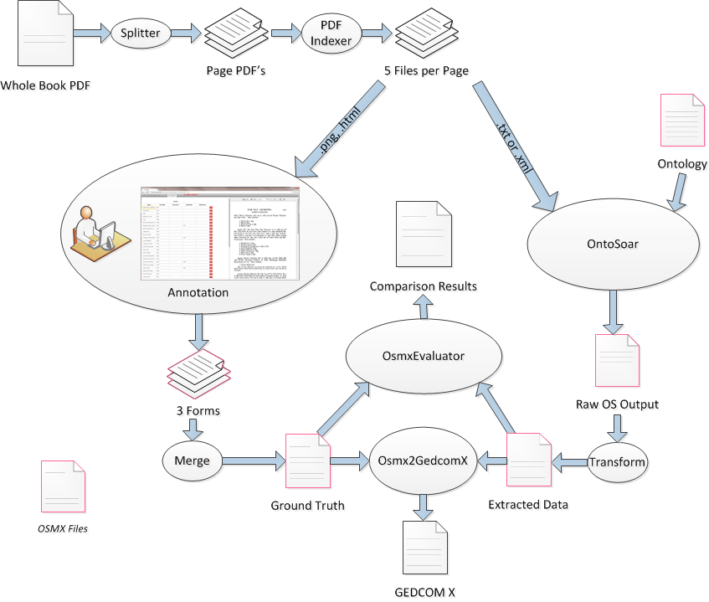
Book Project Data Flow

Slide 9
How OntoSoar works …

Slide 10
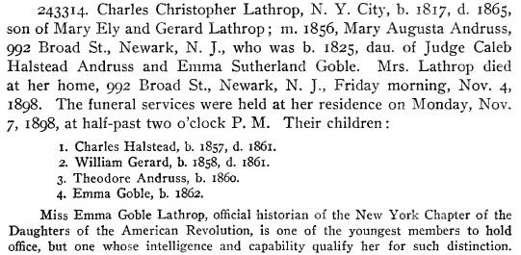
The Problem: Example 1

Slide 11
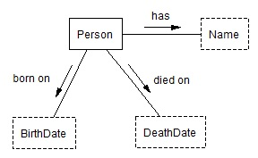
A Simple Ontology
has
Charles Christopher Lathrop
born on
died on
1817
1865

Slide 12
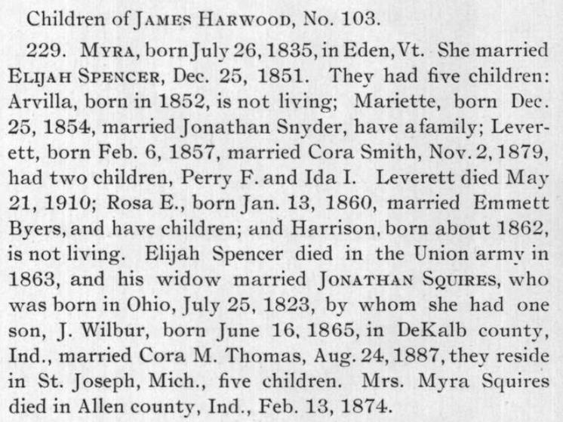
The Problem: Example2

Slide 13
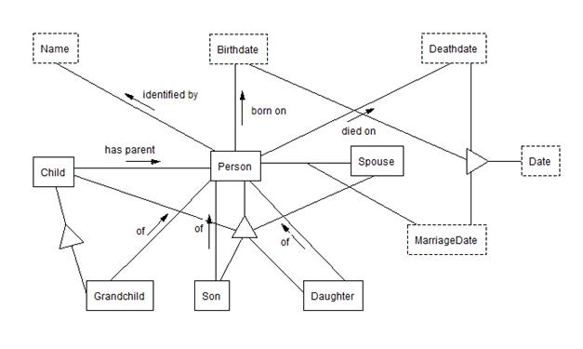
A More Complex Ontology
Myra Harwood
Feb. 13, 1874
Jonathan Squires
J. Wilbur Squires

Slide 14
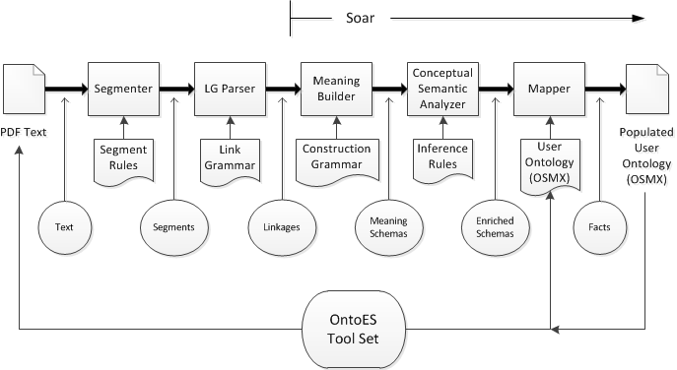
OntoSoar Architecture

Slide 15
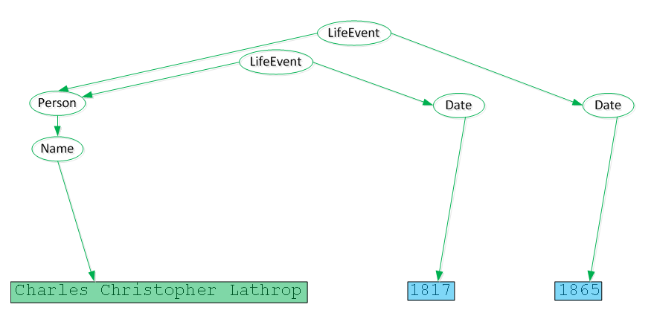
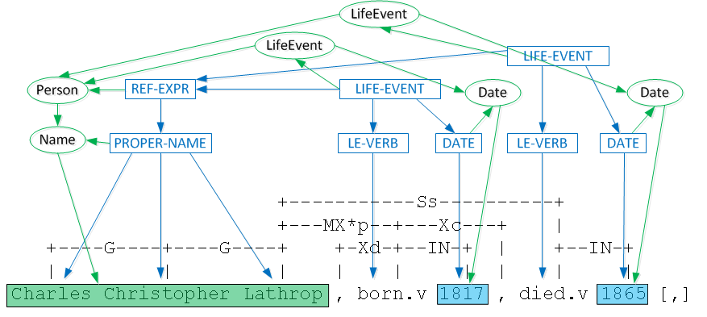
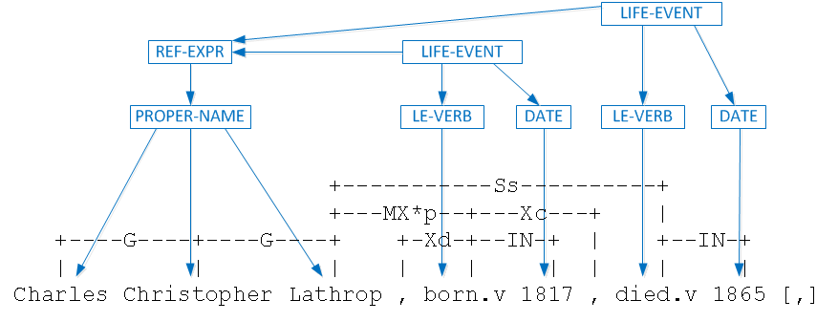
Applying Construction Grammar
Charles Christopher Lathrop, N. Y. City, b. 1817, d. 1865, son of Mary Ely and Gerard Lathrop ;

Slide 16
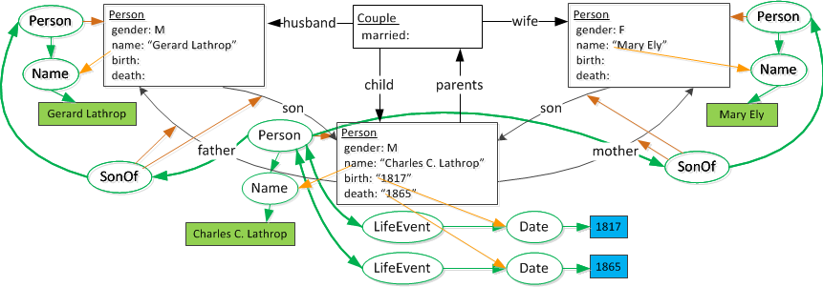
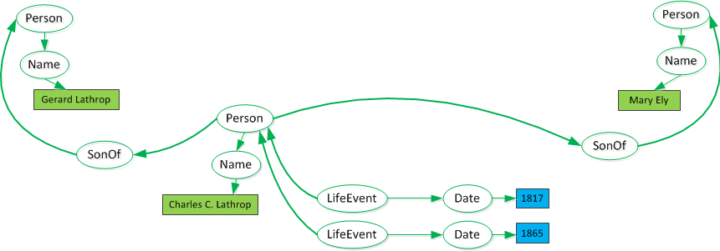
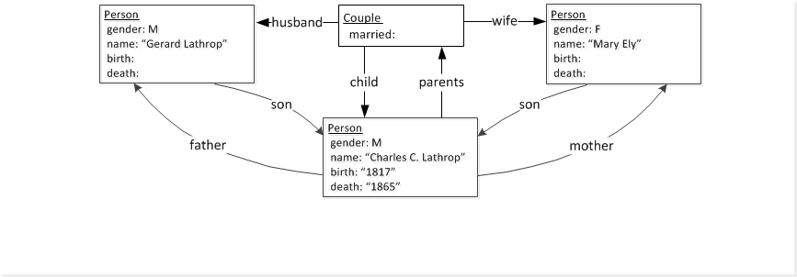
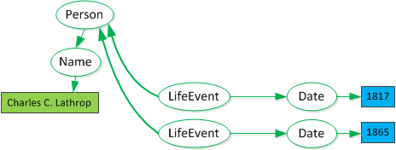
Building Meaning
Charles Christopher Lathrop, N. Y. City, b. 1817, d. 1865, son of Mary Ely and Gerard Lathrop ;

Slide 17
Meaning Structures Compared
Charles Christopher Lathrop, N. Y. City, b. 1817, d. 1865, son of Mary Ely and Gerard Lathrop ;
… his widow married JONATHAN SQUIRES, who was born in Ohio, July 25, 1823, by whom she had one son, J. Wilbur, born June 16, 1865,

Slide 18
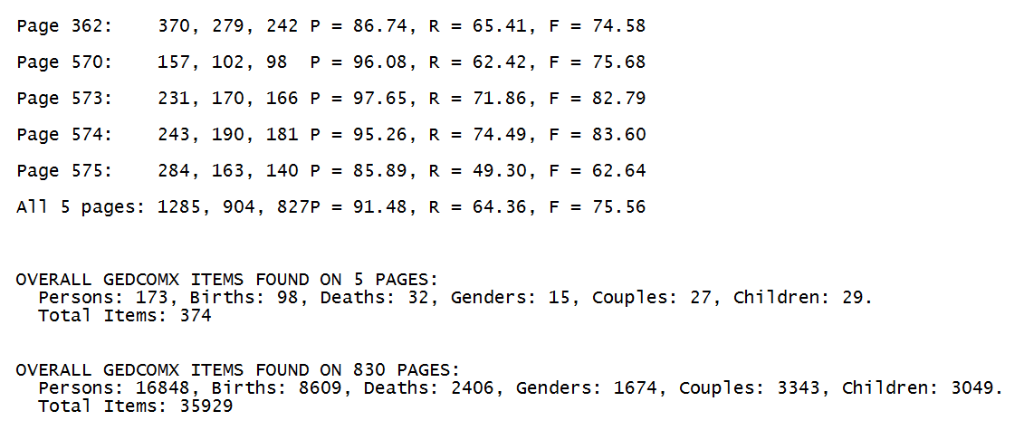
Overall results
> 140,000 books
Ely Ancestry example: 830 pages

