Slide 1
OpenDMAP:
An open source, ontology-driven concept analysis engine, with applications to capturing knowledge regarding protein transport, protein interactions and cell-type-specific gene expressions
by Hunter, et al.

Slide 2
OpenDMAP
Ontology-driven: An ontology is the backbone of the system.
Concept-analysis engine
Each concept in the ontology has an associated recognizer.
A recognizer is a text pattern.
“A pattern describes the words, phrases, parts of speech, syntactic structures or concepts that should cause an instance of the associated concept to be recognized.”

Slide 3
Simple Pattern
Concept: NUCLEUS
Pattern recognizer:
NUCLEUS := nucleus, nuclei, nuclear;

Slide 4
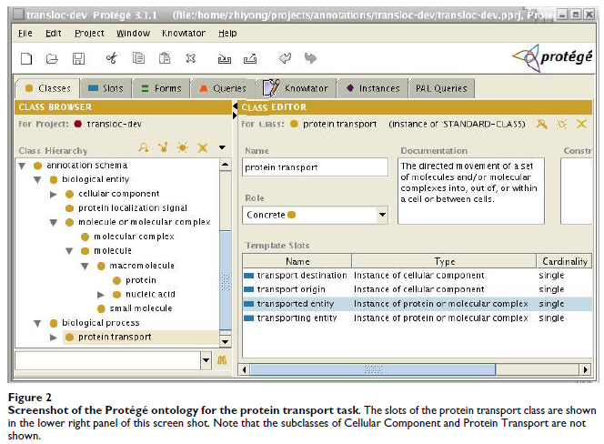
Sample ontology

Slide 5
Complex Pattern
Regular Expression
References to non-terminals
(other concepts)
Recognizes: “… Bax translocation to mitochondria …”

Slide 6
Another Complex Pattern
Fails to recognize: “… Bax translocation to mitochondria from the cytosol …”
But the following succeeds:
Any order markers

Slide 7
Another Complex Pattern
Fails to recognize: “… H1F-1alpha which is present in glomus cells translocates to the nucleus …” because of the intervening “which” clause.
wild-cards (here, too promiscuous)
syntactic constraints (here, a counter-balance to promiscuity)
The following succeeds:

Slide 8
“Powerful” Patterns
Experiments run with just patterns 5–9 augmented with 119 cellular component patterns.

Slide 9
Results*
Run over all abstracts in Medline
Produced 72,460 transport instances
F-measure
0.29, 10% higher than next best
Recall similar to others, but precision ~20% better (0.39)
Manual check on a small subset
Partial recognition counted
Corrected for protein identification
F-measure raised to 0.81
*Caution: See paper for details.

Slide 10
Discussion Messages
Ontology/Language connection
“[Ensures] that the knowledge representation is grounded [wrt] a carefully constructed model of reality”
“[Recognizers] … structured by the ontology ...” which “… finesses many difficult ambiguity resolution problems”
The architecture makes it easy to exploit better gene/protein recognition systems as they are developed.
better any-kind-of recognition systems

