Slide 1
Finding Genealogy Facts with
Linguistic Analysis
Peter Lindes, Deryle W. Lonsdale, David W. Embley
Brigham Young University
© 2014 Peter Lindes

Slide 2
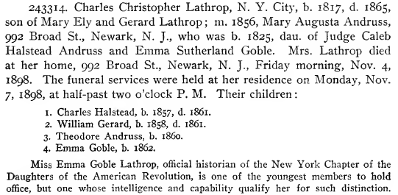
Semi-Structured Text

Slide 3
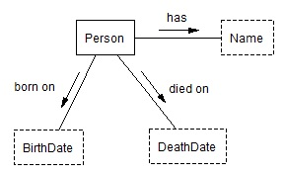
A Simple Ontology
has
Charles Christopher Lathrop
born on
died on
1817
1865

Slide 4
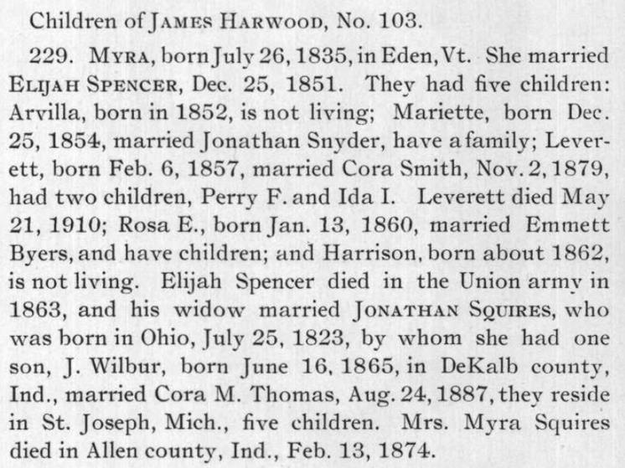
Unstructured Text

Slide 5
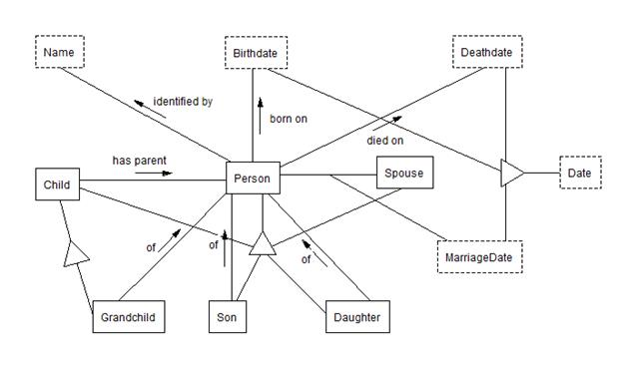
A More Complex Ontology
Myra Harwood
Feb. 13, 1874
Jonathan Squires
J. Wilbur Squires

Slide 6
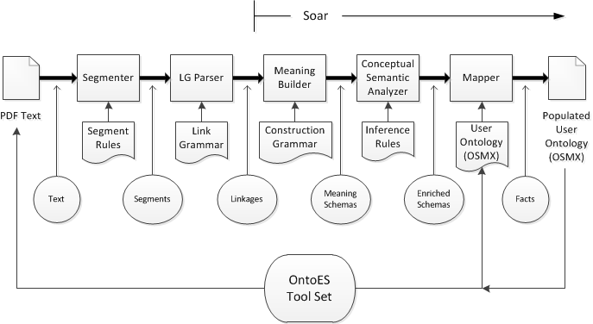
OntoSoar Architecture

Slide 7
Two Cases
Case 1:
Charles Christopher Lathrop, N. Y. City, b. 1817, d. 1865, son of Mary Ely and Gerard Lathrop ;
Case 2:
his widow married JONATHAN SQUIRES, who was born in Ohio, July 25, 1823, by whom she had one son, J. Wilbur, born June 16, 1865, in DeKalb county, Ind.

Slide 8
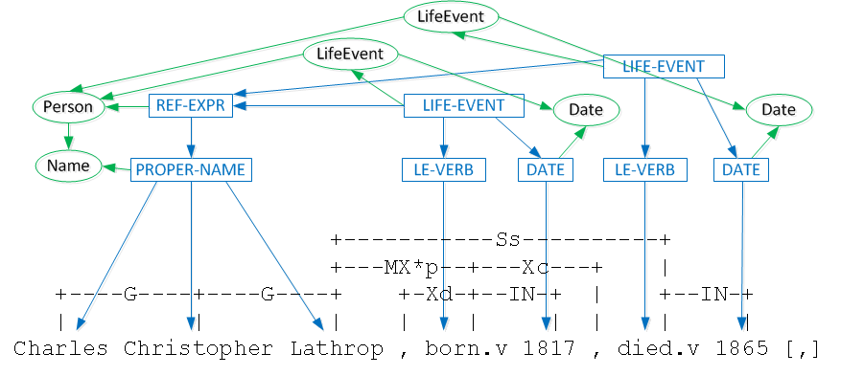
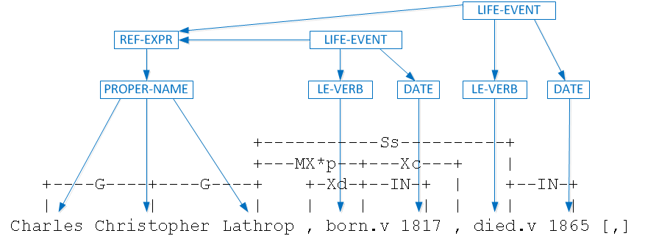
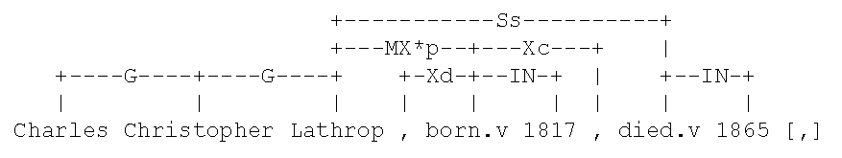
Linguistic Analysis – Case 1A
Charles Christopher Lathrop, …, b. 1817, d. 1865,

Slide 9
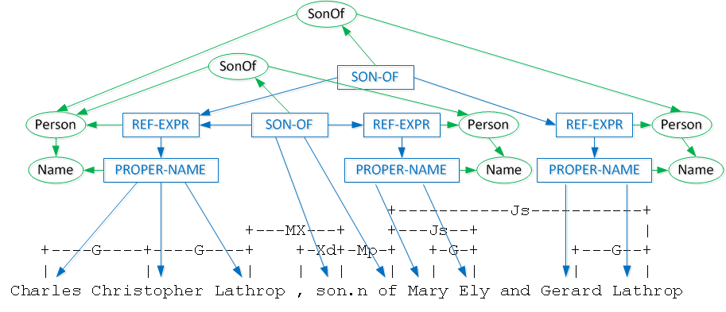
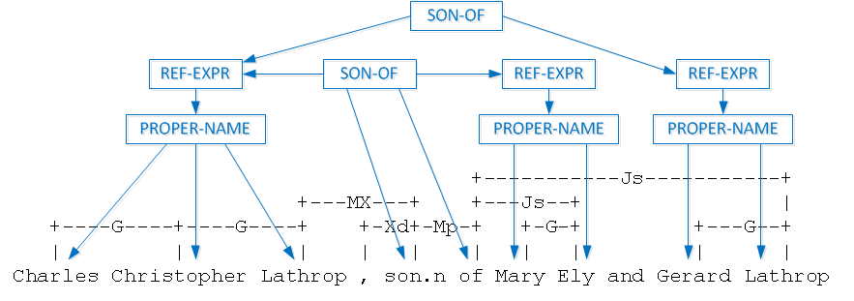
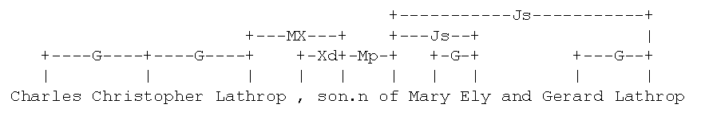
Linguistic Analysis– Case 1B
Charles Christopher Lathrop, … , son of Mary Ely and Gerard Lathrop ;

Slide 10
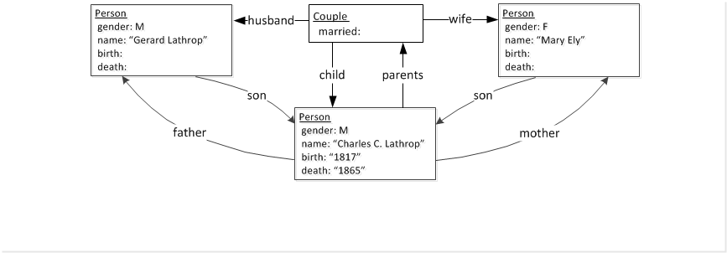
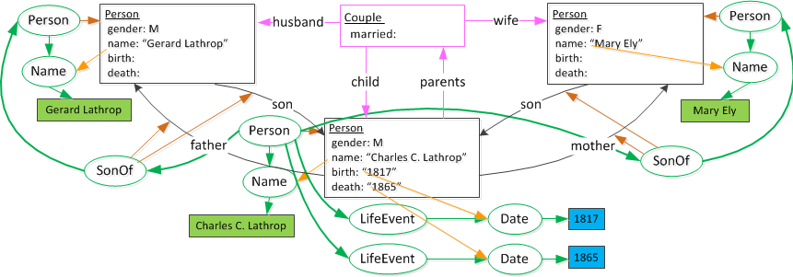
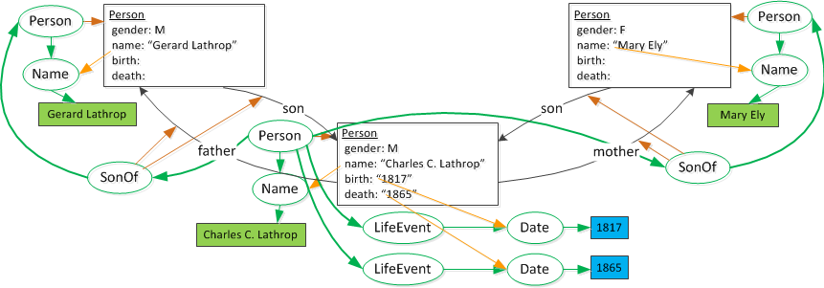
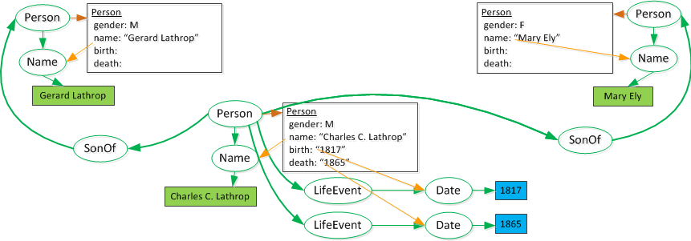
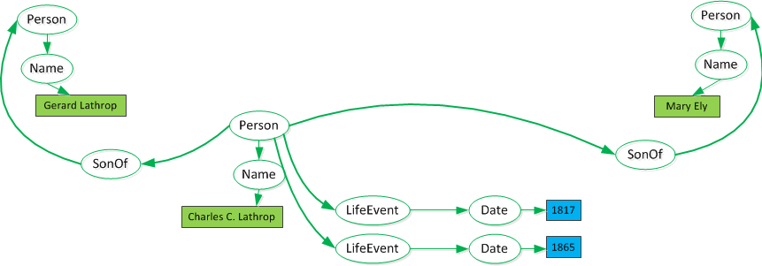
Extracting Meaning – Case 1
Charles Christopher Lathrop, N. Y. City, b. 1817, d. 1865, son of Mary Ely and Gerard Lathrop ;

Slide 11
Linguistic Analysis– Case 2
his widow married JONATHAN SQUIRES, …, by whom she had one son, J. Wilbur, born June 16, 1865, … .
+--------MXsp--------+
+----MXs----+ +--------Xc--------+
+--------Os-------+--MX*x-+ +----Os---+ +---Xd--+ | +----TY---+ |
+--Ds-+---Ss---+ +---G---+ +Xd+-Jr+-Cr+-Ss-+ +-Ds-+ | +--G-+Xca+-Xd-+--IN-+-TM+ +-Xd+Xc+
| | | | | | | | | | | | | | | | | | | | | |
his widow.n married.v JONATHAN SQUIRES , by whom she had.v one son.n , J. Wilbur , born.v June 16 , 1865 ,

Slide 12
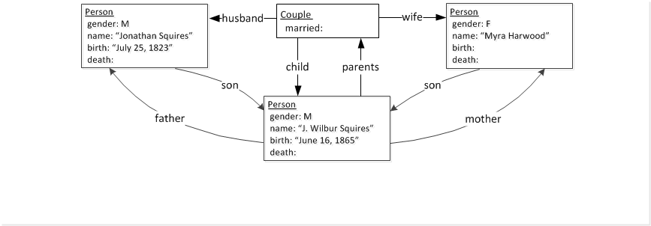
Extracting Meaning – Case 2
his widow married JONATHAN SQUIRES, who was born in Ohio, July 25, 1823, by whom she had one son, J. Wilbur, born June 16, 1865, in DeKalb county, Ind.

Slide 13
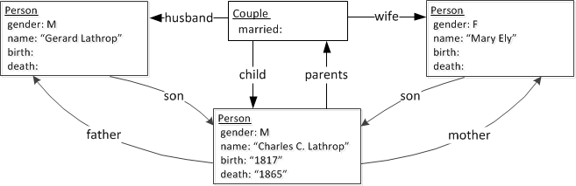
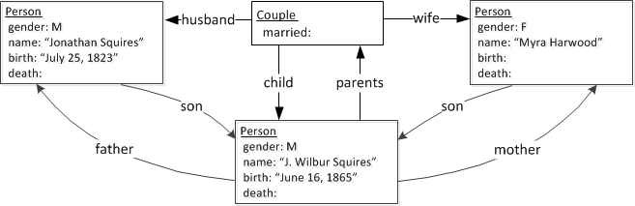
Meaning Structures Compared
Charles Christopher Lathrop, N. Y. City, b. 1817, d. 1865, son of Mary Ely and Gerard Lathrop ;
his widow married JONATHAN SQUIRES, who was born in Ohio, July 25, 1823, by whom she had one son, J. Wilbur, born June 16, 1865, … .

Slide 14
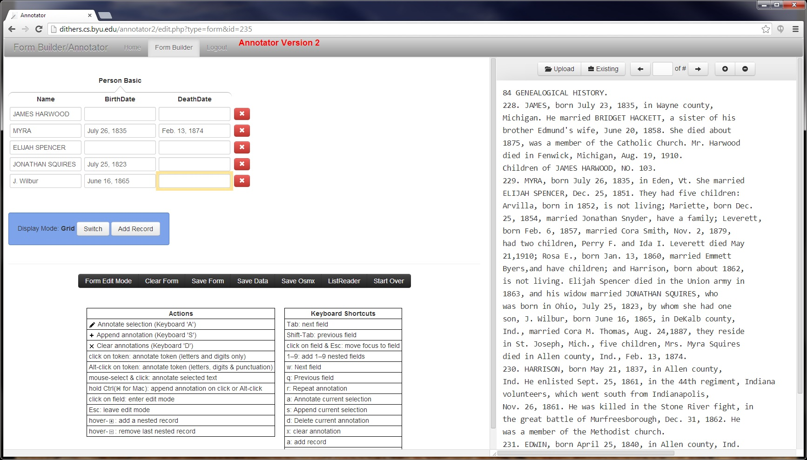
Evaluation

Slide 15
Conclusions
Accomplishments
Future work
Preprocessor/Segmenter
Adapted LG Parser for genealogy text
Built a construction grammar meaning analyzer
Mapped meaning schemas to user-defined ontologies
Integrated all into a single processing pipeline
Partially implemented – works well so far
Complete implementation
Evaluate on a broader corpus
Explore using a named entity recognizer
Build in much more linguistic knowledge
Research how to make the system learn linguistic knowledge

