Slide 1


A Web of Knowledge for Family History
(Research Directions)
Elder David W. Embley
with special thanks to the Data Extraction Research Group at Brigham Young University
and the FamilySearch Engineering Research Team
A service provided by The Church of Jesus Christ of Latter-day Saints. © 2013 by Intellectual Reserve, Inc. All rights reserved.
www.deg.byu.edu
BYU Data Extraction Research Group

Slide 2
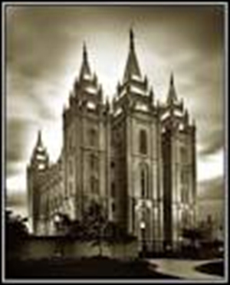
Outline
Web conceptualization initiatives
The vision of a Web of Knowledge (WoK) superimposed over Historical Documents (HD)
Realizing the WoK-HD vision
  Information extraction tools
  Query processing tools
FamilySearch and the WoK-HD
Notes:
Objectives:
See the vision of a Web of Knowledge (WoK) superimposed over historical documents.
Understand what we are trying to do to realize this vision.
Information extraction tools
Query processing tools
Bootstrapping our way into a WoK for family history
Ultimate Objective: work of salvation for the dead
Note each in terms of their source:
Google, Yahoo, Facebook, Microsoft, Metaweb
BYU
BYU
FamilySearch
Tech transfer

Slide 3
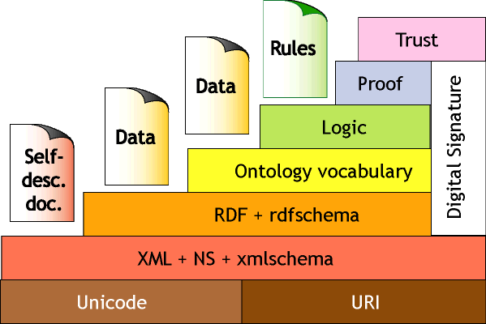
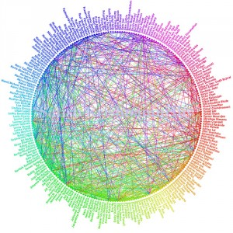
Toward a Web of Knowledge
Conceptualization of the Web
  Semantic search as well as keyword search
  World-wide knowledge sharing
Examples:
  Conceptual Graphs
    Google’s Knowledge Graph
    Yahoo!’s Web of Objects
    Facebook’s Graph Search
    Microsoft’s/Bing’s Satori Knowledge Base
  Metaweb
A Web of Knowledge superimposed
over historical documents (WoK-HD)
Notes:
Consider major projects underway to enable user search queries
Google’s knowledge graph, Dbpedia, Yahoo’s “Web of Concepts” initiative [Kumar et al., PODS’09], Meta-web, others?
Give a one-slide essence picture of each
Point out the connection to conceptual modeling
See abstract in ER13 paper
Wrt veracity: verified conceptualization (in Meadow’s hierarchy)
Transition to our project – the WoK

Slide 4
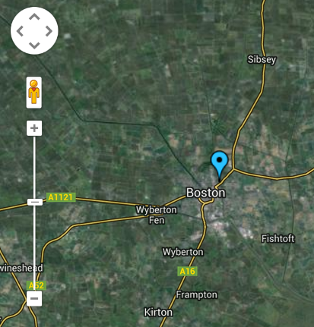

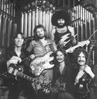

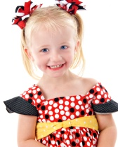

Metaweb
Boston ?
Notes:
Pictures showing Boston?: the Red Sox (current world series in baseball), the Celtics, the city in MA, the city elsewhere, the band, Boston (the child who is having a birthday party).

Slide 5

Metaweb
Don’t forget to take Wendy to Boston’s birthday party at 2:00.
Notes:
Pictures showing Boston?: the Red Sox (current world series in baseball), the Celtics, the city in MA, the city elsewhere, the band, Boston (the child who is having a birthday party).

Slide 6
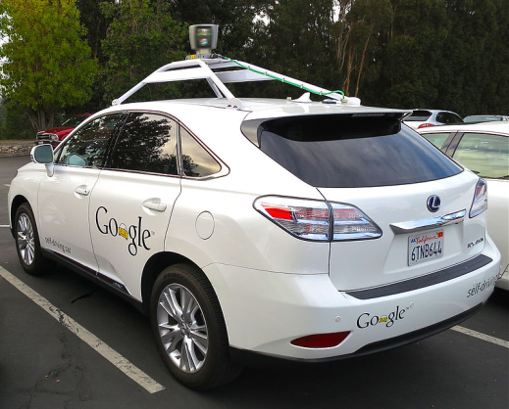
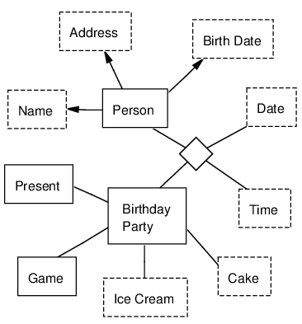
Metaweb
Don’t forget to take Wendy to Boston’s birthday party at 2:00.
Notes:
Pictures showing Boston?: the Red Sox (current world series in baseball), the Celtics, the city in MA, the city elsewhere, the band, Boston (the child who is having a birthday party). “The Semantic Web” featured in Scientific American in May, 2001.

Slide 7
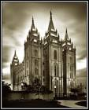
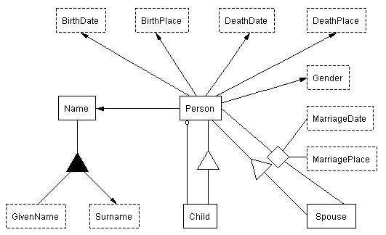
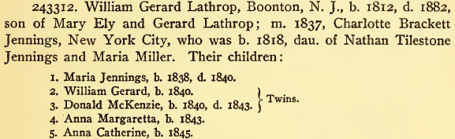
WoK-HD
. . .

Slide 8
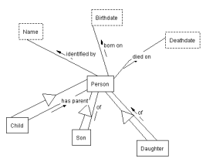
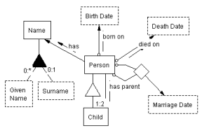
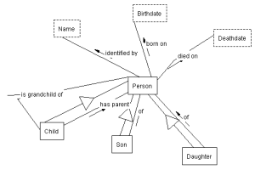
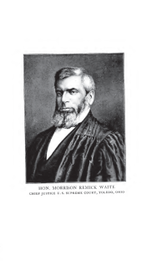

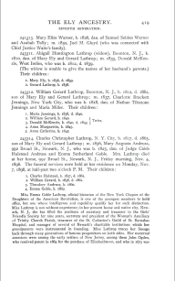
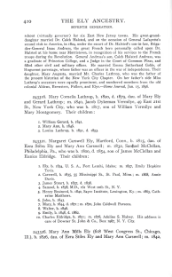
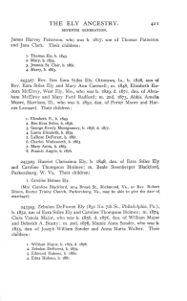
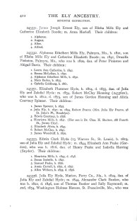
WoK-HD
(A Web of Knowledge Superimposed over Historical Documents)
…
…
…
…
Notes:
Automatic extraction builds links.

Slide 9
WoK-HD
(A Web of Knowledge Superimposed over Historical Documents)
grandchildren of Mary Ely
…
…
…
…
Notes:
Automatic extraction also builds query links.

Slide 10
WoK-HD
(A Web of Knowledge Superimposed over Historical Documents)
grandchildren of Mary Ely
…
…
…
…
Notes:
Selection of best ontology to answer query.

Slide 11
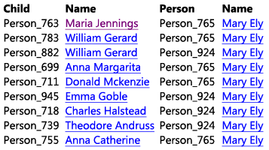
WoK-HD
(A Web of Knowledge Superimposed over Historical Documents)
grandchildren of Mary Ely
…
…
…
…

Slide 12
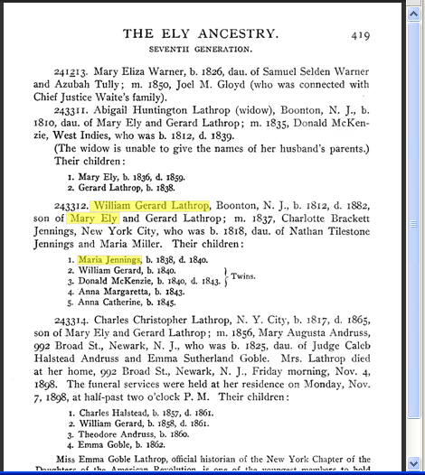
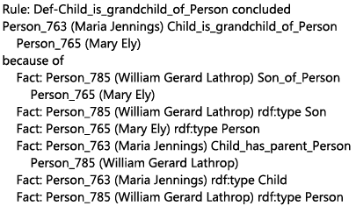
WoK-HD
(A Web of Knowledge Superimposed over Historical Documents)
grandchildren of Mary Ely
…
…
…
…
Notes:
Mockup as designed. Actual implementation quite close. The differences point to where we need to add finishing touches.
Note the conceptual modeling is right in the middle – it’s the “glue” that makes all of this work – will come back to this main point and show how CM comes to the rescue.

Slide 13
WoK-HD Construction (BYU)
Extraction Ontologies
Mitigating Velocity, Variety, & Volume (of Big Data)
  OntoES/FROntIER
  ListReader
  OntoSoar
  GreenFIE-HD/GreenFIELDS-HD
Assuring Veracity (of Big Data)
  Query processing (with links and reasoning chains)
  Evidence-based conceptual models
Practicalities

Slide 14
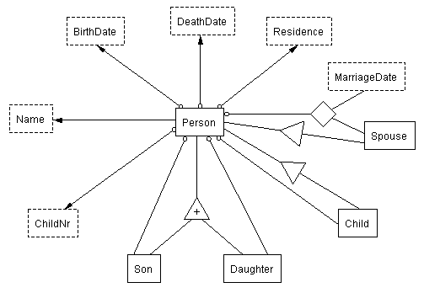
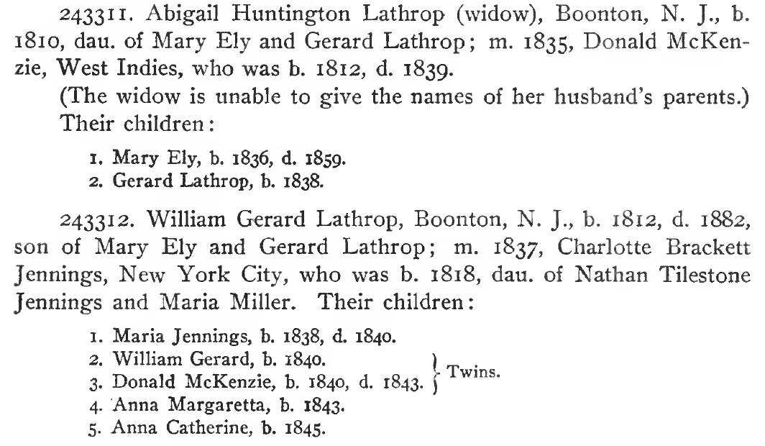
OntoES: Extraction Ontologies
Linguistically Grounded Conceptual Models
Notes:
An augmentation to conceptual models (later we’ll look at moving conceptual models up the information hierarchy)
Mention the four types: lexical object sets ~ named entity recognition, non-lexical object sets ~ ontological commitment; relationship sets; ontology snippets

Slide 15

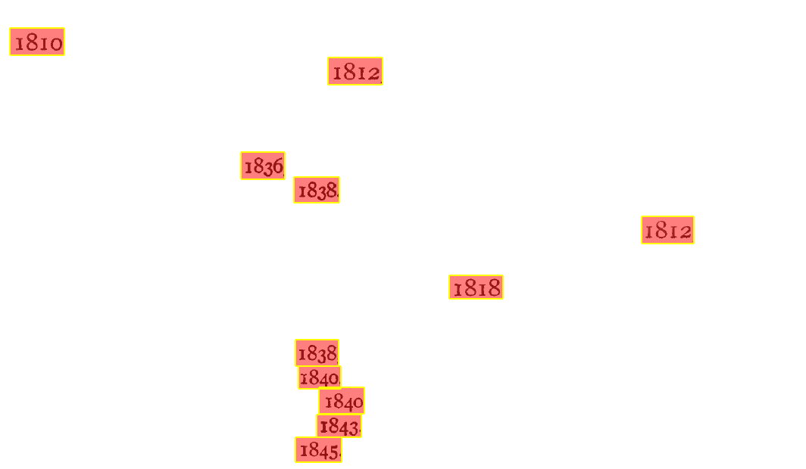
Lexical Object-Set Recognizers
BirthDate
external representation: \b[1][6-9]\d\d\b
left context: b\.\s
right context: [.,]
…
Notes:
FROntIER (Fact Recognizer for Ontologies with Inference and Entity Resolution) but could also be: FRamework for Ontology-based Information Extraction and Reasoning.

Slide 16
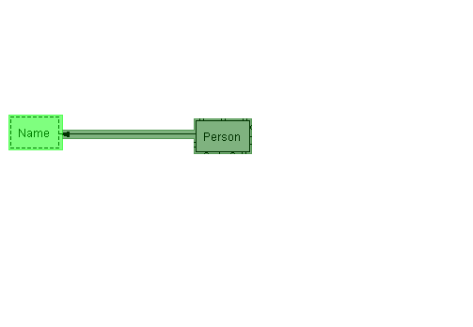
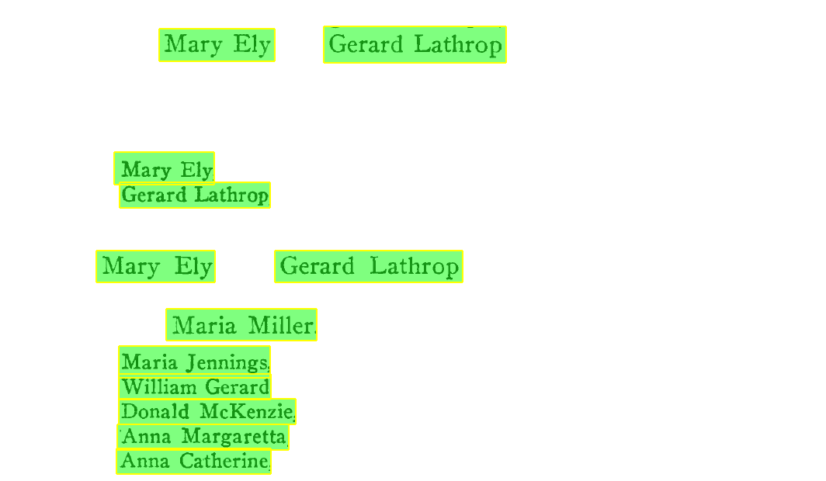
Non-lexical Object-Set Recognizers
Person
object existence rule: {Name}
…
Name
external representation: \b{FirstName}\s{LastName}\b
…

Slide 17

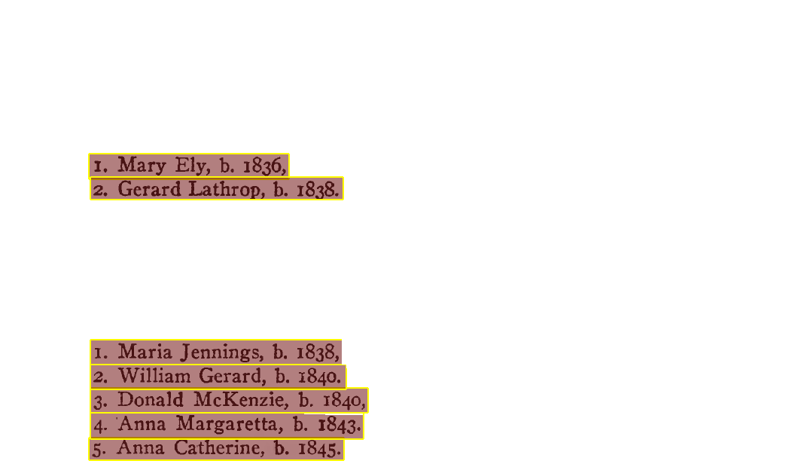
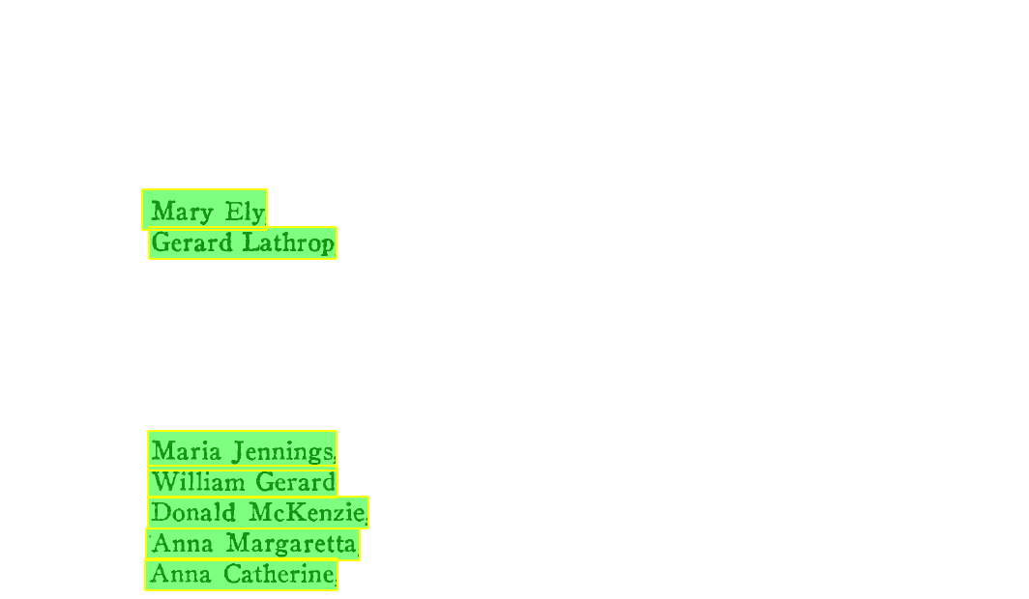
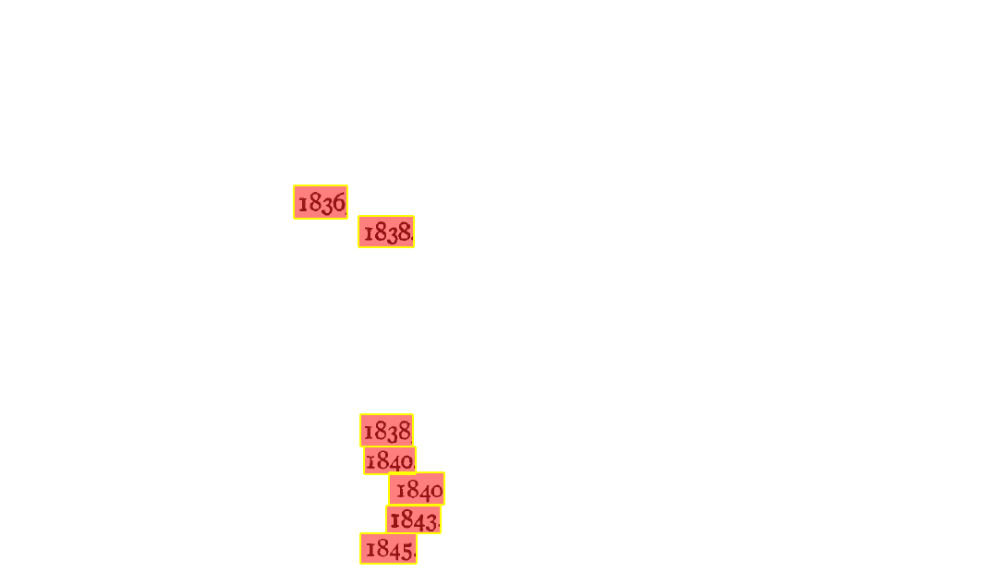
Relationship-Set Recognizers
Person-BirthDate
external representation: ^\d{1,3}\.\s{Person},\sb\.\s{BirthDate}[.,]
…

Slide 18
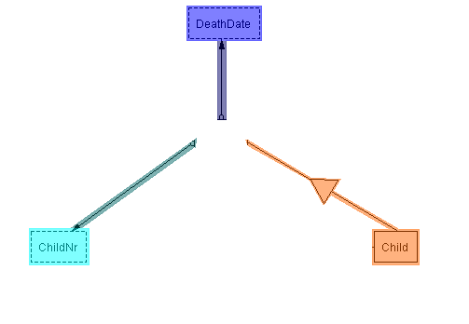
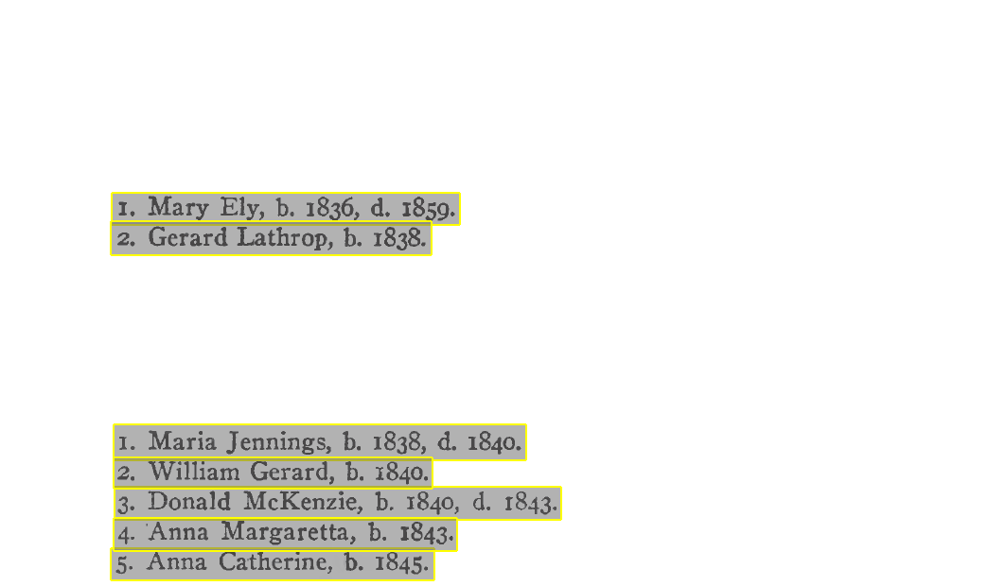

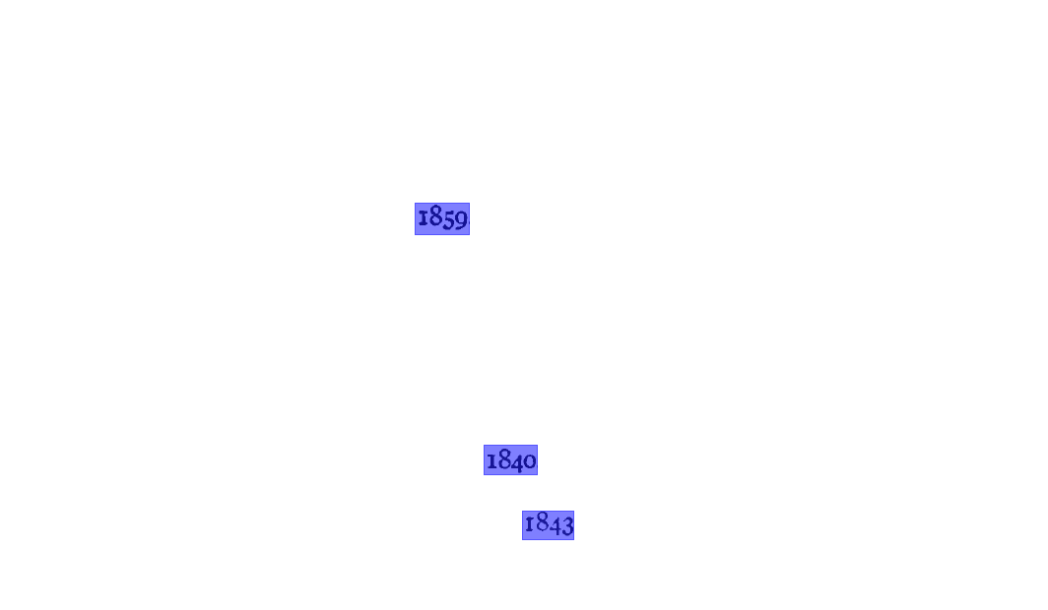
Ontology-Snippet Recognizers
ChildRecord
external representation: ^(\d{1,3})\.\s+([A-Z]\w+\s[A-Z]\w+)
(,\sb\.\s([1][6-9]\d\d))?(,\sd\.\s([1][6-9]\d\d))?\.

Slide 19
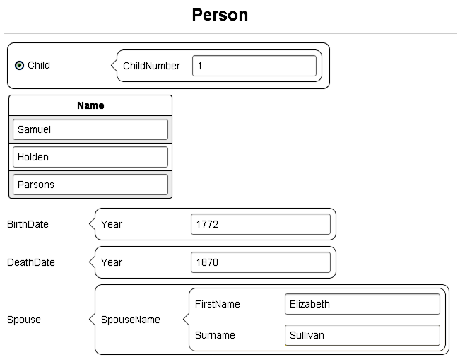
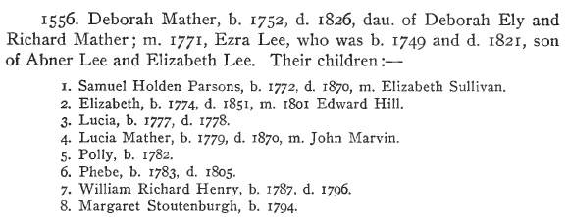
ListReader
ListReader Form
OCR Text
\n(\d)\.\s([A-Z][a-z]{5})\s([A-Z][a-z]{5})\s([A-Z][a-z]{6})\sb\.
(\d{4}),\sd\.\s(\d{4}),\sm\.\s([A-Z][a-z]{8})\s([A-Z][a-z]{7})\.\n
Notes:
User:
View page
Select list
First record
Build form
Click fields
(Form filled in)
Click once per field in the order specified by the form.
One record to start the process (in this old approach)
Low-cost:
* No knowledge engineering
* No ML feature engineering
* Semi-supervised
* Active learning

Slide 20
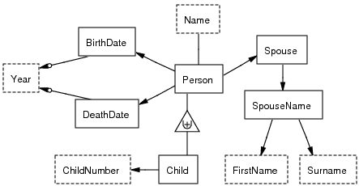
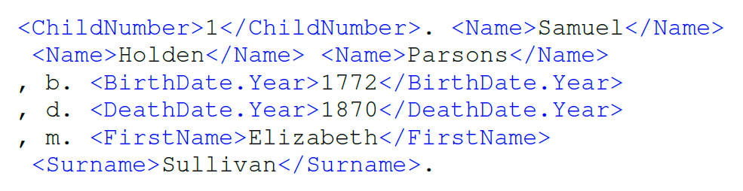
ListReader
\n(\d)\.\s([A-Z][a-z]{5})\s([A-Z][a-z]{5})\s([A-Z][a-z]{6})\sb\.
(\d{4}),\sd\.\s(\d{4}),\sm\.\s([A-Z][a-z]{8})\s([A-Z][a-z]{7})\.\n
Child(p₁)
Person(p₁)
Child-ChildNumber(p₁, “1”)
Child-Name(p₁, n₁)
…
Notes:
ListReader takes over:
Empty Form → ontology schema
Filled-in form + OCR text → labeled text
Induction & execution → more labeled text → predicates → populated ontology
Person.BirthDate.Year vs. Person.DeathDate.Year

Slide 21

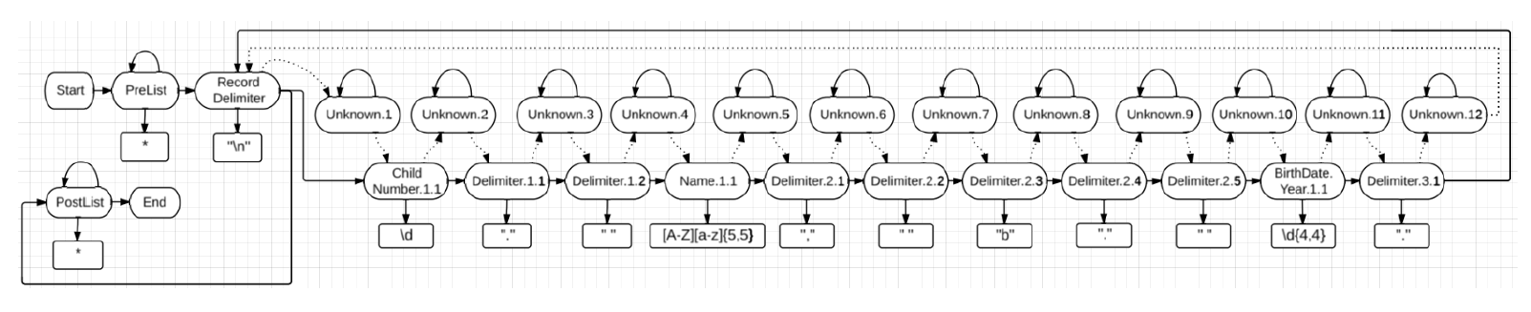
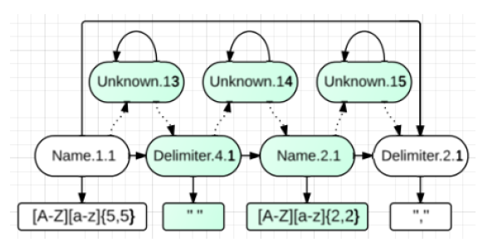
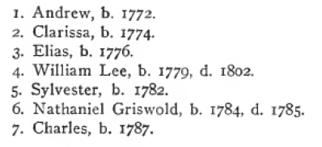
ListReader: HMM Induction
Initialize
Active Learning
(Novelty Detection)
Notes:
HMM is a model of the joint probability of hidden states, transitions, and text emissions.
Hidden states map functionally to labels.
Sparse, Noisy Data:
Parameter smoothing: Prior knowledge as non-zero Dirichlet priors
Emission model parameter tying for shared lexical object sets
Cluster field words in emiss. model with 5 character classes
List Structure:
Transition model is fine-grained total order among word states
Tr. model is cyclical only at record delimiters
Tr. model is a total order: non-zero priors allow for deletions
Tr. model has unique “unknown” states to allow for insertions
Delimiter state emiss. models don’t use word clustering like field states
Same high-level process.
Start with first labeled record.
One state per word token.
Each state emits the corresponding text with prob. 1.0.
Each state transitions to the unique next state with prob. 1.0.
Generalize and specialize it such a way that it accounts for the sparseness, noisiness, and list-like variations of the data.
AL

Slide 22
ListReader Accuracy & Cost
Notes:
To make our labeling task learnable
by the CRF and to ensure a fair test, we tuned its hyper-
parameters and selected an appropriate set of word features.
As test data, we selected and isolated the text of 30 child lists
from throughout The Ely Ancestry [2] containing a total of
137 records and an average of 10 fields per list. We compute
F-measures for field labels over all word tokens not used as
hand-labeled training data. All reported differences between
CRF and ListReader F-measures are statistically significant at
p < 0.01 using both McNemar’s test [7] and a paired t-test.
To test ListReader’s semi-supervised wrapper induction, we
hand-labeled the first record of each list and ran ListReader
separately on it. We compare the results of ListReader to the
CRF, also run separately on each list with varying amounts
of training data. Table I shows the results. Hand-labeling just
the first record has a lower cost for the CRF compared to
ListReader (4.4 v. 4.5 labels per list), but the F-measure is
lower. Not until trained with the “three best” records does the
F-measure of the CRF approach that of ListReader. Even then
it is still significantly less and at over double the number of
labels plus the effort to select the “three best”—a combination
of a longest (1st Best), a least typical (2nd Best), and a most
typical (3rd Best) record.
To evaluate self-supervised learning, we ran ListReader on
one of the lists in semi-supervised mode and then executed it
in self-supervised mode on each of the remaining 29 lists. We
were thus able to see how well ListReader could use a wrapper
generated for one list to begin wrapper induction for another
list using no more human labeling than for new unique fields
not identified in the first list. For the CRF, we hand-labeled
all records in one list to train it and then executed it on each
of the remaining 29 lists. For both ListReader and the CRF,
we repeated the procedure 30 times, using each list in our
test set as a starting list, to compute the averages in Table II.
ListReader achieves a higher F-measure at almost a third the
cost of the CRF.

Slide 23
ListReader⁺⁺
…
1. Mary Ely, b, 1836, d. 1859.
2. Gerard Lathrop, b. 1838.
…
1. Maria Jennings, b. 1838, d. 1840.
2. William Gerard, b. 1840. ) .
3. Donald McKenzie, b. 1840, d. 1843. ]
4. Anna Margaretta, b. 1843.
5. Anna Catherine, b. 1845.
…
1. Charles Halstead, b. 1857, d. 1861.
2. William Gerard, b. 1858, d. 1861.
3. Theodore Andruss, b. i860.
4. Emma Goble, b. 1862.
Notes:
We can see the pattern. If we properly “conflate”, the system can also see the pattern. We conflate cap words -> Aaaa, numbers -> #, and allow for OCR confusion matrices to help

Slide 24
ListReader⁺⁺
Conflate symbols and induce grammar
…
#. Aaaa Aaaa, b, 18##, d. 18##.
#. Aaaa Aaaa, b. 18##.
…
#. Aaaa Aaaa, b. 18##, d. 18##.
#. Aaaa Aaaa, b. 18##. ) .
#. Aaaa AaAa, b. 18##, d. 18##. ]
#. Aaaa Aaaa, b. 18##.
#. Aaaa Aaaa, b. 18##.
…
#. Aaaa Aaaa, b. 18##, d. 18##.
#. Aaaa Aaaa, b. 18##, d. 18##.
#. Aaaa Aaaa, b. i8##.
#. Aaaa Aaaa, b. 18##.
^(\d)\.\s([A-Z][a-z]{3,7})\s([A-Z][a-z]{4,9}),\sb\.\s([i1]8\d\d)$
^(\d)\.\s(([A-Z][a-z][A-Z][a-z]{5})|([A-Z][a-z]{3,7}))\s([A-Z][a-z]{4,9}),\sb[.,]\s(18\d\d)\sd.\s(18\d\d)\.$
Notes:
We can see the pattern. If we properly “conflate”, the system can also see the pattern. We conflate cap words -> Aaaa, numbers -> #, and allow for OCR confusion matrices to help. (The blue regex is more complex: (\d)\.\s(([A-Z][a-z]{3,6})|[A-Z][a-z][A-Z][a-z]) …)
Now, for BIG DATA, it’s important that we learn patterns without human-labeled training data and without having human-engineering (specifying the patterns by hand) – to much volume, velocity, variety.

Slide 25
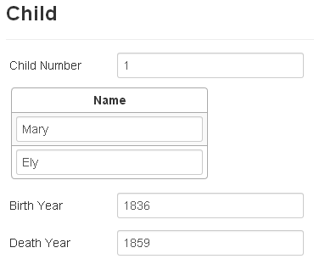
ListReader⁺⁺
…
1. Mary Ely, b, 1836, d. 1859.
2. Gerard Lathrop, b. 1838.
…
1. Maria Jennings, b. 1838, d. 1840.
2. William Gerard, b. 1840. ) .
3. Donald McKenzie, b. 1840, d. 1843. ]
4. Anna Margaretta, b. 1843.
5. Anna Catherine, b. 1845.
…
1. Charles Halstead, b. 1857, d. 1861.
2. William Gerard, b. 1858, d. 1861.
3. Theodore Andruss, b. i860.
4. Emma Goble, b. 1862.
Notes:
Labeling: (1) labels all the rest that fit the pattern; (2) pattern saved for another book; (3) fragments saved. Of course, the same thing happens for the red patterns too.
Starting from scratch, we don’t know how to avoid having the human involved to produce labeling. However, we can bootstrap.

Slide 26
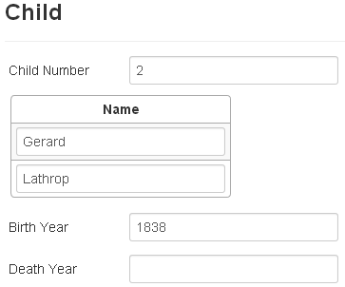
ListReader⁺⁺
…
1. Mary Ely, b, 1836, d. 1859.
2. Gerard Lathrop, b. 1838.
…
1. Maria Jennings, b. 1838, d. 1840.
2. William Gerard, b. 1840. ) .
3. Donald McKenzie, b. 1840, d. 1843. ]
4. Anna Margaretta, b. 1843.
5. Anna Catherine, b. 1845.
…
1. Charles Halstead, b. 1857, d. 1861.
2. William Gerard, b. 1858, d. 1861.
3. Theodore Andruss, b. i860.
4. Emma Goble, b. 1862.
Notes:
Labeling: (1) labels all the rest that fit the pattern; (2) pattern saved for another book; (3) fragments saved. Of course, the same thing happens for the red patterns too.
Starting from scratch, we don’t know how to avoid having the human involved to produce labeling. However, we can bootstrap …

Slide 27
OntoSoar
+--------------Xp-------------+
+Wd+--Ss-+MVp+IN-+ |
| | | | | |
^ Mary died.v in 1853 .
died
on
Soar
in(died,N4)
1853(N4)
Mary(N2)
died(N2)
OntoES
Person(…)
Name(…)
Person(…) has Name(…)
DeathDate(…)
Person(…) died on DeathDate(…)
Person(X1)
Name(X2,"Mary")
Person(X1) has Name(X2)
DeathDate(X3,"1853")
Person(X1) died on DeathDate(X3)
Notes:
Mary died in 1853.
OntoSoar: RUNNING LG PARSER
+------------Xp-----------+
+---Wd--+--Ss-+-MVp+-IN+ |
| | | | | |
LEFT-WALL Mary died.v in 1853 .
OntoSoar: RUNNING LG SOAR LEXICAL SEMANTICS
...
in(died,N4)
1853(N4)
Mary(N2)
died(N2)
...
Person(X1)
Name(X2,"Mary")
Person(X1) has Name(X2)
DeathDate(X3,"1853")
Person(X1) died on DeathDate(X3)
My next steps will be to get it to work for as broad a range of sentences as possible and do the import and export of OSMX files.

Slide 28
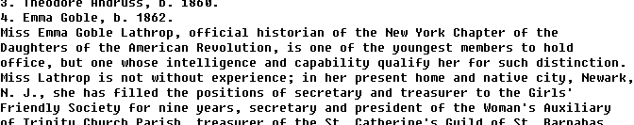

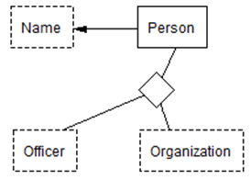

OntoSoar Recognizers
Notes:
Recognizers need not be regex-based. Any recognizer works, so long as it’s results can be mapped to an ontology. NLP: shows how NLP and extraction ontologies work together to find assertions and populate conceptual models.
Soar is a cognitive architecture, created by John Laird, Allen Newell, and Paul Rosenbloom at Carnegie Mellon University, now maintained by John Laird's research group at the University of Michigan. It is both a view of what cognition is and an implementation of that view through a computer programming architecture for Artificial Intelligence (AI). Since its beginnings in 1983 and its presentation in a paper in 1987, it has been widely used by AI researchers to model different aspects of human behavior.
NLP recognizers: discourse analysis.
Reemphasize: no hand-produced training data; no human engineering – for BIG DATA applications.

Slide 29
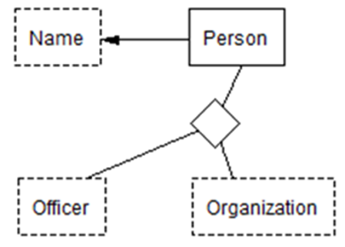
OntoSoar Recognizers
+---------------------------------Xp------------------------------+
| +--------Ost--------+ +-----Js-----+ |
+-Wd-+-Ss-+ +-----A-----+--Mp---+ +---DG--+ |
| | | | | | | | |
^ Emma was.v official.a historian.n of the NYCDAR .
Soar
OntoES
“of”(x1,x2)
“NYCDAR”(x2)
“Emma”(x1)
“historian”(x1)
“official”(x1)
Name(“Emma”)
Officer(“historian”)
Organization(“NYCDAR”)
Person–Name(y1,“Emma”)
Person-Officer-Organization(y1,“official historian”,“NYCDAR”)
Notes:
The “was” comes from recognizing the appositive construction.
Recognizers need not be regex-based. Any recognizer works, so long as it’s results can be mapped to an ontology. NLP: shows how NLP and extraction ontologies work together to find assertions and populate conceptual models.
NLP recognizers: discourse analysis.
Reemphasize: no hand-produced training data; no human engineering – for BIG DATA applications.

Slide 30
Beyond Extraction
Canonicalization
Reasoning
  Extraction of implied assertions
  Generation of implied assertions
  Object identity resolution
Free-form query processing
Form-based advanced query processing
Notes:
Once conceptualized, lots of interesting things to do.

Slide 31
Canonicalization for Lexical Object Sets
Data:
  “Easter 1832” → JulianDate(1832113)
  JulianDate(1832113) → 22 Apr 1832
  “Boonton, N.J.” → “Boonton, NJ, USA”
Operations:
  before(Date₁, Date₂): Boolean
  probabilityMale(Name): 0.0..1.0
Notes:
Each object set has an associated ADT.

Slide 32

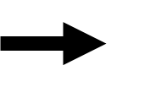
Implied Assertions
Author’s View
Desired View
Gender: Female
Maria Jennings … daughter of …
William Gerard Lathrop
Name:
GivenName: Maria
Jennings
Surname: Lathrop
Notes:
In our implementation, we convert to RDF and use the Jena Reasoner

Slide 33
Implied Assertions
Maria Jennings Lathrop …
child of …
William Gerard Lathrop …
son of …
Mary Ely … Female
⇒
Mary Ely … grandmother of
… Maria Jennings Lathrop
Notes:
In our implementation, we convert to RDF and use the Jena Reasoner.

Slide 34
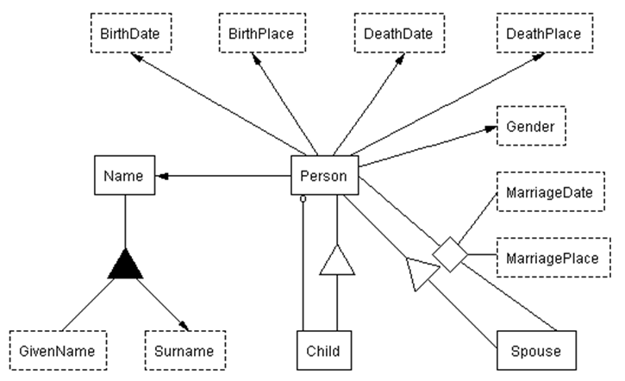
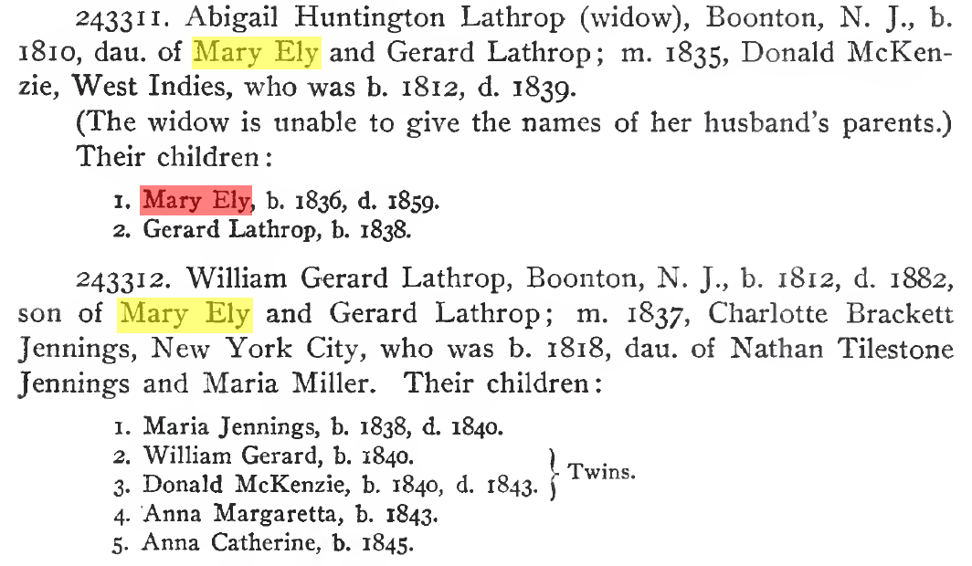
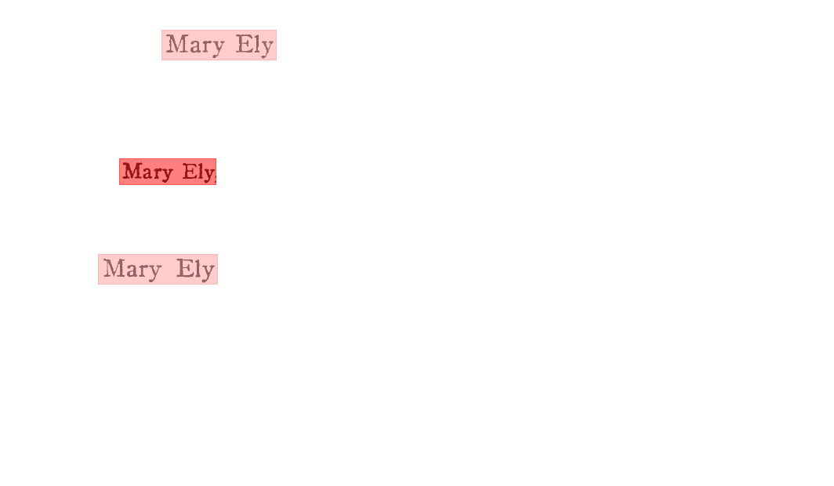
Object Identity Resolution
0.032081
0.995030
0.032081

Slide 35
Free-Form Query Processing
Persons born in 1838

Slide 36
Free-Form Query Processing
Persons born in 1838
born
Person(s)?

Slide 37
Free-Form Query Processing
Persons born in 1838
born
= 1838
Person(s)?
Person Name BirthDate
Person₁₁ Gerard Lathrop McKenzie 1838
Person₁₈ Maria Jennings Lathrop 1838

Slide 38
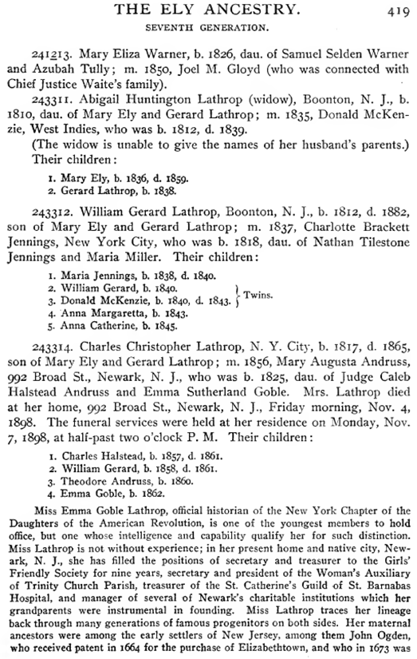
Free-Form Query Processing
Persons born in 1838
Person Name BirthDate
Person₁₁ Gerard Lathrop McKenzie 1838
Person₁₈ Maria Jennings Lathrop 1838
“Gerard Lathrop McKenzie” because:
Person(Person₁₁) has GivenName (“Gerard Lathrop”)
and Child(Person₁₁) of Person(Person₉)
and Person(Person₉) has Gender(“Male”)
and Person(Person₉) has Surname(“McKenzie”)

Slide 39

Form-Based Advanced Query Processing
Cousins of Donald Lathrop who died before he was born or were born after he died.
Cousin
Notes:
i.e., Donald’s cousins who did not live during his lifetime.
Can get cousins directly (implied). Can get conjunctions but not disjunctions with free-form query processing – need form-based query processing. Form generated from conceptual model. Note that in the query Cousin is an object set whose elements relate to first cousins in the Person object set, so that when the Person object(s) identified by Donald Lathrop are identified, only the Cousins of these Person object(s) can be filled into the Cousin part of the form.

Slide 40

Form-Based Advanced Query Processing
Cousins of Donald Lathrop who died before he was born or were born after he died.
…
1. Mary Ely, b, 1836, d. 1859.
2. Gerard Lathrop, b. 1838.
…
1. Maria Jennings, b. 1838, d. 1840.
2. William Gerard, b. 1840. ) .
3. Donald McKenzie, b. 1840, d. 1843. ]
4. Anna Margaretta, b. 1843.
5. Anna Catherine, b. 1845.
…
1. Charles Halstead, b. 1857, d. 1861.
2. William Gerard, b. 1858, d. 1861.
3. Theodore Andruss, b. i860.
4. Emma Goble, b. 1862.
…
Notes:
i.e., Donald’s cousins who did not live during his lifetime.
Can get cousins directly (implied). Can get conjunctions but not disjunctions with free-form query processing – need form-based query processing. Form generated from conceptual model. Open world assumption – thus Gerard Lathrop, because we don’t know when he died.

Slide 41



Multi-Lingual Query Processing
Deceased Name Death Date
Seunglim Ji Nov. 14, 2013
people who died on
14 November 2013
Q
한국어
= 2013318
2013.11.15 03:28
지승림(64) 알티캐스트 회장이 14일 새벽 별세했다.
고인은 2000년 디지털 방송 관련 벤처기업인 알티캐스트의 대표이사로 자리를 옮겼으며, 이명박 전 대통령 선거 캠프의 주요 멤버로 활동하기도 했다. 지난해 초 뇌졸중으로 갑자기 쓰러진 뒤 2년 가까이 투병했다. 유족으로는 지성열(휴맥스 대리) · 성민(삼성전자 대리) 형제가 있다. 빈소는 삼성서울병원, 발인은 16일 오전 7시30분. (02)3410-6914
English

Slide 42

Projects
increased cost reduction
Level of Sophistication | Rule Creation Method
 | Manual | Machine Learning |  | Unsupervised ML or Pre-engineered
 |  | Supervised | Semi-supervised
1. Raw Patterns in Text | OntoES FROntIER | EntityRecog | GreenFIE-HD
2. Generalized Text Patterns | OntoES FROntIER | EntityRecog | GreenFIE-HD
3. Linguistics (syntax/semantics) |  | PNTB |  | OntoSoar
4. Ontological Commitment | FROntIER ProbNNet | ProbNNet | GreenFIE-HD ListReader⁺⁺ | OntoSoar ListReader⁺⁺
5. Pragmatics (reasoning) | FROntIER | PNTB | GreenFIELDS-HD | GreenFIELDS-HD
increased accuracy
increased patron involvement
Application Initiatives:
Scanned Books (100,000+ books,
est. 30% temple opportunities)
Obituaries (71 million +)
Status:
Ground truthing & tool testing
Working toward: GreenFIELDS-HD
Notes:
From a random sample of scanned books, ~17,000 names of people extracted (along with other information about the people). In a match with the data which is now in the Consensus Tree (CT), 40% matched, and were already accounted for, for temple work, leaving 60% unaccounted for, with about half of these 60% still alive. Bottom line 30% are potential temple opportunities (5,100 names to take to the temple from the sample).
Increased cost reduction: knowledge engineers involved less and less, making the systems less costly to get running right.
Increased patron involvement: only knowledge engineers are involved in Manual and Supervised Machine Learning; patrons are only involved when the system fills in the form first; then patrons can be involved to check results and fix them if necessary; the increased patron involvement comes from the system being pro-active in notifying patrons of temple opportunities rather than just waiting for them to look for possibilities.
Increased accuracy: accuracy assumed to increase at more sophisticated levels of “understanding”.
PNTB: Person Name Tree Bank
Probabilistic Name Network: Network of names with probabilities in both directions; objective: decide match with a search given a name. Example: if search on Pat, a good match (high probability) may be either Patrick or Patricia; likewise if search on Patrick, Pat is a reasonable match but Patricia is not.

Slide 43
Summary
Ultimate objective: temple work
An enabling vision: WoK-HD
  Automated information extraction & organization
  Support for search & verification of information
Current efforts: Prototype system construction

