Slide 1

Abenteuer mit
Informatik
A Conceptual-Modeling Approach to Data Extraction -or- “Oh the Places You [Ontologies] Will Go”
Stephen W. Liddle, PhD
Academic Director, Rollins Center
for Entrepreneurship & Technology
Professor, Information Systems Department
Marriott School, Brigham Young University
liddle@byu.edu
Research performed jointly with
David W. Embley & Deryle W. Lonsdale
Computer Science Department
& Linguistics Department, BYU
Data Extraction Group (DEG)
http://www.deg.byu.edu

Slide 2
Oh the Places You’ll Go
Congratulations! Today is your day.
You're off to Great Places! You're off and away!
You have brains in your head. You have feet in your shoes.
You can steer yourself any direction you choose.
You're on your own. And you know what you know.
And YOU are the guy who'll decide where to go.
…
KID, YOU'LL MOVE MOUNTAINS!
...
So…get on your way!
– Theodor S. Geisel (Dr. Seuss)

Slide 3
Outline
Background ideas
Data extraction by means of conceptual models that we call “extraction ontologies”
  Simpler cases
  More challenging cases
A Web of Knowledge (WoK)
Multi-lingual ontologies
Concluding thoughts

Slide 4
Complexity and Simplicity
Some of the most profound theories are really quite simple
e = mc²
See Einstein for Everyone, by John D. Norton

Slide 5
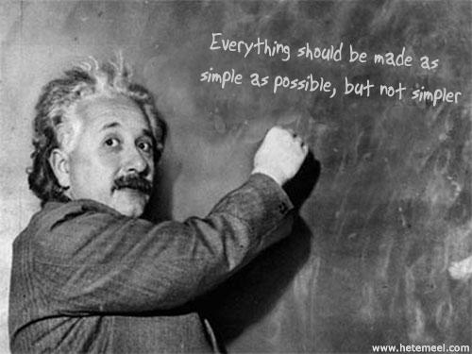

Slide 6

Big Ideas in Computer Science
Integers can represent any information
56,389,473,484,298,023,816,687,691,864,247,869,871,254,222,913,371,503,551,839,380,411,409,248,235,383,209,877,292,917,784,277
=
Okay, sometimes they’re really BIG integers (this one’s relatively small, by the way)

Slide 7
Big Ideas in Computer Science
S language can represent any computable function:
  V ← V - 1
  V ← V + 1
  IF V ≠ 0 GOTO L
Any algorithm can be expressed in these terms: integers and a very simple language!

Slide 8
Other Big Ideas
Mathematical relations nicely describe all data structures
  Relational, ER, and OO Models
    Conceptual design (associations, attributes, is-a, part-of, cardinality constraints)
    Physical design (functional dependencies & normalization)
Company
Employee

Slide 9
Cardinality Constraints
I studied semantic data models and cardinality constraints in the early 1990’s
You can do surprising things with participation constraints
  Graphical query language with universal and existential quantifiers coming from participation constraints
∃ ∀

Slide 10
Executable Conceptual Models
I realized during my PhD work that we could easily execute our OO conceptual models
  Needed to formalize
  Needed to ensure computational completeness
To get computational completeness we just need equivalence with S language
  Lots of ways to model integers
    E.g., count the number of relationships in which an object participates (cardinality constraints again!)
  Easy to map increment, decrement, if ≠ 0 goto

Slide 11
Simplicity Is Profound?
A corollary:
  Out of simplicity arises great complexity
Using S , a few macros, and some rather large integers, we can:
  Perform calculations & adjustments needed to send someone to the moon
  Communicate via radios in our pockets with people half-way around the world
  Compute π to an arbitrary level of precision
  Beat humans at chess or the Jeopardy game show

Slide 12

On Metaphysics and Simplicity
“I think metaphysics is good if it improves everyday life; otherwise forget it.”
“The solutions all are simple … after you’ve already arrived at them. But they’re simple only when you already know what they are.”
– Robert M. Pirsig

Slide 13

“What can be explained on fewer principles is explained needlessly by more.”
- William of Ockham, 1288-1343

Slide 14
What Else Can CMs Do?
With a little help and encouragement, our conceptual models can extract data
Goal: turn data into knowledge

Slide 15
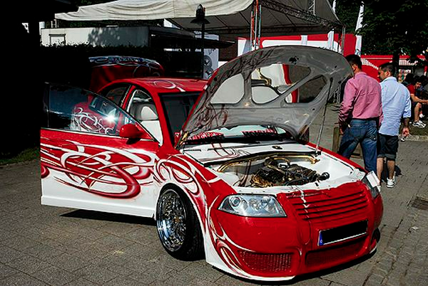
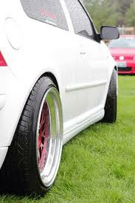
Query the Web like a Database
Example: Get the year, make, model, and price for
1987 or later cars that are red or white
Year Make Model Price
------- ------------- ----------------- ---------
97 CHEVY Cavalier 11,995
94 DODGE 4,995
94 DODGE Intrepid 10,000
91 FORD Taurus 3,500
90 FORD Probe
88 FORD Escort 1,000

Slide 16
Web Not Structured like a DB
Example
<html>
<head>
<title>The Salt Lake Tribune Classifieds</title>
</head>
…
<hr>
<h4> ’97 CHEVY Cavalier, Red, 5 spd, only 7,000 miles on her.
Previous owner heart broken! Asking only $11,995. #1415
JERRY SEINER MIDVALE, 566-3800 or 566-3888</h4>
<hr>
…
</html>

Slide 17
Making the Web Look Like a DB
Web Query Languages
  Treat web as graph (pages = nodes, links = edges)
  Query the graph (e.g., Find all pages within one hop of pages with the words “Cars for Sale”)
Wrappers
  Find page of interest
  Parse page to extract attribute-value pairs and insert them into a database
    Write parser by hand
    Use syntactic clues to generate parser semi-automatically
  Query the database

Slide 18
Automatic Wrapper Generation
for a page of unstructured documents, rich in data and narrow in ontological breadth
Application
Ontology
Web Page
Ontology
Parser
Record
Extractor
Constant/Keyword
Matching Rules
Record-Level Objects,
Relationships, and Constraints
Database
Scheme
Unstructured
Record Documents
Constant/Keyword
Recognizer
Data-Record Table
Database-Instance
Generator
Populated
Database

Slide 19
Application Ontology
Object-Relationship Model Instance
Year
Price
1..*
1..*
Car [-> object];
Car [0..1] has Model [1..*];
Car [0..1] has Make [1..*];
Car [0..1] has Year [1..*];
Car [0..1] has Price [1..*];
Car [0..1] has Mileage [1..*];
PhoneNr [1..*] is for Car [0..1];
PhoneNr [0..1] has Extension [1..*];
Car [0..*] has Feature [1..*];
Make
1..*
has
has
1..*
Mileage
0..1
0..1
0..1
0..1
has
Car
has
0..1
0..*
0..1
has
has
is for
1..*
PhoneNr
Model
1..*
0..1
1..*
has
Feature
1..*
Extension
Graphical Textual

Slide 20
Data Frames
Make matches [10] case insensitive
constant
{ extract "chev"; }, { extract "chevy"; }, { extract "dodge"; },
…
end;
Model matches [16] case insensitive
constant
{ extract "88"; context "\bolds\S*\s*88\b"; },
…
end;
Mileage matches [7] case insensitive
constant
{ extract "[1-9]\d{0,2}k"; substitute "k" -> ",000"; },
…
keyword
"\bmiles\b", "\bmi\b", "\bmi.\b";
end;
...

Slide 21
Ontology Parser
Make : chevy
…
KEYWORD(Mileage) : \bmiles\b
...
create table Car (
Car integer,
Year varchar(2),
… );
create table CarFeature (
Car integer,
Feature varchar(10));
...
Application
Ontology
Ontology
Parser
Constant/Keyword
Matching Rules
Record-Level Objects,
Relationships, and Constraints
Database
Scheme
Object: Car;
...
Car: Year [0..1];
Car: Make [0..1];
…
CarFeature: Car [0..*] has Feature [1..*];

Slide 22
Record Extractor
<html>
…
<h4> '97 CHEVY Cavalier, Red, 5 spd, … </h4>
<hr>
<h4> '89 CHEVY Corsica Sdn teal, auto, … </h4>
<hr>
….
</html>
Web Page
Record
Extractor
Unstructured
Record Documents
…
#####
'97 CHEVY Cavalier, Red, 5 spd, …
#####
'89 CHEVY Corsica Sdn teal, auto, …
#####
...

Slide 23
High Fan-Out Heuristic
<html>
<head>
<title>The Salt Lake Tribune … </title>
</head>
<body bgcolor="#FFFFFF">
<h1 align="left">Domestic Cars</h1>
…
<hr>
<h4> '97 CHEVY Cavalier, Red, … </h4>
<hr>
<h4> '89 CHEVY Corsica Sdn … </h4>
<hr>
…
</body>
</html>
html
head
body
title
h1
… hr h4 hr h4 hr ...

Slide 24
Record-Separator Heuristics
Identifiable separator tags
Highest-count tag(s)
Interval standard deviation
Ontological match
Repeating tag patterns
…
<hr>
<h4> '97 CHEVY Cavalier, Red, 5 spd, <i>only 7,000 miles</i>
on her. Asking <i>only $11,995</i>. … </h4>
<hr>
<h4> '89 CHEV Corsica Sdn teal, auto, air, <i>trouble free</i>.
Only $8,995 … </h4>
<hr>
...
Example:

Slide 25
Consensus Heuristic
Certainty is a generalization of: C(E₁) + C(E₂) - C(E₁)C(E₂).
C denotes certainty and E_{i} is the evidence for an observation.
Our certainties are based on observations from 10 different
sites for 2 different applications (car ads and obituaries)
 | Correct Tag Rank
Heuristic | 1 | 2 | 3 | 4
IT | 96% | 4%
HT | 49% | 33% | 16% | 2%
SD | 66% | 22% | 12%
OM | 85% | 12% | 2% | 1%
RP | 78% | 12% | 9% | 1%

Slide 26
Record Extractor: Results
Heuristic | Success Rate
IT | 96%
HT | 49%
SD | 66%
OM | 85%
RP | 78%
Consensus | 100%
4 different applications (car ads, job ads, obituaries,
university courses) with 5 new/different sites for each
application

Slide 27
Constant/Keyword Recognizer
'97 CHEVY Cavalier, Red, 5 spd, only 7,000 miles on her.
Previous owner heart broken! Asking only $11,995. #1415
JERRY SEINER MIDVALE, 566-3800 or 566-3888
Descriptor/String/Position(start/end)
Year|97|2|3
Make|CHEV|5|8
Make|CHEVY|5|9
Model|Cavalier|11|18
Feature|Red|21|23
Feature|5 spd|26|30
Mileage|7,000|38|42
KEYWORD(Mileage)|miles|44|48
Price|11,995|100|105
Mileage|11,995|100|105
PhoneNr|566-3800|136|143
PhoneNr|566-3888|148|155
Constant/Keyword
Matching Rules
Unstructured
Record Documents
Constant/Keyword
Recognizer
Data-Record Table

Slide 28
Heuristics
Keyword proximity
Subsumed and overlapping constants
Functional relationships
Nonfunctional relationships
First occurrence without constraint violation

Slide 29
Keyword Proximity
Year|97|2|3
Make|CHEV|5|8
Make|CHEVY|5|9
Model|Cavalier|11|18
Feature|Red|21|23
Feature|5 spd|26|30
Mileage|7,000|38|42
KEYWORD(Mileage)|miles|44|48
Price|11,995|100|105
Mileage|11,995|100|105
PhoneNr|566-3800|136|143
PhoneNr|566-3888|148|155
Δ = 2
Δ = 52
'97 CHEVY Cavalier, Red, 5 spd, only 7,000 miles on her. Previous owner heart broken! Asking only $11,995. #1415. JERRY SEINER MIDVALE, 566-3800 or 566-3888

Slide 30
Subsumed/Overlapping Constants
Year|97|2|3
Make|CHEV|5|8
Make|CHEVY|5|9
Model|Cavalier|11|18
Feature|Red|21|23
Feature|5 spd|26|30
Mileage|7,000|38|42
KEYWORD(Mileage)|miles|44|48
Price|11,995|100|105
Mileage|11,995|100|105
PhoneNr|566-3800|136|143
PhoneNr|566-3888|148|155
'97 CHEVY Cavalier, Red, 5 spd, only 7,000 miles. Previous owner heart broken! Asking only $11,995. #1415. JERRY SEINER MIDVALE, 566-3800 or 566-3888

Slide 31
Functional Relationships
Year|97|2|3
Make|CHEV|5|8
Make|CHEVY|5|9
Model|Cavalier|11|18
Feature|Red|21|23
Feature|5 spd|26|30
Mileage|7,000|38|42
KEYWORD(Mileage)|miles|44|48
Price|11,995|100|105
Mileage|11,995|100|105
PhoneNr|566-3800|136|143
PhoneNr|566-3888|148|155
'97 CHEVY Cavalier, Red, 5 spd, only 7,000 miles on her. Previous owner heart broken! Asking only $11,995. #1415. JERRY SEINER MIDVALE, 566-3800 or 566-3888

Slide 32
Nonfunctional Relationships
Year|97|2|3
Make|CHEV|5|8
Make|CHEVY|5|9
Model|Cavalier|11|18
Feature|Red|21|23
Feature|5 spd|26|30
Mileage|7,000|38|42
KEYWORD(Mileage)|miles|44|48
Price|11,995|100|105
Mileage|11,995|100|105
PhoneNr|566-3800|136|143
PhoneNr|566-3888|148|155
'97 CHEVY Cavalier, Red, 5 spd, only 7,000 miles on her. Previous owner heart broken! Asking only $11,995. #1415. JERRY SEINER MIDVALE, 566-3800 or 566-3888

Slide 33
First Occurrence without Constraint Violation
Year|97|2|3
Make|CHEV|5|8
Make|CHEVY|5|9
Model|Cavalier|11|18
Feature|Red|21|23
Feature|5 spd|26|30
Mileage|7,000|38|42
KEYWORD(Mileage)|miles|44|48
Price|11,995|100|105
Mileage|11,995|100|105
PhoneNr|566-3800|136|143
PhoneNr|566-3888|148|155
'97 CHEVY Cavalier, Red, 5 spd, only 7,000 miles on her. Previous owner heart broken! Asking only $11,995. #1415. JERRY SEINER MIDVALE, 566-3800 or 566-3888

Slide 34
Database-Instance Generator
Year|97|2|3
Make|CHEV|5|8
Make|CHEVY|5|9
Model|Cavalier|11|18
Feature|Red|21|23
Feature|5 spd|26|30
Mileage|7,000|38|42
KEYWORD(Mileage)|miles|44|48
Price|11,995|100|105
Mileage|11,995|100|105
PhoneNr|566-3800|136|143
PhoneNr|566-3888|148|155
Record-Level Objects,
Relationships, and Constraints
Database
Scheme
Data-Record Table
Database-Instance
Generator
Populated
Database
insert into Car values(1001, "97", "CHEVY", "Cavalier",
"7,000", "11,995", "556-3800")
insert into CarFeature values(1001, "Red")
insert into CarFeature values(1001, "5 spd")

Slide 35
Recall & Precision
N = number of facts in source
C = number of facts declared correctly
I = number of facts declared incorrectly
(of facts available, how many did we find?)
(of facts retrieved, how many were relevant?)

Slide 36
Results: Car Ads
Salt Lake Tribune
 | Recall % | Precision %
Year | 100 | 100
Make | 97 | 100
Model | 82 | 100
Mileage | 90 | 100
Price | 100 | 100
PhoneNr | 94 | 100
Extension | 50 | 100
Feature | 91 | 99
Training set for tuning ontology: 100
Test set: 116

Slide 37
Car Ads: Comments
Unbounded sets
  Missed: MERC, Town Car, 98 Royale
  Could use lexicon of makes and models
Unspecified variation in lexical patterns
  Missed: 5 speed (instead of 5 spd), p.l (instead of p.l.)
  Could adjust lexical patterns
Misidentification of attributes
  Classified AUTO in AUTO SALES as automatic transmission
  Could adjust exceptions in lexical patterns
Typographical errors
  "Chrystler", "DODG ENeon", "I-15566-2441”
  Could look for spelling variations and common typos

Slide 38
Results: Computer Job Ads
Los Angeles Times
 | Recall % | Precision %
Degree | 100 | 100
Skill | 74 | 100
Email | 91 | 83
Fax | 100 | 100
Voice | 79 | 92
Training set for tuning ontology: 50
Test set: 50

Slide 39
Obituaries (More Demanding)
Multiple
Dates
Our beloved Brian Fielding Frost,
age 41, passed away Saturday morning,
March 7, 1998, due to injuries sustained
in an automobile accident. He was born
August 4, 1956 in Salt Lake City, to
Donald Fielding and Helen Glade Frost.
He married Susan Fox on June 1, 1981.
He is survived by Susan; sons Jord-
dan (9), Travis (8), Bryce (6); parents,
three brothers, Donald Glade (Lynne),
Kenneth Wesley (Ellen), …
Funeral services will be held at 12
noon Friday, March 13, 1998 in the
Howard Stake Center, 350 South 1600
East. Friends may call 5-7 p.m. Thurs-
day at Wasatch Lawn Mortuary, 3401
S. Highland Drive, and at the Stake
Center from 10:45-11:45 a.m.
Names
Family
Relationships
Multiple
Viewings
Addresses

Slide 40
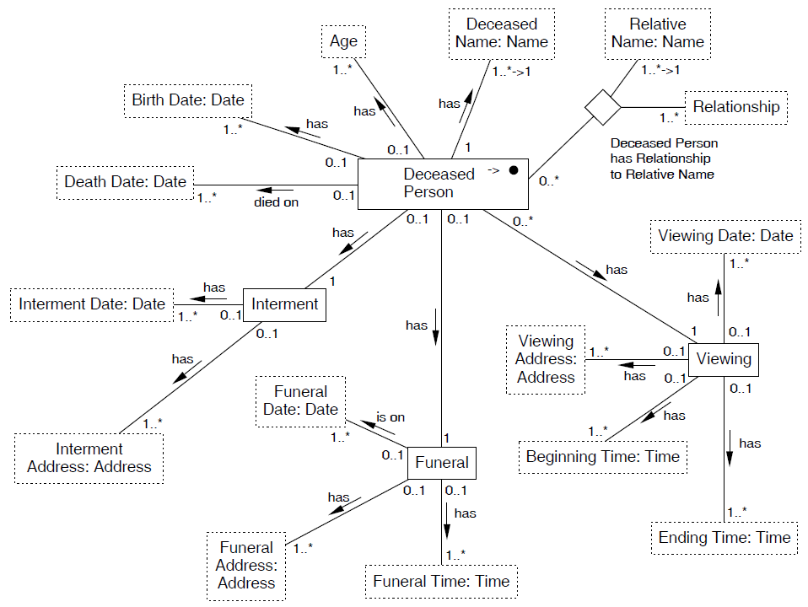
Obituary Ontology

Slide 41
Lexicons & Specializations
Name matches [80] case sensitive
constant
{ extract First, "\s+", Last; },
…
{ extract "[A-Z][a-zA-Z]*\s+([A-Z]\.\s+)?", Last; },
…
lexicon
{ First case insensitive; filename "first.dict"; },
{ Last case insensitive; filename "last.dict"; };
end;
Relative Name matches [80] case sensitive
constant
{ extract First, "\s+\(", First, "\)\s+", Last; substitute "\s*\([^)]*\)" -> ""; }
…
end;
…
Relative Name : Name;
...

Slide 42
Keyword Heuristics: Singleton Items
RelativeName|Brian Fielding Frost|16|35
DeceasedName|Brian Fielding Frost|16|35
KEYWORD(Age)|age|38|40
Age|41|42|43
KEYWORD(DeceasedName)|passed away|46|56
KEYWORD(DeathDate)|passed away|46|56
BirthDate|March 7, 1998|76|88
DeathDate|March 7, 1998|76|88
IntermentDate|March 7, 1998|76|98
FuneralDate|March 7, 1998|76|98
ViewingDate|March 7, 1998|76|98
...

Slide 43
Keyword Heuristics: Multiple Items
…
KEYWORD(Relationship)|born … to|152|192
Relationship|parent|152|192
KEYWORD(BirthDate)|born|152|156
BirthDate|August 4, 1956|157|170
DeathDate|August 4, 1956|157|170
IntermentDate|August 4, 1956|157|170
FuneralDate|August 4, 1956|157|170
ViewingDate|August 4, 1956|157|170
BirthDate|August 4, 1956|157|170
RelativeName|Donald Fielding|194|208
DeceasedName|Donald Fielding|194|208
RelativeName|Helen Glade Frost|214|230
DeceasedName|Helen Glade Frost|214|230
KEYWORD(Relationship)|married|237|243
...

Slide 44
Results: Obituaries
Arizona Daily Star
 | Recall % | Precision %
DeceasedName* | 100 | 100
Age | 86 | 98
BirthDate | 96 | 96
DeathDate | 84 | 99
FuneralDate | 96 | 93
FuneralAddress | 82 | 82
FuneralTime | 92 | 87
…
Relationship | 92 | 97
RelativeName* | 95 | 74
*partial or full name
Training set for tuning ontology: ~24
Test set: 90

Slide 45
Results: Obituaries
Salt Lake Tribune
 | Recall % | Precision %
DeceasedName* | 100 | 100
Age | 91 | 95
BirthDate | 100 | 97
DeathDate | 94 | 100
FuneralDate | 92 | 100
FuneralAddress | 96 | 96
FuneralTime | 97 | 100
…
Relationship | 81 | 93
RelativeName* | 88 | 71
*partial or full name
Training set for tuning ontology: ~12
Test set: 38

Slide 46
Extraction Conclusions
Given an ontology and a Web page with multiple records:
  It is possible to extract and structure the data automatically
Recall and precision results are encouraging
  Car Ads: ~ 94% recall and ~ 99% precision
  Job Ads: ~ 84% recall and ~ 98% precision
  Obituaries: ~ 90% recall and ~ 95% precision (except on names: ~ 73% precision)

Slide 47
Next Steps: Refinement
There are many ways to improve
  Find and categorize pages of interest
  Strengthen heuristics for separation, extraction, and construction
  Add richer conversions and additional constraints to data frames
But let’s get more ambitious and pick a more interesting problem…

Slide 48
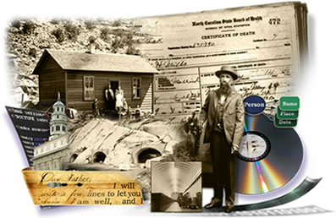
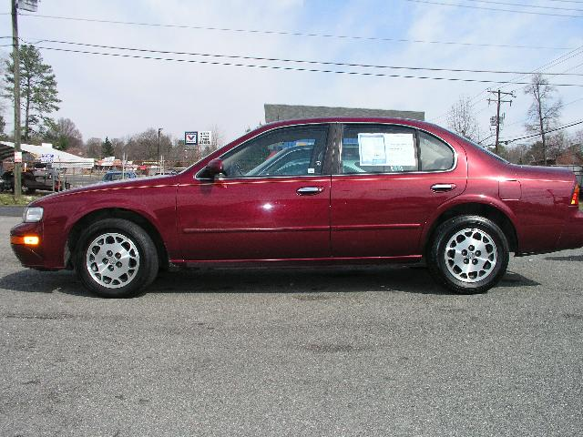
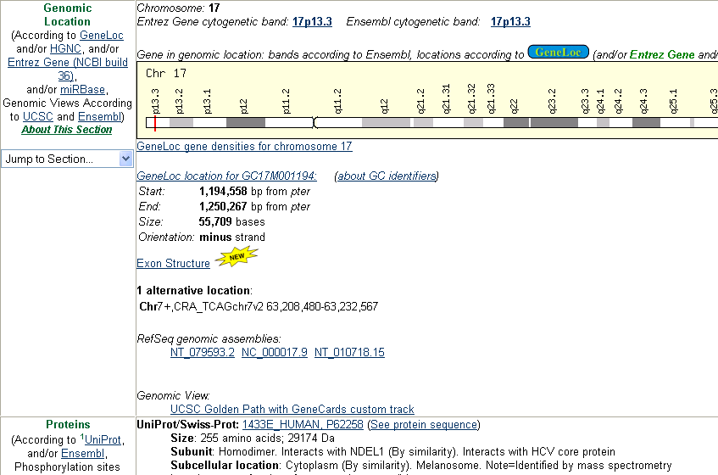
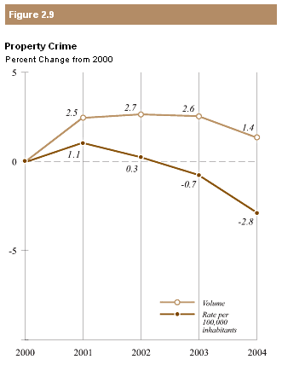
A Web of Pages  A Web of Facts
Birthdate of my great grandpa Orson
Price and mileage of red Nissans, 1990 or newer
Location and size of chromosome 17
US states with property crime rates above 1%

Slide 49
Toward a Web of Knowledge
Fundamental questions
  What is knowledge?
  What are facts?
  How does one know?
Philosophy
  Ontology
  Epistemology
  Logic and reasoning

Slide 50
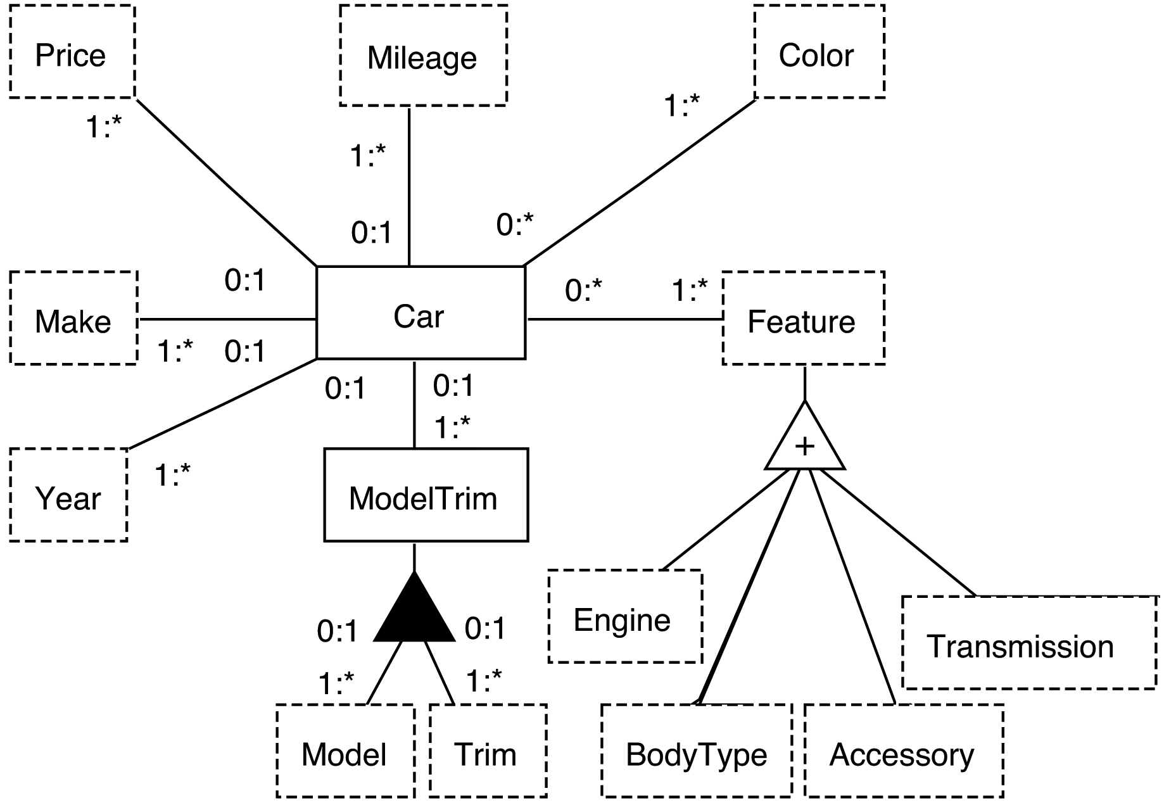
Ontology
Study of Existence ⎯ asks “What exists?”
Concepts, relationships, and constraints
Notes:
Study of being, existence, reality, …

Slide 51
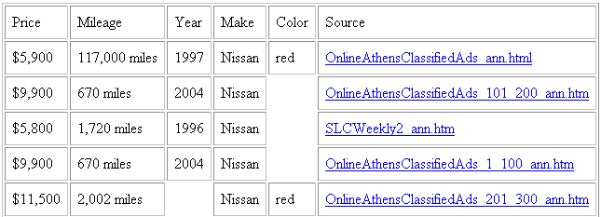
Epistemology
The nature of knowledge ⎯ asks: “What is knowledge?” and “How is knowledge acquired?”
Populated conceptual model

Slide 52
Logic
Principles of valid inference ⎯ asks: “What can be inferred?”
For us, it answers: what can be inferred (in a formal sense) from conceptualized data.
Find price and mileage of red Nissans, 1990 or newer
Notes:
Inferred: facts like how old they are and the fact that they are cars are for sale and can be purchased.
More formally, implied facts based on predicate calculus – will see better later.

Slide 53
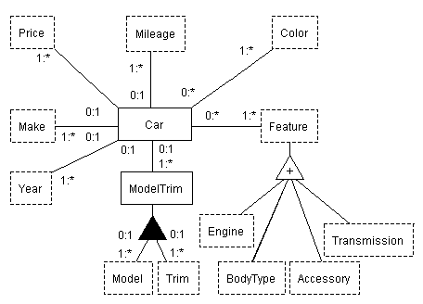
Linguistics: Communication
(Turning Raw Symbols into Knowledge)
Symbols: $ 4,500 117K Nissan CD AC
Data: price($4,500) mileage(117K) make(Nissan)
Conceptualized data:
  Car(C₁₂₃) has Price($11,500)
  Car(C₁₂₃) has Make(Nissan)
Knowledge:
  “Correct” facts
  Provenance

Slide 54
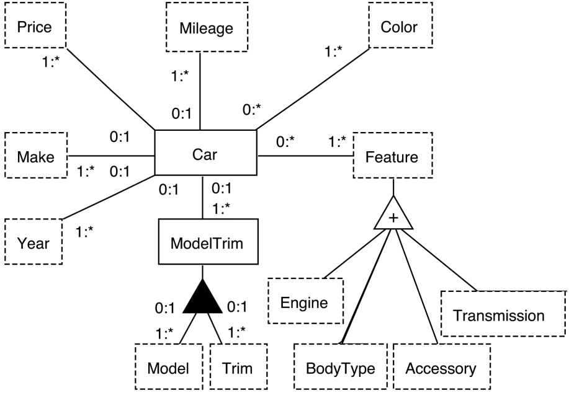
Linguistics: Communication
(Turning Raw Symbols into Knowledge)
Symbols: $ 4,500 117K Nissan CD AC
Data: price($4,500) mileage(117K) make(Nissan)
Conceptualized data:
  Car(C₁₂₃) has Price($4,500)
  Car(C₁₂₃) has Make(Nissan)
Knowledge:
  “Correct” facts
  Provenance

Slide 55
IE Actualization (with Extraction Ontologies)
Find me the price and
mileage of all red Nissans. I want a 1990 or newer.
Notes:
Again, use of linguistics to “understand” query.

Slide 56

IE Actualization (with Extraction Ontologies)
Linguistic “understanding”
of query.
Find me the price and
mileage of all red Nissans. I want a 1990 or newer.
≥ 1990
Notes:
Again, use of linguistics to “understand” query.

Slide 57
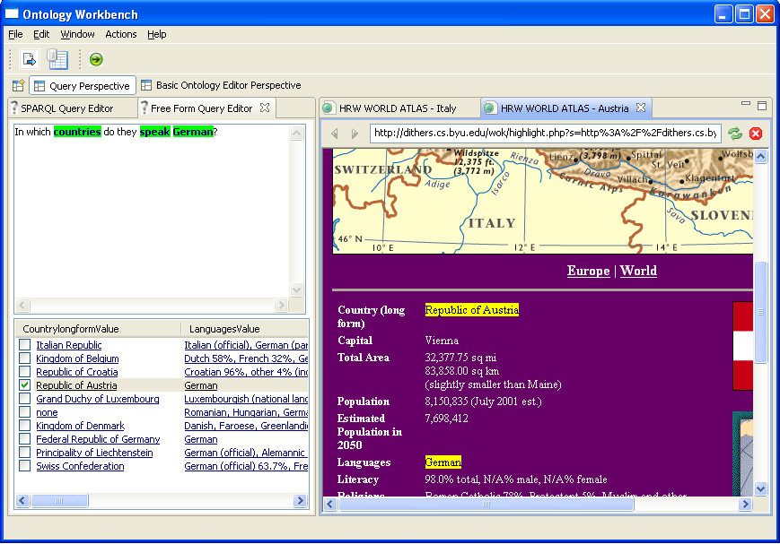
Free-form Query Processing with Annotated Results
Klagenfurt
Notes:
Say a bit about how this works & tie it in to understanding. Also: choice of ontology, mapping to formal query, …

Slide 58
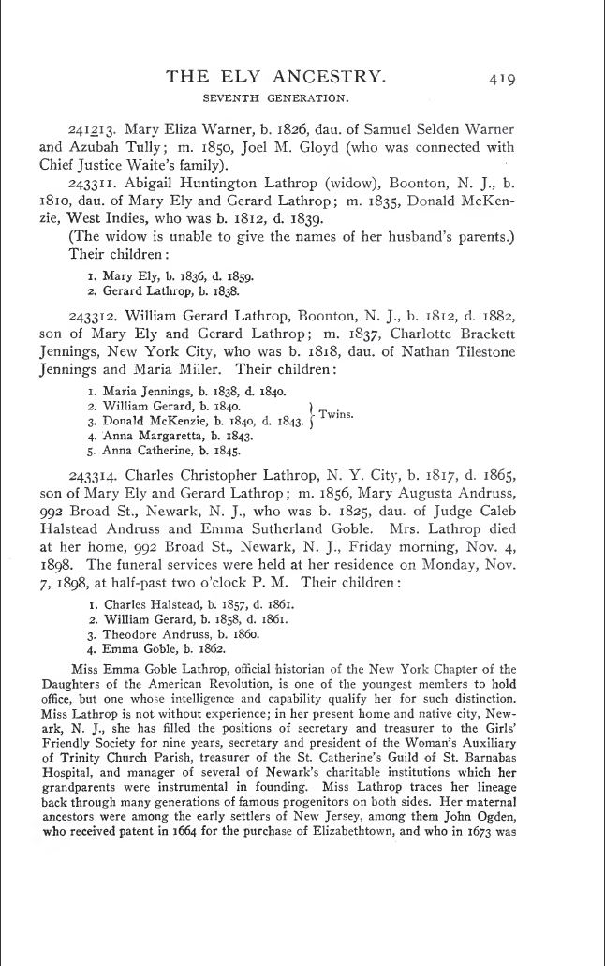
Finding Facts in Historical Documents
A Web of Knowledge superimposed over
Historical Documents
Notes:
Automatic extraction builds links.

Slide 59
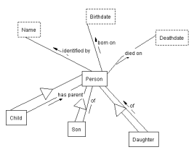
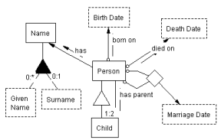
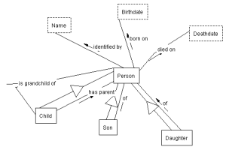
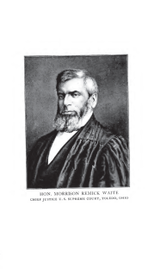

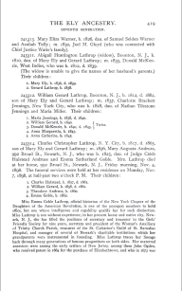
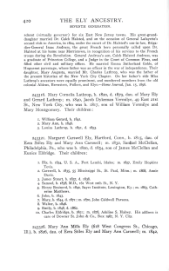
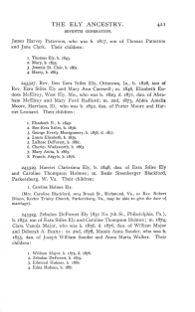
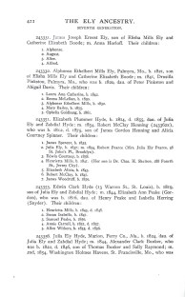
Finding Facts in Historical Documents
(A Web of Knowledge Superimposed over Historical Documents)
…
…
…
…
Notes:
Automatic extraction builds links.

Slide 60
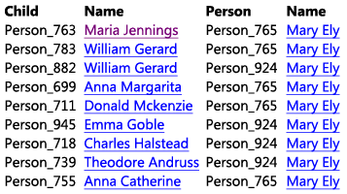
Finding Facts in Historical Documents
(A Web of Knowledge Superimposed over Historical Documents)
grandchildren of Mary Ely
…
…
…
…

Slide 61
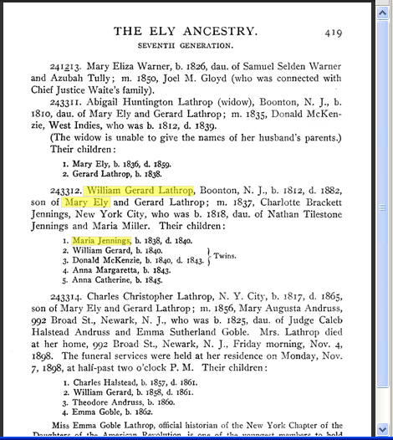
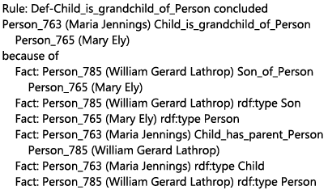
Finding Facts in Historical Documents
(A Web of Knowledge Superimposed over Historical Documents)
grandchildren of Mary Ely
…
…
…
…
Notes:
Mockup as designed. Actual implementation quite close. The differences point to where we need to add finishing touches.

Slide 62
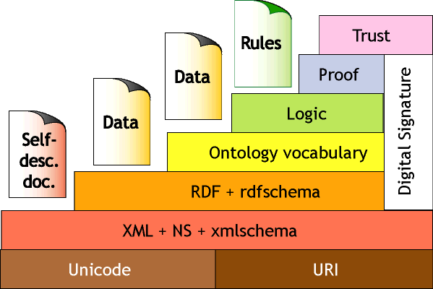
Finding Facts in Historical Documents
(Nicely illustrates Semantic Web “layer cake”)
Notes:
Automatic extraction builds links.

Slide 63
Additional Help Needed: Examples
Ontology
  Issue: ontological commitment distinguishing person, place, & thing
  Solution? reliance on plausible relationships & context
Epistemology
  Issue: trust
  Solution?
    grounding facts in source documents
    evidence-based community agreement
    probabilistic plausibility
Logic
  Issue: tractability
  Solution? detect long-running queries; interactive resolution
Linguistics
  Issue: rapid construction of mappings
  Solution? use of WordNet and other lexical resources
Notes:
Admit that this is rough and speculative. HOWEVER, make the point that even though I may not know the solutions the best, I do know that once I have an issue, I know where to go look for answers—in the philosophical disciplines.
Ontology: accurate conceptualizations should aid in integration; may need more powerful conceptual models and a way to come to community agreement
Epistemology: If anyone can declare a fact, we should make it possible for the fact to be verified (to the extent possible).
Logic: I suspect that users will wish to ask queries that cannot be answered in real time; in an interaction with the user, the system should be able to determine whether it should proceed or not and help the user write a more reasonable query or at least know that it will take a long time to answer the question. Decidability could be much the same: in general, if we allow for logic systems that are undecidable, many queries may nevertheless be decidable.
Linguistics: Linguistic resources should be helpful in quickly generating mappings both for integration and multilingual ontologies.

Slide 64
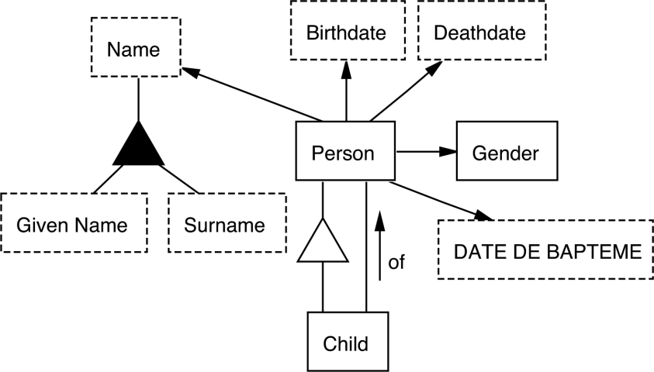
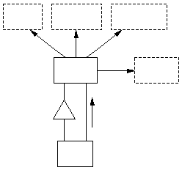
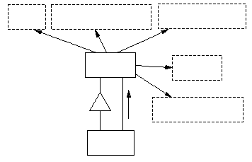
Multilingual Query Processing
Wie alt war Mary Ely als ihr Son William geboren wurde? (die Mary Ely die Maria Jennings Lathrops Oma ist)
이름
생년월일
사망날짜
nom
date de naissance
date de décès
…
사람
성별
individu
sexe
의
Additional help needed from philosophical disciplines
de
date de baptême
자식
enfant
Notes:
It doesn’t matter what language, many app domains are the same
Multilingual ontologies leverages this point – models the world in a
language-independent manner
Language independent model (English, although could use symbols (e.g., man/woman symbols for Gender) and a mixture of languages.

Slide 65
Future Directions
Continue building WoK tools
  Semantic annotation tools
    We have access to a world-class set of historical documents that we hope to help annotate better
  Improved ontology creation tools
    This is a hard problem that takes expert attention
  Improved query tools
    Perhaps separate extraction and query ontology profiles
  Multi-lingual ontology capabilities
    Enhanced universalilty

Slide 66
Summary
Principles from philosophical disciplines
  Can guide CM research
  Can enhance CM applications
Apply principles pragmatically:
  Simplicity
  Sufficiency
  But not overzealously
When you have formal tools, they may be able to do a LOT more than you first think
Notes:
Take home message: Conceptual-model researchers should draw ideas and seek guidance from the disciplines of ontology, epistemology, logic, and linguistics to enhance conceptual-modeling applications, but should not become distracted from computationally practical solutions by insisting that philosophical tenets should prevail. (Occam’s Razor; Einstein’s maxim)

Slide 67
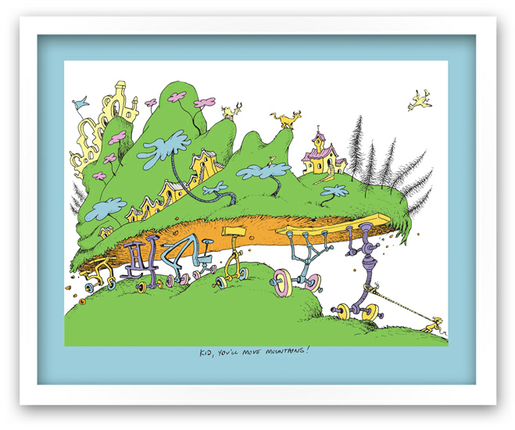
Kid [Conceptual Modeling],
You’ll Move Mountains!
Company
Employee

Slide 68
More Information
Visit the Data Extraction Research Group’s web page:
  http://www.deg.byu.edu
There you can find electronic versions of our papers and presentations
Thanks for your attention!

