Slide 1
A Web of Knowledge for Historical Documents
David W. Embley

Slide 2
Enabling Search for Facts and Implied Facts by Automating the Construction of a Web of Knowledge for Historical Documents
David W. Embley

Slide 3
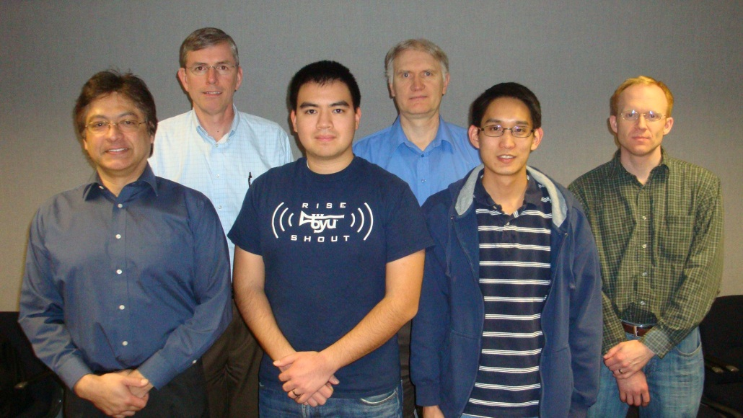
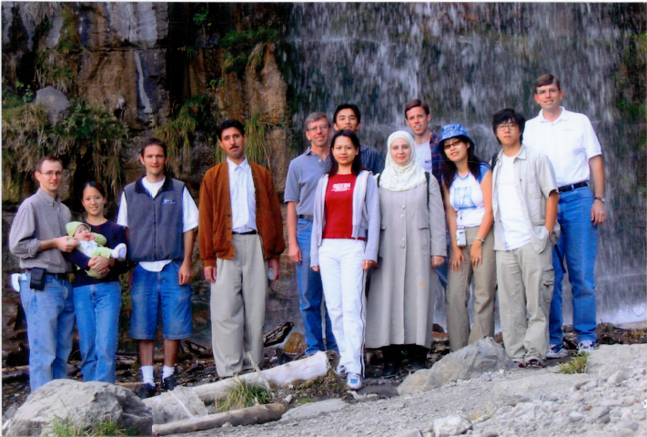
BYU Data Extraction Research Group
Stephen W. Liddle, Deryle W. Lonsdale, Spencer Machado, Thomas Packer, Joseph Park, Nathan Tate, Andrew Zitzelberger
Notes:
Pictures would be better here – do we have older pictures of our research group?

Slide 4
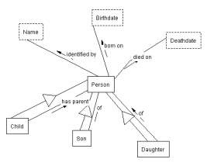
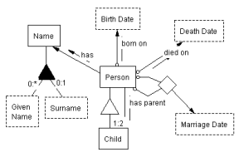
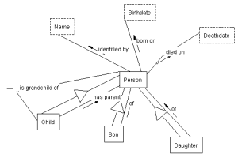
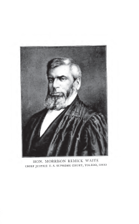
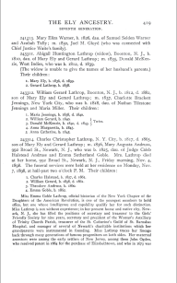
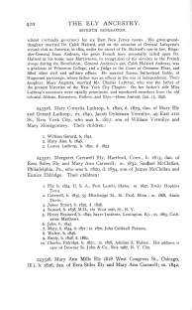
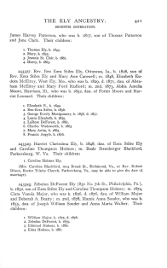
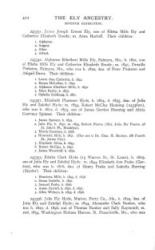
WoK-HD (A Web of Knowledge Superimposed over Historical Documents)
…
…
…
…
Notes:
Automatic extraction builds links.

Slide 5
WoK-HD (A Web of Knowledge Superimposed over Historical Documents)
grandchildren of Mary Ely
…
…
…
…
Notes:
Automatic extraction also builds query links.

Slide 6
WoK-HD (A Web of Knowledge Superimposed over Historical Documents)
grandchildren of Mary Ely
…
…
…
…
Notes:
Selection of best ontology to answer query.

Slide 7
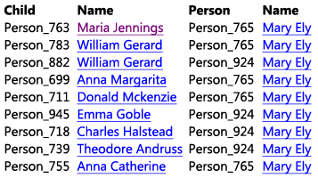
WoK-HD (A Web of Knowledge Superimposed over Historical Documents)
grandchildren of Mary Ely
…
…
…
…

Slide 8
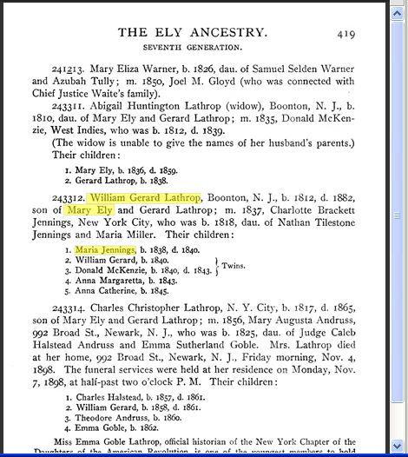
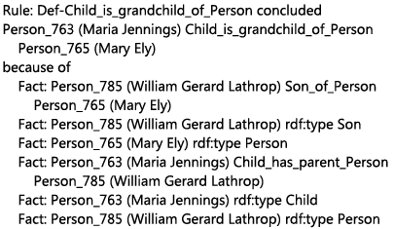
WoK-HD (A Web of Knowledge Superimposed over Historical Documents)
grandchildren of Mary Ely
…
…
…
…
Notes:
Mockup as designed. Actual implementation quite close. The differences point to where we need to add finishing touches.

Slide 9
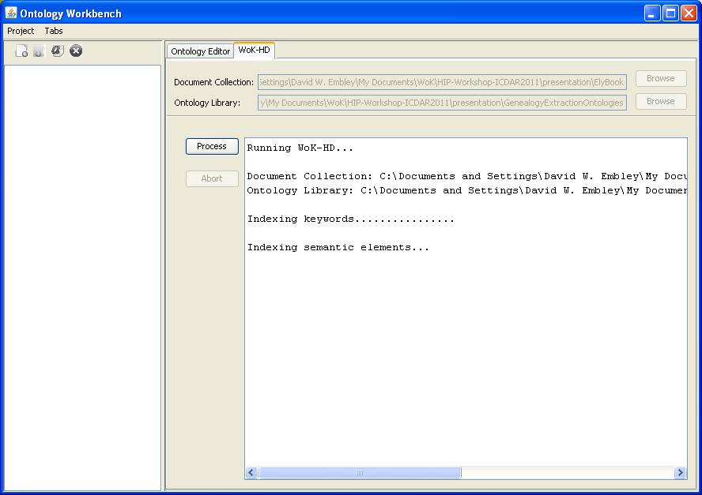
WoK-HD Input
Notes:
Demo: initial screen

Slide 10
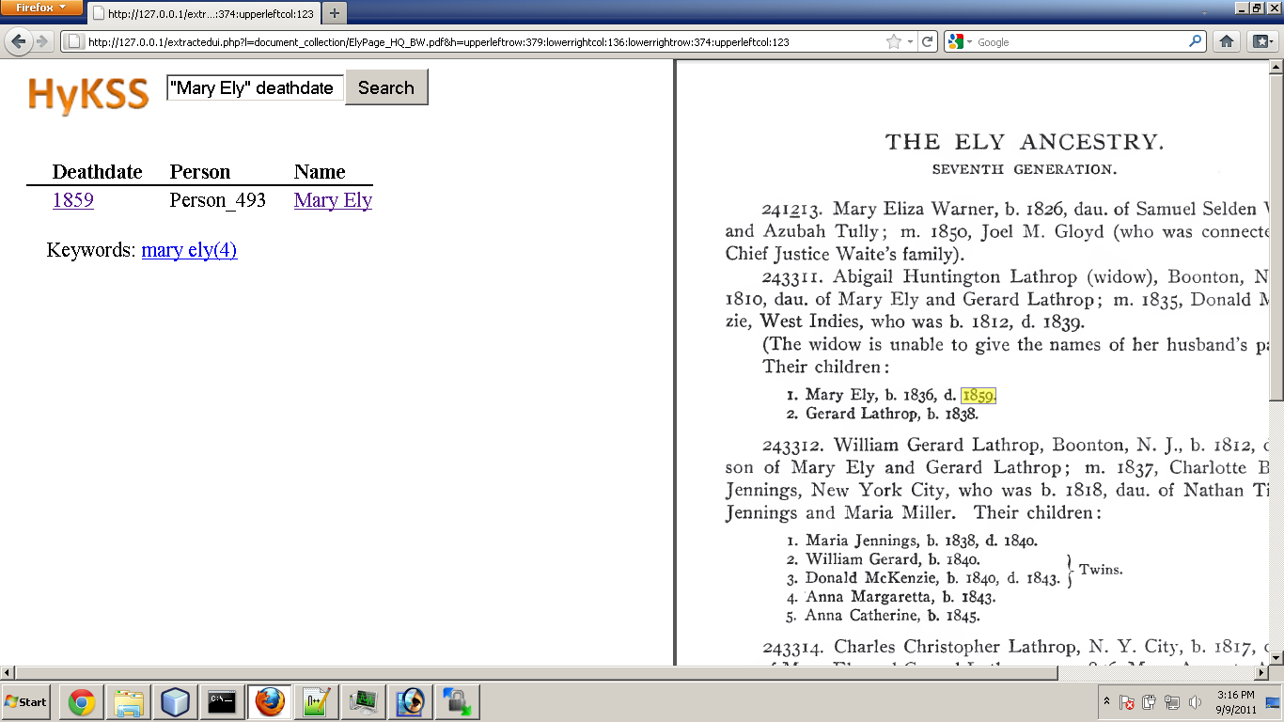
Querying for Facts & Implied Facts
Notes:
Facts. Demo: Query screen shots

Slide 11
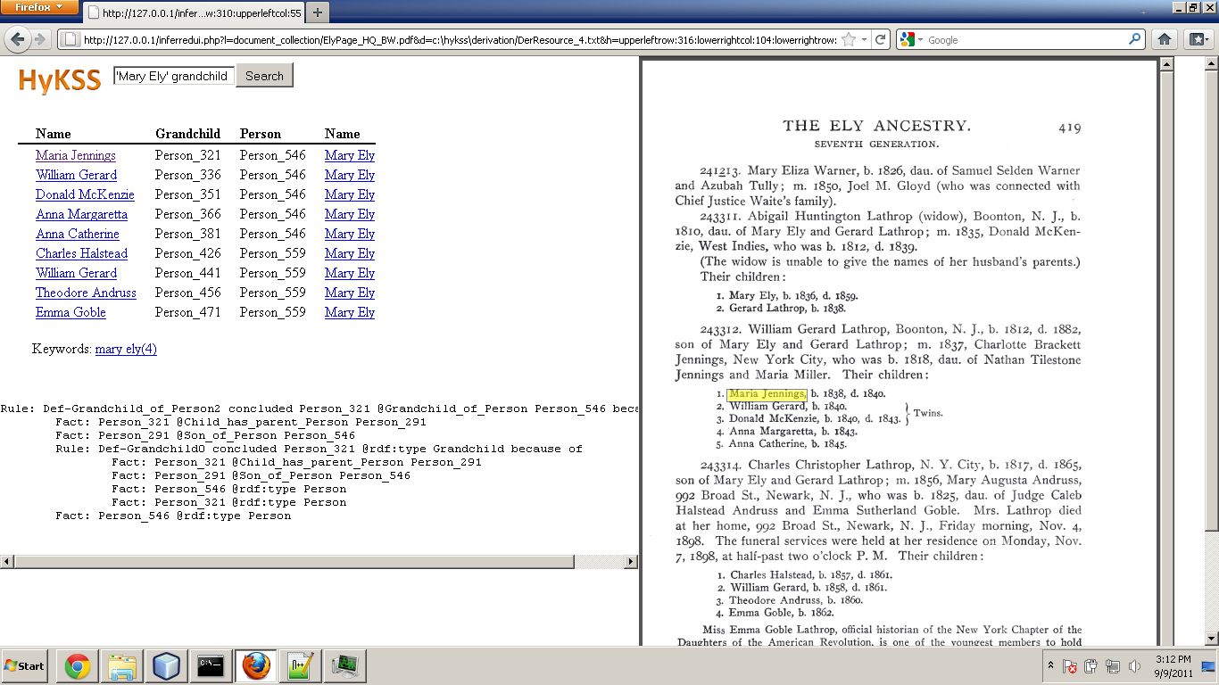
Querying for Facts & Implied Facts
Animation of
Extraction query, results, highlighting
Reasoned Query, results, reasoning chain, highlighting
Notes:
Implied Facts. Demo: Query screen shots

Slide 12
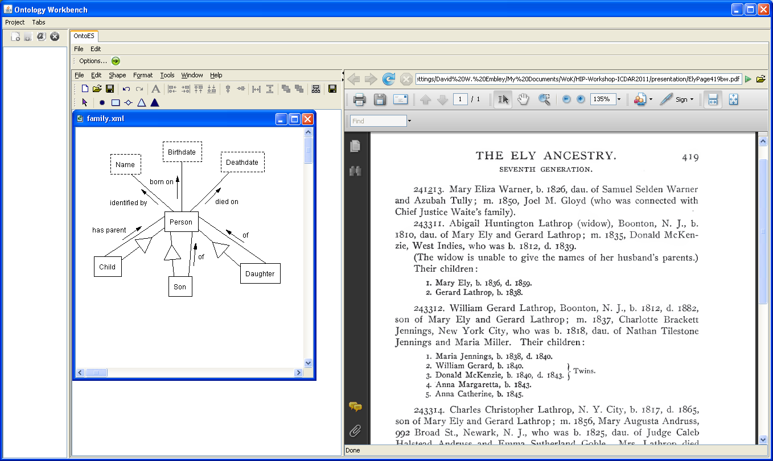
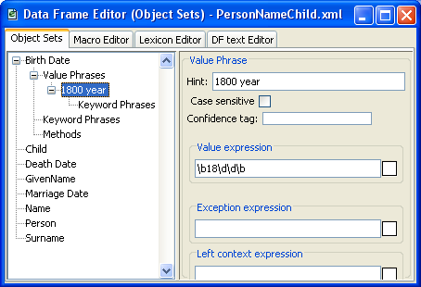
Extraction Ontologies
Notes:
This begins the explanation of how it works.

Slide 13
Extraction Ontologies
Notes:
… indexing …

Slide 14
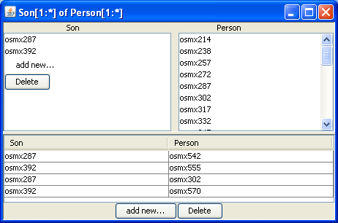
Fact Extraction
Notes:
Populated object and relationship sets

Slide 15
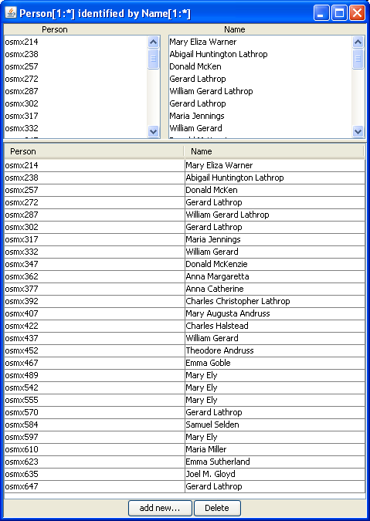
Fact Extraction

Slide 16
Fact Extraction

Slide 17
Reasoning for Implied Facts
Notes:
Declaration of reasoning rules.

Slide 18
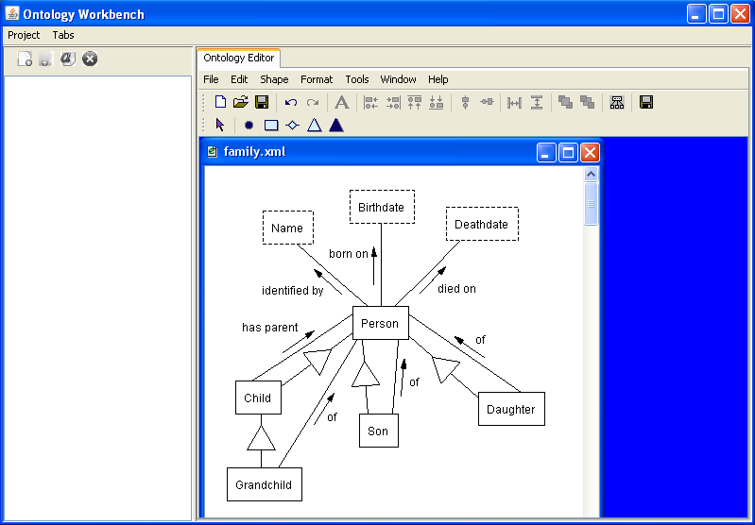
Reasoning for Implied Facts
Notes:
Reasoning rules yields new object and relationship sets.

Slide 19
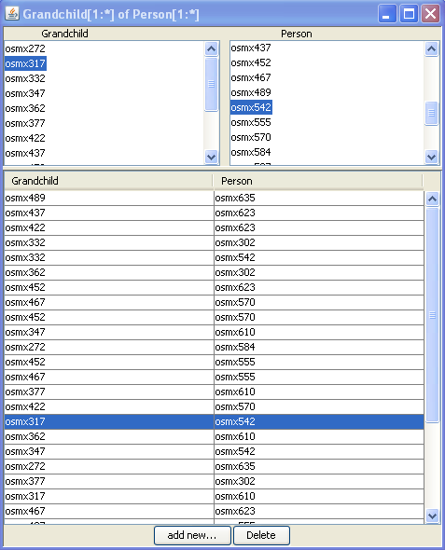
Reasoning for Implied Facts
Notes:
… and new data instances

Slide 20
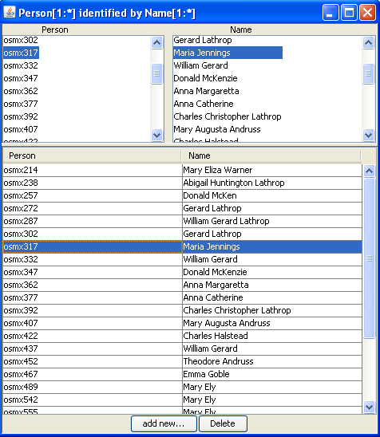
Reasoning for Implied Facts

Slide 21
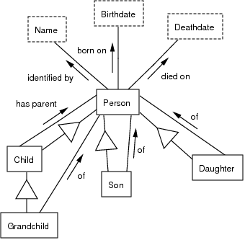
Query Interpretation
“Mary Ely” grandchild

Slide 22
Query Interpretation
“Mary Ely” grandchild

Slide 23
Query Interpretation
“Mary Ely” grandchild

Slide 24
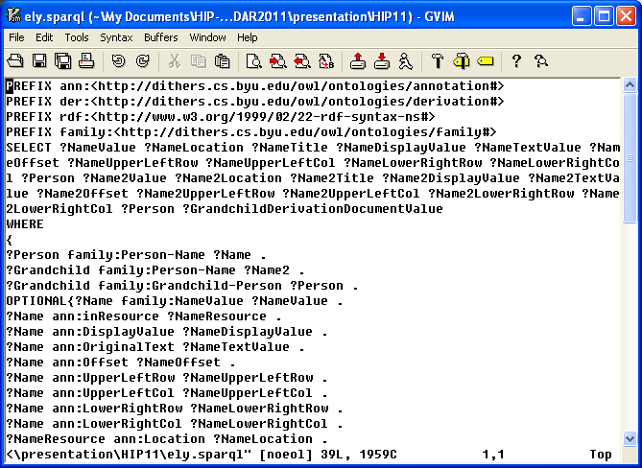
Generated SPARQL Query

Slide 25
Generated SPARQL Query

Slide 26
Query Results

Slide 27
Results of Processing the Ely Ancestry (all 830 Pages)
Number of facts extracted: 22,251
8,740 Person-Birthdate facts
3,803 Person-Deathdate facts
9,708 children facts, including
5,020 Child-has-parent-Person facts
2,394 Son-of-Person facts
2,294 Daughter-of-Person facts
Number of implied grandchild facts inferred: 5,277
Processing time:
~18 seconds per page
CPU time: ~4 hours
Processing 10 in parallel: ~24 minutes
Notes:
Grand total: 27,528
Each page took an average of about 18 seconds, so the entire job took roughly 4 hours of CPU time to process (4 hours 9 min, when estimated using 18 seconds per page on the 100 pages sampled). Run on Marylou, processing 10 pages at a time in parallel. ?? So, wall-clock time should be 240 minutes / 10 = 24 minutes. (Does the 18 seconds include the time to do the inferencing? yes)
Person-Name facts not counted (miscommunication about whether they were wanted)

Slide 28
Results of Processing the Ely Ancestry (all 830 Pages)
Precision: .52 (by randomly selecting & checking 100 of the 22,251 facts)
Recall: .33 & Precision: .40 (by randomly selecting and checking 2 fact-filled family pages)
Errors:
Name recognizer
Text pattern expectations
OCR
Varying accuracy (for pages checked)
Recall: .11, Precision: .11 (bad combination of all problems)
Recall: .50, Precision: .68 (some problems, but closer to expectations)
Recall: .59, Precision: .71 (10 pages, mostly as expected)
Recall: .91, Precision: .94 (tuned, no problems except a few OCR errors)
Notes:
Failures of name recognizer: (1) names weren’t in dictionary (occasionally due to OCR errors), (2) names such as the month “May” that are in the name dictionary, (3) relationship set recognizers such as “son of” or “born on” that “forced” the system to pick out a name, which it sometimes did incorrectly. Layout expectations: expected “children:” but not “children of” (switch for no apparent reason), window extent for relationships such as “children:”, “son of”, and “daughter of” turned out to be longer than expected

Slide 29
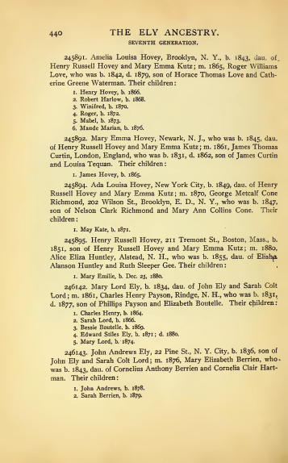
Results after adding Recognizers for Relationship Sets
Name: 0.91
Birthdate: 0.92
Deathdate: 1.00
Person born on Birthdate: 0.89
Person died on Deathdate: 0.75
Son of Person: 0.83
Daughter of Person: 0.33
Child: has parent Person: 0.79
Average F-measure: 0.80
Correct extracted facts: 143
Total extracted facts: 165
Actual number of facts: 172
Notes:
I modified the relationshipset heuristics to find the objects that subsume the one found using the relphrase expression. This mostly solves the problem of the final relphrase having a huge OR statement where it will recognize an arbitrary value in that OR statement (and it usually chooses a shorter one). Here are the results with object sets included (as a side note, I also flattened the OCRed text to a single line which solved the regex any character not picking up newline characters):
Precision:
ObjectSet: Name, 0.85
ObjectSet: Birthdate, 1.0
ObjectSet: Deathdate, 1.0
RelationshipSet: Person[1:*] born on Birthdate[1:*], 0.9230769230769231
RelationshipSet: Person[1:*] died on Deathdate[1:*], 0.75
RelationshipSet: Son[1:*] of Person[1:*], 0.8333333333333334
RelationshipSet: Daughter[1:*] of Person[1:*], 0.5
RelationshipSet: Child[1:*] has parent Person[1:*], 0.8275862068965517
Average Precision: 0.835499557913351
Recall:
ObjectSet: Name, 0.9807692307692307
ObjectSet: Birthdate, 0.8571428571428571
ObjectSet: Deathdate, 1.0
RelationshipSet: Person[1:*] born on Birthdate[1:*], 0.8571428571428571
RelationshipSet: Person[1:*] died on Deathdate[1:*], 0.75
RelationshipSet: Son[1:*] of Person[1:*], 0.8333333333333334
RelationshipSet: Daughter[1:*] of Person[1:*], 0.25
RelationshipSet: Child[1:*] has parent Person[1:*], 0.75
Average Recall: 0.7847985347985348
F-measure:
ObjectSet: Name, 0.9107142857142857
ObjectSet: Birthdate, 0.923076923076923
ObjectSet: Deathdate, 1.0
RelationshipSet: Person[1:*] born on Birthdate[1:*], 0.888888888888889
RelationshipSet: Person[1:*] died on Deathdate[1:*], 0.75
RelationshipSet: Son[1:*] of Person[1:*], 0.8333333333333334
RelationshipSet: Daughter[1:*] of Person[1:*], 0.3333333333333333
RelationshipSet: Child[1:*] has parent Person[1:*], 0.7868852459016394
Average F-measure: 0.8032790012810503
Number of correct extracted facts: 143.0
Total number of extracted facts: 165.0
Actual number of facts: 172.0
Here are the results for just the relationships:
Precision:
RelationshipSet: Person[1:*] born on Birthdate[1:*], 0.9230769230769231
RelationshipSet: Person[1:*] died on Deathdate[1:*], 0.75
RelationshipSet: Son[1:*] of Person[1:*], 0.8333333333333334
RelationshipSet: Daughter[1:*] of Person[1:*], 0.5
RelationshipSet: Child[1:*] has parent Person[1:*], 0.8275862068965517
Average Precision: 0.7667992926613616
Recall:
RelationshipSet: Person[1:*] born on Birthdate[1:*], 0.8571428571428571
RelationshipSet: Person[1:*] died on Deathdate[1:*], 0.75
RelationshipSet: Son[1:*] of Person[1:*], 0.8333333333333334
RelationshipSet: Daughter[1:*] of Person[1:*], 0.25
RelationshipSet: Child[1:*] has parent Person[1:*], 0.75
Average Recall: 0.6880952380952381
F-measure:
RelationshipSet: Person[1:*] born on Birthdate[1:*], 0.888888888888889
RelationshipSet: Person[1:*] died on Deathdate[1:*], 0.75
RelationshipSet: Son[1:*] of Person[1:*], 0.8333333333333334
RelationshipSet: Daughter[1:*] of Person[1:*], 0.3333333333333333
RelationshipSet: Child[1:*] has parent Person[1:*], 0.7868852459016394
Average F-measure: 0.718488160291439
Number of correct extracted facts: 64.0
Total number of extracted facts: 77.0
Actual number of facts: 88.0

Slide 30
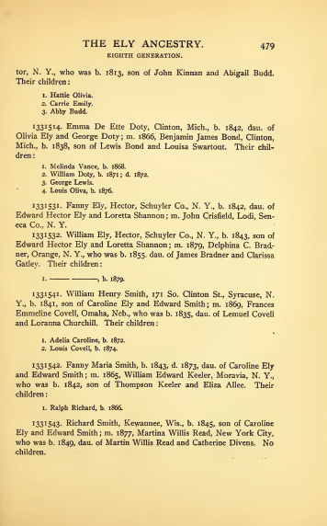
Results after adding Recognizers for Relationship Sets
Name: 0.70
Birthdate: 0.88
Deathdate: 1.00
Person born on Birthdate: 0.56
Person died on Deathdate: 1.00
Son of Person: 0.89
Daughter: of Person: 0.45
Child has parent Person: 0.30
Average F-measure: 0.72
Correct extracted facts: 79
Total extracted facts: 119
Actual number of facts: 119
Notes:
Here are the results of the second test page (pdf page 649, actual page 479)
Precision:
ObjectSet: Name, 0.5932203389830508
ObjectSet: Birthdate, 1.0
ObjectSet: Deathdate, 1.0
RelationshipSet: Person[1:*] born on Birthdate[1:*], 0.6428571428571429
RelationshipSet: Person[1:*] died on Deathdate[1:*], 1.0
RelationshipSet: Son[1:*] of Person[1:*], 1.0
RelationshipSet: Daughter[1:*] of Person[1:*], 0.5
RelationshipSet: Child[1:*] has parent Person[1:*], 0.4
Average Precision: 0.7670096852300243
Recall:
ObjectSet: Name, 0.8536585365853658
ObjectSet: Birthdate, 0.7777777777777778
ObjectSet: Deathdate, 1.0
RelationshipSet: Person[1:*] born on Birthdate[1:*], 0.5
RelationshipSet: Person[1:*] died on Deathdate[1:*], 1.0
RelationshipSet: Son[1:*] of Person[1:*], 0.8
RelationshipSet: Daughter[1:*] of Person[1:*], 0.4166666666666667
RelationshipSet: Child[1:*] has parent Person[1:*], 0.25
Average Recall: 0.6997628726287263
F-measure:
ObjectSet: Name, 0.6999999999999998
ObjectSet: Birthdate, 0.8750000000000001
ObjectSet: Deathdate, 1.0
RelationshipSet: Person[1:*] born on Birthdate[1:*], 0.5625000000000001
RelationshipSet: Person[1:*] died on Deathdate[1:*], 1.0
RelationshipSet: Son[1:*] of Person[1:*], 0.888888888888889
RelationshipSet: Daughter[1:*] of Person[1:*], 0.45454545454545453
RelationshipSet: Child[1:*] has parent Person[1:*], 0.3076923076923077
Average F-measure: 0.7235783313908314
Number of correct extracted facts: 79.0
Total number of extracted facts: 119.0
Actual number of facts: 119.0
Here are the results of just the relationships:
Precision:
RelationshipSet: Person[1:*] born on Birthdate[1:*], 0.6428571428571429
RelationshipSet: Person[1:*] died on Deathdate[1:*], 1.0
RelationshipSet: Son[1:*] of Person[1:*], 1.0
RelationshipSet: Daughter[1:*] of Person[1:*], 0.5
RelationshipSet: Child[1:*] has parent Person[1:*], 0.4
Average Precision: 0.7085714285714285
Recall:
RelationshipSet: Person[1:*] born on Birthdate[1:*], 0.5
RelationshipSet: Person[1:*] died on Deathdate[1:*], 1.0
RelationshipSet: Son[1:*] of Person[1:*], 0.8
RelationshipSet: Daughter[1:*] of Person[1:*], 0.4166666666666667
RelationshipSet: Child[1:*] has parent Person[1:*], 0.25
Average Recall: 0.5933333333333333
F-measure:
RelationshipSet: Person[1:*] born on Birthdate[1:*], 0.5625000000000001
RelationshipSet: Person[1:*] died on Deathdate[1:*], 1.0
RelationshipSet: Son[1:*] of Person[1:*], 0.888888888888889
RelationshipSet: Daughter[1:*] of Person[1:*], 0.45454545454545453
RelationshipSet: Child[1:*] has parent Person[1:*], 0.3076923076923077
Average F-measure: 0.6427253302253302
Number of correct extracted facts: 28.0
Total number of extracted facts: 44.0
Actual number of facts: 58.0

Slide 31
Current and Future Work (Making the WoK-HD Vision Practical)
4. Internationalization:
Français
한국인
…
grandchildren of Mary Ely
3. Accurate and
Efficient Query Processing
2. Automated Conceptual Organization
1. Cost-effective and Accurate Extraction
…
…
…
…
Notes:
Old Slide:
Implementation Status:
Full line works (but is fragile & needs finishing touches)
HyKSS integrated (but not all features)
Scalability:
Handcrafted extraction ontologies & reasoning rules (worth the work for certain applications)
ListReader (plus bootstrapping for lists and general extraction)
Optimization (especially for query processing)
Integration:
Mapping extraction ontologies to domain ontologies
Object identity for people and places
What needs to be done to make the vision practical:
(a) Automate as much as possible the construction of fact extractors.
(b) Build tools to clean and organize facts, including information
integration and object-identity resolution.
(c) Enhance and optimize hybrid keyword and semantic search.
(d) Enable multilingual fact extraction and query processing.

Slide 32
1. Cost-effective and Accurate Extraction
Focus on semi-structured elements first
Bootstrap synergistically
Extract from semi-structured elements
Learn extraction ontologies
Extract from plain text
Notes:
Automate as much as possible the construction of fact extractors.
Documents: here, assume family histories
Focus on semi-structured elements of a document first.
When starting from scratch, system watches user and learns patterns, takes over, and also begins to build extraction ontologies.
Bootstrapping: make use of extraction ontologies to automate the learning of other semi-structured elements. Continue building extraction ontologies.
Extract from non-semi-structured text synergistically.
When continuing in the same domain (not starting from scratch):
the system makes use of prior knowledge and works synergistically with the user from the beginning.
To avoid over learning, it adjusts its extraction ontologies for the particular task at hand, not assuming that everything it has learned applies
Separately, it also contributes to domain knowledge by continuing to build domain-level extraction ontologies.

Slide 33
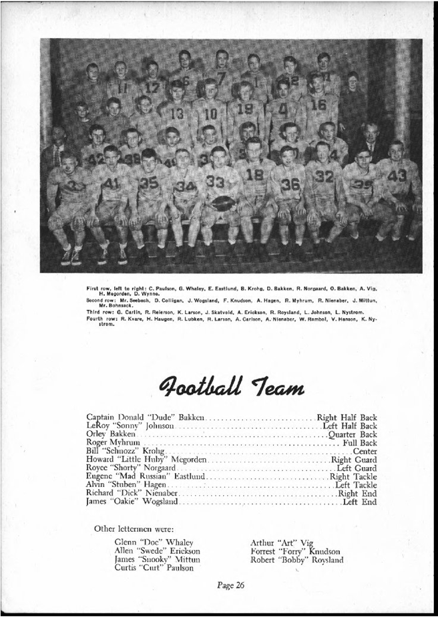
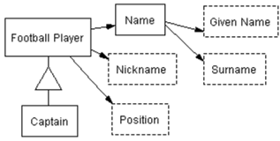
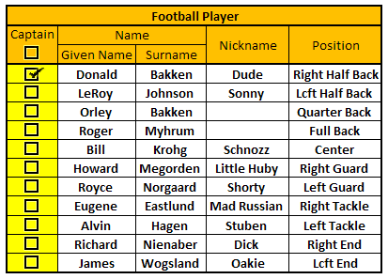
ListReader: Wrapper Induction for Lists

Slide 34
Part I: Semi-supervised

Slide 35
newline First row, left to right: C. Paulson, G. Whaley, E Eastlund, B. Krohg, D. Bakken, R. Norgaard, 0. Bakken, A. Vig, newline H. Megorden, D Wynne newline Second row- Mr. See bach, D. Colligan, J. Wogsland, F Knudson, A. Hagen, R. Myhrum, R. Nienaber, J. Mittun, newline Mr. Bohnsack. newline Third row: G. Carlm, R. Reterson, K Larson, J Skatvold, A. Enckson, R Roysland, L.Johnson, L. Nystrom. newLine Fourth row: R. Kvare, H. Haugen, R. Lubken, R Larson, A. Carlson, A. Nienaber, W Ram bo I, V Hanson, K. Ny- newline newline QootLaM "leam newline newline Captain Donald "Dude" Bakken ............... Right Half Back newline LeRoy "Sonny' Johnson ..................,.... Lcft Half Back newline Orley Bakken ...........,...........,.......... Quarter Back newline Roger Myhrum ................................... Full Back newline Bill "Schnozz" Krohg .............................. Center newline Howard "Little Huby" Megorden ................ Right Guard newline Royce "Shorty" Norgaard ....................... Left Guard newline Eugene "Mad Russian" Easthind ............... Right Tackle newline Alvin "Stuben" Hagen ......................... Left Tackle newline Richard "Dick" Nienabcr ........................ Right End newline James "Oakie" Wogsland .......................... Lcft End newline newline Other lettermen were- newline Glenn "Doc" Whaley newline Allen "Swede" Enckson newline James "Snooky" Mittun newline Curtis "Curt" Paulson newline Arthur "Art" Vig newline Forrest "Forry" Knudson newline Robert "Bobby" Roysland newline Page 26 newline
OCR

Slide 36
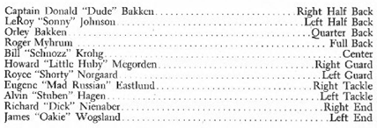
Hand
Form Creation & Labeling

Slide 37
Hand
Form Creation & Labeling
√

Slide 38
Hand
Form Creation & Labeling
√
Donald

Slide 39
Hand
Form Creation & Labeling
√
Donald
Bakken

Slide 40
Hand
Form Creation & Labeling
√
Donald
Bakken
Dude

Slide 41
Hand
Form Creation & Labeling
√
Donald
Bakken
Dude
Right Half Back

Slide 42
1. Captain, 2. Given Name, 3. Nickname, 4. Surname, 5. Position
(Captain) (\w{6,6}) "(\w{4,4})" (\w{6,6}) \.{14,14} ((\w{4,5}){3,3})\n
Generate Wrapper for First Record
Captain Donald "Dude" Bakken ............... Right Half Back newline LeRoy "Sonny' Johnson ..................,.... Lcft Half Back newline Orley Bakken ...........,...........,.......... Quarter Back newline Roger Myhrum ................................... Full Back newline Bill "Schnozz" Krohg .............................. Center newline Howard "Little Huby" Megorden ................ Right Guard newline Royce "Shorty" Norgaard ....................... Left Guard newline Eugene "Mad Russian" Easthind ............... Right Tackle newline Alvin "Stuben" Hagen ......................... Left Tackle newline Richard "Dick" Nienabcr ........................ Right End newline James "Oakie" Wogsland .......................... Lcft End newline newline Other lettermen were- newline Glenn "Doc" Whaley newline Allen "Swede" Enckson newline James "Snooky" Mittun newline Curtis "Curt" Paulson newline Arthur "Art" Vig newline Forrest "Forry" Knudson newline Robert "Bobby" Roysland newline Page 26 newline

Slide 43
2. Captain, 3. Given Name, 5. Nickname, 6. Surname, 7. Position
((Captain) )?(\w{5,6})( "(\w{4,5}) ['"] )? (\w{6,7}) [\.,]{14,34} ((\w{4,7} ){2,3})\n
Update Wrapper &
Annotate Records
Captain Donald "Dude" Bakken ............... Right Half Back newline
LeRoy "Sonny' Johnson ..................,.... Lcft Half Back newline
Orley Bakken ...........,...........,.......... Quarter Back newline
Roger Myhrum ................................... Full Back newline Bill "Schnozz" Krohg .............................. Center newline Howard "Little Huby" Megorden ................ Right Guard newline Royce "Shorty" Norgaard ....................... Left Guard newline Eugene "Mad Russian" Easthind ............... Right Tackle newline Alvin "Stuben" Hagen ......................... Left Tackle newline Richard "Dick" Nienabcr ........................ Right End newline James "Oakie" Wogsland .......................... Lcft End newline newline Other lettermen were- newline Glenn "Doc" Whaley newline Allen "Swede" Enckson newline James "Snooky" Mittun newline Curtis "Curt" Paulson newline Arthur "Art" Vig newline Forrest "Forry" Knudson newline Robert "Bobby" Roysland newline Page 26 newline

Slide 44
2. Captain, 3. Given Name, 5. Nickname, 7. Surname, 8. Position
((Captain) )?(\w{4,7})( “((\w{4,7}){1,2})['"] )? (\w{5,8} ) [\.,]{14,34} ((\w{4,7} ){1,3})\n
Final Wrapper
and Annotation
Captain Donald "Dude" Bakken ............... Right Half Back newline
LeRoy "Sonny' Johnson ..................,.... Lcft Half Back newline
Orley Bakken ...........,...........,.......... Quarter Back newline
Roger Myhrum ................................... Full Back newline
Bill "Schnozz" Krohg .............................. Center newline
Howard "Little Huby" Megorden ................ Right Guard newline
Royce "Shorty" Norgaard ....................... Left Guard newline
Eugene "Mad Russian" Easthind ............... Right Tackle newline
Alvin "Stuben" Hagen ......................... Left Tackle newline
Richard "Dick" Nienabcr ........................ Right End newline
James "Oakie" Wogsland .......................... Lcft End newline

Slide 45
Part II: Weakly-supervised

Slide 46
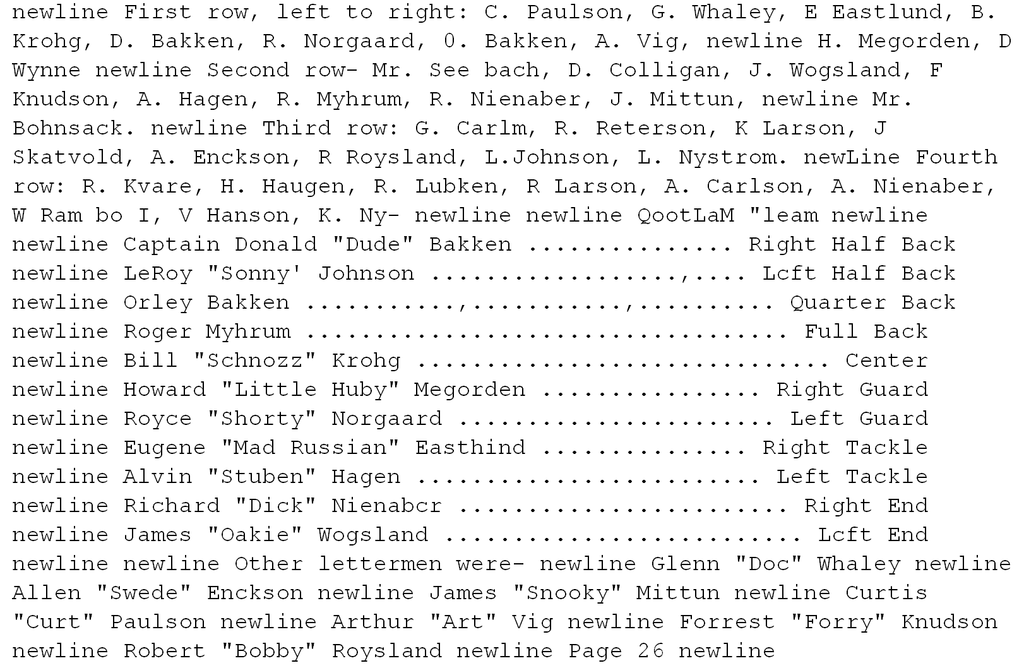
Apply Extraction Ontologies

Slide 47
Find List and Generate Wrapper
Base list finding on whether a wrapper can be generated.
Base wrapper generation on best-labeled record.
Notes:
Can base list finding on whether a wrapper can be generated.
Can base wrapper generation on best-labeled record.

Slide 48
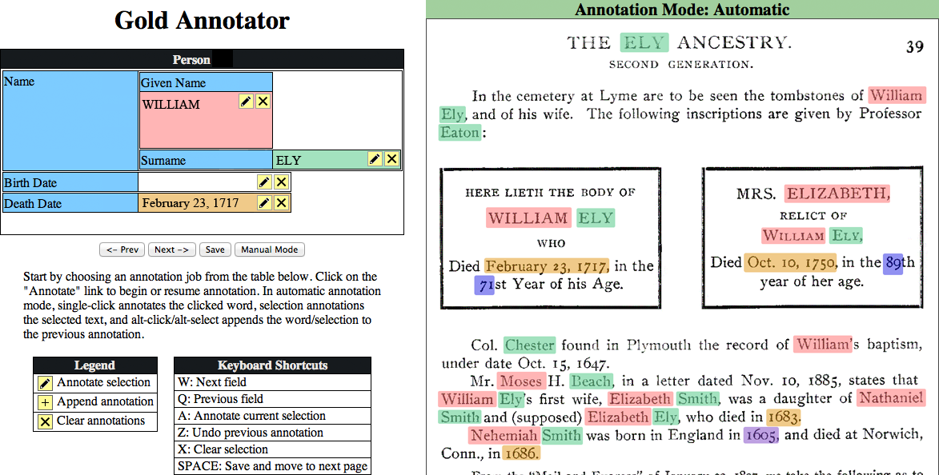
Extract Synergistically from Text
Notes:
Can learn plain-text patterns “on the go” by seeing which patterns repeat. (In essence, create tailored Hurst patterns for a particular document collection or domain.)

Slide 49
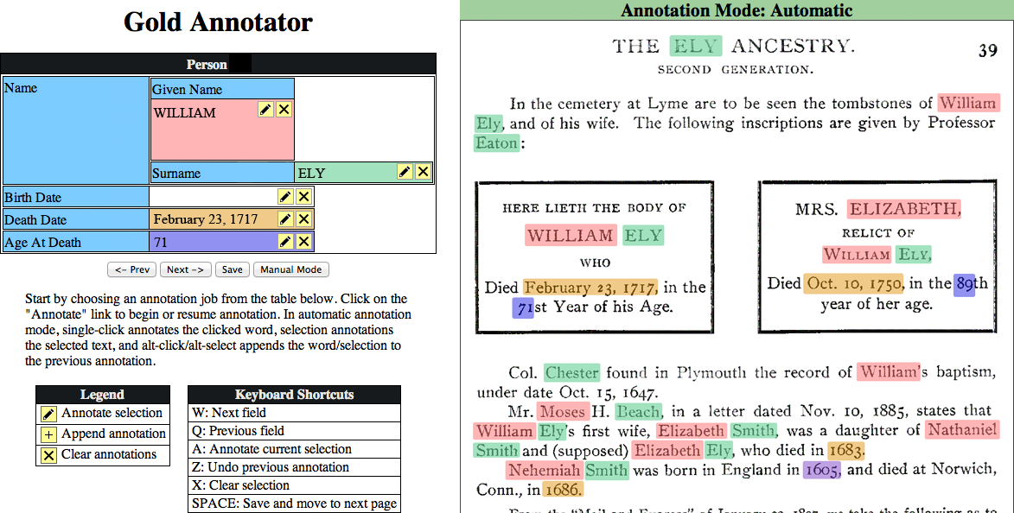
Extract Synergistically from Text
Notes:
Can learn plain-text patterns “on the go” by seeing which patterns repeat. (In essence, create tailored Hurst patterns for a particular document collection or domain.)

Slide 50
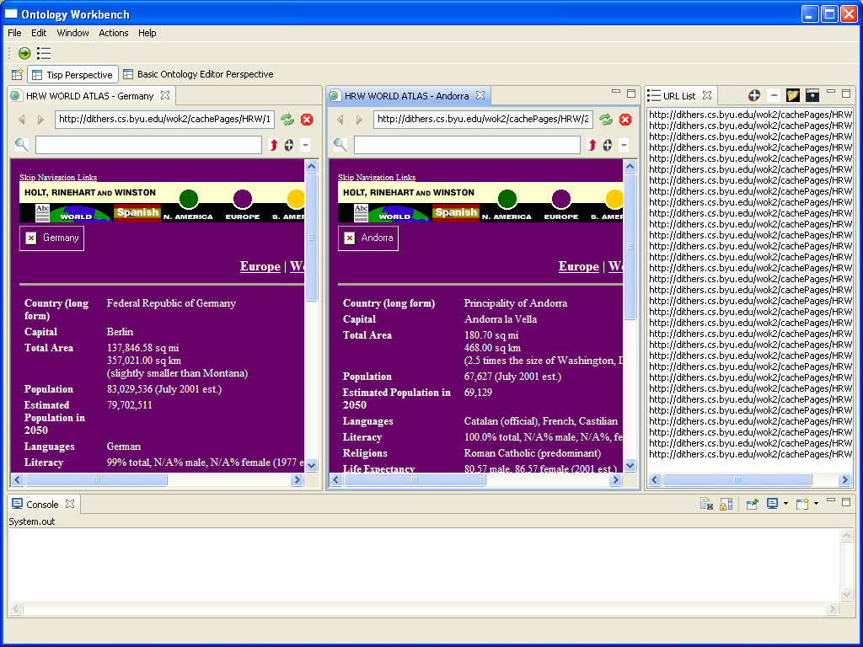
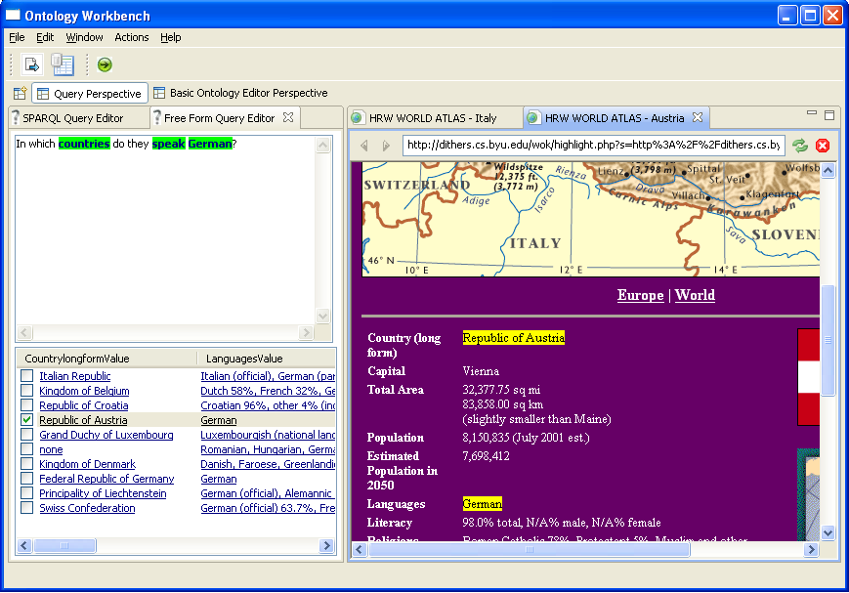
TISP & TISP++
TISP interprets sibling tables. TISP++ annotates interpreted tables for generated ontologies . TISP & TISP++ superimpose a queriable knowledge structure over web pages.
OWL
Sibling tables—automatically converted to OWL and RDF
Reason
RDF
Query
Notes:
Also worked on tables w/o sibling tables, turning their facts into RDF:
Some tables can be interpreted automatically
Others with simple aid of a user clicking in upper-left and lower-right of the grid data area

Slide 51
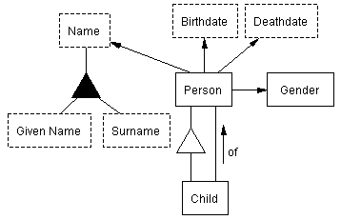
Making Relational Databases Sematic-Web Queriable
“Birthdate of Mary Ely,
grandmother of Maria
Jennings Lathrop”
WordNet
RDB
2 Nov 1843
SQL
Notes:
“Easy” when can “easily” interpret: get meta-model and instances. (Although still not easy to handle free-form queries – must somehow augment, perhaps with WordNet.)
Preprocess a collection of relational databases
Reverse-engineer schemas to conceptual models
Add recognizers
Process queries
Generate SQL queries for HyKSS-generated SPARQL queries over virtual RDF triple stores
Execute SQL queries and return results for HyKSS ranking and display

Slide 52
2. Automated Conceptual Organization
Resolve object identity
Integrate
Conceptualizations
Data
Allow for discrepancies
Alternate views
Arbitration
Ground truth authentication
Notes:
Build tools to clean and organize facts, including information
integration and object-identity resolution.

Slide 53
Clean & Organize Facts
…
…
…
…

Slide 54
Resolve Identity
 | Mary_Ely_1 | Mary_Ely_2 | Mary_Ely_3 | Mary_Ely_4 | Mary_Ely_5
Mary_Ely_1 | 1.000 | 0.542 | 0 | 0.574 | 0.574
Mary_Ely_2 | - | 1.000 | 0 | 0 | 0
Mary_Ely_3 | - | - | 1.000 | 0 | 0
Mary_Ely_4 | - | - | - | 1.000 | 0
Mary_Ely_5 | - | - | - | - | 1.000

Slide 55
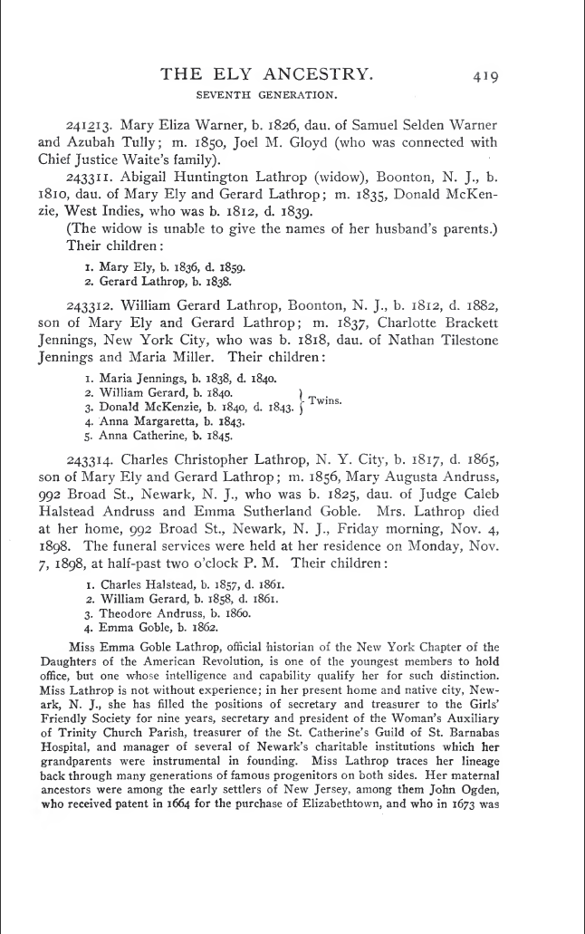
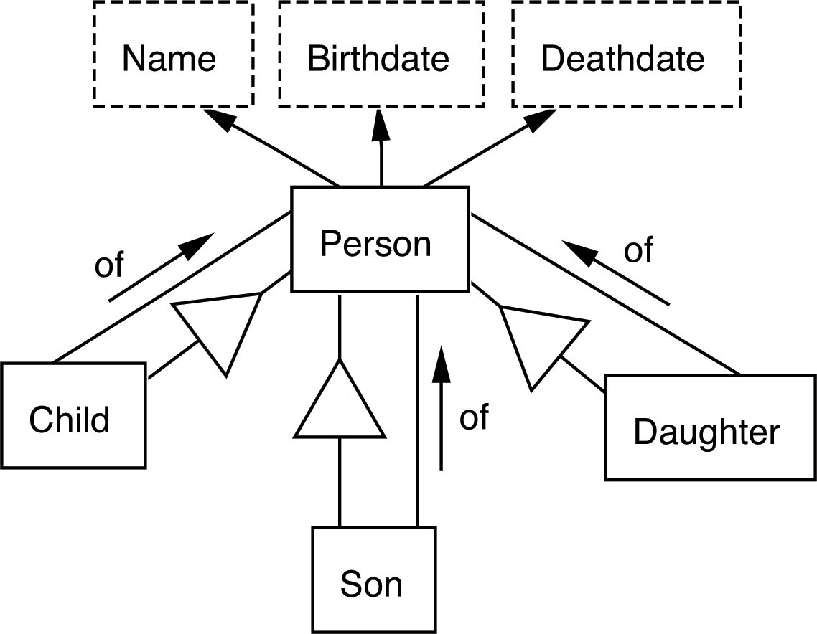
Information Integration
Schema mapping
Logic
Lexical parsing
Lexical inference
Notes:
Accurate conceptualizations tend to help in the integration process.
Logic based on localized custom appears to be necessary here – sometimes difficult to capture computationally.

Slide 56
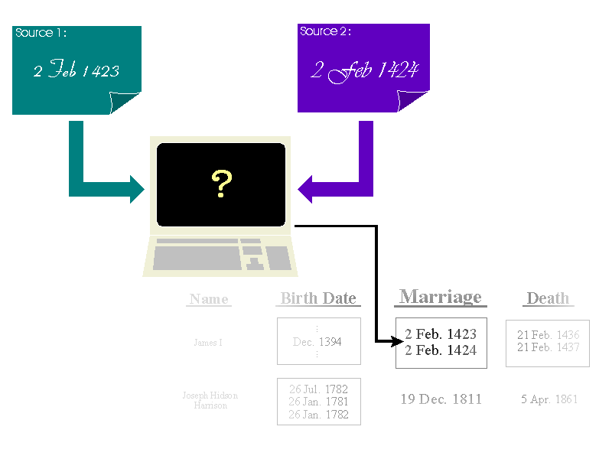
Integrating, Storing, and Querying Uncertain Data

Slide 57
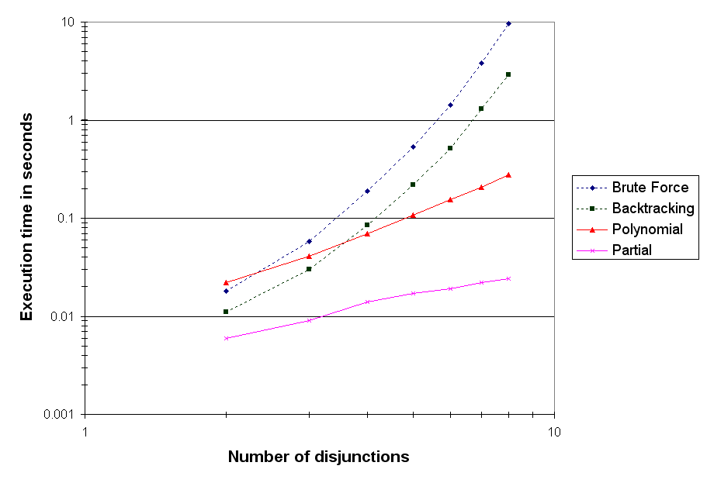
Integrating, Storing, and Querying Uncertain Data

Slide 58
3. Accurate and Efficient Query Processing
Issues
Context discovery
Query generation
Query execution (and result ranking)
Authentication processing and display
Advanced search
Resolutions

Slide 59
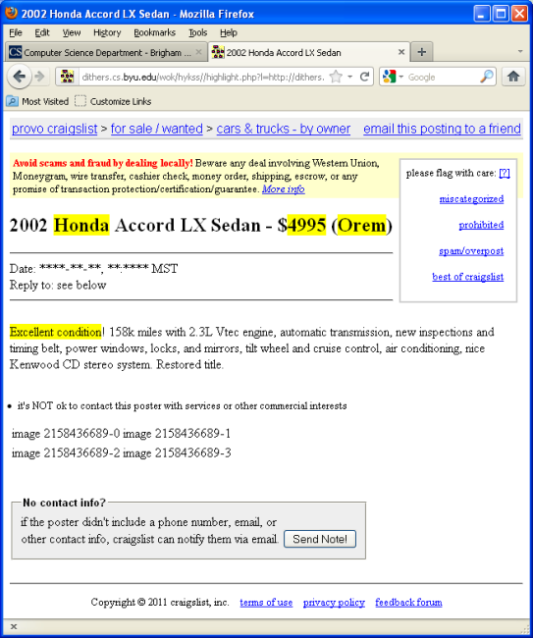
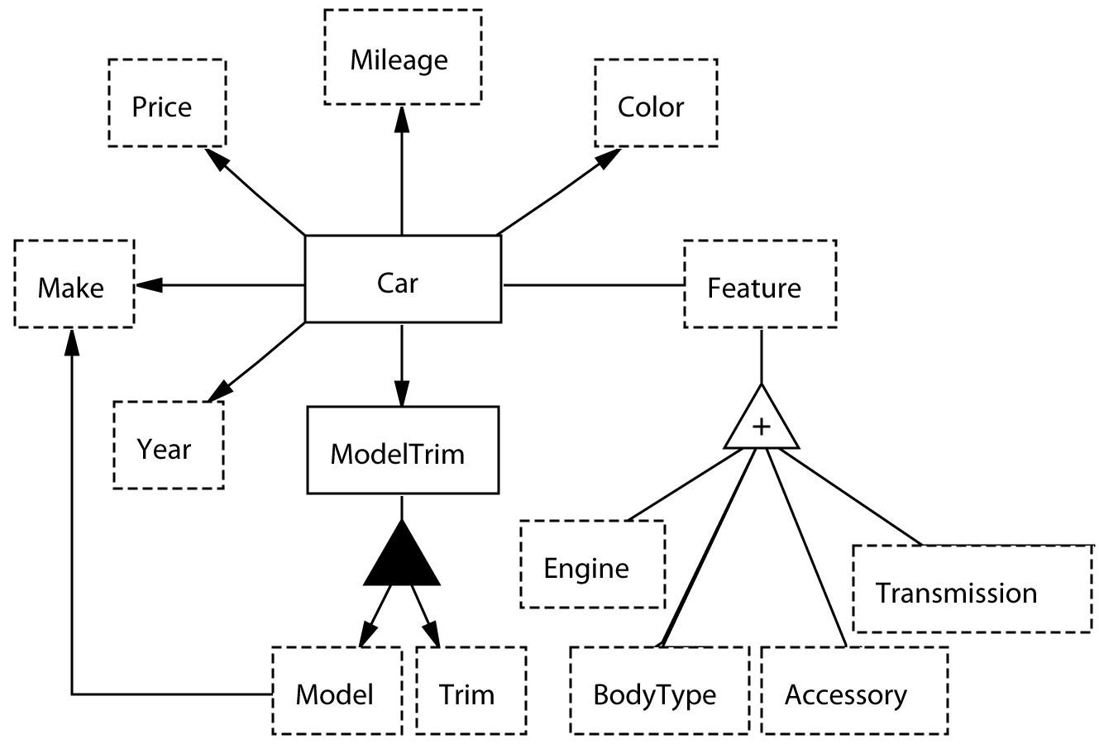
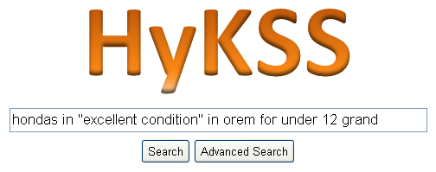
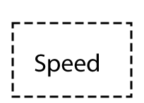
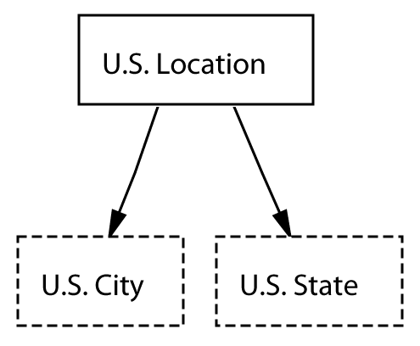
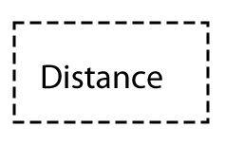
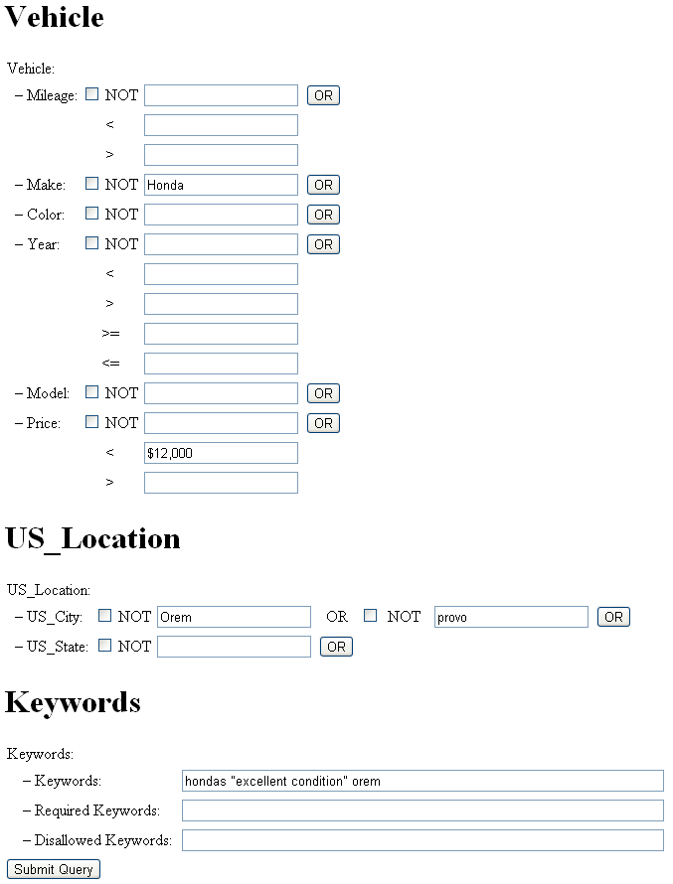
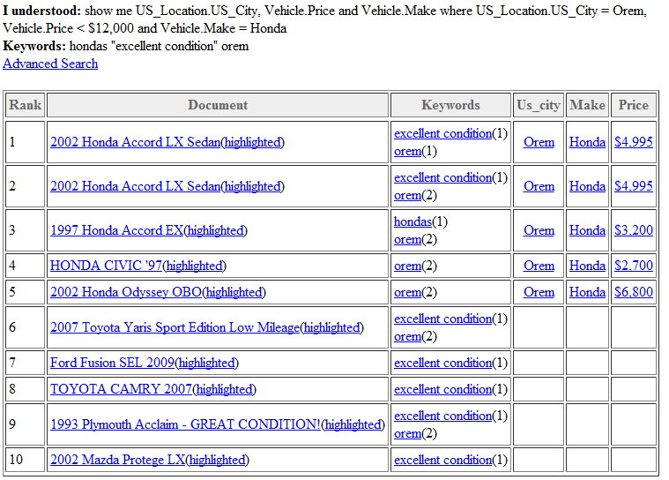
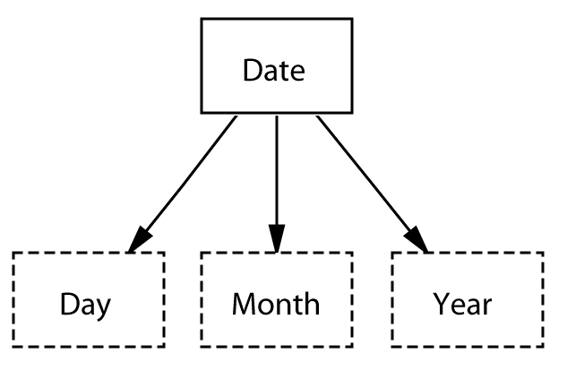
59
Notes:
I can say that this is the project in which we worked on accurate query processing and advanced query processing
(although I should also say that it’s a work in progress).
I can also say that it’s this project that has begun to point to us some issues and possible solutions for query processing performance.

Slide 60
Recognition Accuracy
Depends on extraction ontology recognizers
Instance recognition
Keyword recognition
Operator & parameter recognition
Disambiguation options
No cycles in context ontologies
Cycle disambiguation
Keywords select paths
Multiple hits
Execute and return all
Notes:
Execute all
Eliminate one if no results
Give both answers, say if A then Aanswer and if B then Banswer
Ask the user to disambiguate

Slide 61
Advanced Search
Negations and disjunctions
Recursion
Unfold for bounded depth
Closure for unbounded depth

Slide 62
Enormous Data Sets
Number of Facts
Est. 40-100B people
10 facts per person, as much as 1T
However, only ?? people for which we can locate records
Number of Implied Facts
Potentially unbounded
But realistically, 20? pre-computed with hundreds more computable
Uncertainty

Slide 63
Ideas for Resolutions
Context discovery: Semantic indexes over recognizers
Query generation: Fast given
context ontology set &
semantic-index matches
Query execution:
Semantic indexes over extracted facts
Materialized views (partitioned data sets)
Current research on SPARQL query optimization
Authentication: real-time highlighting of cached pages
Notes:
Enhance and optimize hybrid keyword and semantic search.
Optimizations to mention (?)
Materialized views (might work well for historical facts) A data warehouse organization might be possible, where new facts are included in the view automatically
Others have worked on and are currently working on SPARQL query optimization (e.g., see view paper I’m reading – lots of examples)
Our thoughts on semantic indexing (index entire sets denoted by regular expressions, to the extent possible)

Slide 64
4. Internationalization
Extract facts in any language
Support multilingual queries
Allow for cultural differences
Notes:
Enable multilingual fact extraction and query processing.

Slide 65
Arabic Nutrition Project

Slide 66
Arabic Nutrition Project

Slide 67
Multilingual Query Processing
“Find a BBQ restaurant near the Umeda station, with typical prices under $40”
Language-Agnostic Ontology
Notes:
The Umedia Station is in which City? YT tells me it’s Osaka.

Slide 68
Multilingual Query Processing
Wie alt war Mary Ely als ihr Son William geboren wurde? (die Mary Ely die Maria Jennings Lathrops Oma ist)
이름
생년월일
사망날짜
nom
date de naissance
date de décès
…
사람
성별
individu
sexe
의
de
date de baptême
자식
enfant
Notes:
It doesn’t matter what language, many app domains are the same
Multilingual ontologies leverages this point – models the world in a
language-independent manner
Language independent model (English, although could use symbols (e.g., man/woman symbols for Gender) and a mixture of languages.

Slide 69
Obituaries: Some Examples and Interesting Issues
Notes:
Condolence calls in Korean
Obit ontology
+ update for condolence calls
+ extraction example
+ English query about condolence calls ?
Gender references in French (we can always get them and get them correct)

Slide 70
Summary and Conclusion
WoK-HD
Web of Knowledge
Superimposed over historical documents
To build and deploy successfully:
Better, more cost-effective extraction
Integration, organization, & record linkage
Efficient implementation
Internationalization
www.deg.byu.edu
Notes:
1. What a web of knowledge superimposed over historical documents is.
2. How to automate the process of superimposing a web of knowledge
over historical documents:
(a) Construct extraction ontologies that can automatically extract
information from historical documents.
(b) Preprocess historical documents, building links from conceptual-
izations in the web of knowledge to facts in historical documents.
(c) Define inference rules, and preprocess extracted facts to obtain
implied facts.
(d) Using extraction ontologies, interpret user queries, return results,
and provide result justifications.
3. The status of a prototype implementation along with some experimen-
tal results.
4. What needs to be done to make the vision practical:
(a) Automate as much as possible the construction of fact extractors.
(b) Build tools to clean and organize facts, including information
integration and object-identity resolution.
(c) Enhance and optimize hybrid keyword and semantic search.
(d) Enable multilingual fact extraction and query processing.

