Slide 1



Extraction Rule Creation by Text Snippet Examples
David W. Embley (Brigham Young University & FamilySearch)
George Nagy (Rensselaer Polytechnic Institute)

Slide 2
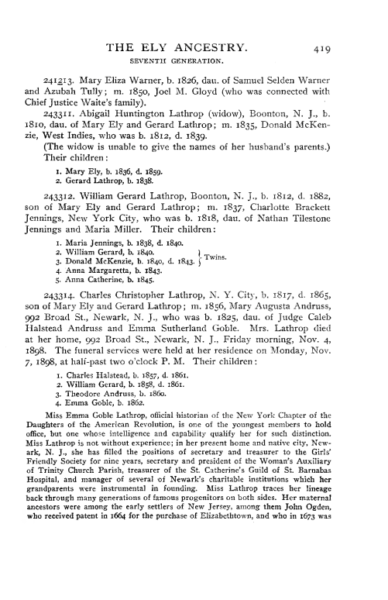
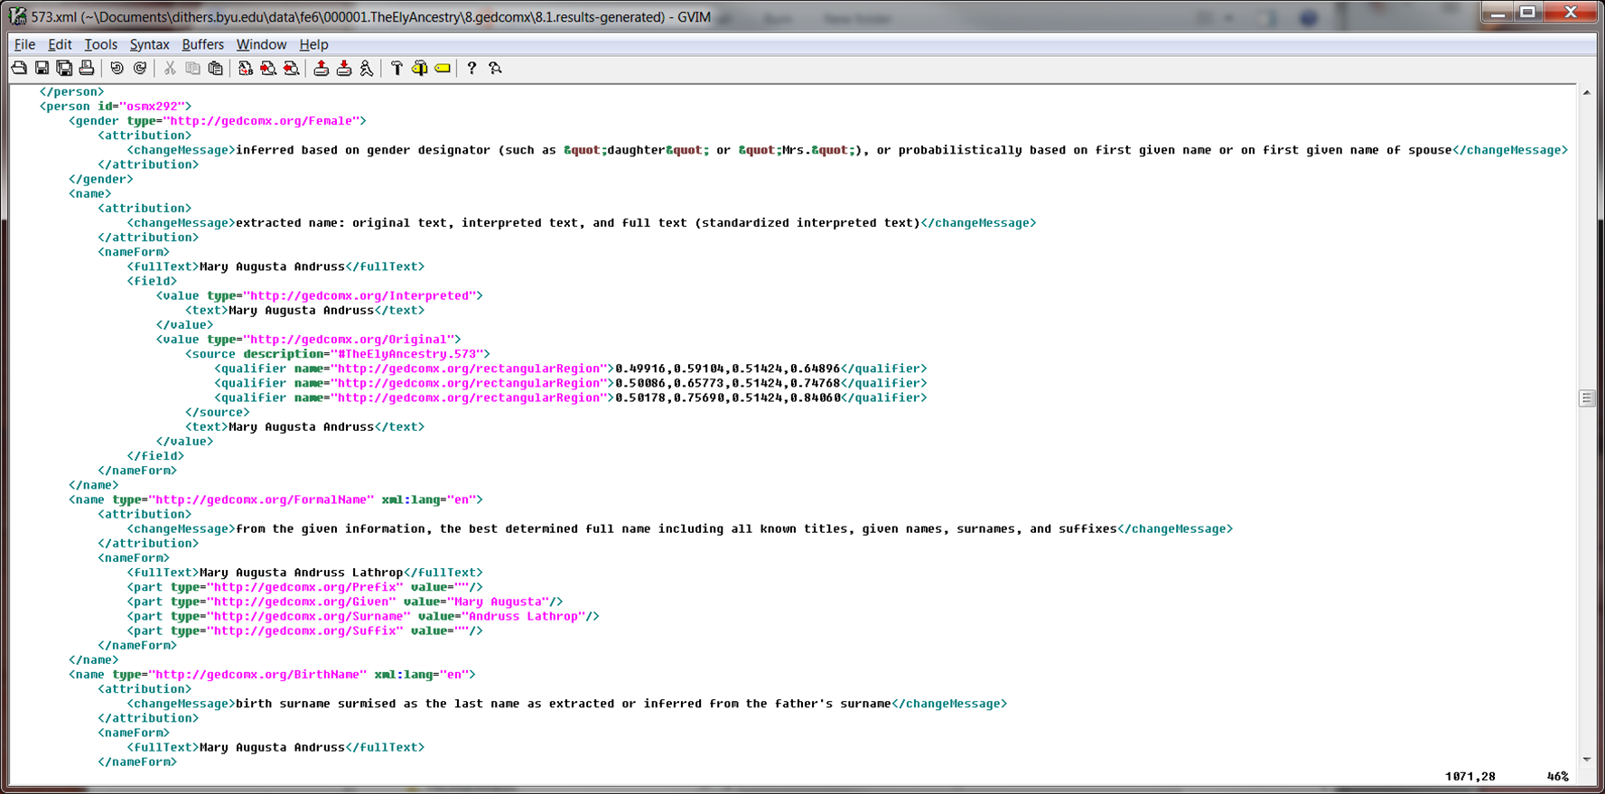
Project Objectives
Extraction Engines
  Rules
  NLP
  Machine Learning
Organization Pipeline
  Curate
  Import
Rule Creation by Text Snippet Examples
  (Hopefully) usable by non-experts
  (Hopefully) rapid development
  (Hopefully) high quality results
Notes:
350,000 ? Family History Books

Slide 3
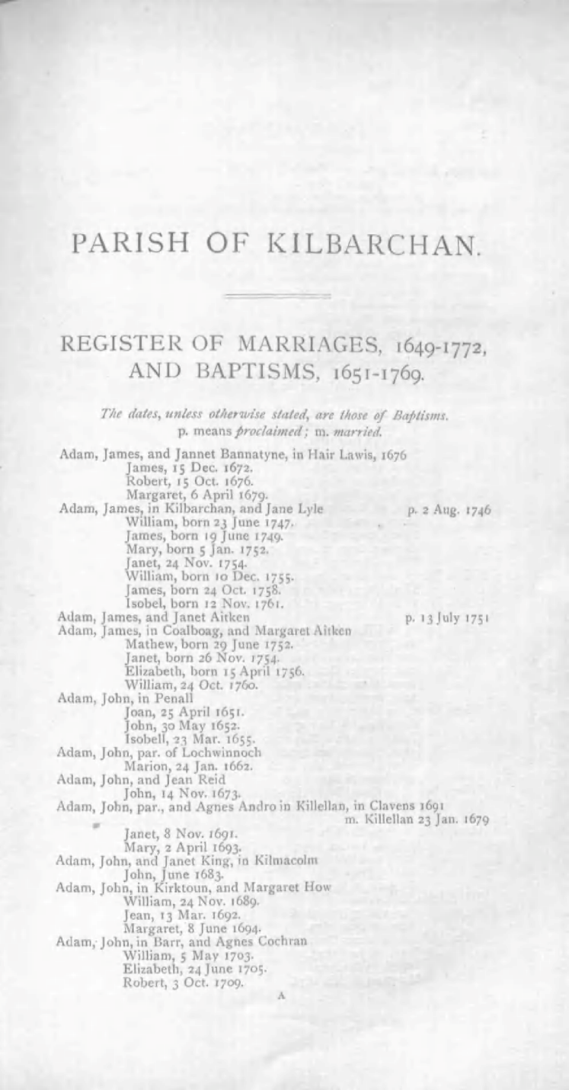
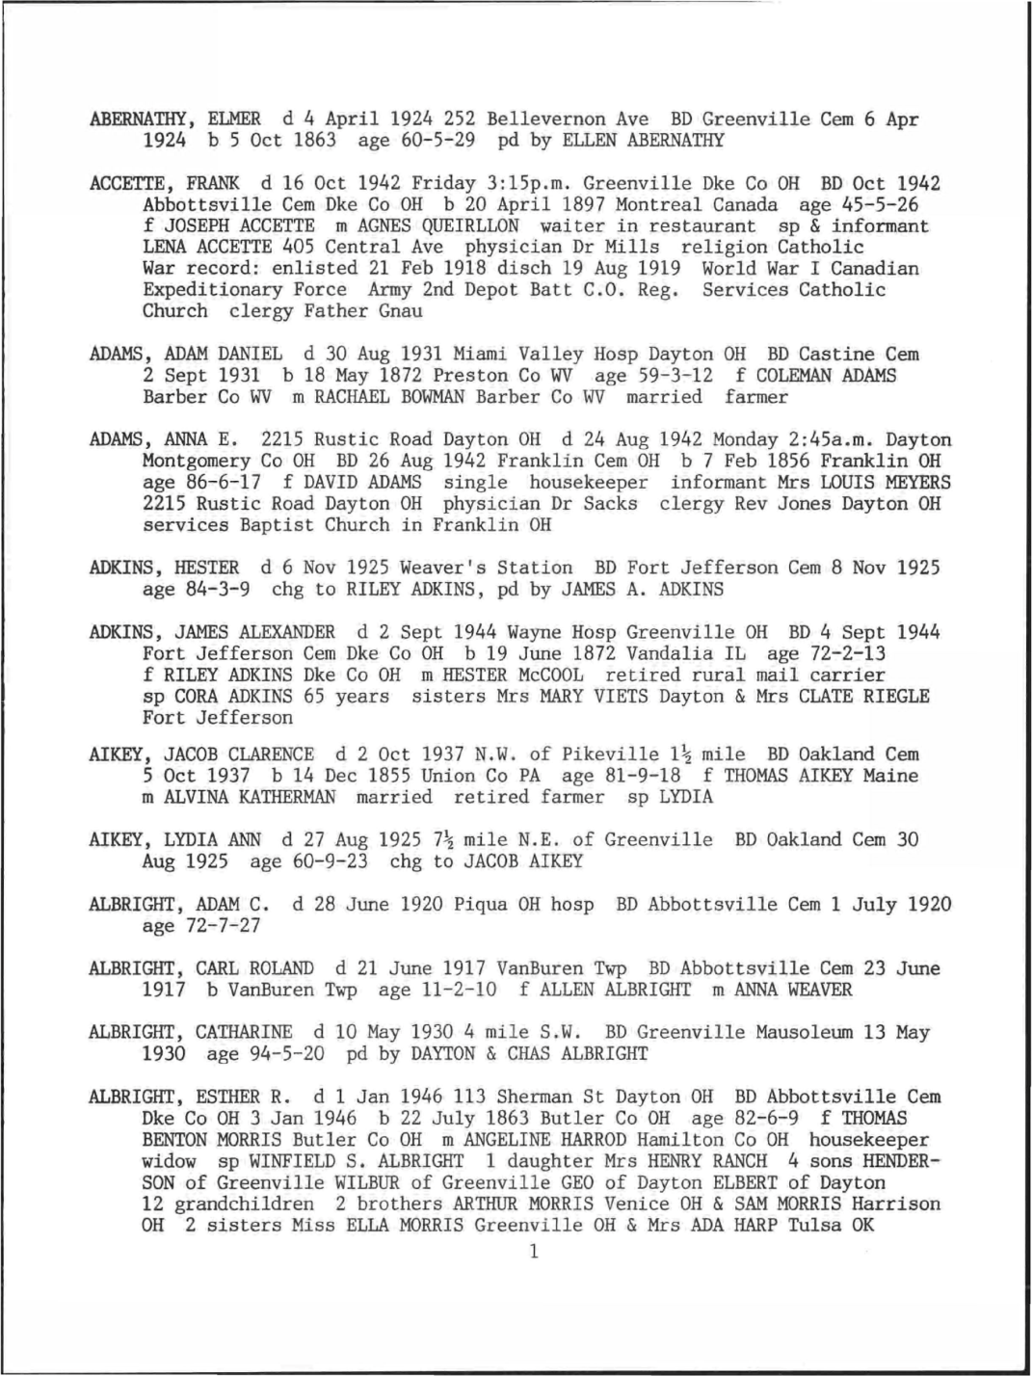

Pattern Examples

Slide 4
Pattern Examples – Large (layout components)

Slide 5
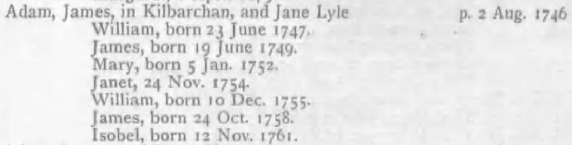
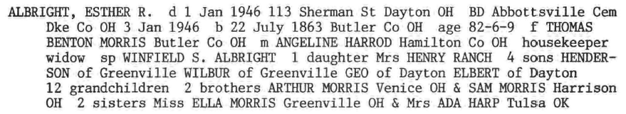
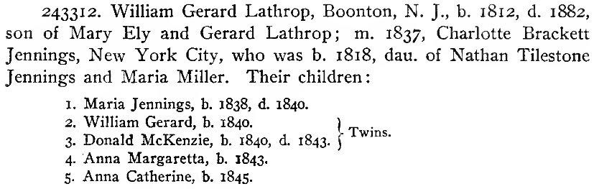
Pattern Examples – Intermediate (records)
Couple
Person
Family

Slide 6
Pattern Examples – Small (text snippets)
Notes:
Text snippets = NER patterns

Slide 7
Rule Creation: Record-based NER
Couple record
Name: ^ Adam, James,
SpouseName: and Jane Lyle
MarriageDate: p. 2 Aug. 1746 $
Name: ^ Cap , Cap ,
SpouseName: and Cap Cap
MarriageDate: p. Num Cap . Num $
Notes:
Record-based NER: a record is a set of attribute-value pairs describing an object

Slide 8
Rule Creation: Record-based NER
Person record
Name: ^ James, born
Name: ^ Janet, 24
ChristeningDate: , 24 Nov. 1754. $
BirthDate: born 24 Oct. 1758. $
Name: ^ Cap , born
Name: ^ Cap , Num
…

Slide 9
Rule Creation: Record-based NER
Family record
Parent1: ^ Adam, James,
Parent2: and Jane Lyle
Child: ^ James, born
Child: ^ Janet, 24
Parent1: ^ Cap , Cap ,
…

Slide 10
Rule Creation: Record-based NER
Person record
Name: ^ James, born
Name: ^ Janet, 24
ChristeningDate: , 24 Nov. 1754. $
BirthDate: born 24 Oct. 1758. $
Couple record
Name: ^ Adam, James,
SpouseName: and Jane Lyle
MarriageDate: p. 2 Aug. 1746 $
Family record
Parent1: ^ Adam, James,
Parent2: and Jane Lyle
Child: ^ James, born
Child: ^ Janet, 24
Name: ^ Cap , Cap ,
SpouseName: and Cap Cap
MarriageDate: p. Num Cap . Num $
Name: ^ Cap , born
Name: ^ Cap , Num
…
Parent1: ^ Cap , Cap ,
…
Notes:
Note that the record types overlap and thus must be processed separately.

Slide 11
Step1: Specify the Records

Slide 12
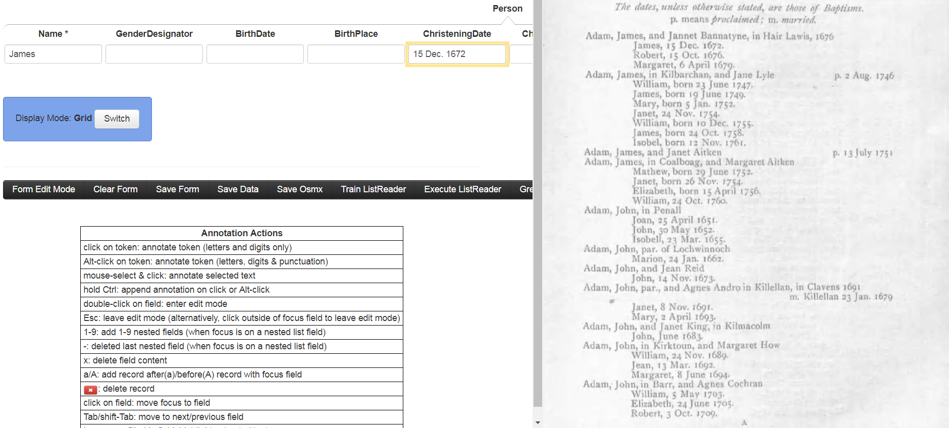
Step 2: Create Rules
James, 15 Dec. 1672. ELINE
Run
Save

Slide 13
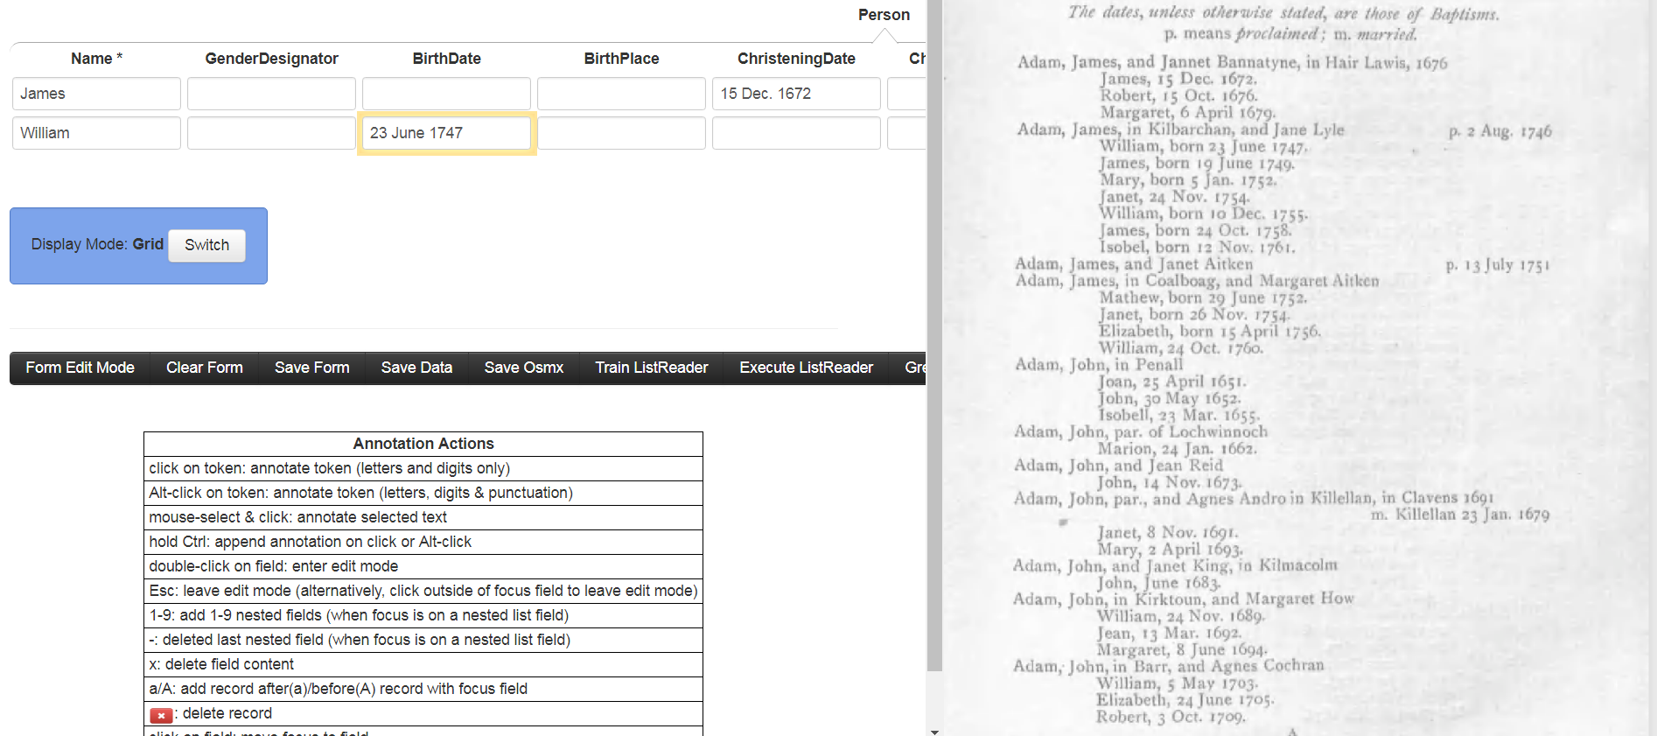
Step 2: Create Rules
born 23 June 1747. ELINE
Run
Save

Slide 14
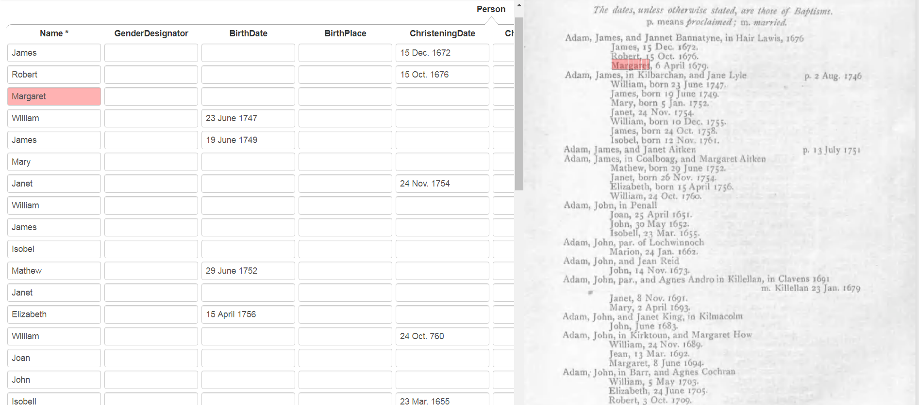
Step 2: Create Rules (check rule set)

Slide 15
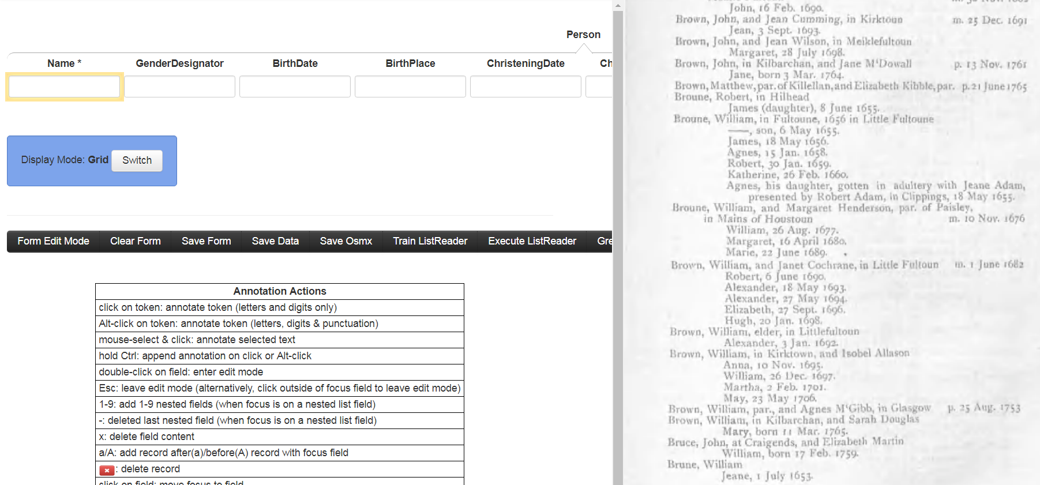
Step 3: Process Candidate Rules
1523
Name
. 1753 Brown, William, in Kilbarchan, and Sarah
>
Make
Dismiss
48
Name
Feb. 1759. Brune, William Jeane,
>
Make
Dismiss
19
Name
Oct. 1752. Napier and William, born 8 Feb
>
Make
Dismiss
18
Name
Robert, in Hilhead James (daughter), 8 June
>
Make
Dismiss

Slide 16
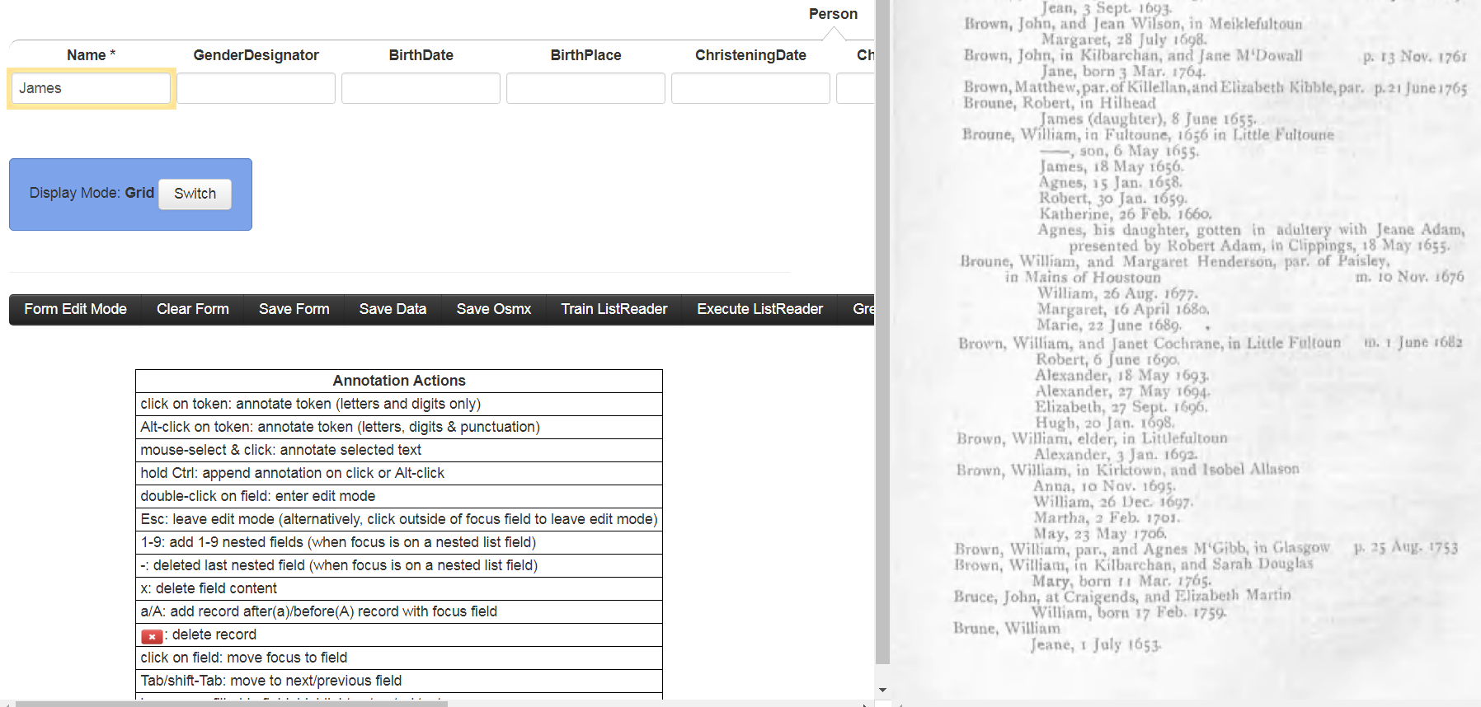
Step 3: Process Candidate Rules
SLINE James (daughter), 8
Run
Save

Slide 17
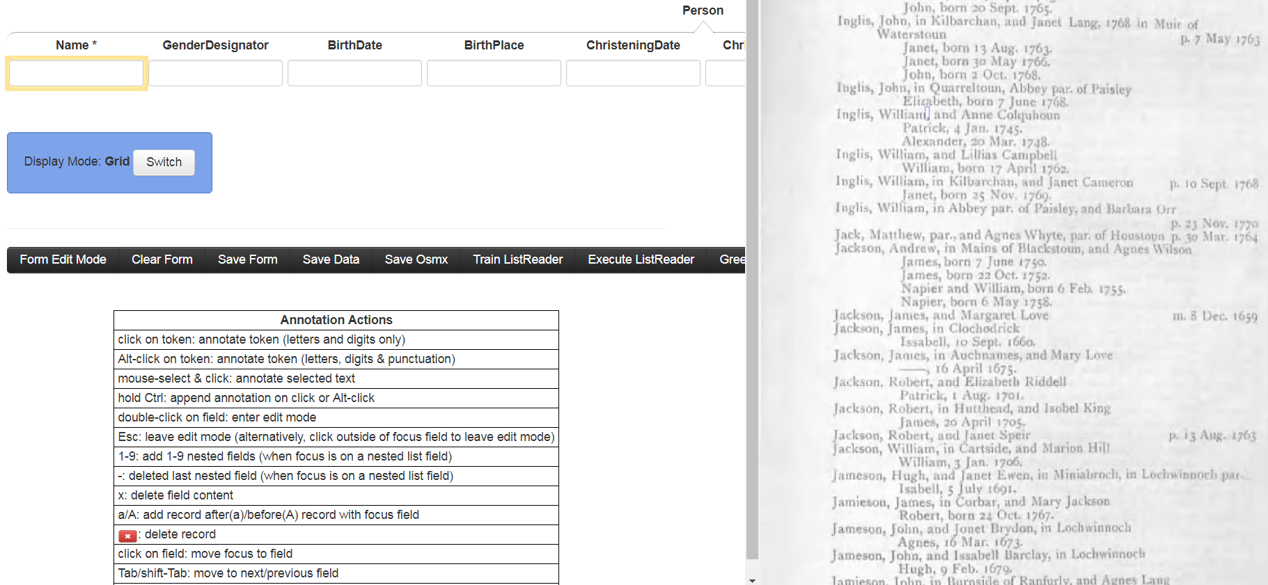
Step 3: Process Candidate Rules
19
Name
Oct. 1752. Napier and William, born 8 Feb
>
Make
Dismiss

Slide 18
GreenQQ (current implementation)
Green: tools that improve with use
Q1: Quick
  Quick to learn to use
  Quick to execute
Q2: Quality
  Quality rules
  Quality results
GreenQQ characterization: record-based NER

Slide 19
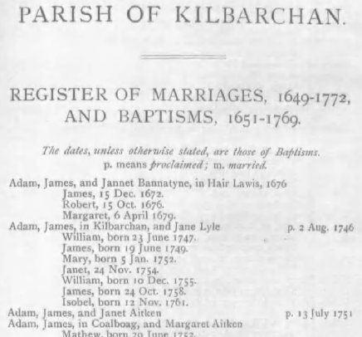
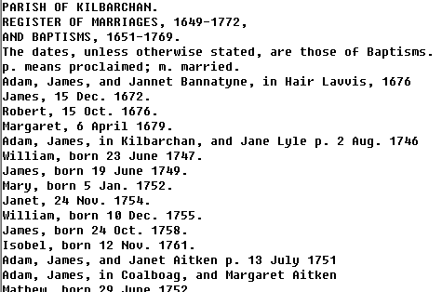
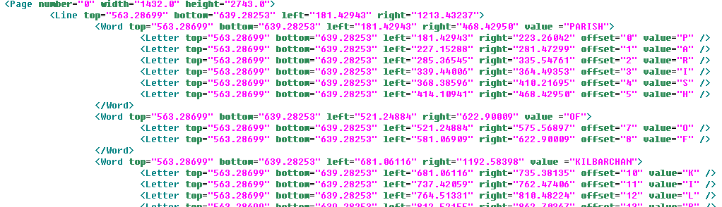
Demo (input doc’s)

Slide 20
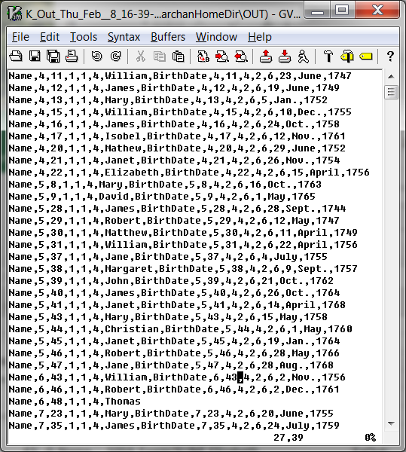
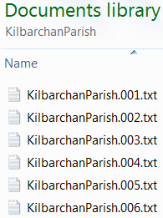
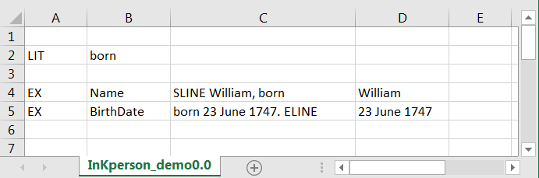



Demo (I/O)
Records
Input
…
Text Snippet Coordinates
Output
Notes:
The Thomas example here is interesting: It locates another record pattern where we can potentially extract more information. It illustrates the general need for postprocessing generated records. I record here, for example, may include two BirthDates, indicating that something is wrong.

Slide 21
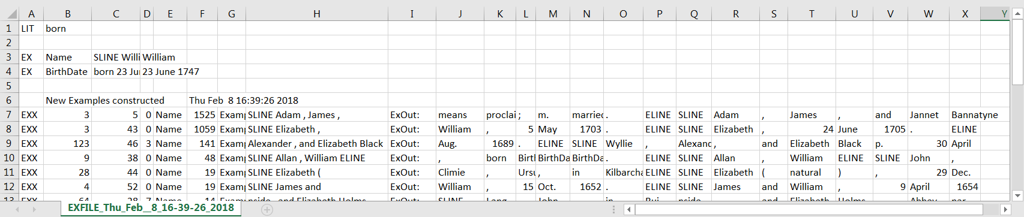
Demo (candidate rule generation)
SLINE Elizabeth , 24 June 1705 . ELINE
ChristeningDate
Name
SLINE Elizabeth , 24 June 1705 . ELINE
SLINE Elizabeth ( natural ) , 29
Name

Slide 22
Initial Experimental Results
Notes:
With 14 rules, GreenQQ extracted ~45,000 field values (~29,000 unique) and organized them into ~19,000 records with a “hard” accuracy of 85% (“hard” meaning that every record was perfect) and a “soft” accuracy of 95% (“soft” meaning that all field values of all records are correct, although some field values present on the page may not have been extracted). Since it takes a couple of minutes to specify an example-based rule with the current GreenQQ interface, it took about 30 minutes of work to extract ~19,000 records, ~650/minute. (With the new interface, we would expect around 2,000/minute.)
Note: Kilbarchan is nicely structured, the author is consistent, and the OCR is good. A degradation of any of these factors will negatively impact results.

Slide 23
Initial Experimental Results
Notes:
As Table 2 shows, GreenQQ extracted 68,596 field values and organized them into 15,265 records.
Text snippet patterns designating field values vary much more in Miller than in Kilbarchan. “Soft” and “Hard” recall scores, respectively 0.79 and 0.73, indicate that more text patterns are needed to cover the variability, especially for burial dates and birth places. GreenQQ can help users find these patterns. Record formation has a respectable F-score of 0.97. Record formation depends on being able to accurately identify field values for the grouping field. For Miller records, “Name” is the grouping field, and the “Soft” and “Hard” F-scores are 1.00 and 0.97 respectively. These high F-scores mean that almost all field values are properly grouped into records. Indeed, in the experimental run, only one record contained an extraneous field value.

Slide 24

“Gotchas”
Document applicability
Record identifiers
Overlapping records
OCR errors
Ambiguity
Boundary-crossing patterns
Application tailoring
Notes:
Document applicability: a document must have “structured” record patterns for the data to be extracted.
Record identifiers: If we miss a HEAD, we’ll get precision errors; record postprocessing may be able to detect and even fix the precision error, but can do nothing with recall except pinpoint where there may be additional good data. If we mistakenly declare a HEAD, we may get recall errors by not grouping all the data that belongs to a record; record postprocessing may be able to heuristically/statistically detect that something may be wrong.
Overlapping records, such as twins in Kilbarchan and couples in Ely need rule partitioning; rule sets for each partition are to be run separately, but can we automatically detect overlaps and partition rules without user intervention?
OCR errors: we should be able to generalize the same-error/same-substitution within the same context so that “jonet -> Jonet” is sufficient to also catch and fix “janet -> Janet”, ‘jane -> Jane”, … . Are there other generalizations?
Ambiguity: two rules are ambiguous if they classify the same text differently; e.g. one rule declares text to be a ChristeningDate while another declares the same text to be a BirthDate; we should be able to test rules for ambiguity. A common error is to use too little context: “SLINE CAP ,” in Kilbarchan extracts both father surnames and child given names.
Boundary-crossing patterns: templates that cross line boundaries may be already coded, but I suspect that end-of-line hyphens have not yet been worked on. Succeeding for page-boundary crossings would be great; and may have already been worked on.
Application tailoring: you already have something for months – it appears that both non-abbreviated and abbreviated month names are recognized by a pattern for either one. I’ve seen some mention of special tags for name variations. What else is possible? (a gazetteer for place names?, day ranges by month?, reasonable years for documents?, …?)

Slide 25
Future Work (in progress)
Build Interface
Adjust Code to Resolve “Gotchas”
Seize Opportunities
  Improve candidate pattern identification
  Assess and adjust for increased usability
Notes:
Usability (alternate way to process):
Instead of the proposed interface, we make GreenQQ “green” by only having users fill in forms (no rule specification or candidate rule editing). GreenQQ operates in the background. When a user fills in a record field f, we generate an extraction rule and execute it on the the page which creates additional records (as needed) and fills them in for field f. The “as needed” is because in filling-in previous fields, partially filled in records may have already been generated. When the user moves to a new page, the system generates and fills in all the records it can. The user checks records and adds data as needed. If the user U is satisfied that GreenQQ is extracting information well enough, U can let it run to the completion of the book on its own.

Slide 26
Conclusion
Rule creation by text snippet examples
(Hopefully) objectives will be achieved
  Usable by non-experts (examples only; user-friendly interface)
  Quick development (click/copy rule development; candidate rule generation)
  Quality results (good precision and recall)

Slide 27

Conclusion
Rule creation by text snippet examples
(Hopefully) objectives will be achieved
  Usable by non-experts (examples only; user-friendly interface)
  Quick development (click/copy rule development; candidate rule generation)
  Quality results (good precision and recall)

