Slide 1
Web People Search using Extracted Attributes
Joseph S. Park
Computer Science
Brigham Young University

Slide 2
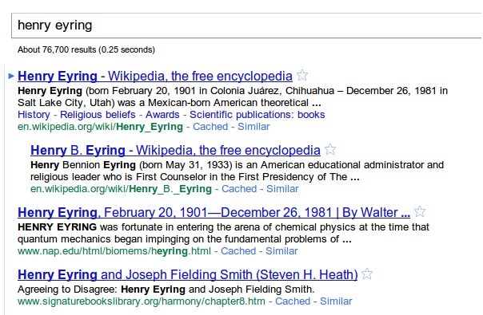
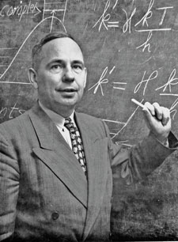
Query Search
Google search
[2]

Slide 3
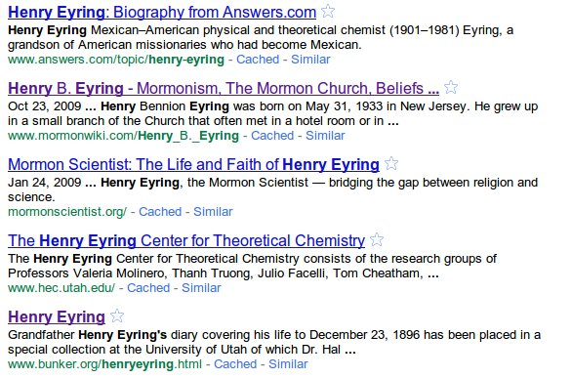
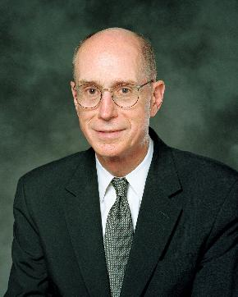
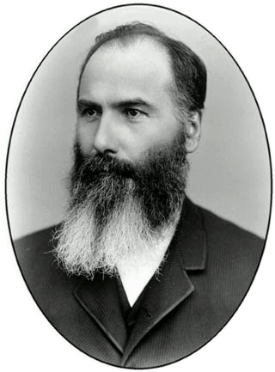
Person Name Disambiguation
[3]
Google search
[4]

Slide 4
Solution 1
Create Bag-of-Words
Attributes
Cap-Word n-grams
Whole document
Compute combined probability of similarity
Cluster

Slide 5
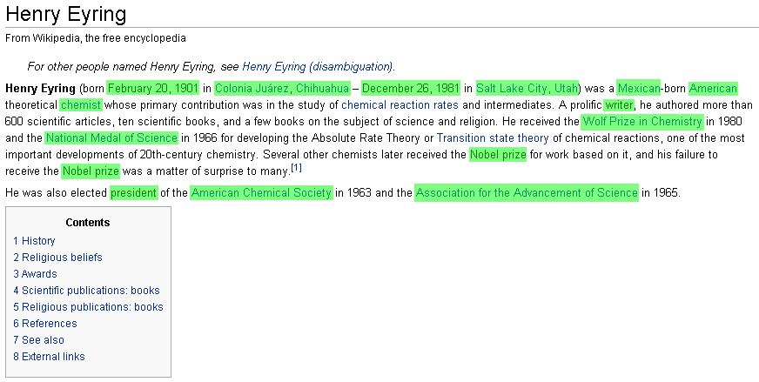
Attribute Extraction

Slide 6
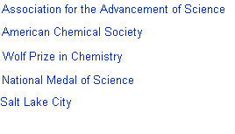
Cap-Word n-grams
[AE04]

Slide 7
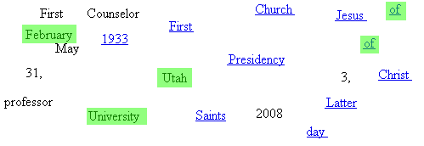
Bag-of-Words Clustering

Slide 8
Probability Matrix
Threshold t = 0.65
Henry Eyring | 000 | 001 | 002 | 003 | 004 | 005
000 | 1 | 0.7 | 1 | 0.7 | 0.58 | 0.7
001 | 0.7 | 1 | 0.7 | 1 | 0.58 | 1
002 | 1 | 0.7 | 1 | 0.7 | 0.58 | 0.7
003 | 0.7 | 1 | 0.7 | 1 | 0.58 | 1
004 | 0.58 | 0.58 | 0.58 | 0.58 | 1 | 0.58
005 | 0.7 | 1 | 0.7 | 1 | 0.58 | 1
*Not documents from Google search
**Documents from WePS-3 competition

Slide 9
WePS-3 XML
<clustering searchString="HENRY EYRING">
<entity id="1">
<documents>
<doc rank="0" /> ← Henry Eyring
<doc rank="1" /> ← Henry B. Eyring
<doc rank="2" /> ← Henry Eyring
<doc rank="3" /> ← Henry B. Eyring
<doc rank="5" /> ← Henry B. Eyring
</documents>
</entity>
<entity id="2">
<documents>
<doc rank="4" /> ← Henry Eyring
</documents>
</entity>
Henry B. Eyring
Henry Eyring

Slide 10
WePS-3 Results
System | Avg. Precision | Avg. Recall | Avg . F-measure
YHBJ_2_unofficial | 0.61 | 0.6 | 0.55
AXIS_2 | 0.69 | 0.46 | 0.5
TALP_5 | 0.4 | 0.66 | 0.44
RGAI_AE_1 | 0.38 | 0.61 | 0.4
WOLVES_1 | 0.31 | 0.8 | 0.4
DAEDALUS_3 | 0.29 | 0.84 | 0.39
BYU | 0.52 | 0.39 | 0.38
one_in_one_baseline | 1 | 0.23 | 0.35
HITSGS | 0.26 | 0.81 | 0.35
all_in_one_baseline | 0.22 | 1 | 0.32
*Marylou was used to process the corpus of 60,000 documents

Slide 11
Solution 2
No more Bag-of-Words!
Cap-Word n-grams with learned probabilities

Slide 12
Projected Standing
System | Avg. Precision | Avg. Recall | Avg. F-measure
YHBJ_2_unofficial | 0.61 | 0.6 | 0.55
AXIS_2 | 0.69 | 0.46 | 0.5
BYU | 0.80 | 0.37 | 0.47
TALP_5 | 0.4 | 0.66 | 0.44
RGAI_AE_1 | 0.38 | 0.61 | 0.4
WOLVES_1 | 0.31 | 0.8 | 0.4
DAEDALUS_3 | 0.29 | 0.84 | 0.39
one_in_one_baseline | 1 | 0.23 | 0.35
HITSGS | 0.26 | 0.81 | 0.35
all_in_one_baseline | 0.22 | 1 | 0.32
*Marylou was used to process the corpus of 60,000 documents

Slide 13
Solution 3
Properly associate attributes with person names
Use their uniqueness properties to generate probabilities

Slide 14
Proper Attribute Association
Examples of prominent LDS scientists in the mid-twentieth century include chemist Henry Eyring and physicists Harvey Fletcher and Willard Gardner. Eyring pioneered the application of quantum mechanics to chemistry and developed the Absolute Rate Theory of chemical reactions, for which he received the National Medal of Science. He was elected president of the American Chemical Society (1963) and of the American Association for the Advancement of Science (1965). Fletcher directed research at Bell Labs, where he played a central role in the development of stereophonic reproduction. He was elected president of the American Physical Society (1945). The American Society of Agronomy cited Gardner as "the father of soil physics" for his descriptions of the movement of water through unsaturated soils by reference to capillary potential. The number of Latter-day Saints significantly involved in scientific pursuits continued to grow throughout the twentieth century.
[6]

Slide 15
Find Relationships
Examples of prominent LDS scientists in the mid-twentieth century include chemist Henry Eyring and physicists Harvey Fletcher and Willard Gardner. Eyring pioneered the application of quantum mechanics to chemistry and developed the Absolute Rate Theory of chemical reactions, for which he received the National Medal of Science. He was elected president of the American Chemical Society (1963) and of the American Association for the Advancement of Science (1965). Fletcher directed research at Bell Labs, where he played a central role in the development of stereophonic reproduction. He was elected president of the American Physical Society (1945). The American Society of Agronomy cited Gardner as "the father of soil physics" for his descriptions of the movement of water through unsaturated soils by reference to capillary potential. The number of Latter-day Saints significantly involved in scientific pursuits continued to grow throughout the twentieth century.
[6]

Slide 16
Associate Objects
Examples of prominent LDS scientists in the mid-twentieth century include chemist Henry Eyring and physicists Harvey Fletcher and Willard Gardner. Eyring pioneered the application of quantum mechanics to chemistry and developed the Absolute Rate Theory of chemical reactions, for which he received the National Medal of Science. He was elected president of the American Chemical Society (1963) and of the American Association for the Advancement of Science (1965). Fletcher directed research at Bell Labs, where he played a central role in the development of stereophonic reproduction. He was elected president of the American Physical Society (1945). The American Society of Agronomy cited Gardner as "the father of soil physics" for his descriptions of the movement of water through unsaturated soils by reference to capillary potential. The number of Latter-day Saints significantly involved in scientific pursuits continued to grow throughout the twentieth century.
[6]

Slide 17
Conclusions & Current Work
Conclusions
Solution 1: F-measure = 0.38
Solution 2: F-measure = 0.47
Goal: F-measure = 0.80
Increase precision and recall over relationship sets
Use confidence factors to improve clustering

Slide 18
References
[AE04] Rheema Al-Khama, and David W. Embley, Grouping Search-Engine Returned Citations for Person-Name Queries, ACM 6th International Workshop on Web Information and Data Management (WIDM 2004), Jun '04
[AGS09] Javier Artiles, Julio Gonzalo, and Satoshi Sekine, WePS 2 Evaluation Campaign: Overview of the Web People Search Clustering Task, WePS-2, '09
[ECJ+99] D.W. Embley, D.M. Campbell, Y.S. Jiang, S.W. Liddle, D.W. Lonsdale, Y.-K. Ng, R.D. Smith, Conceptual-Model-Based Data Extraction from Multiple-Record Web Pages, Data & Knowledge Engineering, Nov '99
[SB75] Edward H. Shortliffe, and Bruce G. Buchanan, A Model of Inexact Reasoning in Medicine, Mathematical Biosciences 23:351-379, '75
[1] http://nlp.uned.es/weps/weps-3
[2] http://en.wikipedia.org/wiki/File:HenryEyring1951.jpg
[3] http://www.mormonwiki.com/File:Med_Eyring_large.jpg
[4] http://www.historypreserved.com/images/Cornella/Henry.JPG
[5] http://www.cs.cmu.edu/~mccallum/bow/
[6] http://www.lightplanet.com/mormons/daily/education/science_scientists.htm
[7] http://mccammon.ucsd.edu/~jswanson/index.html

