Slide 1
GreenFIE-HD: A Form-based Information Extraction Tool for Historical Documents
Tae Woo Kim
Notes:
There are thousands of books that contain rich genealogical information and there is a demand for extracting genealogical facts from them. In responding to the demand, we intend to build a ‘green’ annotation tool—one that improves with use

Slide 2
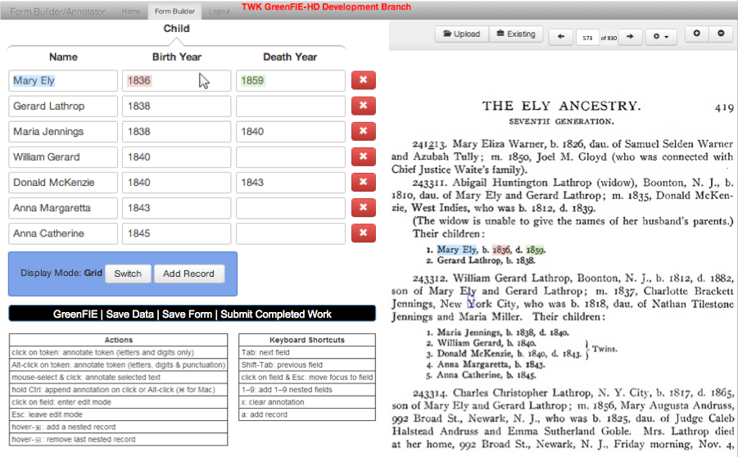
Interface
Notes:
This is how the interface works.
When the system initially loads a page, it fills out the form as best it can by using the information-extraction rules it has.
A user can then check and either confirm that it is complete and correct or make necessary changes to make it so.
To allow the user to check each record more easily , the system highlights each field and the corresponding text in the document when the user hovers over a record.
So how the system really works behind. How does it get its rules and when it’s wrong, how does it adjust them so that it gets better with use.

Slide 3
Extraction Rule Creation
\d{1}\.\s([A-Z][a-z]{2,6})\s([A-Z][a-z]{4,10}),\sb\.\s(\d{4}),\sd\.\s(\d{4})\.
Notes:
So first, let me tell you how does it create rules.
When a user fills in this form, the system knows exactly where those strings are on the page. So it is trivial to create a regular-expression and adjust it so that it will be more general for the fields.
When it applies its rules, sometimes it’s wrong.

Slide 4
Recall Error
i860
\d{1}\.\s([A-Z][a-z]{2,8})\s([A-Z][a-z]{1,8}),\sb\.\s(\d{4})(\.|,\sd\.\s(\d{4}))
\d{1}\.\s([A-Z][a-z]{2,8})\s([A-Z][a-z]{1,8}),\sb\.\s(\d{4}|i\d{3})(\.|,\sd\.\s(\d{4}))
Notes:
And here is a example. It misses whole record because of OCR error.
A user can fix this by clicking “Add Record” button to add blank record and then annotate the missing record. Then the system adjust the rule.

Slide 5
Precision Error
\.\s([A-Z][a-z]{2,8})\s([A-Z][a-z]{1,8}),
\d{1}\.\s ([A-Z][a-z]{2,8})\s([A-Z][a-z]{1,8}),\sb\.\s
Notes:
Sometimes, a rule picks up something it shouldn’t. A user can delete this record by clicking this red x button. And the system makes the pattern more robust by looking for more contexts to the left and right side of pattern.

Slide 6
Summary
Look-ahead: automatic extraction
Look-behind: rule derivation and adjustment
Reduces the cost of human labor
Notes:
GreenFIE-HD is a green annotation tool that gets better with use.
It looks ahead and do automatic extraction, and
looks behind the user’s annotation to derive extraction rules and adjust them
to reduce the cost of human labor.

