Slide 1
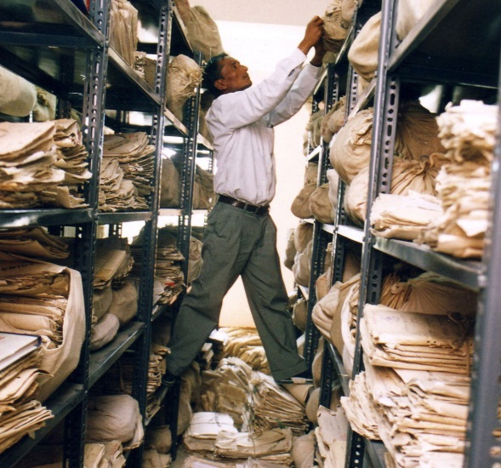
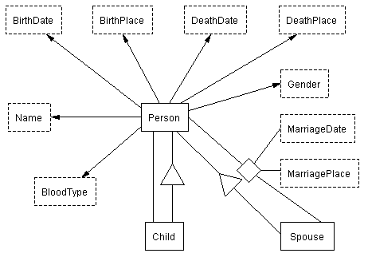
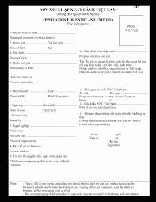
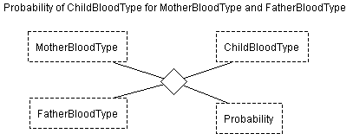
A Superstructure for Organizing Family History Information
David W. Embley
Scott N. Woodfield

Slide 2
Often a computer is little more than an electronic filing clerk.

Slide 3
To make computers do more (especially for family history), they must:
Automatically process
Certainty information
Conflicting information
Support
Evidence-based family history research
Automated collaboration
Provide automated research guidance
Notes:
Collaboration: Human to human, human to machine, machine to machine

Slide 4
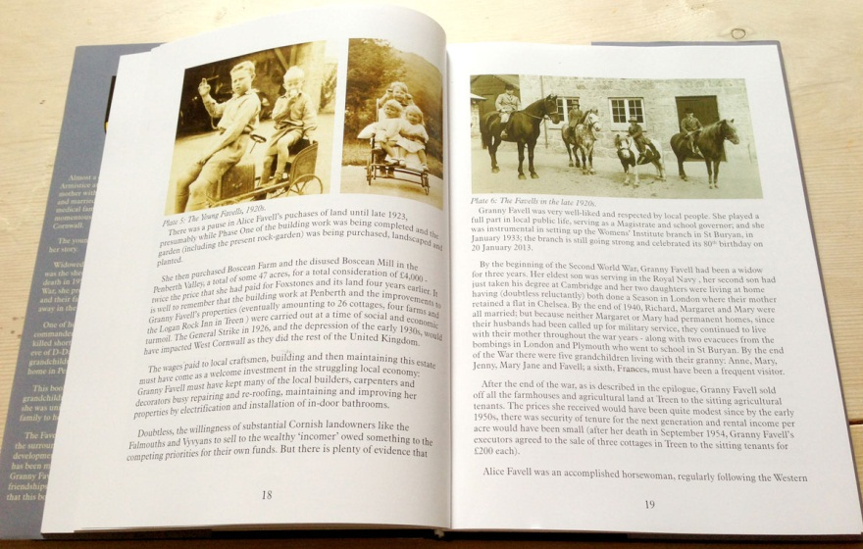
Our solution is inspired by how people think.
gather information
conceptualize
Notes:
Add conceptual models to family history software
Make them explicit
Not buried in the code
Make them malleable
Use them to understand and process “data”

Slide 5
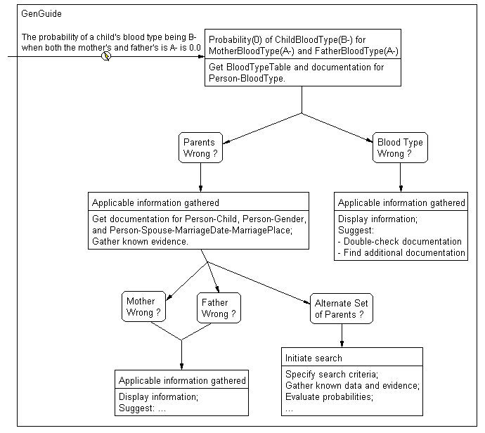
A Proposed Superstructure
Seven Layers*
Symbol
Class
Information
Knowledge
Evidence
Communication
Action
Wisdom
* Charles T. Meadow and others

Slide 6
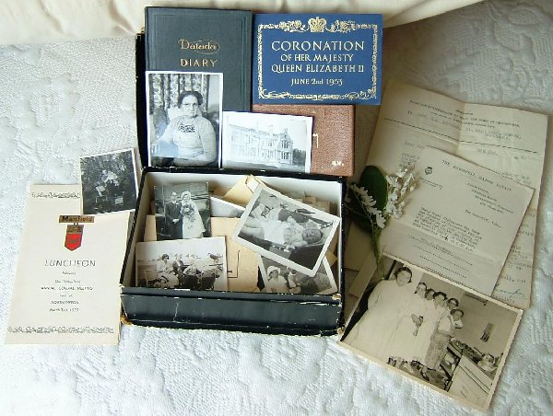
Our Story
Notes:
Sheri the researcher
Judith and Roger Williams, great-grand parents
Stan, their son who died in the great war
All of this information has been scanned into the computer

Slide 7
Symbol
Doc. Found: 6 Mar 2014

Slide 8
Symbol
facsimile
symbol
A-
Doc. Found: 6 Mar 2014

Slide 9
Class
BloodType
external repesentation:
\b(A+|A-|B+|B-|AB+|AB-|O+|O-)\b
context keywords: \b[Bb]lood\s[Tt]ype\b
Input method: BloodTypeToString
Output method: StringToBloodType
Operator methods:
CanDonateTo(x:BloodType, y:BloodType)
returns (Boolean)
end;
Notes:
Data Frame

Slide 10
Class
regular-expression recognizer for reading text
BloodType
external repesentation:
\b(A+|A-|B+|B-|AB+|AB-|O+|O-)\b
context keywords: \b[Bb]lood\s[Tt]ype\b
input method: BloodTypeToString
output method: StringToBloodType
operator methods:
CanDonateTo(x:BloodType, y:BloodType)
returns (Boolean)
end
read & store
write to text
operate/compute

Slide 11
Information

Slide 12
Information
functional constraint
relationship set
Generalization/specialization, “isa” constraint

Slide 13
Knowledge
Doc. Found: 6 Mar 2014

Slide 14
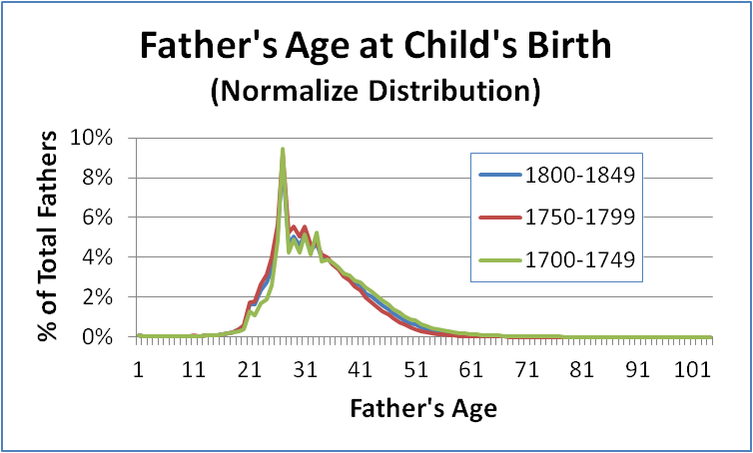
Knowledge
x₁
Doc. Found: 6 Mar 2014
A-
B-
meta-information connection
constraint violation
soft constraint

Slide 15
Evidence
Doc. Found: 6 Mar 2014

Slide 16
Evidence
formal
informal
Doc. Found: 6 Mar 2014
formal

Slide 17
Evidence
formal
informal
0.0
x₁
B-
Doc. Found: 6 Mar 2014
Reasoning with the evidence:
formal
Person(x₁)-BloodType(x₂),
Person(x₃)-BloodType(x₄), Person(x₅)-BloodType(x₆),
Child(x₁)-Person(x₃), Person(x₃)-Gender(‘F’),
Child(x₁)-Person(x₄), Person(x₄)-Gender(‘M’),
Probability(x₇)-of-ChildBloodType(x₂)-and-
MotherBloodType(x₄)-FatherBloodType(x₆),
->
Certainty(x₇)---Person(x₁)-BloodType(x₂)

Slide 18
Communication

Slide 19
Communication
receive & read
write & send
receive & read

Slide 20
Communication
receive & read
write & send
receive & read
model structure:
Probability[1:*] of ChildBloodType[1:*] for MotherBloodType[1:*] and FatherBloodType[1:*]
end;
model instance:
Probability(93.75%) of ChildBloodType(A-) for MotherBloodType(A-) and FatherBloodType(A-);
Probability(6.25%) of ChildBloodType(O-) for MotherBloodType(A-) and FatherBloodType(A-);
…
end;

Slide 21
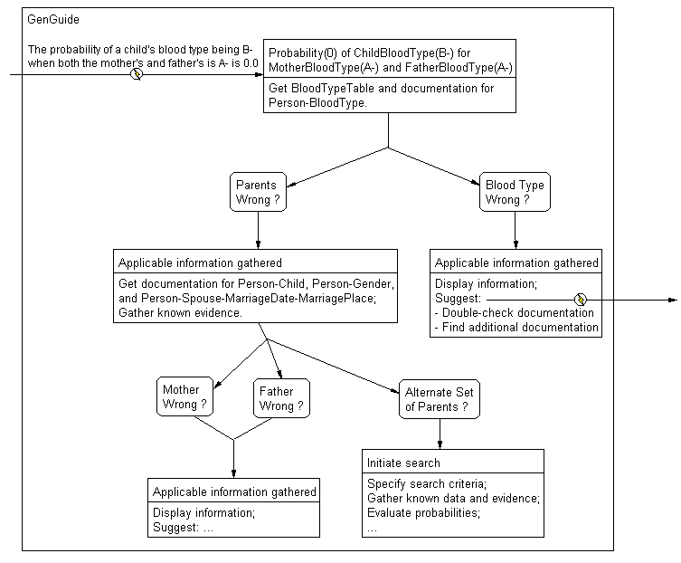
Action

Slide 22
Action
triggered on arrival of information
automatic information gathering

Slide 23
Wisdom
The proper application of
Knowledge
Evidence (Truth)
Communication
Action
When Properly Applied
Record and process richer information
Perform evidence-based reasoning
Collaborate effectively
Semi-automate family history research
}
Upper 4 superstructure layers

