Slide 1
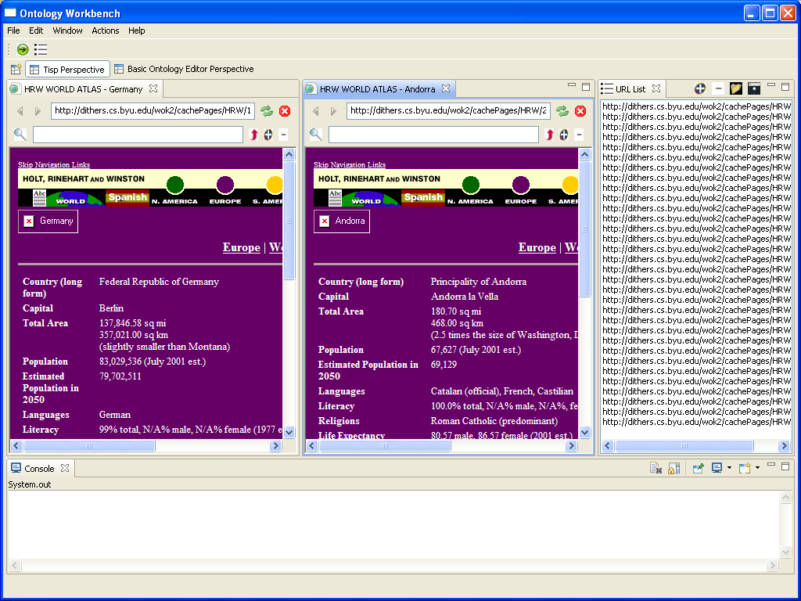
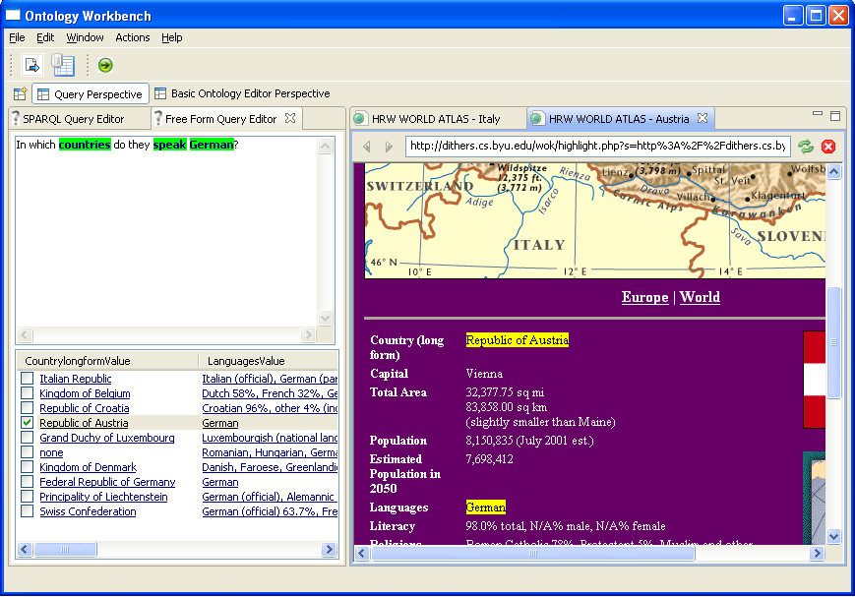
TISP & TISP++
TISP interprets sibling tables. TISP++ annotates interpreted tables for generated ontologies . TISP & TISP++ superimpose a queriable knowledge structure over web pages.
OWL
Sibling tables—automatically converted to OWL and RDF
Reason
RDF
Query

