Slide 1
GreenFIE-HD: A
“Green” Form-based Information Extraction Tool for Historical Documents
Tae Woo Kim
Notes:
Hello, my name is Tae Woo. I’d like to propose GreenFIE-HD: A Form-based Information Extraction Tool for Historical Document (to the next slide).
<li class="proposal">
<div class="venue">Thesis Proposal, BYU CS</div>
<div class="title">GreenFIE-HD: A "Green” Form-based Information Extraction Tool for Historical Documents</div>
<div class="date">August 2014</div>
<div class="author">Tae Woo Kim</div>
<div class="download"><a href="TaeWoo.Proposal.0814.pptx">View/Download</a>
<div class="size">1.5MB</div>
</div>
</li>

Slide 2
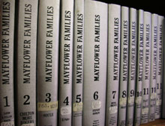
Motivation
Thousands of OCRed books with rich genealogical information
Many efforts to extract asserted facts
  General information-extraction research
  FamilySearch
  BYU DEG research and tools
Notes:
There are so many historical documents. In fact The Church of Jesus Christ of Latter-day Saints has gathered, scanned, and OCRed thousands of books that contain rich genealogical information about people and events in their lives. There are demands to extract these valuable information; however, because of volumes of facts and the lack of structure of these facts, the Church’s current indexing program is insufficient for handling the task.
Well, there are many efforts to extract these asserted facts. For instance, there are many people who are interested in information-extraction research. And there is FamilySearch which gathers genealogical information. In fact, in our research lab alone, there are three other tools that can extract asserted facts and GreenFIE-HD is an addition to them.

Slide 3
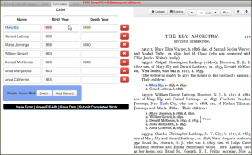
GreenFIE-HD
“Green” Form-based Information Extraction for Historical Documents
“Green” --- improves with use
UI metaphor: form fill-in
Objective: extract asserted facts
Application: historical documents, rich in family history
Approach to “Green” improvement
  Observe user work
  Generate/Modify automatic extraction rules
  Reuse:
    GreenFIE-HD-created extraction rules
    And DEG-tool-created extraction rules
Notes:
So what is GreenFIE-HD? It’s a ‘Green” form-based information extraction tool for historical document.
- The ‘Green’ means, a tool or system that improves with use.
- Its user interface has a form to fill in.
- and a page to extract asserted facts.
- It can be used to extract asserted facts from historical documents, especially documents that are rich in genealogical information.
so, how it is “Green”. It observes the user input to generate and modify automatic extraction rules. And it reuses extraction rules that are created by GreenFIE-HD and other DEG tools.
Let’s look the architecture of the system (to the next slide).

Slide 4
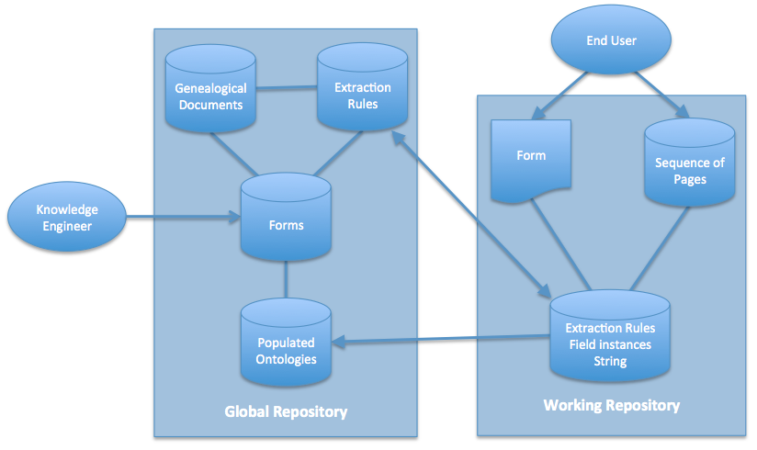
Architecture
Notes:
It has two repositories, global and working. In global repository, a Knowledge Engineer creates forms for the end user to use. There are genealogical documents and extraction rules.
Once the end user chose a form and a sequence of pages, GreenFIE-HD will store all useful extraction rules from global repository to working repository. All the newly created extraction rules from processing the chosen sequence of pages will also be stored in the working repository and when the selected book is done, they will be stored in global repository.
Let me explain the interface of the tool (to the next slide).

Slide 5
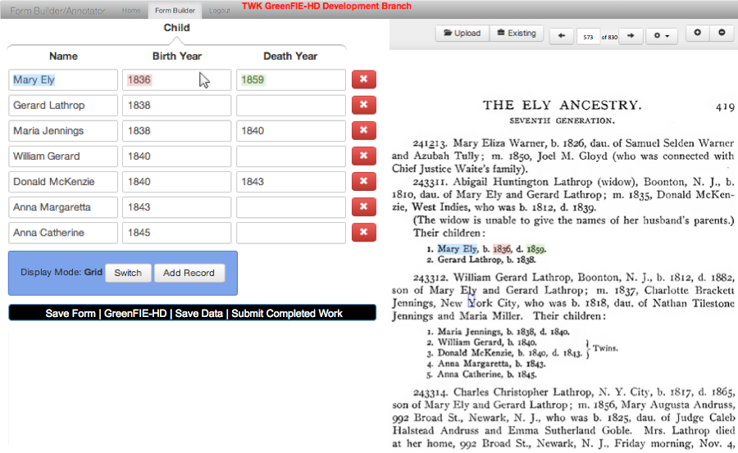
User Interface
Notes:
So this is how the system works ‘ideally’. When the end user selects a form, a sequence of pages, and a page to work on. The extraction rules in working repository find all the facts in the page completely and correctly like this in the figure. Observe that it finds all the facts that correspond to the form. To help the user to more easily check each record, it highlights the extracted information when the user hovers over a record. Once the user checked all the records and they are complete and correct, the user can click on “Submit Completed Work”. Then the tool will show the next page and the form that is filled in as much as the system could. Then the user can again check whether it is correct or not.
So basically this UI has two main purpose. (next slide)

Slide 6
UI Usage Cycle
Initialize filled-in form for a page in a book
  From output of any DEG information-extraction tool
  And from GreenFIE-HD-learned rules from previous pages
  (No initial form-fill is also acceptable)
Check and fix
  When fully correct, submit
  Fix recall errors
    Missing record
    Missing field in a record
  Fix precision errors
    Invalid field in a record
    Invalid record
Notes:
Initializing filled-in form for a page in a book and check and fix the filled-in form. GreenFIE-HD can initialize the form from output of any DEG information-extraction tool and from extraction rules that GreenFIE-HD learned from previous pages. It also can start with empty form when there is no output of other tools and no extraction rules that GreenFIE-HD learned.
But when the form is filled-in in whichever way, then user can check. If it is correct, the user can submit. Or if it is incorrect, the user can fix. GreenFIE-HD can make two types of errors, recall and precision error. In recall error, it can miss one or more whole record or one or more field in a record. In precision error, it can fill one or more field in a record with invalid information or one or more whole record could be invalid.
We will look at how user can fix these errors and how GreenFIE-HD learns from the corrections in the following slides. But before we do that, let’s look at how GreenFIE-HD create extraction rules first. (next slide)

Slide 7

Recall Error: Missing Record
(Extraction Rule Creation)
\d{1}\.\s([A-Z][a-z]{2,6})\s([A-Z][a-z]{4,10}),\sb\.\s(\d{4}),\sd\.\s(\d{4})\.
Notes:
When there are no rules or no rules for this record
When a user fills in this form, the system knows exactly where each strings are on the page. So it is trivial to create a regular-expression and adjust it so that it will be more general for the fields. The transformations for turning a labeled text pattern into a regular-expression may change as we learn more about rule initialization.

Slide 8
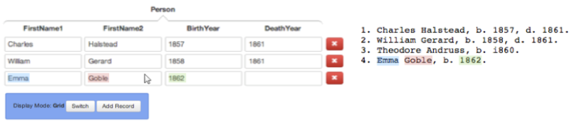
Recall Error: Missing Record
(Extraction Rule Adjustment)
i860
\d{1}\.\s([A-Z][a-z]{2,8})\s([A-Z][a-z]{1,8}),\sb\.\s(\d{4})(\.|,\sd\.\s(\d{4}))
\d{1}\.\s([A-Z][a-z]{2,8})\s([A-Z][a-z]{1,8}),\sb\.\s(i\d{3})\.
\d{1}\.\s([A-Z][a-z]{2,8})\s([A-Z][a-z]{1,8}),\sb\.\s(\d{4}|i\d{3})(\.|,\sd\.\s(\d{4}))
Notes:
First, Let’s look at recall error. This is when it misses a whole record, “Theodore Andruss”. It misses because there is an OCR error and the system never seen a character in dates before. So user can fix this by clicking ‘Add Record” button which will create an empty record and then the user can fill it in. Then the system will create a new extraction rule for the new record. The system may merge the new extraction rule with an existing rule in the working repository. In this example, it will merge with an existing rule since it has the same delimiter.

Slide 9
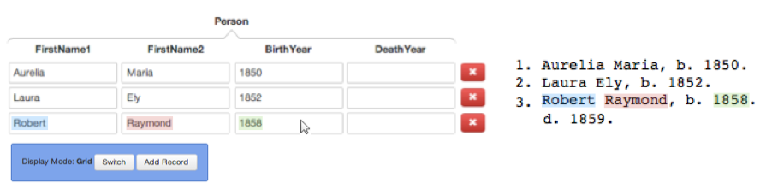
Recall Error: Missing Field
(Extraction Rule Adjustment)
i860
\d{1}\.\s([A-Z][a-z]{2,8})\s([A-Z][a-z]{1,8}),\sb\.\s(\d{4})\.
\d{1}\.\s([A-Z][a-z]{2,8})\s([A-Z][a-z]{1,8}),\sb\.\s(\d{4})\.\sd\.\s(\d{4})
\d{1}\.\s([A-Z][a-z]{2,8})\s([A-Z][a-z]{1,8}),\sb\.\s(\d{4})(\.|\.\sd\.\s(\d{4}))
Notes:
This is an example of recall error where it misses a field. The extraction rule that GreenFIE-HD had wasn’t sufficient to pick up the death date of Robert Raymond. The user can fix this by simple annotate the death date for the Robert. Then the system will adjust the rule.

Slide 10
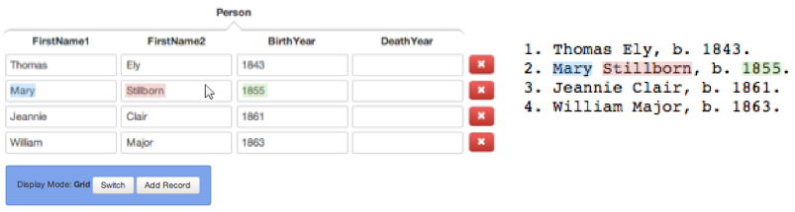
Precision Error: Invalid Field
(Extraction Rule Adjustment)
Exception Expression
Notes:
Now, let’s look at precision errors. In this example, “Stillborn” is not a first name. In order to fix this, user can simply delete the incorrect information. Then the system can make special note on the deleted string and make an exception which OntoES make it really easy to do that.
(to the next slide).

Slide 11
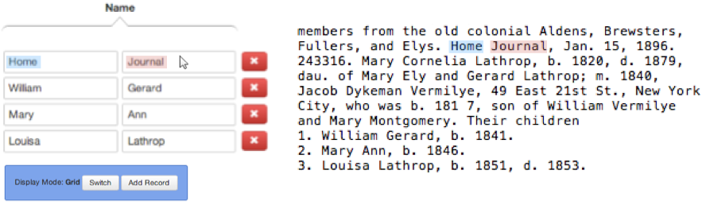
Precision Error: Invalid Record
(Extraction Rule Adjustment)
\.\s([A-Z][a-z]{2,8})\s([A-Z][a-z]{1,8}),
\d{1}\.\s ([A-Z][a-z]{2,8})\s([A-Z][a-z]{1,8}),\sb\.\s
Notes:
Lastly, this is when the entire record is wrong. “Home Journal” is not a name; however, the pattern is so simple that it picked up “Home Journal” as a name. The user can fix this by clicking this red “x” button which will delete the record and the system will make the rule more robust. In this case, getting more context to the left and right side of the pattern will not match “Home Journal” but will match other three names.
(to the next slide).

Slide 12
Validation
Thesis Statement: GreenFIE-HD, whose features include look-ahead automatic extraction and look-behind pattern derivation and adjustment, can reduce the time of annotation for a user.
Field experiment
  Three books / sequence of ten pages / three forms
  N subjects (6—10),
    Half annotate with GreenFIE-HD first
    Half annotate with the BYU Annotator first
Observations
  Annotation time with vs. without GreenFIE-HD
  Greenness (improvement with use):
    Percentage decrease from page to page in the number of required annotations
    Recall and precision errors as a function of the number of patterns created/merged
Notes:
There is no other tools that GreenFIE-HD directly competes with. So instead, we will run a field experiment.
- We plan to use 3 historical books that contain semi-structured genealogical information. And from each books, we will select sequence of 10 pages that have a lot of information that corresponds to the forms we plan to use. The 3 forms we plan to use are person, marriage, and parent-child.
- We plan to have 6 to 10 subjects (hopefully more). The half of them will be given a task of annotating with GreenFIE-HD first then annotating with BYU Annotator. The other half will do this task in reverse order. This procedure will alleviate the effect of having an experience with one method or the other first.
From the experiment, we will observe annotation time with and without GreenFIE-HD to see if it reduces time of annotation. We will also validate the ‘Greenness” of the system. - We will see the percentage decrease from page to page in the number of required user annotations.
- We will also measure the “greenness” of the system by observing recall and precision errors as a function of the number of patterns created/ merged.

Slide 13
Summary
GreenFIE-HD features:
  Look-ahead automatic extraction
  (yielding) annotation time reduction
  Look-behind rule derivation and adjustment
  (yielding) tool improvement with use
Notes:
GreenFIE-HD is a “green” annotation tool that gets better with use. It looks ahead to do automatic extraction to reduce annotation time and it looks behind the user’s input to derive or adjust extraction rules to improve itself.

