Slide 1
Bootstrapping Regular-Expression Recognizers to Help Human Annotators
Tae Woo Kim

Slide 2
Background
Human annotators annotate entities
Top to bottom, a person at a time
Find what they can find

Slide 3
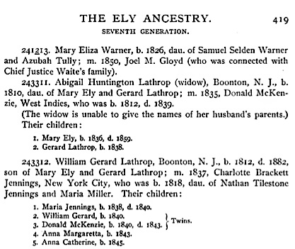
Background
Person
Name: Birth date: Death date: Residence: Father: Mother: | Mary Eliza Warner 1826 Samuel Selden Warner Azubah Tully Warner

Slide 4
Background
Person
Name: Birth date: Death date: Residence: Father: Mother: | Samuel Selden Warner

Slide 5
Background
The form fills out the ontology snippet

Slide 6
Motivation
Too many genealogical documents for human annotators
611,923 Historical documents and family tree with Ely
The documents represent information in similar patterns
Why not use these patterns!

Slide 7
Solution
While human annotators annotate entities, the system watches and learn
Break the text of the documents into sentence fragments
Find sentence fragments that are in the same pattern
Turn the pattern into regular expressions

Slide 8
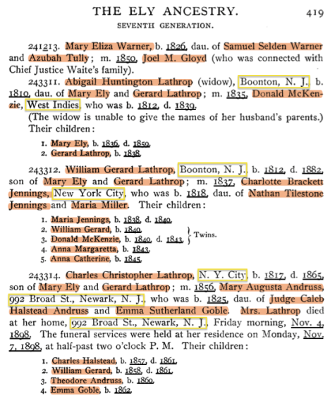
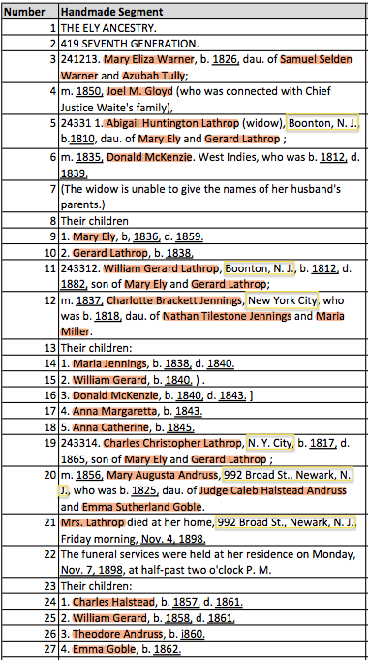
What human annotators have
What the system has

Slide 9
Solution
[1digit num.]._[name],_b._[date],_d._[date].
(\d).\s([A-Z][a-z]+\s[A-Z][a-z]+),\sb.\s(\d{4}),\sd.\s(\d{4}).

Slide 10
Solution
Run the regular-expressions in the rest of the documents
Ontology snippet can be filled out with the extracted data
The system fills out the form for the annotators

Slide 11
Conclusion
Regular-expression recognizers watches and learn from human annotators
Generate regular-expression to find entities for annotators
The system will get better and better as it learns more patterns

