Slide 1
Semi-Supervised, Knowledge-Based Information Extraction for the Semantic Web
Thomas L. Packer
Funded in part by the National Science Foundation.
Notes:
Efficient extracting, build up, vast Internet

Slide 2
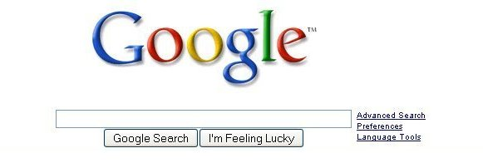
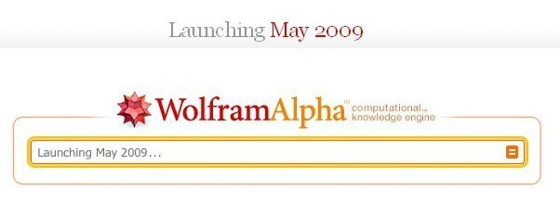
From Web to Semantic Web
Notes:
Look for information
Purpose of IR?

Slide 3
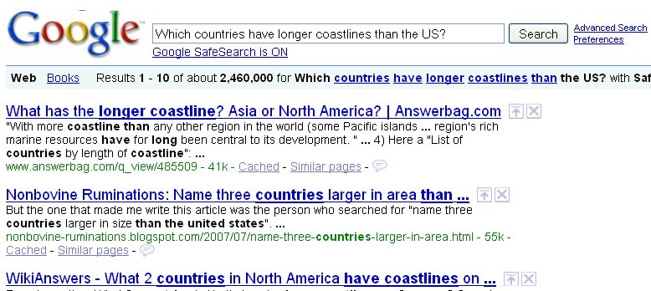
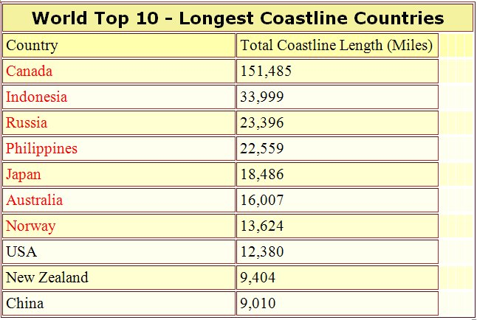
QA and IR from much Knowledge, IE
Notes:
Google answer → Pages containing lucky
Answer better? → answering questions
Still return pages. 1 2 3
Both QA & IR better?
Knowledge: 1 2
QA & IR better ← IE
Lot of knowledge. → Do IE efficiently and accurately

Slide 4
Evolution of Manual Work Supporting Information Extraction
Hand-written Rules and other Knowledge
Hand-labeling Examples for Machine Learning
Document Selection for Semi-Supervised KE
Notes:
IE evolved, efficient, hand work computer. 1 2 3
Always more efficient & accurate?
Thankfully

Slide 5
Ontos
1. Web Pages
3. Automatic Extraction
2. Manually Write Ontology
Extraction Ontology
(Big and Specific enough?)
Extracted Data
Notes:
2 things
extraction, automatically, any number of pages
Precision & recall

Slide 6
FOCIH
1. Training Pages
3. Few Hand-Labels
4. Automatic Extraction
Semi-supervised
2. Manually Write Ontology Schema
Ontology and Extracted Data
Notes:
3 things
again

Slide 7
Semi-supervised Knowledge Engineering with FOCIH and Ontos
1. Training Pages
3. More Pages
2. Semi-Supervised Training with FOCIH
4. Automatic Extraction with Ontos
Extraction Ontology
Extracted Data
5. Autonomy via Feedback
Notes:
Proposal: combine
Feeding information between, system more autonomous, less manual coding & training examples.
1 2
More information extracted → more automatically identified on new web pages.

Slide 8
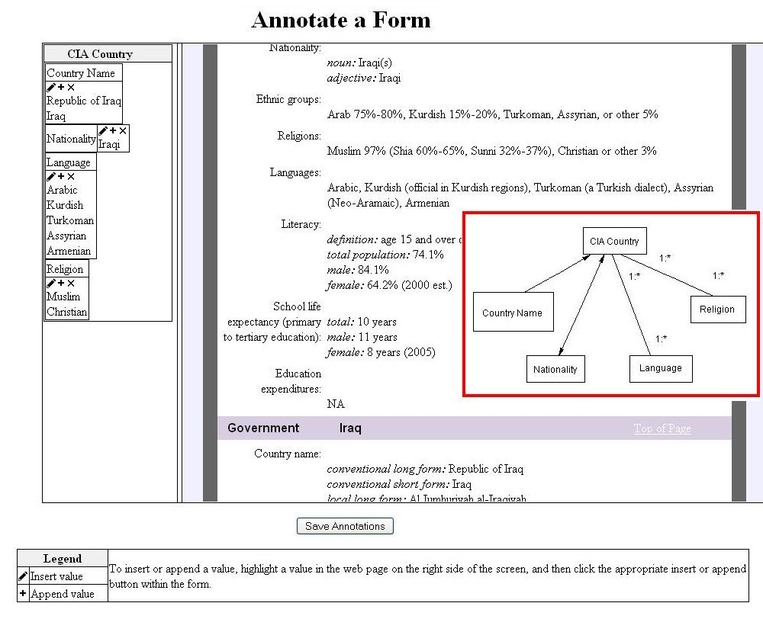
From CIA to Semanitic Web
Notes:
1 2 3
Process
Hand labels, consistent format → all countries
Knowledge extract & index other pages, unstructured
Step to Semantic Web

Slide 9
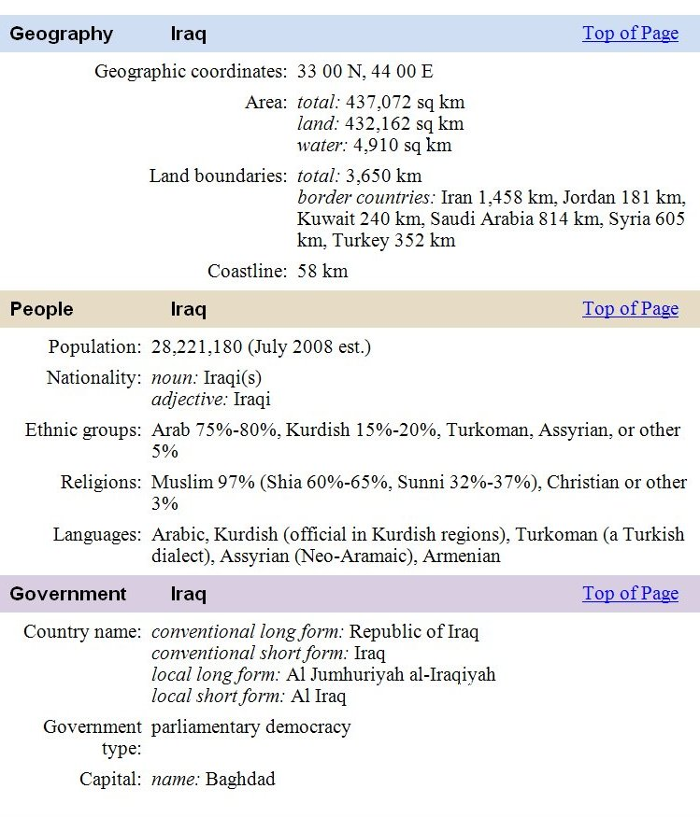
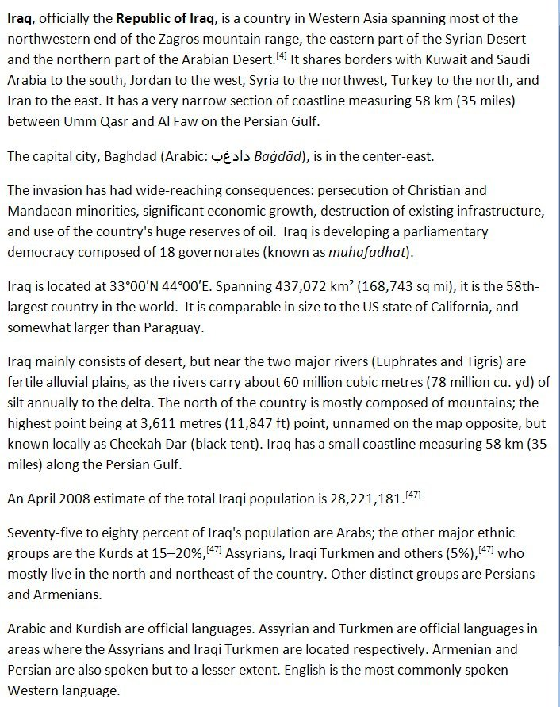
From Structured to Unstructured
Notes:
More info Iraq
Know country names
Other info
More info on topic → disambiguate terms & linguistic structure
Sem Web

Slide 10
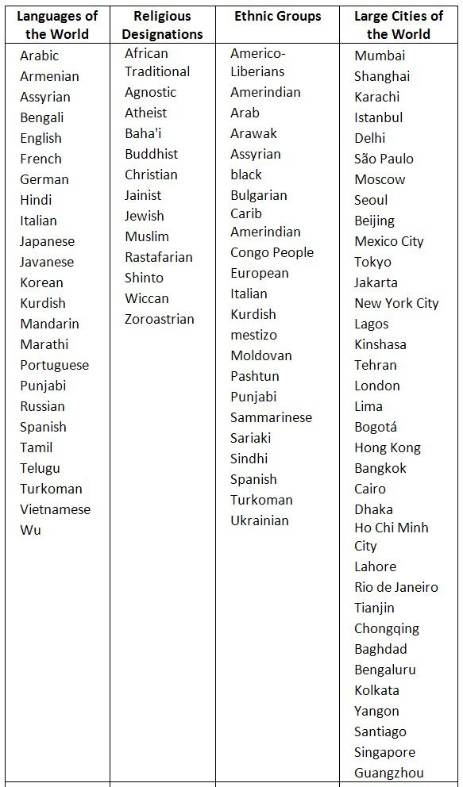
From Simple to Complex Structure
Notes:
Complicated: label or decompose
Concepts appear in text ← fill lexicons
Grammar induction
Regex
Examples → learning regular expression
Sibling → free training
Things to investigate.

Slide 11
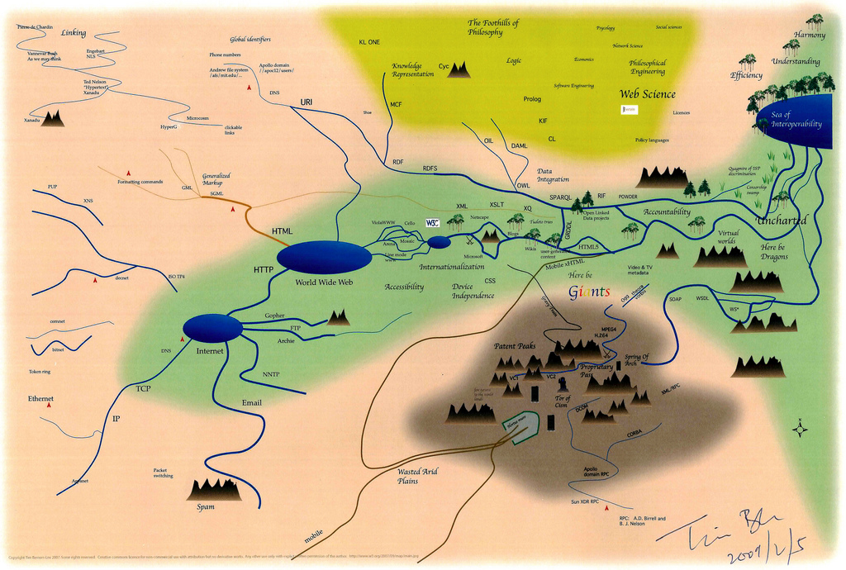
The End

