Slide 1


Theoretical Foundations for Enabling a Web of Knowledge
David W. Embley
Andrew Zitzelberger
Brigham Young University
www.deg.byu.edu

Slide 2
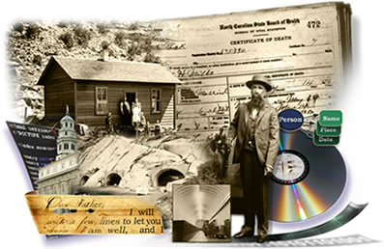
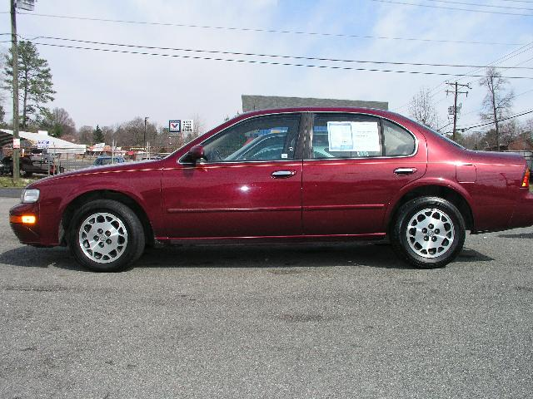
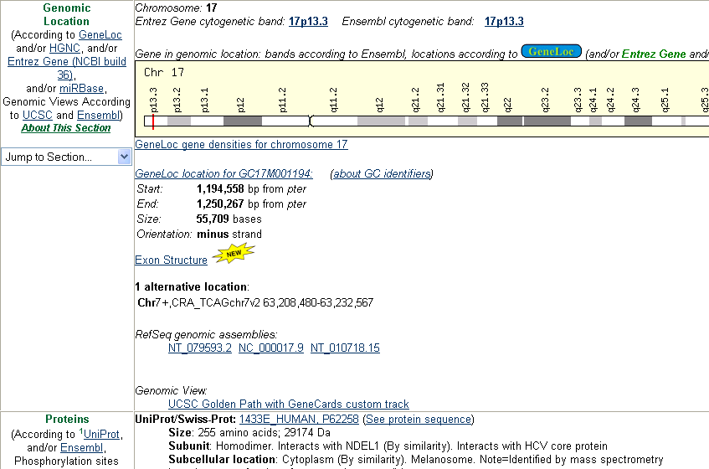
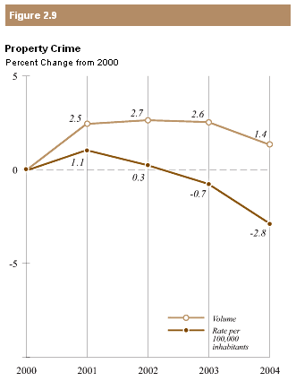
A Web of Pages  A Web of Facts
Birthdate of my great grandpa Orson
Price and mileage of red Nissans, 1990 or newer
Location and size of chromosome 17
US states with property crime rates above 1%

Slide 3
Toward a Web of Knowledge
Fundamental questions
  What is knowledge?
  What are facts?
  How does one know?
Philosophy
  Ontology
  Epistemology
  Logic and reasoning
(a computational view)
Notes:
Philosophy (a computational view): we dumb these down so that a “stupid” computer can deal with them.

Slide 4
Ontology
Existence—asks “What exists?”
Concepts, relationships, and constraints

Slide 5
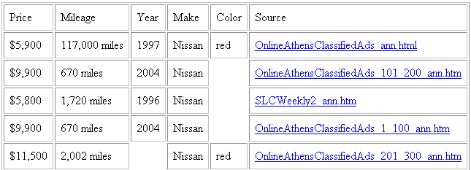
Epistemology
The nature of knowledge—asks: “What is knowledge?” and “How is knowledge acquired?”
Populated conceptual model

Slide 6
Logic and Reasoning
Principles of valid inference—asks: “What is known?” and “What can be inferred?”
Justified, inference from conceptualized data (reasoning chain, grounded in source)
Find price and mileage of red Nissans, 1990 or newer

Slide 7
Logic and reasoning
Principles of valid inference – asks: “What is known?” and “What can be inferred?”
For us, it answers: what can be inferred (in a formal sense) from conceptualized data.
Find price and mileage of red Nissans, 1990 or newer

Slide 8
WoK Foundation Details
Objectives
  Establish formal WoK foundation (can it work?)
  Enable WoK construction tools (can it be built?)
WoK Vision Practicalities
  Simplicity
  Scalability
  Spin-off
    Extraction ontologies
    Free-form query processing
    Knowledge bundles
    Knowledge-bundle building tools
    …
Notes:
Take-home msg: (1) formalization of extraction ontologies, knowledge bundles, and web of knowledge and (2) formalization of construction tools. Hopefully see simplicity and elegance and practical uses of subcomponents. (Note: tie into a computational view of ontology, epistemology, and reasoning.)
Scalability: performance scalability (based on decidability & tractability) and human scalability (based on KBB tools); and simplicity (ease of understanding and use.
Guidance thoughts: overcome construction barriers & usage barriers.
Spinoff examples: Alerter for extraction ontologies, Bio-research for KBs, and reverse-engineering, semantic enhancement, data integration and organization tools, record linkage, named entity recognition, ontology learning, …

Slide 9
WoK Knowledge Bundle (KB) Formalization
KB: a 7-tuple: (O, R, C, I, D, A, L)
  O: Object sets—one-place predicates
  R: Relationship sets—n-place predicates
  C: Constraints—closed formulas
  I: Interpretations—predicate calc. models for (O, R, C)
  D: Deductive inference rules—open formulas
  A: Annotations—links from KB to source documents
  L: Linguistic groundings—data frames

Slide 10
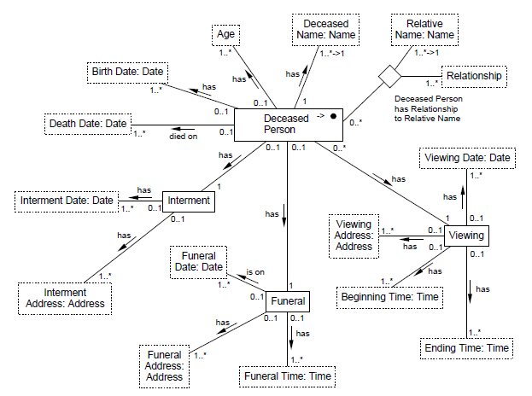
KB: (O, R, C, …)

Slide 11
KB: (O, R, C, …)
O: one-place predicates: DeceasedPerson(x), Age(x), …
R: n-place predicates: DeceasedPerson(x)hasAge(y), …
C: constraints: ∀x(DeceasedPerson(x)
⇒ ∃^{≤1}y(DeceasedPerson(x)hasAge(y))
…

Slide 12
KB: (O, R, C, I, …)
Age(69)
DeceasedPerson(x₃₇)
DeceasedPerson(x₃₇)hasAge(69)
Notes:
(O, R, C, I): predicate calculus model if all constraints hold; valid interpretation

Slide 13
Aside #1: Decidability & Tractability
Mapping to OWL-DL
Also to ALCN
  ALCN Tableaux Calculus
  Decidable, PSPACE-complete
Enforce integrity constraints in DB fashion
Further exploration
  Complexity of the particular FOL fragment for KBs
  Adjustments to conceptual-modeling features?
Notes:
Call for help to better pin down decidable and tractable results.
ALCN: Attribute concept Language with Complement and Numeric (min:max) cardinality.
It’s the ALCN Tableaux Calculus that’s decidable and Pspace-complete.
To enforce in DB fashion, I should check the complexity of non-1 max and G/S constraints; keys and simple ref integrity should be OK.

Slide 14
Aside #2: Metamodel
(in terms of itself)

Slide 15
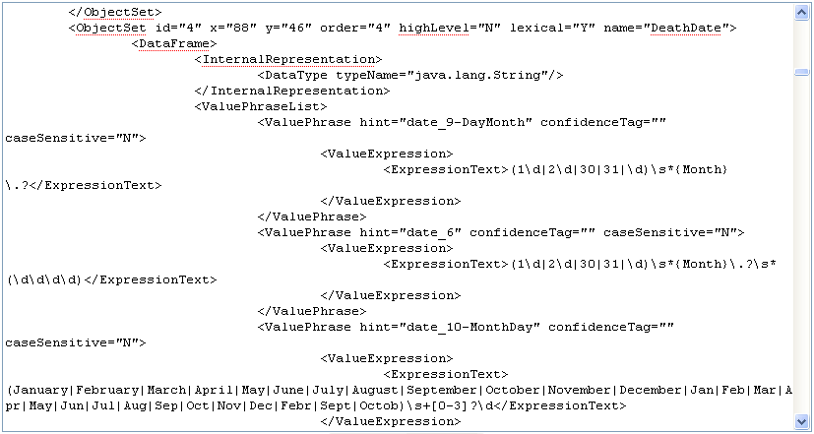
KB: (O, R, C, I, …, L)

Slide 16
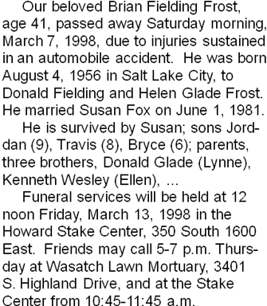
KB: (O, R, C, I, …, A, L)

Slide 17
KB: (O, R, C, I, D, A, L)
Brother(y, z) :-
DeceasedPerson(x)hasRelationship(‘son’)toRelativeName(y),
DeceasedPerson(x)hasRelationship(‘son’)toRelativeName(z),
y != z.
Notes:
Just mention?: query reasoning decidable, tractable; ask for interaction. (Note: If I can, I should contact Andrea again and see if I can get answers.)

Slide 18
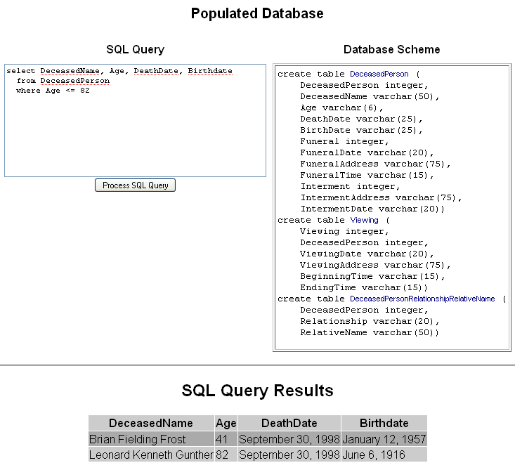
KB Query

Slide 19
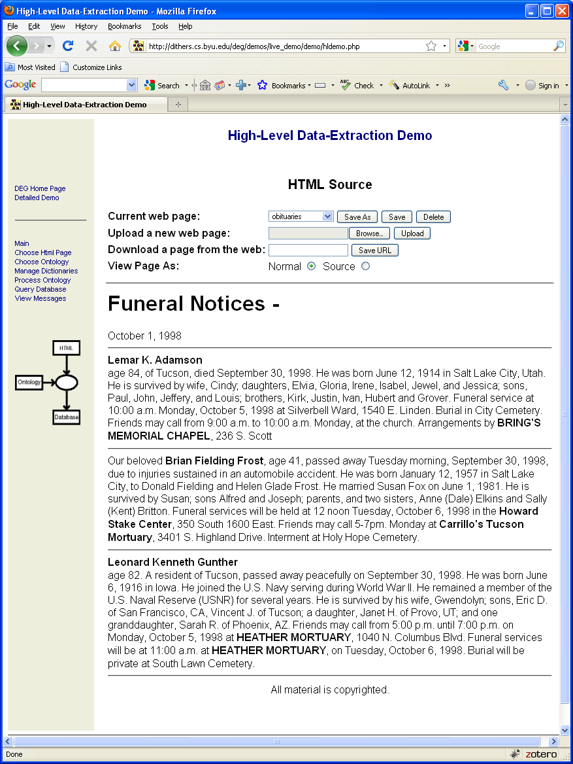
KB Query

Slide 20
Web of Knowledge (WoK)
Plato: “justified true belief”
Facts
  Extensional (grounded to source)
  Intentional (exposed reasoning chains)
Knowledge Bundle (KB)
  Populated ontology
  Superimposed over web documents
Web of Knowledge: interconnected KBs
  Instance equality links
  Class equality links
Notes:
(Scary thing to try to define) We take a simple computational view that appears to work well for the WoK

Slide 21
WoK Construction Tools
Automatic Construction
Semi-Automatic Construction
Construction via Semantic Integration
  Semantic enrichment
  Schema mapping
  Record linkage
Construction via Extraction Ontologies
Synergistic Construction
  You “pay-as-you-go”
  It “learns-as-it-goes”
Notes:
Mention that the problem is reverse engineering. Semantic enrichment needed when abstracted away in the original construction AND also to help align ontologies.

Slide 22
Transformation Principles
5-tuple: (R, S, T, Π, Σ)
  R: Resources
  S: Source
  T: Target
  Π: Procedural transformation
  Σ: Non-procedural transformation
Information & Constraint Preservation
  Procedure exists to compute S from T
  C_{T} ⇒ C_{S} (constraints of T imply constraints of S)
(KB: Knowledge Bundle)
Notes:
The less structured the source, the less likely is to be able to identify the predicates make

Slide 23
Construction: Reverse Engineering
(Formal Data Structures)
XML Schema
C- XML
Also for RDB, OWL/RDF, …
Notes:
In general, reverse engineering from any structured schema.

Slide 24
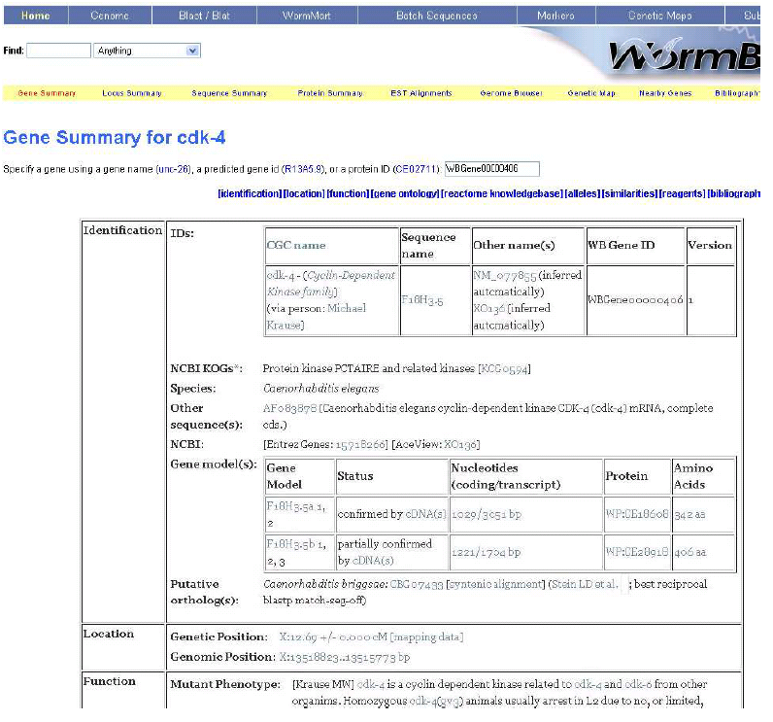
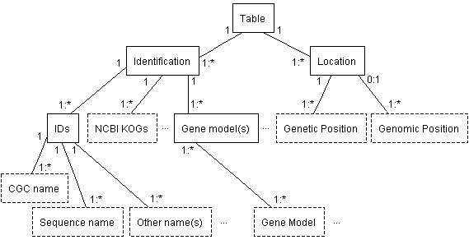
Construction: Reverse Engineering
(Nested Tables)
…
Table interpretation needed

Slide 25
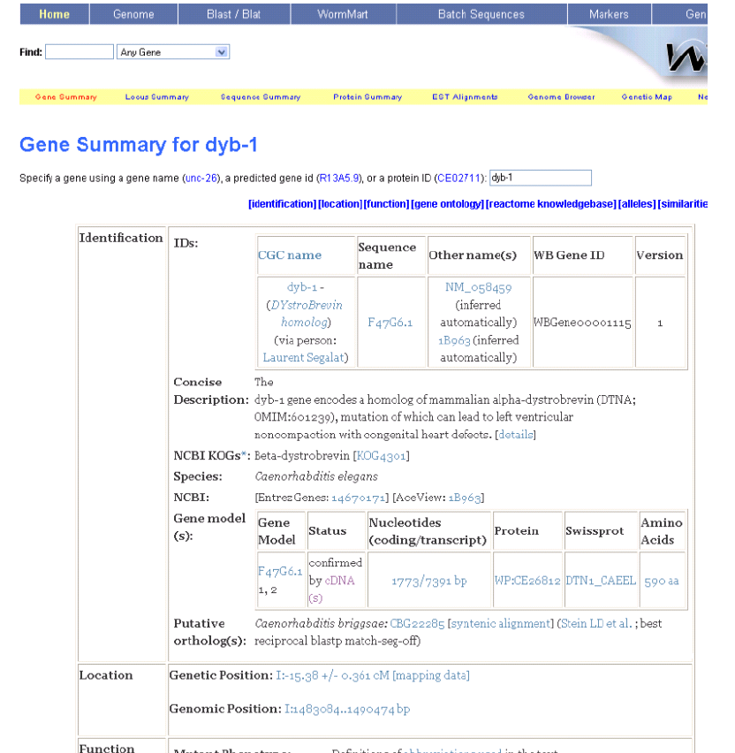
Construction with TISP:
Table Interpretation by Sibling Pages
Same

Slide 26
Construction with TISP:
Table Interpretation by Sibling Pages
Different
Same

Slide 27
Construction with TISP:
Table Interpretation by Sibling Pages
…

Slide 28
Construction via Semantic Integration
TANGO: Table ANalysis for Generating Ontologies
fleck | velter
 | gonsity (ld/gg) | hepth (gd)
burlam | 1.2 | 120
falder | 2.3 | 230
multon | 2.5 | 400
repeat:
understand table
generate mini-ontology
match with growing ontology
adjust & merge
until ontology developed
Growing
Ontology

Slide 29
Table Analysis
Vertical-cut-first notatioin:
[{ [C D ][C1 {D1 D2 }][C2 {D1 D2 }]} {A [{A1 [A11A12 ]}A2 ][d11 d12 d13]
[d21 d22 d23 ][d31 d32 d33 ][d41 d42 d43 ]}].
Category notation:
(A,{(A1,{(A11,Φ),(A12,Φ)}),(A2,Φ)})
(C, {(C1,Φ),(C2,Φ)})
(D, {(D1,Φ),(D2,Φ)})
Delta notation:
δ({A.A1.A11,C.C1,D.D1}) = d11
δ({A.A1.A12,C.C1,D.D1}) = d12
...
A C D
Notes:
Wang notation w/ G. Nagy et al. Others to acknowledge: Pivk? et al., Gatterbauer et al., Giles et al. and even Halevy et al. at Google.

Slide 30
Semantic Enrichment
Semantic information lost in abstraction
  Concepts
  Relationships
  Constraints
Recovery via outside resources
  WordNet
  Data-frame library
Example …
Notes:
Some concepts, relationships, and constraints lost (not all); or some aspects meta-data about … (e.g., class names of concepts)

Slide 31
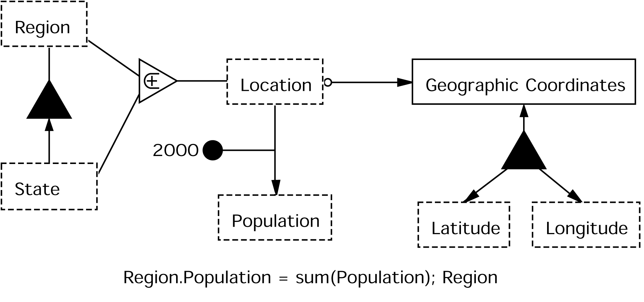
Sample Input
Semantic Enrichment Example
Region and State Information
Location | Population (2000) | Latitude | Longitude
Northeast | 2,122,869
Delaware | 817,376 | 45 | -90
Maine | 1,305,493 | 44 | -93
Northwest | 9,690,665
Oregon | 3,559,547 | 45 | -120
Washington | 6,131,118 | 43 | -120
Sample Output
Notes:
- Explain what is “mini” about the ontology
Walk user through the mini-ontology to explain what it tells us about the concepts/relationships

Slide 32
Concept/Value Recognition
Lexical Clues
  Labels as data values
  Data value assignment
Data Frame Clues
  Labels as data values
  Data value assignment
Default
  Recognize concepts and values by syntax and layout

Slide 33
Concept/Value Recognition
Lexical Clues
  Labels as data values
  Data value assignment
Data Frame Clues
  Labels as data values
  Data value assignment
Default
  Recognize concepts and values by syntax and layout
Concepts and Value Assignments
Location
Region
State
Northeast
Northwest
Delaware
Maine
Oregon
Washington

Slide 34
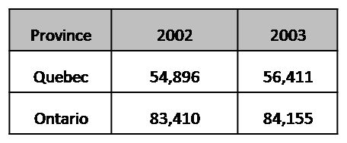
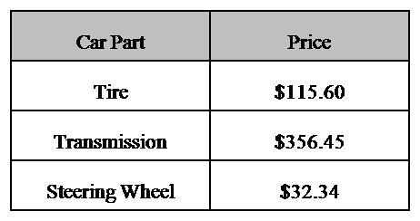
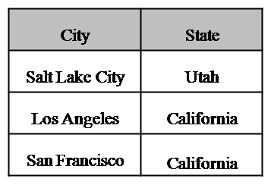
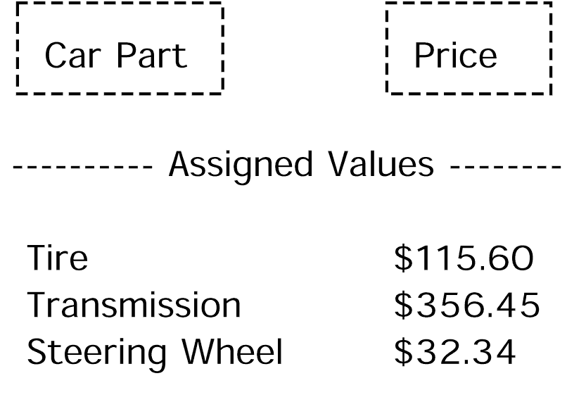
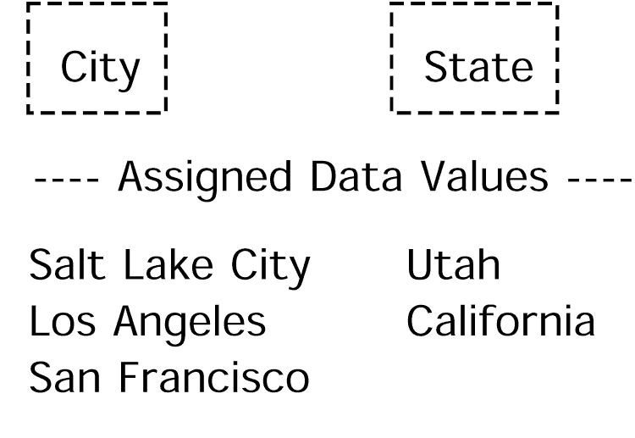
Concept/Value Recognition
Lexical Clues
  Labels as data values
  Data value assignment
Data Frame Clues
  Labels as data values
  Data value assignment
Default
  Recognize concepts and values by syntax and layout
Year
2002
2003
Concepts and Value Assignments
Location
Region
State
Population
Latitude
Longitude
Northeast
Northwest
Delaware
Maine
Oregon
Washington
2,122,869
817,376
1,305,493
9,690,665
3,559,547
6,131,118
45
44
45
43
-90
-93
-120
-120

Slide 35
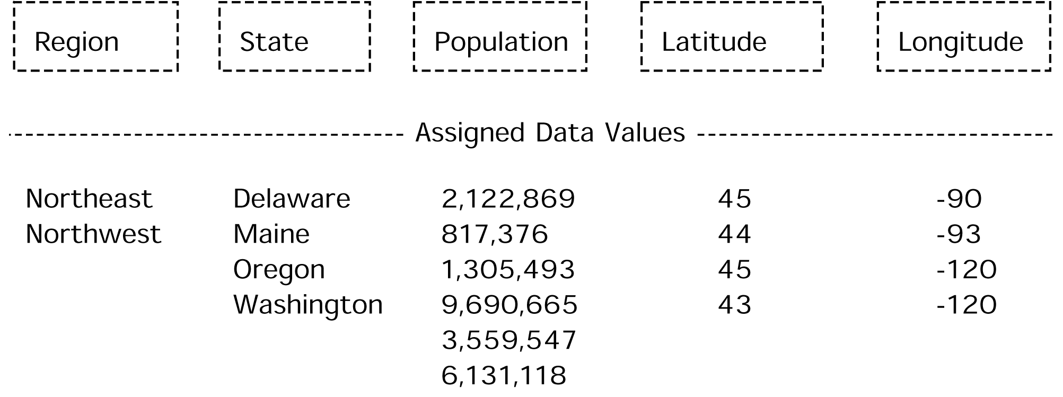
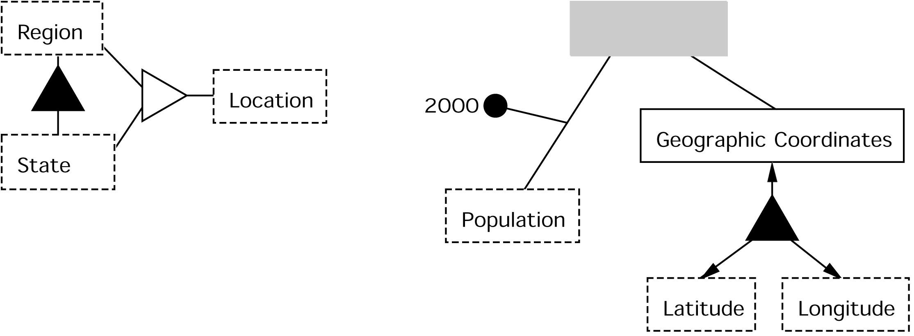
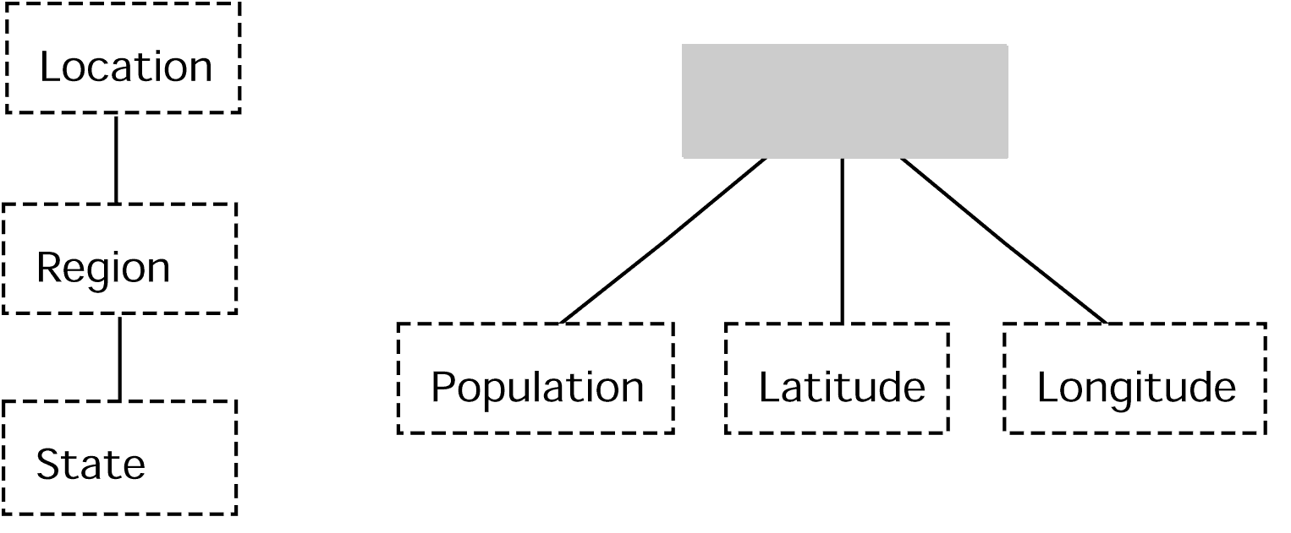
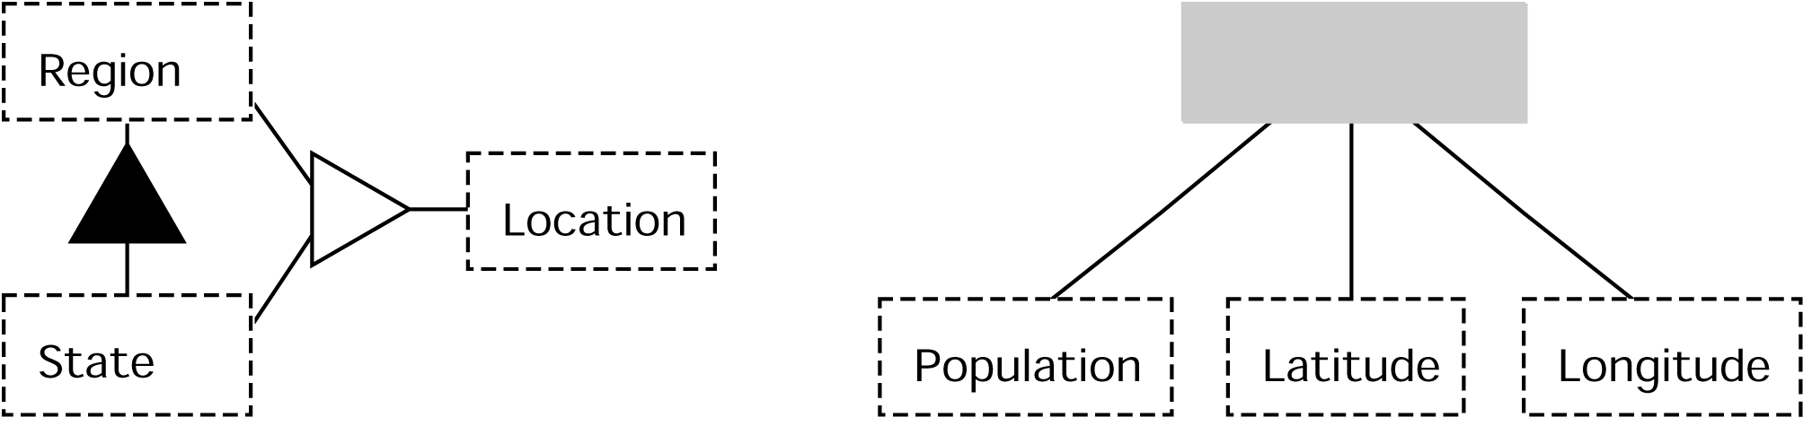
Relationship Discovery
2000
Dimension Tree Mappings
Lexical Clues
  Generalization/Specialization
  Aggregation
Data Frames
Ontology Fragment Merge

Slide 36
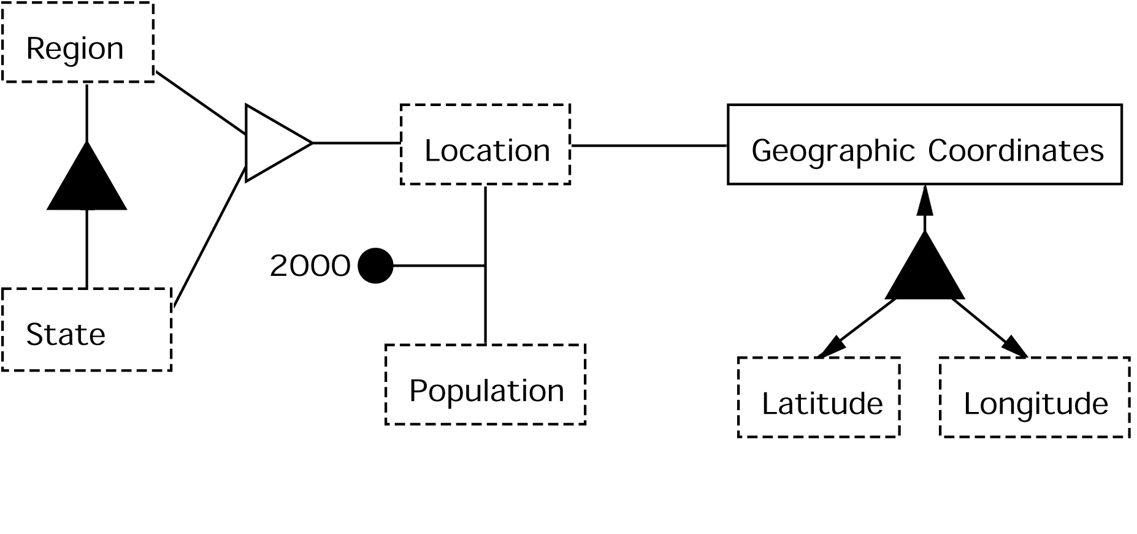
Relationship Discovery
Dimension Tree Mappings
Lexical Clues
  Generalization/Specialization
  Aggregation
Data Frames
Ontology Fragment Merge

Slide 37
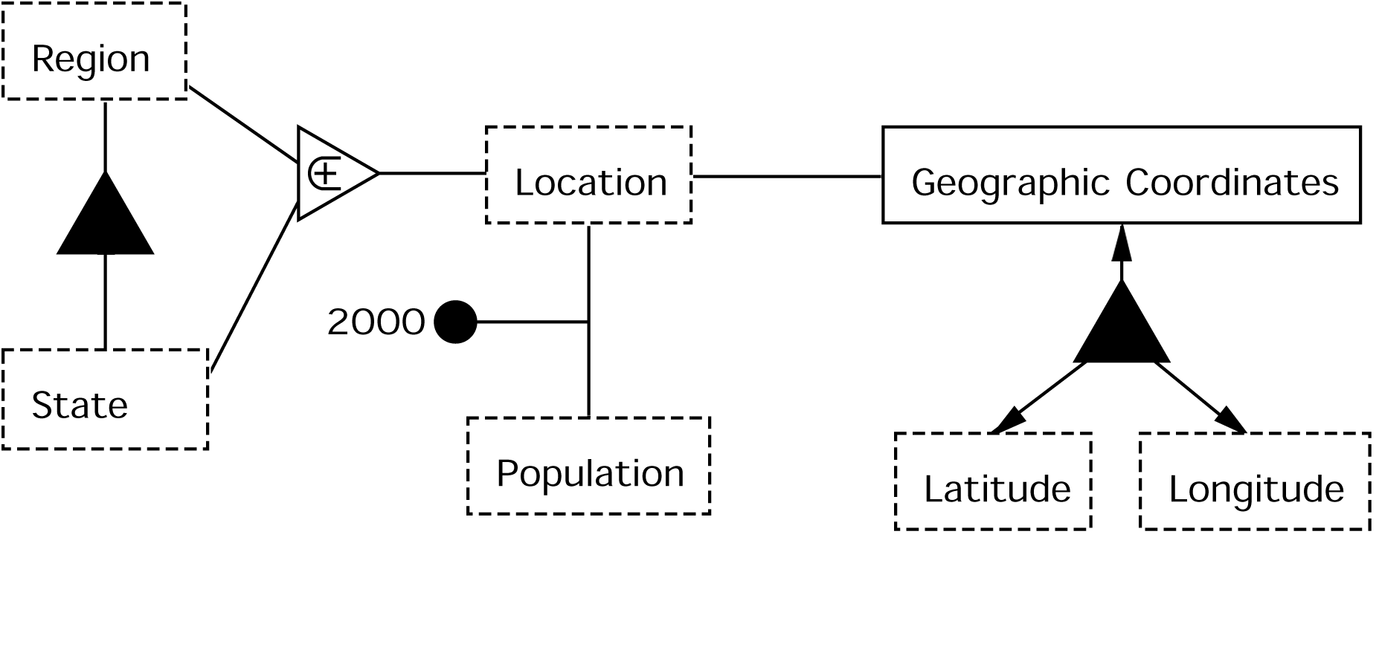



Constraint Discovery
Generalization/Specialization
Computed Values
Functional Relationships
Optional Participation
Region and State Information
Location | Population (2000) | Latitude | Longitude
Northeast | 2,122,869
Delaware | 817,376 | 45 | -90
Maine | 1,305,493 | 44 | -93
Northwest | 9,690,665
Oregon | 3,559,547 | 45 | -120
Washington | 6,131,118 | 43 | -120
Notes:
- Explain how functional dependencies are found better – values in original table are functionally determined

Slide 38
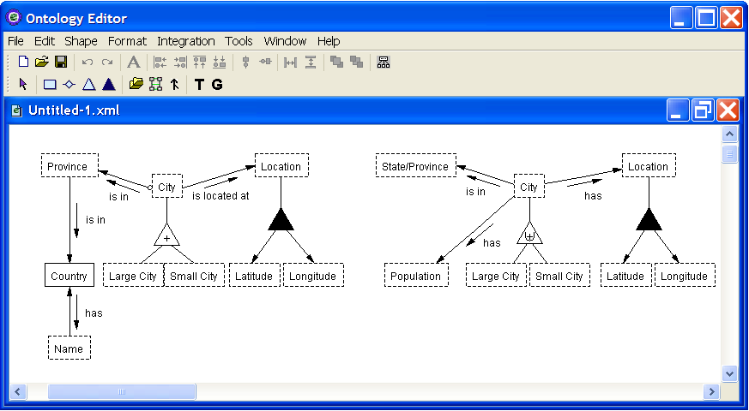
Mapping and Merging

Slide 39
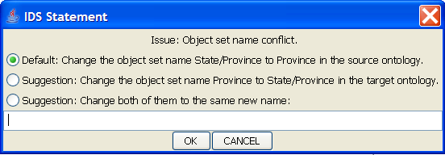
Mapping and Merging

Slide 40
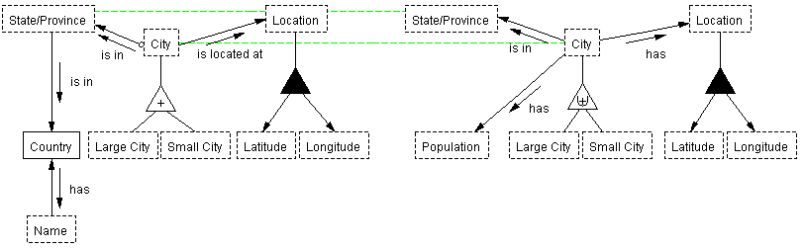
Mapping and Merging

Slide 41
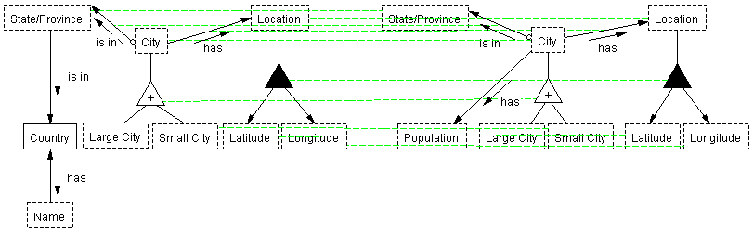
Mapping and Merging

Slide 42
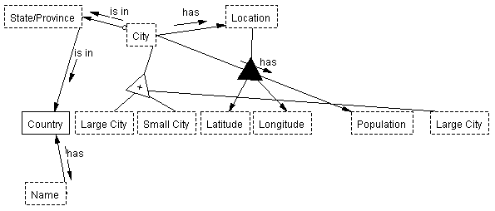
Mapping and Merging

Slide 43
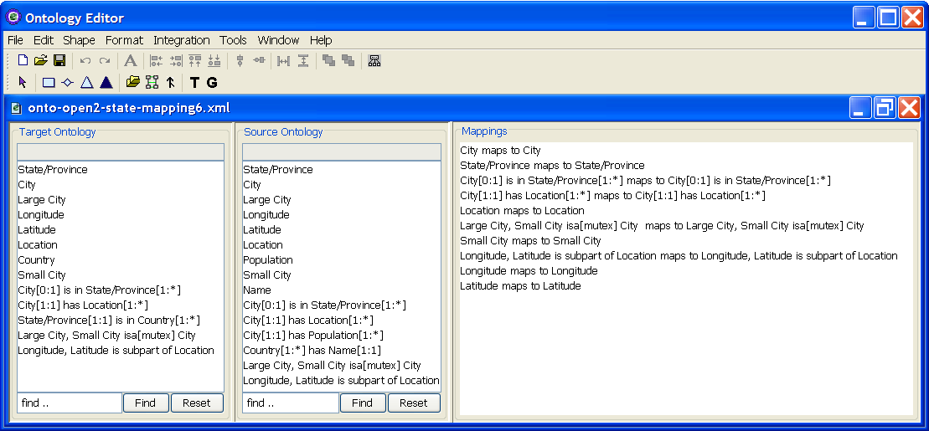
Mapping and Merging
Notes:
The tool with three panels

Slide 44
Automated Schema Matching
Central Idea: Exploit All Data & Metadata
Matching Possibilities (Facets)
  Attribute Names
  Data-Value Characteristics
  Expected Data Values
  Data-Dictionary Information
  Structural Properties
Direct & Indirect Matching

Slide 45
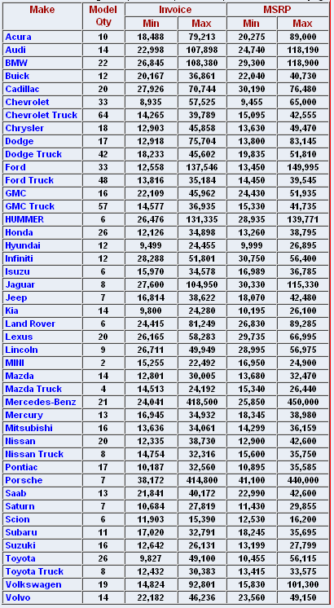
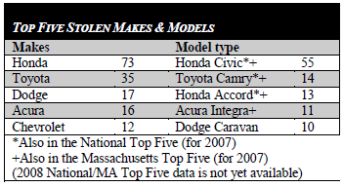
Expected Data Values
Make

Slide 46
Direct & Indirect Schema Mappings
Year
Year
Color
Make
Feature
Make
&
Model
Body Type
Model
Car
Cost
Car
Style
Mileage
Phone
Miles
Cost
Target
Source
Notes:
Cost: purchase vs. lease

Slide 47
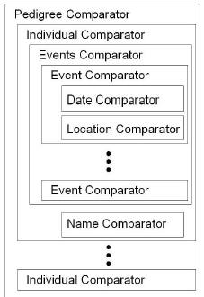
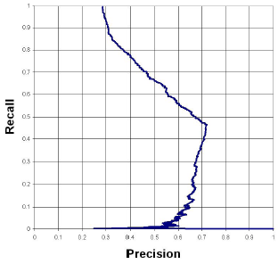
Ontological Record Linkage

Slide 48
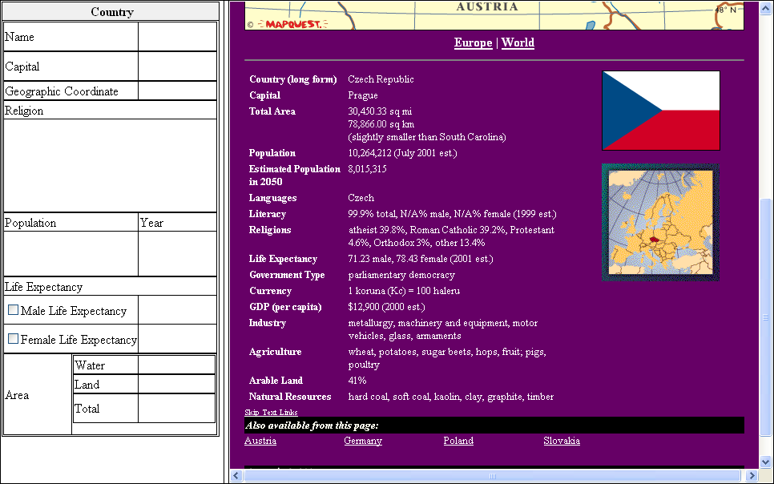
Construction with FOCIH:
(Form-based Ontology Creation and Information Harvesting)
Notes:
Lixto: mention (perhaps just say like Lixto in many ways, and it could work here as well), check & comment appropriately

Slide 49
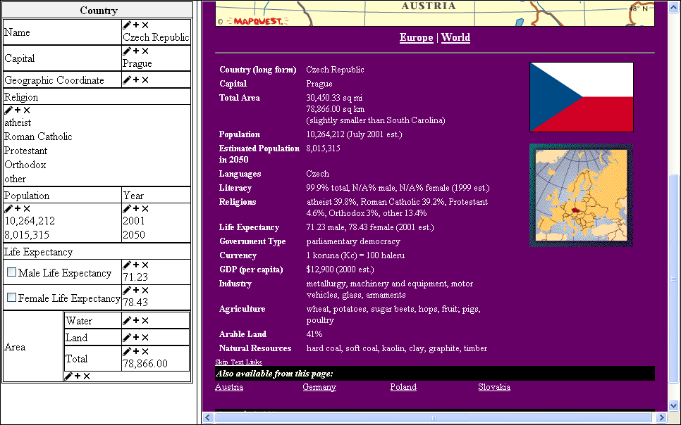
Construction with FOCIH:
(Form-based Ontology Creation and Information Harvesting)

Slide 50
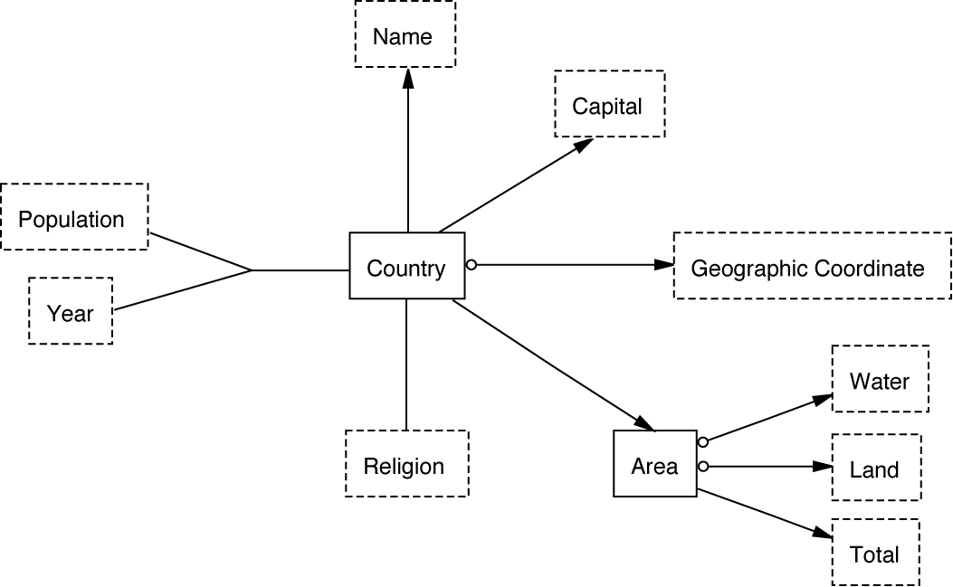
Ontology Generation
Czech Republic
Germany
France
…
Prague
Berlin
Paris
…
10,264,212 2001
8,015,315 2050
…
atheist
Roman Catholic
Protestant
Orthodox
other
…
78,866.00 sq km
551,695.00 sq km
357,114.22 sq km
…

Slide 51
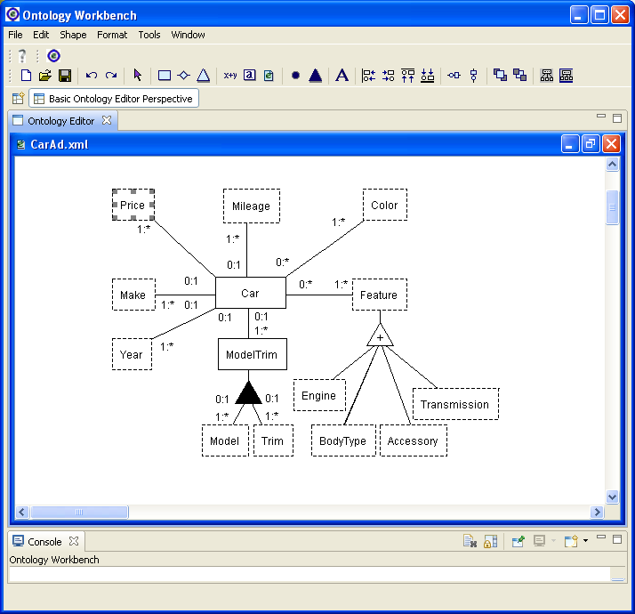
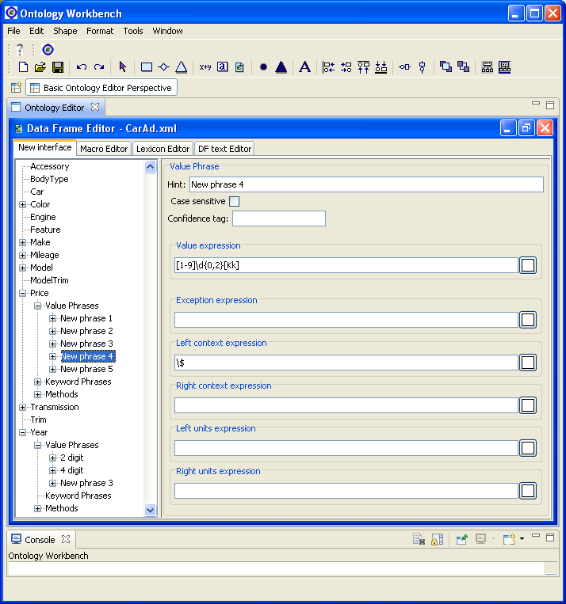
Construction with
Extraction Ontology Editor

Slide 52
Synergistic Construction
Knowledge Begets Knowledge
Czech Republic
Germany
France
…
Prague
Berlin
Paris
…
Population-Year
data-frame recognizer
atheist
Roman Catholic
Protestant
Orthodox
other
…
sq km
data-frame recognizer

Slide 53
Synergistic Construction
You “pay-as-you-go” / It “learns-as-it-goes”
Czech Republic
Germany
France
…
Prague
Berlin
Paris
…
Population-Year
data-frame recognizer
atheist
Roman Catholic
Protestant
Orthodox
other
…
sq km
data-frame recognizer

Slide 54
WoK Usage Tools
Based on “Understanding”
“Read” / “Write”
Applications
  Free-form query processing
  Reasoning chains grounded in annotated instances
  Knowledge augmentation
  Research studies
S: Usually not formal;
makes “understanding”
difficult (& interesting)
“Understanding”:
S: Source Conceptualization
T: Target Conceptualization (formalized as a KB)
If there exists an S-to-T transformation:
  – One-place & n-place predicates
  – Facts (wrt predicates)
  – Operations
  – Constraints of T all hold
But: Linguistically grounded KBs
are also extraction ontologies,
that can construct mappings.
“Understanding” is the mapping; “reading” constructs the mapping;
“writing” explains the mapping in its own words.
Notes:
Homomorphism: structure mapping between two algebraic structures. (Understanding is the mapping; reading constructs the mapping; writing explains understanding in its own words)
(Unfortunately) S is usually not formal – which makes understanding difficult (and interesting)

Slide 55
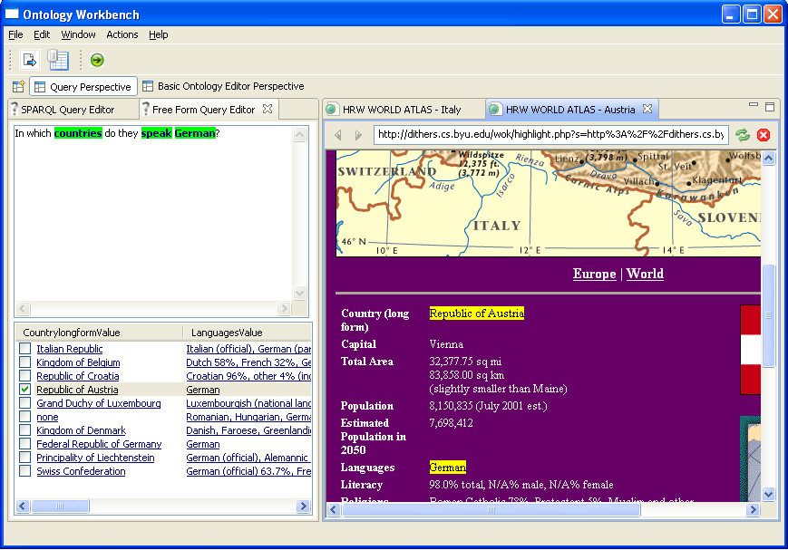
Free-form Query Processing with Annotated Results
Notes:
Say a bit about how this works & tie it in to understanding. Also: choice of ontology, mapping to formal query, …

Slide 56
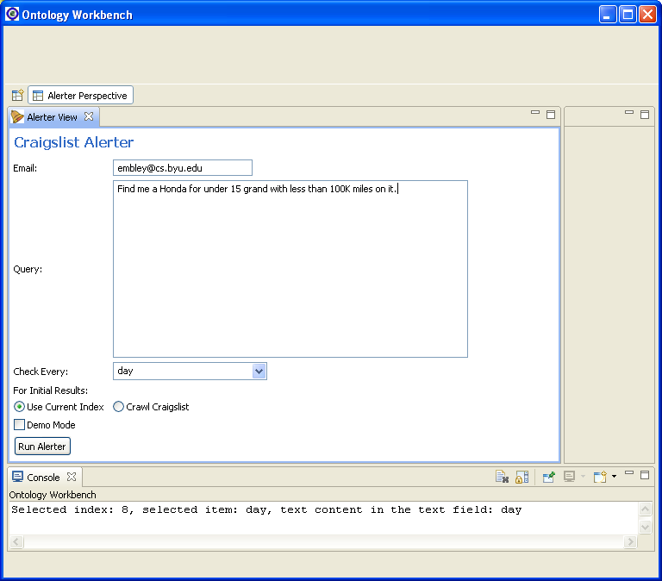
Alerter for www.craigslist.org

Slide 57
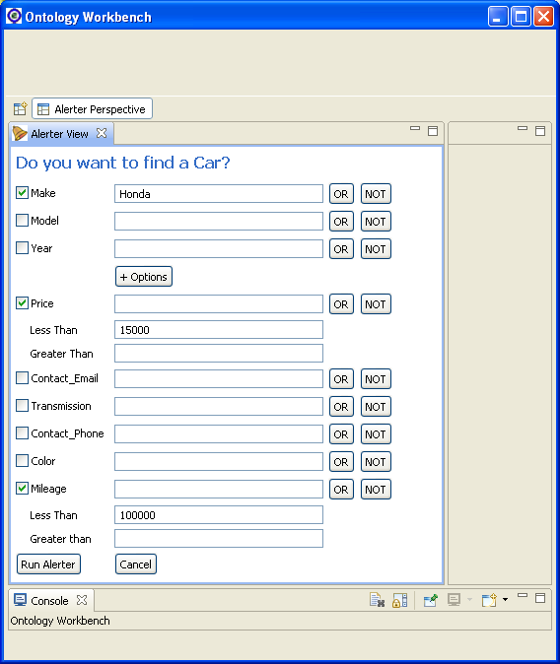
Alerter for www.craigslist.org

Slide 58
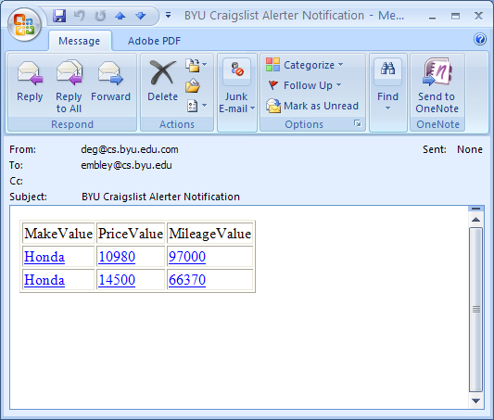
Alerter for www.craigslist.org

Slide 59
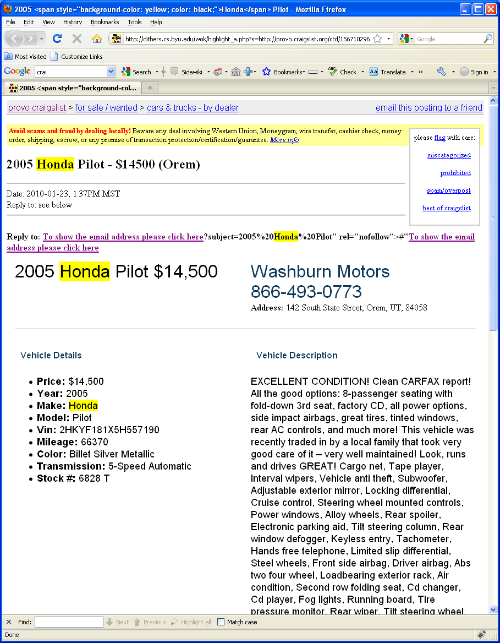
Alerter for www.craigslist.org

Slide 60
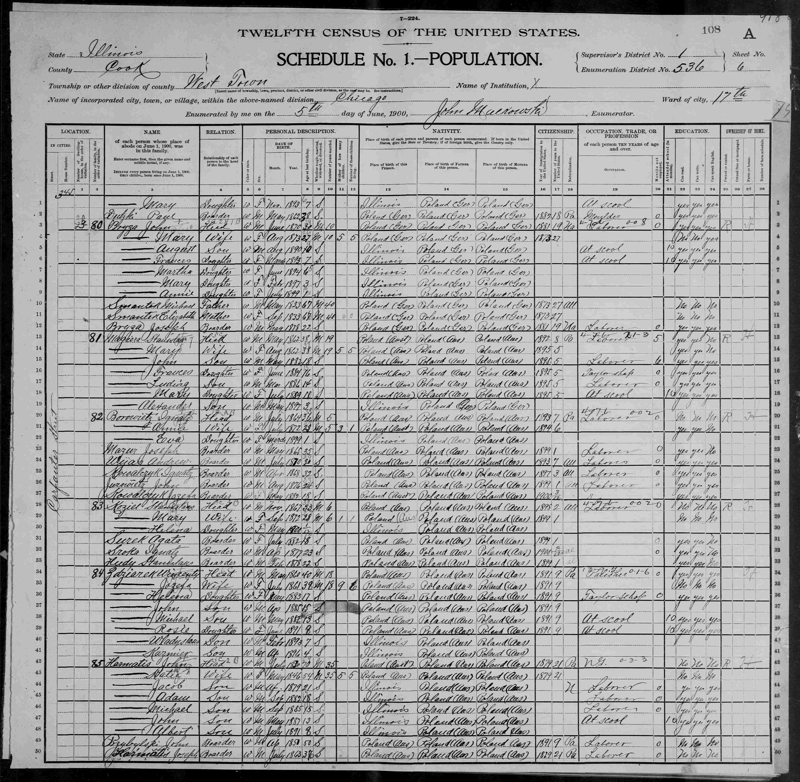
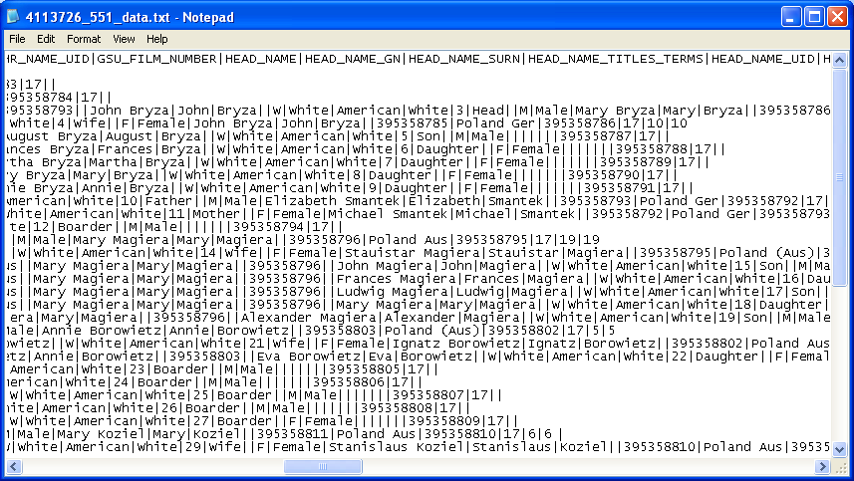
Reasoning Chains
Grounded in Annotated Instances
FamilySearch.org – Indexing
250 Million+ records indexed
√

Slide 61
Reasoning Chains
Grounded in Annotated Instances
FamilySearch.org – Indexing
250 Million+ records indexed
Person(x)isHusbandOfPerson(y) :- Person(x), Person(y), Person(x)hasGender(‘Male’), Person(x)hasRelationToHead(‘Head’),
Person(y)hasRelationToHead(‘Wife’), Person(x)isInSameFamilyAsPerson(y).
Person(x)isInSameFamilyAsPerson(y) :-
Person(x)hasFamilyNumber(z)inCensusRecord(w),
Person(y)hasFamilyNumber(z)inCensusRecord(w).
Person(x)named(y)isHusbandOfPerson(z)named(w) :- Person(x)isHusbandOfPerson(z),
Person(x)hasName(y), Person(z)hasName(w).
√

Slide 62
Reasoning Chains
Grounded in Annotated Instances
FamilySearch.org – Indexing
250 Million+ records indexed
Who is the husband of Mary Bryza?
Husband Name Wife Name
…
John Bryza Mary Bryza
…
Person(x)isHusbandOfPerson(y) :- Person(x), Person(y), Person(x)hasGender(‘Male’), Person(x)hasRelationToHead(‘Head’),
Person(y)hasRelationToHead(‘Wife’), Person(x)isInSameFamilyAsPerson(y).
Person(x)isInSameFamilyAsPerson(y) :-
Person(x)hasFamilyNumber(z)inCensusRecord(w),
Person(y)hasFamilyNumber(z)inCensusRecord(w).
Person(x)named(y)isHusbandOfPerson(z)named(w) :- Person(x)isHusbandOfPerson(z),
Person(x)hasName(y), Person(z)hasName(w).
√

Slide 63
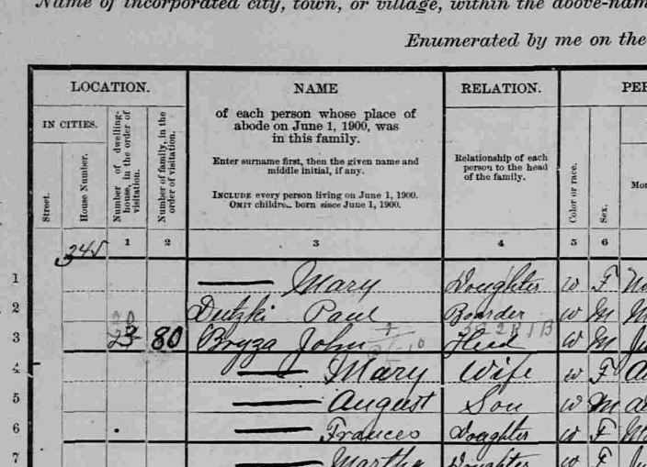
Reasoning Chains
Grounded in Annotated Instances
FamilySearch.org – Indexing
250 Million+ records indexed
Who is the husband of Mary Bryza?
Husband Name Wife Name
…
John Bryza Mary Bryza
…
Person(x)isHusbandOfPerson(y) :- Person(x), Person(y), Person(x)hasGender(‘Male’), Person(x)hasRelationToHead(‘Head’),
Person(y)hasRelationToHead(‘Wife’), Person(x)isInSameFamilyAsPerson(y).
Person(x)isInSameFamilyAsPerson(y) :-
Person(x)hasFamilyNumber(z)inCensusRecord(w),
Person(y)hasFamilyNumber(z)inCensusRecord(w).
Person(x)named(y)isHusbandOfPerson(z)named(w) :- Person(x)isHusbandOfPerson(z),
Person(x)hasName(y), Person(z)hasName(w).
√

Slide 64
Reasoning Chains
Grounded in Annotated Instances
Person(p1) named(‘John Bryza’) is husband of Person(p2) named(‘Mary Bryza’)
because:
Person(p1) is husband of Person(p2) and Person(p1) has Name(‘John Bryza’)
and Person(p2) has Name(‘Mary Bryza’);
and Person(p1) is husband of Person(p2)
because:
Person(p1) has gender(‘Male’) and Person(p1) has relation to Head(‘Head’),
and Person(p2) has relation to Head(‘Wife’)
and Person(p1) is in same family as Person(p2).
and Person(p1) is in same family as Person(p2)
because:
Person(p1) has family number(80) in Census Record(r1)
and Person(p2) has family number(80) in Census Record(r1).
FamilySearch.org – Indexing
250 Million+ records indexed
Who is the husband of Mary Bryza?
Husband Name Wife Name
…
John Bryza Mary Bryza
…
Person(x)isHusbandOfPerson(y) :- Person(x), Person(y), Person(x)hasGender(‘Male’), Person(x)hasRelationToHead(‘Head’),
Person(y)hasRelationToHead(‘Wife’), Person(x)isInSameFamilyAsPerson(y).
Person(x)isInSameFamilyAsPerson(y) :-
Person(x)hasFamilyNumber(z)inCensusRecord(w),
Person(y)hasFamilyNumber(z)inCensusRecord(w).
Person(x)named(y)isHusbandOfPerson(z)named(w) :- Person(x)isHusbandOfPerson(z),
Person(x)hasName(y), Person(z)hasName(w).
√

Slide 65
Reasoning Decidability & Tractability
“… extending OWL-DL with safe, positive Datalog rules preserves decidability of reasoning.” [Rosati, JWS05]
“… answering conjunctive queries (a.k.a. select-project-join queries) under DL-Lite … is polynomial …” [Cali,Gottlob,Pieris, ER09]
Further exploration
  Adjustments as issues are better understood
  Example: negation – “… guarded Datalog± is PTIME-complete …” [Cali,Gottlob,Lukasievicz, DL09]
Notes:
Safe, positive Datalog rules: Safe Datalog rule: A Datalog rule p :- q1, ..., qn. is safe (1) if every variable that occurs in a negated subgoal also appears in a positive subgoal and
(2) if every variable that appears in the head of the rule also appears in the body of the rule. [Rosati05]: Journal of Web Semantics
Full quote from Cali, et al. ER09: “In particular, answering conjunctive queries (a.k.a select-project-join queries under DL-Lite knowledge bases is polynomial in data complexity; it is actually better than polynomial, more precisely, it is in AC0 in data complexity, where AC0 is the complexity of recognizing words in languages defined by constant-depth Boolean circuits with an (unlimited fan-in) AND and OR gates.
Guarded Datalog+/-: A Datalog rules is “guarded” if it contains an atom in its body that contains all universally quantified variables. [Cali09]: 22nd Int’l Wkshp on Descr. Logics
PTIME-complete: complexity class that contains all decision problems … solved … using a polynomial amount of … time, i.e. polynomial time, also just called complexity class P.

Slide 66
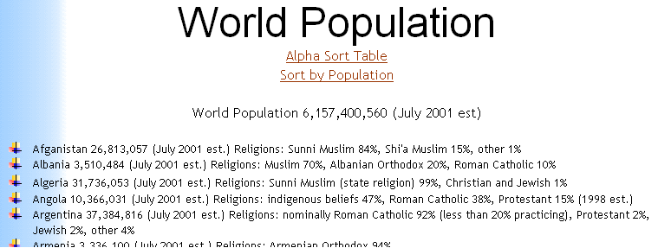
Knowledge Augmentation (TANGO)
Religion
Population Albanian Roman Shi’a Sunni
Country (July 2001 est.) Orthodox Muslim Catholic Muslim Muslim other
Afganistan 26,813,057 15% 84% 1%
Albania 3,510,484 20% 70% 30%

Slide 67
Construct Mini-Ontology
Religion
Population Albanian Roman Shi’a Sunni
Country (July 2001 est.) Orthodox Muslim Catholic Muslim Muslim other
Afganistan 26,813,057 15% 84% 1%
Albania 3,510,484 20% 70% 30%

Slide 68
Discover Mappings

Slide 69
Merge
resulting in augmented knowledge

Slide 70
Fact Finding and Organization for Research Studies
Example: A Bio-Research Study
Objective: Study the association of:
  TP53 polymorphism and
  Lung cancer
Task: Locate, Gather, Organize Data from:
  Single Nucleotide Polymorphism database
  Medical journal articles
  Medical-record database
Notes:
Doesn’t matter whether it is the essence of ACM-L or not – may be better to pitch it as one possible way to achieve Active Conceptual Modeling for Learning (ACM-L).

Slide 71
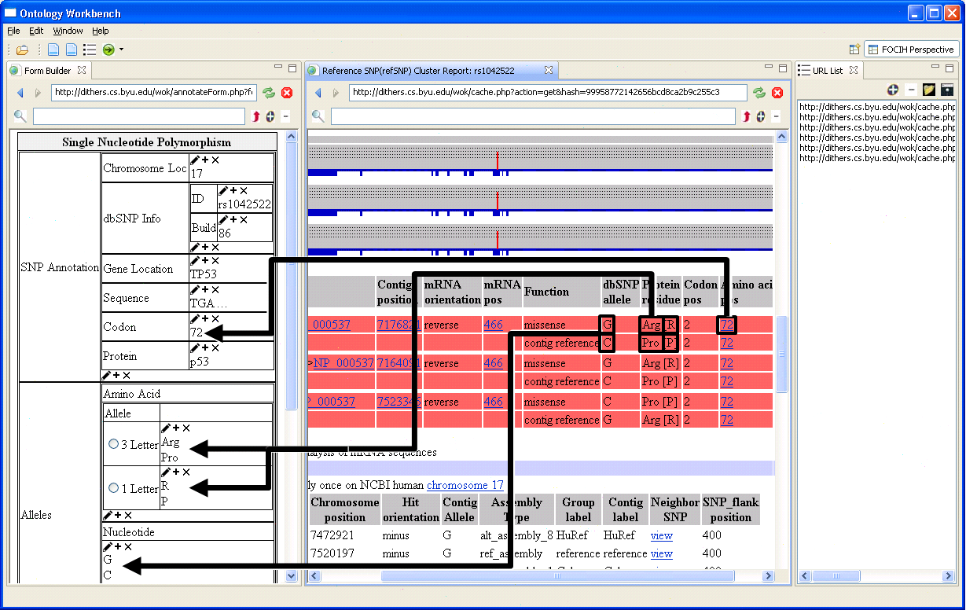
Gather SNP Information from the NCBI dbSNP Repository
SNP: Single Nucleotide Polymorphism
NCBI: National Center for Biotechnology Information
Notes:
Explain how FOCIH works. Also, how it will work when we add a filtering mechanism (e.g., minor allele frequency > 1%)

Slide 72

Search PubMed Literature
PubMed: Search-engine access to life sciences and biomedical scientific journal articles
Notes:
Works by linguistically grounding an extraction ontology. (e.g., people in the bioInformatics community may know about OpenDMAP)

Slide 73

Reverse-Engineer Human Subject Information from INDIVO
INDIVO: personally controlled health record system

Slide 74

Reverse-Engineer Human Subject Information from INDIVO
INDIVO: personally controlled health record system

Slide 75

Add Annotated Images
Radiology Report
(John Doe, July 19, 12:14 pm)

Slide 76

Query and Analyze Data in Knowledge Bundle

Slide 77
Summary, Conclusions & Future Work
WoK Vision
  Formalism: “as simple as possible, but no simpler”
  Valuable subcomponents
    Extraction ontologies (IR, alerter, search-engine enhancement)
    Reverse engineering (for understanding, for redesign and deployment)
    Knowledge bundles (for research studies, for sharing knowledge)
    Truth authentication (annotation, reasoning chains, provenance)
Scalability Issues
  System performance
    Decidable & tractable
    Parallel-processing opportunities
  Human input requirements
    Semi-automatic—burden shifted as much as possible to the system
    Synergistic incremental construction
      You “pay as you go”
      It “learns as it goes”
www.deg.byu.edu
Notes:
Formalism: theoretically elegant; Einstein
Valuable: makes the effort worthwhile even if the full vision is not attained.
Theoretically scalable.

