Slide 1
Think Globally
Research Proposal
Using data-extraction ontologies for multi-lingual interaction with a mono-lingual web service
A multi-lingual personal concierge for foreign visitors to Japan
Kwansei Gakuin University
Dept. of Applied Informatics
Geng Zhichen
Act Locally

Slide 2
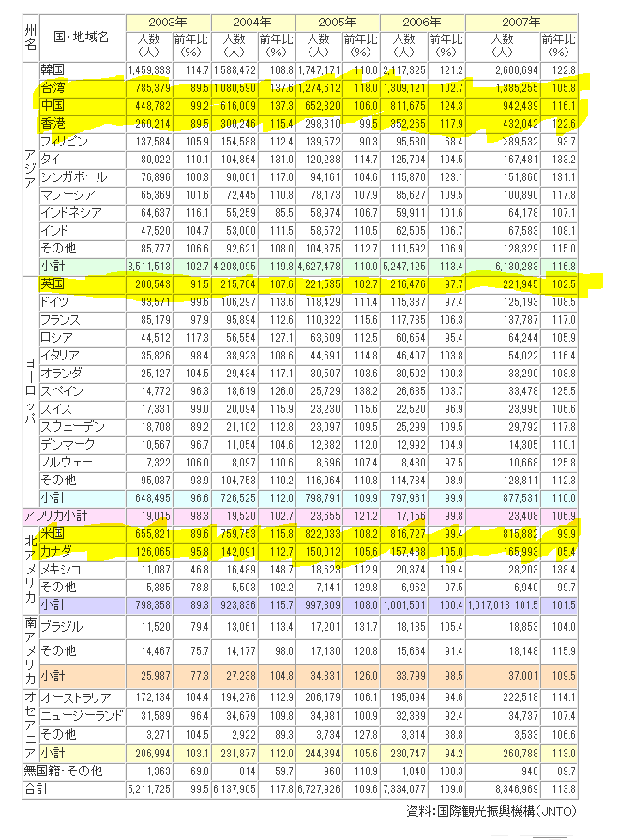
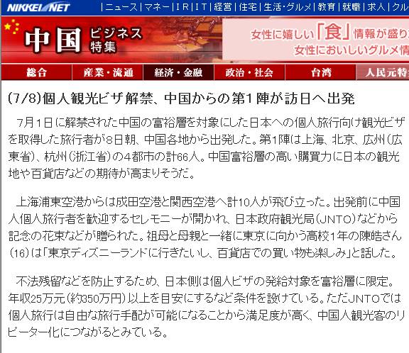
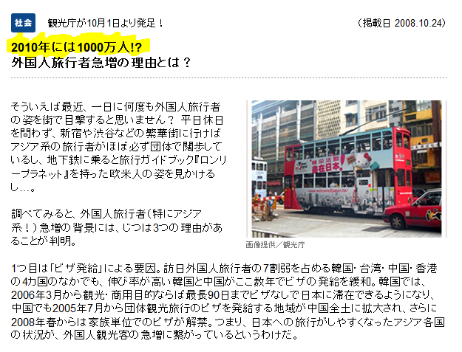
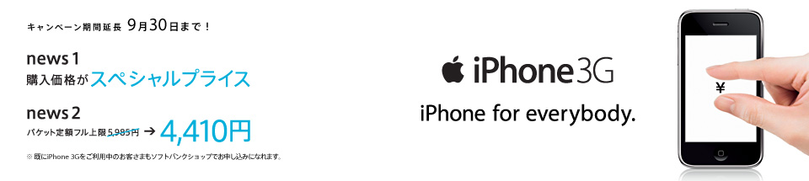
bACKGROUND
Most internet users in Japan are mobile users.
This project is conceptualized to fill an specific need in the tourism industry.
Japan’s broadband wireless networks and hand-held mobile devices functionality are second to none in the world.
China and Japan recently relaxed their regulations for personal travel to Japan by Chinese nationals. While the personal economic power keeps on increasing parallel to China’s economic surge.
The number of foreign visitors to Japan increases every year.
Over 70% foreign visitors are either Chinese or English speakers.

Slide 3
2.Conceptual design
Natural
Language
Interface
Multilingual
Original Application
Ease of use

Slide 4
3. main Target users
Foreign visitors to Japan who do not speak Japanese.
Start with Chinese and English to cover 70% of the cases
Short-stay visitors who do not qualify for local mobile phone contracts, but need to get around on their own.

Slide 5
4.Motivation
Develop a truly multi-lingual semantic web application
Experiment with the usability of domain-specific data-extraction ontologies in the tourist industry in Japan
Help ease the language barrier burden of short-stay foreign visitors to Japan
Demonstrate that data-extraction ontologies can be a RAD platform for multilingual semantic web applications

Slide 6
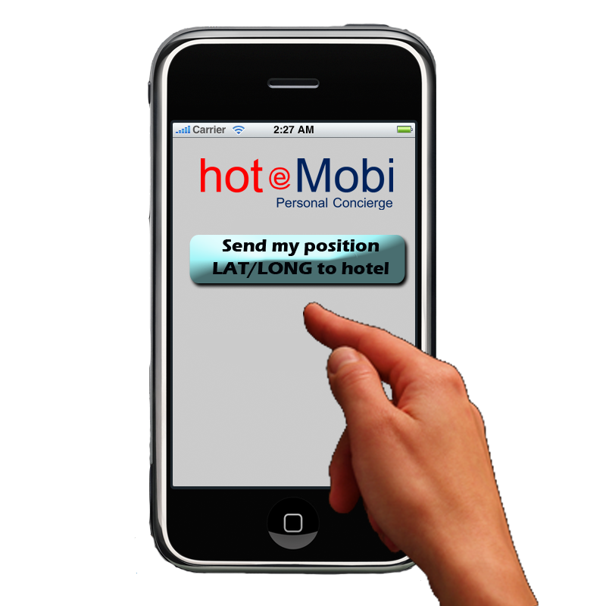
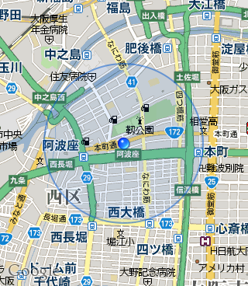


5.1業務内容
大阪城に行きたい
想去大阪城
I wanna go to Osaka Castle
出発地はどこですか：
1.現在地から（GPS）
2.ホテルから
その他：（入力）
从哪里出发：
1.现在地出发（GPS）
2.酒店出发
其他(输入)
From：
1.Here（GPS）
2.Hotel
Other(Input)
I lost my wallet! ! Can you send someone to bring me back to hotel?
Take me to famous tourist spots
Tell me more about this destination
Recommend dining a wining spots
Take back to the hotel
Other visitor related assistance
Emergency assistance
多国語
自然言語
【現在地を押す】
【按下现在地】
【Press here】
現在地から、大阪城までの経由情報：
从现在地到大阪城的路经情报：
The route from here to Osaka Castle：
最寄駅 なんば まで歩く約５分 地図
電車 - 大阪市営御堂筋線・千里中央行
12:42 なんば 発
2分
12:44 心斎橋 着
電車 - 大阪市営長堀鶴見緑地線・門真南行
5分で乗換
12:49 心斎橋 発
10分
12:59 大阪ビジネスパーク 着
大阪府大阪市中央区大阪城１−１ まで歩く約 10分 地図
その他のルート（時間条件指定）
到最近站 难波(なんば) 徒步约5分钟 地图
地铁- 大阪市营御堂筋线 – 千里中央方向
(電車 - 大阪市営御堂筋線・千里中央行)
12:42 出发 难波 (なんば)
2分
12:44 到达 心斋桥 (心斎橋)
地铁 –大阪市营长掘鹤见绿地线 – 门真南方向
電車 - 大阪市営長堀鶴見緑地線・門真南行
5分钟换乘
12:49 出发 心斋桥 (心斎橋)
10分
12:59 到达 大阪商业公园 (大阪ビジネスパーク)
到大阪府大阪市中央区大阪城１−１ 徒步约 10分 地图
其他条件检索
To nearest station Nanba(なんば) Walk about 5 min MAP
Subway- Osaka suji-line
(電車 - 大阪市営御堂筋線・千里中央行)
12:42 depart Nanba (なんば)
2Min
12:44 Arrive Shinsaibashi (心斎橋)
Subway – Osaka Nakahoriturumityokuti line
電車 - 大阪市営長堀鶴見緑地線・門真南行
5min change
12:49 depart Shinsaibashi (心斎橋)
10分
12:59 Arrive OsakaBusinessPark (大阪ビジネスパーク)
To Osaka Castle walk about 10 min MAP
Use other condition
ホテル
Where are you?
？
？
？
？
大阪駅周辺のお店、施設など：
飲食店 ホテル レンタカー ＜カテゴリ一覧＞
大阪站附近的饮食店,设施等：
饮食店 酒店 租车 ＜目录一览＞
Restaurants or others near by Osaka Castle：
Restaurant Hotel RentCar ＜Category＞
大阪城に行きたい
We got your position.
We’ll send staff to pick you up.
I don’t know!!!

Slide 7
5.2 System components
Browser
(Web or mobile)
Location-based Semantic Web Servers
Data-extraction ontologies
Existing Web Services
Other web applications like recommender systems

Slide 8
6.Potential Commercial Interests
Hotels become the local semantic web service provider and increases local revenue sources through local partnerships
Can provide a new revenue source to the saturated mobile carrier markets of Japan

Slide 9
7.スケジュール
Develop a proof of concept by the end of October 2009
Develop a fully featured alpha system that can handle queries in Japanese, English and Chinese by June 2010
Complete alpha testing by September 2010
Start a beta test with selected clients after successful completion of alpha test on September 2010
Introduce other languages such as Korean as needed, thereafter

Slide 10
終わり End 末端 끝
ありがとうございます。
Thank you very much.
谢谢您
감사합니다

