Slide 1
Pragmatic Quality Assessment for Automatically Extracted Data
Scott N. Woodfield, Deryle W. Lonsdale,
Stephen W. Liddle, Tae Woo Kim,
David W. Embley, and Christopher Almquist

Slide 2
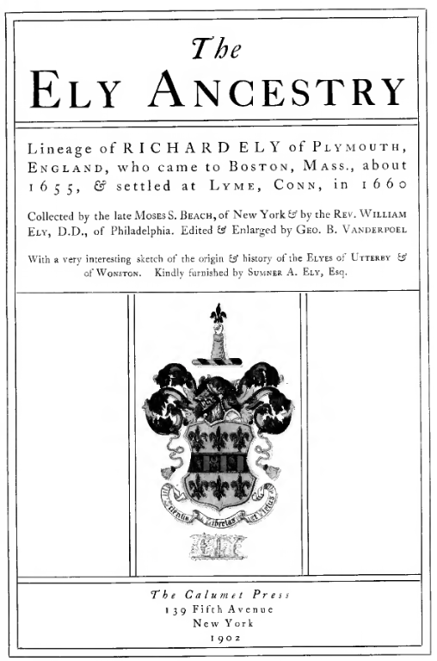
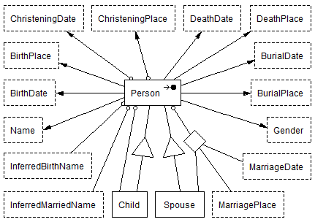
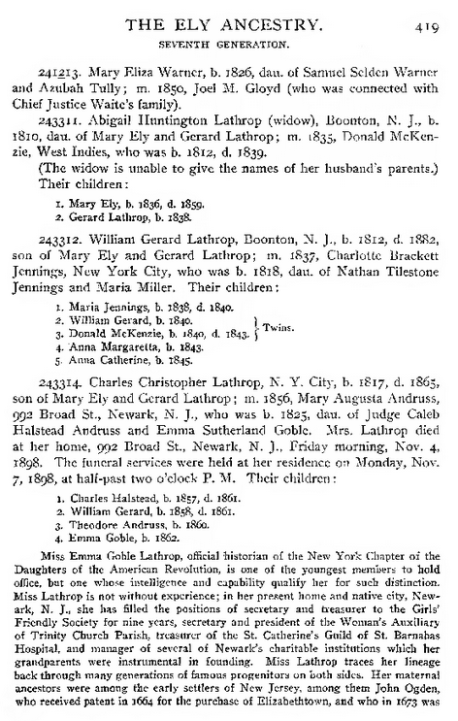
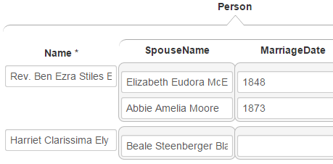
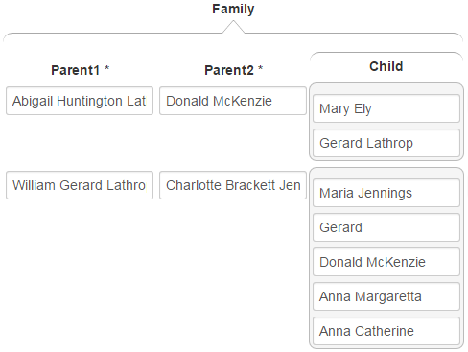
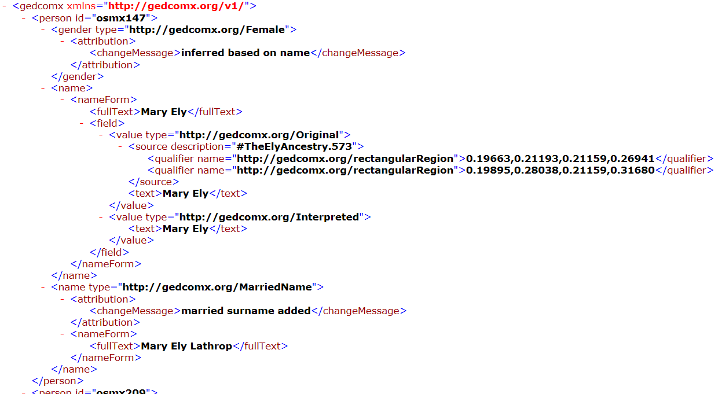
Model-Based Architecture
COMET
FROntIER
ListReader
OntoSoar
GreenFIE
Notes:
Overview of Project
Don’t skip the model
Even automated extractors make mistakes – often silly ones
Manual Correction with COMET
NOTE: this is our opportunity to tie this paper to the conference theme
NOTE: use term GEDCOMX, note that it’s industry standard for this domain

Slide 3
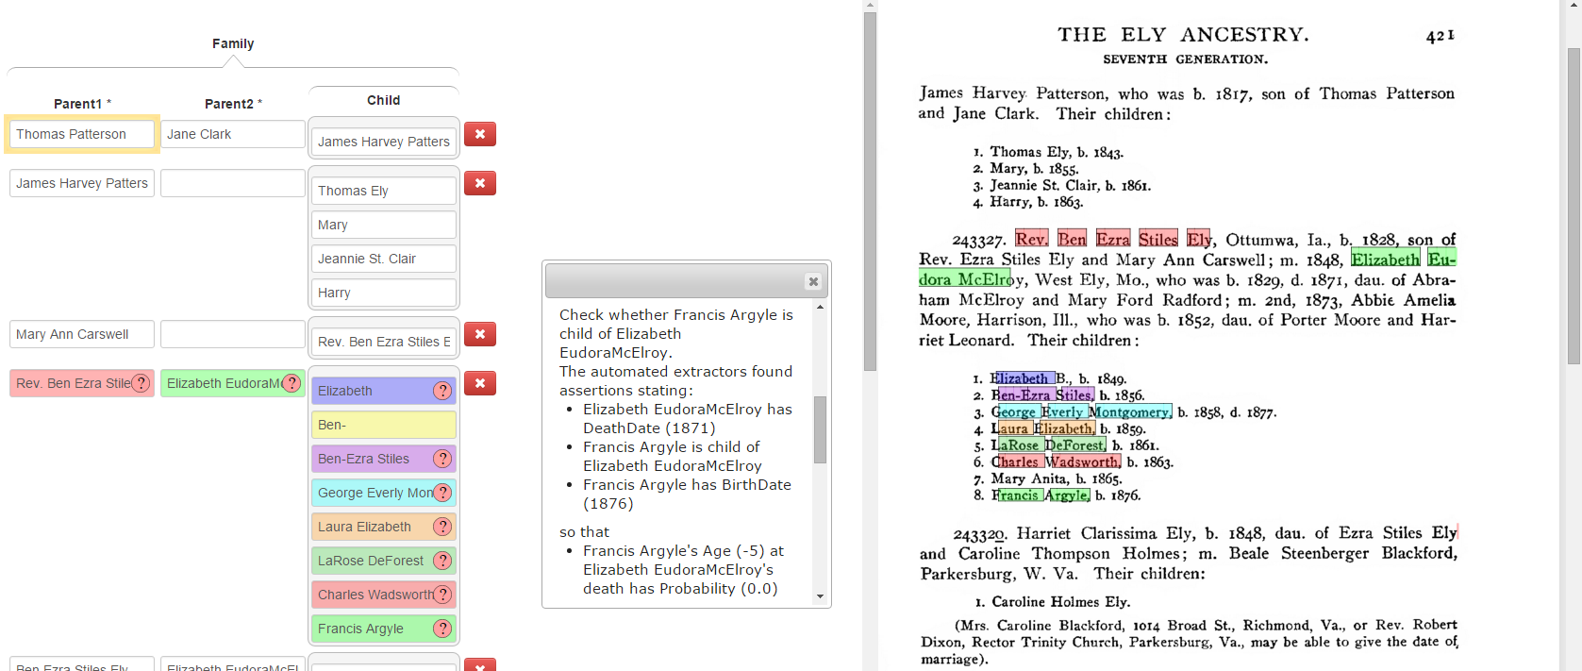
COMET
Notes:
The color coding helps but it is still difficult to manually extract information with pieces spread all over the page
It would be nice if we could automatically detect problems and suggest them to the human inspector
NOTE: say “manual validation”, not “manual extraction” – we’ve done some automated extraction using the previous slide’s four extractors

Slide 4
The Constraint Enforcer
Model
FROntIER
Constraint
Enforcer
ListReader
OntoSoar
GreenFIE

Slide 5
Problems with Constraints
Valid model assumption
  Constraint: Mother can only have 1 to 15 children
  But: We extract a mother with 16 children
Under-constrained models
  -- Proposed solution: Mother can have 1 or more children
  -- Problem: Under-constrained or unconstrained model
Crisp logic required by first-order based logic definitions of models
  A mother can have a child at 44 but not at 45
General constraints are often difficult to automatically translate and execute
  A person can’t be their own ancestor
Notes:
Based on the assumption of model validity if a mother has more then 15 children we can only record 15 of them
Over-relaxation, a common solution but it yields an under-constrained and in some cases an unconstrained model
The crisp nature of constraints because of the formal definition of conceptual models using predicate logic
.5% at age 44, .2% at age 45 – not exact numbers

Slide 6
Problem Solutions
Extract all information before checking it
  Extracted information may be invalid
    We can extract and store the 16 children of a mother
  Constraints can be written as “realistic” constraints
    A mother may have at most 15 children
    Checked and handled later
Allow for probabilistic constraints by adding distributions, thresholds, and cutoffs
  Constraints need not be “crisp”
  The probability that a mother has a child at age 50 or greater is 1%

Slide 7
General Constraint Example
  Use Datalog type syntax to express general constraints
    Person(p) has DeathDate(dd),
    Child(c) is child of Person(p),
    Person(c) has BirthDate(bd),
    Difference(dd, bd, childsAgeAtParentsDeath),
    CheckProbabilityOf(childsAgeAtParentsDeath, probability) ⇒
    HandleChildsAgeAtParentsDeath(antecedents, probability)
Notes:
Parent(x) of Child(y) ⇒ Ancestor(x,y);
Parent(a) of Child(b), Ancestor(b,c) ⇒ Ancestor(a, c);
Ancestor(x,x), CheckProbabilityOfPersonBeingOwnAncestor(x,p) ⇒
HandlePersonIsOwnAncestor(rules, x, p)

Slide 8
Architecture
Constraint
has
0:*
Checker
1
1:*
1:*
has
Handler
0:*
Notes:
NOTE: don’t say “constraint is true”, say “constraint holds”

Slide 9
Handler Capabilities
If a conclusion is false, it follows that one of the antecedents is false
Use of general constraint rules with their antecedents allows us to
  Produce hints as to where a human might look for sources of errors
  Intelligently and automatically retract erroneous antecedence
Notes:
Talk about antecedents first to identify sources of errors

Slide 10
Use of Rule Antecedents

Slide 11
Evaluation Setup
Generation of constraints
  Cardinality constraints in the model
  Examined set of pages from 3 source books to identify needed general constraints
Creation of a blind test set consisting of 4 different pages from the same 3 books

Slide 12
  How Well Does The Constraint Checker Identify All Constraint Violations
Calculation
  Identified all violations
  Identified all actual violations caught by constraint enforcer
  Identified all violations caught by the constraint enforcer that were not real violations
  From this we computed precision, recall, and the F-score
Results
Precision | Recall | F-score
100 | 81 | 90
Notes:
First list contained true and false positives
True-positives = pre-list – post-list
False-positives = pre-list ∩ post-list
|Positives| = all violations

Slide 13
  Can We Automatically Improve The Quality Of The Extracted Information?
For every general constraint violation we removed all of the antecedent-based assertions from the information base and re-ran the constraint checker
Results
 | Precision | Recall | F-score
Original | 71.4 | 62.4 | 66.6
Post-removal | 70.4 | 59.4 | 64.4
Notes:
Number of false positives did decrease
But, the number of true positives also decreased
NOTE: don’t dwell on the naïve method that didn’t work; propose alternative possibilities that we’ll explore in future work

Slide 14
Discovery of Other Quality Improvement Heuristics
If children have two sets of parents, choose the one that is closest textually
Check relation incorrectness before date incorrectness

Slide 15
Summary
The constraint enforcer is fast and precise but does not find all constraint violations
  We need to find other useful constraints
Automatic quality improvement is a work in progress
  The intelligence of the assertion retraction engine needs to be improved

