Slide 1
Extracting and Organizing Facts of Interest from OCRed Historical Documents
Joseph S. Park and David W. Embley
Brigham Young University

Slide 2
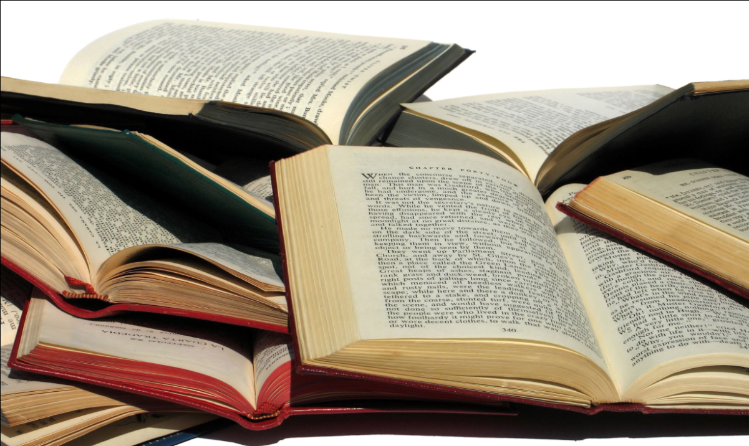
Motivation
Large collection of scanned, OCRed books
  Stated facts
Implied facts
  Inferred
  Same-as
  (entities)

Slide 3
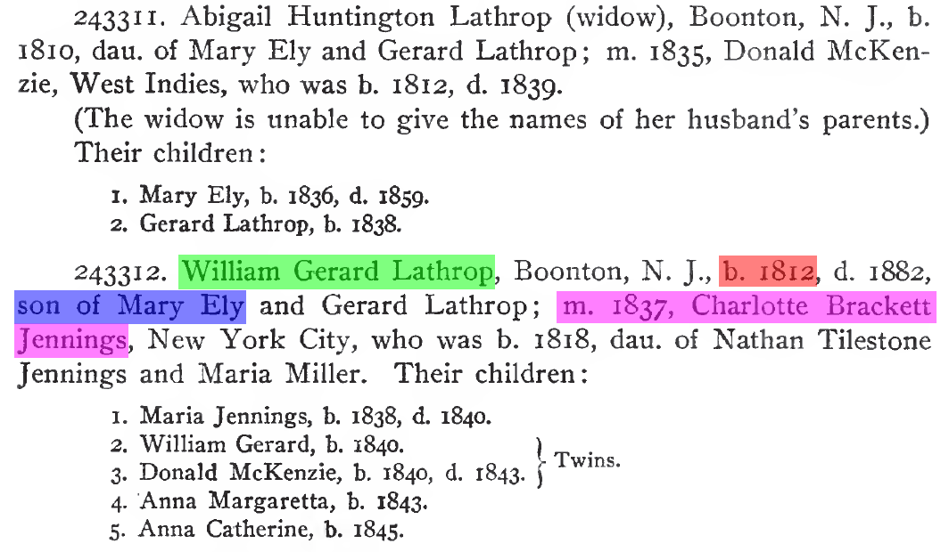
Stated Facts of Interest
William Gerard Lathrop
  married Charlotte Brackett Jennings in 1837
  is the son of Mary Ely
  was born in 1812

Slide 4
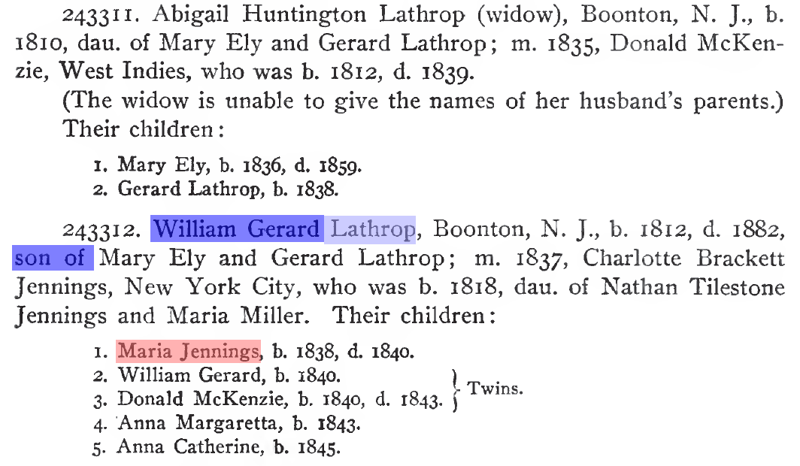
Inferred Facts of Interest
William Gerard Lathrop has gender Male
Maria Jennings has gender Female
Maria Jennings has surname Lathrop

Slide 5
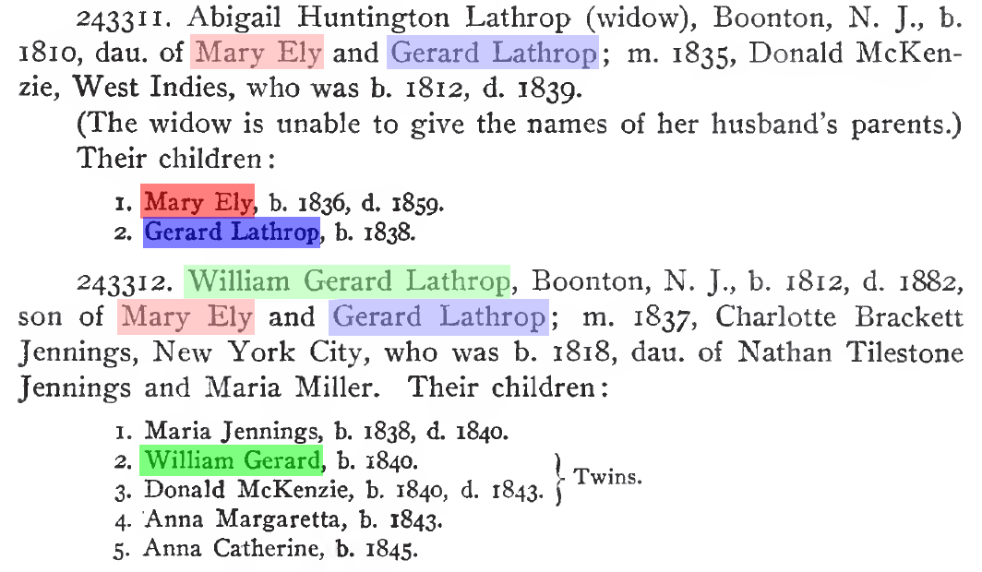
Same-as (Entities)
William Gerard Lathrop
Gerard Lathrop
Mary Ely

Slide 6
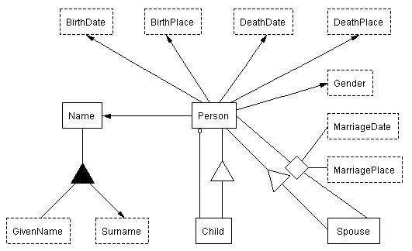
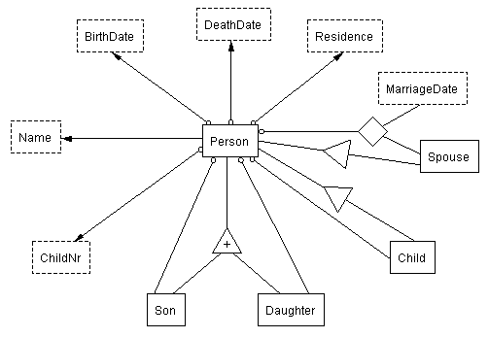
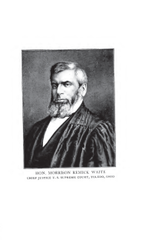
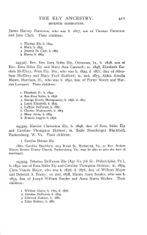
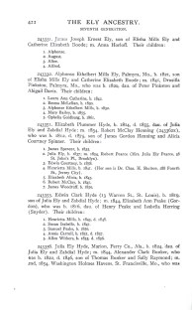
FROntIER
<owl:Thing rdf:ID="Person_1"/>
<owl:Thing rdf:about="#Person_1">
<rdf:type rdf:resource="&family;Person"/>
<rdf:type rdf:resource="&family;Child"/>
<rdf:type rdf:resource="&family;Spouse"/>
</owl:Thing>
<owl:Thing rdf:ID="Name_1"/>
<owl:Thing rdf:about="#Name_1">
<rdf:type rdf:resource="&family;Name"/>
</owl:Thing>
<owl:Thing rdf:ID="GivenName_1"/>
<owl:Thing rdf:about="#GivenName_1">
<rdf:type rdf:resource="&family;GivenName"/>
</owl:Thing>
<rdf:Description rdf:about="#GivenName_1">
<family:GivenNameValue rdf:datatype="&xsd;string">Abigail</family:GivenNameValue>
</rdf:Description>
<owl:Thing rdf:ID="GivenName_2"/>
<owl:Thing rdf:about="#GivenName_2">
<rdf:type rdf:resource="&family;GivenName"/>
</owl:Thing>
<rdf:Description rdf:about="#GivenName_2">
<family:GivenNameValue rdf:datatype="&xsd;string">Huntington</family:GivenNameValue>
</rdf:Description>
<owl:Thing rdf:ID="Surname_1"/>
<owl:Thing rdf:about="#Surname_1">
<rdf:type rdf:resource="&family;Surname"/>
</owl:Thing>
<rdf:Description rdf:about="#Surname_1">
<family:SurnameValue rdf:datatype="&xsd;string">Lathrop</family:SurnameValue>
</rdf:Description>
<owl:Thing rdf:ID="BirthDate_1"/>
<owl:Thing rdf:about="#BirthDate_1">
<rdf:type rdf:resource="&family;BirthDate"/>
</owl:Thing>
<rdf:Description rdf:about="#BirthDate_1">
<family:BirthDateValue rdf:datatype="&xsd;date">1810-00-00</family:BirthDateValue>
</rdf:Description>
<owl:Thing rdf:ID="MarriageDate_1"/>
<owl:Thing rdf:about="#MarriageDate_1">
<rdf:type rdf:resource="&family;MarriageDate"/>
</owl:Thing>
<rdf:Description rdf:about="#MarriageDate_1">
<family:MarriageDateValue rdf:datatype="&xsd;date">1835-00-00</family:MarriageDateValue>
</rdf:Description>
<owl:Thing rdf:ID="Gender_1"/>
<owl:Thing rdf:about="#Gender_1">
<rdf:type rdf:resource="&family;Gender"/>
</owl:Thing>
<rdf:Description rdf:about="#Gender_1">
<family:GenderValue rdf:datatype="&xsd;string">Female</family:GenderValue>
</rdf:Description>
<rdf:Description rdf:about="#Person_1">
<family:Person-BirthDate rdf:resource="#BirthDate_1"/>
<family:Person-Name rdf:resource="#Name_1"/>
<family:Person-Gender rdf:resource="#Gender_1"/>
<family:Person-Child rdf:resource="#Person_5"/>
<family:Person-Child rdf:resource="#Person_6"/>
</rdf:Description>
<rdf:Description rdf:about="#Name_1">
<family:Name-GivenName rdf:resource="#GivenName_1"/>
<family:Name-GivenName rdf:resource="#GivenName_2"/>
<family:Name-Surname rdf:resource="#Surname_1"/>
</rdf:Description>
<owl:Thing rdf:ID="PersonMarriageDateMarriagePlaceSpouse_1"/>
<rdf:Description rdf:about="#PersonMarriageDateMarriagePlaceSpouse_1">
<family:PersonMarriageDateMarriagePlaceSpouse-Person rdf:resource="#Person_1"/>
<family:PersonMarriageDateMarriagePlaceSpouse-Spouse rdf:resource="#Person_4"/>
<family:PersonMarriageDateMarriagePlaceSpouse-MarriageDate rdf:resource="#MarriageDate_1"/>
</rdf:Description>
RDF output
convert to RDF
Jena reasoner
parameters
comparators
OntoES
convert to csv
owl:sameAs
Duke
[(?x rdf:type source:Person) -> (?x rdf:type target:Person)]
[(?x source:Person-Name ?n),(?n source: NameValue ?nv),
isMale(?nv),makeTemp(?gender)
-> (?x target:Person-Gender ?gender),(?gender rdf:type target:Gender),
(?gender target:GenderValue `Male'^^xsd:string)]

Slide 7
FROntIER
<owl:Thing rdf:ID="Person_1"/>
<owl:Thing rdf:about="#Person_1">
<rdf:type rdf:resource="&family;Person"/>
<rdf:type rdf:resource="&family;Child"/>
<rdf:type rdf:resource="&family;Spouse"/>
</owl:Thing>
<owl:Thing rdf:ID="Name_1"/>
<owl:Thing rdf:about="#Name_1">
<rdf:type rdf:resource="&family;Name"/>
</owl:Thing>
<owl:Thing rdf:ID="GivenName_1"/>
<owl:Thing rdf:about="#GivenName_1">
<rdf:type rdf:resource="&family;GivenName"/>
</owl:Thing>
<rdf:Description rdf:about="#GivenName_1">
<family:GivenNameValue rdf:datatype="&xsd;string">Abigail</family:GivenNameValue>
</rdf:Description>
<owl:Thing rdf:ID="GivenName_2"/>
<owl:Thing rdf:about="#GivenName_2">
<rdf:type rdf:resource="&family;GivenName"/>
</owl:Thing>
<rdf:Description rdf:about="#GivenName_2">
<family:GivenNameValue rdf:datatype="&xsd;string">Huntington</family:GivenNameValue>
</rdf:Description>
<owl:Thing rdf:ID="Surname_1"/>
<owl:Thing rdf:about="#Surname_1">
<rdf:type rdf:resource="&family;Surname"/>
</owl:Thing>
<rdf:Description rdf:about="#Surname_1">
<family:SurnameValue rdf:datatype="&xsd;string">Lathrop</family:SurnameValue>
</rdf:Description>
<owl:Thing rdf:ID="BirthDate_1"/>
<owl:Thing rdf:about="#BirthDate_1">
<rdf:type rdf:resource="&family;BirthDate"/>
</owl:Thing>
<rdf:Description rdf:about="#BirthDate_1">
<family:BirthDateValue rdf:datatype="&xsd;date">1810-00-00</family:BirthDateValue>
</rdf:Description>
<owl:Thing rdf:ID="MarriageDate_1"/>
<owl:Thing rdf:about="#MarriageDate_1">
<rdf:type rdf:resource="&family;MarriageDate"/>
</owl:Thing>
<rdf:Description rdf:about="#MarriageDate_1">
<family:MarriageDateValue rdf:datatype="&xsd;date">1835-00-00</family:MarriageDateValue>
</rdf:Description>
<owl:Thing rdf:ID="Gender_1"/>
<owl:Thing rdf:about="#Gender_1">
<rdf:type rdf:resource="&family;Gender"/>
</owl:Thing>
<rdf:Description rdf:about="#Gender_1">
<family:GenderValue rdf:datatype="&xsd;string">Female</family:GenderValue>
</rdf:Description>
<rdf:Description rdf:about="#Person_1">
<family:Person-BirthDate rdf:resource="#BirthDate_1"/>
<family:Person-Name rdf:resource="#Name_1"/>
<family:Person-Gender rdf:resource="#Gender_1"/>
<family:Person-Child rdf:resource="#Person_5"/>
<family:Person-Child rdf:resource="#Person_6"/>
</rdf:Description>
<rdf:Description rdf:about="#Name_1">
<family:Name-GivenName rdf:resource="#GivenName_1"/>
<family:Name-GivenName rdf:resource="#GivenName_2"/>
<family:Name-Surname rdf:resource="#Surname_1"/>
</rdf:Description>
<owl:Thing rdf:ID="PersonMarriageDateMarriagePlaceSpouse_1"/>
<rdf:Description rdf:about="#PersonMarriageDateMarriagePlaceSpouse_1">
<family:PersonMarriageDateMarriagePlaceSpouse-Person rdf:resource="#Person_1"/>
<family:PersonMarriageDateMarriagePlaceSpouse-Spouse rdf:resource="#Person_4"/>
<family:PersonMarriageDateMarriagePlaceSpouse-MarriageDate rdf:resource="#MarriageDate_1"/>
</rdf:Description>
RDF output
convert to RDF
Jena reasoner
parameters
comparators
OntoES
convert to csv
owl:sameAs
Duke
[(?x rdf:type source:Person) -> (?x rdf:type target:Person)]
[(?x source:Person-Name ?n),(?n source: NameValue ?nv),
isMale(?nv),makeTemp(?gender)
-> (?x target:Person-Gender ?gender),(?gender rdf:type target:Gender),
(?gender target:GenderValue `Male'^^xsd:string)]

Slide 8
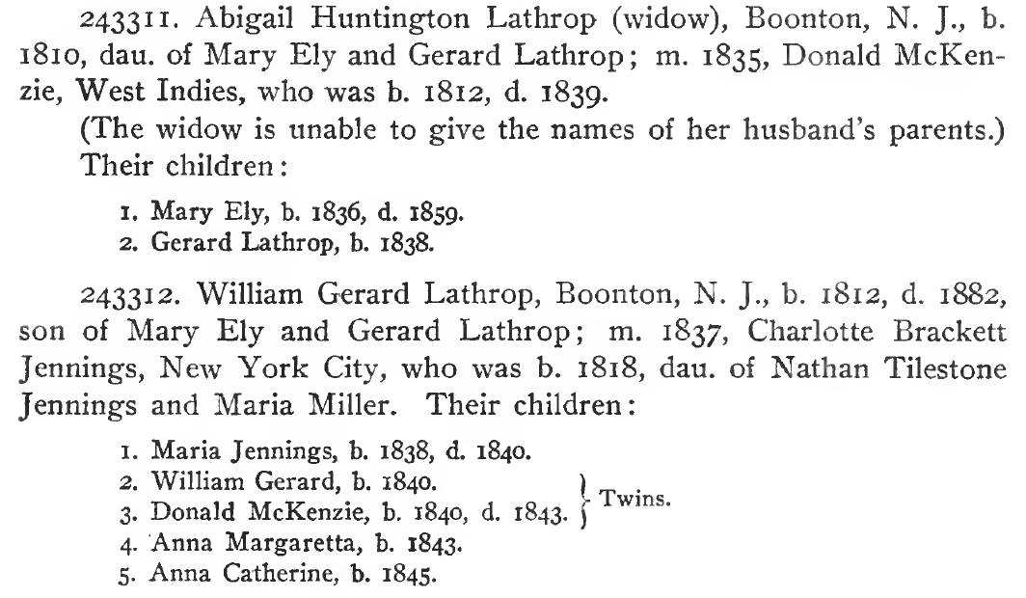
Extraction Ontologies
Conceptual model
Instance recognizers

Slide 9
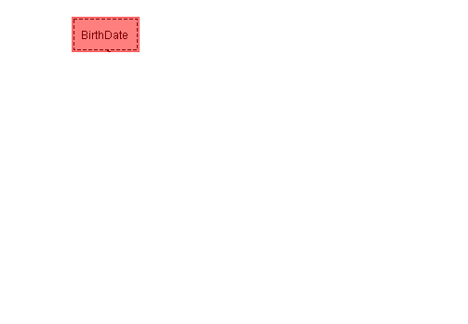
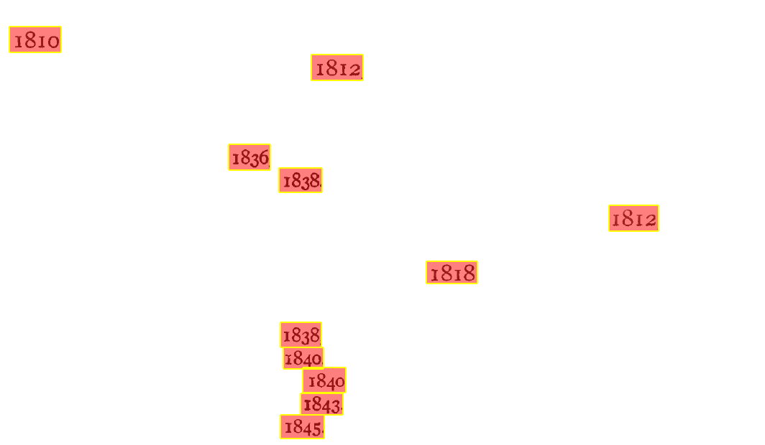
Lexical Object-Set Recognizers
BirthDate
external representation: \b[1][6-9]\d\d\b
left context: b\.\s
right context: [.,]
…

Slide 10
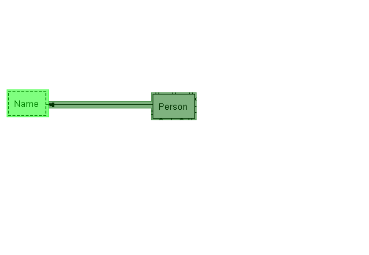
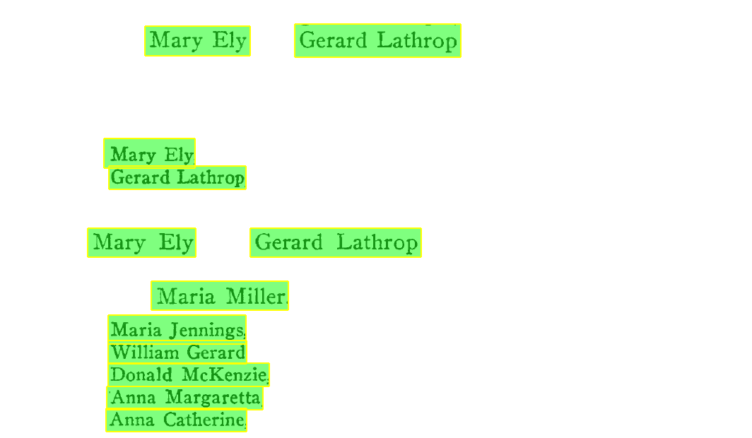
Non-lexical Object-Set Recognizers
Person
object existence rule: {Name}
…
Name
external representation: \b{FirstName}\s{LastName}\b
…

Slide 11
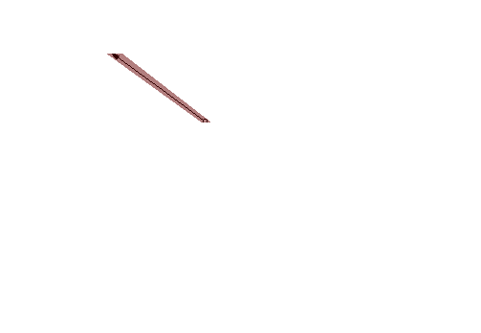
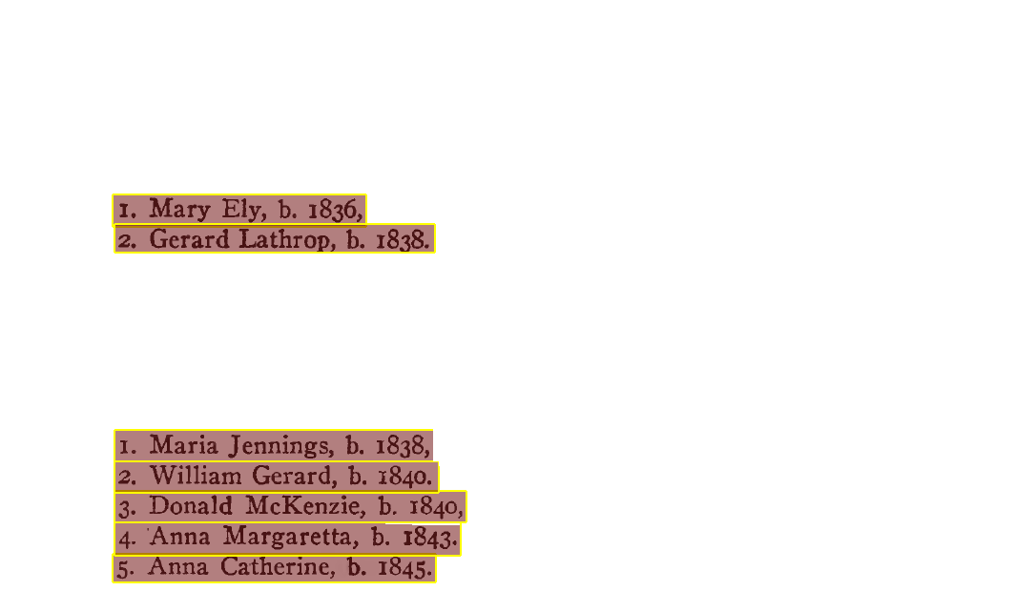
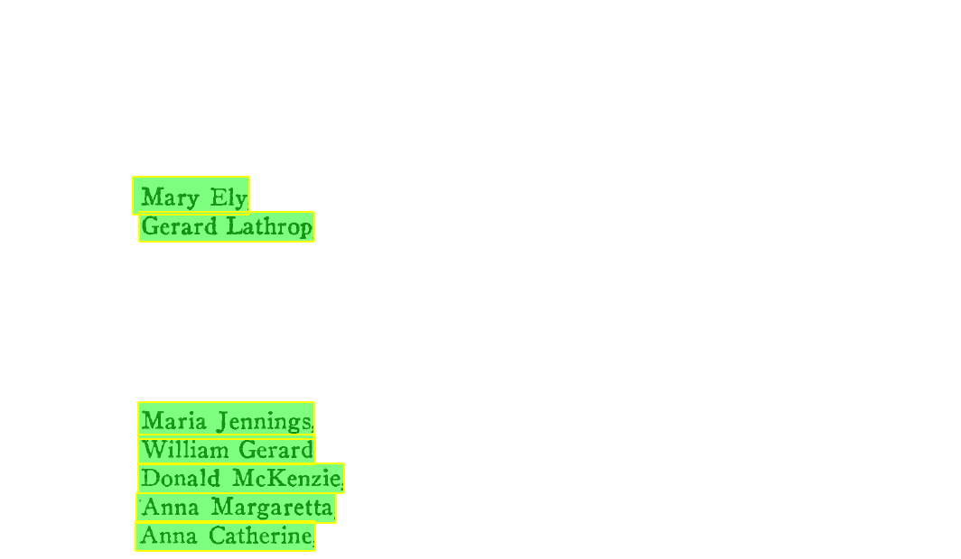
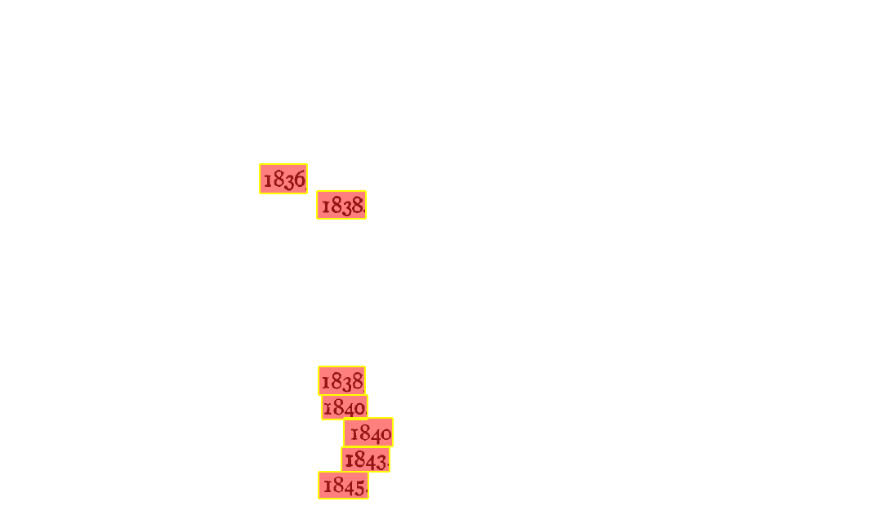
Relationship-set Recognizers
Person-BirthDate
external representation: ^\d{1,3}\.\s{Person},\sb\.\s{BirthDate}[.,]
…

Slide 12
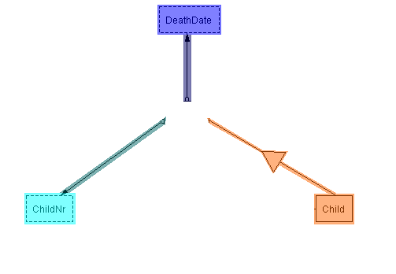
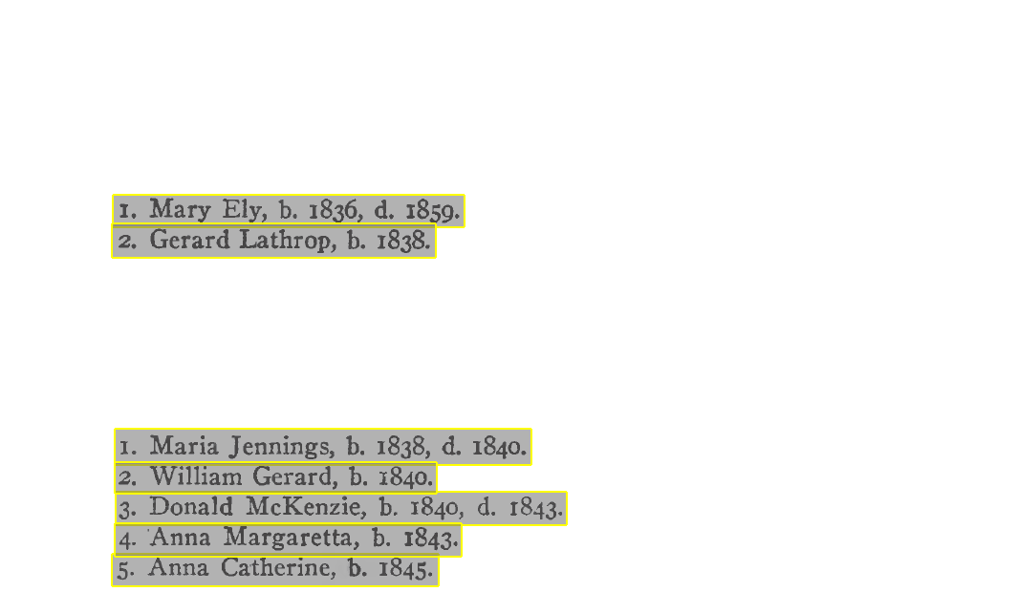

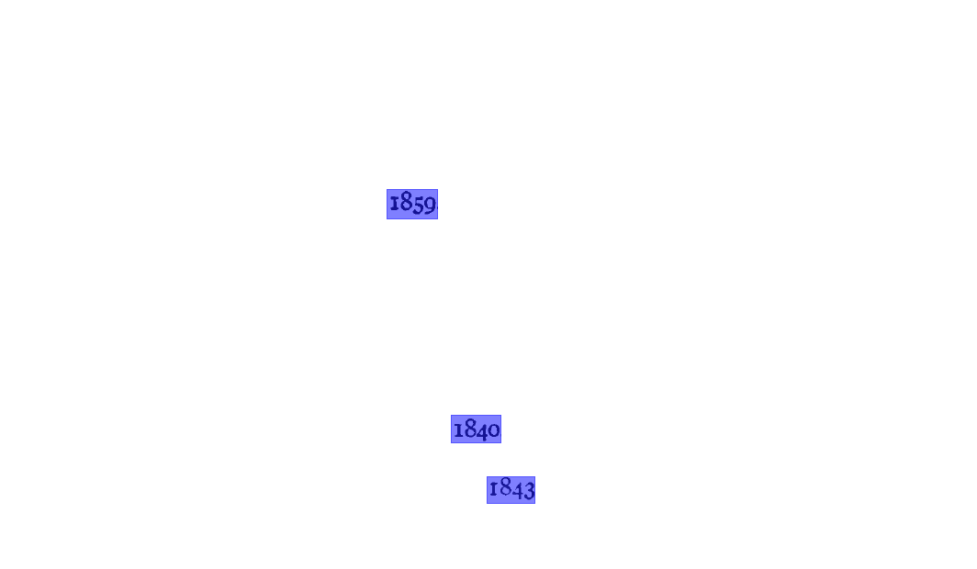
Ontology-snippet Recognizers
ChildRecord
external representation: ^(\d{1,3})\.\s+([A-Z]\w+\s[A-Z]\w+)
(,\sb\.\s([1][6-9]\d\d))?(,\sd\.\s([1][6-9]\d\d))?\.

Slide 13
FROntIER
<owl:Thing rdf:ID="Person_1"/>
<owl:Thing rdf:about="#Person_1">
<rdf:type rdf:resource="&family;Person"/>
<rdf:type rdf:resource="&family;Child"/>
<rdf:type rdf:resource="&family;Spouse"/>
</owl:Thing>
<owl:Thing rdf:ID="Name_1"/>
<owl:Thing rdf:about="#Name_1">
<rdf:type rdf:resource="&family;Name"/>
</owl:Thing>
<owl:Thing rdf:ID="GivenName_1"/>
<owl:Thing rdf:about="#GivenName_1">
<rdf:type rdf:resource="&family;GivenName"/>
</owl:Thing>
<rdf:Description rdf:about="#GivenName_1">
<family:GivenNameValue rdf:datatype="&xsd;string">Abigail</family:GivenNameValue>
</rdf:Description>
<owl:Thing rdf:ID="GivenName_2"/>
<owl:Thing rdf:about="#GivenName_2">
<rdf:type rdf:resource="&family;GivenName"/>
</owl:Thing>
<rdf:Description rdf:about="#GivenName_2">
<family:GivenNameValue rdf:datatype="&xsd;string">Huntington</family:GivenNameValue>
</rdf:Description>
<owl:Thing rdf:ID="Surname_1"/>
<owl:Thing rdf:about="#Surname_1">
<rdf:type rdf:resource="&family;Surname"/>
</owl:Thing>
<rdf:Description rdf:about="#Surname_1">
<family:SurnameValue rdf:datatype="&xsd;string">Lathrop</family:SurnameValue>
</rdf:Description>
<owl:Thing rdf:ID="BirthDate_1"/>
<owl:Thing rdf:about="#BirthDate_1">
<rdf:type rdf:resource="&family;BirthDate"/>
</owl:Thing>
<rdf:Description rdf:about="#BirthDate_1">
<family:BirthDateValue rdf:datatype="&xsd;date">1810-00-00</family:BirthDateValue>
</rdf:Description>
<owl:Thing rdf:ID="MarriageDate_1"/>
<owl:Thing rdf:about="#MarriageDate_1">
<rdf:type rdf:resource="&family;MarriageDate"/>
</owl:Thing>
<rdf:Description rdf:about="#MarriageDate_1">
<family:MarriageDateValue rdf:datatype="&xsd;date">1835-00-00</family:MarriageDateValue>
</rdf:Description>
<owl:Thing rdf:ID="Gender_1"/>
<owl:Thing rdf:about="#Gender_1">
<rdf:type rdf:resource="&family;Gender"/>
</owl:Thing>
<rdf:Description rdf:about="#Gender_1">
<family:GenderValue rdf:datatype="&xsd;string">Female</family:GenderValue>
</rdf:Description>
<rdf:Description rdf:about="#Person_1">
<family:Person-BirthDate rdf:resource="#BirthDate_1"/>
<family:Person-Name rdf:resource="#Name_1"/>
<family:Person-Gender rdf:resource="#Gender_1"/>
<family:Person-Child rdf:resource="#Person_5"/>
<family:Person-Child rdf:resource="#Person_6"/>
</rdf:Description>
<rdf:Description rdf:about="#Name_1">
<family:Name-GivenName rdf:resource="#GivenName_1"/>
<family:Name-GivenName rdf:resource="#GivenName_2"/>
<family:Name-Surname rdf:resource="#Surname_1"/>
</rdf:Description>
<owl:Thing rdf:ID="PersonMarriageDateMarriagePlaceSpouse_1"/>
<rdf:Description rdf:about="#PersonMarriageDateMarriagePlaceSpouse_1">
<family:PersonMarriageDateMarriagePlaceSpouse-Person rdf:resource="#Person_1"/>
<family:PersonMarriageDateMarriagePlaceSpouse-Spouse rdf:resource="#Person_4"/>
<family:PersonMarriageDateMarriagePlaceSpouse-MarriageDate rdf:resource="#MarriageDate_1"/>
</rdf:Description>
RDF output
convert to RDF
Jena reasoner
parameters
comparators
OntoES
convert to csv
owl:sameAs
Duke
[(?x rdf:type source:Person) -> (?x rdf:type target:Person)]
[(?x source:Person-Name ?n),(?n source: NameValue ?nv),
isMale(?nv),makeTemp(?gender)
-> (?x target:Person-Gender ?gender),(?gender rdf:type target:Gender),
(?gender target:GenderValue `Male'^^xsd:string)]

Slide 14
Canonicalization
“Sam’l” and “Geo.” -> “Samuel” and “George”
“New York City” -> “New York, NY”
“Boonton, N.J.” -> “Boonton, NJ”

Slide 15
Schema Mapping
our view
author’s view

Slide 16
Direct Schema Mapping Rule
[(?x rdf:type source:Person) -> (?x rdf:type target:Person)]
Person₇
Person₇

Slide 17
Name Decomposition Rule
[(?x rdf:type source:Person),(?x source:Person-Name ?y),(?y rdf:type source:Name),…
-> (?x rdf:type target:Person),(?x target:Person-Name ?y),(?y rdf:type target:Name),…]
William
Gerard
Lathrop
Person₇
Name₇
Person₇
William
Gerard
Lathrop

Slide 18
Person has gender Male Rule
[(?x rdf:type source:Son),makeSkolem(?gender, ?x)
-> (?x target:Person-Gender ?gender),(?gender rdf:type target:Gender),
(?gender target:GenderValue 'Male'^^xsd:string)]
Male
Name₇
Person₇
Name₇
Person₇
William
Gerard
Lathrop
Person₇
William
Gerard
Lathrop

Slide 19
FROntIER
<owl:Thing rdf:ID="Person_1"/>
<owl:Thing rdf:about="#Person_1">
<rdf:type rdf:resource="&family;Person"/>
<rdf:type rdf:resource="&family;Child"/>
<rdf:type rdf:resource="&family;Spouse"/>
</owl:Thing>
<owl:Thing rdf:ID="Name_1"/>
<owl:Thing rdf:about="#Name_1">
<rdf:type rdf:resource="&family;Name"/>
</owl:Thing>
<owl:Thing rdf:ID="GivenName_1"/>
<owl:Thing rdf:about="#GivenName_1">
<rdf:type rdf:resource="&family;GivenName"/>
</owl:Thing>
<rdf:Description rdf:about="#GivenName_1">
<family:GivenNameValue rdf:datatype="&xsd;string">Abigail</family:GivenNameValue>
</rdf:Description>
<owl:Thing rdf:ID="GivenName_2"/>
<owl:Thing rdf:about="#GivenName_2">
<rdf:type rdf:resource="&family;GivenName"/>
</owl:Thing>
<rdf:Description rdf:about="#GivenName_2">
<family:GivenNameValue rdf:datatype="&xsd;string">Huntington</family:GivenNameValue>
</rdf:Description>
<owl:Thing rdf:ID="Surname_1"/>
<owl:Thing rdf:about="#Surname_1">
<rdf:type rdf:resource="&family;Surname"/>
</owl:Thing>
<rdf:Description rdf:about="#Surname_1">
<family:SurnameValue rdf:datatype="&xsd;string">Lathrop</family:SurnameValue>
</rdf:Description>
<owl:Thing rdf:ID="BirthDate_1"/>
<owl:Thing rdf:about="#BirthDate_1">
<rdf:type rdf:resource="&family;BirthDate"/>
</owl:Thing>
<rdf:Description rdf:about="#BirthDate_1">
<family:BirthDateValue rdf:datatype="&xsd;date">1810-00-00</family:BirthDateValue>
</rdf:Description>
<owl:Thing rdf:ID="MarriageDate_1"/>
<owl:Thing rdf:about="#MarriageDate_1">
<rdf:type rdf:resource="&family;MarriageDate"/>
</owl:Thing>
<rdf:Description rdf:about="#MarriageDate_1">
<family:MarriageDateValue rdf:datatype="&xsd;date">1835-00-00</family:MarriageDateValue>
</rdf:Description>
<owl:Thing rdf:ID="Gender_1"/>
<owl:Thing rdf:about="#Gender_1">
<rdf:type rdf:resource="&family;Gender"/>
</owl:Thing>
<rdf:Description rdf:about="#Gender_1">
<family:GenderValue rdf:datatype="&xsd;string">Female</family:GenderValue>
</rdf:Description>
<rdf:Description rdf:about="#Person_1">
<family:Person-BirthDate rdf:resource="#BirthDate_1"/>
<family:Person-Name rdf:resource="#Name_1"/>
<family:Person-Gender rdf:resource="#Gender_1"/>
<family:Person-Child rdf:resource="#Person_5"/>
<family:Person-Child rdf:resource="#Person_6"/>
</rdf:Description>
<rdf:Description rdf:about="#Name_1">
<family:Name-GivenName rdf:resource="#GivenName_1"/>
<family:Name-GivenName rdf:resource="#GivenName_2"/>
<family:Name-Surname rdf:resource="#Surname_1"/>
</rdf:Description>
<owl:Thing rdf:ID="PersonMarriageDateMarriagePlaceSpouse_1"/>
<rdf:Description rdf:about="#PersonMarriageDateMarriagePlaceSpouse_1">
<family:PersonMarriageDateMarriagePlaceSpouse-Person rdf:resource="#Person_1"/>
<family:PersonMarriageDateMarriagePlaceSpouse-Spouse rdf:resource="#Person_4"/>
<family:PersonMarriageDateMarriagePlaceSpouse-MarriageDate rdf:resource="#MarriageDate_1"/>
</rdf:Description>
RDF output
convert to RDF
Jena reasoner
parameters
comparators
OntoES
convert to csv
owl:sameAs
Duke
[(?x rdf:type source:Person) -> (?x rdf:type target:Person)]
[(?x source:Person-Name ?n),(?n source: NameValue ?nv),
isMale(?nv),makeTemp(?gender)
-> (?x target:Person-Gender ?gender),(?gender rdf:type target:Gender),
(?gender target:GenderValue `Male'^^xsd:string)]

Slide 20
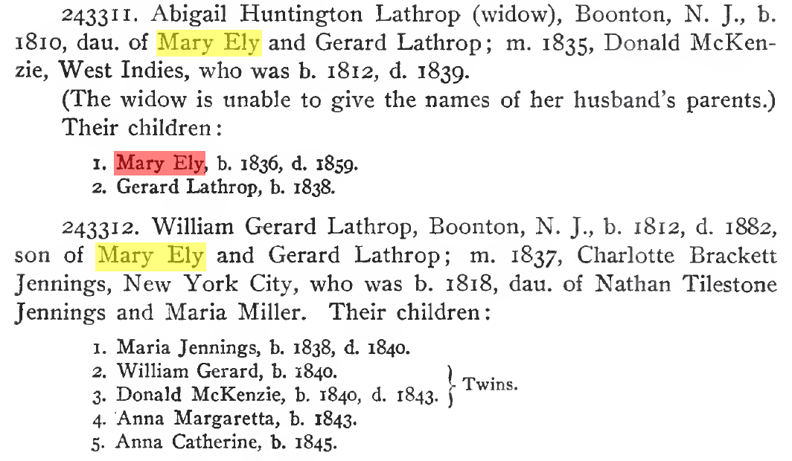
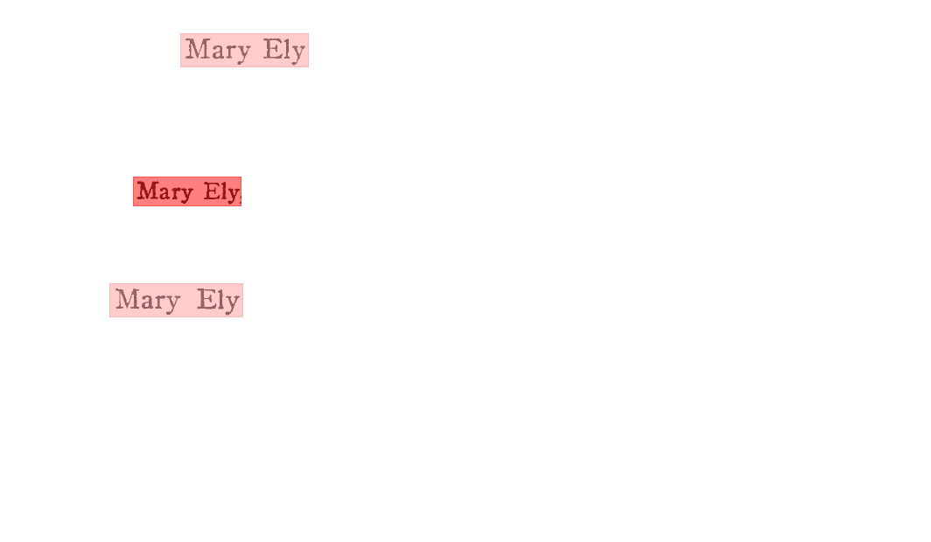
Resolving Mary Elys Example
Person₂ (1st Mary Ely) owl:sameAs
Person₈ (3rd Mary Ely)
0.032081
0.995030
0.032081

Slide 21
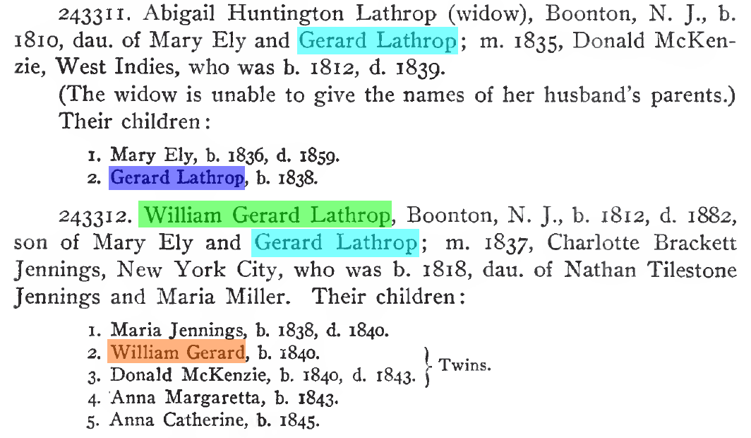
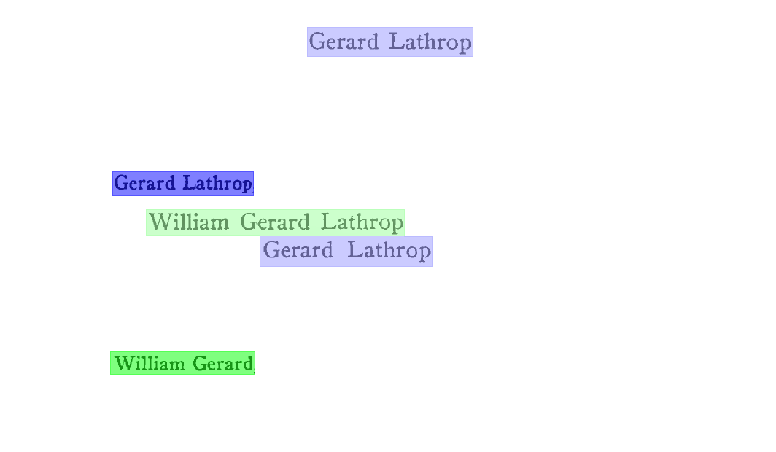
Resolving Gerard Lathrop Example
Person₃ (1st Gerard Lathrop) owl:sameAs
Person₉ (2nd Gerard Lathrop)
0.032081
0.088043
~0.0
0.953839
0.078216
0.032081
~0.0
0.028505
0.028505
0.000007

Slide 22
Experiment
The Ely Ancestry, page 419
  Extracted facts: excerpt
  Inferred facts: excerpt
  Same-as facts: excerpt
Annotated gold standard files
  Extracted facts: automated evaluation tool
  Inferred facts: automated evaluation tool
  Same-as facts: hand checked

Slide 23
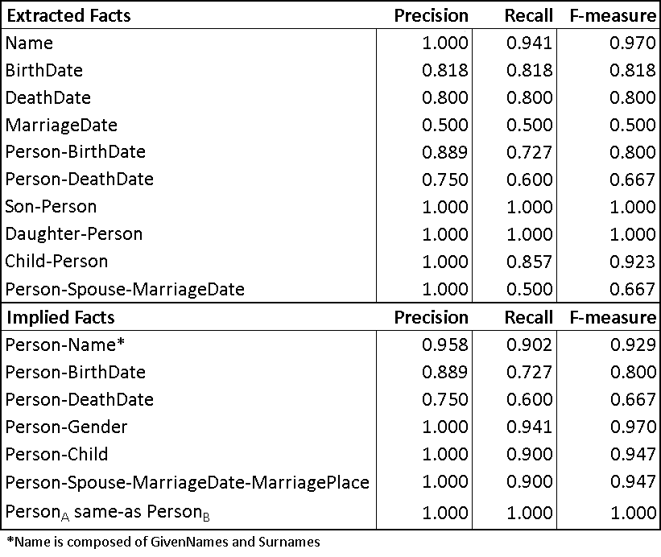
Experimental Results

Slide 24
Concluding Remarks
Proof of concept
Current and Future work:
  Corpus of 50,000+ books provided by LDS Church
  200 randomly selected pages
  Estimate the following:
    Time required
    Expertise required
    Accuracy (precision & recall)

