Slide 1



Ontologies for multilingual extraction
Supported by the
www.deg.byu.edu
Deryle W. Lonsdale
David W. Embley
Stephen W. Liddle

Slide 2
Overview
Background
  OSM ontologies
  OntoES and related tools
Multilingual extraction
  Vision
  Implementation
Current status, conclusions

Slide 3
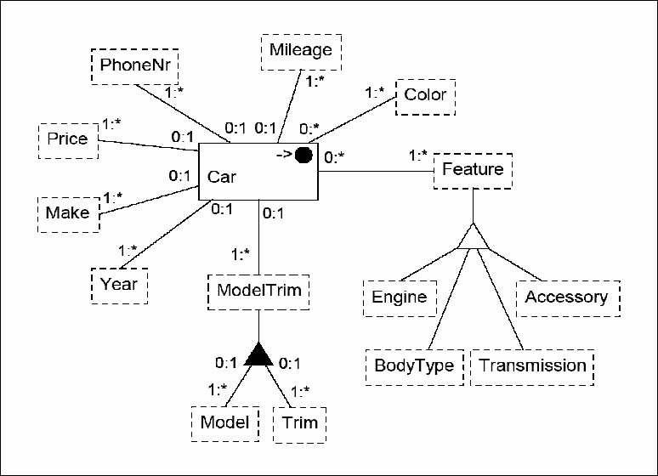
Conceptual modeling and ontologies
Concepts, relationships, and constraints with formal foundation

Slide 4
Ontology components
Object sets
Relationship sets
Participation constraints
Lexical
Non-lexical
Primary object set
Aggregation
Generalization/Specialization
Notes:
Extraction Ontology = conceptual model
Object set = collection of instances

Slide 5
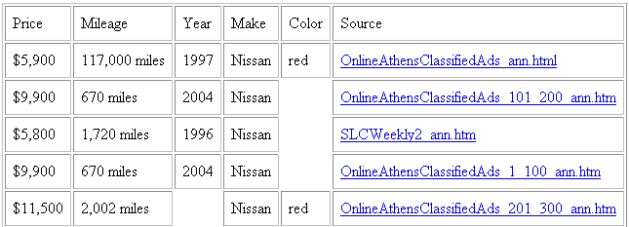
Ontologies and data extraction
Recovering knowledge: “What is knowledge?” and “Where is knowledge found?”
Populated conceptual model

Slide 6
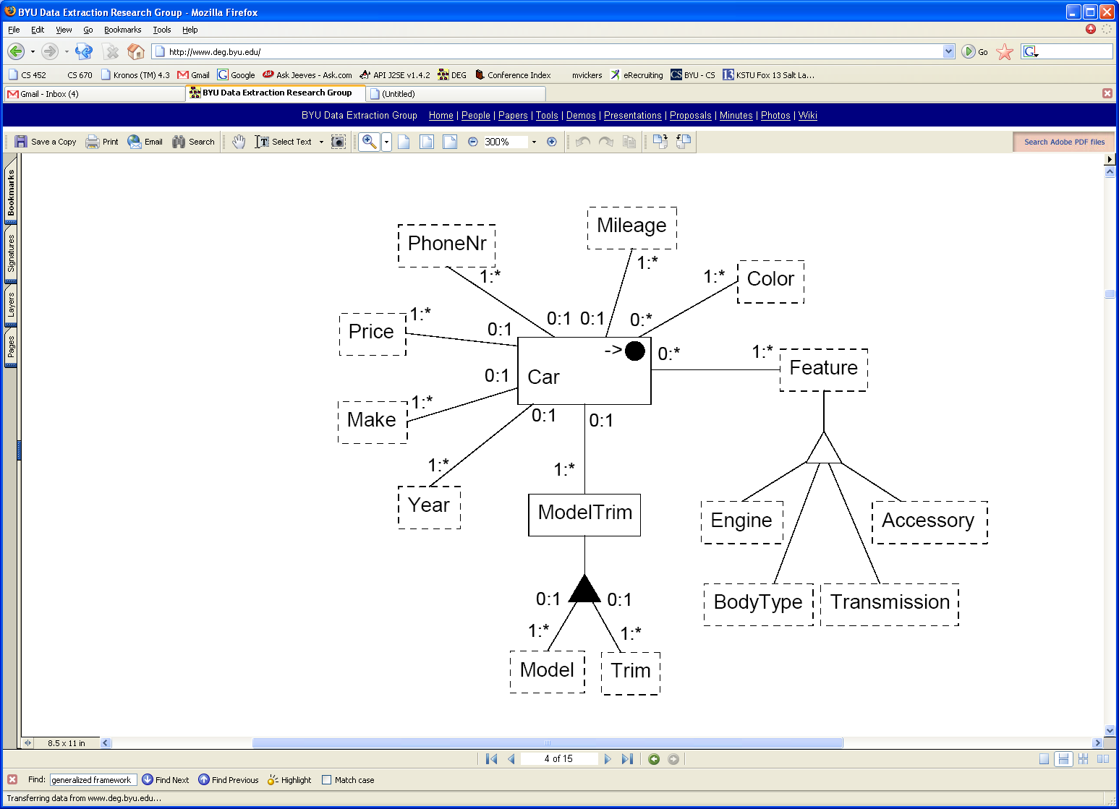
Data frames
Data frame:
Internal Representation: float
Values
External Rep.: \s*[$]\s*(\d{1,3})*(\.\d{2})?
Left Context: $
Key Word Phrase
Key Words: ([Pp]rice)|([Cc]ost)| …
Operators
Operator: >
Key Words: (more\s*than)|(more\s*costly)|…
Notes:
Basic Idea: Data Frames describe the value the Object Set holds

Slide 7
Extraction ontologies: generality & resiliency
Generality: assumptions about web pages
  Data rich
  Narrow domain
  Document types
    Single-record documents (hard, but doable)
    Multiple-record documents (harder)
    Records with scattered components (even harder)
Resiliency: declarative
  Still works when web pages change
  Works for new, unseen pages in the same domain
  Scalable, but takes work to declare the extraction ontology

Slide 8

From symbols to knowledge
Symbols: $ 11,500 117K Nissan CD AC
Data: price(11,500) mileage(117K) make(Nissan)
Conceptualized data:
  Car(C123) has Price($11,500)
  Car(C123) has Mileage(117,000)
  Car(C123) has Make(Nissan)
  Car(C123) has Feature(AC)
Knowledge
  “Correct” facts
  Provenance

Slide 9
OntoES data extraction system

Slide 10
OntoES semantic annotation

Slide 11
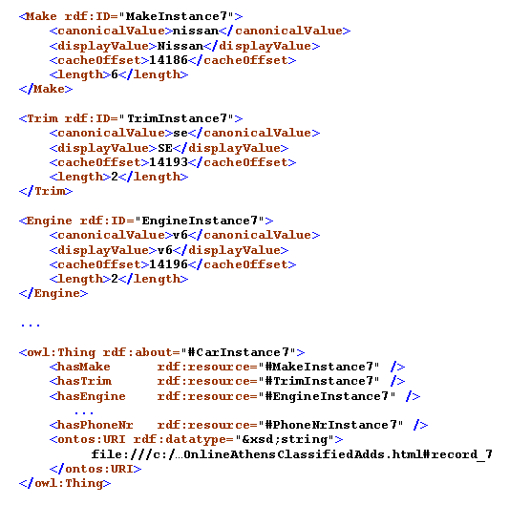
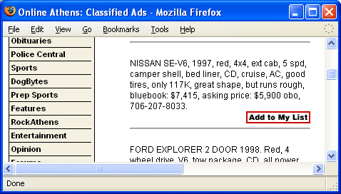
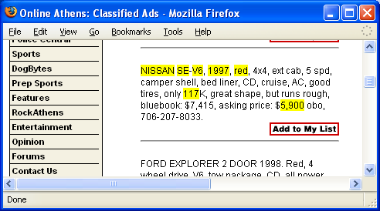
Annotation results

Slide 12
Query-based extraction
Find me the price and mileage of all red Nissans – I want a 1990 or newer.

Slide 13
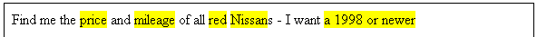
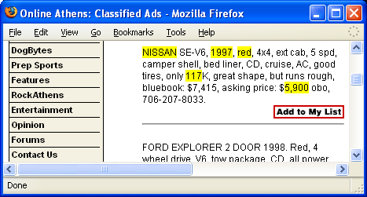
Query semantically annotated data

Slide 14
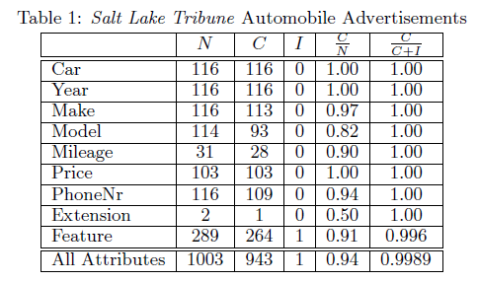
Extraction recall/precision
High precision, recall when documents are data-rich, domain-specific.

Slide 15
Issue: ontology construction
Several dozen person-hours per ontology
Scalability: thousands (?) of extraction ontologies needed
Automate the process as much as possible
  Forms-based interaction
  Instance recognizers
  Some pre-existing instance recognizers
  Lexicons
Notes:
As we shall see: doesn’t require an ontology-language expert; doesn’t require conceptual modeling expert.

Slide 16
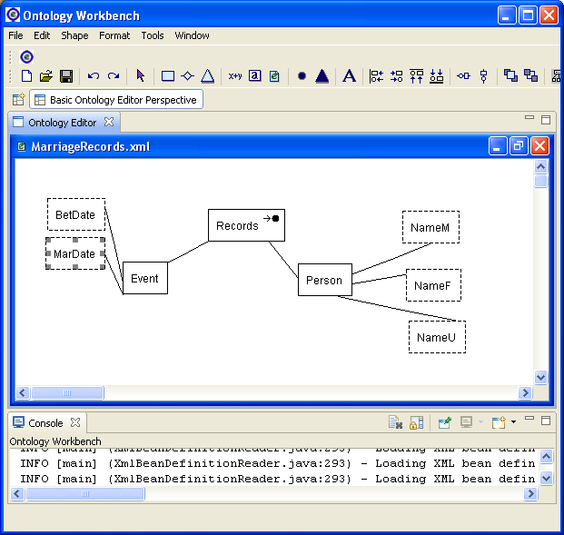
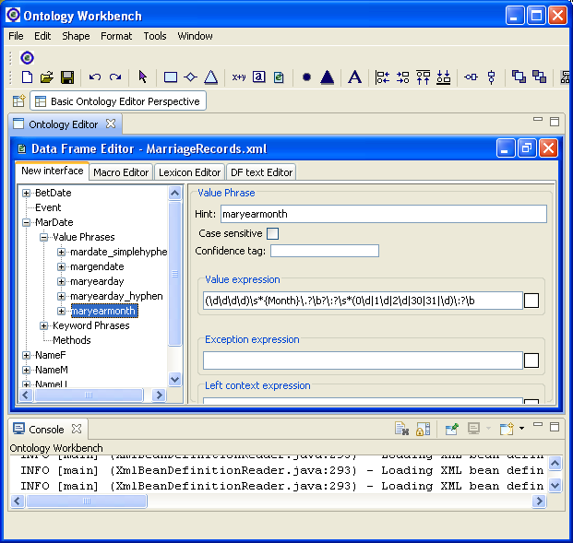
Ontology editor

Slide 17
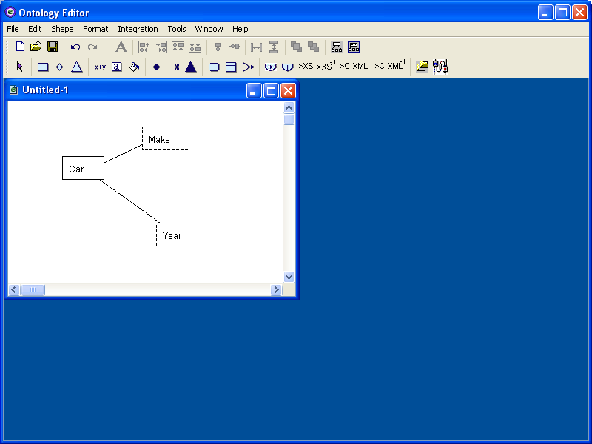
Building ontologies manually

Slide 18
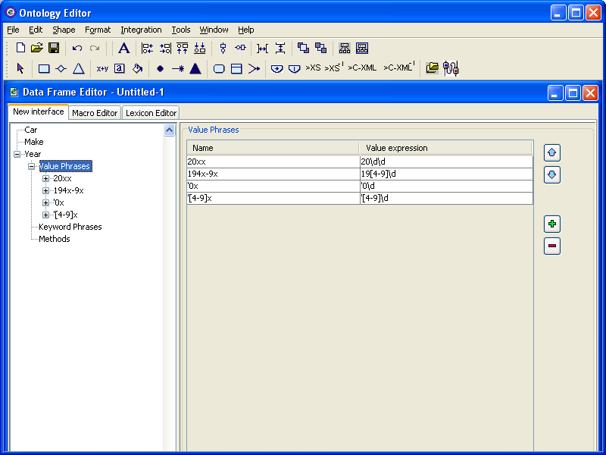
Building ontologies manually

Slide 19
Building ontologies manually
Library of instance recognizers
Library of lexicons

Slide 20
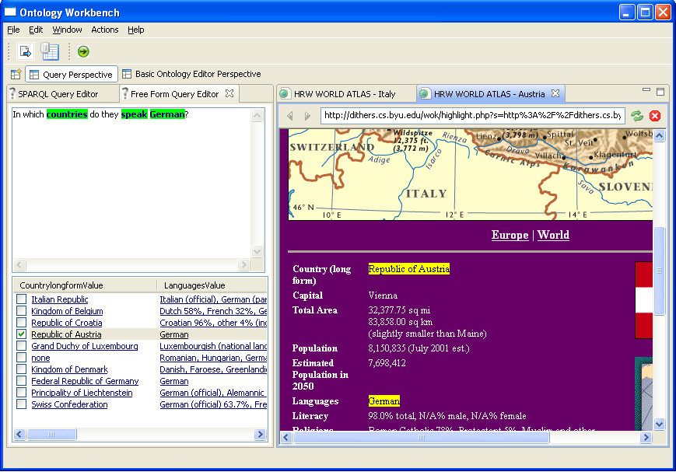
Ontology workbench
Notes:
We are working toward KBs and KBBs …

Slide 21
Workbench functions
Ontology editor (hand-construct ontologies)
Semantic annotation
GUI for creating user-specified forms
  Form-driven creation of ontologies
Generating ontologies from tabular data
Merging and mapping ontologies
Transforming results between various data formats
Supporting queries over extracted data

Slide 22
Beyond English
English Web is increasingly being overshadowed
We are investigating the viability of our approach for other languages
Goal: develop a multilingual ontology-based semantic web application

Slide 23
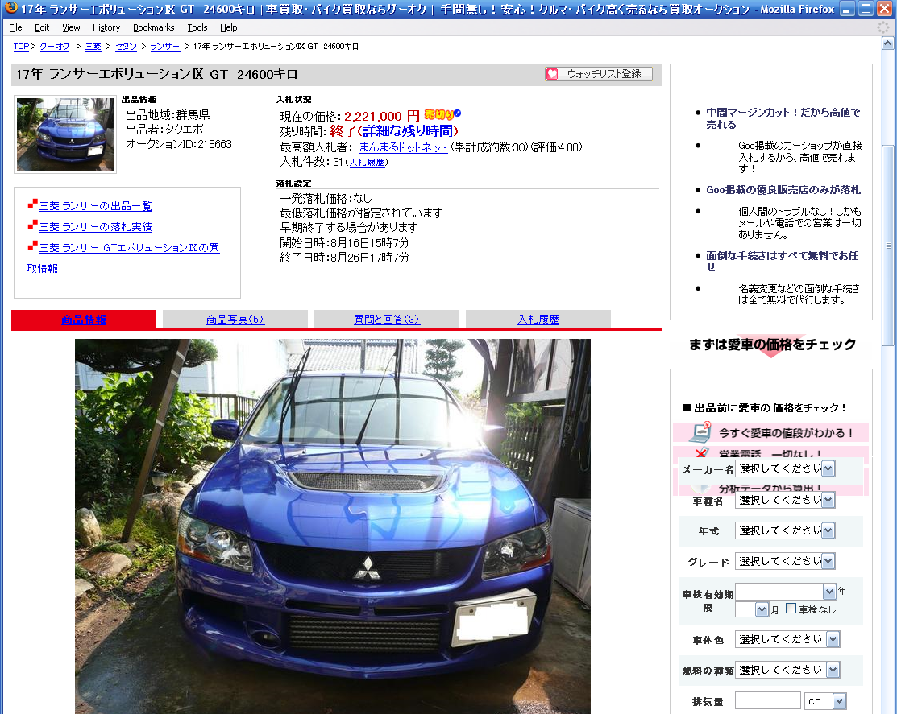
How different is this?

Slide 24
Current state of the art
Some multilingual/crosslinguistic extraction efforts exist
  Norwegian drilling, VerbMobil, EU trains
  CLEF, NTCIR
Variety of technologies used: alignment, cognate matching, various translation strategies, IR techniques, machine learning
Few use ontologies

Slide 25
Our solution(s)
Enhance ontologies:
  Compound recognizers
  Pattern discovery
  Discover and extract relationships among objects
Demonstrate viability of ontologies beyond English
  Declare narrow-domain ontologies in other languages
  Develop lexicons, value recognizers, data frames for multilingual processing
  Create crosslinguistic mappings
Develop working prototype showing multilingual capabilities

Slide 26
Multilingual adaptation
OntoES, workbench are already largely multilingual-capable
  UTF-8, Java
  Some prototyping work remains
Knowledge sources
  Many exist; don’t have resources to re-invent the wheel
  NLP resources: lexical databases, WordNet, …
  Termbases, multilingual lexicons, …
  Aligned bitext

Slide 27
Expected results
Monolingual queries possible in languages where components developed
Ontological content, lexical primitives can provide some degree of mediation between languages
  Crosslinguistic queries: query in English, retrieve data in another language, map back
  Reminiscent of conceptual “pivot”, “interlingua” in MT

Slide 28
Basic premises
Analogous data-rich documents should not differ substantially crosslinguistically
Ontological content should only involve minimal conceptual variation across langua-ges/cultures
  Obituaries: “tenth-day kriya”, “obsequies”
Existing technologies can provide large-scale mapping between languages

Slide 29
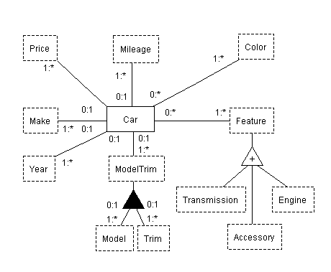
Car ontology (English)

Slide 30
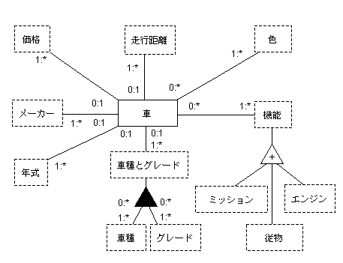
Car ontology (Japanese)

Slide 31
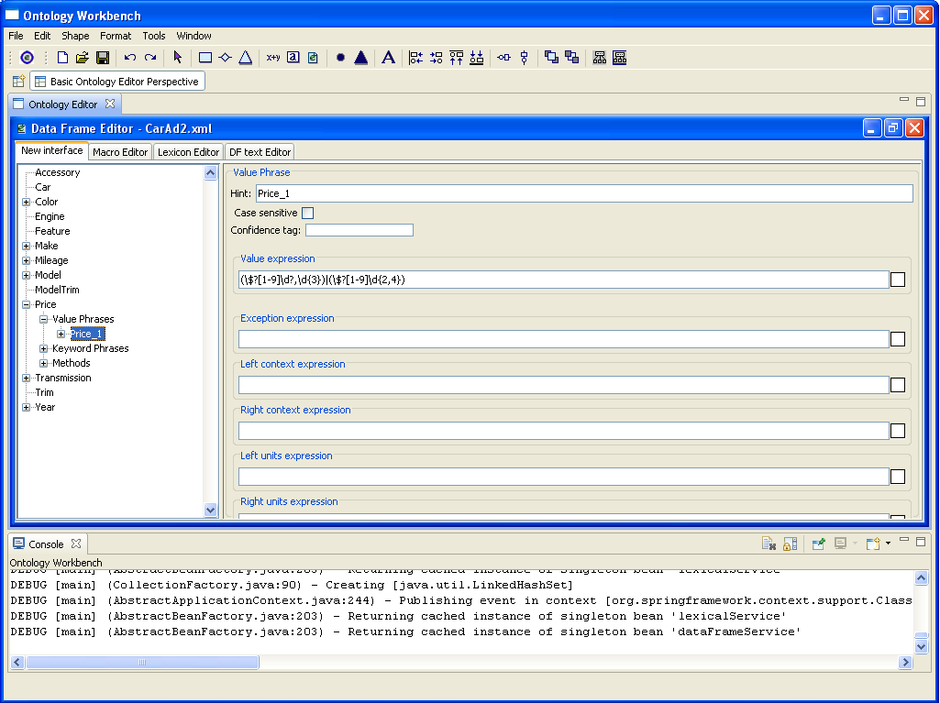
English price data frame

Slide 32
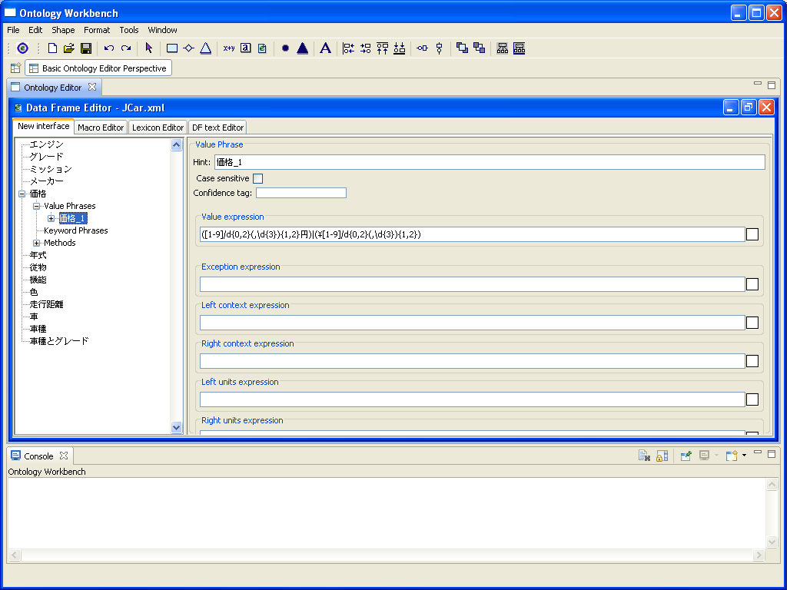
Japanese price data frame

Slide 33
Current status
Successful proof-of-concept, prototype implementations beyond English
  Japanese car ads
  Spanish obituaries
  French obituaries
Knowledge sources need further development
Formal evaluations needed

Slide 34
Conclusions
Ontologies, tools provide flexible, tractable framework for monolingual data extraction
  English well explored, documented
  Preliminary work on other languages
Mappings at the conceptual/lexical levels might enable crosslinguistic functionality
Implications for larger context: multilingual semantic web

Slide 35
Questions?

Slide 36
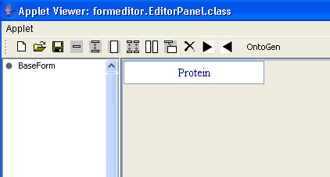
GUI for creating extraction forms
Basic form-construction facilities:
single-entry field
multiple-entry field
nested form
…

Slide 37
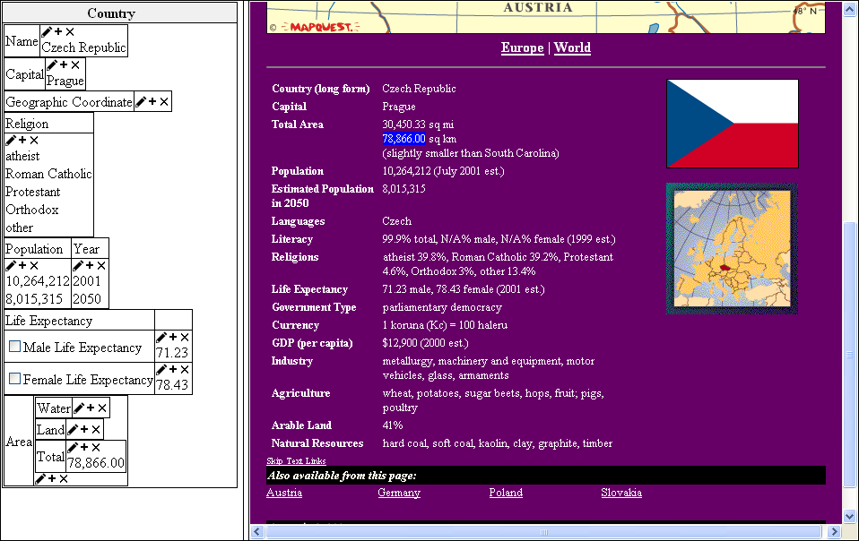
Creating ontologies from forms

Slide 38
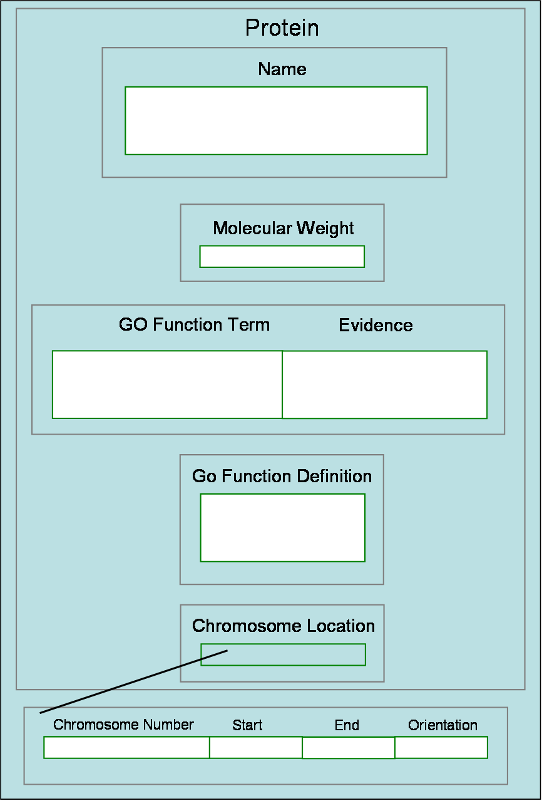
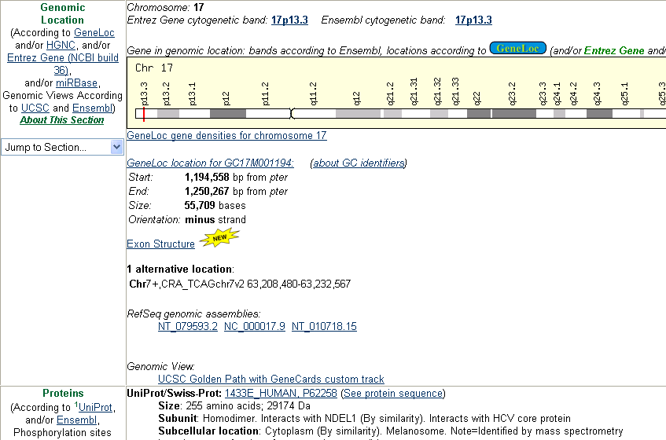
Source-to-form mapping

Slide 39
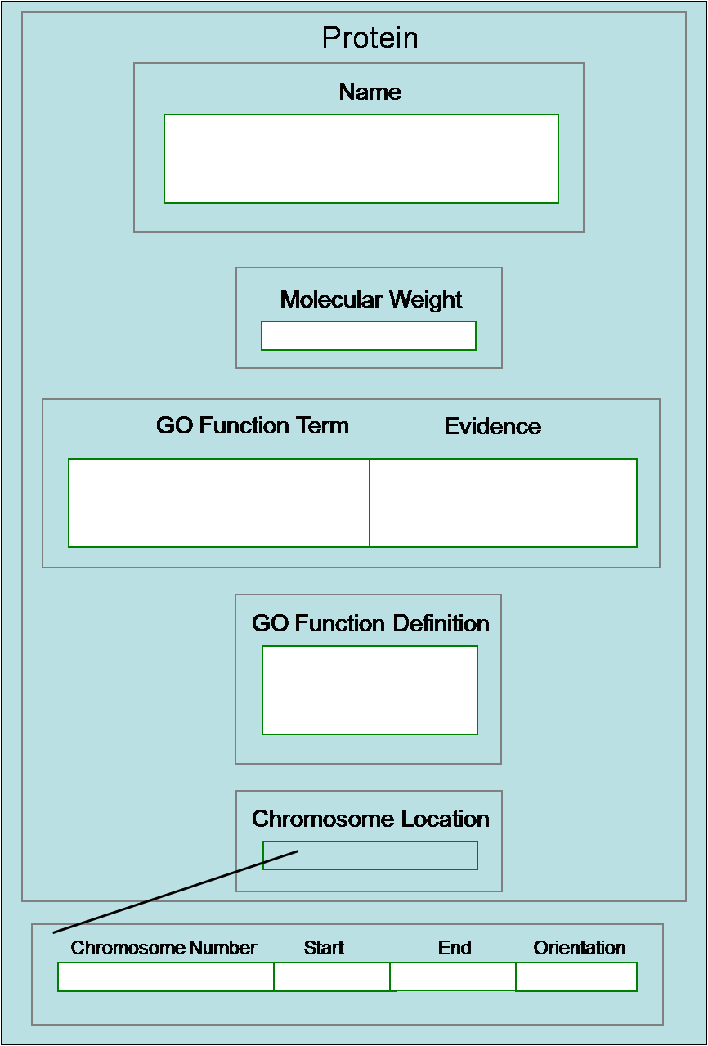
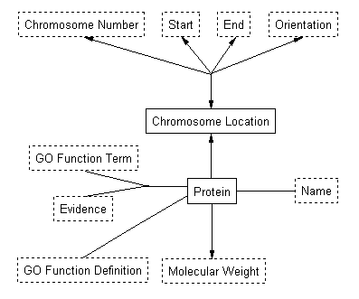
Forms-driven ontology creation
Notes:
Point out correspondences: Protein/Protein (non-lexical), Name/Name (lexical) ... ; explain cardinalities

Slide 40
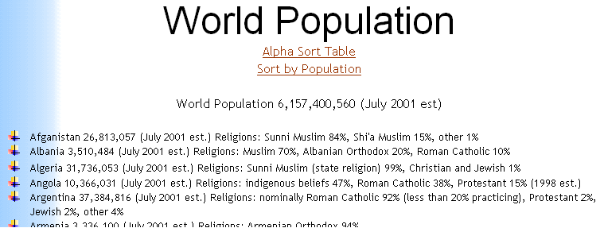
Inferring ontologies from tables
Religion
Population Albanian Roman Shi’a Sunni
Country (July 2001 est.) Orthodox Muslim Catholic Muslim Muslim other
Afganistan 26,813,057 15% 84% 1%
Albania 3,510,484 20% 70% 10%

Slide 41
Merging and mapping ontologies

Slide 42
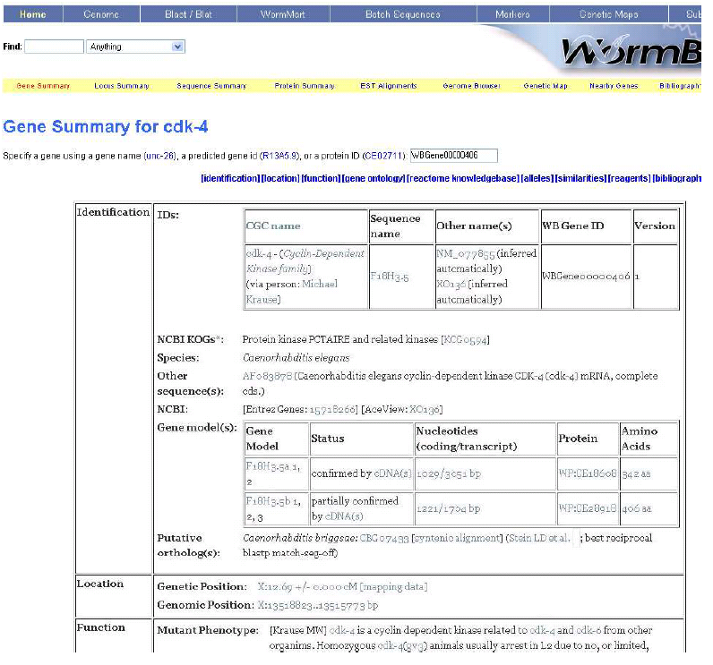
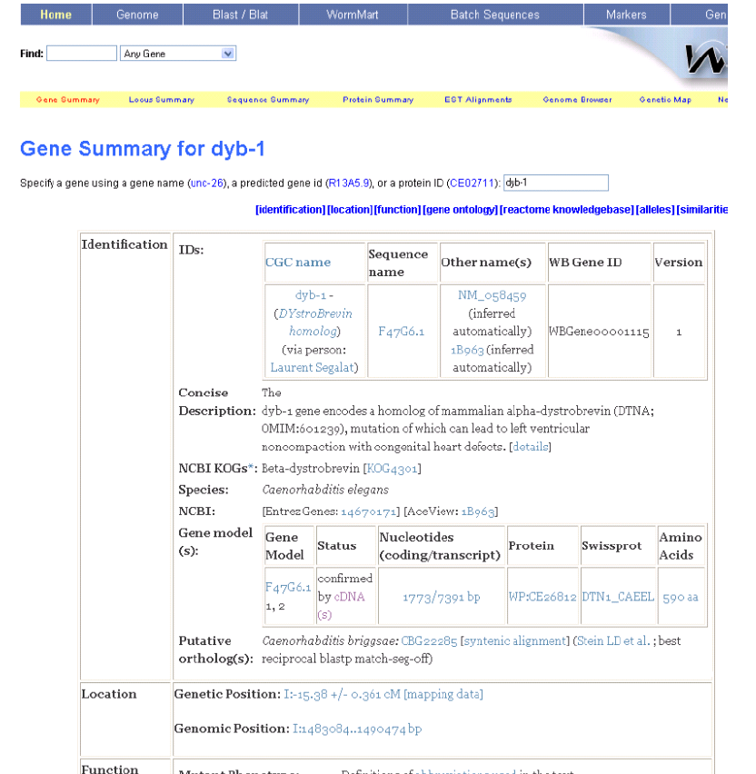
Interpret tables from sibling pages
Different
Same

Slide 43
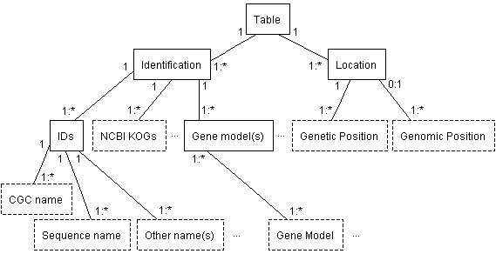
Interpret tables from sibling pages

Slide 44
C-XML: Conceptual XML
XML Schema
C- XML
Notes:
In general, reverse engineering from any structured schema.

Slide 45
Free-form query

Slide 46
Parse free-form query
“Find me the and of all s – I want a ”
price
mileage
red
Nissan
1996
or newer
>= Operator

Slide 47
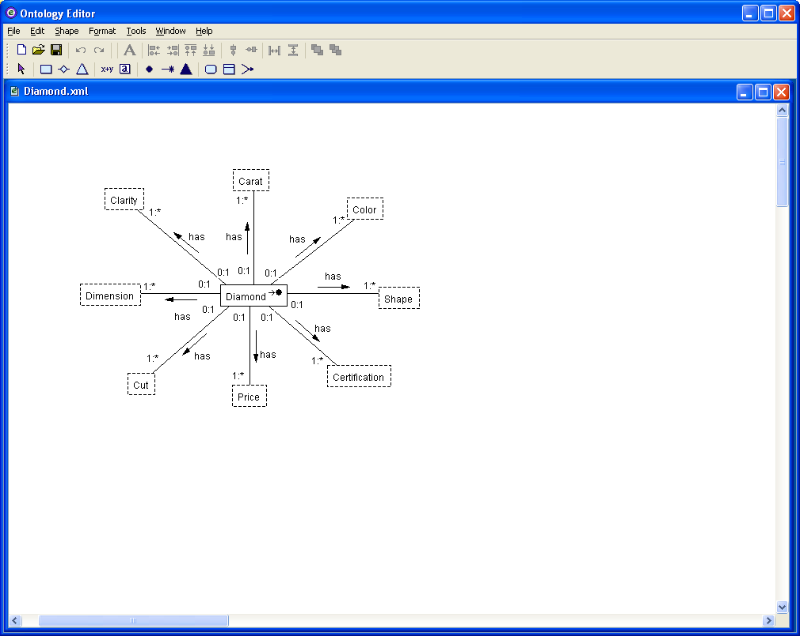
Select appropriate ontology
“Find me the price and mileage of all red Nissans – I want a 1996 or newer”

Slide 48
Formulate query expression
Conjunctive queries and aggregate queries
Projection on mentioned object sets
Selection via values and operator keywords
  Color = “red”
  Make = “Nissan”
  Year >= 1996
>= Operator

Slide 49
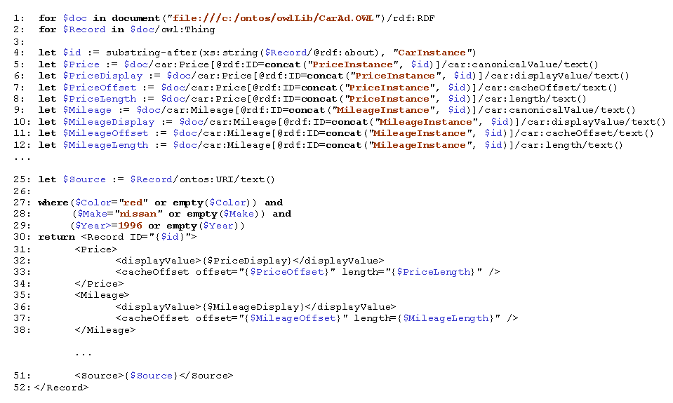
Formulate query expression
For
Let
Where
Return

Slide 50
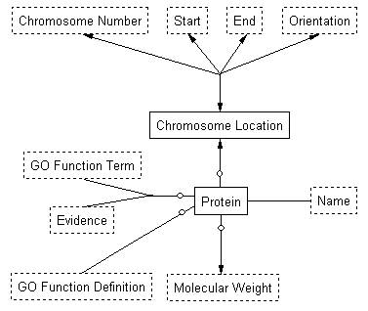
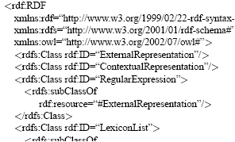
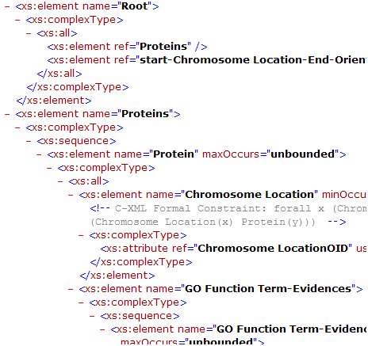
Ontology transformations
Transformations to and from all
Notes:
Not quite equivalent in modeling power.

Slide 51
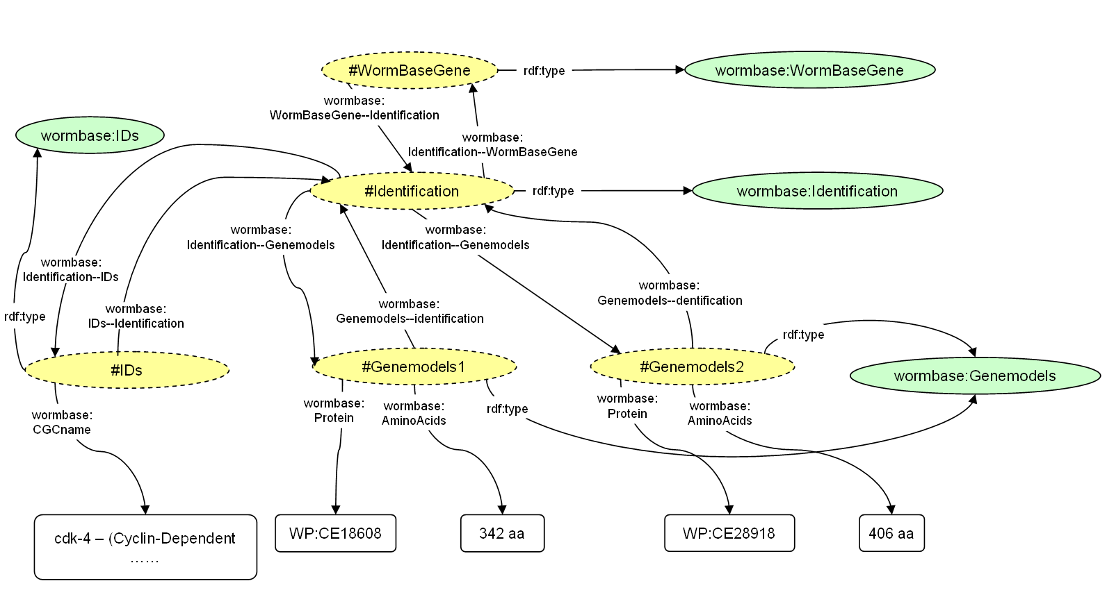
Generated RDF

