Slide 1
Multilingual Extraction Ontologies

Slide 2
Outline
Our MEG
A possible WWW paper
Getting there from here
  What we propose(d) to do
  Multilingual resources
  Evaluation

Slide 3
MEG details
Funding
  Starts ASAP
  Stops at end 2011
PI’s: Embley, Liddle, Lonsdale, Tijerino
$20,000 total: $18,000 for student wages, $1500 for travel, $500 for supplies (mobile device)

Slide 4
MEG objective(s)
Enhance ontologies:
  Compound recognizers
  Pattern discovery
  Discover and extract relationships among objects
  Discover patterns that can lead to identification and extraction of object instances and relationship instances

Slide 5
MEG objective(s)
Demonstrate crosslinguistic viability of ontologies
  Create crosslinguistic mappings
  Integrate lexicons for multilingual processing
  Develop multilingual (crosslingual?) value recognizers

Slide 6
MEG objective(s)
Tech transfer
  Develop working prototype showing multilingual capabilities
    Hand-held travel assistant
  Build business plan, enter BYU competition
  Develop patent application

Slide 7
Research plan
Winter 2010: recruit students
  CS undergrad
  Linguistics undergrad
  e-business undergrad
Activities
  Setup: Eclipse, OntoES, repository

Slide 8
Premises
English Web is increasingly being overshadowed
We want to show viability of our approach crosslinguistically
  Some efforts exist: Norwegian drilling, VerbMobil, EU trains, CLEF, NTCIR
  Not all use ontologies

Slide 9
Approach
Declare a narrow domain ontology (cf. car ads)
Add linguistic recognizers (data frames ++)
Extend to (an)other language(s)
Let ontological content be a sort of “interlingua”

Slide 10
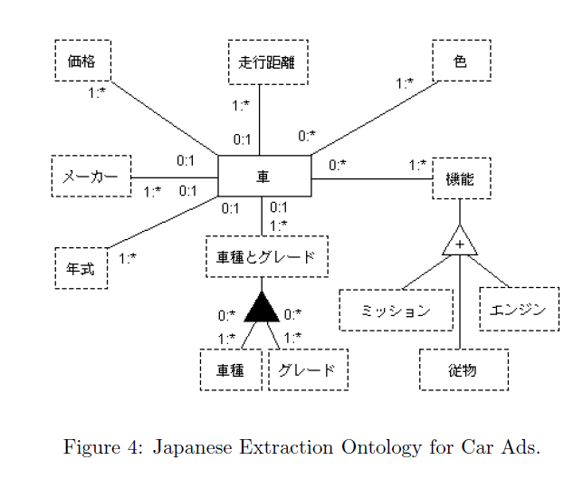
Japanese extraction ontology

Slide 11
Multilingual adaptation
OntoES, workbench should be inherently capable
  UTF-8, Java
  Some work remains
Knowledge sources
  Many exist; don’t have resources to re-invent the wheel
  WordNet, termbases

Slide 12
CS-related work
New algorithms, data structures for linguistically-grounded intologies
Implement compound recognizers
Design and run evaluation

Slide 13
Linguistics-related work
Locate and evaluate lexical resources
Engineer ways to implement multiple or crosslinguistic language resources
Help in system evaluation

Slide 14
Business-related work
Research needs of international travelers
Brainstorm business app, do market research
Write, submit business plan
Investigate tech transfer, patent issues

