Slide 1
Cross-language Information Retrieval
Joseph Park
Notes:
After explaining how it works:
display
Extraction results
Selection and projection transformation vs translation of query – flaw is keyword portion of search
In-language querying doesn’t work as well
Meta-word and stop word removal
Currency and unit conversion
Transliteration of names and places
display
Translation results
Works better with the whole system
Explain why the two experiments are enough
Conclusion & future work

Slide 2
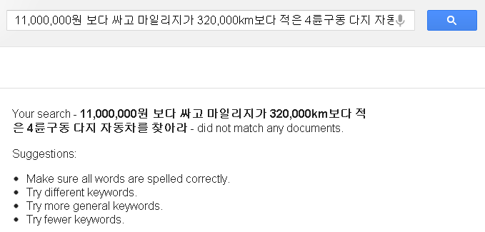
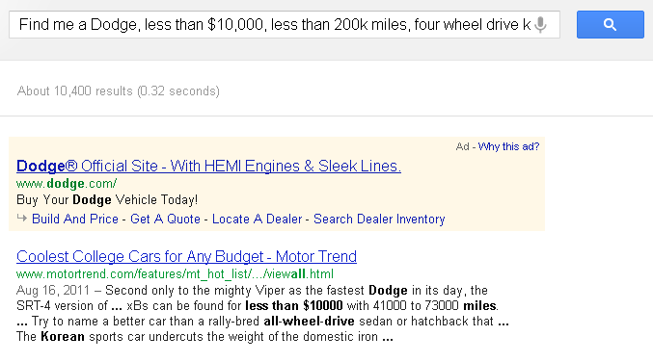
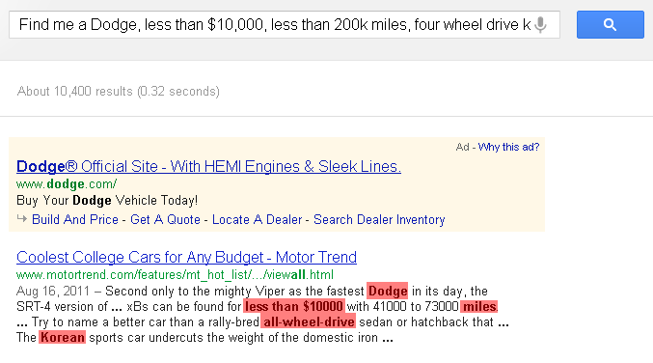
Motivation
11,000,000원 보다 싸고 마일리지가 320,000km보다 적은 4륜구동 다지 자동차를 찾아라0
Find me a Dodge, less than $10,000, less than 200k miles, four wheel drive korea

Slide 3
Key Concepts
Extraction Ontology – conceptual model for extracting and storing data
ML-HyKSS – MultiLingual Hybrid Keyword and Semantic Search
Query Transformation – Semantic rewrite of search query from one language to another

Slide 4
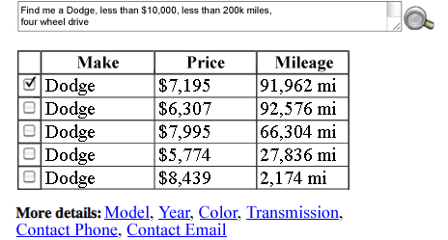
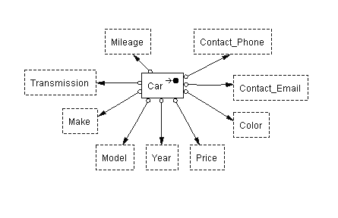
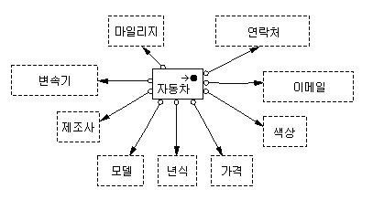
ML-HyKSS
Find me a Dodge, less than $10,000,
less than 200k miles, four wheel drive
< 200000
Dodge
< 10000
Language-Agnostic Ontology
< 124274
제조사 | 가격 | 마일리지
닷지 | 8100000 | 148000
닷지 | 7100000 | 148988
닷지 | 9000000 | 106707
닷지 | 6500000 | 44799
닷지 | 9500000 | 3500
닷지
< 11257000

Slide 5
Evaluation Results
Validation + Test Sets
Korean Car Ads | Declared | Extracted | Correct | Precision | Recall | F-Measure
모델 (Model) | 107 | 107 | 106 | 0.99 | 0.99 | 0.99
가격 (Price) | 107 | 107 | 107 | 1.00 | 1.00 | 1.00
마일리지 (Mileage) | 107 | 107 | 102 | 0.95 | 0.95 | 0.95
제조사 (Make) | 107 | 107 | 106 | 0.99 | 0.99 | 0.99
년식 (Year) | 107 | 107 | 107 | 1.00 | 1.00 | 1.00
색상 (Color) | 107 | 107 | 107 | 1.00 | 1.00 | 1.00
20 validation pages + 80 blind test pages
Car Ad Queries | Recall |  |  | Precision
 | σ | π | κ | σ | π | κ
Korean-to-English | 98% | 100% | 100% | 93% | 99% | 52%
10 validation queries + 40 blind test queries
Notes:
selection and projection translations are always correct because ML-HyKSS translates them at
the conceptual level by matching methods and object sets respectively, which
are necessarily in a one-to-one correspondence

Slide 6
Conclusions
Cross-language query transformation retains semantics
Extensive knowledge-base required for lexicon mappings
Keyword transformation may be difficult
Future Work:
Dynamic augmentation of language agnostic ontology
Integration of WordNet for meta-word synset

