Slide 1
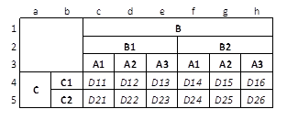
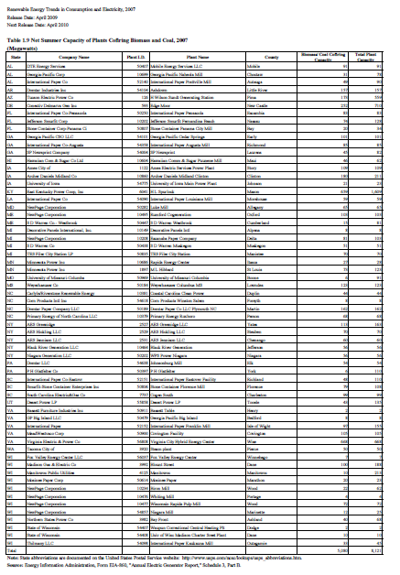
Data Extraction from Web Tables: the Devil is in the Details
George Nagy Electrical, Computer, and Systems Engineering DocLab, Rensselaer Polytechnic Institute Troy, NY, USA 12180 nagy@ecse,rpi.edu | Sharad Seth, Dongpu Jin Computer Science and Engineering Department University of Nebraska – Lincoln Lincoln, NE, USA 68588 seth@cse.unl.edu, jindongpu@hotmail.com | David W. Embley, Spencer Machado Computer Science Department Brigham Young University Provo, UT, USA 84602 embley@cs.byu.edu, admiralmachado@gmail.com | Mukkai Krishnamoorthy Computer Science Department & RCOS Rensselaer Polytechnic Institute Troy, NY, USA 12180 mskmoorthy@gmail.com
DATA FLOW
1. Web page (HTML)
Excel import
2. CSV table (text file)
Python critical cell location
3. List of critical cells (CSV)
VeriClick confirmation /correction
4. Corrected lists of critical cells (CSV)
Python path extraction
5. Header paths (text file)
Sis factoring
6. Canonical expression (text file)
Java constructor
7. Relational tables and RDF triples
SQL or OWL
This work was supported by NSF Grants # 044114854 (at RPI) and # 0414644 (at BYU) and by the Rensselaer Center for Open Software. Mangesh Tamhankar (RPI) developed VeriClick.
Table Notation
1. Web table
Table 1.9 Renewable
Energy Resources
Stub
Row header
Column header
Data (delta) cells
Virtual header (“CH1”) needed for category A !
Wang categories:
2. CSV intermediate format
Segmentation and path extraction are programmed from
CSV because of ease of cell-level operations.
,,B,,,,,
,,B1,,B2,,
,,A1,A2,A3,A1,A2,A3
C,C1,D11,D12,D13,D14,D15,D16
,C2,D21,D22,D23,D24,D25,D26
WFT
Every delta cell of a well-formed table is indexed completely and
uniquely by its row and column headers. The headers form trees.
A table with only one row or column of delta cells is degenerate.
A structure missing any row or column headers is a list.
Other semi-structured data: forms.
Tables are meant to disseminate information.
Forms are meant to collect information.
3. Critical cells are verified or corrected:
7a. MySQL relational table generation
CREATE TABLE Fig_1(C varchar(2),B varchar(2),
CH1_A1 varchar(3),CH1_A2 varchar(3),CH1_A3 varchar(3),
PRIMARY KEY (C, B));
INSERT INTO Fig_1 VALUES("C1", "B1", "D11", "D12", "D13");
INSERT INTO Fig_1 VALUES("C1", "B2", "D14", "D15", "D16");
INSERT INTO Fig_1 VALUES("C2", "B1", "D21", "D22", "D23");
INSERT INTO Fig_1 VALUES("C2", "B2", "D24", "D25", "D26");
7b. RDF triple generation
<rdf:RDF
xmlns:rdf="http://www.w3.org/1999/02/22-rdf-syntax-ns#"
xmlns:Fig_1="mysql://localhost:3306/Fig_1#">
<rdf:Description
rdf:about="mysql://localhost:3306/Fig_1/C-B_0"
Fig_1:C="C1"
Fig_1:B="B1"
Fig_1:CH1_A1="D11"
Fig_1:CH1_A2="D12"
Fig_1:CH1_A3="D13"
/>
...
</rdf:RDF>
4. Critical cells are: a1, b3, c4, h5
Details:
Missing header roots
Ambiguous roots in stub
Missing headers
Dedented headers
Unit rows
Blank rows
Duplicate header cells
Duplicate header paths
Aggregates
Table titles
Notes and footnotes
Missing data
Special symbols
Nested tables
Concatenated tables
Incorrect tables
5. Header paths are extracted:
rowpaths =
(("<0,3>C"*"<1,3>C1")
+("<0,4>C"*"<1,4>C2"));
colpaths =
(("<2,0>B"*"<2,1>B1"*"<2,2>A1")
+("<3,0>B"*"<3,1>B1"*"<3,2>A2")
+("<4,0>B"*"<4,1>B1"*"<4,2>A3")
+("<5,0>B"*"<5,1>B2"*"<5,2>A1")
+("<6,0>B"*"<6,1>B2"*"<6,2>A2")
+("<7,0>B"*"<7,1>B2"*"<7,2>A3"));
6. Canonical expression using Sis:
C*(C1+C2)+B*(B1+B2)+CH1*(A1+A2+A3)
Experimental results:
200 web tables →
197 segmented (26 errors corrected)
196 canonical expressions
376 relational tables
34,110 subject-predicate-object tuples

