Slide 1
HyKSS: A Multiple Ontology Approach to Hybrid Search
Andrew Zitzelberger
Brigham Young University
MS Thesis Proposal
Notes:
1

Slide 2
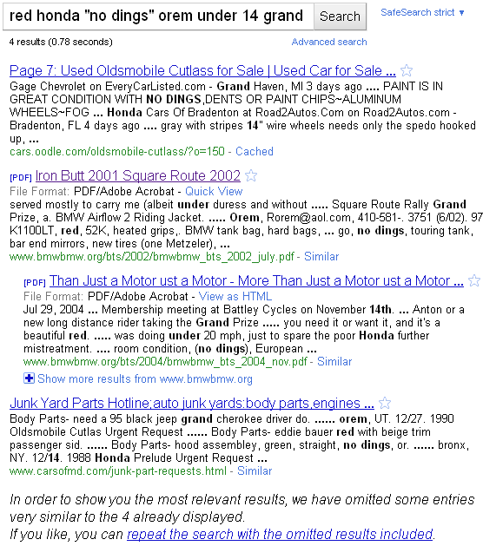
Keyword Limitations
Notes:
2
Show what Google lacks

Slide 3
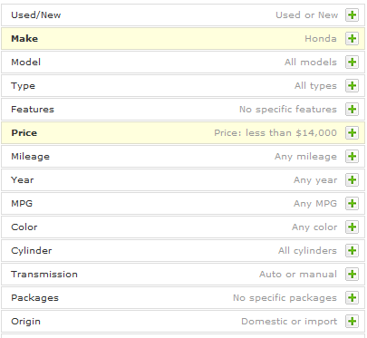
Semantic Search
Notes:
3
Demonstrate that forms are used for efforts like these

Slide 4
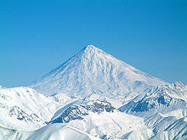
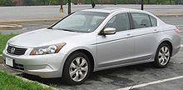
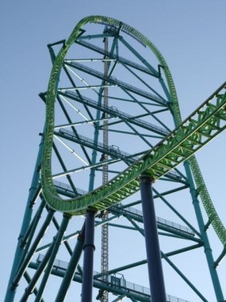
less than 100K miles
over 18,000 feet high
faster than 100 mph
Notes:
4
Show that there are sites that have information like this that we are interested in

Slide 5
HyKSS:
Hybrid Keyword and Semantic Search
Combine separate keyword and semantic search
Semi-automatically extract semantic annotations
Query over multiple conceptual models
Notes:
5

Slide 6
Thesis Statement
HyKSS
outperforms keyword and semantic search
allows queries over multiple ontologies
allows pay-as-you-go improvement

Slide 7
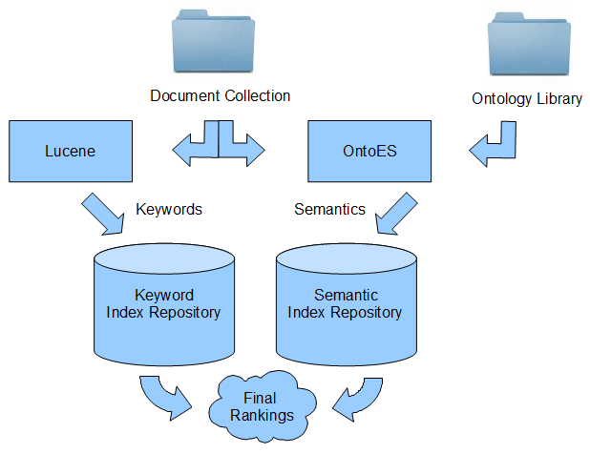
Architecture
Notes:
7
An architecture slide

Slide 8
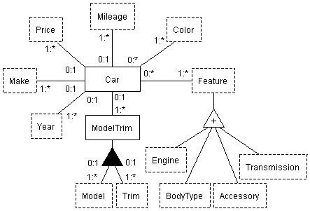
Extraction Ontologies
Notes:
8
Extraction Ontologies

Slide 9
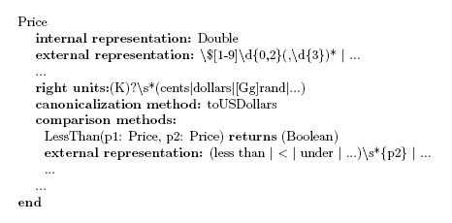
Data Frames
Notes:
9
Demo what data frames are

Slide 10
Keyword Query Processing
Step 1: Remove Constraints
red honda “no dings” orem under 14 grand
Regular Expression
under (\d{0,2} grand|…)
over (\d{0,2} grand|…)
newer than ((19|20)\d{2}|…)
older than ((19|20)\d{2}|…)
…
…
…
…
…

Slide 11
Keyword Query Processing
Step 2: Score Documents
red honda “no dings” orem
VSM based approach from Lucene
Document | red | Honda | no dings | orem | Score
1 | 1 | 2 | 0 | 1 | 0.79
2 | 1 | 2 | 1 | 1 | 0.85
3 | 0 | 2 | 1 | 1 | 0.80
4 | 0 | 1 | 0 | 1 | 0.41
5 | 2 | 2 | 1 | 2 | 0.89

Slide 12
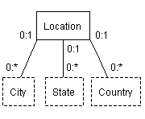
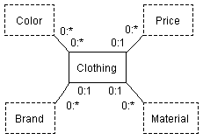
Semantic Query Processing
Step 1: Score Ontologies
red honda “no dings” orem under 14 grand
Match Score: 1
Match Score: 3
Match Score: 1

Slide 13
Semantic Query Processing
Step 2: Score Ontology Sets
red honda “no dings” orem under 14 grand
Make :
honda
Car
Location
Make :
honda
Car
Price:
<14000
Price:
<14000
City:
orem
Color:
red
Color:
red
Clothing
Match Score: 4
Location
Clothing
Color:
red
City:
orem
Match Score: 2

Slide 14
Semantic Query Processing
Step 3: Score Documents
Car
Location
Make :
honda
Price:
<14000
City:
orem
Color:
red
Document | Car.Make | Car.Color | Car.Price | Location.City | Score
1 | honda | red | 2700 | orem | 4
2 | honda | red | 5000 | orem | 4
3 | honda |  | 2350 | orem | 3
4 | honda |  | 3500 | spanish fork | 1
5 | honda | red | 17500 | orem | 2

Slide 15
Query Processing: Combine Scores
$Score=$ $αk+ β\left(γo+ δd\right)$
$$where α= β= γ= δ=0.5;o and d are normalized$$
Document | Keyword Score | Ontology Match Score | Document Match Score | Final Score
1 | 0.79 | 3/3 = 1.00 | 4/4 = 1.00 | 0.90
2 | 0.85 | 3/3 = 1.00 | 4/4 = 1.00 | 0.93
3 | 0.80 | 3/3 = 1.00 | 3/4 = 0.75 | 0.84
4 | 0.41 | 3/3 = 1.00 | 1/4 = 0.25 | 0.52
5 | 0.89 | 3/3 = 1.00 | 2/4 = 0.50 | 0.82

Slide 16
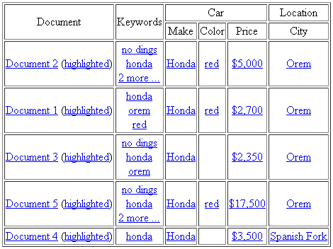
Displaying Results

Slide 17
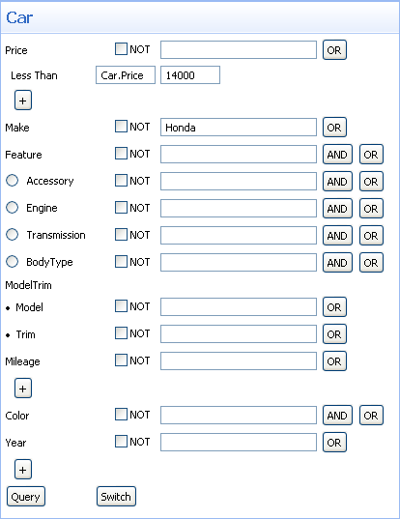
Advanced Search
Form based interface
Allows negations and disjuncts

Slide 18
Pay-as-you-go
Iterative improvement
Customizable ontology library
Add, remove, modify
Re-extract and index

Slide 19
Validation
Documents from Ancestry.com, craigslist, and Wikipedia
100 pseudo-randomly generated queries
Development test and blind test sets
Mean average precision (MAP):
$$\frac{1}{|Q|}\sum_{j=1}^{|Q|}{\frac{1}{M_{j}}}\sum_{k=1}^{M_{j}}{Precision(R_{jk}})$$

Slide 20
Conclusions
HyKSS - Hybrid Keyword and Semantic Search system
Improves mean average precision
Query over multiple ontologies
Pay-as-you-go improvements
Notes:
20

