Slide 1
Mock-ups for Discussing the CMS Administrator Interface

Slide 2
Scan to Submit within an Hour 10-10-10-10-10 Guideline
(up to 10 minutes for each phase)
Preprocess
Collection
Keyword &
Semantic Search
Automatic
Form Fill
Deduplication
& Ingest
Ordinance
Request
(indexing)
OCR & HWR
+ (as available) auto-extraction
Collection
Capture
Search
Repository
Form
Records
Tree
Temple
corrections
auto-extraction improvement

Slide 3
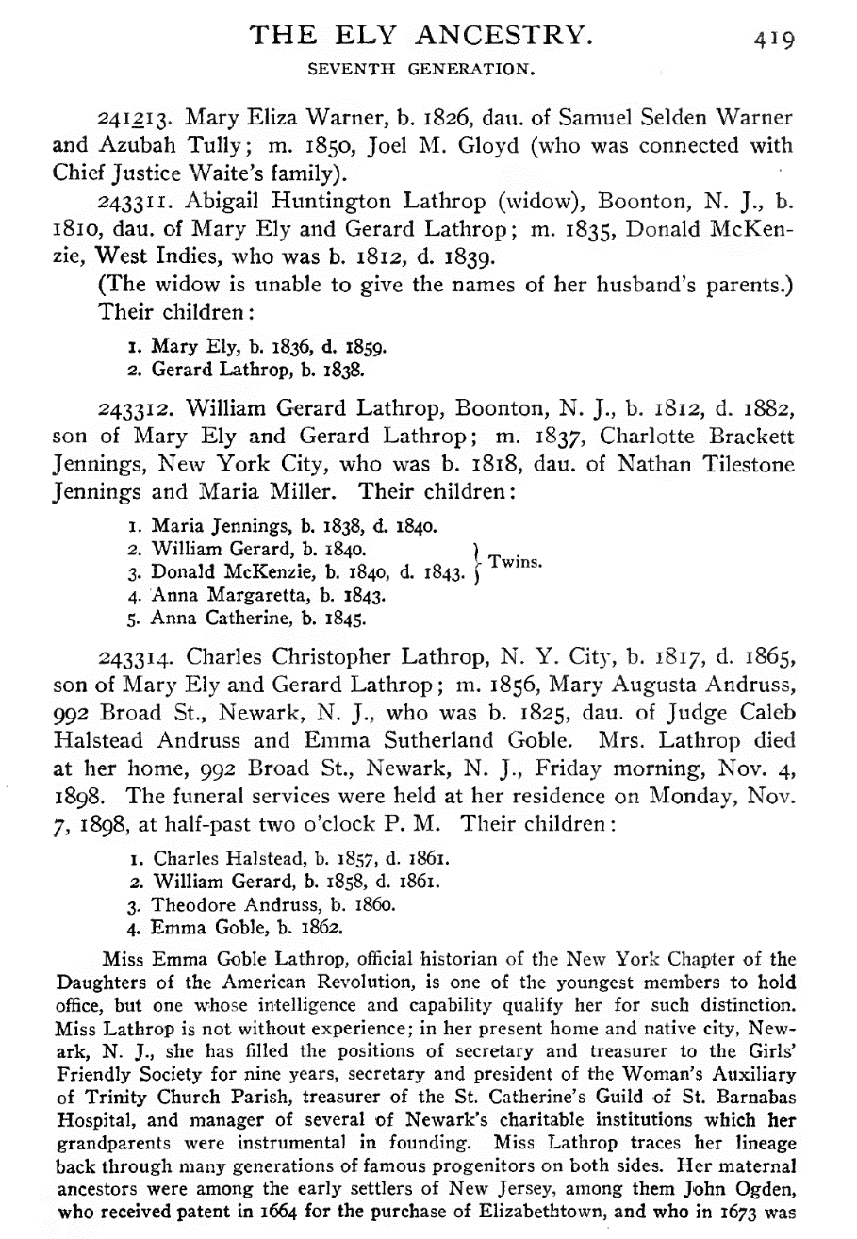
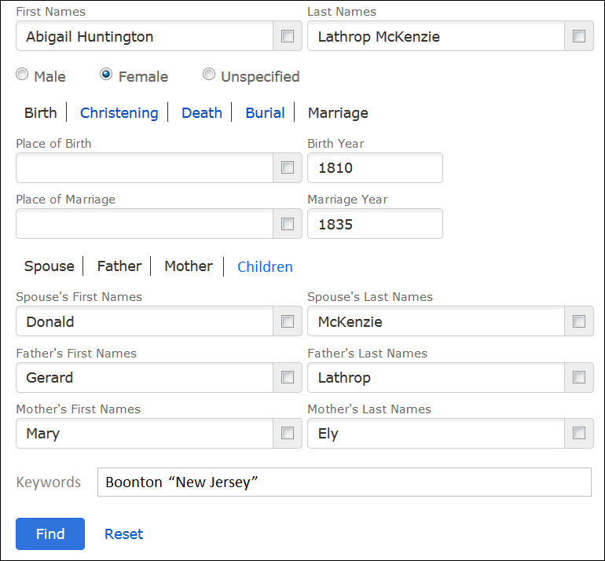
Keyword & Semantic Search
Notes:
HyKSS
Keyword Search: standard for specified keywords (also? standard for fielded words, except when semantically superseded (i.e. there is a semantic hit anywhere in the document that involves the entity in a relationship) or when qualified, where qualified, for example, could be “before 1810” or “1805 – 1815” or “within 10 miles of Newark, New Jersey”)
Semantic Search: entities – fuzzy search given that the entity is a name, date, or place (e.g. within alternate name expectations, within a date range, within a longitude/latitude range for a historical place).

Slide 4

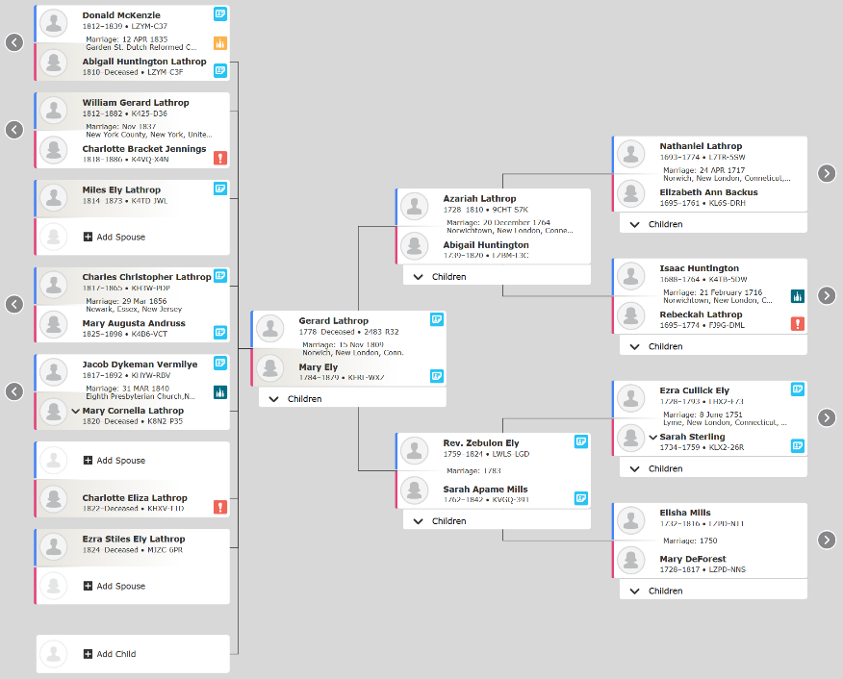
Deduplication
Spouse
Gerard Lathrop (osmx154)
Gerald Lathrop (2483-R32)
Father
Rev. Zebulon Ely (LWLS-LGD)
Person
Mary Ely (osmx161)
Mother
Sarah Apame Mills (KVGQ-391)
Person
Mary Ely (KFRL-WXZ)
Birth: 30 Aug 1748
Death: 1879
Mary Eli (MGV1-9BJ)
Child
Abigail Huntington Lathrop (osmx463)
Abigail Lathrop (LZYM-C3F)
Child
Miles Ely Lathrop (K4T1-JWL)
Ezra Styles Ely Lathrop (MPV2-1TB)
Mary Cornelia Lathrop (K8N2-P35)
Charlotte Eliza Lathrop (KHX-T1D)
Ezra Styles Ely Lathrop (MJZC-6PR)

Slide 5
Workflow Pipeline
1.pages
2.tools
<toolName>
PMCFI: extracted (osmx)
2.1.tool-ontology-extracted
2.2.ontology-extracted
2.3.extracted-text-cleaned
3.json-from-osmx
3.1.ontology-merged
3.2.value-cleaned
3.3.date-value-parsed
3.4.bad-relationships-fixed
3.5.authority-checked
PMCFI: osmx
4.json-working
PMCFIT: json
5.json-final
PMCFIT: json & osmx
6.osmx-checked
6.1.ontology-merged
6.2.value-cleaned
6.3.date-value-parsed
6.4.constraint-checked
6.5.authority-checked
PMCFI: osmx
7.osmx-enhanced
7.1.target-ontology-generated
7.2.value-standardized
7.3.information-inferred
T: json
8.gedcomx
8.1.results-generated
8.2.FS-imports-generated (CDS & FamilyTree)
TreeReady-txt
TreeReady-pdf
TreeReady-json
8.3.tree-generated (LLS & FamilyTree)
FamilyTree-gedcomx
MergedPersonas-json
MergedPersonas-pdf
MergedPersonasTreeReady-json
COMET Bypass
COMET Loop
PMCFIT = Person, Marriage, ChildOf, Family, Individual, TreeReady
Notes:
The pipeline, [1 2 3 (4 5 6)* 7 8], produces results for FamilySearch with user intervention (for FamilyTree) or without user intervention (for CDS or LLS). It supports four scenarios:
Tool testing. [1 2 3 4 5] lets users run extraction tools and observe the results in COMET. If desired by experimenters and a GroundTruth exists, a PRF (PrecisionRecallFscore) report can be generated; experimenters can also create GroundTruth while in COMET.
Indexing. [1 2 3 7 8] is for automatic indexing. If the target is CDS (Canonical Data Store), results in either TreeReady-Json or TreeReady-txt plus documentation in TreeReady-pdf are sent to CDS. If the target is LLS (Linked Lineage Store), results in FamilyTree-gedcomx plus documentation in MergedPersonas-pdf are sent to LLS.
Scan-to-submit: [1 (2 3)? (4 5 6)+ 7 8] lets a patron P find an ancestor in a document; and with or without extraction-tool help, fill in a form (Individual). Then, using COMET, P can iterate until the form is filled-out satisfactorily. The results in 8.2 are sent to the FamilyTree. (Continuation to the tree and to temple ordinances is beyond the pipeline; it makes use of current FamilySearch software for adding to the tree.) Also, we collect information and begin or update the indexing of the document.
Add-to-tree: [8] lets patrons add person records to the tree. For each merged persona in MergedPersonas-json, a patron must check and, if necessary, edit the results in MergedPersonas-json and produce the final filled-out Individual record in MergedPersonasTreeReady-json. (Continuation to the tree is as above.)

Slide 6
Add To Tree (Mockup)
Set up by producing an ordered list of mergedPersonaIDs to FamilyTree_{i}; then process the list in order as follows.
Check and Edit with COMET; should only need Save and Submit buttons
On Submit, internally search for on tree duplicates, then:
If not found, add to tree using FamilySearch and add the documentation and add all one-hop relatives to the tree, each possibly requiring a merge.
If found, resolve merge with FamilySearch and add the documentation and add all one-hop relatives to the tree, each possibly requiring a merge.
Iteratively, continue through the ordered mergedPersonaID list. Because one-hop relatives will have been added to the tree, we can guarantee that the next mergedPersonaID in the ordered list will already be on the tree. (We must ensure that the FamilySearch duplicate detection will find them.) Thus, for all mergedPersonaIDs beyond the first:
Resolve merge.
Add documentation.
Add all one-hop relatives to the tree, possibly requiring a merge.
Manage the processing of adding to the tree: if the user quits mid-stream, save the state and manage the resumption by allowing anyone to select the task and resume the work.
Notes:
Find an example that will work (Miller may be the best place to look. Find a generated FamilyTree and add it to the FamilySearch Tree, taking screen shots along the way.)

Slide 7
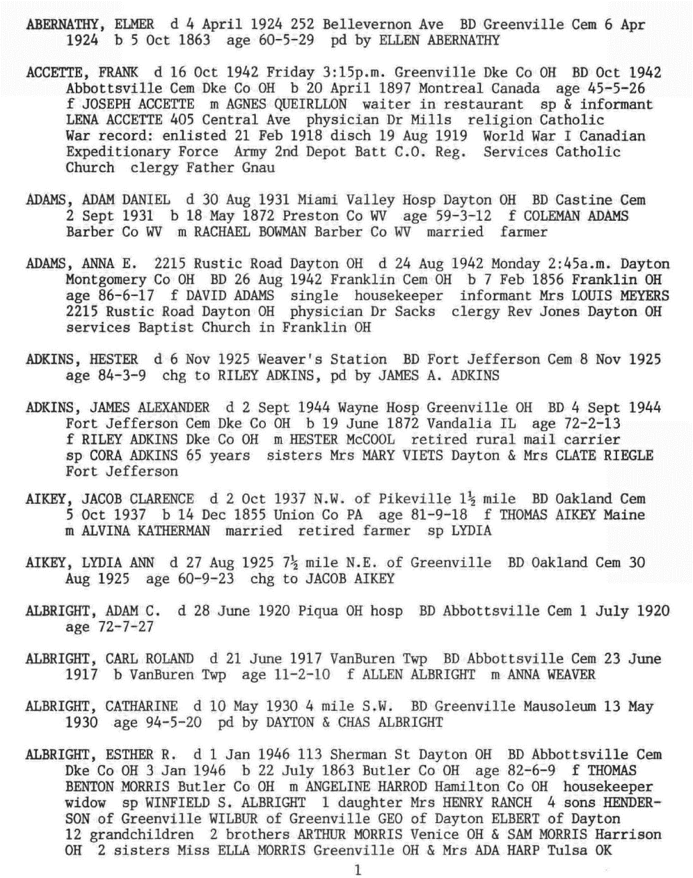
GreenQQ Demo

Slide 8
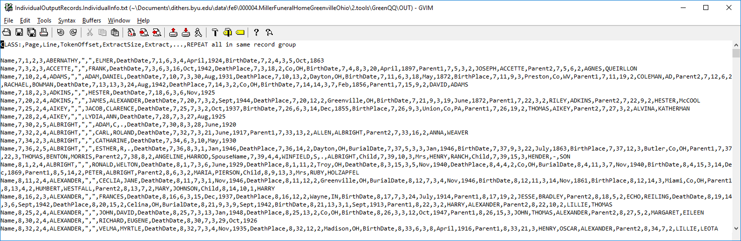
GreenQQ Demo

Slide 9
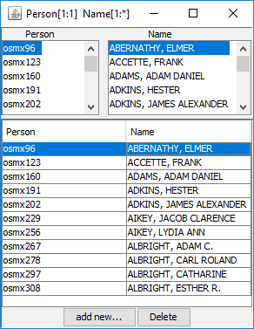
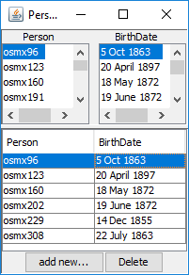
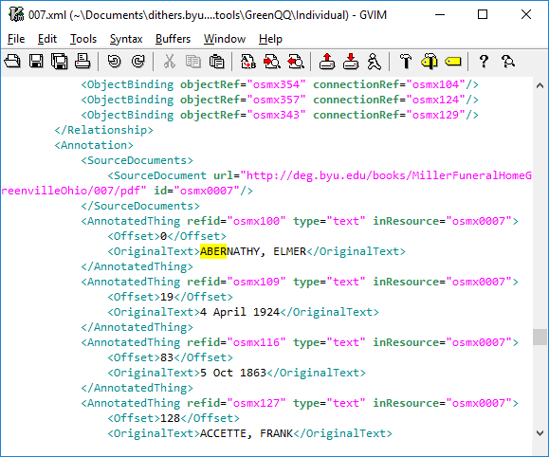
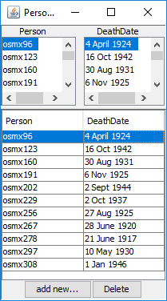
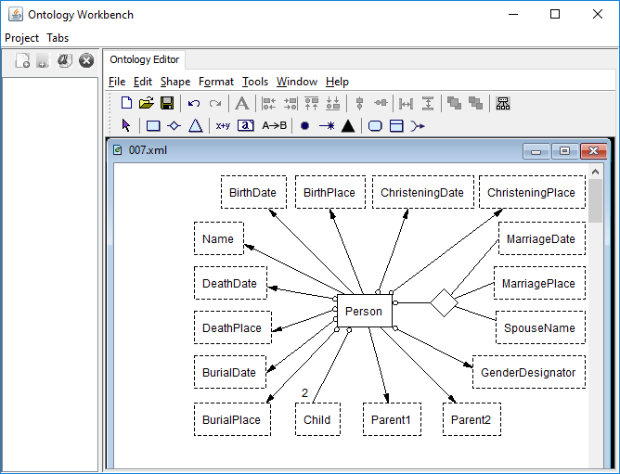
GreenQQ Demo

Slide 10
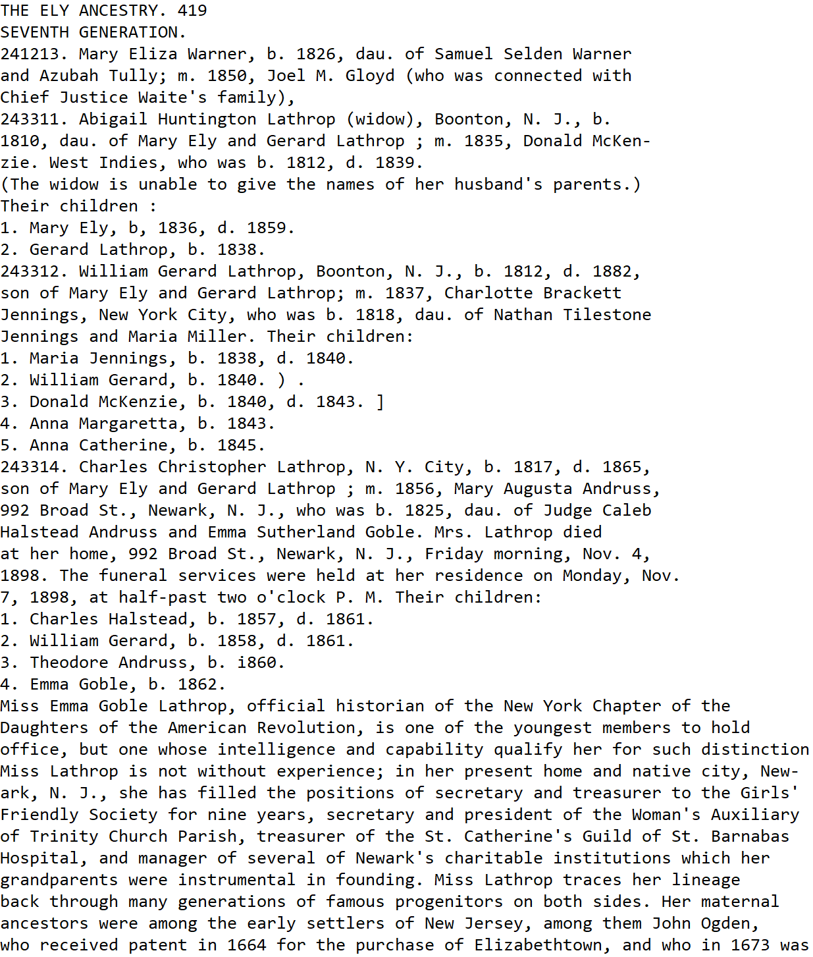
Advanced User Interface (Mockup)
Home Directory
…
HEAD
LIT
KEY
ALIAS
Rules
Frequent Tag Sequences
000001.TheElyAncestry\2.tools\GreenQQ
Name
b
d
b
d
243312
1
born b
died d
Name: SOL 243312 . William Gerard Lathrop ,
Name: m . 1837 , Charlotte Brackett Jennings ,
Name: SOL 1 . Maria Jennings ,
BirthDate: b . 1812
DeathDate: d . 1882
573
573
573
575
575
: 1 . Name , b , YEAR , d . DeathDate
. Name , b . yyyy . 4 . Name
CAP ’ yyy yyy ) , 243311 . CAP CAP CAP ( yyy
1 . CAP INIT . , b . BirthDate . 2 . CAP
. CAP - CAP CAP , b . BirthDate . 3 . CAP

Slide 11
Patron Indexer User Interface (Notes)
Establish Designator Keys (these are book dependent designators associated with a class):
Ely: (b, BirthDate), (d, DeathDate), (m, MarriageDate), (died, DeathPlace), (died, DeathDate), (born, BirthDate), (bapt, ChristeningDate), …(?)
Kilbarchan: (m, MarriagePlace), (m, MarriageDate), (p, MarriagePlace), (p, MarriageDate), (born, BirthDate), (bom, BirthDate)
Miller: (d, DeathDate), (d, DeathPlace), (BD, BurialDate), (BD, BurialPlace), (b, BirthPlace), (b, BirthPlace), (f, PARENT1), (m, PARENT2), (sp, SPOUSE), (daughter, CHILD), (daughters, CHILD), (son, CHILD), (sons, CHILD)
We can preset these for a book, but users should be able to add to the list. These are also LITs,; the user should also be able to set other LITs that are not necessarily designators, e.g. and, son of, dau. of, … .
Default search phrases (two types):
In the presence of a designator LIT: search to the left for the first designator (if any); if its Class matches the name of the Form Field, generate the rule: “X … E” where X is the designator LIT and E is the Extract, the filled in value.
No designator or a mismatch of Class: as before
EXTRA: a class that stops the look-ahead search for an Extract. (When a user sees that GreenQQ has gone beyond a list of sons, daughters, children, or spouses, the user can designate a LIT which when seen will stop the run-away list.)

Slide 12
Patron Indexer User Interface (Mockup)
Parent1: <|> SoL 2433312 . William Gerard Lathrop , <|>
SoL NUM5+ . NameType(CAP) ,
Parent2: <|> m . 1837 , Charlotte Brackett Jennings <|>
m … NameType(CAP)
Child: <|> SOL 1 . Maria Jennings , b <|>
SoL NUM1or2 . NameType(CAP)
Red: literal
Blue: key
Purple: both
Black: neither
Green:
NameType(style)
DateType(style)
PlaceType(style)
Save
Highlight Checked
Delete Checked
Execute Rules
Find Rule Candidate Examples
Submit
Notes:
Initial context (for Case 2, no search phrase designator):
* default for both left and right: one token beyond any punctuation (include the punctuation, if any, in the context)
* left (exceptions)
* if the extract is for a HEAD, stop at \n on the left and include it if hit within the default
* if the extract is for a HEAD and \n is the third or fourth(?) token on the left, include it too
* right (exceptions)
* treat \n as a space (ignore it)
* if the extract is a HEAD and \n is within the default, include it and stop
* general (exceptions)
* if recognized as a duplicate template (e.g. a HEAD for another form), initially display the duplicate if adjusted
* also include automatically any other template generated for the class (e.g. other HEAD templates)
* note: in the mockup, the first rule has been adjusted by removing the second token on the right
* note: Case 1 templates should not need adjustment; ? If they must be adjusted, turn them into a Case 2 template
* ?? 3 tokens left, 1 token right. Adjust with <|>.

Slide 13
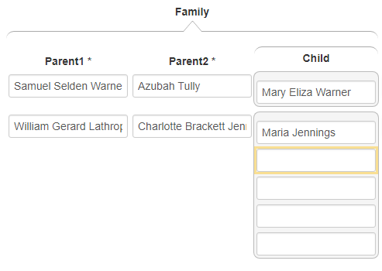
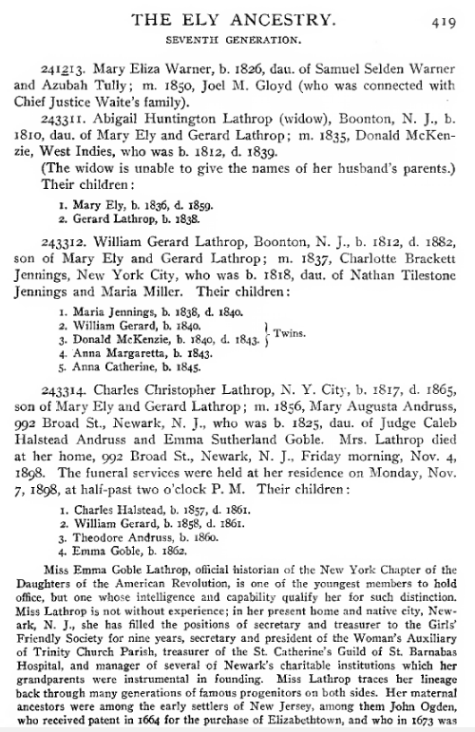
Patron Indexer User Interface (Mockup)
Not Working – we may need a Parents Form
Or maybe we can do everything from the Individual form
but then how do we also let Children be Heads?
Also, brainstorm what to do about Kilbarchan-like twins
Rules (Grouping “head” attribute is: Child)
Parent1: <|> dau . of Samuel Selden Warner <|>
Parent2: <|> and Azubah Tully ; <|>
Child: <|> SoL 241213 . Mary Eliza Warner , <|>
Parent1: <|> 243312 . William Gerard Lathrop , <|>
Parent2: <|> m . 1837 , Charlotte Brackett Jennings , <|>
Child: <|> 1 . Maria Jennings , <|>
Candidate Examples
109 573 Tully; m. 1850, Joel M. Gloyd (
93 573 ), SoL 243311. Abigail Huntington Lathrop (widow),
Page List for location of missing “head”’s
573 575 …
Notes:
Suppose we add a Parents form: Child Parent1 Parent2.
Now a rule for all is that the first field is the head. (Although the patron need not know or worry about it.)
The objective is just to do the whole book for the form. Someone else or even the same patron can do the other forms for the book.
Interesting opportunity: we keep all templates generated earlier. Perhaps we can prefill some fields automatically. Indeed, for the page we should be able to fill forms and do highlights as we go. Example: suppose we have family heads in Ely573 and BirthDates and we’re using the Person form. When the user clicks on the first Child, “Mary Ely” all the rest of the children on the page would also create records or be highlighted or both. In addition, without any action from the patron, all the BirthDates for all these children would also be recognized and filled in for every child (except the i860 for Theodore).
Kilbarchan twins may be problematic. But suppose for the Person form all the non-twins along with their BirthDates and ChristeningDates had already been done and that the patron has seen the “William and James, 12 June 1756.” has been missed although “12 June 1756” has been recognized. Then completing the form for “William” ~ “SoL Cap and” will add all first twins. And then asking for a new template and filling it with “James” which will also prefill the ChristeningDate “12 June 1756” along with generating the template “and Cap , NUM4”. Here the problem is how we process overlapping rules. But why not just let the algorithm run by considering the tokens one-by-one rather than jumping ahead – seems like it should work.

Slide 14
Patron Indexer User Interface (Mockup)
Rules: (Grouping “head” attribute is: Parent1)
Parent1: <|> SOL 2433312 . William Gerard Lathrop , <|>
SOL NUM5+ . NameType(CAP) ,
Parent2: <|> m . 1837 , Charlotte Brackett Jennings , <|>
m . NUM4 , NameType(CAP) ,
Child: <|> SOL 1 . Maria Jennings , b <|>
SOL NUM1or2 . NameType(CAP) , b
Red: literal
Blue: key
Purple: both
Black: neither
Green:
NameType(style)
DateType(style)
PlaceType(style)
Save
Highlight Checked
Delete Checked
Execute Rules
Find Rule Candidate Examples
Submit
Notes:
Initial context:
* default for both left and right: one token beyond any punctuation (include the punctuation, if any, in the context)
* left (exceptions)
* stop at SOL on the left and include it if hit within the default
* if the extract is for a HEAD and SOL is the third token on the left, include it too
* right (exceptions)
* treat EOL as a space (ignore it and the following SOL)
* if the extract is a HEAD and EOL is within the default, include it and stop
* note: in the mockup, the first two rules have been adjusted by removing the second token on the right
* When a period or comma is a literal AND (part of) a key, the key designation allows them to be OCR-error interchangeable.
* ?? 3 tokens left, 1 token right. Adjust with <|>.

Slide 15
Patron Indexer User Interface (Mockup)
Rules (Grouping “head” attribute is: Child)
Parent1: <|> dau . of Samuel Selden Warner <|>
Parent2: <|> and Azubah Tully ; <|>
Child: <|> SoL 241213 . Mary Eliza Warner , <|>
Parent1: <|> 243312 . William Gerard Lathrop , <|>
Parent2: <|> m . 1837 , Charlotte Brackett Jennings , <|>
Child: <|> 1 . Maria Jennings , <|>
Candidate Examples
109 573 Tully; m. 1850, Joel M. Gloyd (
93 573 SoL 243311. Abigail Huntington Lathrop (widow),
Page List for location of missing “head”’s
573 575 …
Notes:
Tag templates not shown; should we have them at all?
Some right-context adjustments
The “Joel M. Gloyd” example would not come up – would now work immediately.
The numbers preceding the page number in the Candidate Examples is a frequency count; the Candidate Examples are to be sorted in descending order by this count.

Slide 16



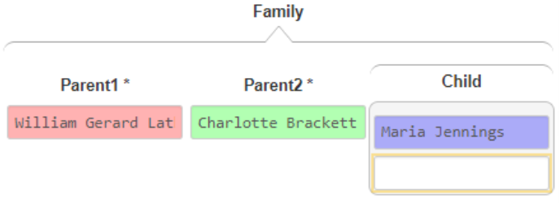
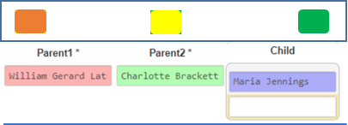
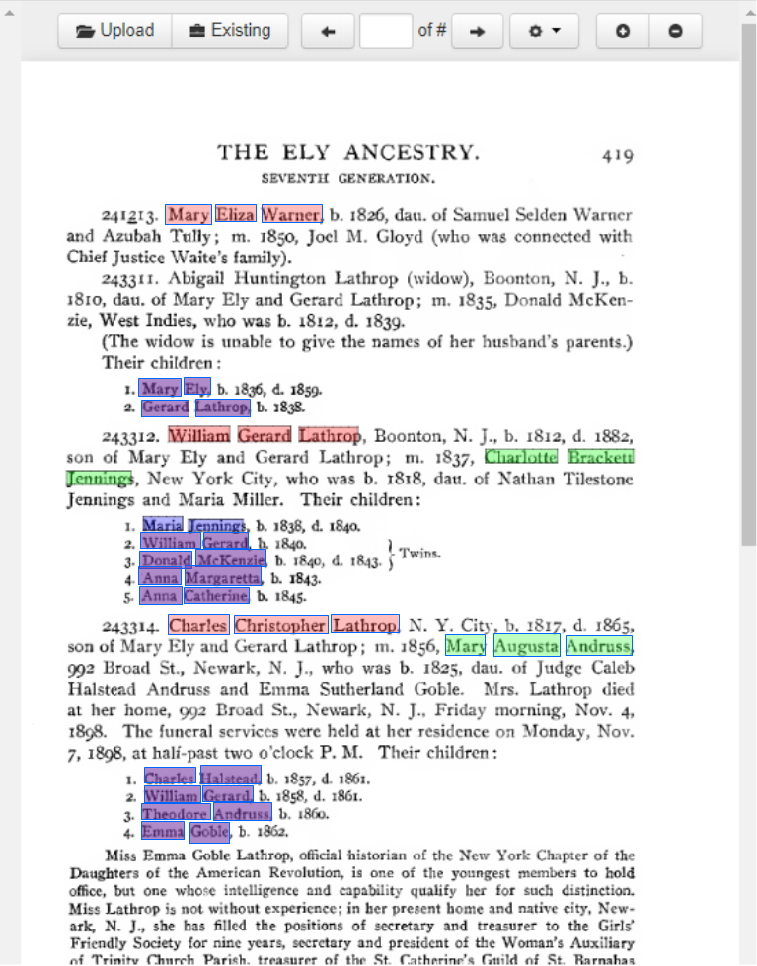
Mobile Patron Indexer User Interface (Mockup)
Notes:
Objective: For a record type t, correctly cover the t-records on the page, where “correctly cover” means that each t-record is correctly bounded and each data item within the bounded t-record is correctly color-highlighted.
Progress indicator: report running totals for page and book. Page: Parent1:3, Parent2:2, Child:11; Book: Parent1:1,651, Parent2:1,101, Child:6,059.
Stop when the progress indicator levels off or osculates or n-minutes have expired. ??
Green button: execute all generated templates yielding appropriate highlights and progress indicator. (?? Hopefully, user rule-fix not needed: but if we can’t auto fix erroneous/ambiguous/conflicting extraction rules (see red button below), a pop-up can be requested to adjust rules. ??)
Yellow button: move to a page judged to have “the most critical something” missing, which will be highlighted in yellow; the rest of the text is highlighted according to current rule set. Determining “the most critical something”: heads with embedded subsequence frequency greater than n(=5?) or otherwise the non-head with the largest frequency. The user “must” deal with the yellow highlight by either (1) adding something or (2) explicitly declaring that there is nothing within the yellow highlight to be added. The user can then also treat the page like the first page by completing the t-record extraction for the page. In the mockup example the user should add Abigail Huntington Lathrop in the usual way, which will break the bogus record AND auto-add to the record the children, Mary Ely and Gerard Lathrop. To complete the page, Donald McKenzie and Joel M. Gloyd should be added. If explicitly dismissed, the proposed template suggesting the yellow should be removed from further yellow-click help. (?? Hopefully not needed: a pop-up that displays examples with frequencies and lets a user select which one to work on. ??)
Red button: The user selects an incorrect record, fixes it, and then presses the red button. Fixes include (1) adjusting the record boundaries by declaring additional heads, or by extending the record boundary, or both; and (2) adding, removing, or modifying field values. Behind the scenes, we figure out how to adjust the rule set and redisplay according to the new the adjusted rule set. (?? Hopefully, we won’t have to have the user work directly with the rule set to make needed adjustments. ??)
Recall errors: fix (1) by sight on page (can also move to other pages by left/right swipe or by scroll-bar) and (2) by yellow-button help.
Precision errors: fix with red-button actions. (Example for the incorrect record above: (1) add a record boundary yielding two partially filled in records: [Parent1: Mary Eliza Warner; Parent2: null; Child: null)][Parent1: null; Parent2: null; Child: Mary Ely, Gerard Lathrop]; (2) add missing head yielding: [Parent1: Mary Eliza Warner; Parent2: null; Child: null)][Parent1: Abigail Huntington Lathrop; Parent2: null; Child: Mary Ely, Gerard Lathrop]; (3) add missing field values yielding [Parent1: Mary Eliza Warner; Parent2: Joel M. Gloyd; Child: null)][Parent1: Abigail Huntington Lathrop; Parent2: Donald McKenzie; Child: Mary Ely, Gerard Lathrop]; and (4) adjust field values – no change in this example.
Differences with the large-monitor version: Instead of top/bottom panels, the layout is in side-by-side panels ala COMET; and the full set of records is displayed in the left panel ala COMET.

Slide 17
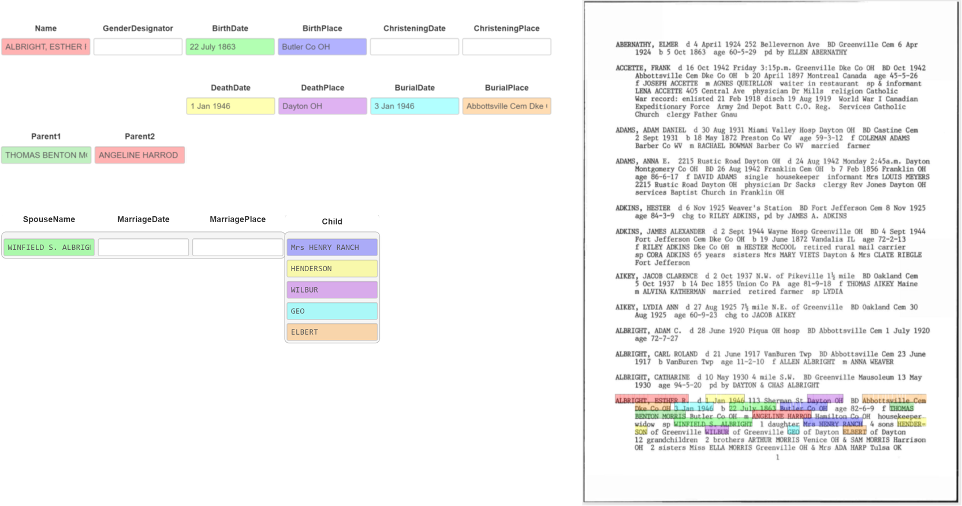
Patron All-Records User Interface (Mockup)
Notes:
Basic Records: (a head-to-head grouping of each of these basic record templates must partition the text; otherwise, not record-semiStructured)
Person(Name, BirthDate, BirthPlace, ChristeningDate, ChristeningPlace, DeathDate, DeathPlace, BurialDate, BurialPlace)
Marriage(Name, (SpouseName, MarriageDate, MarriagePlace)*)
ChildOf(Name, Parent1, Parent2)
Family(Name, (Child)*)
Customization: (head-to-head grouping must partition the text, here always on Name (? HeadName or PersonName or …))
Miller: (Name, BirthDate, BirthPlace, DeathDate, DeathPlace, BurialDate, BurialPlace, Parent1, Parent2, (SpouseName)*, (Child)*)
Kilbarchan:
(Name, BirthDate, ChristeningDate)
(Name, SpouseName, MarriageDate, MarriagePlace, (Child)*)
Ely:
(Name, BirthDate, ChristeningDate, DeathDate, BurialDate, Parent1, Parent2) (too few Places to worry about ??)
(Name, (SpouseName, MarriageDate)*)
(Name, (Child)*)
Modifications to record templates (forms):
Person: ? omit GenderDesignator or skip it in customization (may be needed in cultures in which names do not indicate gender)
Marriage: MarriageDate -> MarriageEventDate; MarriagePlace -> MarriageEventPlace; ? SpouseName -> Spouse; ? Child -> ChildName; ? Name -> PersonName
ChildOf: new record template (Couple deprecated; C is now code name for ChildOf)
Family: omit Parent2; Parent1 ->? PrimaryParent (Family may not be the right name, but we needn’t display it; internal code still F ?)
Advanced User Interface: must be able to set up everything, including customizing record templates and designation of SearchPhrase indicators
Patron User Interface: to what extent can the set-up be omitted? (Or do we only let them work after an advanced user has set up the job?)
Mobile Patron User Interface: must we only use the basic forms?

Slide 18
Overlap & Ambiguous
(Name, SpouseName, MarriageDate, MarriagePlace, (Child)*)
(Name, BirthDate, ChristeningDate)

Slide 19
Relationship Issues
n-ary (n>2): partitioning unbalanced attribute groups
?
Run-away lists & EXTRA

Slide 20
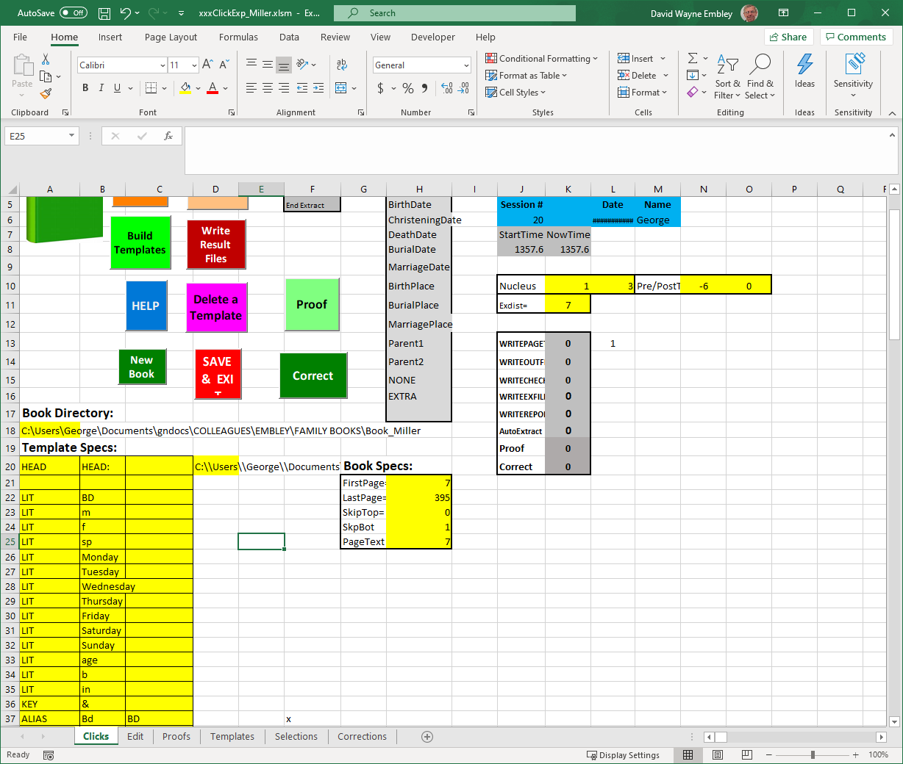
Set-up Info

Slide 21
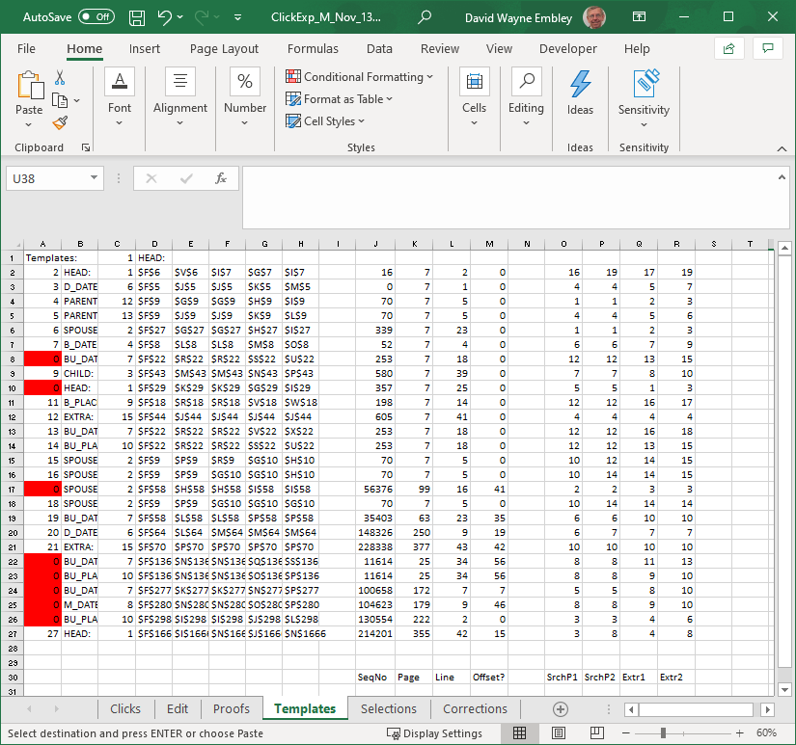
Template Input

Slide 22
Assumptions
An ontology is prespecified (it supplies lexical-entity class names, non-lexical record objects, and relationship sets).
LITs, KEYs, ALIASs(?) are system specified, but can be altered for a run of a book.
DataFrame external representation templates (in terms of tokens) are prespecified.
OCR of the book includes initial line tabs.

Slide 23
Instructions
Give the first and last page of the section of the book to be processed.
Determine the major grouping layout (individual, family, nested family).
Click on the name of the primary person in any one of the major groups. (Make sure that the displayed rectangles bound the major groups throughout the book: Click on any primary person incorrectly included in a bounding rectangle.) If the layout is “nested family”, repeat this step within a group for every level of nesting.
Click on the name of a child of any primary person and continue clicking on children of primary persons until all are highlighted.
Click on the name of a spouse of any person and then also on any marriage event date and marriage event place. Continue clicking until all spouses and their marriage event date and place are all highlighted.
Click on the properties of any person, spouse, or child. Continue clicking until all properties of every person, spouse, or child are all highlighted. (Properties: BirthDate, BirthPlace, ChristeningDate, ChristeningPlace, DeathDate, DeathPlace, BurialDate, BurialPlace, and also Parent1 and Parent2.)
For, nested families, repeat the process at each level of nesting. (Children of the next higher level will be automatically relabeled as primary persons. Spouses along with their properties and all other properties are likely to be already labeled.)
Notes:
Nested families are those in which there are children who also have children.
In 4, it’s important to deal only with children of primary persons.
5 and 6 could be done as one step – here, we are only interested in recognizing entities.
Adding the rectangles so that that they cross over page boundaries and don’t cross-over “extraneous stuff” that should not be included might be tricky. (We probably don’t need to worry about “extraneous stuff” being included, as the only instructions at in this step are to click on primary persons incorrectly included in bounding boxes.)
Also note that we can often provide a list of places to look for possibly missing primary persons (as already built into GreenQQ, i.e. where the SearchPhrase applies but there is no extract).
We must also give them an option to click on text that is highlighted that should not be highlighted. And, then we need to fix the extraction templates. ?? How? I’m not sure.

Slide 24
Click on the name of the primary person in any one of the major groups. Repeat for nested groups, if any.
Notes:
Initially, the patron record template has the focus on Name (rename?: PersonName or PrimaryPersonName) with the rest of the record template greyed out.
The SearchPhrase (in yellow and outlined with blue) is associated with the one PrimaryPersonName clicked on. (If the SearchPhrase yields incorrect results, it can be adjusted by the patron.)
The patron could have also included the title “Rev.” – because we can include titles (or not) in our external-representation specifications, this should work either way.
“Aitken (Akin)” would likely not be in our ext-rep specs. The user should add it. The pattern then becomes part of the book-specific ext-rep specs for a primary person name.
Note that we have a really ugly problem with Kilbarchan “W. Richard Allasone”. The book author has not been consistent: the last-name-comma pattern has been violated, and the line is formatted as a wrap-around line with one tab of indentation. If these problems are recognized, they can likely be remedied by adding yet another SearchPhrase and ext-rep pattern – “likely” because this kind of thing may upset the apple cart. Also, we’re not likely to be able to help the user find these kinds of issues. Not finding and resolving these issues can cause problems – here, the spouse, Ninian Aitkine, would become a second spouse of Thomas Aitkine.

Slide 25

Click on the name of the primary person in any one of the major groups. Repeat for nested groups, if any.
Notes:
For nested family groups, the user should check that the declared nesting for the group also holds for other groups in the book. (If not, fix the nesting and keep checking.)
The system should keep track of the level being worked on. In the following for Mullinix, we’re working only on the outer layer until we explicitly shift to an inner level. As we work on an outer label, the inner rectangles and the labeling of inner PrimaryPersons are removed until the explicit shift. (?? We may not want to remove the inner bounding boxes.)

Slide 26
Click on the name of a child of any primary person and continue clicking on children of primary persons until all are highlighted.
Notes:
Note that with one click we get all the Ely children and all but one of the Kilbarchan children – the missing twin.
Clicking on the twin gets it. The SearchPhrase for William, the second twin, is “and <Name> , NUM1or2” – here and elsewhere “and” should be a literal. The rule I’m thinking of for declaring a SearchPhrase here is go both left and right until one non-punctuation token is encountered and also include the next tokens on the left back to StartOfLine if the token preceding the left non-punctuation token is a tab or SOL; in the latter case, we then drop the right context if the Extract is for a non-lexical object, i.e. the Name of a Person, Spouse, or Child. This rule is superseded when we can find a declared SearchPhrase on the left (e.g. “b” or “d” or “sp” or …) An immediate tab on the left for primary persons and children should also supersede, and all tabs should be included in the SearchPhrase – the number of tabs matters.

Slide 27
Click on the name of a child of any primary person and continue clicking on children of primary persons until all are highlighted.
Notes:
Among many others, “daughter” and “sons” are predeclared SearchPhrases.
Also in this example, “grandchildren” is a predeclared EXTRA SearchPhrase. EXTRA SearchPhrases should not be marked for the user. They preempt run-away lists. Here “sons” preempts a “daughter” run-away list, but there is nothing to prevent the “sons” list from also picking up “ARTHUR MORRIS”, “SAM MORRIS”, “Miss ELLA MORRIS”, and “Mrs ADA HARP”.
A subtle point here is that the “Mrs.” is sometimes important. Otherwise “HENRY RANCH” will be designated as ESTER’s child.
In Mullinix, note that the number of tabs distinguishes children from grandchildren and great-grandchildren.

Slide 28
Click on the name of a spouse of any person and then also on any marriage event date and marriage event place. Continue clicking until all spouses and their marriage event date and place are all highlighted.
Notes:
In Kilbarchan, note that many SearchPhrase patterns are necessary. It’s interesting, however, that none violates the rule for generating contextual SearchPhrases – except perhaps the one that ends with an end of line. That one may need to be adjusted by the patron because the default would be the CAP following it on the next line. (Normally, end of lines on the right may cause problems, but not in this case; how can the patron tell the difference?)

Slide 29
Click on the name of a spouse of any person and then also on any marriage event date and marriage event place. Continue clicking until all spouses and their marriage event date and place are all highlighted.
Notes:
As seen in Mullinix, labeling the spouse of the head also labels the spouses of the children and potentially the spouses of the grandchildren as well. Important!: when post-processing properties (i.e. lexicals), the presence of a record object obtained by ontological commitment (i.e. non-lexicals), the presence of a record object stops the search. In this example and in Ely too, we stop searching for spouses when we hit the children. Also important!: when we are searching just for spouses, it’s a non-lexical object other than spouses that stops the search.
GreenQQ, as an entity recognizer will also recognize spouses that are not spouses of the primary person. How should we deal with this? Possibilities: (1) show them (e.g. Mullinix as shown here), (2) show them but greyed out, (3) don’t show them, … Choosing (1), we should also comment that other spouses may also be recognized even though they are not spouses of the primary person (that’ll happen in Mullinix and also in Ely where children’s spouses appear quite often).
For post processing, for any level of nesting, we only dip into the next-most inner nesting to retrieve children – and nothing else!

Slide 30
Click on the properties of any person, spouse, or child. Continue clicking until all properties of every person, spouse, or child are all highlighted.

Slide 31
Click on the properties of any person, spouse, or child. Continue clicking until all properties of every person, spouse, or child are all highlighted.
Notes:
Here, again, we get properties in inner nesting levels, but we ignore all except the children in the next-most level of nesting.
“m” is ambiguous among forms; it may not matter since in Miller the “m” data will be filled into the Parent2 field whereas in Ely the “m” data will be filled into the SpouseName and MarriageEventDate fields and in Kilbarchan the “m” data will be filled into the MarriageEventPlace and MarriageEventDate fields.
I didn’t try to get patterns for Places; we need to depend as much as we can on data-frame external representations, but that might be difficult. (Thought: I may be able to get a list of places, perhaps just for English- and German-speaking places; then we can tokenize the list and pick out the patterns.) Alternatively, in Miller where we have descriptive place names, we could just pick them up, i.e. get all text between recognized Extracts and recognized SearchPhrases.
“ca.” means something and we should probably process it downstream.
Point-size differences in Mullinix may need some special attention.
Died, with the pattern “1862-1866” is something we don’t handle but could.

Slide 32

Repeat process with next nested group.
Notes:
Within a group, recursively do the same thing. Initially, the highlight on top-level PrimaryPersons is removed and the next inner PrimaryPersons are reset as PrimaryPersons (they are the children of the upper-level PrimaryPerson). The outer bounding boxes are turned black to indicate the content outside the outer-most red bounding boxes is to be ignored when post-processing. Other highlights remain in place and need not be redone.
When post-processing, both outer and inner labels need to be properly handled (ignored or included as appropriate).

Slide 33
… after adding children … spouses and attributes are already in place … and we’re done
Notes:
For post-processing, we need to pay attention to groups. It’s probably not good enough to use functional dependency rules to stop accumulating properties (i.e. a property could be missing and we might end up with the property of a child in the next level of nesting). Sorting out multiple spouses is even more difficult to detect and prevent. In the example above, without boundaries Child Mildred Morgan Mullinix would not only have spouse George O. Shipley but also spouse Walker A. Schwyhart who is acutaly her child’s spouse.

Slide 34
Repeat process with next nested group. … and after one click to label a child, we’re done
Notes:
Note that we do not have the spouse ambiguity for Mildred Morgan Mullinix because Lydia Ann Shipley is recognized as a child at this level of nesting and her spouse is Walker A. Schwyhart.

Slide 35
COMET View of Results
…
Name
Aitken, James
SpouseName MarriageEventDate MarriageEventPlace
Mary Henderson 10 July 1741
Child
John
James
Robert
Matthew
William
Name
Aitken, James
SpouseName MarriageEventDate MarriageEventPlace
Janet Moodie
Child
Elizabeth
…
Notes:
The view is standard COMET, but with the form record being automatically tailored to the text by a union of record types that partition the text (one or more such union). Here:
Marriage + Family (Head with Children)
Person (with Birth & Death Info)
Note that there are no instances of ChildOf, and hence, it is omitted.

Slide 36
COMET View of Results
…
Name
John
BirthDate BirthPlace ChristeningDate ChristeningPlace
DeathDate DeathPlace BurialDate BurialPlace
26 Dec. 1742
Name
James
BirthDate BirthPlace ChristeningDate ChristeningPlace
DeathDate DeathPlace BurialDate BurialPlace
28 Sept. 1744
…
Notes:
The view is standard COMET, but with the form record being automatically tailored to the text by a union of record types that partition the text (one or more such union). Here:
Marriage + Family (Head with Children)
Person (with Birth & Death Info)
Note that there are no instances of ChildOf, and hence, it is omitted.

Slide 37
Another Family Layout to be Considered
Rev. Ben Ezra Stiles Ely …
m. 1848, Elizabeth Eudora McElroy …
Elizabeth B.
Ben-Ezra Stiles
George Everly Montgomery
m. 1873, Abbie Amelia Moore …
Francis Argyle
Harriet Clarissima Ely …
m. Beale Steenberger Blackford …
Caroline Holmes Ely
Zebulon DeForest Ely …
m. 1874, Clara Vanola Major …
William Major
m. 1878, Mamie Anna Souder
Zebulon DeForest
Edmund Holmes
Edna Holmes
Rev. Ben Ezra Stiles Ely …
m. 1848, Elizabeth Eudora McElroy …
Elizabeth B.
Ben-Ezra Stiles
George Everly Montgomery
m. 1873, Abbie Amelia Moore …
Francis Argyle
Harriet Clarissima Ely …
m. Beale Steenberger Blackford …
Caroline Holmes Ely
Zebulon DeForest Ely …
m. 1874, Clara Vanola Major …
William Major
m. 1878, Mamie Anna Souder
Zebulon DeForest
Edmund Holmes
Edna Holmes
Rev. Ben Ezra Stiles Ely …
m. 1848, Elizabeth Eudora McElroy …
Elizabeth B.
Ben-Ezra Stiles
George Everly Montgomery
m. 1873, Abbie Amelia Moore …
Francis Argyle
Harriet Clarissima Ely …
m. Beale Steenberger Blackford …
Caroline Holmes Ely
Zebulon DeForest Ely …
m. 1874, Clara Vanola Major …
William Major
m. 1878, Mamie Anna Souder
Zebulon DeForest
Edmund Holmes
Edna Holmes
Notes:
Two linear separations are needed with different primary persons. Both record types are Parent-Child*

Slide 38
Extraction Scan-to-Submit User Interface (Mockup)

Slide 39
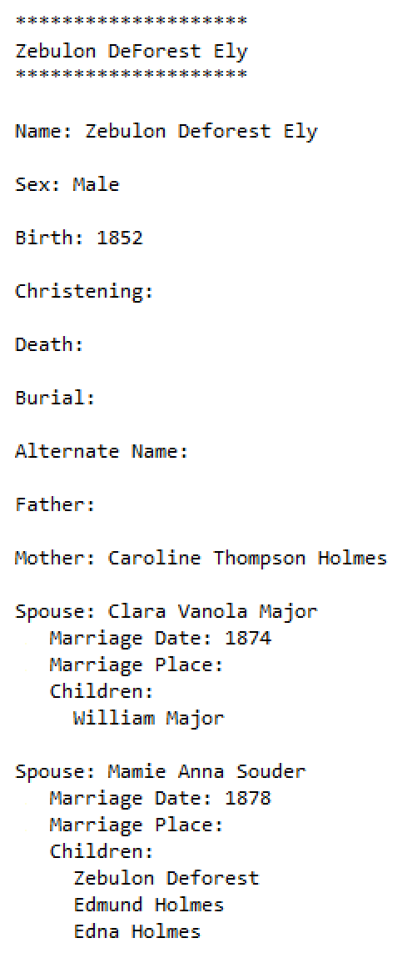
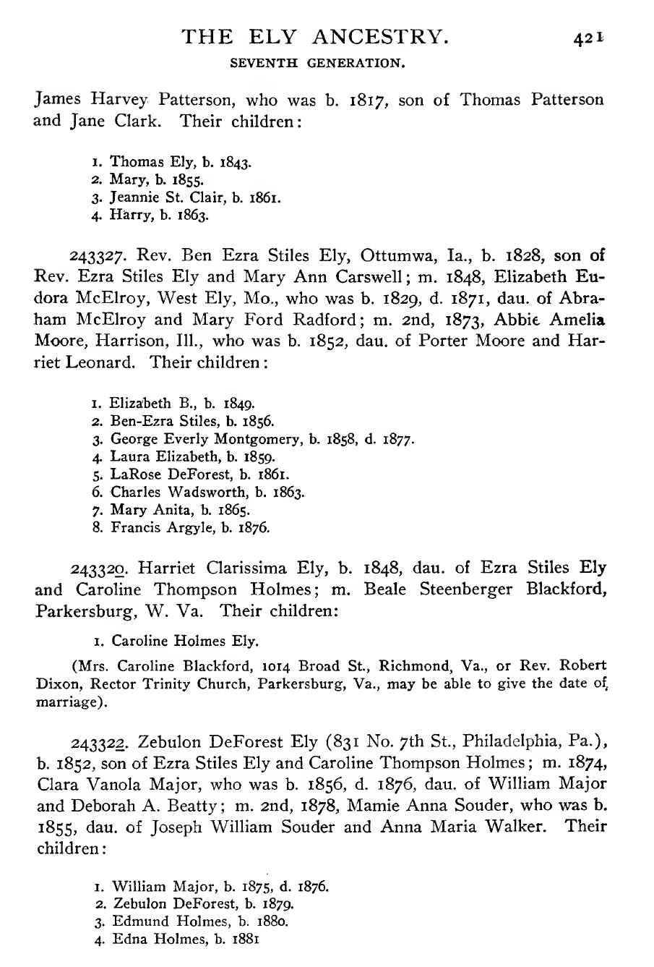
Submission Scan-to-Submit User Interface (Mockup)
Ezra Stiles Ely
Notes:
The form can be COMET, but the only edits that can be made are to the text fields by typing.

Slide 40
Requirements for Realization
Research
HWR (and OCR) for languages of interest
Auto-extraction (Machine Learning, Pattern Recognition, Natural Language Processing)
Bootstrapping/Improving auto-extraction from information gleaned only from Temple-Ready pipeline
ML: learning from minimal and potentially imperfect training data, active learning from corrections
PR: rule generation from form-filled submissions to tree, rule-set update from corrections to auto-filled forms
NLP: language learning from examples, both correct and incorrect
Proof-of-concept prototype development
Implementation
Search repository
Enable hybrid keyword & semantic search
Handle corrections
Update repository based on rerun of auto-extraction
Form fill
Create interface
Auto-fill form
Support additions and corrections
Tree import
Duplicate detection
Information import

Slide 41
Workflow System Notes
Path Codes
Q: Quick Test (3.2 > 6.PCF > PRF-report and also > 4.PCF)
T: Full Test (3.4 > 6.PCF > PRF-report and also > 4.PCF)
R: Book Run, from extraction to ingest ready (3.4 > 7.1)
U: User Alone, without extraction ensemble (1 > 4.PCF)
I: Index Batch, with or without extraction
User Options (while in 4.PCF)
Ground Truth (only for those configuring and testing extraction tools)
Ingest Ready (only for those who are indexing)
Save Work
Indexing
Control as before except without adjudicator and with the option to loop as desired
Loop: 4.PCF > 5.PCF > 6 > 6.PCF > 4.PCF
Finish when batch is ingest ready
Error Processing (thoughts)
Fatal Errors: stop pipeline run and save current state, save log and include error message, alert administrator
Page Errors: if cumulative number exceeds a threshold, throw a fatal error
Summary Error Report: send to administrator (eventually, if no errors, auto-submit to search system and …)

Slide 42
Database Schema
book (id, user-id)
user (id, username, email, password, name, type)
job (id, name, book-id, max-page)
batch (id, pages, status, job-id, user-id)
form (id, form-name, version)
eventlog (id, user-id, batch-id, session-id, log-info, time-written)
user_type (type, description)
P: patron
D: developer
A: administrator
N: not assigned
A: assigned
W: withdrawn (to be reassigned)
S: submitted (for checking)
D: done (to be sent downstream)
Notes:
DB supports:
Indexing
Tool configuration
Pipeline runs
The user-id in book is the assigned developer who configures tools to either processes the whole book or in preparation for indexing.

Slide 43
User Name:
Full Name:
Email:
Password:
Confirm Password:
PIN:

Slide 44
Administrator/Developer Menu
Register Book (administrator only)
Import Book
Configure Extraction Tools
Initiate Pipeline Run
Manage Indexing Pipeline Run (administrator only)
Manage Indexing Jobs and Batches (administrator only)
Edit User Account (administrator only)
Notes:
Hamburger icon ?
Click reveals menu ?

Slide 45
Register Book
Book PDF:
Browse
Short Title:
Bibliographic citation:
Upload
Notes:
Administrator has the pdf of the book on a local machine
Administrator has browsed the book for the info requested
Copy/Paste or type in full path to book
Or, browse to the book
Upload:
Assigns the next unique id#
Checks the short title for uniqueness
Trusts that the bibliographic citation is good so long as it has a reasonable number of words

Slide 46
Import Book
Select Book:
v
Book Information: <display of book meta information>
Browse Book
Upload
Notes:
Select Book:
Displays book information
Lets a user browse the book
Upload:
Assigns the selected book to the user
Creates directory structure
Adds initial content

Slide 47
Configure Extraction Tools
Book:
First Page (to process):
Last Page (to process):
Tool:
v
Browse
v
Go
Notes:
Book: Select book to work on (from among assigned books)
User can browse selected book
Select range of pages in book to be processed
Select Tool to configure

Slide 48
FROntIER
Use FROntIER interface, as is, to create an extraction ontology
Upload either the predefined single ontology or the three PCF ontologies
Future?: upload a user-defined ontology along with a mapping Java jar file
Use CMS testing interface to test the created extraction ontology
Run test (as can be done for all tools)
Set ground truth (as possible for all tools)
Future?: embed Workbench
Predefined FROntIER ontology:
Browse
Directory of Person, Couple, and Family ontologies:
Browse
Upload
Upload clears all current ontologies and installs whatever is uploaded.
A test run uses either the predefined ontology or the PCF ontologies or both depending on what has been uploaded.
Test displays the “Test Extraction Tool Ensemble” page with the current book selected for Book, the most recent page, page list, or page range filled in for Test Page(s), FROntIER as the only tool checked, and Quick chosen as the Test Type.
Test

Slide 49
GreenDDA
Select book
Create training set
Train ML tool to training set
Apply trained ML tool to book

Slide 50
GreenQQ
Book: <book being processed>
First Page: <specified first page to process>
Last Page: <specified last paget to process
Skip Top Lines:
Skip Bottom Lines:
<list of input specs>
x
^
…
…
<new Person>
<new Couple>
<new Family>
v
Standard User Interface
Advanced User Interface
ClickEx User Interface
Notes:
Book already selected, browsed, and pages selected for processing
Set parameters: Header and Footer lines to skip
Edit:
Choose an input spec to edit
or choose <new> to create a new one
User chooses new for one of the forms and specifies a name
The system generates: <Form>InputSpecs.<user-chosen name>.csv
Click Standard or Advanced User Interface to edit

Slide 51
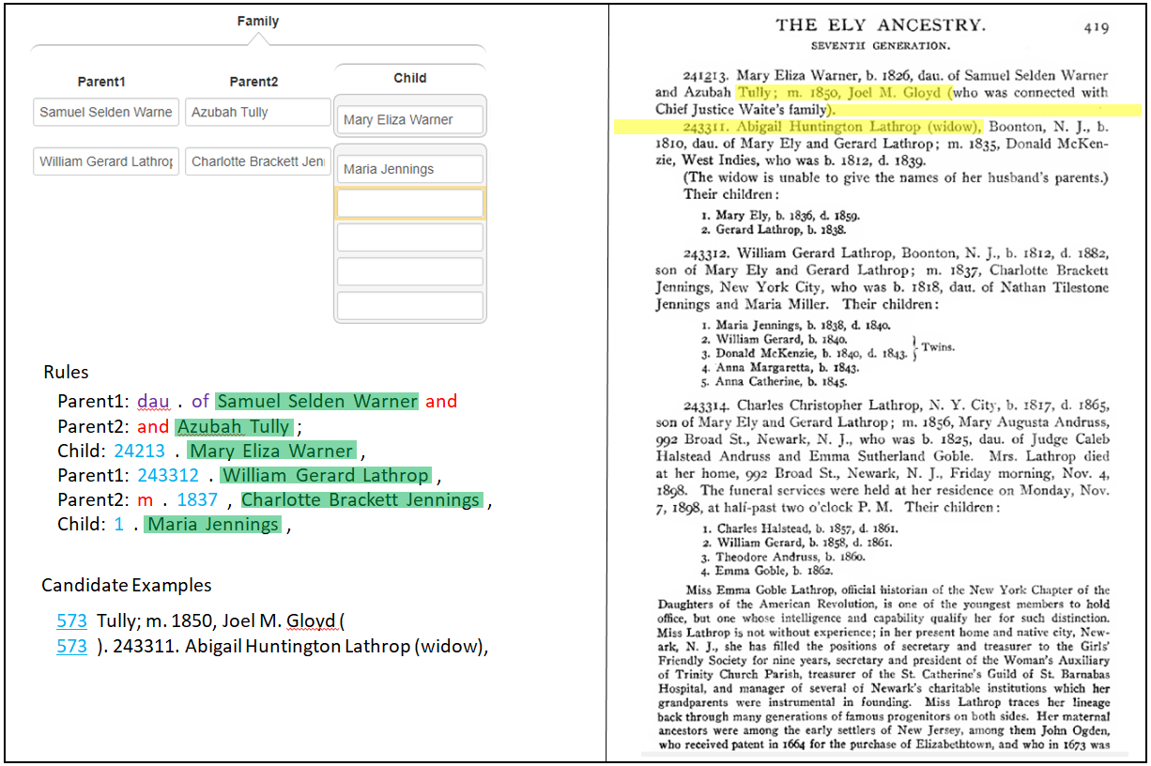
Standard User Interface
Test pages
Quick Test
Quick Test (all)
Full Test
Full Test (all)
Ensemble Test

Slide 52
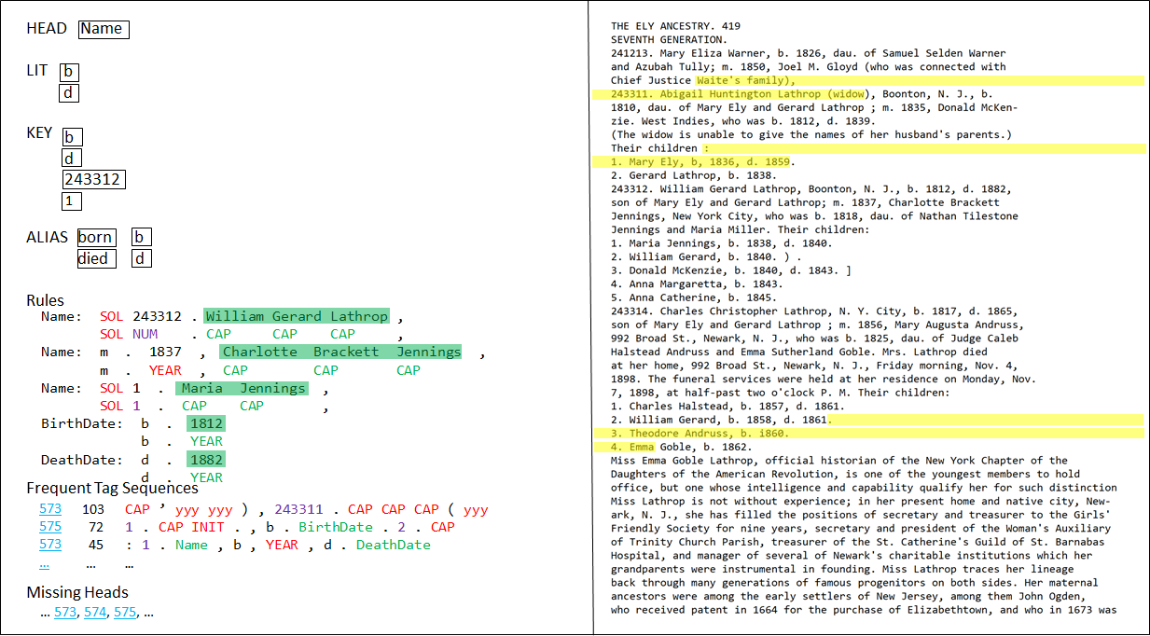
Advanced User Interface
Test pages
Quick Test
Quick Test (all)
Full Test
Full Test (all)
Ensemble Test
Notes:
Test pages: auto-filled-in with the current page; editable to any list or range
Quick Test: run a quick test (COMET view & PRF report) with just the extraction specs being worked (i.e. just the form and the particular variation being worked on; or if we wanted we could make the Quick Test be for just the form, but for all variations – the concern for this choice is that it can include rules beyond those on the screen in front of the user, which may be confusing)
Quick Test (all): run a quick test with all the GreenQQ extraction specs being developed
Full Test: run a full test (COMET view & PRF report after any OCR correction, any relationship fixes, and constraint & authority checking) with the current GreenQQ extraction specs for the form being worked
Full Test (all): run a full test with all the GreenQQ extraction specs being developed
Ensemble Test: configure a quick or full test over multiple tools (see Test Extraction Tool Ensemble for setting up the run)

Slide 53
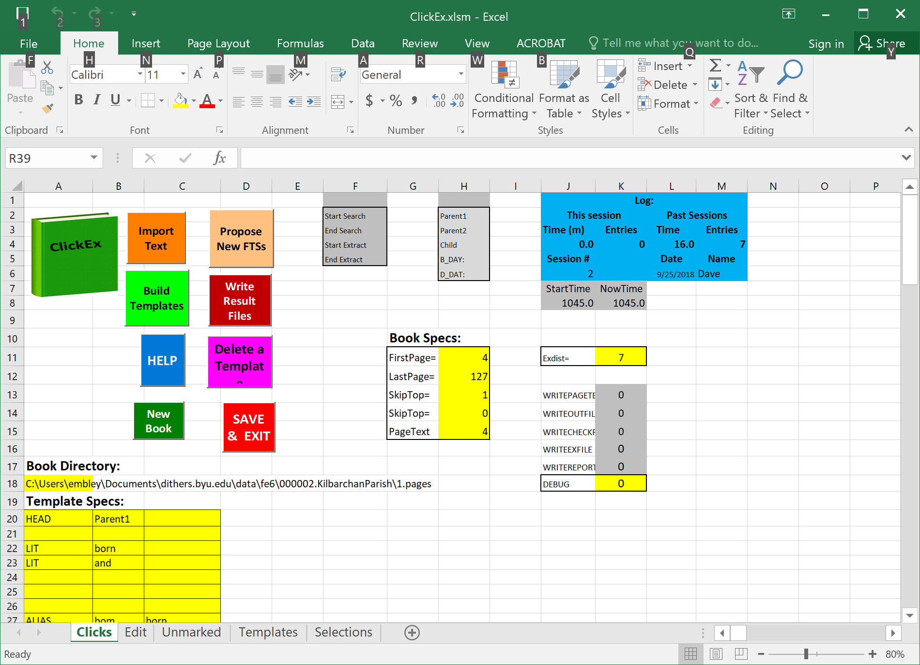
ClickEx User Interface
Test pages
Quick Test
Quick Test (all)
Full Test
Full Test (all)
Ensemble Test
Notes:
Test pages: auto-filled-in with the current page; editable to any list or range
Quick Test: run a quick test (COMET view & PRF report) with just the extraction specs being worked (i.e. just the form and the particular variation being worked on; or if we wanted we could make the Quick Test be for just the form, but for all variations – the concern for this choice is that it can include rules beyond those on the screen in front of the user, which may be confusing)
Quick Test (all): run a quick test with all the GreenQQ extraction specs being developed
Full Test: run a full test (COMET view & PRF report after any OCR correction, any relationship fixes, and constraint & authority checking) with the current GreenQQ extraction specs for the form being worked
Full Test (all): run a full test with all the GreenQQ extraction specs being developed
Ensemble Test: configure a quick or full test over multiple tools (see Test Extraction Tool Ensemble for setting up the run)

Slide 54
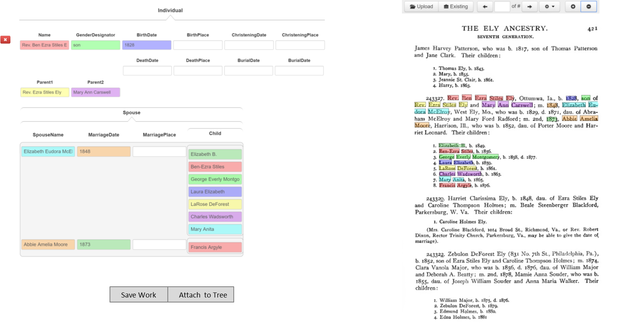
Ghost Indexing Interface
Notes:
When a user is filling in a form, we index behind the scenes. Modified GreenQQ and GreenFIE should both work, but it’ll take a great deal of effort.

Slide 55
GreenFIE
Regular GreenFIE interface embedded in CMS test mode
Selectively save/retract generated rules
Changes to COMET interface (or should we just use the TWK annotator? Note that we’ll also need a COMET interface for GreenDDA and GreenGN)
Add GreenFIE “Regex” button
Replace button controls with a mechanism to save/retract generated rules and to initiate a “Quick” test run.
Make page number a type in box
GreenFIE
Regex
Regex
Regex
Regex
Test

Slide 56

ListReader
Select book and run ListReader (future: also set text abstraction parameters)
One record from all three forms on the lhs
Highlights on the rhs as generated by ListReader
Control buttons
Next (to tell ListReader to save the current labeling and ask for the next)
Stop (to stop the labeling cycle)
ListReader
Next
Stop

Slide 57
OntoES
Rule

Slide 58
OntoSoar
Deryle to specify

Slide 59
Test Extraction Tool Ensemble
Select Book
Specify test page(s)
Include tools in ensemble test
Choose run type: Quick or Full
Click Run
Progress bar
Abort button
v
Book:
Test Page(s):
Tools Included in Test Run:
[ ] FROntIER
[ ] GreenDDA
[ ] GreenFIE
[ ] GreenQQ
[ ] ListReader
[ ] OntoES
[ ] OntoSoar
Test Type:
o Quick
o Full
Book: initialized as the book chosen by the tool that initiated the Test.
Other choices include books for which tools have been configured but are not yet either fully processed or are in progress of being processed.
Test Page(s): <page, e.g. 099> or <page list, 030, 031, 099> or <page range, e.g. 030-031>. Test Page(s) default is the most recent choice of test pages by the initiating tool for the book or, if none, the default is the range of pages specified for processing for the book.
Tools Included in Test Run: initialized by a check for the tool that initiated the test. Other tools can be added, in which case, the ensemble of tools checked is run.
Quick Test Type: extract, merge, split to forms, and display in COMET. (Allow for edit and creation of ground truth.)
Full Test Type: extract, merge, fix OCR & bad relationships, check constraints & authorities and add warnings, split to forms, display in COMET (allow edits and creation of ground truth), produce PRF reports, standardize, infer, generate GedcomX and import files.
We need a progress bar showing how much has been completed and also an abort button. (Perhaps in place of the Run button.)
Run

Slide 60
Test Run Results
Run pipeline with status T
Results of a test run (for both Quick and Full)
COMET for each page/form
Editable to create/replace ground truth
Additional results for Full test run
COMET with warning icons and messages
Ground-truth reports
FS-import products
batch status = “T”
Generate Ground Truth
range.030-031.PRFreport-soft.txt
Person/range.030-031.PRFreport-soft.txt
Person/030.PRFreport-soft.txt
Person/031.PRFreport-soft.txt
Couple/range.030-031.PRFreport-soft.txt
Couple/030.PRFreport-soft.txt
Couple/031.PRFreport-soft.txt
Family/range.030-031.PRFreport-soft.txt
Family/030.PRFreport-soft.txt
Family/031.PRFreport-soft.txt
clickable list of available reports

Slide 61
Manage Jobs and Batches
Steve to specify

Slide 62
Initiate Pipeline Run
Pops up on “Initiate Pipeline Run” in admin menu
On “Run”
Confirm initiation
Remind user to click on “Manage Pipeline Run” – banner will be in place
Book
Select from options
Page Range
–
Tools
FROntIER
GreenDDA
GreenFIE
ListReader
OntoES
OntoSoar
Run Type
with COMET
without COMET
Run

Slide 63
Manage Pipeline Run
Display progress for book
Show progress for each page
Report failures
Allow admin to kill and restart tasks
When running through COMET:
Display progress of each job
Percent complete
Status of each batch: Unassigned/InProgress/Done
Status of InProgress batches
User assigned
Page/form status
Eventlog for batch (upon request)
Retract batch from user
Assign batch to user
Reassign batch to user
User status
Batches completed
Batches assigned
Eventlog report for user (upon request)
View results
with COMET – view filled records by page & form
with and without COMET – view Gedcom X reports
Submit completed work to FS

Slide 64
Manage Pipeline Run (post “Initiate Pipeline Run”)
Display progress for book
Show progress for each page
Report failures
Kill and restart tasks
Check completed runs
Select page/form for COMET view
Select page/report for Gedcom X view
Release results (depending on the state) for:
Patron batch selection
Ingest into FamilySearch
If “with COMET” directly to tree
Otherwise, to LLS
Extracting data
FROntIER
OntoES
Cleaning extracted text
Merging extracted data
Cleaning data values
Parsing dates
Fixing bad relationships
Consolidating data
Standardizing data
Inferring additional data
Generating conclusions
Nr. pages tried: 100 completed: 100
List only selected tools
“with COMET”: replace the last four with
Generating PCF json
Post COMET, add the last four back
Stop Run
Resume Run
Select from options
View Results
Release Results
Not active until run is done

Slide 65
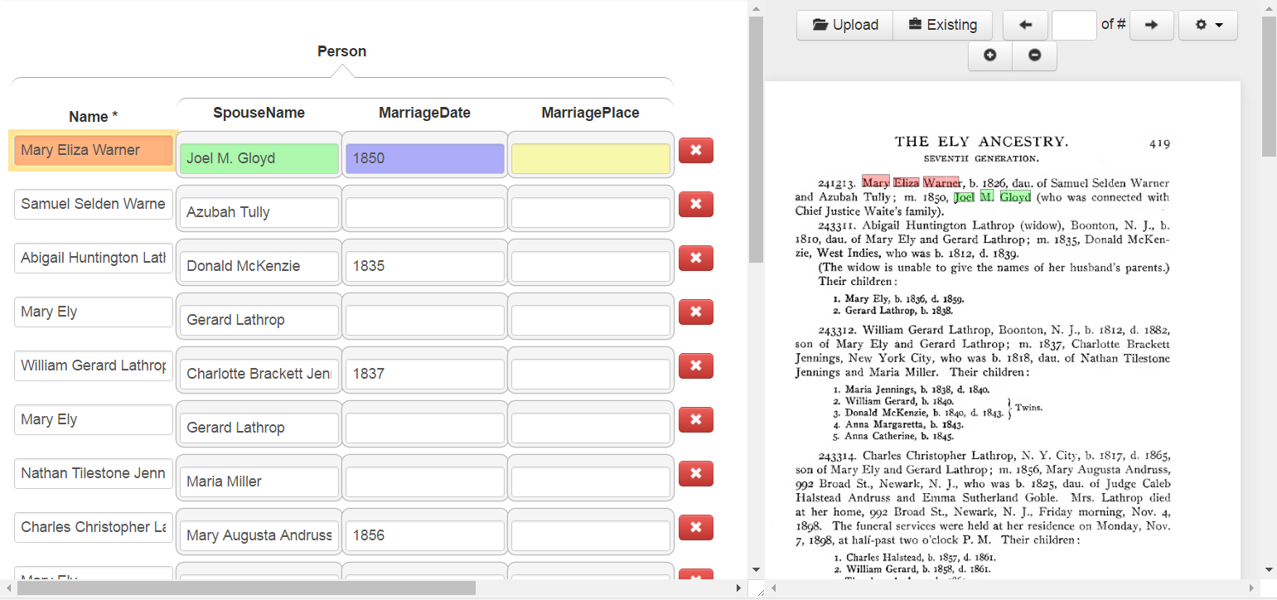
View Results (with COMET)
Display page & form
Click on form for page
Display filled in records in COMET
Any edits are retained ?
Release for patron batch selection
TheElyAncestry
Page Form
571 Person Couple Family
572 Person Couple Family
573 Person Couple Family
574 Person Couple Family
575 Person Couple Family
Release Results

Slide 66
View Results (without COMET)
Display page & form
Click on form for page
Display filled in records in COMET
Any edits are retained ?
Release for patron batch selection
<?xml version="1.0" encoding="UTF-8" standalone="yes"?>
<gedcomx xmlns="http://gedcomx.org/v1/">
<person id="osmx112">
<gender type="http://gedcomx.org/Male">
<attribution>
<changeMessage>inferred based on gender designator (such as &quot;daughter&quot; or &quot;Mrs.&quot;), or probabilistically based on first given name or on first given name of spouse</changeMessage>
</attribution>
</gender>
<name>
<nameForm>
<fullText>Gerard Lathrop</fullText>
<field>
<value type="http://gedcomx.org/Original">
<source description="#TheElyAncestry.573">
<qualifier name="http://gedcomx.org/rectangularRegion">0.50160,0.29793,0.51424,0.37077</qualifier>
<qualifier name="http://gedcomx.org/rectangularRegion">0.50165,0.38086,0.51451,0.46729</qualifier>
</source>
<text>Gerard Lathrop</text>
</value>
<value type="http://gedcomx.org/Interpreted">
<text>Gerard Lathrop</text>
TheElyAncestry
Page
571
572
573
Release Results

Slide 67
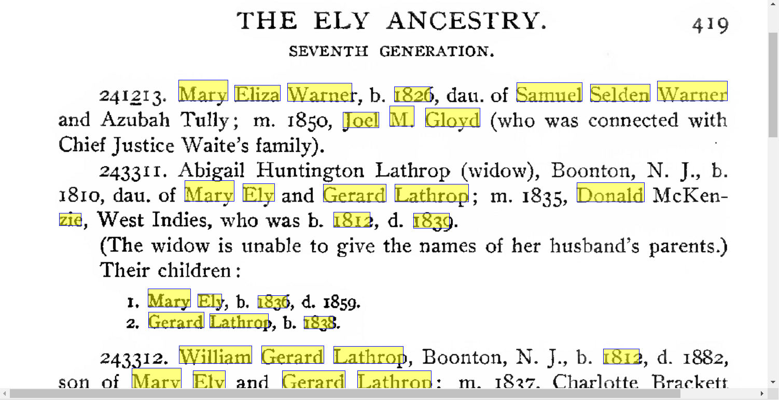
View Results (without COMET)
Display page & form
Click on form for page
Display filled in records in COMET
Any edits are retained ?
Release for patron batch selection
TheElyAncestry
Page Person
+ 571
+ 572
- 573
Mary Eliza Warner
Samuel Selden Warner
Release Results
Full page here?

Slide 68
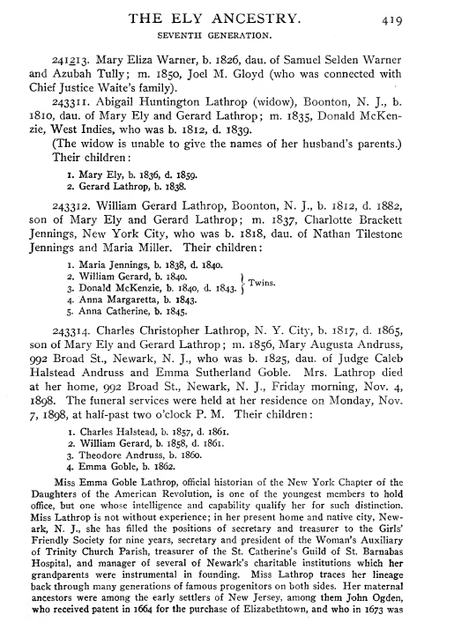
View Results (without COMET)
Display page & form
Click on form for page
Display filled in records in COMET
Any edits are retained ?
Release for patron batch selection
*********************************
Person osmx226: Mary Eliza Warner
*********************************
Name:
Conclusion Name: Mary Eliza Warner
Original Document Text: Mary Eliza Warner
Interpreted Document Text: Mary Eliza Warner
Gender: Unknown
Facts:
BirthDate:
Conclusion: 1826
Original Document Text: 1826
Interpreted Document Text: 1826
BirthPlace:
Marriage Relationships:
ParentOf Relationships
ChildOf Relationships:
TheElyAncestry
Page Person
+ 571
+ 572
- 573
Mary Eliza Warner
Samuel Selden Warner
Release Results

Slide 69
Activity Title
Name of Book and link to overall PDF
Zoom
< Previous
Page v
Next >
Name list
Page with highlights
Info box
(empty for slide 19)
URL of page for direct access to unmarked PDF
Toolbar
Toolbar

Slide 70
Edit User Account
Find user
Set any/all:
Password
Username
Email
Full name
Change privileges
Disable account
Select user:
id
username
email
name
search

Slide 71
Edit User Account
Find user
Set any/all:
Password
Username
Email
Full name
Change privileges
Disable account
User:
id
username
email
name
Change password
Change username
Change email
Change full name
Change privileges
o Patron
o Adjudicator-patron
o Administrator
o Super-administrator
o Disable account
done

