Slide 1
D-Dupe-like Mary Ely Example

Slide 2
Auto-generated View of Mary Ely Ingest
Spouse
Gerard Lathrop (osmx154)
Gerard Lathrop (osmx205)
Gerard Lathrop (osmx147)
Gerald Lathrop (2483-R32)
Father
Rev. Zebulon Ely (LWLS-LGD)
Person
Mary Ely (osmx161)
Mary Ely (osmx456)
Mary Ely (osmx 147)
Mary Ely (osmx275)
BirthDate: 1836
DeathDate: 1859
Mother
Sarah Apame Mills (KVGQ-391)
Person
Mary Ely (KFRL-WXZ)
Birth: 30 Aug 1748
Death: 1879
Mary Eli (MGV1-9BJ)
Mother
Abigail Huntington Lathrop (osmx463)
Child
Abigail Huntington Lathrop (osmx463)
Abigail Lathrop (LZYM-C3F)
William Gerard Lathrop (osmx353)
William Gerard Lathrop (K425-D36)
Charles Christopher Lathrop (osmx334)
Charles Christopher Lathrop (KH3W-PDP)
Child
Miles Ely Lathrop (K4T1-JWL)
Ezra Styles Ely Lathrop (MPV2-1TB)
Mary Cornelia Lathrop (K8N2-P35)
Charlotte Eliza Lathrop (KHX-T1D)
Ezra Styles Ely Lathrop (MJZC-6PR)
Father
Donald McKenzie (osmx179)
?

Slide 3
1. Fix errors in the automated assessment.
Spouse
Gerard Lathrop (osmx154)
Gerard Lathrop (osmx205)
Gerard Lathrop (osmx147)
Gerald Lathrop (2483-R32)
Father
Rev. Zebulon Ely (LWLS-LGD)
Person
Mary Ely (osmx161)
Mary Ely (osmx456)
Mary Ely (osmx 147)
Mother
Sarah Apame Mills (KVGQ-391)
Person
Mary Ely (KFRL-WXZ)
Birth: 30 Aug 1748
Death: 1879
Mary Eli (MGV1-9BJ)
Child
Abigail Huntington Lathrop (osmx463)
Abigail Lathrop (LZYM-C3F)
William Gerard Lathrop (osmx353)
William Gerard Lathrop (K425-D36)
Charles Christopher Lathrop (osmx334)
Charles Christopher Lathrop (KH3W-PDP)
Child
Miles Ely Lathrop (K4T1-JWL)
Ezra Styles Ely Lathrop (MPV2-1TB)
Mary Cornelia Lathrop (K8N2-P35)
Charlotte Eliza Lathrop (KHX-T1D)
Ezra Styles Ely Lathrop (MJZC-6PR)
2. Generate ingest plan.
3. Execute plan.

Slide 4
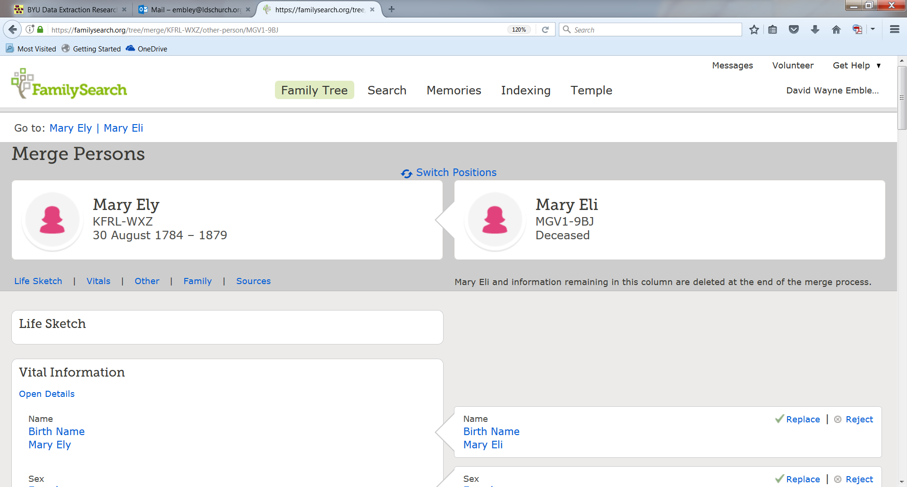
3a. Merge tree-side Persons.
Person
Mary Ely (KFRL-WXZ)
Birth: 30 Aug 1748
Death: 1879
Mary Eli (MGV1-9BJ)

Slide 5
3b. Add source documentation for (merged) Mary Ely.

Slide 6
3c. Ingest and merge information for matching children.
Child
Abigail Huntington Lathrop (osmx463)
Abigail Lathrop (LZYM-C3F)
William Gerard Lathrop (osmx353)
William Gerard Lathrop (K425-D36)
Charles Christopher Lathrop (osmx334)
Charles Christopher Lathrop (KH3W-PDP)

Slide 7
3d. Resolve and document any remaining conflicting information.
Gerard

