Slide 1
Record Merge (book persona-record merge & merged-persona-record/tree-persona-record merge)
Team Members
David W. Embley, Scott N. Woodfield, Gary James Norris
Stephen W. Liddle, Deryle W. Lonsdale, George Nagy,

Slide 2

Book Persona Record Merge Overview
Extract Persona Records
Curate Persona Records
Merge Persona Records
Persona Equivalence Classes (records to be merged)
Merged Personas pdf (documentation)
Merged Personas json (user check with COMET)
Merged Personas Tree Ready json (user check & fix)
Family Trees Gedcomx (for export to …)

Slide 3
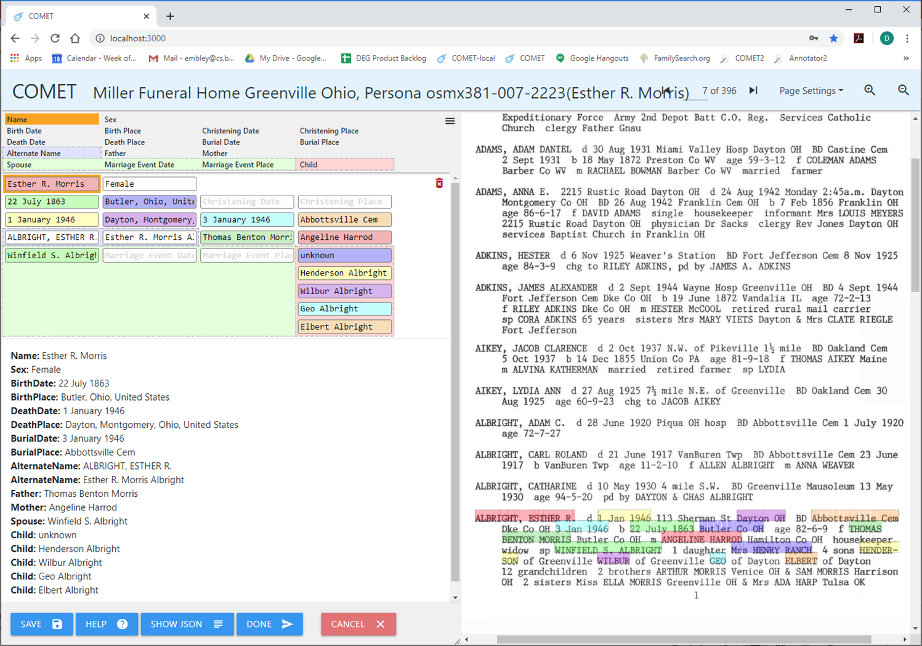
Curated Input Persona Record

Slide 4
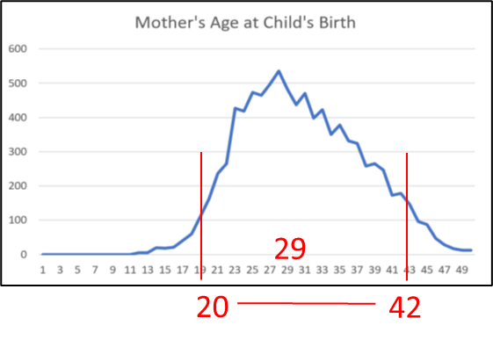
Shallow Match
…

Slide 5
Shallow Match
…

Slide 6
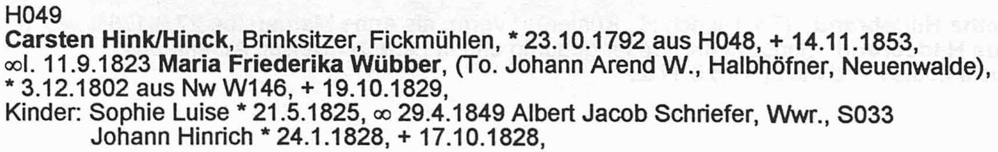
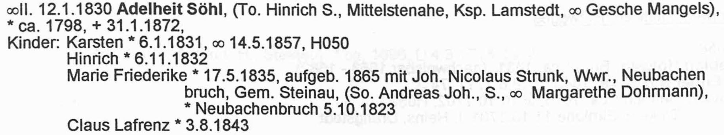
Persona Merge: Persona Integrity Check
Flögeln Example:
Number of persona: 4,583
Total number of unique defective persona found by all constraints: 101(2.2%)
HISTOGRAM OF NUMBER OF UNIQUE PERSONA(BY CONSTRAINT)
ChildBeingBornYearsAfterMarriageEventDat XXXXXXXXXXXXXXXXXXXXXXXXXXXXX(29/1803 failed 1.6%)
ChildBeingChristenedYearsAfterMarriageEv XXXXXX(6/196 failed 3.1%)
FatherHasAgeAtBirthOfChild XXXXXXXXXXXXXXXXXXX(19/362 failed 5.2%)
MarriedCoupleCannotHaveSameGenderConstra XXXXXXXXXXXXXXXXXXXXXXXX(24/1869 failed 1.3%)
MotherDiedBeforeChildWasBorn XXXXXXX(7/257 failed 2.7%)
MotherDiedBeforeChildWasChristened All Passed(92 tested)
MotherHasAgeAtBirthOfChild XXXXXXXXXXXX(12/384 failed 3.1%)
PersonDyingBeforeOrToLongAfterBirth All Passed(1044 tested)
PersonDyingBeforeOrToLongAfterChristenin All Passed(116 tested)
PersonMarriedAfterDeath XXXX(4/528 failed 0.8%)
PersonNotOwnAncestorConstraint All Passed(3609 tested)
PersonNotOwnSpouseConstraint All Passed(1894 tested)
Number of persona: 4583
Number of persona checked: 4291
Total number of unique defective persona found by all constraints: 101
Percent of unique persona who were defective = 2.2%
Percent persona checked who were defective = 2.4%
Total number of persona tested by all constraints: 16834
Total number of defective persona found by all constraints: 130
Percent of persona who were defective = 0.8%
HISTOGRAM OF NUMBER OF UNIQUE PERSONA(BY CONSTRAINT) -- 1.0 test cases per X
ChildBeingBornYearsAfterMarriageEventDat XXXXXXXXXXXXXXXXXXXXXXXXXXXXX(29/1803 failed 1.6%)
ChildBeingChristenedYearsAfterMarriageEv XXXXXX(6/196 failed 3.1%)
FatherHasAgeAtBirthOfChild XXXXXXXXXXXXXXXXXXX(19/362 failed 5.2%)
MarriedCoupleCannotHaveSameGenderConstra XXXXXXXXXXXXXXXXXXXXXXXX(24/1869 failed 1.3%)
MotherDiedBeforeChildWasBorn XXXXXXX(7/257 failed 2.7%)
MotherDiedBeforeChildWasChristened All Passed(92 tested)
MotherHasAgeAtBirthOfChild XXXXXXXXXXXX(12/384 failed 3.1%)
PersonDyingBeforeOrToLongAfterBirth All Passed(1044 tested)
PersonDyingBeforeOrToLongAfterChristenin All Passed(116 tested)
PersonMarriedAfterDeath XXXX(4/528 failed 0.8%)
PersonNotOwnAncestorConstraint All Passed(3609 tested)
PersonNotOwnSpouseConstraint All Passed(1894 tested)
Notes:
Note number of persona evaluated, number that were defective, and percent

Slide 7
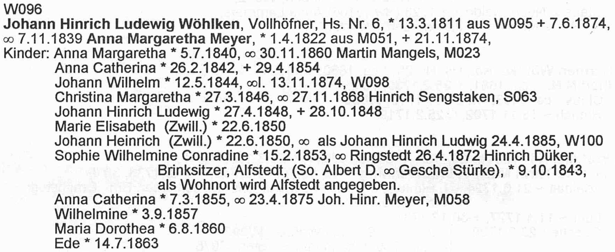
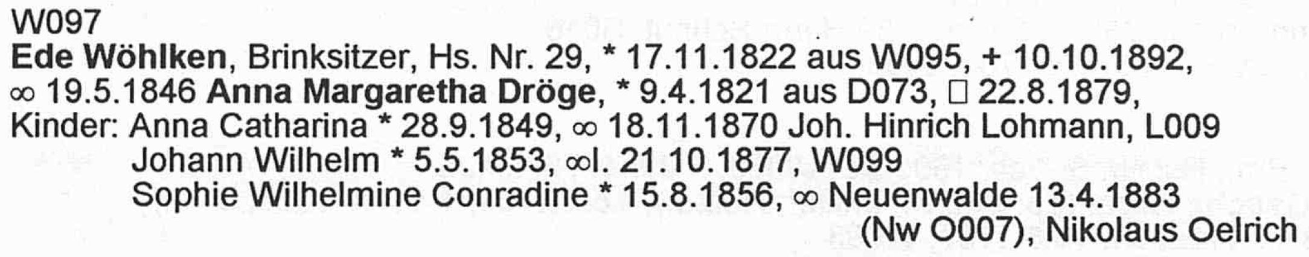
Persona Merge: Red-Flag Check
Flögeln Example:
Total number of persona pairwise constraints tested: 4,640
Total number of persona pairs red flagged: 969 (20.9%)
HISTOGRAM OF NUMBER OF RED FLAGGED PAIRS(BY CONSTRAINT)
TwoPeopleHaveTheSameBirthDate XXXXXXXXXXXXXXXXXXXXXXXXXXXXXXXXXXXXXXXXXXXXXXXXXXXXXXXXXXX(302/659 failed 45.8%)
TwoPeopleHaveTheSameBurialDate XXXXXXXXXXXXXX(74/84 failed 88.1%)
TwoPeopleHaveTheSameChristeningDate XXXXXXXXXX(51/110 failed 46.4%)
TwoPeopleHaveTheSameDeathDate XXXXXXXXXXXXXXXXXXXX(105/105 failed 100.0%)
TwoPeopleHaveTheSameGender XXXXX(26/1804 failed 1.4%)
TwoPeopleHaveTheSameName XXXXXXXXXXXXXXXXXXXXXXXXXXXXXXXXXXXXXXXXXXXXXXXXXXXXXXXXXXXXXXXXXXXXXXXXXXXXXXXX(411/1878 failed 21.9%)

Slide 8
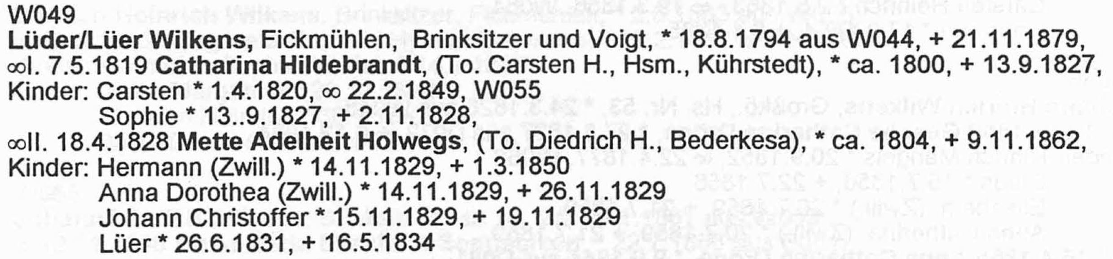
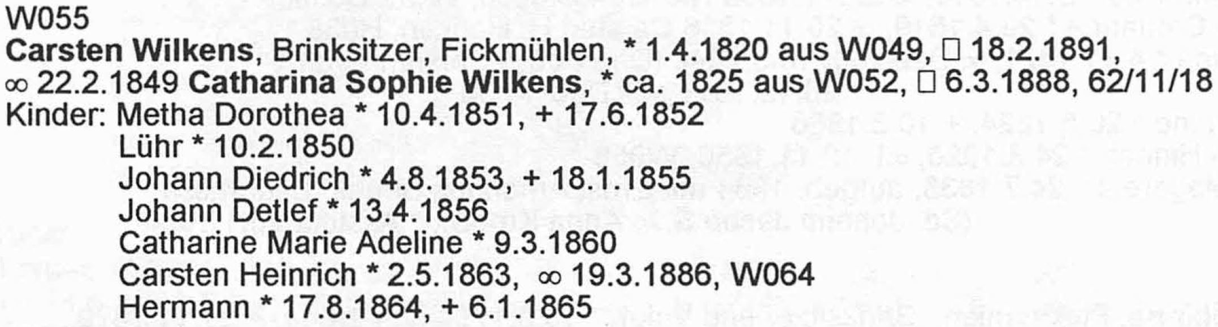
Persona Merge: Temp-Merge Check
Flögeln Example:
Total number of merged persona tested by all constraints: 3,011,818
Total number of defective merged persona found by all constraints: 30,684 (1.0%)
HISTOGRAM OF NUMBER OF DEFECTIVE MERGED PERSONA(BY CONSTRAINT)
ChildBeingBornYearsAfterMarriageEventDat X(194/564 failed 34.4%)
ChildBeingChristenedYearsAfterMarriageEv (29/113 failed 25.7%)
FatherHasAgeAtBirthOfChild XXXXXXXXXXXXXXXXXXXXXXXXXXXXXXXXXXXXXXXX(16900/1653644 failed 1.0%)
MarriedCoupleCannotHaveSameGenderConstra All Passed(1505 tested)
MotherDiedBeforeChildWasBorn (8/450 failed 1.8%)
MotherDiedBeforeChildWasChristened All Passed(76 tested)
MotherHasAgeAtBirthOfChild XXXXXXXXXXXXXXXXXXXXXXXXXXXXXXXX(13520/1352404 failed 1.0%)
ParentsChildrenSpacedFarEnoughApart (14/661 failed 2.1%)
ParentsOfChildMeetMustMeetParentalConstr All Passed(894 tested)
PersonCantHaveOverlappingSpouses All Passed(113 tested)
PersonDyingBeforeOrToLongAfterBirth (2/533 failed 0.4%)
PersonDyingBeforeOrToLongAfterChristenin All Passed(126 tested)
PersonMarriedAfterDeath (17/735 failed 2.3%)
PersonNotOwnAncestorConstraint None Tested
PersonNotOwnSpouseConstraint None Tested
Notes:
15 constraints
This is a merge of Hans Jürgen Ehlbeck as a son in the household of Claus Ehlbeck with the Hans Jürgen Ehlbeck as the head of household in the next household (on the next page). Somehow the head of house hold picked up Gesche Catharine Ehlbeck on the previous page.

Slide 9
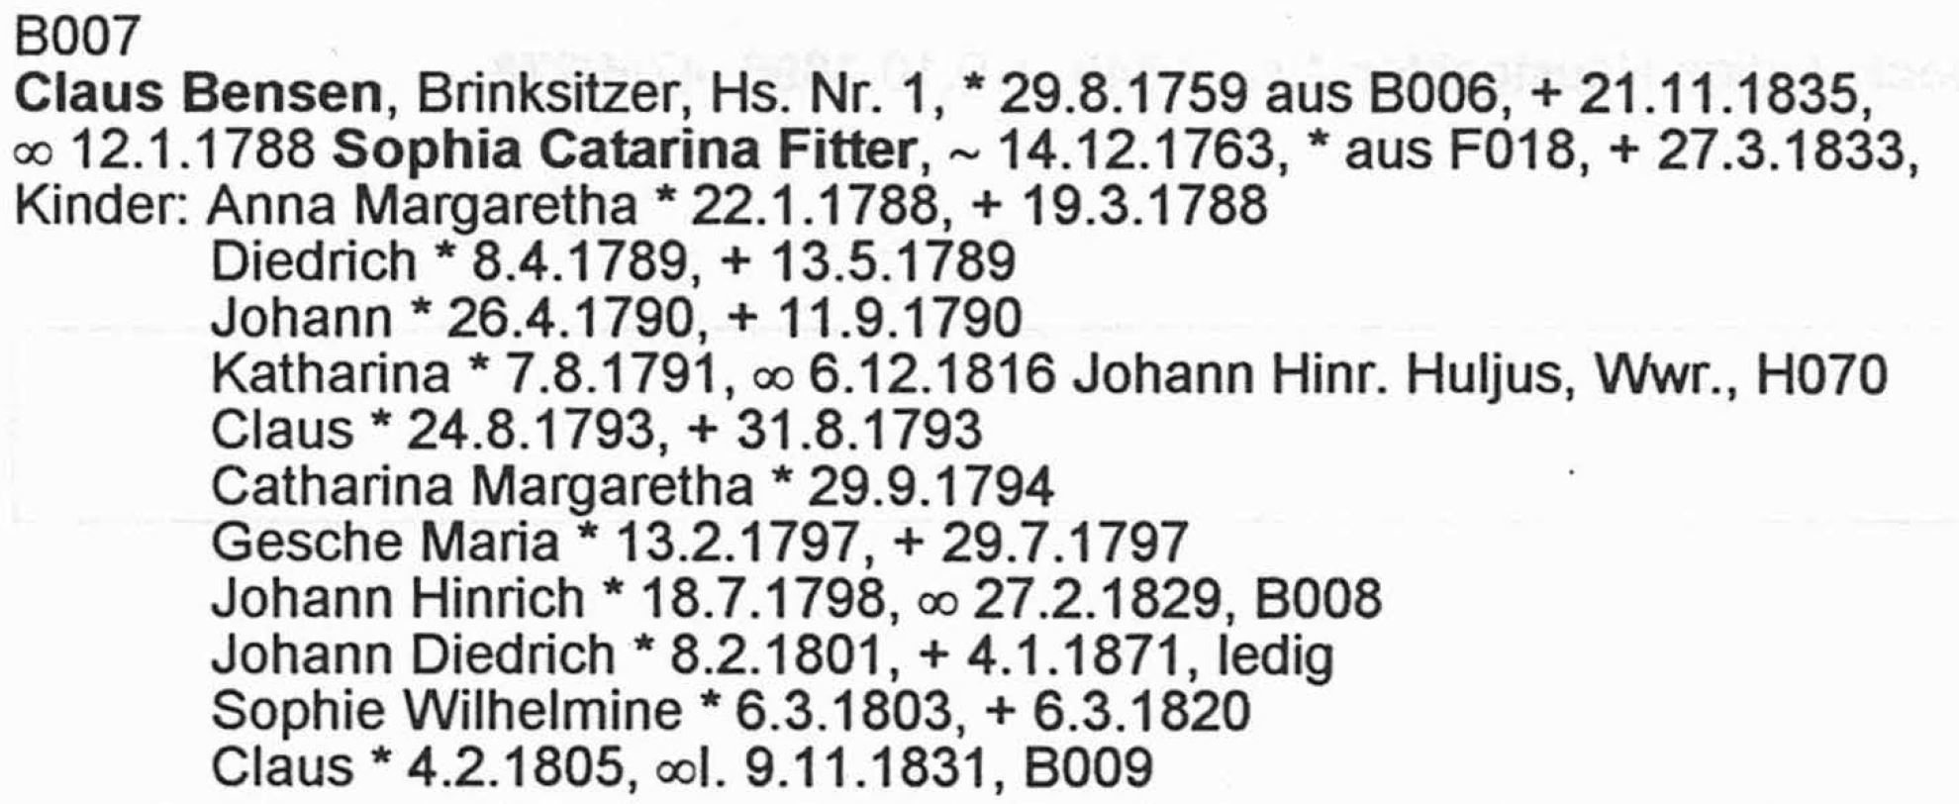
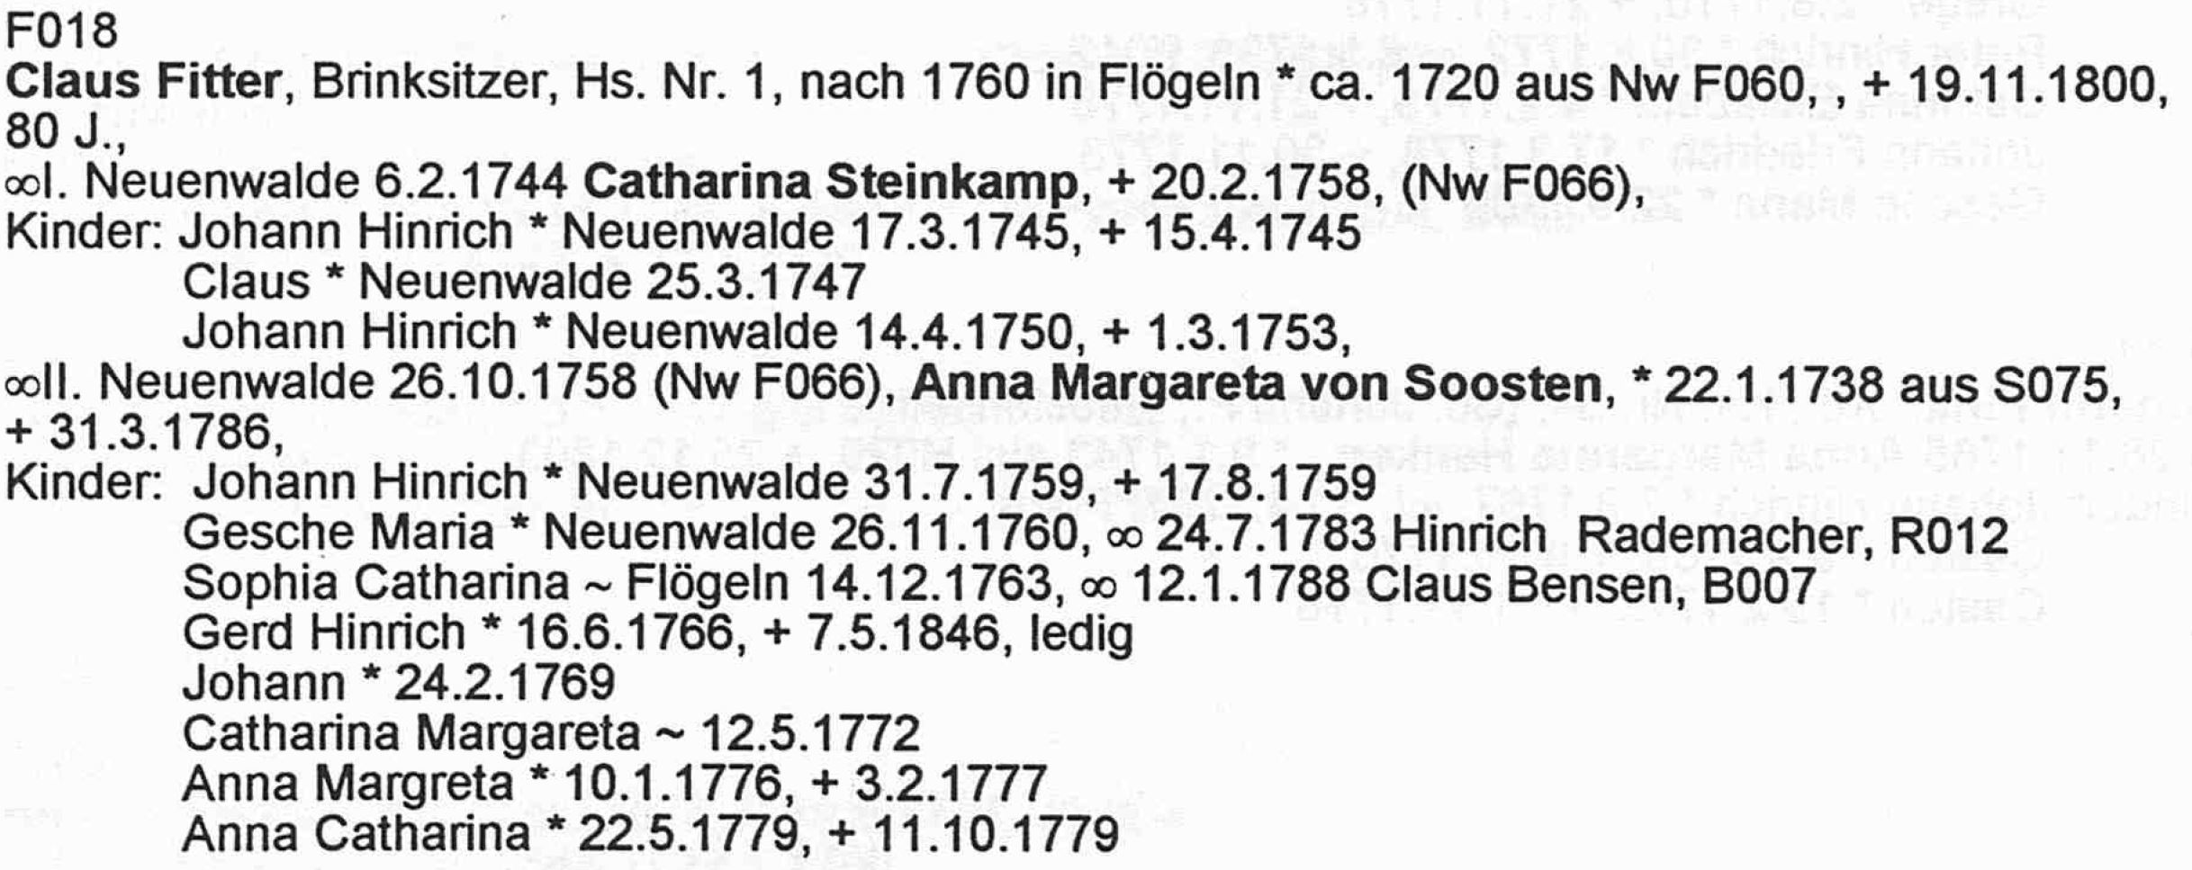
Persona Merge: Sufficient-Evidence Check
Flögeln Example:
HISTOGRAM OF EQIVALENT PAIR SIMILARITY VALUES
0.00 <= value <= 1.00 (0)
1.00 < value <= 2.00 XXXXXXXXXXXX(115)
2.00 < value <= 3.00 X(6)
3.00 < value <= 4.00 XXXXXXXXXXXXXXXXXXXXXXXXXXXXXXXXXXXXXXXXXXXXXXXXXXXXXXXXXXXXXXXXXXXXXXXXXXXXXXXX(753)
4.00 < value <= 5.00 (0)
5.00 < value <= 5.46 (0)
---------------------------------------------------------------------------------------------------- Threshold = 5.46 (MinNumberOfAttributesRequiredConstant * AverageConstraintResolutionPower)
5.46 < value <= 6.00 (1)
6.00 < value <= 7.00 XX(22)
7.00 < value <= 8.00 XXXXXXXXXXXXXXXXXXXXXXXXXXXXXXXXXXXX(339)
Number of compatible merge candidates = 362, Number of incompatible merge candidates = 874, percent with sufficient information(29.29%)
P(M|E₁, …, E_{n}) = P(E₁, …, E_{n}|M) P(M)/P(E₁, …, E_{n})
log P(E₁, …, E_{n}|M) P(M)/P(E₁, …, E_{n}) = P(M) + ∑^{n}_{i=1}P(E_{i}|M)/P(E_{i}) yielding ∑^{n}_{i=1}1/P(E_{i})
Weight, 1/P(E_{i}), tempered by probability of a match, e.g. P(“Waddington” ≈ “Clitheroe”)
=1
Notes:
The surnames are identical, the given names are off by one letter (Catarina vs. Catharina), and the extracted married name was off by one letter (Sensen vs. Benson)
P(M|E1, …, En) is the probably of a match M given the evidence E1, …, En.
We obtain it with Bayes’ Law and then turn it into a summation of the evidence (as in a courtroom argument)
P(M) is just a constant value, an irrelevant offset for the summation of evidence.
P(Ei|M) = 1; i.e. given that the persona records match, in reality the evidence must match (e.g. the birth dates, mother’s given names, spouses’ and children’s information, … must all match)
(We note, however, that there may be recording “errors” – partial or abbreviated names in place of full names, OCR errors, one place when another is meant, e.g. Provo not Orem as a birthplace.)
Errors:
OCR error: “Sensen” in B007 and “Bensen” in F018
Extraction error: missing template for christening dates with christening places
Programming omission: failed to compare marriage dates
Author spelling error: “Catarina” in B007 but “Catharina” in F018

Slide 10

Book Persona Record Merge Overview
Extract Persona Records
Curate Persona Records
Merge Persona Records
Persona Equivalence Classes (records to be merged)
Merged Personas pdf (documentation)
Merged Personas json (user check with COMET)
Merged Personas Tree Ready json (user check & fix)
Family Trees Gedcomx (for export to …)
MOBs
⇨
Duplicates
Notes:
Find Tree Intersection
Convert json persona records associated with a generated tree to MOBs
Use MOBs to find intersecting nodes – all potential duplicates
Deep-Check Intersecting Nodes
Curate and Import intersection nodes
Run a deep check (yielding match confidence and explanations)
Add to Tree (all new data, any corrected conflicting data, and documentation)
Auto-add (non-match nodes and conflict-free-match nodes)
Computer-assisted add (match nodes with conflicts)

Slide 11

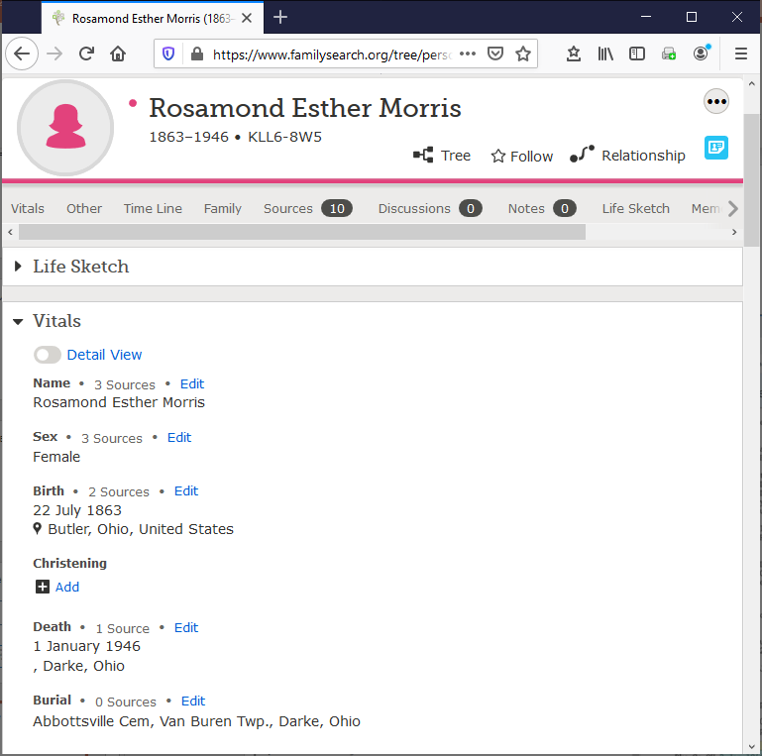
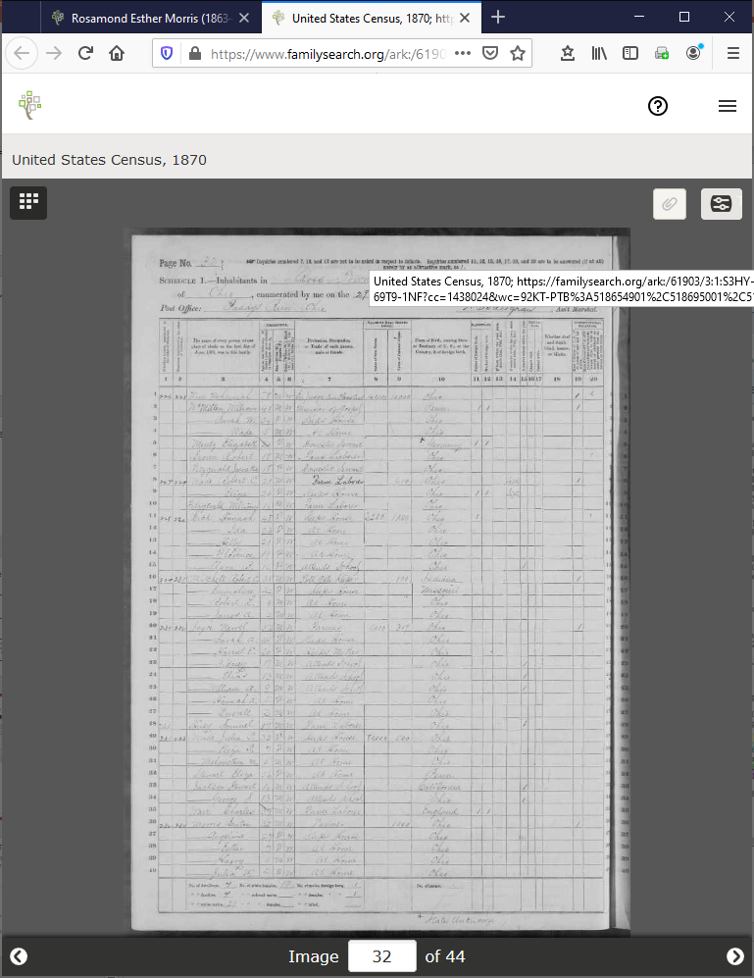
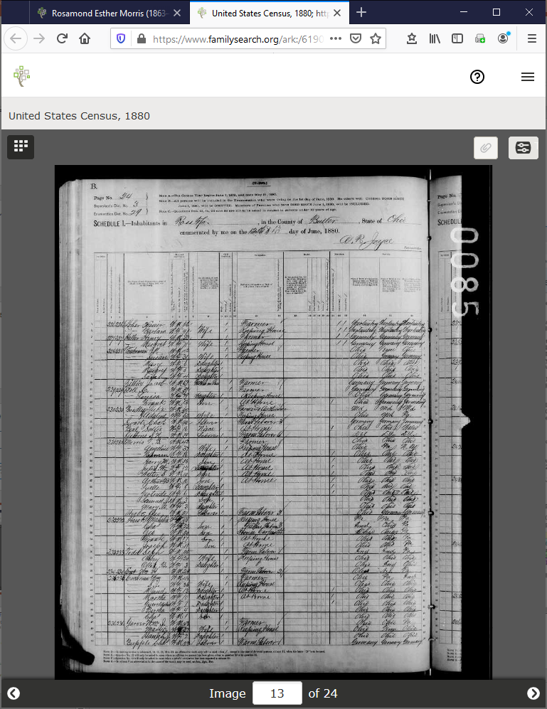
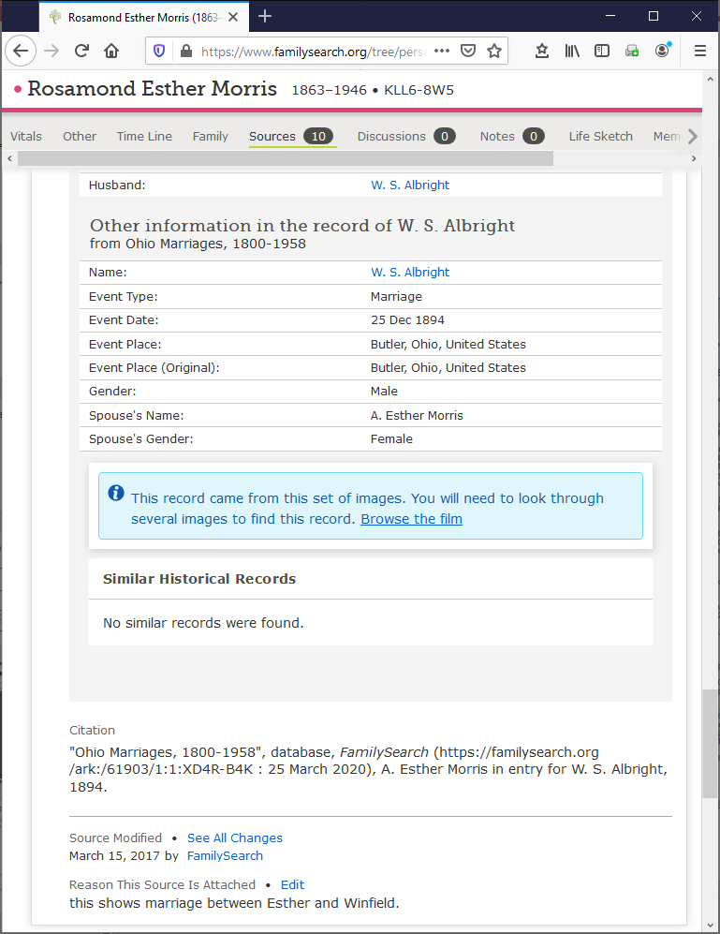
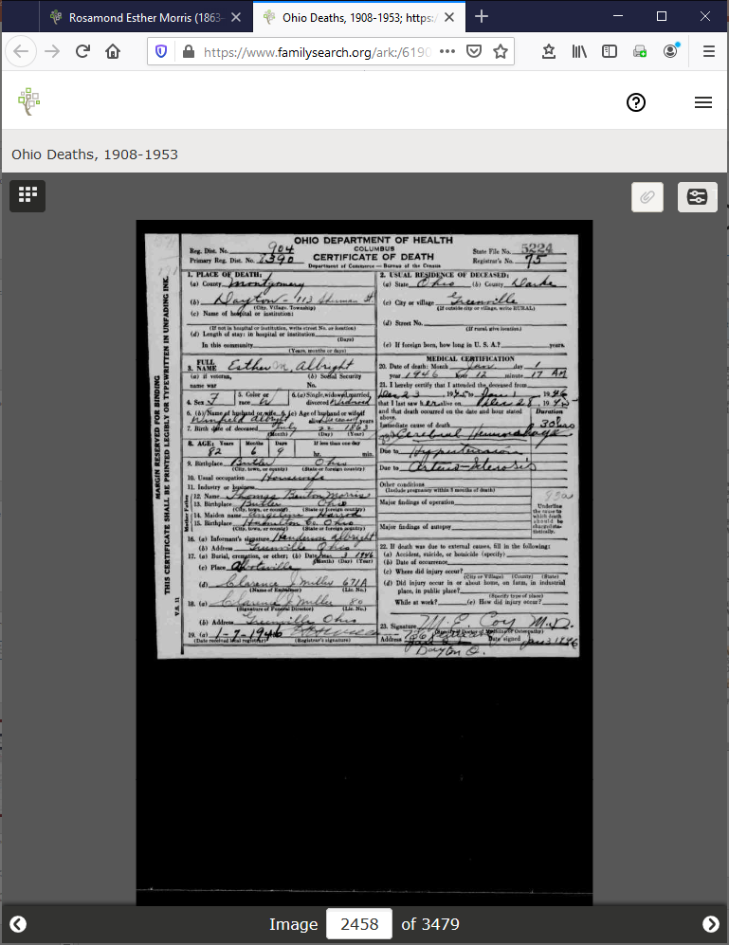
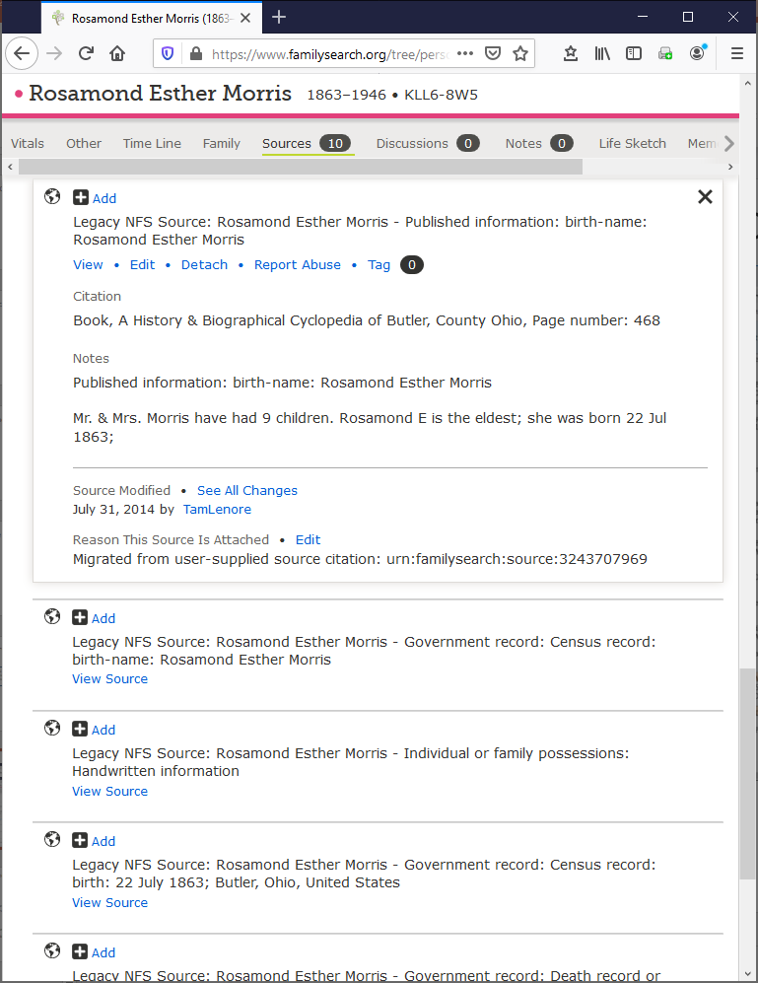
Add to Tree
Notes:
Name variations in various sources:
Family Tree: Rosamond Esther Morris
Greenville Funeral Home Record: Esther R. Morris
1870 Census: Esther Morris
1880 Census: Rosman Morris
Ohio Marriages, 1800-1958: A. Esther Morris (as indexed) (It might be interesting to browse the referenced film to see the original handwritten name; there’s a good chance the “A” looks more like an “R”)
Ohio Deaths, 1908-1953: Esther M. Albright
“A History & Biographical Cyclopedia of Butler, County Ohio”, page 468: Rosamond Esther Morris (reference and notes added by “TamLenore”)

Slide 12
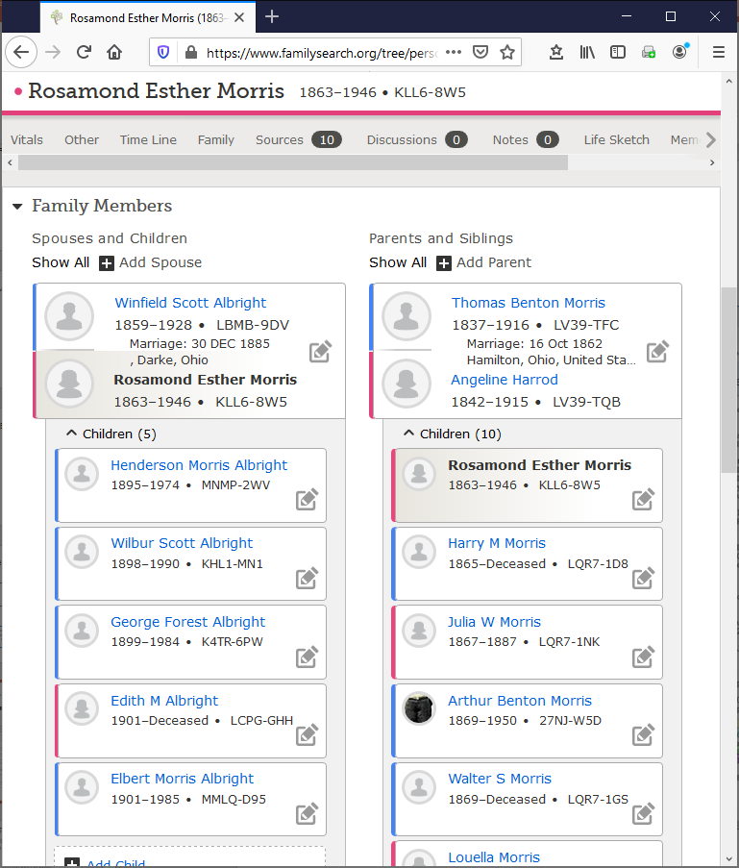
Add to Tree

Slide 13
Merge Book-Generated Family Trees with the FamilySearch Tree (Brainstorming Thoughts)
Find Tree Intersection
Convert merged persona json records associated with a generated tree to MOBs
Use MOBs to find intersecting nodes – all potential duplicates
Deep-Check Intersecting Nodes
Curate and Import intersection nodes
Run a deep check (yielding match confidence and explanations)
Add to Tree (new data, resolved conflicting data, and documentation)
Auto-add (non-match nodes and conflict-free match nodes)
Computer-assisted add (match nodes with conflicts)
Notes:
Computer-assisted cases to consider:

