Slide 1
Record Merge (book persona-record merge & merged-persona-record/tree-persona-record merge)
Team Members
David W. Embley, Scott N. Woodfield, Gary James Norris
Stephen W. Liddle, Deryle W. Lonsdale, George Nagy,

Slide 2

Book Persona Record Merge Overview
Extract Persona Records
Curate Persona Records
Merge Persona Records
Persona Equivalence Classes (records to be merged)
Merged Personas pdf (documentation)
Merged Personas json (user check with COMET)
Merged Personas Tree Ready json (user check & fix)
Family Trees Gedcomx (for export to …)

Slide 3
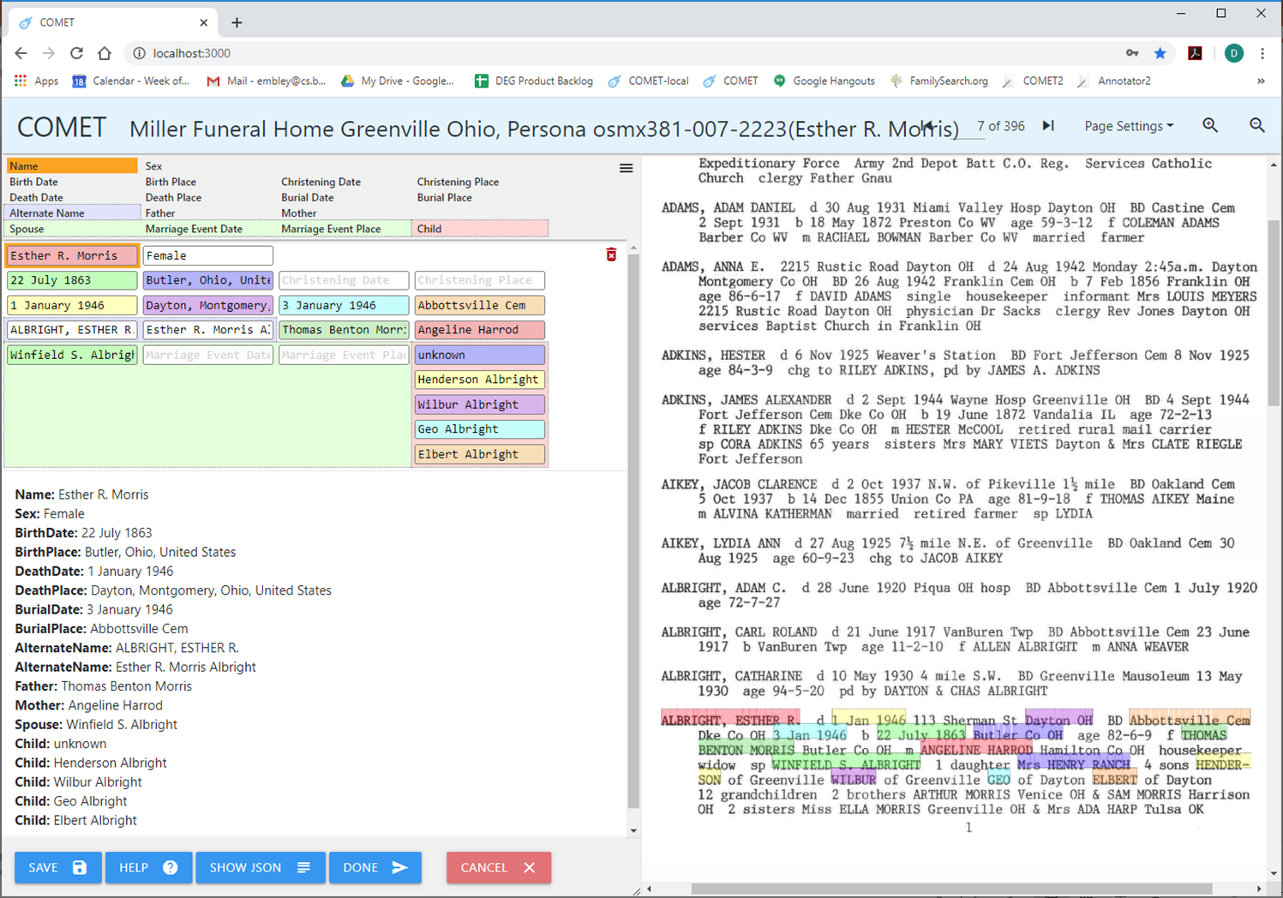
Curated Input Persona Record

Slide 4
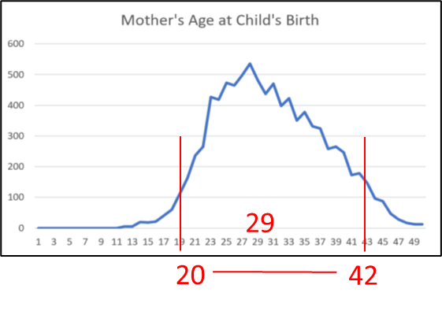
Shallow Match
…

Slide 5
Shallow Match
…

Slide 6
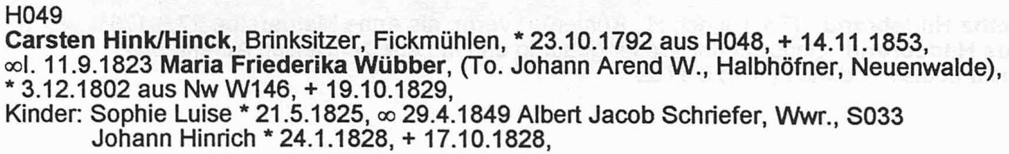
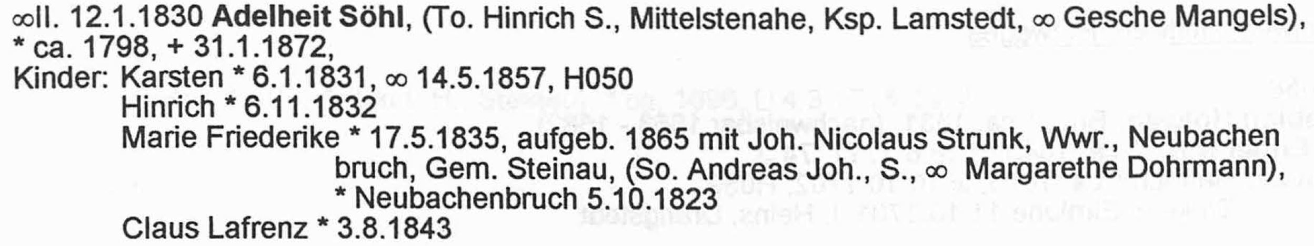
Persona Merge: Persona Integrity Check
Flögeln Example:
Number of persona: 4,583
Total number of unique defective persona found by all constraints: 101(2.2%)
HISTOGRAM OF NUMBER OF UNIQUE PERSONA(BY CONSTRAINT)
ChildBeingBornYearsAfterMarriageEventDat XXXXXXXXXXXXXXXXXXXXXXXXXXXXX(29/1803 failed 1.6%)
ChildBeingChristenedYearsAfterMarriageEv XXXXXX(6/196 failed 3.1%)
FatherHasAgeAtBirthOfChild XXXXXXXXXXXXXXXXXXX(19/362 failed 5.2%)
MarriedCoupleCannotHaveSameGenderConstra XXXXXXXXXXXXXXXXXXXXXXXX(24/1869 failed 1.3%)
MotherDiedBeforeChildWasBorn XXXXXXX(7/257 failed 2.7%)
MotherDiedBeforeChildWasChristened All Passed(92 tested)
MotherHasAgeAtBirthOfChild XXXXXXXXXXXX(12/384 failed 3.1%)
PersonDyingBeforeOrToLongAfterBirth All Passed(1044 tested)
PersonDyingBeforeOrToLongAfterChristenin All Passed(116 tested)
PersonMarriedAfterDeath XXXX(4/528 failed 0.8%)
PersonNotOwnAncestorConstraint All Passed(3609 tested)
PersonNotOwnSpouseConstraint All Passed(1894 tested)
Number of persona: 4583
Number of persona checked: 4291
Total number of unique defective persona found by all constraints: 101
Percent of unique persona who were defective = 2.2%
Percent persona checked who were defective = 2.4%
Total number of persona tested by all constraints: 16834
Total number of defective persona found by all constraints: 130
Percent of persona who were defective = 0.8%
HISTOGRAM OF NUMBER OF UNIQUE PERSONA(BY CONSTRAINT) -- 1.0 test cases per X
ChildBeingBornYearsAfterMarriageEventDat XXXXXXXXXXXXXXXXXXXXXXXXXXXXX(29/1803 failed 1.6%)
ChildBeingChristenedYearsAfterMarriageEv XXXXXX(6/196 failed 3.1%)
FatherHasAgeAtBirthOfChild XXXXXXXXXXXXXXXXXXX(19/362 failed 5.2%)
MarriedCoupleCannotHaveSameGenderConstra XXXXXXXXXXXXXXXXXXXXXXXX(24/1869 failed 1.3%)
MotherDiedBeforeChildWasBorn XXXXXXX(7/257 failed 2.7%)
MotherDiedBeforeChildWasChristened All Passed(92 tested)
MotherHasAgeAtBirthOfChild XXXXXXXXXXXX(12/384 failed 3.1%)
PersonDyingBeforeOrToLongAfterBirth All Passed(1044 tested)
PersonDyingBeforeOrToLongAfterChristenin All Passed(116 tested)
PersonMarriedAfterDeath XXXX(4/528 failed 0.8%)
PersonNotOwnAncestorConstraint All Passed(3609 tested)
PersonNotOwnSpouseConstraint All Passed(1894 tested)
Notes:
Note number of persona evaluated, number that were defective, and percent

Slide 7
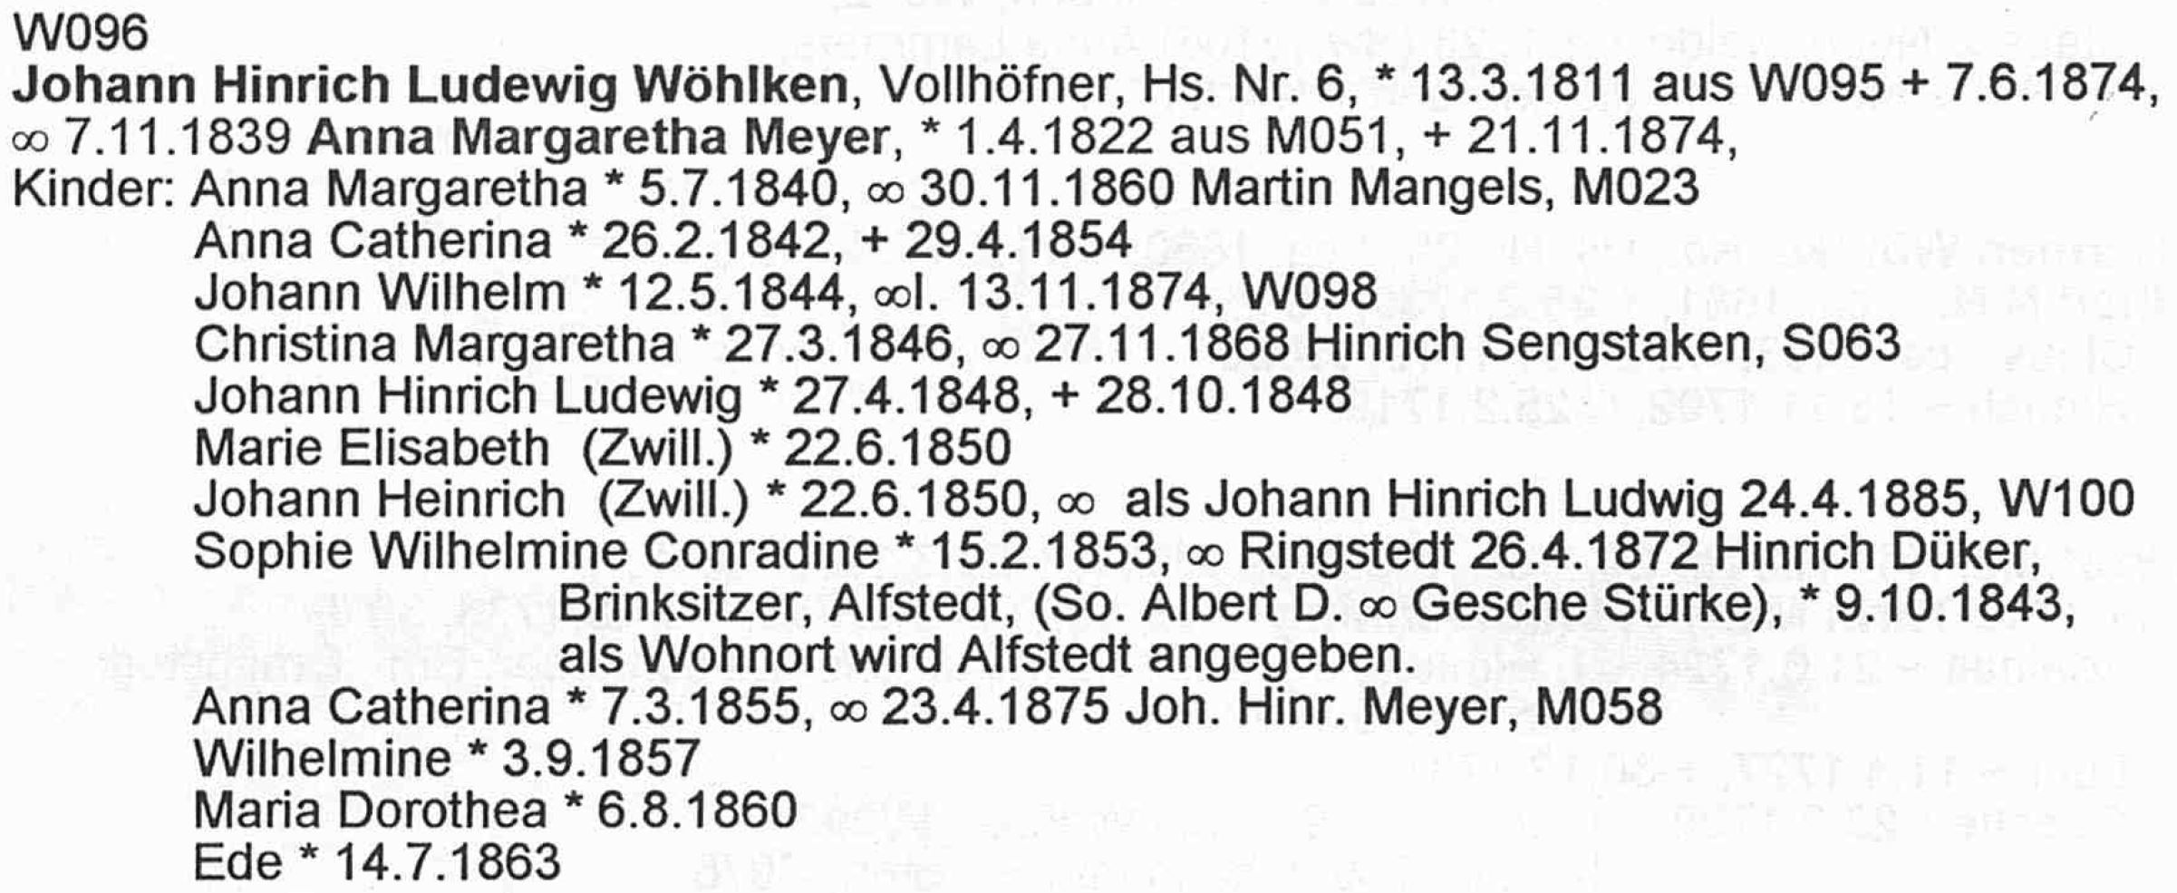
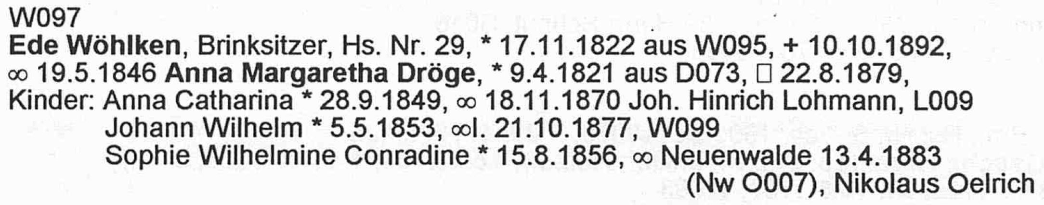
Persona Merge: Red-Flag Check
Flögeln Example:
Total number of persona pairwise constraints tested: 4,640
Total number of persona pairs red flagged: 969 (20.9%)
HISTOGRAM OF NUMBER OF RED FLAGGED PAIRS(BY CONSTRAINT)
TwoPeopleHaveTheSameBirthDate XXXXXXXXXXXXXXXXXXXXXXXXXXXXXXXXXXXXXXXXXXXXXXXXXXXXXXXXXXX(302/659 failed 45.8%)
TwoPeopleHaveTheSameBurialDate XXXXXXXXXXXXXX(74/84 failed 88.1%)
TwoPeopleHaveTheSameChristeningDate XXXXXXXXXX(51/110 failed 46.4%)
TwoPeopleHaveTheSameDeathDate XXXXXXXXXXXXXXXXXXXX(105/105 failed 100.0%)
TwoPeopleHaveTheSameGender XXXXX(26/1804 failed 1.4%)
TwoPeopleHaveTheSameName XXXXXXXXXXXXXXXXXXXXXXXXXXXXXXXXXXXXXXXXXXXXXXXXXXXXXXXXXXXXXXXXXXXXXXXXXXXXXXXX(411/1878 failed 21.9%)

Slide 8
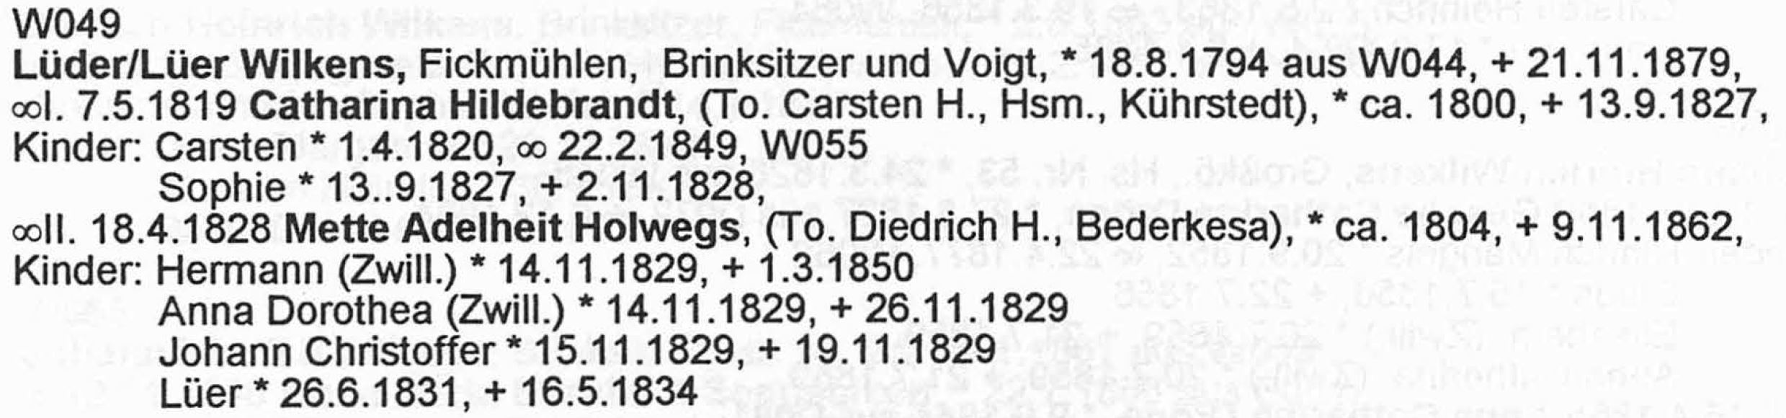
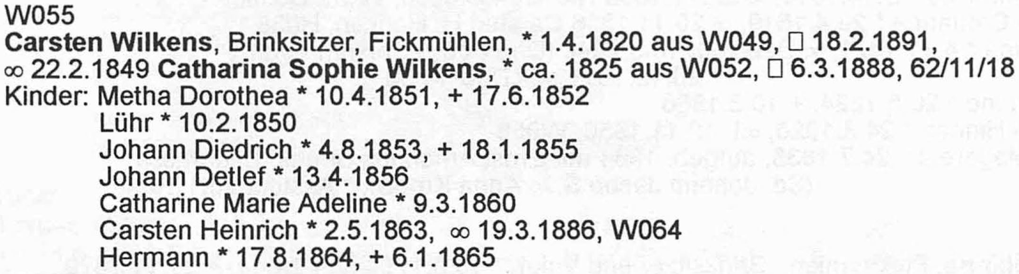
Persona Merge: Temp-Merge Check
Flögeln Example:
Total number of merged persona tested by all constraints: 3,011,818
Total number of defective merged persona found by all constraints: 30,684 (1.0%)
HISTOGRAM OF NUMBER OF DEFECTIVE MERGED PERSONA(BY CONSTRAINT)
ChildBeingBornYearsAfterMarriageEventDat X(194/564 failed 34.4%)
ChildBeingChristenedYearsAfterMarriageEv (29/113 failed 25.7%)
FatherHasAgeAtBirthOfChild XXXXXXXXXXXXXXXXXXXXXXXXXXXXXXXXXXXXXXXX(16900/1653644 failed 1.0%)
MarriedCoupleCannotHaveSameGenderConstra All Passed(1505 tested)
MotherDiedBeforeChildWasBorn (8/450 failed 1.8%)
MotherDiedBeforeChildWasChristened All Passed(76 tested)
MotherHasAgeAtBirthOfChild XXXXXXXXXXXXXXXXXXXXXXXXXXXXXXXX(13520/1352404 failed 1.0%)
ParentsChildrenSpacedFarEnoughApart (14/661 failed 2.1%)
ParentsOfChildMeetMustMeetParentalConstr All Passed(894 tested)
PersonCantHaveOverlappingSpouses All Passed(113 tested)
PersonDyingBeforeOrToLongAfterBirth (2/533 failed 0.4%)
PersonDyingBeforeOrToLongAfterChristenin All Passed(126 tested)
PersonMarriedAfterDeath (17/735 failed 2.3%)
PersonNotOwnAncestorConstraint None Tested
PersonNotOwnSpouseConstraint None Tested
Notes:
15 constraints
This is a merge of Hans Jürgen Ehlbeck as a son in the household of Claus Ehlbeck with the Hans Jürgen Ehlbeck as the head of household in the next household (on the next page). Somehow the head of house hold picked up Gesche Catharine Ehlbeck on the previous page.

Slide 9
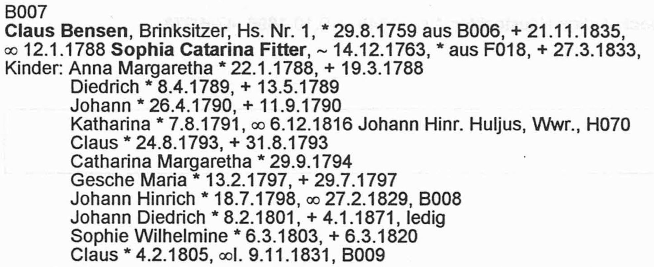
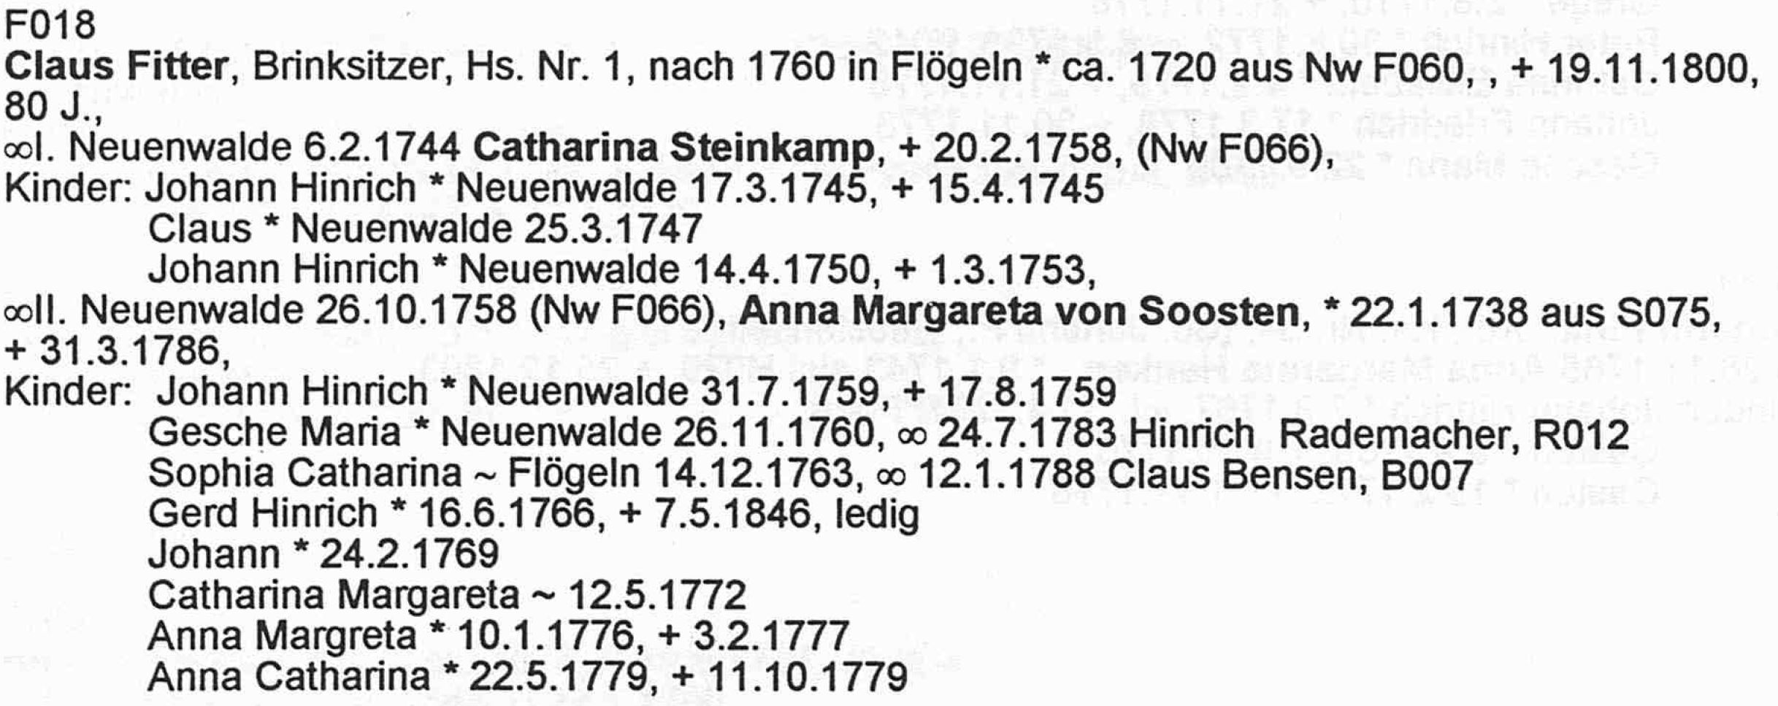
Persona Merge: Sufficient-Evidence Check
Flögeln Example:
HISTOGRAM OF EQIVALENT PAIR SIMILARITY VALUES
0.00 <= value <= 1.00 (0)
1.00 < value <= 2.00 XXXXXXXXXXXX(115)
2.00 < value <= 3.00 X(6)
3.00 < value <= 4.00 XXXXXXXXXXXXXXXXXXXXXXXXXXXXXXXXXXXXXXXXXXXXXXXXXXXXXXXXXXXXXXXXXXXXXXXXXXXXXXXX(753)
4.00 < value <= 5.00 (0)
5.00 < value <= 5.46 (0)
---------------------------------------------------------------------------------------------------- Threshold = 5.46 (MinNumberOfAttributesRequiredConstant * AverageConstraintResolutionPower)
5.46 < value <= 6.00 (1)
6.00 < value <= 7.00 XX(22)
7.00 < value <= 8.00 XXXXXXXXXXXXXXXXXXXXXXXXXXXXXXXXXXXX(339)
Number of compatible merge candidates = 362, Number of incompatible merge candidates = 874, percent with sufficient information(29.29%)
P(M|E₁, …, E_{n}) = P(E₁, …, E_{n}|M) P(M)/P(E₁, …, E_{n})
log P(E₁, …, E_{n}|M) P(M)/P(E₁, …, E_{n}) = P(M) + ∑^{n}_{i=1}P(E_{i}|M)/P(E_{i}) yielding ∑^{n}_{i=1}1/P(E_{i})
Weight, 1/P(E_{i}), tempered by probability of a match, e.g. P(“Waddington” ≈ “Clitheroe”)
=1
Notes:
The surnames are identical, the given names are off by one letter (Catarina vs. Catharina), and the extracted married name was off by one letter (Sensen vs. Benson)
P(M|E1, …, En) is the probably of a match M given the evidence E1, …, En.
We obtain it with Bayes’ Law and then turn it into a summation of the evidence (as in a courtroom argument)
P(M) is just a constant value, an irrelevant offset for the summation of evidence.
P(Ei|M) = 1; i.e. given that the persona records match, in reality the evidence must match (e.g. the birth dates, mother’s given names, spouses’ and children’s information, … must all match)
(We note, however, that there may be recording “errors” – partial or abbreviated names in place of full names, OCR errors, one place when another is meant, e.g. Provo not Orem as a birthplace.)
Errors:
OCR error: “Sensen” in B007 and “Bensen” in F018
Extraction error: missing template for christening dates with christening places
Programming omission: failed to compare marriage dates
Author spelling error: “Catarina” in B007 but “Catharina” in F018

Slide 11

Book Persona Record Merge Overview
Extract Persona Records
Curate Persona Records
Merge Persona Records
Persona Equivalence Classes (records to be merged)
Merged Personas pdf (documentation)
Merged Personas json (user check with COMET)
Merged Personas Tree Ready json (user check & fix)
Family Trees Gedcomx (for export to …)
MOBs
⇨
Duplicates
Notes:
Find Tree Intersection
Convert json persona records associated with a generated tree to MOBs
Use MOBs to find intersecting nodes – all potential duplicates
Deep-Check Intersecting Nodes
Curate and Import intersection nodes
Run a deep check (yielding match confidence and explanations)
Add to Tree (all new data, any corrected conflicting data, and documentation)
Auto-add (non-match nodes and conflict-free-match nodes)
Computer-assisted add (match nodes with conflicts)

Slide 12

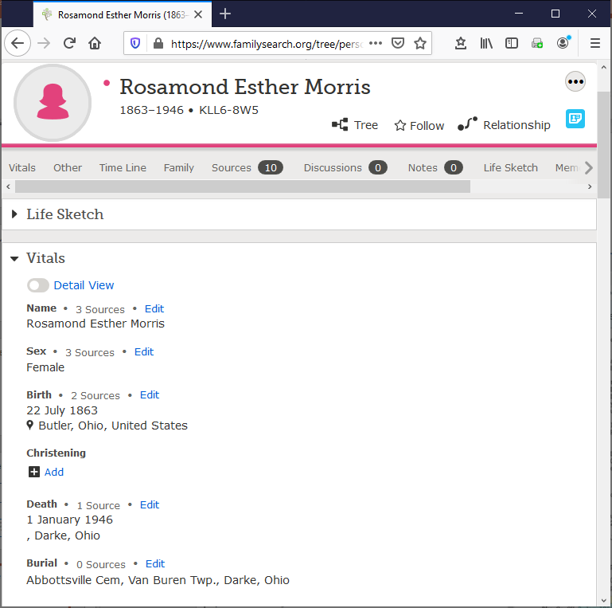
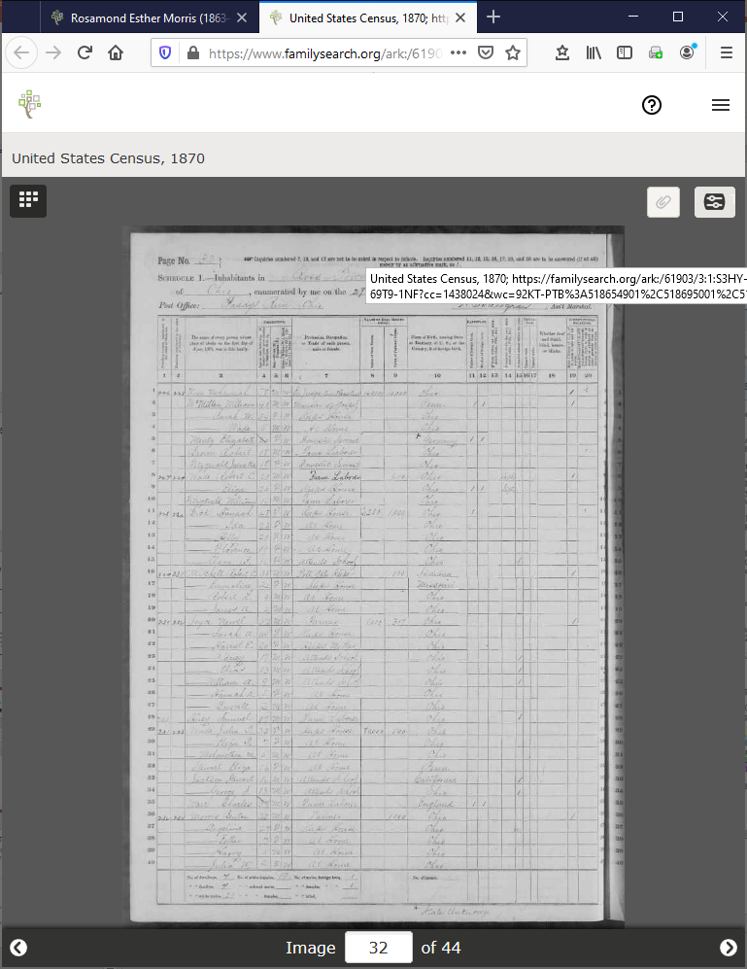
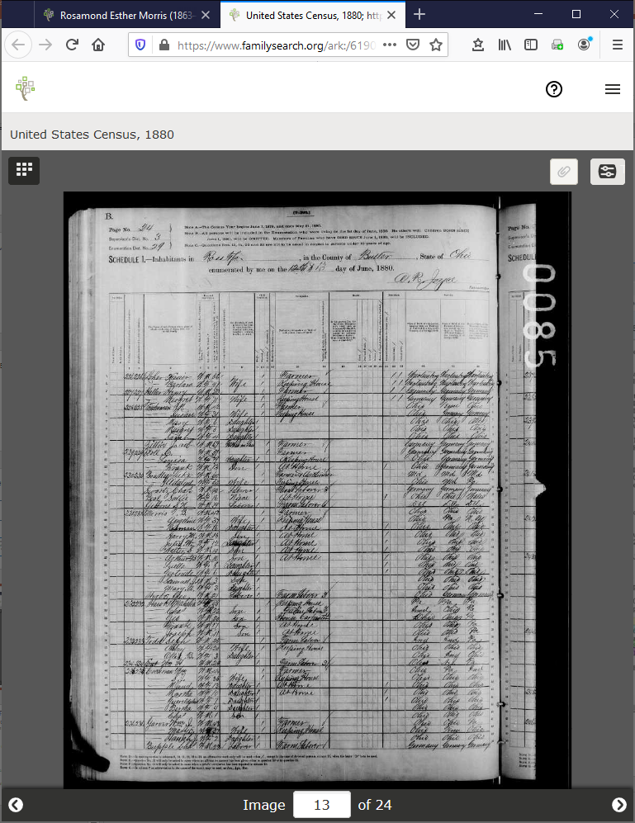
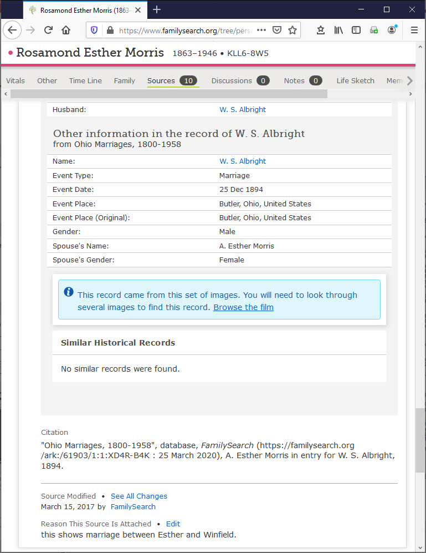
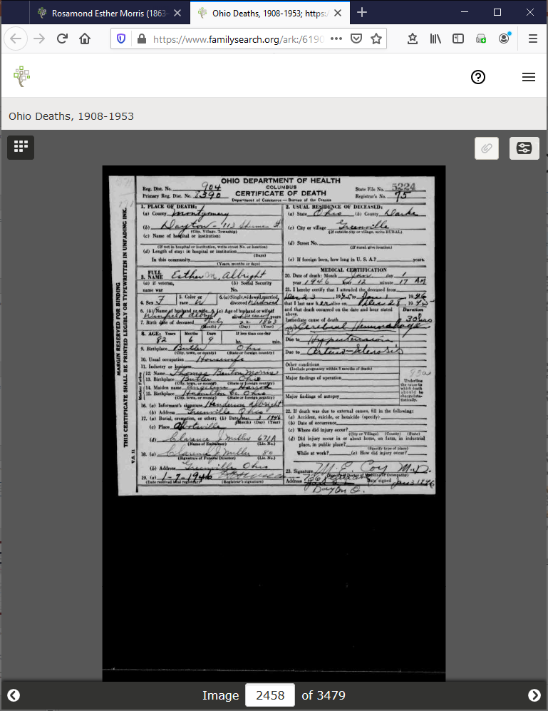
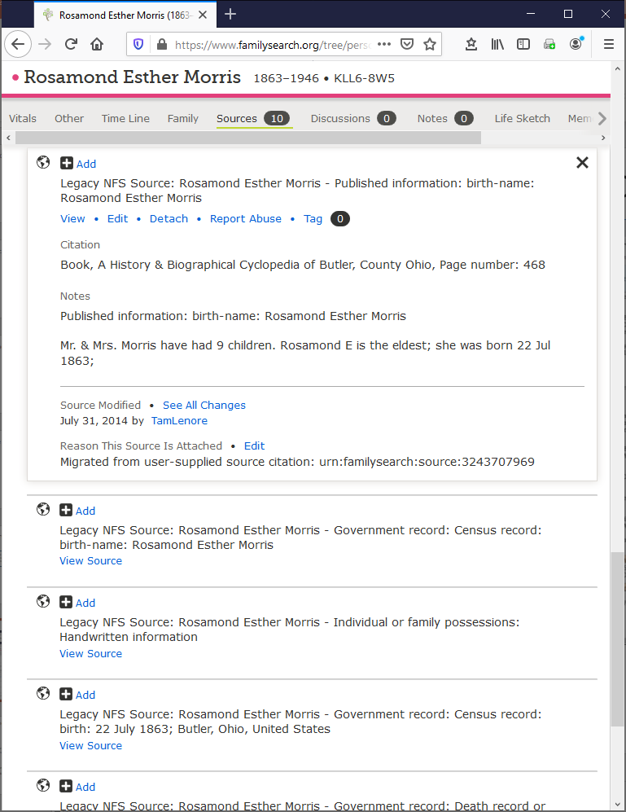
Add to Tree
Notes:
Name variations in various sources:
Family Tree: Rosamond Esther Morris
Greenville Funeral Home Record: Esther R. Morris
1870 Census: Esther Morris
1880 Census: Rosman Morris
Ohio Marriages, 1800-1958: A. Esther Morris (as indexed) (It might be interesting to browse the referenced film to see the original handwritten name; there’s a good chance the “A” looks more like an “R”)
Ohio Deaths, 1908-1953: Esther M. Albright
“A History & Biographical Cyclopedia of Butler, County Ohio”, page 468: Rosamond Esther Morris (reference and notes added by “TamLenore”)

Slide 13
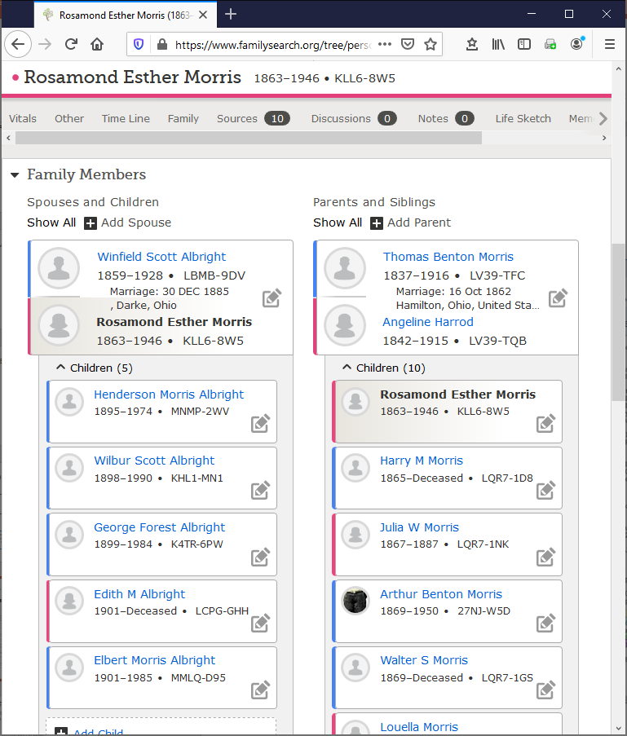
Add to Tree
Notes:
Deryle suggests a visualization of the overlap of our Gedcomx family tree and FamilyTree – one to zoom in and out of.

Slide 14
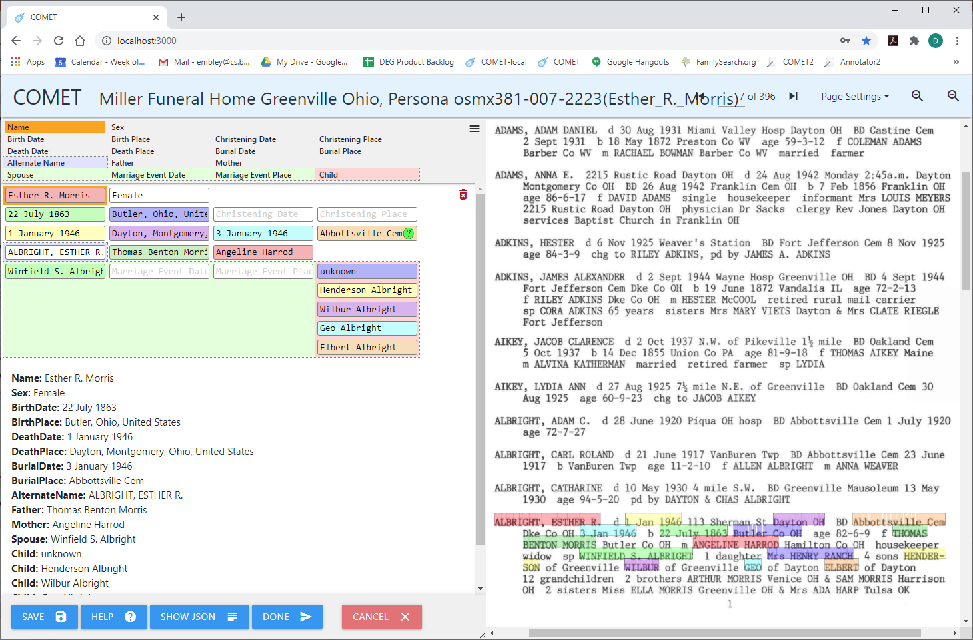
Add to Tree

Slide 15
Add to Tree

Slide 16

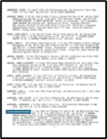
Add to Tree
!
!
!
?
Merge Integrity
Merge Confidence
?
!
Notes:
Green !: add/replace
Yellow !: click on COMET and type in desired text

Slide 17
Add to Tree
!
!
!
?
Merge Integrity
Merge Confidence
?
Notes:
Green !: add/replace
Yellow !: click on COMET and type in desired text

Slide 18
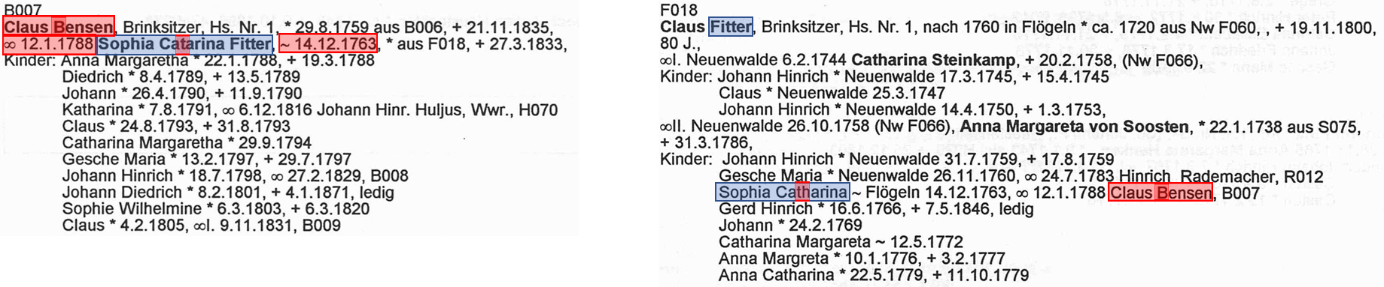
Add to Tree
!
!
!
?
Merge Integrity
Merge Confidence
?
Notes:
Green !: add/replace
Yellow !: click on COMET and type in desired text

Slide 19


Add to Tree
!
!
!
?
Merge Integrity
Merge Confidence
?
!
Notes:
Green !: add/replace
Yellow !: click on COMET and type in desired text

Slide 20
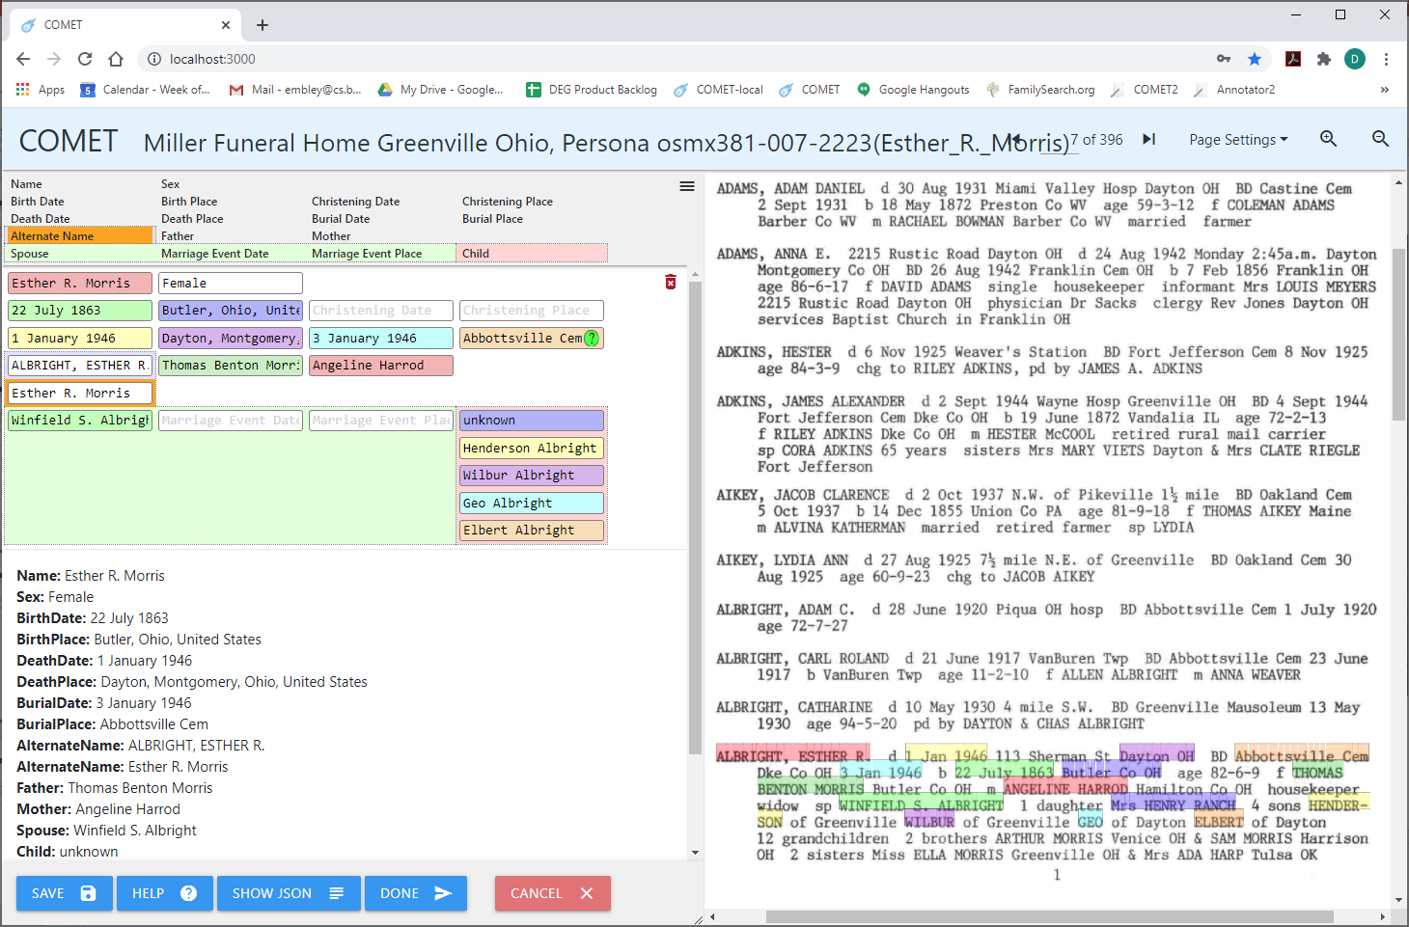
Add to Tree
!
!
!
!
!
?
Merge Integrity
Merge Confidence
?
!
Submit
Notes:
Green !: add/replace
Yellow !: click on COMET and type in desired text

Slide 21
Add to Tree
Brainstorming objective
Minimize coding both for COMET-side and FamilyTree-side
Learn from experience how to create a better UI
COMET-side
Warning and confirming messages
Editable fields in preparation for merge
FamilyTree-side
Alignment with edited COMET-side
Replace, add, and undo options

Slide 22
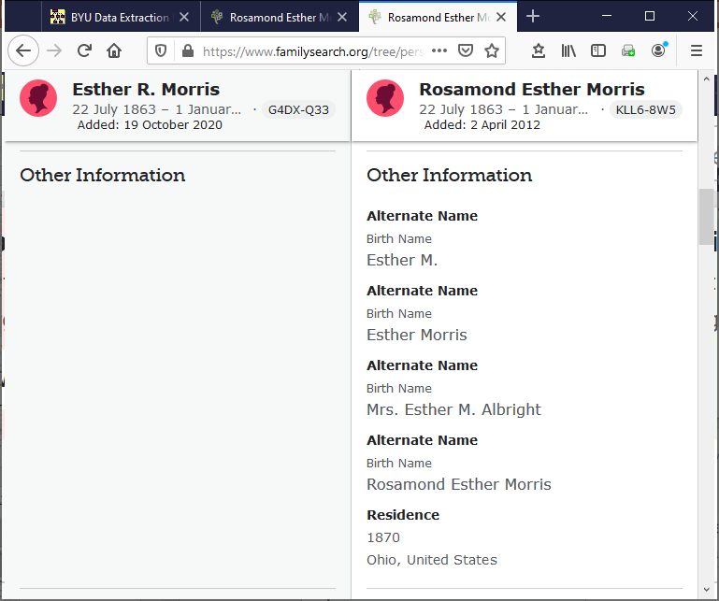
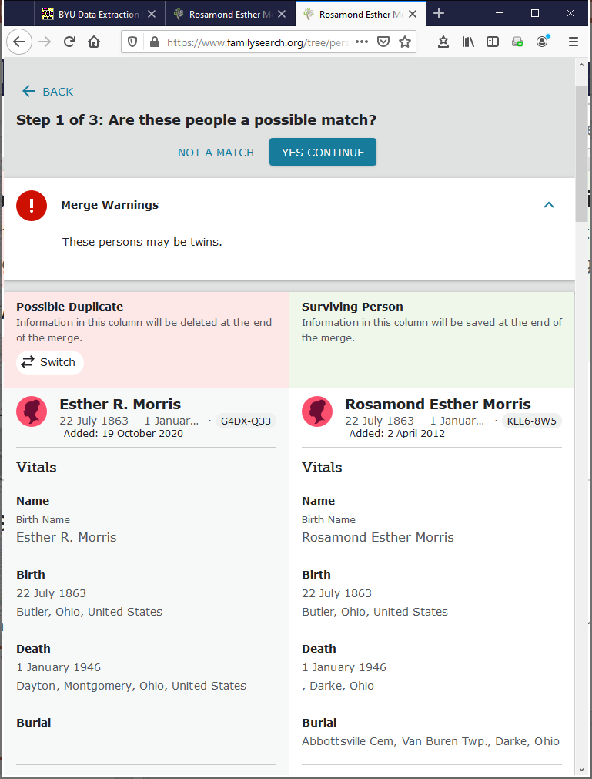
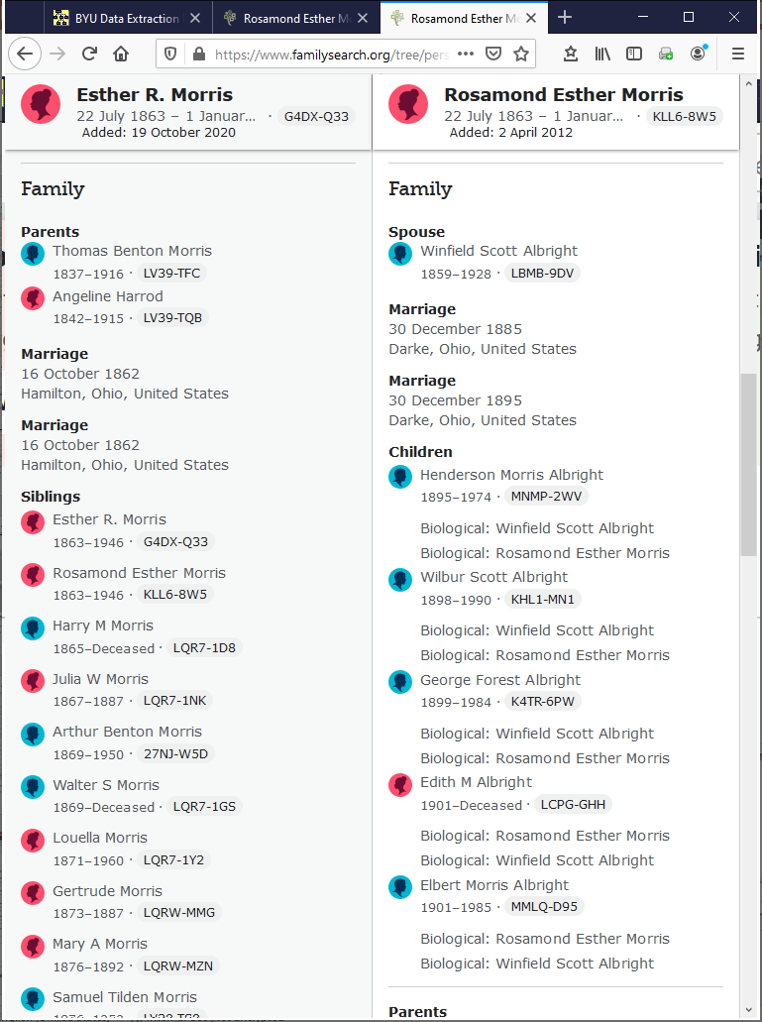
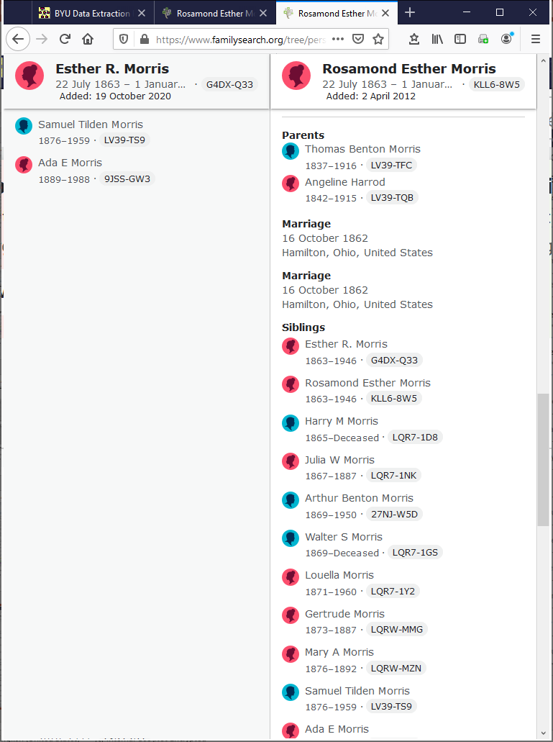
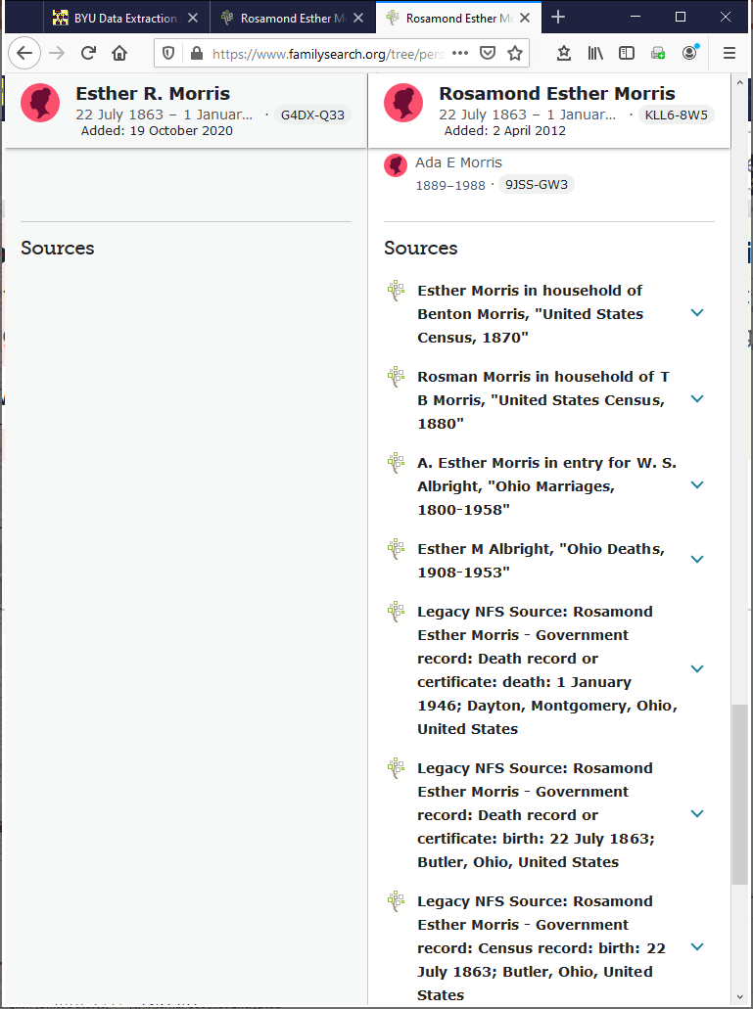
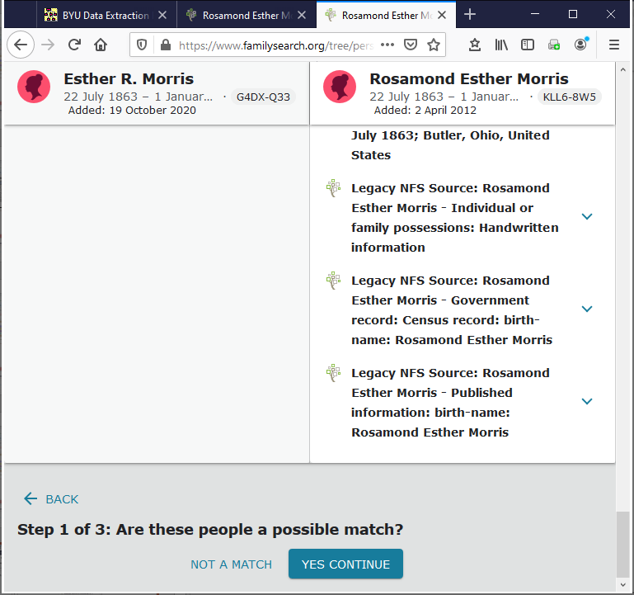
Add to Tree
Skip this check for a possible match:
Not well aligned
Not editable
No explanatory messages
Notes:
This FS check for a possible match should be skipped altogether:
Not well aligned
Not editable

Slide 23
Add to Tree
?
Merge Integrity
Merge Confidence
?
Notes:
Note differences from this view last time: no exclamation-point directives. (only editing as needed; here the addition of “Esther R. Morris” as an alternate name)
Needed programming on COMET-side: add Merge Integrity comments, add Merge Confidence comments; alter button functionality.
Needed programming on FamilyTree-side: none.

Slide 24
Add to Tree
Vitals
Name
Esther R. Morris
Sex
Female
Birth
22 July 1863
Butler, Ohio, United States
Christening
Death
1 January 1946
Dayton, Montgomery, Ohio, United States
Burial
3 January 1946
Abbottsville Cem
Vitals
Name
Rosamond Esther Morris
Sex
Female
Birth
22 July 1863
Butler, Ohio, United States
Christening
Death
1 January 1946
, Darke, Ohio
Burial
Abbottsville Cem, Van Buren Twp., Darke, Ohio
Notes:
Replace and Undo as usual:
Replace Death info
But note that this will not work well for the Burial (but we can return to COMET and edit Abbottsville Cem, which BTW was marked with a “?”)

Slide 25
Add to Tree
Vitals
Name
Esther R. Morris
Sex
Female
Birth
22 July 1863
Butler, Ohio, United States
Christening
Death
1 January 1946
Dayton, Montgomery, Ohio, United States
Burial
3 January 1946
Abbottsville Cemetery, Abbotsville, Darke, Ohio, United States
Vitals
Name
Rosamond Esther Morris
Sex
Female
Birth
22 July 1863
Butler, Ohio, United States
Christening
Death
1 January 1946
, Darke, Ohio
Burial
Abbottsville Cem, Van Buren Twp., Darke, Ohio
Notes:
Now, Replace and Undo as usual:
Replace Death info
Replace Burial
Needed programming on COMET-side: none except to output the information in a form acceptable to the FamilyTree-side
Needed programming on FamilyTree-side: from the output on the COMET-side, establish the standard Step 2 of 3 view (and let the user proceed as usual)

Slide 26
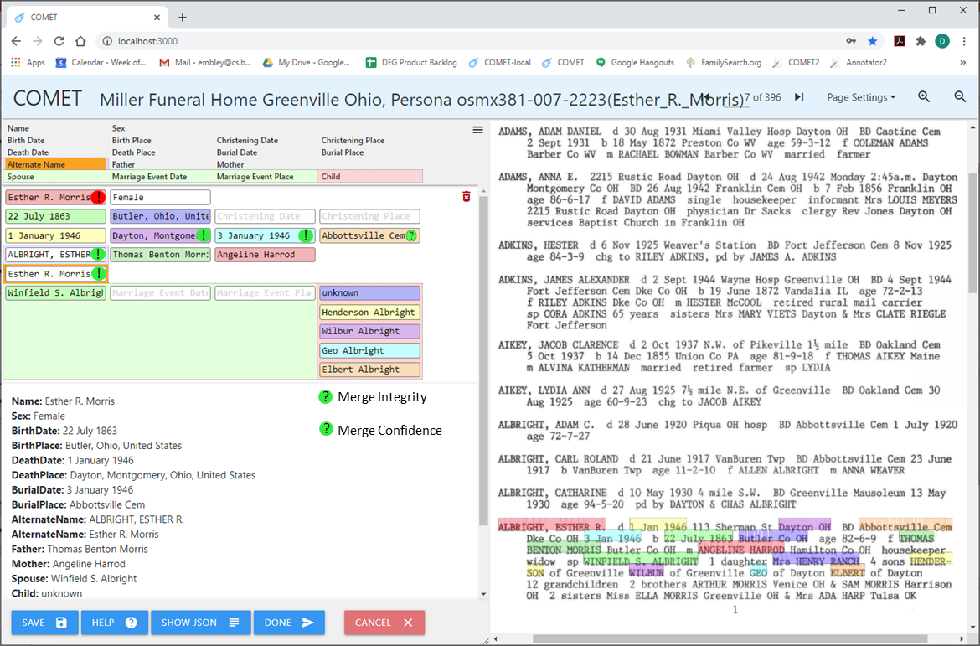

Add to Tree
Can also skip the second step:
Check visually with COMET & FamilyTree
Replace can be dictated with (!)
Finish by hand in FamilyTree if needed.
Abbottsville Cemetery, Abbotsville, Darke, Ohio, United States
Notes:
From this view, get the update on the following slide.
In replacing the Burial Place with “Abbottsville Cem Dke Co OH”, the system could also standardize it (as shown). And then a green exclamation point can replace the green question mark, so that replace can be executed.

Slide 27
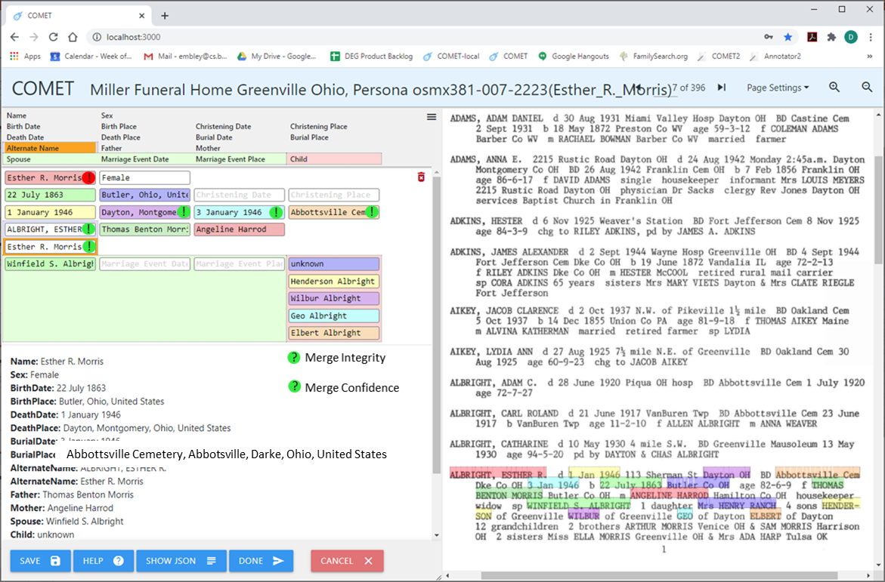
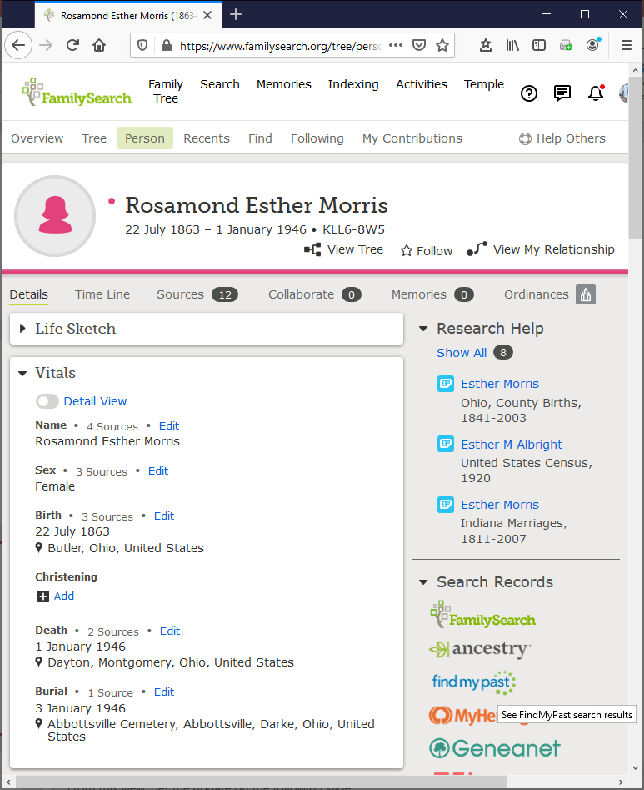
Add to Tree
Can also skip the second step:
Check visually with COMET & FamilyTree
Replace dictated with (!)
Finish by hand in FamilyTree if needed.
Notes:
Needed coding:
COMET side: add Merge Integrity and Merge Confidence; add (!) option; change buttons; and code the addition/merge (Joe Price’s student’s code). Must also decide what to do for various cases and alter the code to meet our needs for adding the full Gedcomx.
FamilyTree side: no coding.
Family members align exactly and need no replacement in this case (and are not shown in the slide). Moreover, although we can align other family members automatically, there is an issue when coming from COMET because the COMET persons may or may not be on the already on the FamilyTree. Indeed, the question of how we deal with these situations coming from the COMET-side Gedcomx-tree is another discussion, which we need to have.
Cases to consider (some initial thoughts – needs more thought):
No potential duplicates: add
One or more duplicates on FamilyTree side: merge, or reject merge and add
An additional (not enough evidence to be confident) on COMET side: do a second, third, … merge (or not)
One hop relationships:
Already processed (by us as part of adding the Gedcomx to the tree): do nothing
Not already processed: check to see if the FamilyTree ID is already in some yet-to-be processed equivalence class; if so, do nothing; otherwise, add it to the equivalence class of the matching person.

Slide 28
Add to Tree
Vitals
Name
Esther R. Morris
Sex
Female
Birth
22 July 1863
Butler, Ohio, United States
Christening
Death
1 January 1946
Dayton, Montgomery, Ohio, United States
Burial
3 January 1946
Abbottsville Cemetery, Abbotsville, Darke, Ohio, United States
Vitals
Name
Rosamond Esther Morris
Sex
Female
Birth
22 July 1863
Butler, Ohio, United States
Christening
Death
1 January 1946
, Darke, Ohio
Burial
Abbottsville Cem, Van Buren Twp., Darke, Ohio
Notes:
Now, Replace and Undo as usual:
Replace Death info
Replace Burial
Needed programming on COMET-side: none except to output the information in a form acceptable to the FamilyTree-side
Needed programming on FamilyTree-side: from the output on the COMET-side, establish the standard Step 2 of 3 view (and let the user proceed as usual)

Slide 29
Merge Book-Generated Family Trees with the FamilySearch Tree
Find Tree Intersection
Convert merged persona json records associated with a generated tree to MOBs
Use MOBs to find intersecting nodes – all potential duplicates
Deep-Check Intersecting Nodes
Curate and Import intersection nodes
Run a deep check (yielding match confidence and explanations)
Add to Tree (new data, resolved conflicting data, and documentation)
Auto-add (non-match nodes and conflict-free match nodes)
Computer-assisted add (match nodes with conflicts)
Notes:
Computer-assisted cases to consider:

