Slide 1
Genealogical Books Project Overview
Temple (top-level goal to keep in mind)
End-Product Contributions (Tree, LLS, CDS)
Patron Contributions (Who can do what? And how to make it easier?)
Prototype Development
Build (extend, debug)
Evaluate
Tech Transfer
Future Possibilities (e.g., library OFBs, online OFBs, Jiapu?, …)
Notes:
Put the “final” specs for interfaces and for using them here.

Slide 2
Scan-to-Submit within an Hour of Capture 10-10-10-10-10 Guideline
Temple
(up to 10 minutes for each phase)
Preprocess
Collection
Keyword &
Semantic Search
(Automatic)
Form Fill
Deduplication
& Ingest
Ordinance
Request
(indexing)
OCR & HWR
+ (as available) auto-extraction
Collection
Capture
Search
Repository
Form
Records
Tree
Temple
corrections
auto-extraction improvement

Slide 3
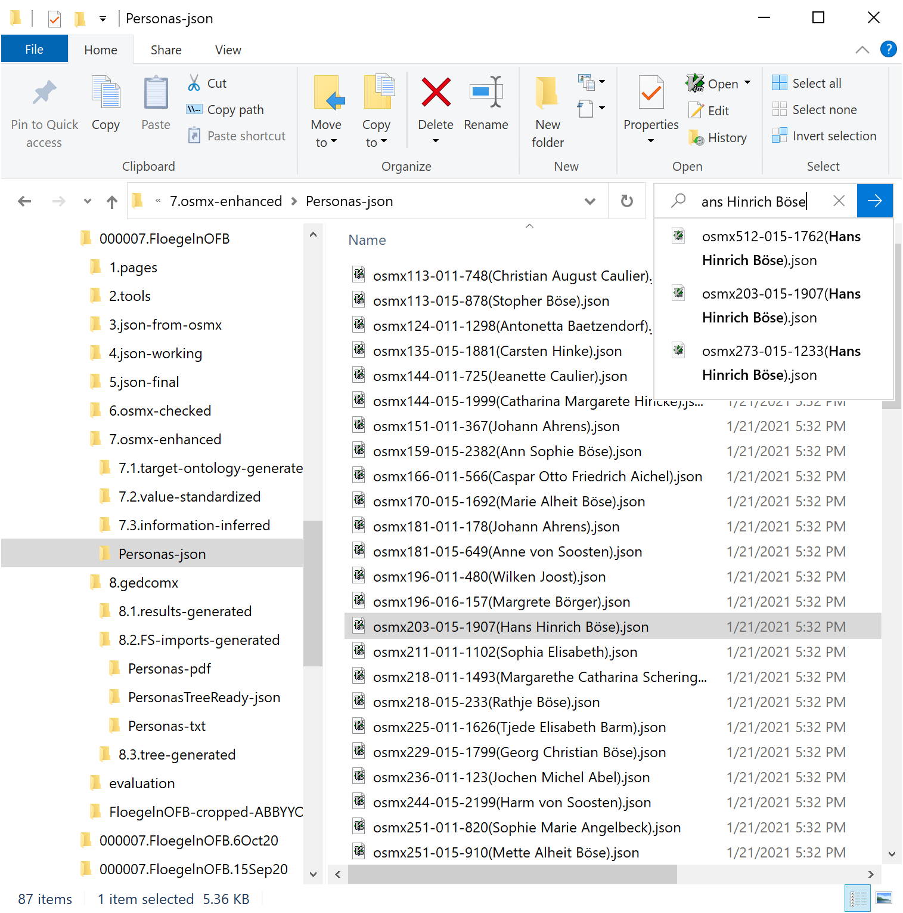
End-Product Contributions: CDS
Extract
Check
Curate
Import
CDS
LLS
Tree

Slide 4
End-Product Contributions: CDS
Notes:
Note that the information has been curated: dates standardized (places too) and names canonicalized (broken into name parts and missing name parts inferred). (So the extraction is not just what’s in the text and is actually better for search.
Auto-extracted records must have their associated source documentation. (No one will have checked it for accuracy, and we sometimes get strange results.)
When record are found (and selected), a COMET view like this should be returned. This not only makes the correspondence clear, but it also provides for immediate record correction)

Slide 5
End-Product Contributions: CDS
Notes:
Another persona record for the same Hans Hinrich Böse.

Slide 6
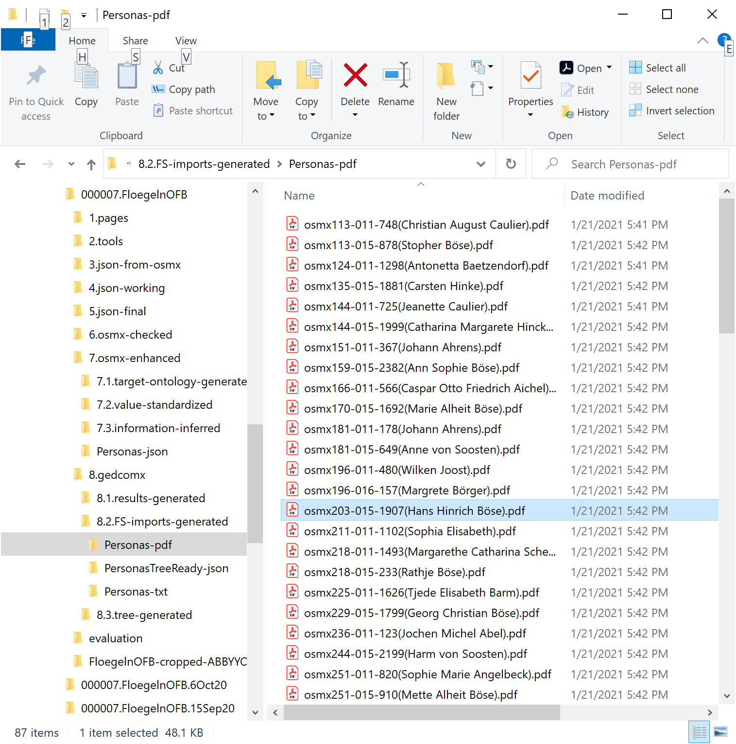
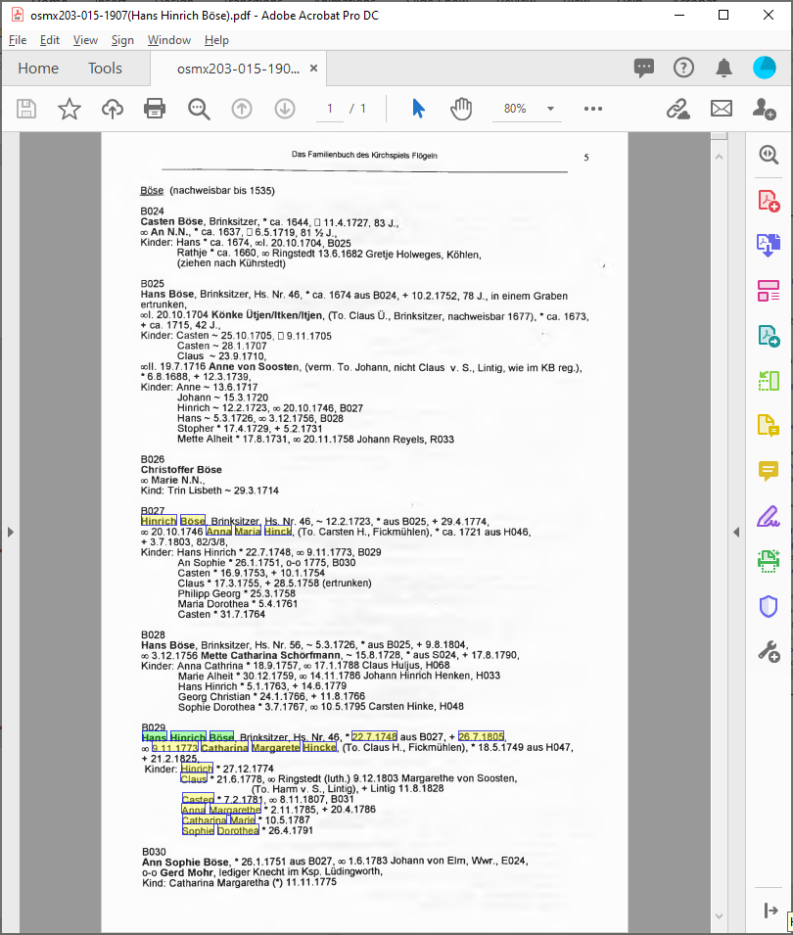
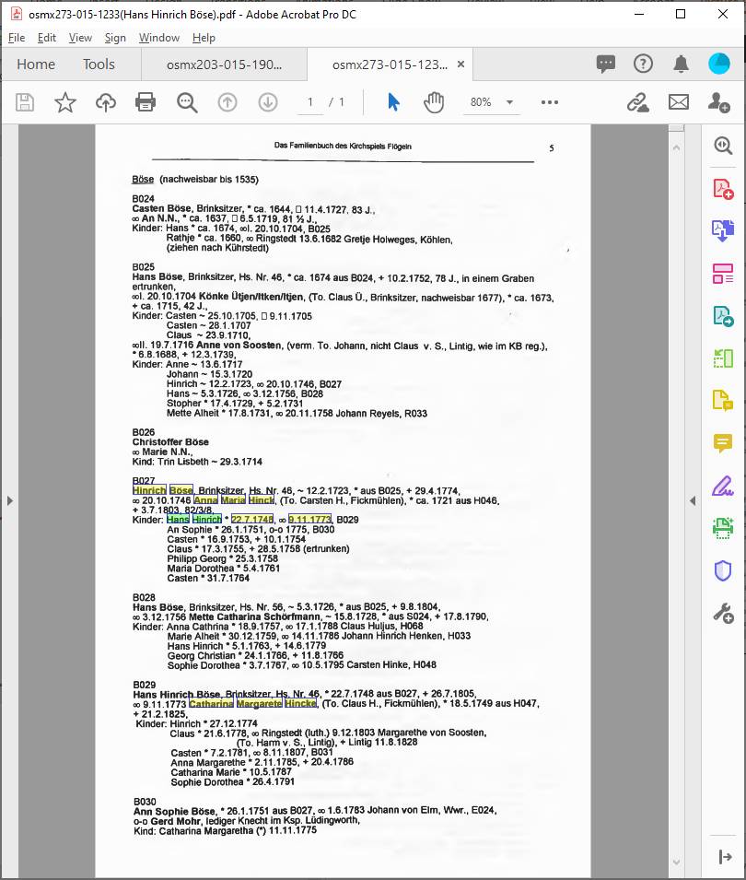
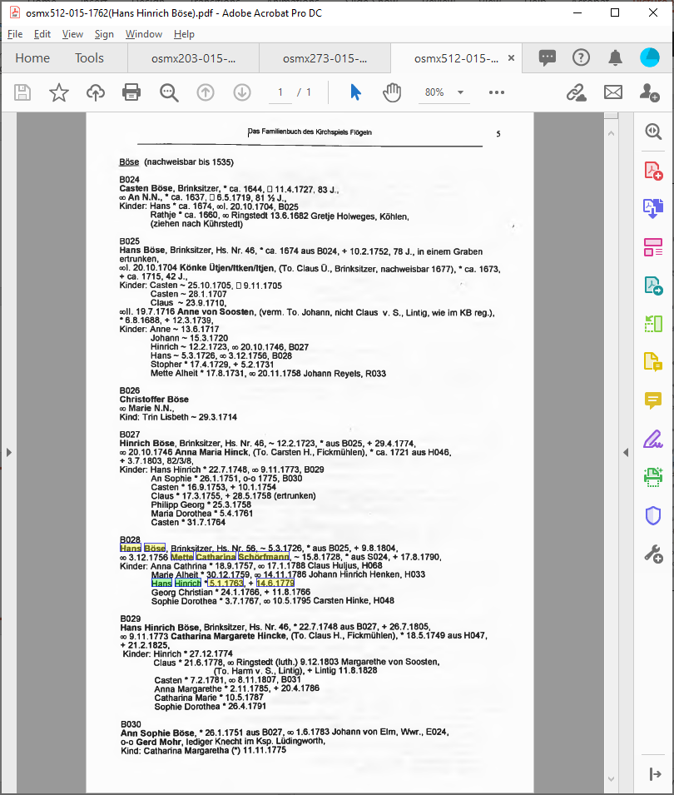
End-Product Contributions: CDS
Documentation for three Hans Hinrich Böse persona records
Notes:
This is the difference between our CDS records and our LLS records (which would have merged the two records for the Hans Hinrich Böse’s that are the same person).

Slide 7
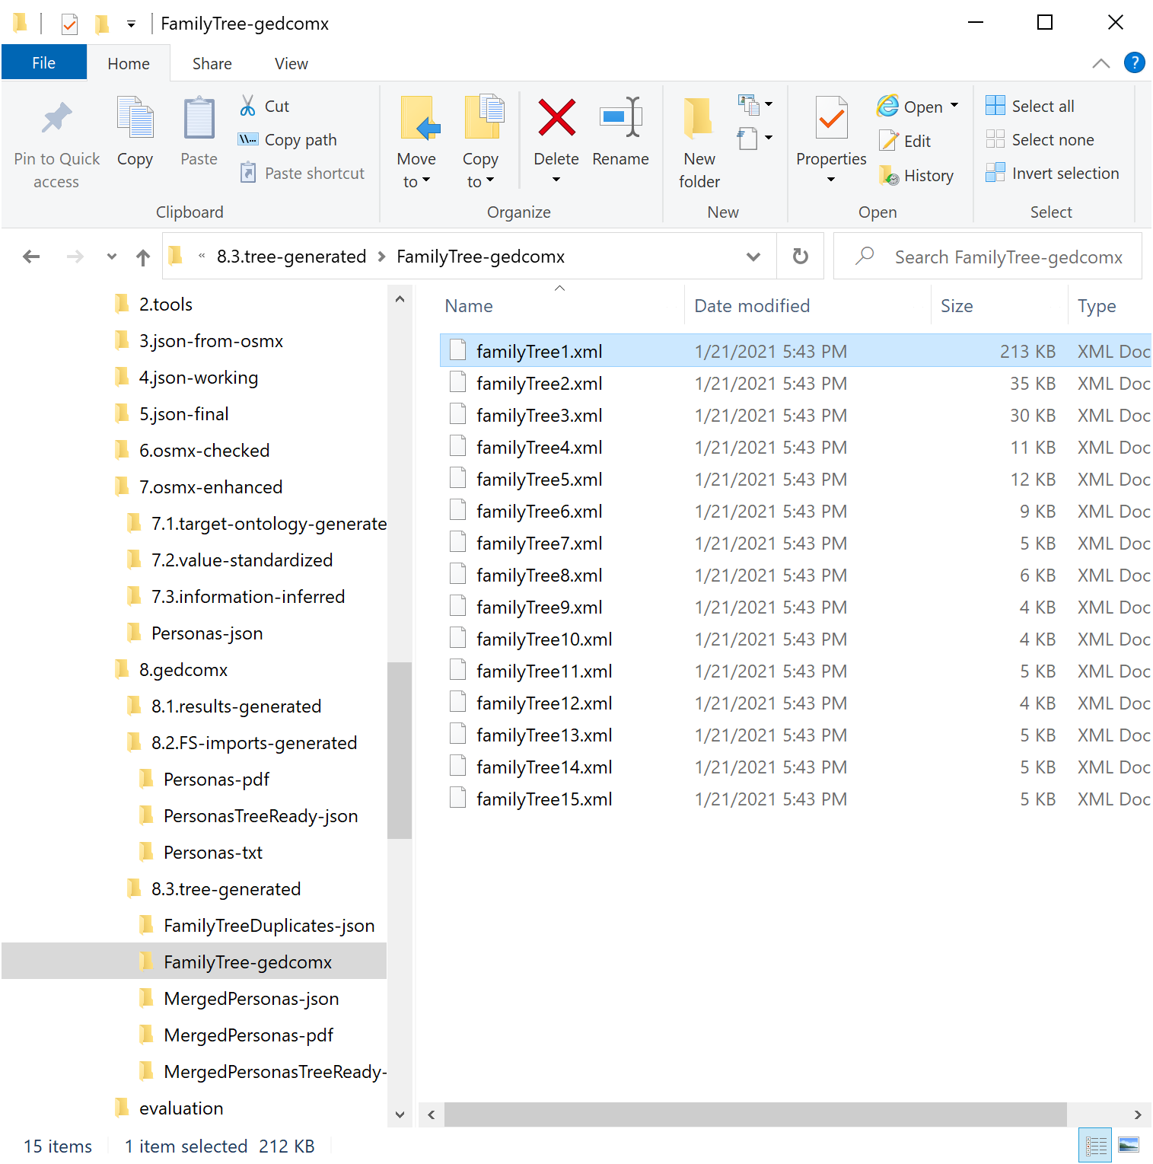
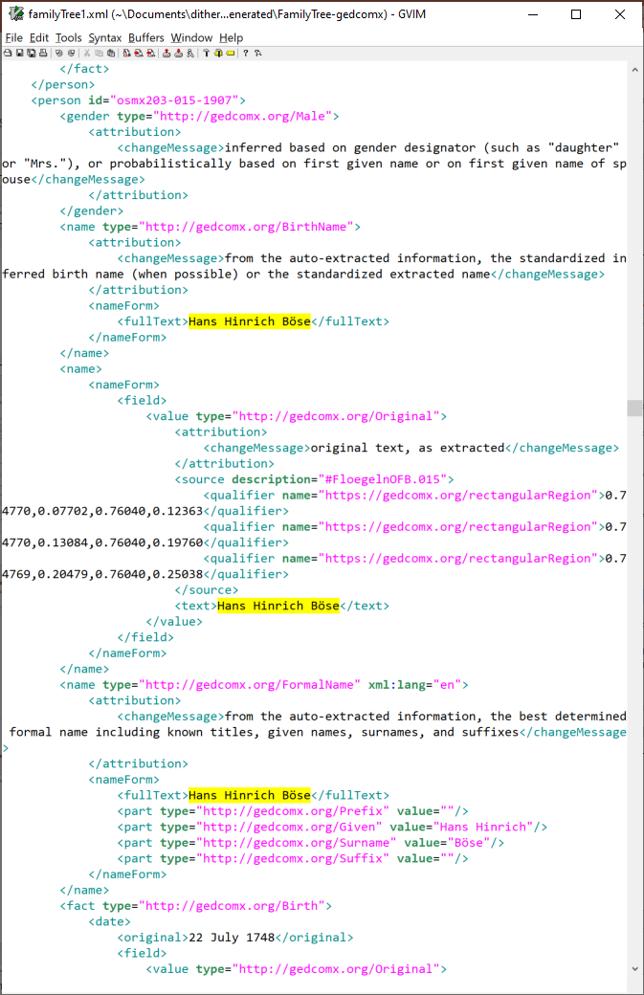
End-Product Contributions: LLS
Notes:
Note 15 disjoint trees covering 87 persona records (from a few pages – some Böse & Dröge families)

Slide 8
End-Product Contributions: LLS
Notes:
This is just one record in a larger inter-generational family tree.
With the same interface, we also have here the possibility of record correction.

Slide 9
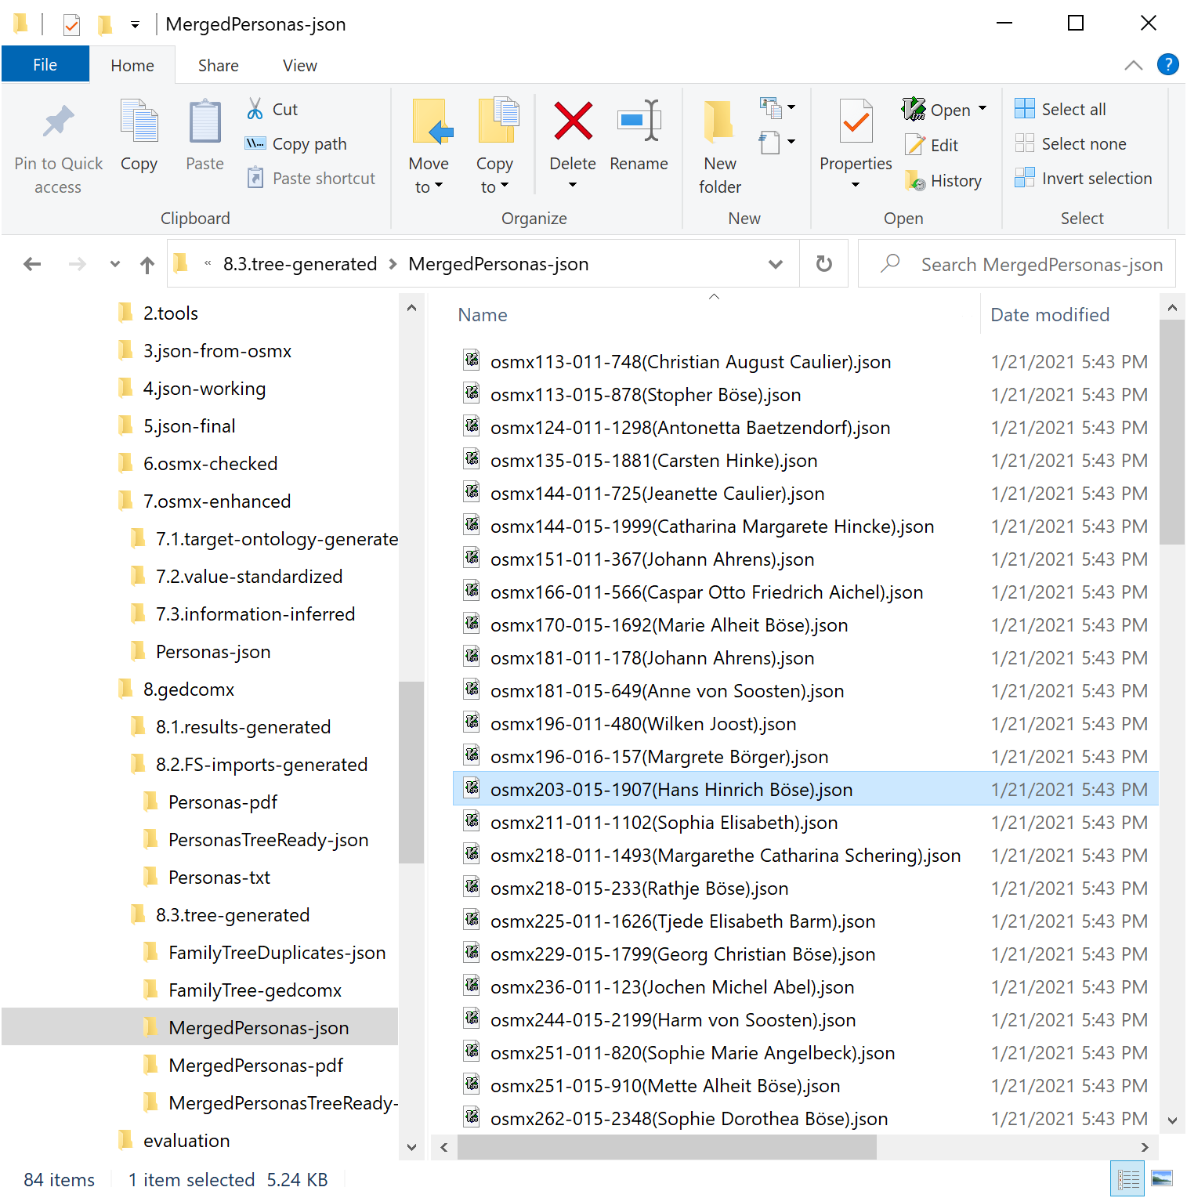
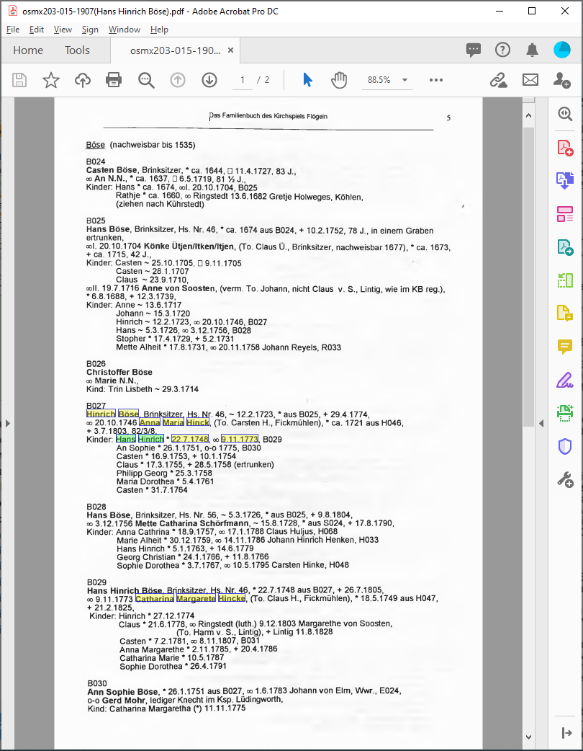
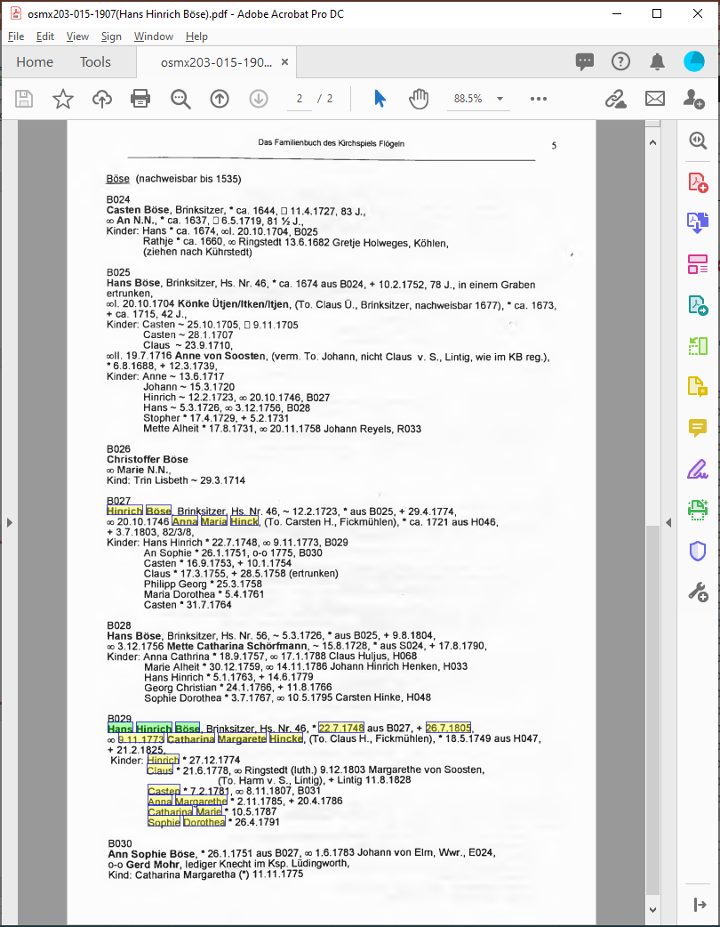
End-Product Contributions: LLS
Notes:
… and we have a combined single-document source.

Slide 10
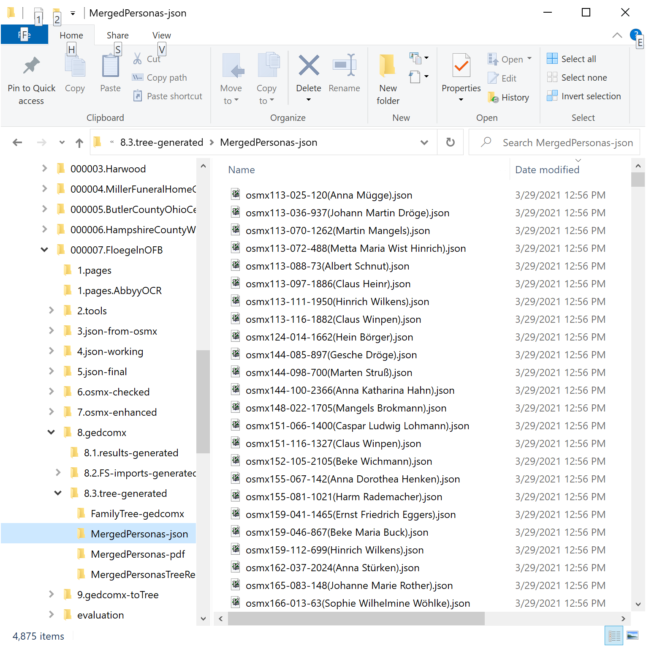
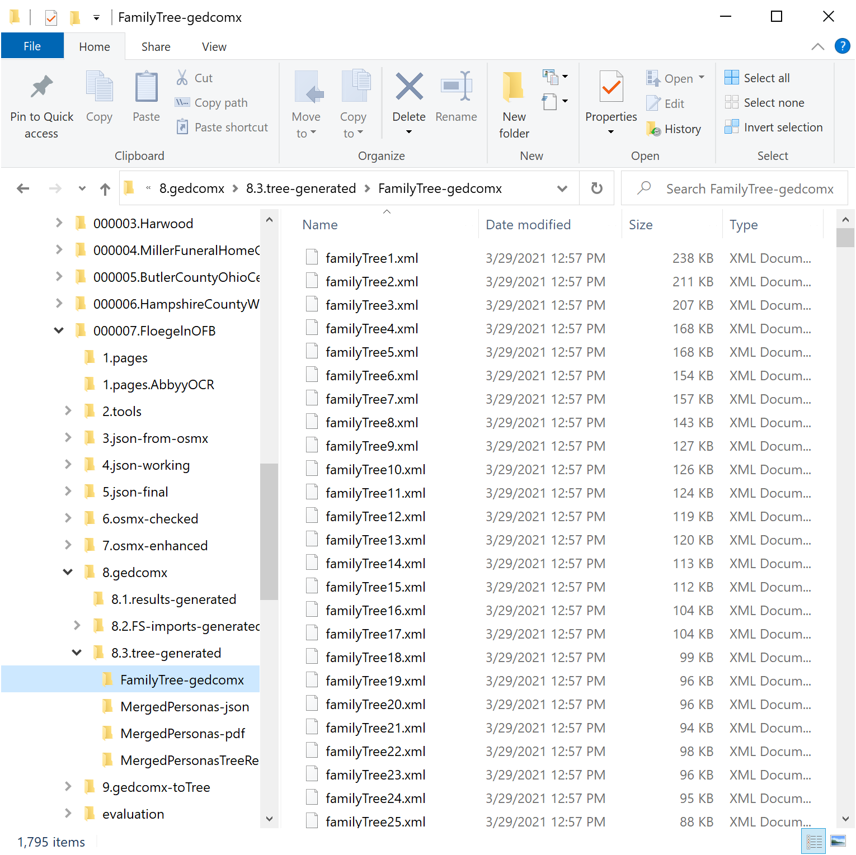
End-Product Contributions: Tree

Slide 11
End-Product Contributions: Tree
Notes:
A patron can and should check and edit the record wrt to the book’s document.
Find duplicates; take “best”; the patron is shown info in book and on FsTree (vitals, relationships, and sources) and an analysis with SW’s 4 phases. (The lines in the mockup are to be replaced by (?) + a note about the confidence.)
The patron determines whether there is a match.
Not a match – so simply (meaning with one click) add Hans to tree as a new person + all one-hop relationships as new persons (osmxPerson has a name and a FsID). Internally, we store the correspondence as a bijective map between FsID and our osmxID. (When we then process a persona with one of these osmxIDs in the map, we retrieve, as one of the matches of persons on the tree, the person with the corresponding FsID and deal with it.)

Slide 12
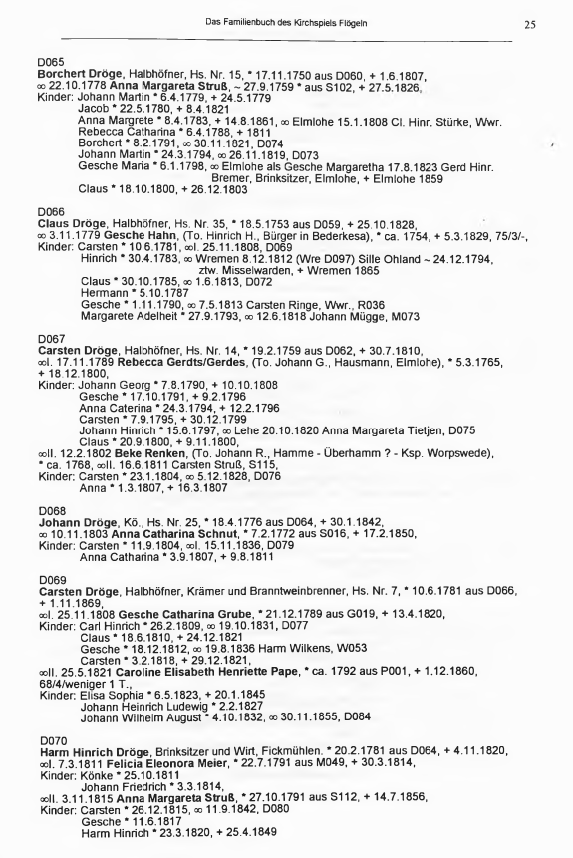
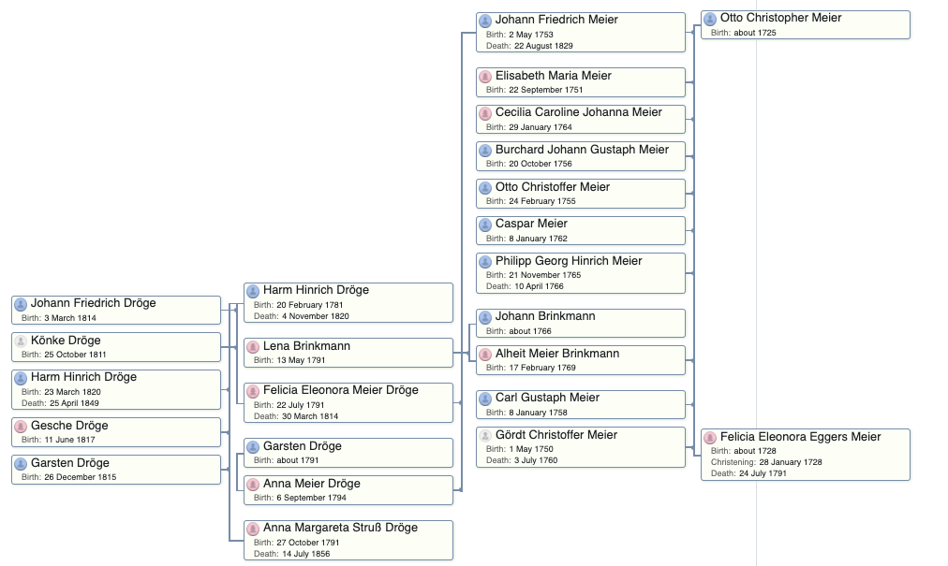
End-Product Contributions: Tree

Slide 13
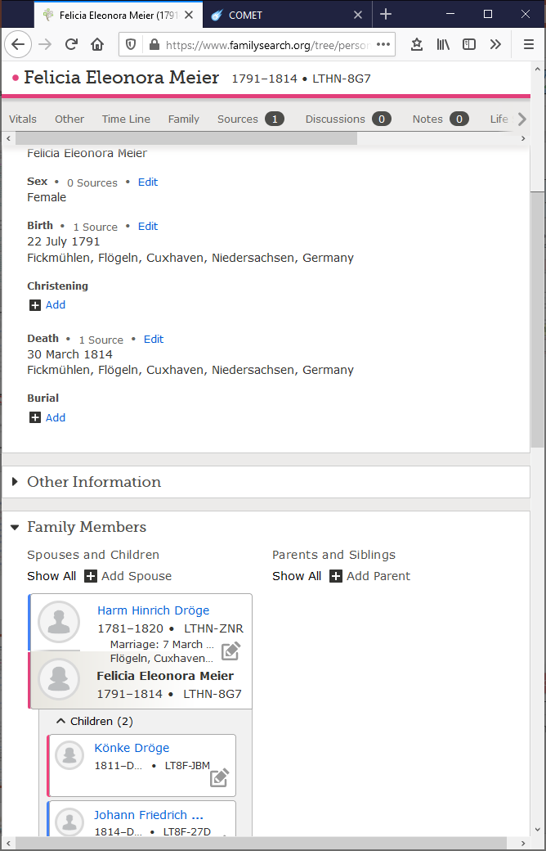
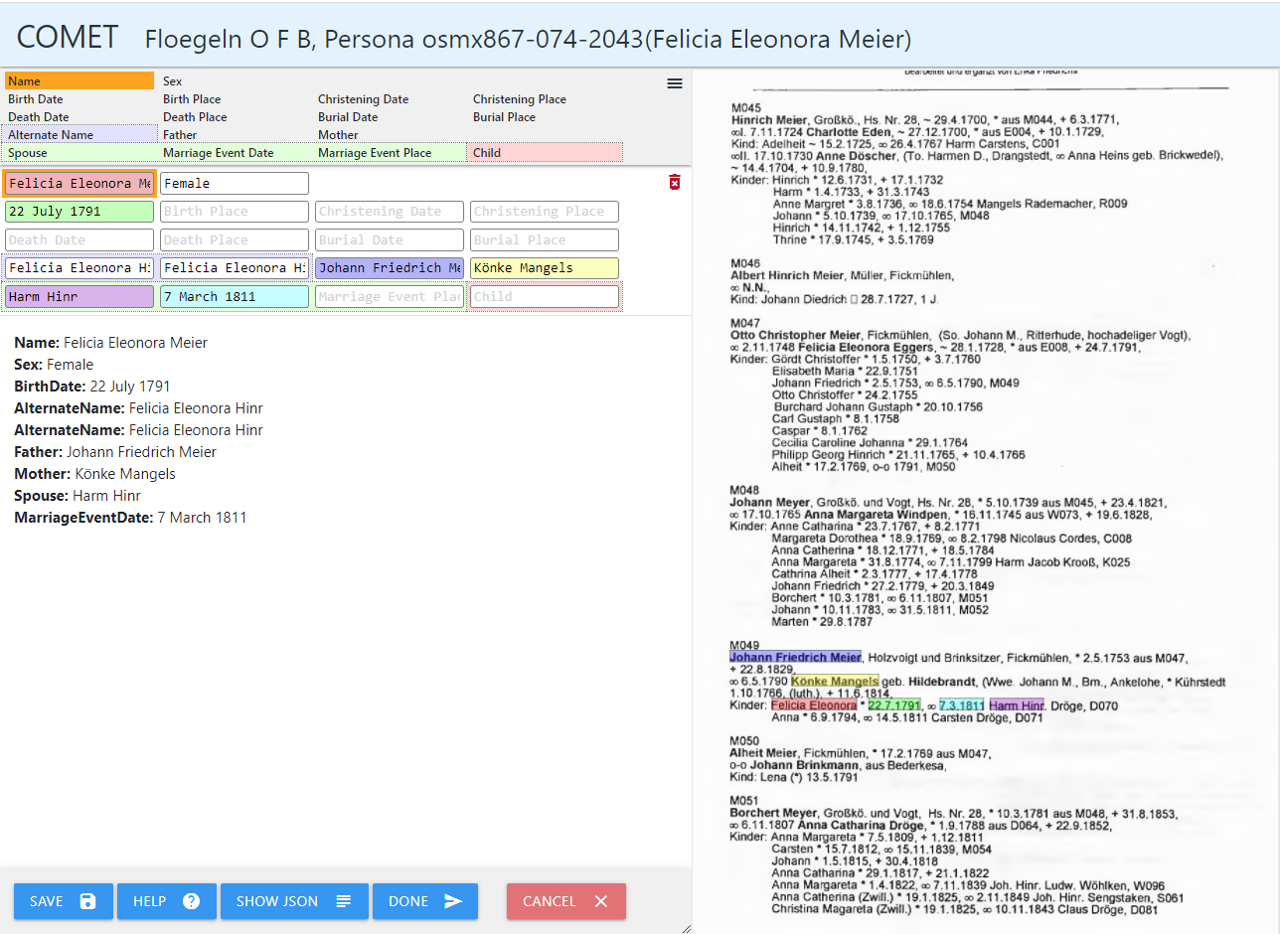
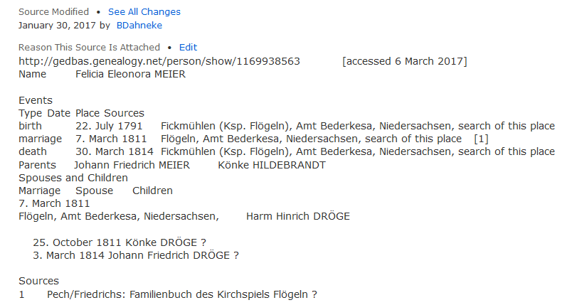
End-Product Contributions: Tree
Notes:
Is a match (Not sure why the other persona record for Felicia didn’t merge; it included the two children and the death date.)
Edit in COMET fields so that the following update rules for corresponding fields result in what we want:
If personaField and personField are identical, no update.
If personaField has a value and personField does not, add.
If personaField field does not have a value, do nothing.
If personaField and personField have values that conflict, replace personField value with personaField value.
(In our example, we would either delete the Spouse name, “Harm Hinr”, or edit it to be “Harm Hinrich Dröge”)
For the one-hop relationships, we do the following:
If we have already added that person to the tree, link to it (this includes linking to any existing osmxPerson records).
If not, add a new osmxPerson to the tree.
(In our example, using what is currently on the tree and assuming we have already processed her husband, we would link to him and his/their children and create and link person records for her parents.)
(Note that for this assumption, Felicia’s osmxPerson would have already been on the tree when we started working on her; we could have then chosen this osmxPerson record as the initial best match, so that after initial patron edits and an add-click, the osmxPerson record would have all the information, including all one-hop relationships, that the book has to offer.)

Slide 14
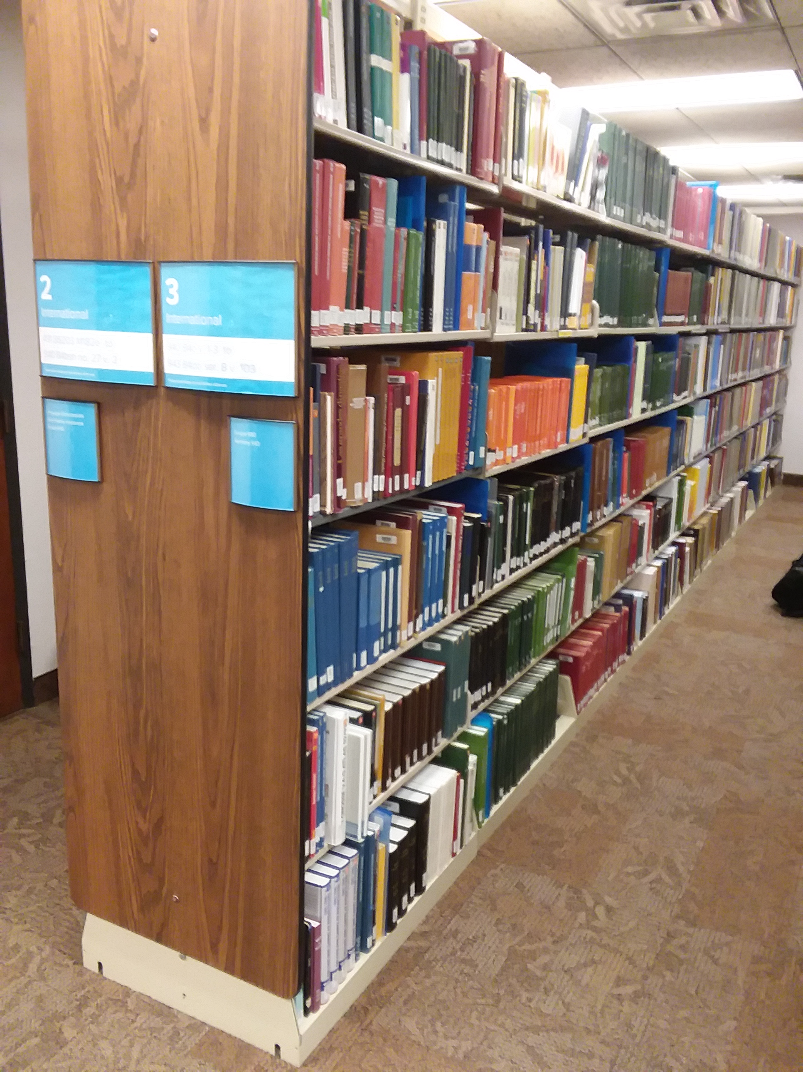
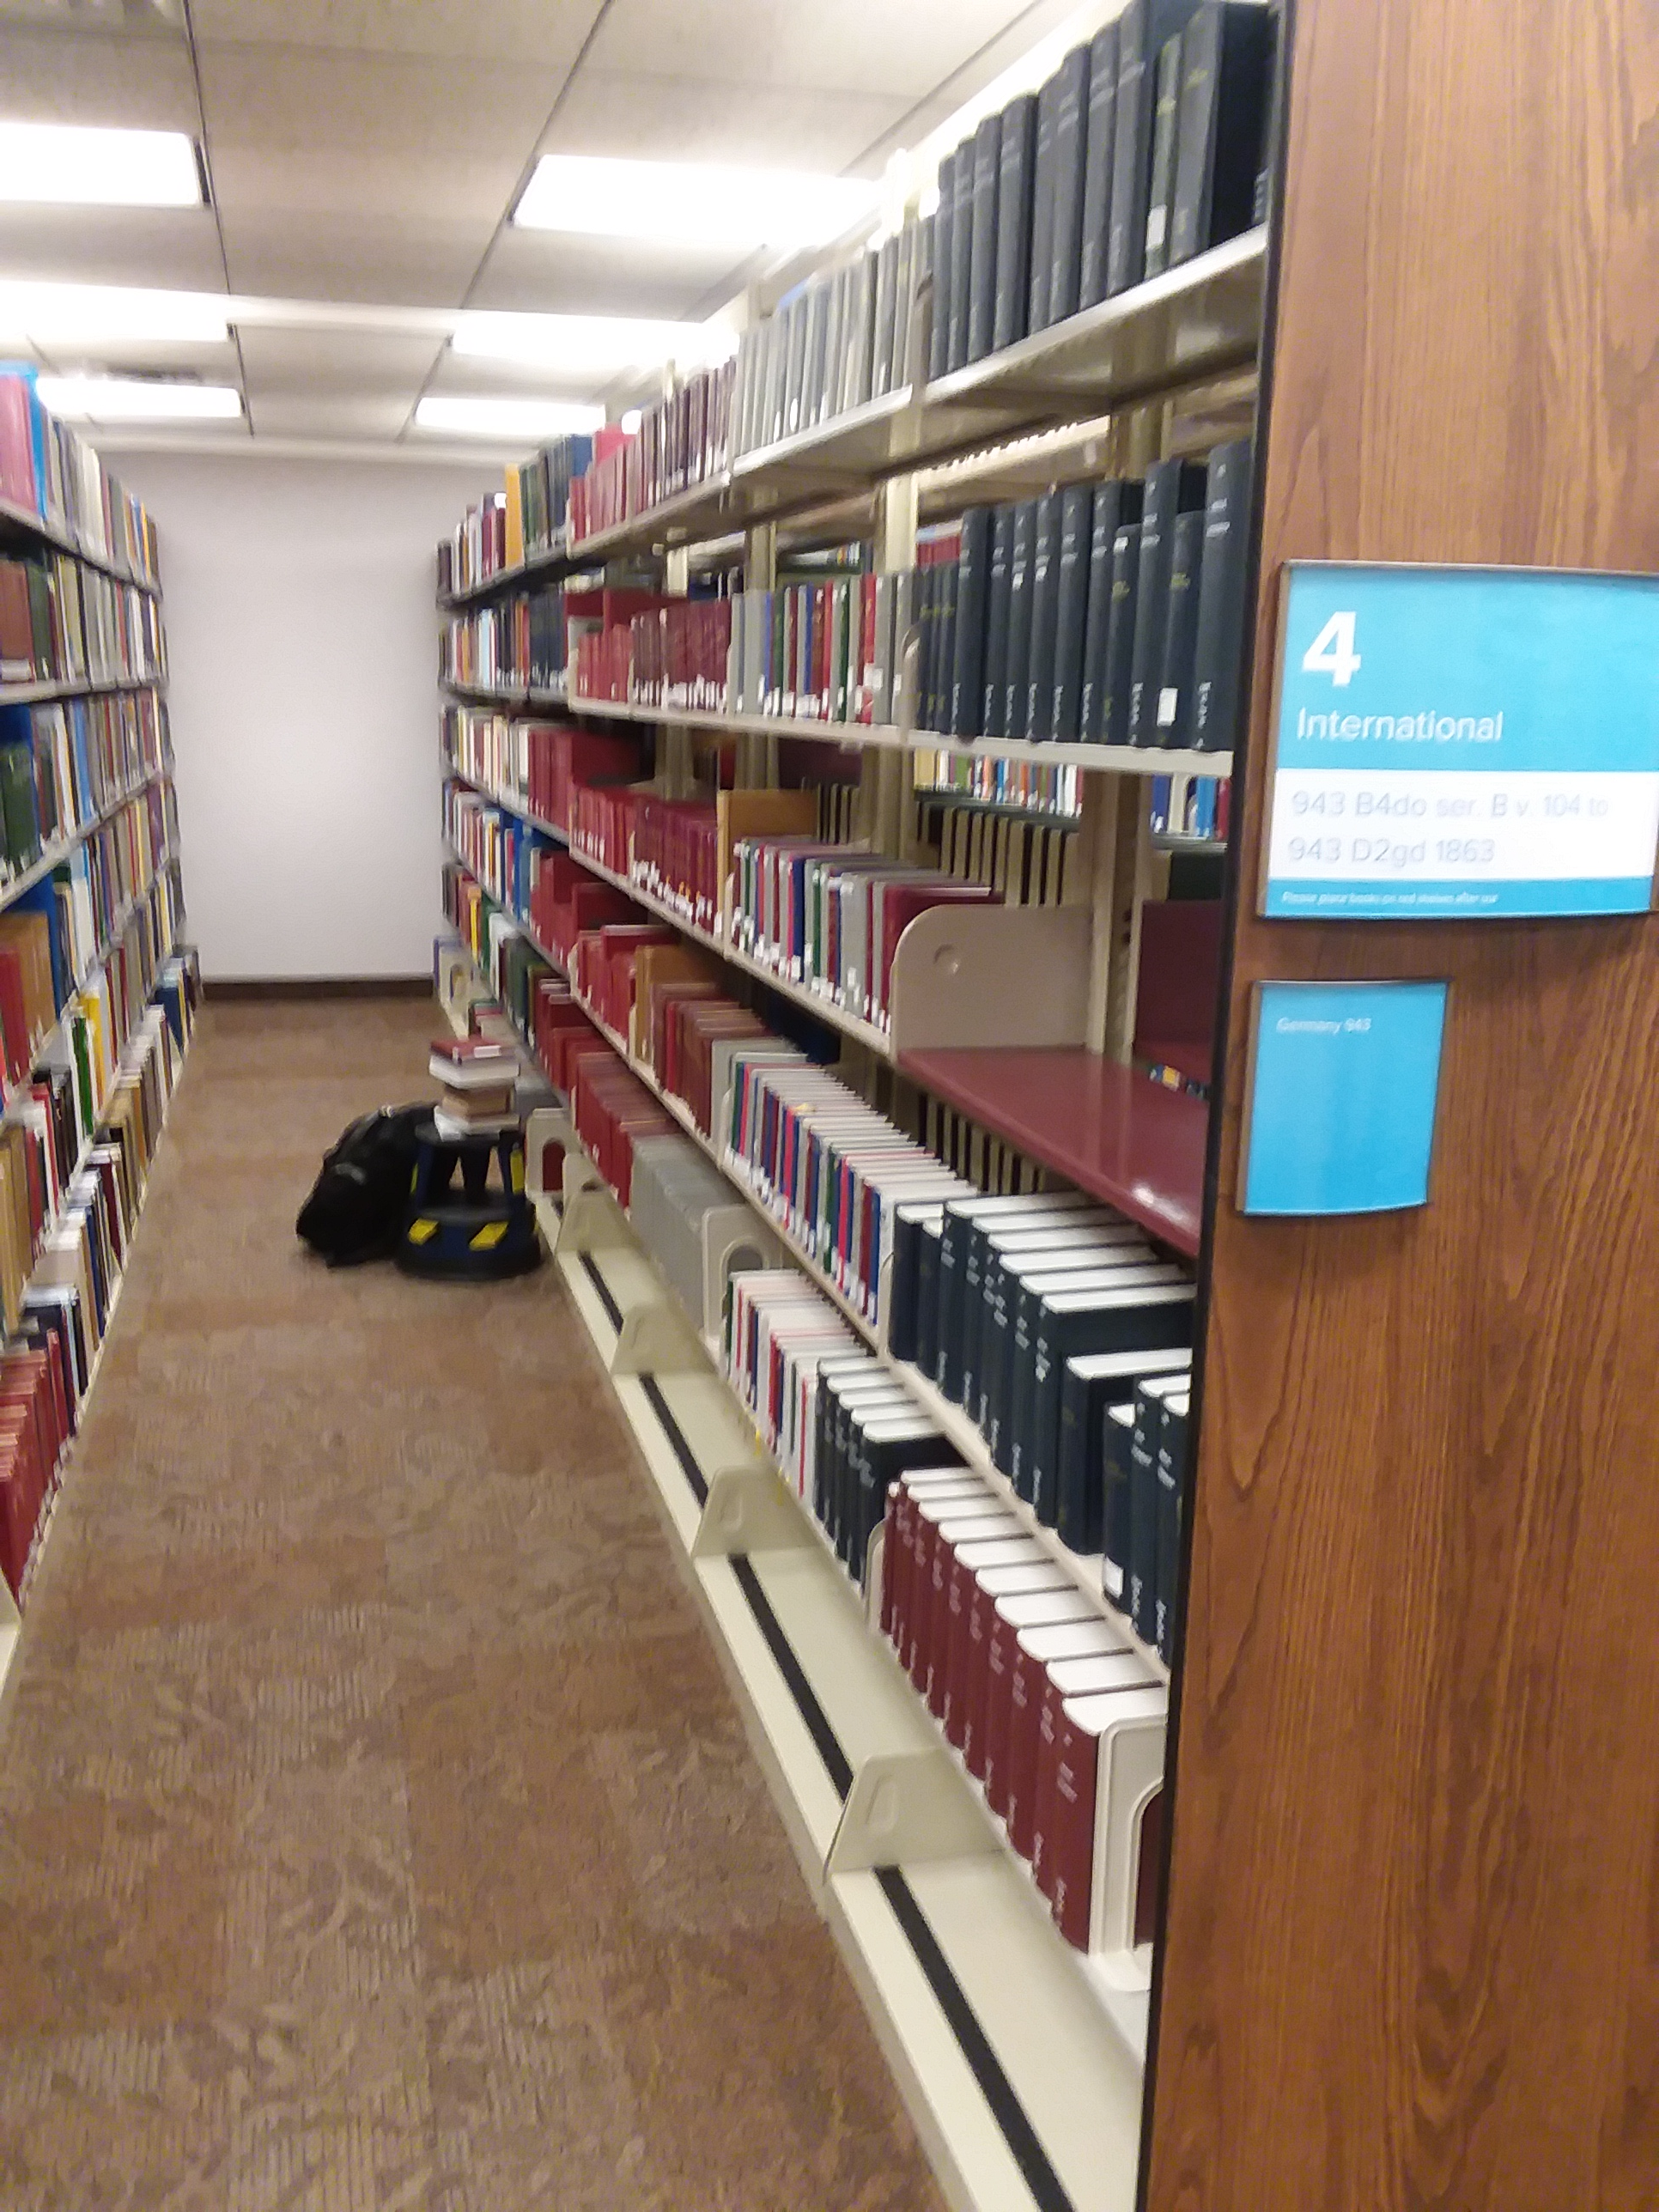
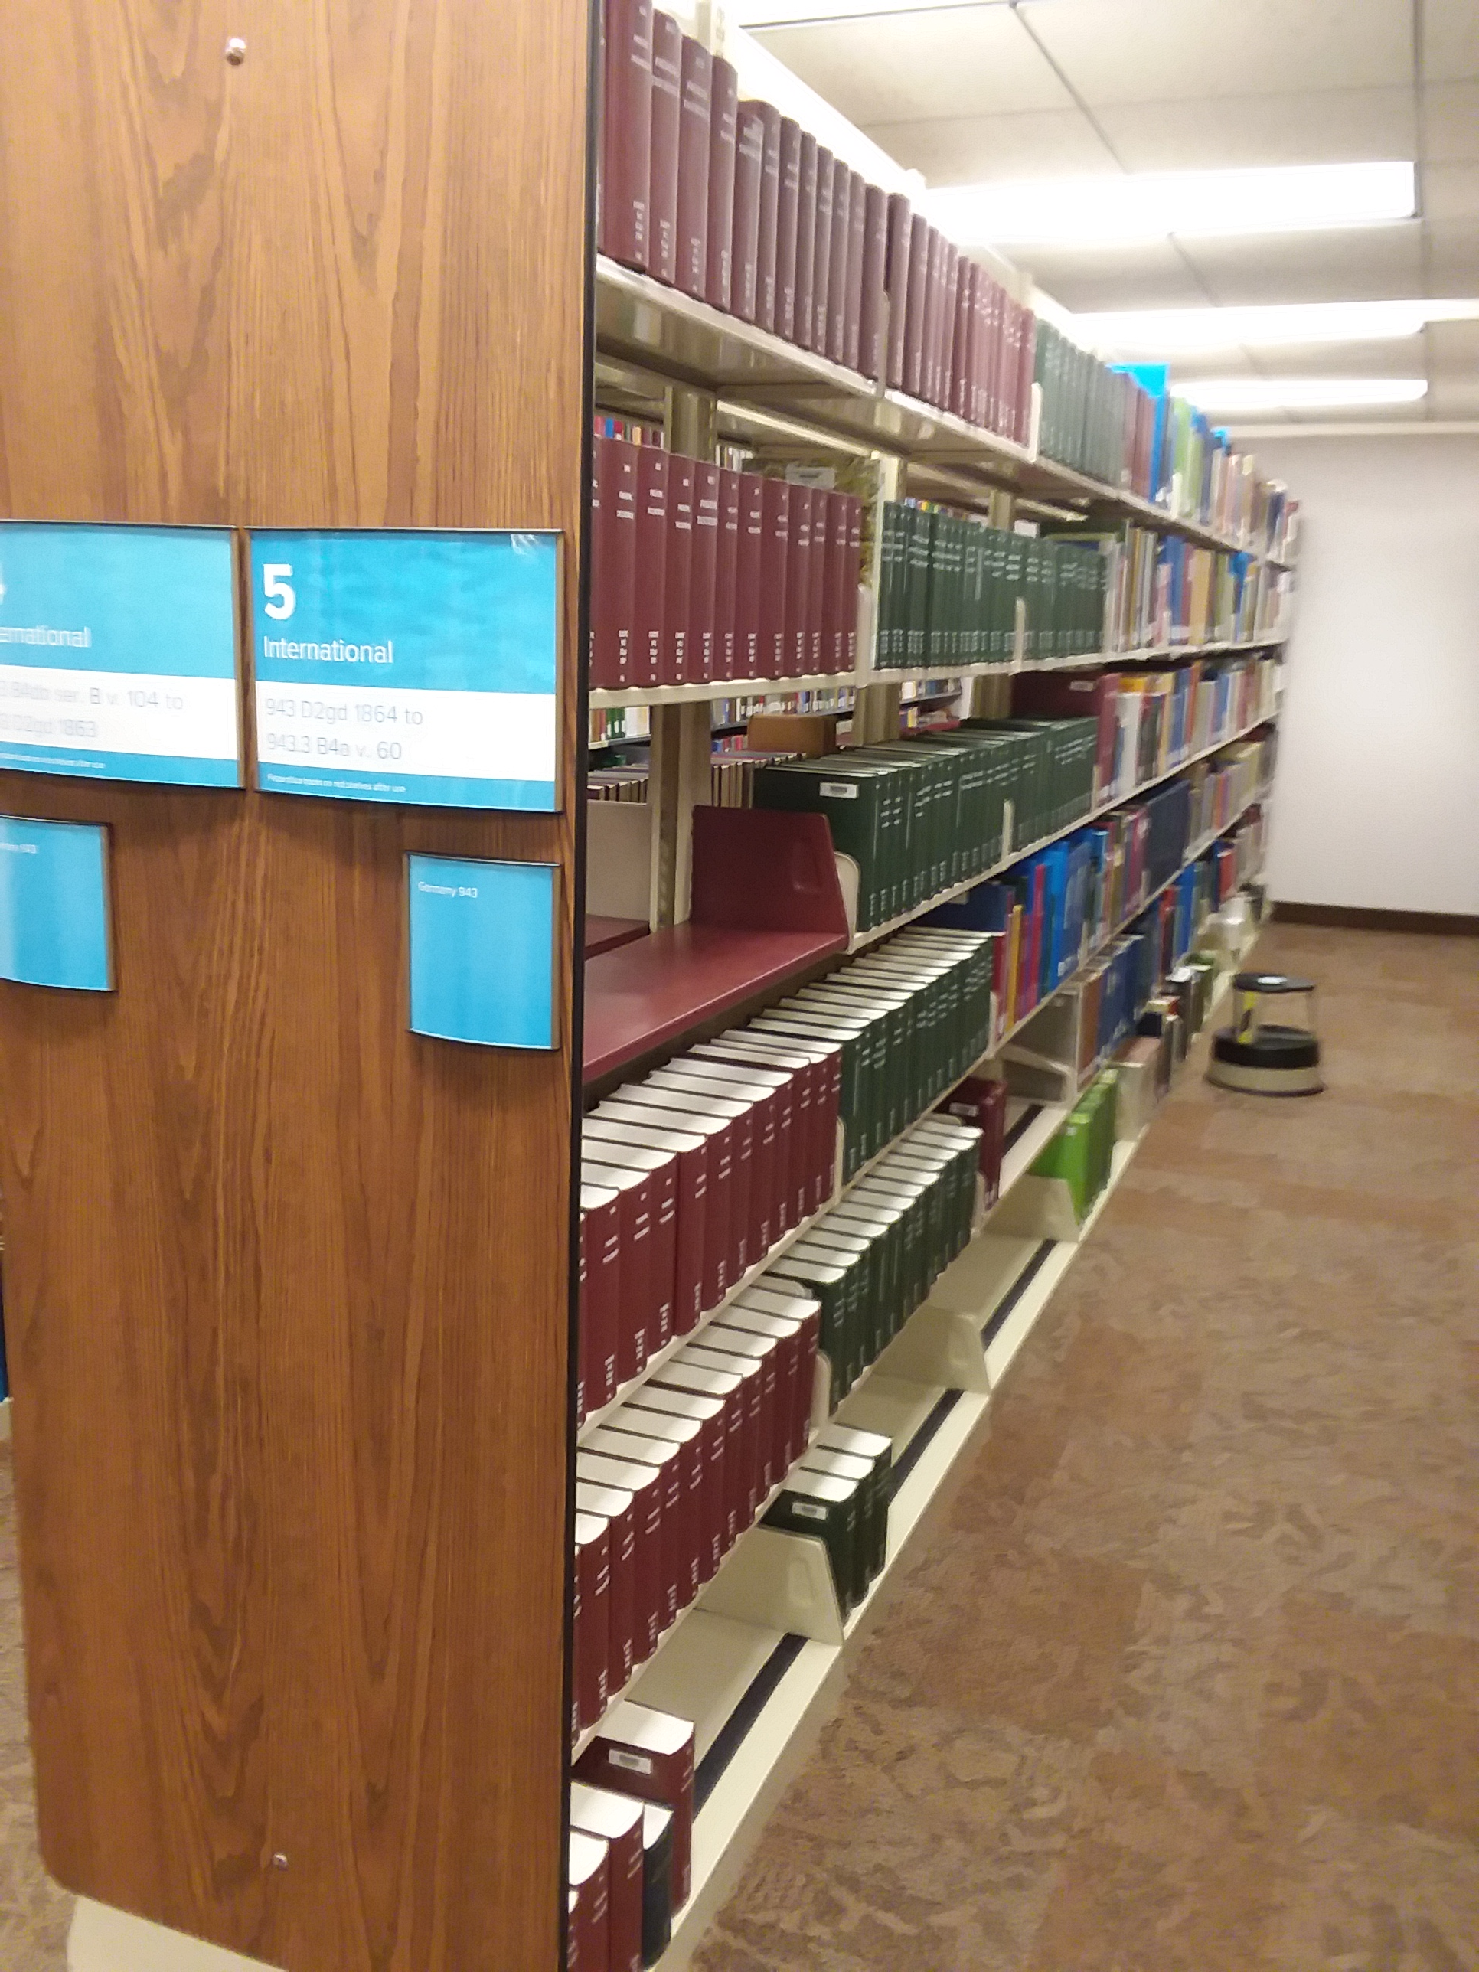
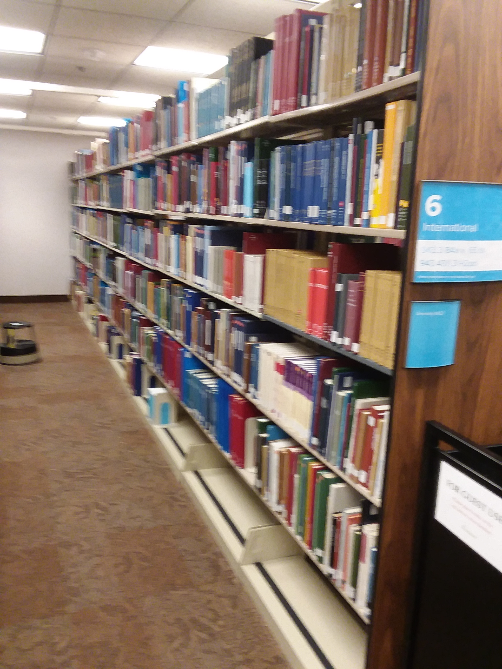
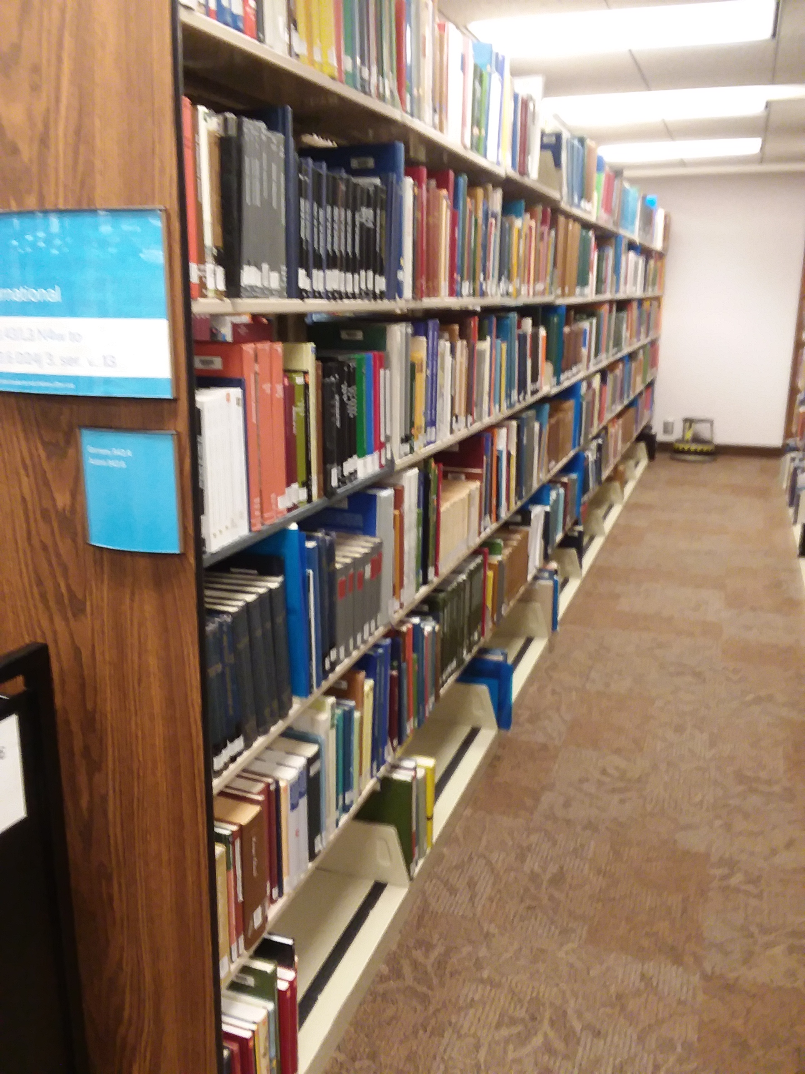
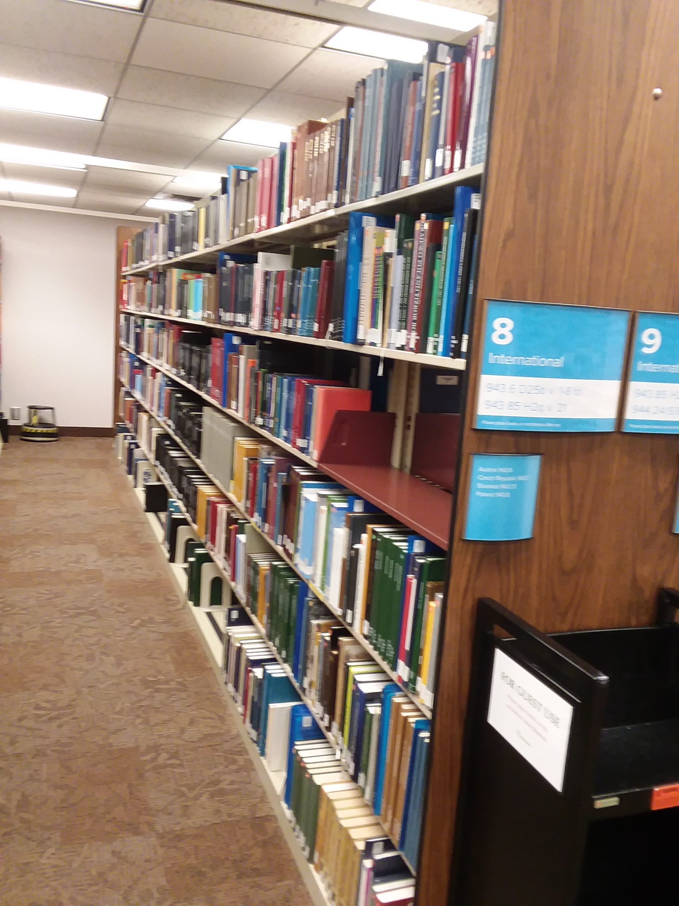
Future Possibilities: library OFBs
~1,400 new print OFBs
~? 100 old print OFBs
~? 5,000 persona records per book
(~7.5M CDS records)
~? 3,000 person records per book
(~ 4.5M LLS records linked in genealogies)
?? new persons for the FamilySearch Tree
Notes:
+ who knows how many OFB books exist that are not in our library

Slide 15
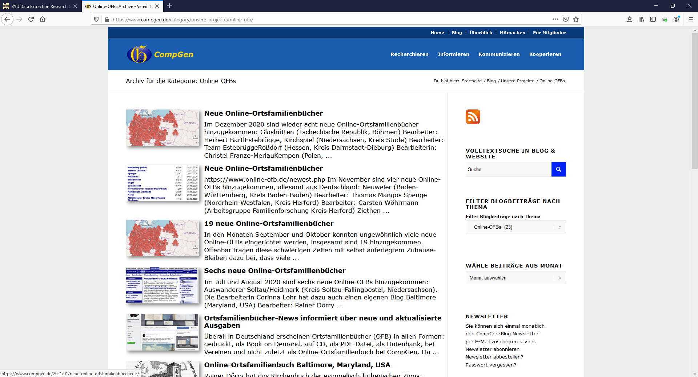
Future Possibilities: online OFBs
10M+ records and more coming all the time

Slide 16
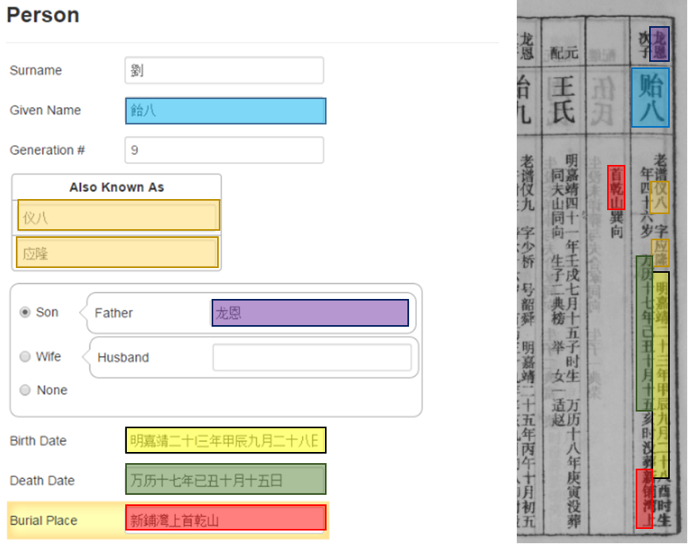
Future Possibilities: Jiapu?
12,871,979 Jiapu images
~ half billion fact assertions
Machine learning is likely the best way to extract BUT obtaining training data for traditional machine learning may be overwhelming.
The GreenQQ extraction tool is a “one-shot” learner, needing only training data of a few dozen examples for a Jiapu collection (and even less for additional collections as we can reuse training data).

