Slide 1
GreenQQ
Extraction Rule Creation by Text Snippet Examples

Slide 2
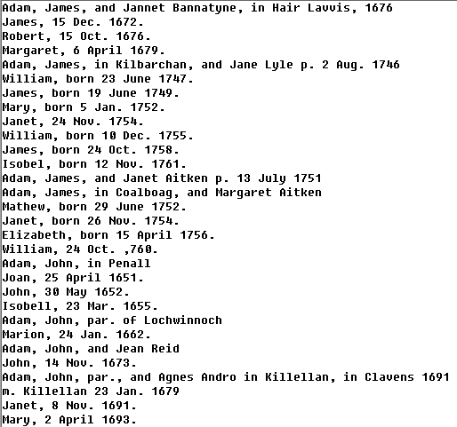

Slide 4
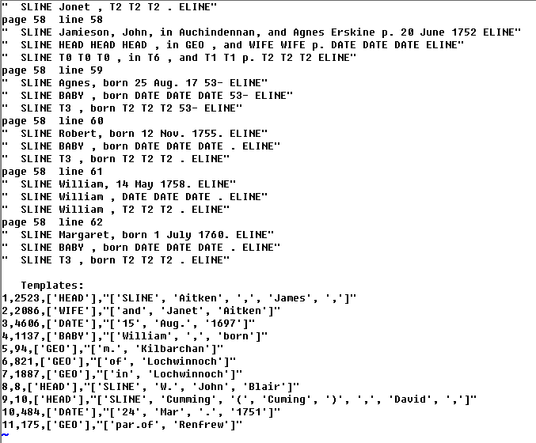

Slide 5
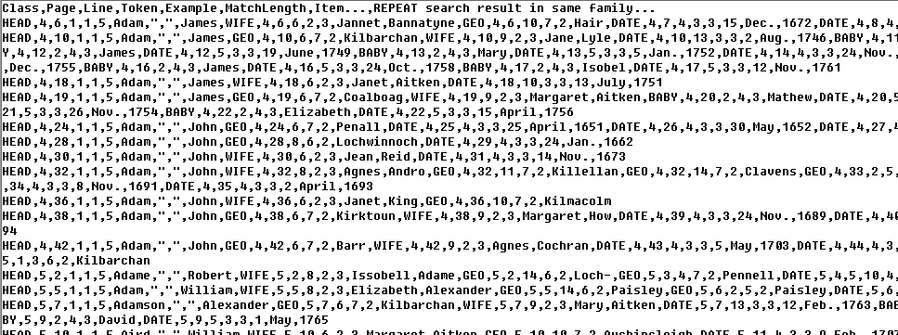

Slide 6
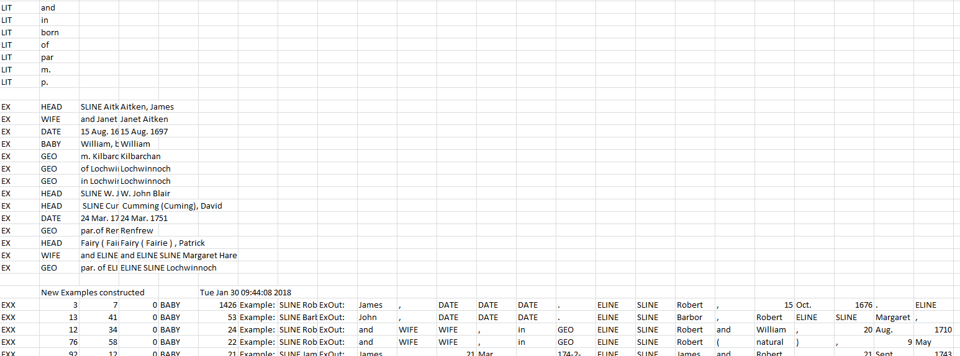
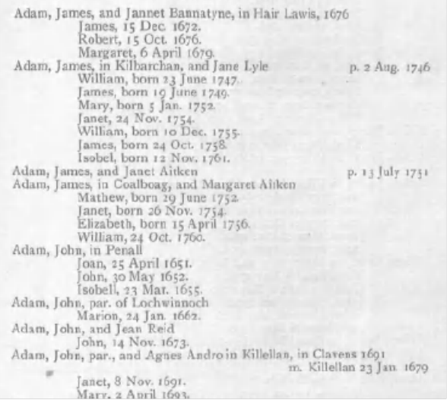
^^^ Robert

Slide 7
HEAD
^ Barbor
^^ Robert

Slide 8
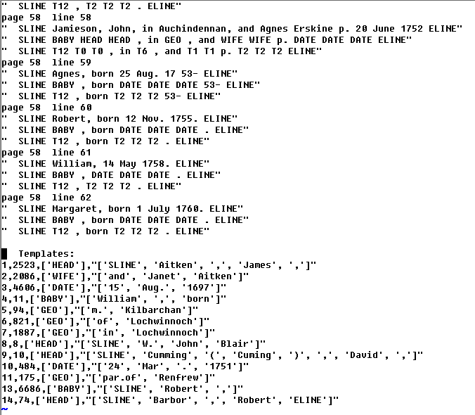

Slide 9
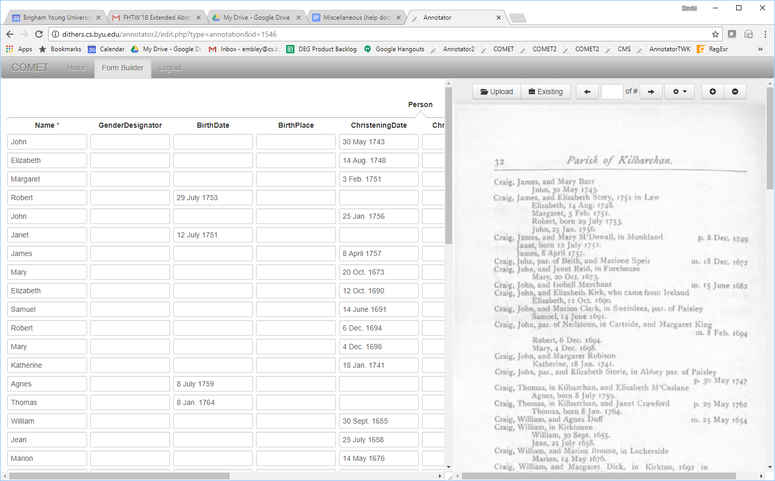

Slide 10
Default Rule Generation: -2/+2 context with no markup
ELINE SLINE CAP , ANUM
Immediate execution check upon request

Slide 11
Default Rule Generation: -2/+2 context with no markup
CAP , ANUM CAP ANUM . ELINE
Immediate execution check upon request

Slide 12
Custom Rule Creation: edit default
ELINE SLINE CAP , LOW
SLINE CAP, born
Immediate execution check upon request

Slide 13
Custom Rule Creation: edit default
, LOW ANUM CAP ANUM . ELINE
, born ANUM CAP ANUM . ELINE
Immediate execution check upon request

