Slide 1



Extraction Rule Creation by Text Snippet Examples
David W. Embley (Brigham Young Univeristy & FamilySearch)
George Nagy (Rensselaer Polytechnic Institute)

Slide 2
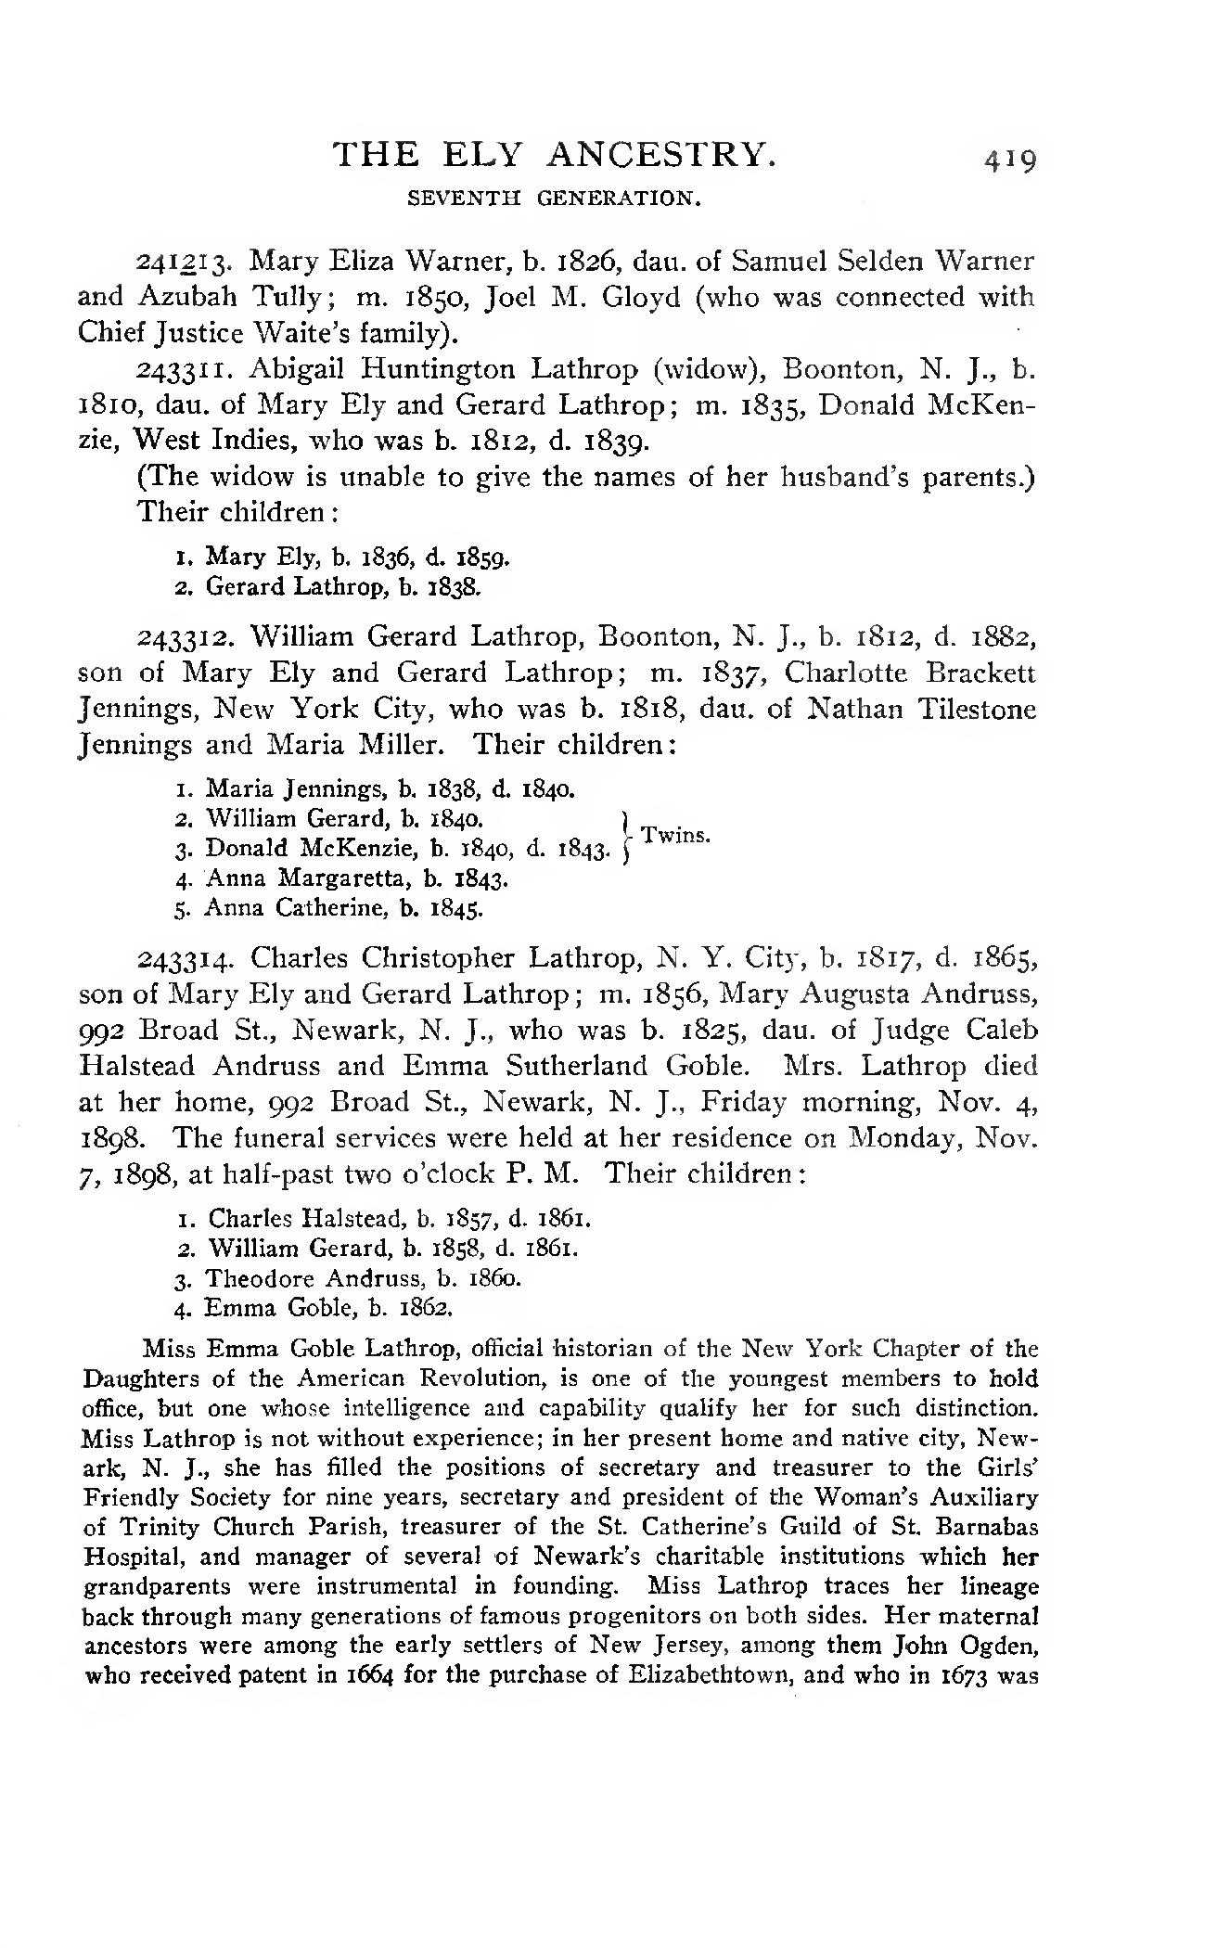

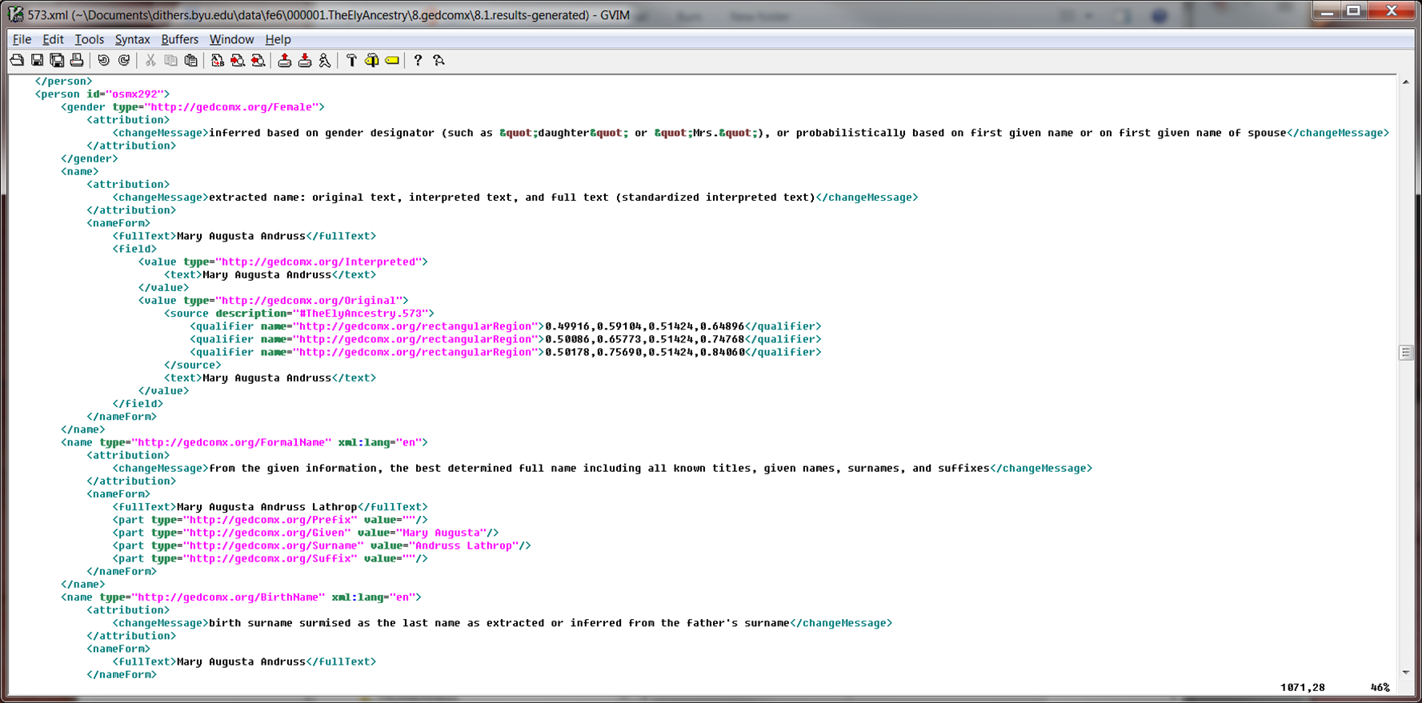
Project Objectives
Overall objective
  Extract and organize BMD information from scanned/OCR’d family history books
Extraction Engines
  Rules (especially for semi-structured text)
  NLP (especially for free-running text)
  Machine Learning
Organization Pipeline
  Curate: merge, check, infer, standardize
  Import for search and possible tree update
Today’s presentation: Rule creation by text snippet examples
  (Hopefully) usable by non-experts
  (Hopefully) rapid development
  (Hopefully) high quality results

Slide 3
Project Objectives
Overall objective
  Extract and organize BMD information from scanned/OCR’d family history books
Extraction Engines
  Rules (especially for semi-structured text)
  NLP (especially for free-running text)
  Machine Learning
Organization Pipeline
  Curate: merge, check, infer, standardize
  Import for search and possible tree update
Today’s presentation: Rule creation by text snippet examples
  (Hopefully) usable by non-experts
  (Hopefully) rapid development
  (Hopefully) high quality results

Slide 4
Project Objectives
Overall objective
  Extract and organize BMD information from scanned/OCR’d family history books
Extraction Engines
  Rules (especially for semi-structured text)
  NLP (especially for free-running text)
  Machine Learning
Organization Pipeline
  Curate: merge, check, infer, standardize
  Import for search and possible tree update
Today’s presentation: Rule creation by text snippet examples
  (Hopefully) usable by non-experts
  (Hopefully) rapid development
  (Hopefully) high quality results

Slide 5
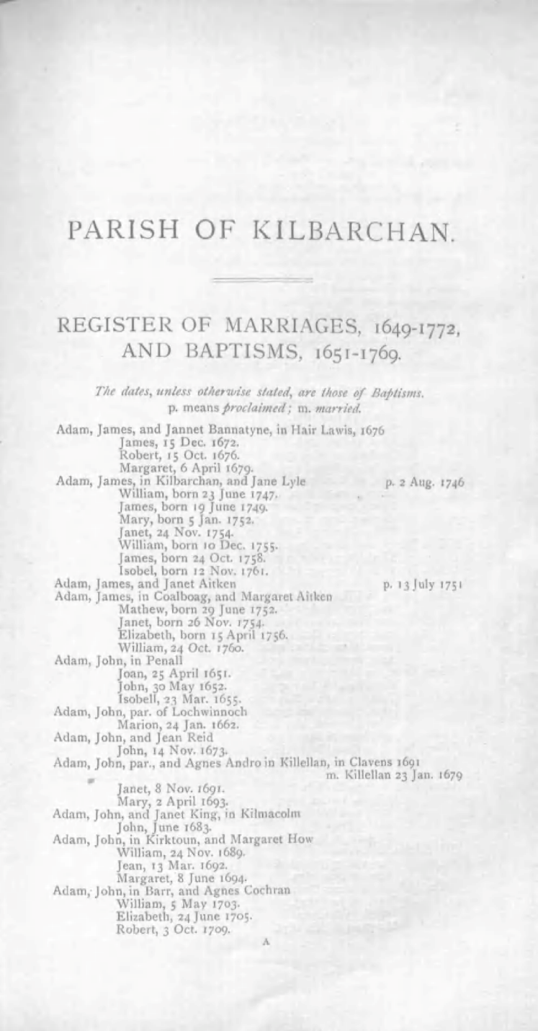
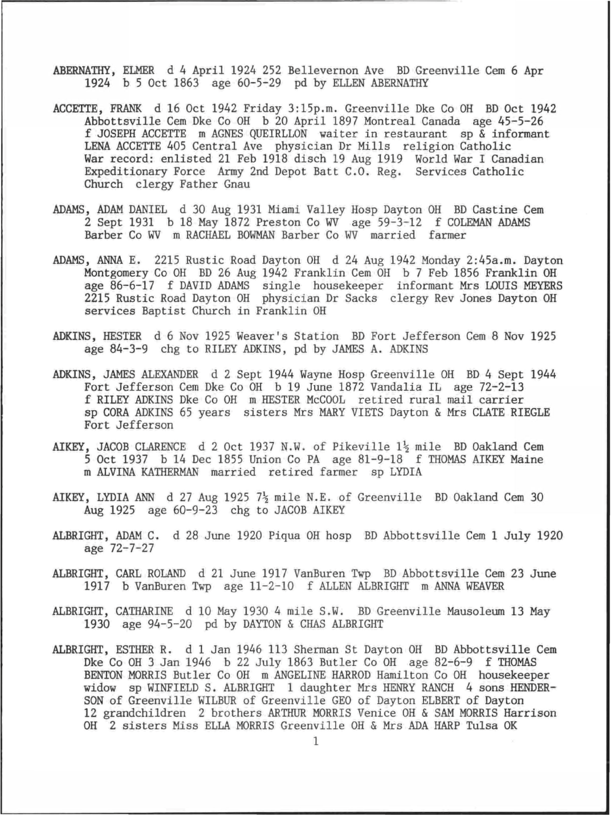
Pattern Examples

Slide 6
Pattern Examples – Large (layout components)

Slide 7
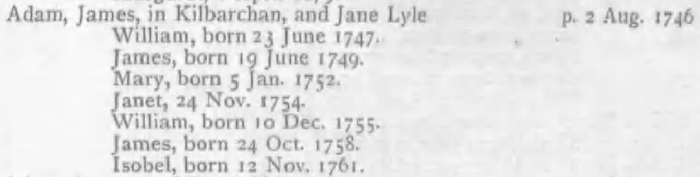
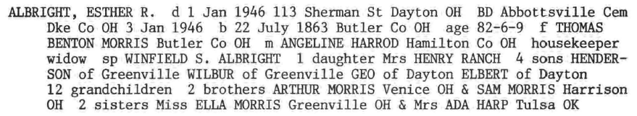
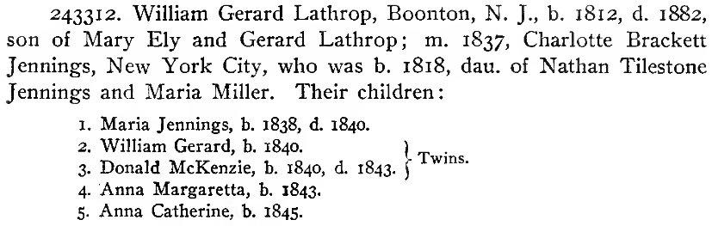
Pattern Examples – Intermediate (records)
Couple
Person
Family
Notes:
Where we’re headed is to something I call record-based NER (Named Entity Recognition). A record describes an object in terms of its properties -- the record’s fields, which are attribute-value pairs. Example: the Miller person object is described by the record: Person((Name, ALBRIGHT, ESTHER R.), (DeathDate, 1 Jan 1946), …). (Aside: the 2016 DAS paper by Kooli and Belaid nicely describes this idea in the first paragraph of the intro.) The idea of our record-based NER system is to choose text snippet examples whose patterns uniquely identify text that contains properly classified record field values and then to group classified field values into records (from HEAD to HEAD).

Slide 8
Pattern Examples – Small (text snippets)
Notes:
The red-boxed text snippets are representative of unique patterns within K, M, and E (E for Ely). The idea is to choose examples so that their text snippet patterns uniquely identify text that contains properly classified record field values, e.g. sorts out the Kilbarchan dates classifying them as proclamation dates (approximate marriage dates) for a Couple records, and christening and birth dates for Person records; sorts out person names as identifying parents and children for Family records and spouses for Couple records; and sorts out the Miller place names as birth places or burial places for Person records.

Slide 9
Pattern Examples – Small (text snippets groups)
Couple
Person
Family
Notes:
The green-boxed text are the record HEADs.

Slide 10
Rule Creation By Text Snippet Examples
Person record
* Name: ^ James, born
* Name: ^ Janet, 24
ChristeningDate: , 24 Nov. 1754. $
BirthDate: born 24 Oct. 1758. $
Couple record
* Name: ^ Adam, James,
SpouseName: and Jane Lyle
MarriageDate: p. 2 Aug. 1746 $
Family record
* Parent1: ^ Adam, James,
Parent2: and Jane Lyle
Child: ^ James, born
Child: ^ Janet, 24
Notes:
User-created records. Notation: red stars mark record HEAD classes; ^ and $ are vi-standard SLINE and ELINE markers.
Note that the record types overlap and thus must be processed separately. But also note that the processing is as you have coded it.

Slide 11
Rule Creation By Text Snippet Examples
Person record
* Name: ^ James, born
* Name: ^ Janet, 24
ChristeningDate: , 24 Nov. 1754. $
BirthDate: born 24 Oct. 1758. $
Couple record
* Name: ^ Adam, James,
SpouseName: and Jane Lyle
MarriageDate: p. 2 Aug. 1746 $
Family record
* Parent1: ^ Adam, James,
Parent2: and Jane Lyle
Child: ^ James, born
Child: ^ Janet, 24
SLINE CAP , born
p. NUM CAP . NUM ELINE
SLINE CAP , CAP ,
Notes:
System tagging. (Here, I am choosing to use NUM for numbers for presentation purposes. We can of course use ANUM or whatever we wish.)
Users specify literals; here “born” and “p.”

Slide 12
Step1: Specify the Records
Notes:
This “Form Builder” is already implemented. The “Add a Form” button adds another form to the collection. The “>” next to each field, when clicked, lets a user nest form fields of various kinds under the field.
Here I have defined three form/record templates: Person, Couple, and Family. These are the record definitions for GreenQQ. Each one corresponds one-to-one with the mini-ontologies in Figures 7, 8, and 9 of the emisa paper. The red asterisk specifies the grouping HEAD class for the record (i.e. the field for ontological commitment which you can read more about in the emisa paper, but which essentially means that when the text for this class is recognized/extracted, a record-object is instantiated).
The classes specified for GreenQQ are the leaf-level field names. (In general, further nesting is possible, e.g. under BirthDate we could nest BirthDay, BirthMonth, BirthYear, in which case BirthDay, BirthMonth, and BirthYear would be class names while BirthDate would then not be a class name.)
In our FamilySearch application, these forms/record-templates are pre-defined; an end user need never bother with them.

Slide 13
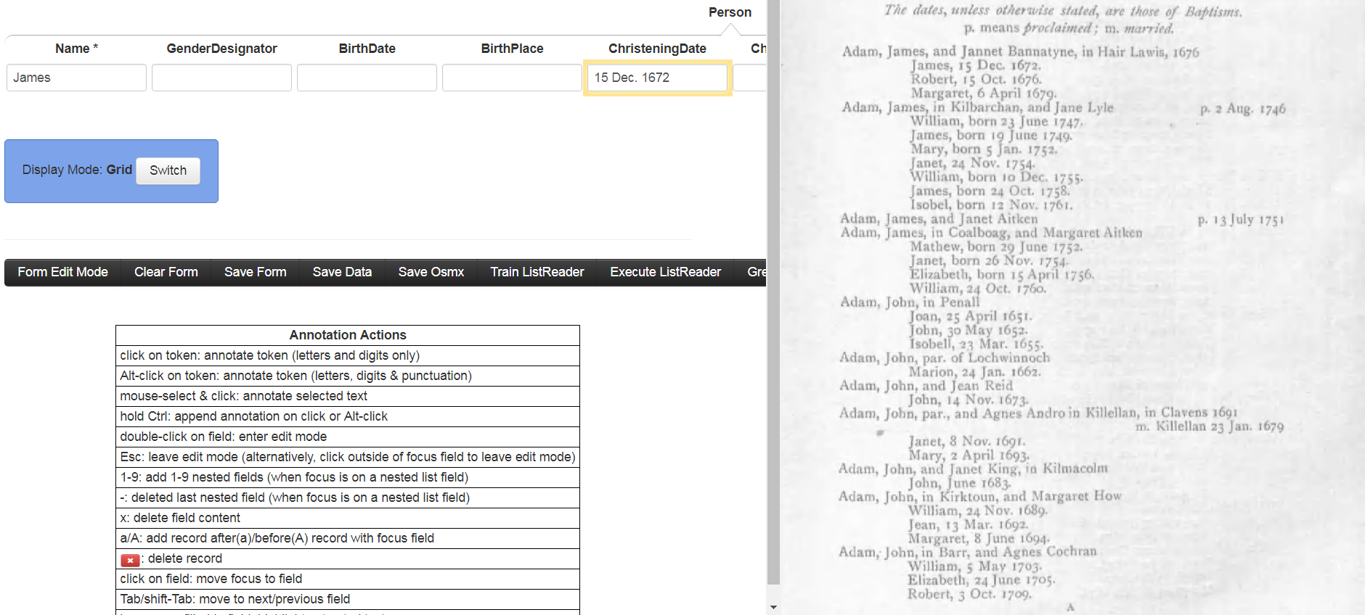
Step 2: Create Rules
James, 15 Dec. 1672. ELINE
Run
Save
Notes:
This step builds on the already implemented COMET interface. The Annotation Actions explain how to use COMET. For example with the focus (yellow outline) on a Name box, a click on James is all that’s required to fill in the field; and with the focus on the ChristeningDate field (as in the mocked-up screenshot), while holding Ctrl, a click on 15, an Alt-click on Dec., and a click on 1672 fills in the field with 15 Dec. 1672. (Holding Ctrl keeps the focus on the same field; without holding the focus moves to the next field.)
The proposed addition to COMET for GreenQQ rule creation are these form-filling actions – and that’s all it takes! The generated rule is displayed to the user in terms of the example -- the extract in green letters and the context in black. GreenQQ generates it as a template (e.g. here “CAP , ANUM CAP . ANUM . ELINE”) with the class and extract taken from the filled form field (e.g. here the class is ChristeningDate, the field name, and the extract is “15 Dec. 1672”, the content of the field). In the screen shot above the user has just made the three clicks to enter 15 Dec. 1672 and clicked on Run – nothing else! In this mode of operation, GreenQQ at this point creates the rule template and executes it on the page highlighting all instances it recognizes. In the mock-up, the single click action to create the rule for James has already been executed and the rule saved. Before saving a rule, the user can edit the rule. (The next slide shows a continuation of this example in which there is an edit.)
SLINE and ELINE should sometimes be part of the template and sometimes not. They should (or at least can be) when a pattern always starts or ends a line (e.g. the ELINE in the example here; a user could add SLINE at the beginning here too, but it’s not in the mock-up screenshot here because I’m using +2/-2 tokens as a default for the context). SLINE and ELINE should not appear in an example when some pattern just runs over a line (e.g. a spouse name could have a line break between the first and last name).

Slide 14
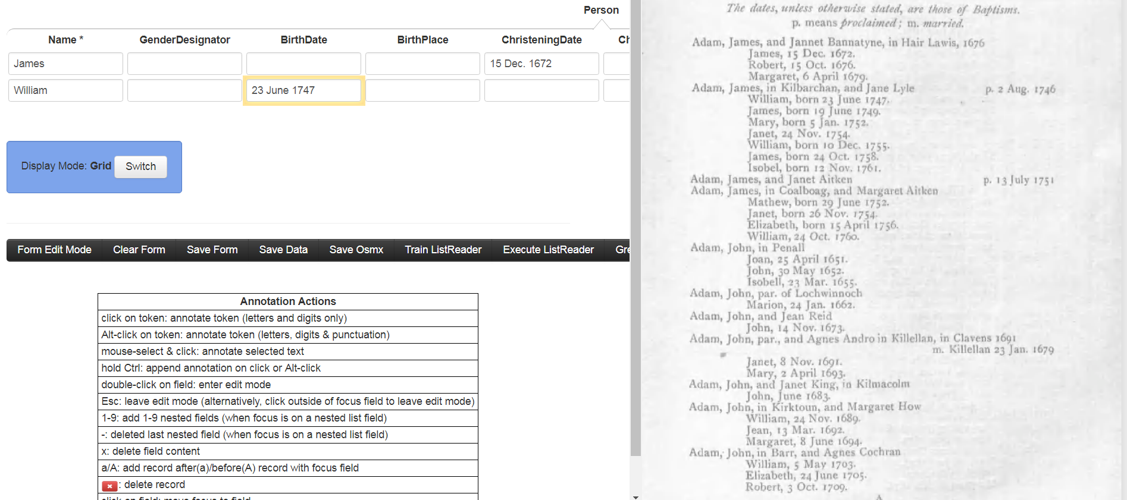
Step 2: Create Rules
born 23 June 1747. ELINE
Run
Save
Notes:
The mocked-up screen shot here is taken just after a user-edit marking “born” as a literal. GreenQQ accepts it as “LIT born” and places it in the IN spreadsheet. Also, prior to marking “born” as a literal, the user would have removed the “,” which would have been the first token in the template assuming -2/+2 for context. I am also assuming that a rule for Name: William was created by editing the default “ELINE SLINE William , born” to be “SLINE William , born”, in which the first token ELINE was removed and “born” would have been marked as a literal. In this case, “born” in the screenshot here would have been red to begin with, and the user would not have needed to mark it. Another example of creating a LIT would be to mark “m.” as a literal in “m. Killellan 23 Jan . 1679” which would generate “LIT m.”. The user could also add SLINE to the beginning of this marriage-date example -- expanding context is also an acceptable edit.

Slide 15
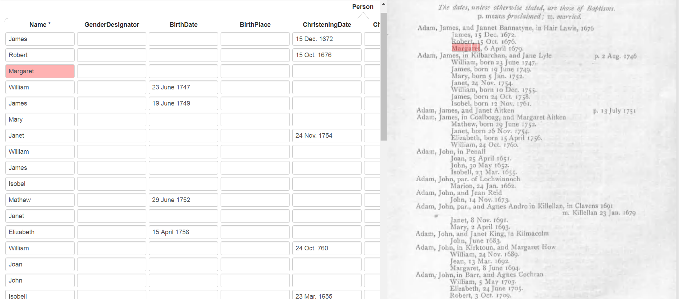
Step 2: Create Rules (check rule set)
Notes:
Instead of just executing the current rule being developed, the entire rule set can be executed. In our example, when we execute the four rule templates so far in our rule set, we obtain the results above with all the names of the children (some hidden below the end of the screen) along with BirthDates with non-abbreviated months and ChristeningDates with abbreviated months. This display feature of COMET is already implemented. Hovering over a record highlights both the fields in a record and the text extracted on the page for each field. In the screenshot here the mouse is hovering over the highlighted Margaret record. This makes it easy for a user to scan down the records and see what’s correct, incorrect, incomplete, and missing.
At this point, the user could return to the rule-creation mode and add the additional rules still needed to capture more of the Person information for the page. See next slide.

Slide 16
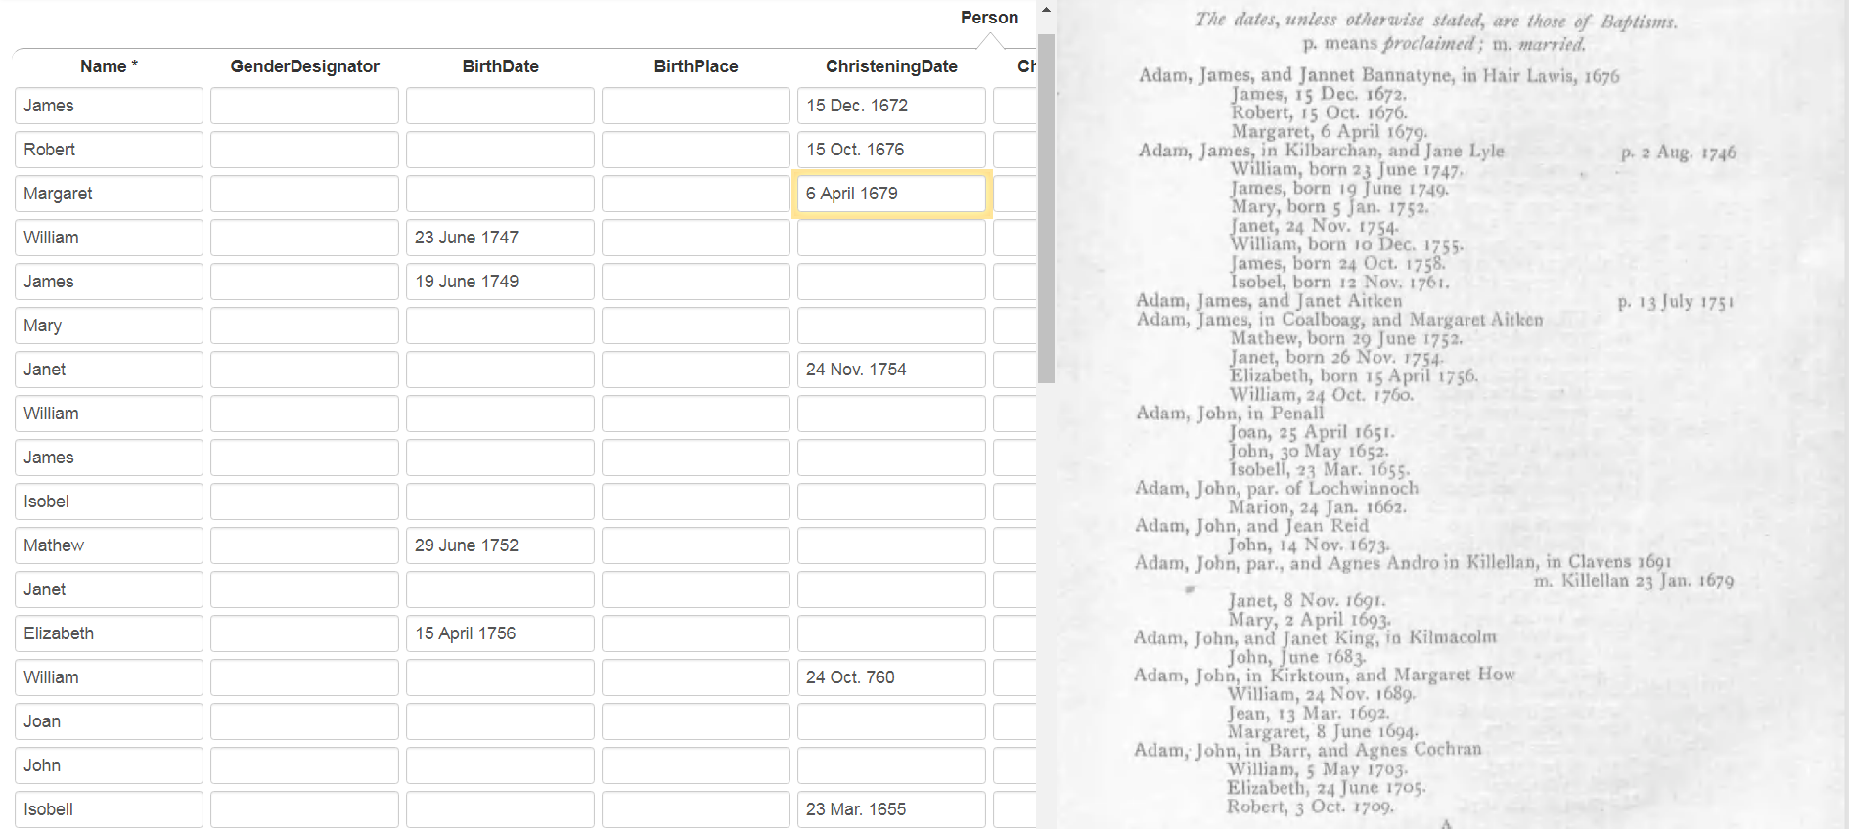
Step 2: Create Rules (check rule set)
Margaret, 6 April 1679. ELINE
Run
Save
Notes:
This rule is created by clicking on Margaret’s ChristeningDate components as explained earlier AND assuming that there is an OCR error, i679) double-clicking on the filled-in field and replacing the “i“ with a “1”. This edit corrects the OCR error and tells GreenQQ to generate “ANUM i679”. Based on what I see in some example spreadsheets you sent me (e.g. I see “CAP jean”), I’m assuming that this works. (It also occurs to me that we some additional programming, dates with an “i“ followed by three digits could also be tokenized as ANUM, perhaps limited to only those in the context of an extraction-rule template.)
A user may now be ready for GreenQQ to generate some candidate rules. Thinking ahead, an astute user might believe that GreenQQ would probably generate all the rules needed as candidates after having created just the first two. Users need not wait until the have perfect results for a page; they can begin iterating as soon as they wish. Also, while iterating they can return to initial rule creation and go back and forth as desired. In this example here, we’re still missing the rule needed for “John, June 1683.”

Slide 17
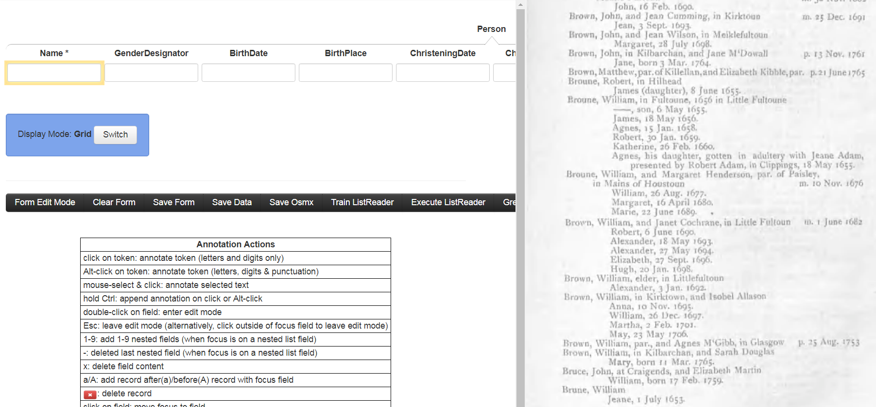
Step 3: Process Candidate Rules
1523
Name
. 1753 Brown, William, in Kilbarchan, and Sarah
>
Make
Dismiss
48
Name
Feb. 1759. Brune, William Jeane,
>
Make
Dismiss
19
Name
Oct. 1752. Napier and William, born 8 Feb
>
Make
Dismiss
18
Name
Robert, in Hilhead James (daughter), 8 June
>
Make
Dismiss
Notes:
GreenQQ generates n candidate rules (here just 4) and sorts them according to frequency of pattern occurrence. It also picks a page on which the highest frequency pattern appears and among the many of the possibilities, a page that has a maximum number of other patterns. For each rule whose pattern appears on the page, GreenQQ picks an example, highlights the text and highlights the extract with green box. Rules whose pattern is not on the page have no highlighting. Clicking on an non-highlighted “>” causes the system to display the referenced page and highlight the text and extract for the rule (also for any other rule whose pattern matches text on the page).
A user can choose to Make or Dismiss rules as desired, in any order. Dismissing a rule removes it from the list; it also stores the rule in a dismissed list so that in subsequent iterations the rule will not be presented to the user as a candidate rule. In this example, the first two rules should be dismissed since they do not identify Names that belong to Person records (i.e. neither the highlighted William nor the highlighted Brune have any associated birth or death information). Clicking on Make for a rule causes a mode change to the rule creation display. In doing so, it also fills in a form record with the extract. If the rule is what’s wanted, a simple click on save is all that’s necessary to complete the making of a new rule. Otherwise, the user can edit, test, and save the rule as previously explained. The next slide gives an example for the GreenQQ “James (daughter)” candidate rule.
Note that I have removed “ELINE SLINE” from these examples, but do still count them in the +6/-6 I’m using as the default context for candidate rule context.

Slide 18
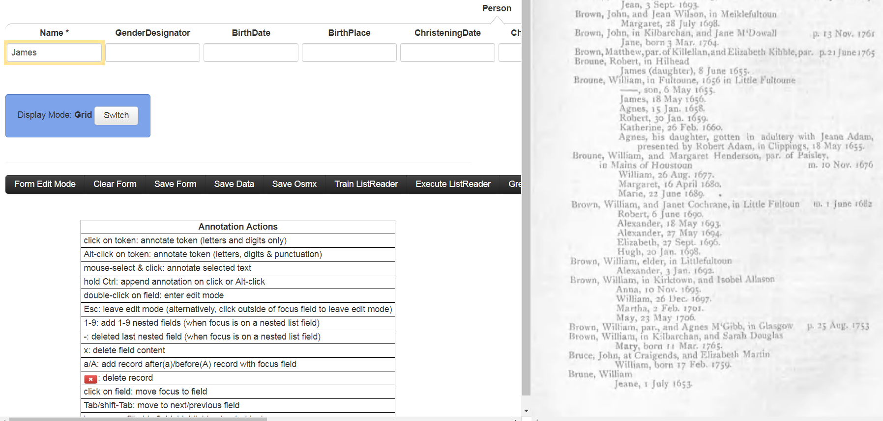
Step 3: Process Candidate Rules
SLINE James (daughter), 8
Run
Save
Notes:
The mock-up shows the state after editing and clicking on Run. The user actions to get here comprise: (1) clicking on Make for the rule in the previous slide (resulting in the rule being displayed AND James being filled into the Name field), (2) editing to remove “Robert, in Hilhead ELINE” from the beginning of the rule and “June” from the end, and (3) clicking on Run to highlight James on the page. (Note that in candidate rule snippet text I do not display SLINE and ELINE, but do for rules in rule-creation mode. Start- and end-of-line markers are often the best discriminators.) The user can now Save the rule. Note that GreenQQ generalizes the rule with LWRC (lower-case word) replacing “daughter” so that this pattern extracts other names followed by a parenthesized word, e.g. “(natural)” or “(posthumous)”.
Now, a user should recognize that the GenderDesignator field should also be filled in as well as the ChristeningDate. As before, the user could ask for the full rule set to be executed on the page to help discover that rules for GenderDesignator and ChristeningDate do not already exist. While in this mode, all the facilities of the mode are available to the user. In fact, this is the only mode in which rules are created. The next slide shows a mock-up screen shot for adding these two additional rules.
When a user chooses to Make a rule, the default context initially includes SLINE and ELINE if included in the +6/-6 context. The user should edit them out in the case that they should not be used as anchors for the rule. (I’m open to a better way to handle SLINE ELINE. The problem is that we really do have two cases: (1) when a pattern really does begin or end on a line and (2) when the pattern simply runs across the end of a line (or the end of a page).

Slide 19
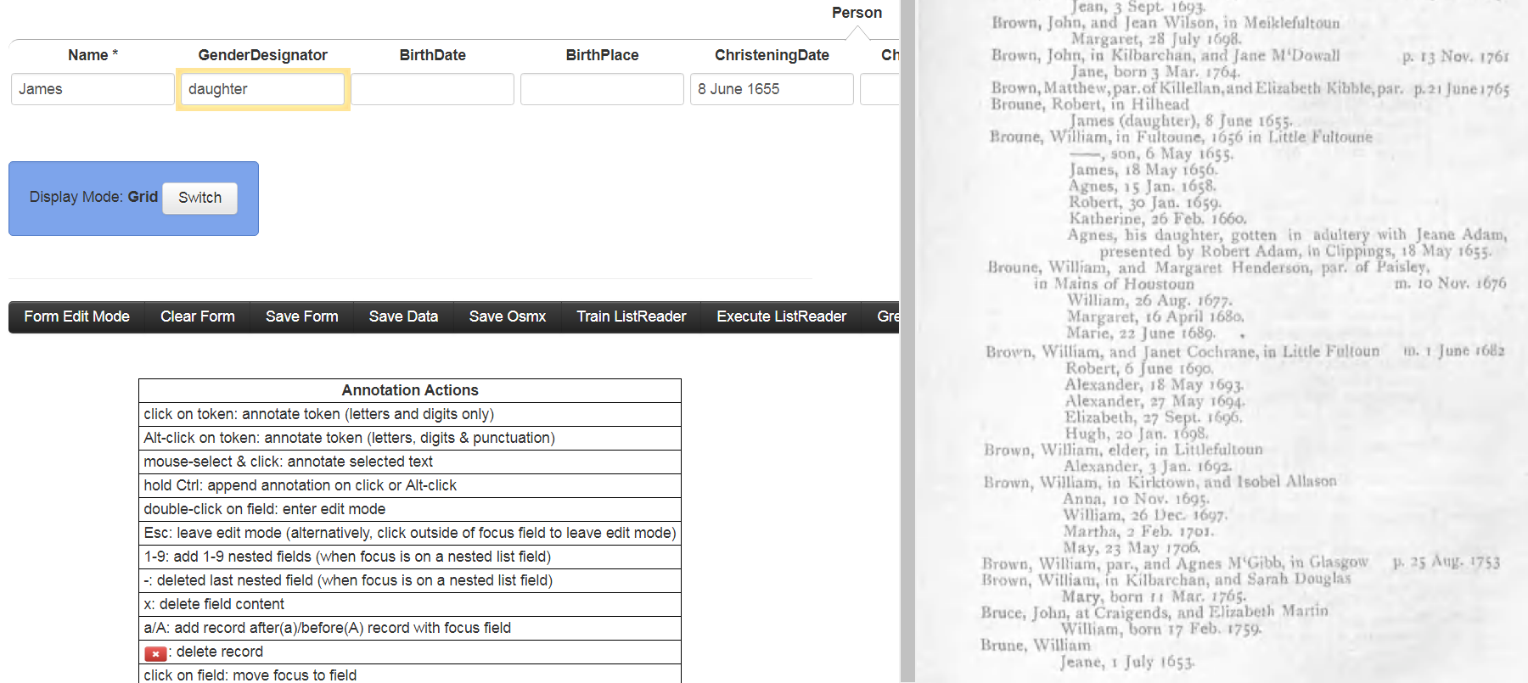
GreenQQ Step 3: Process Candidate Rules
James (daughter)
Run
Save
Notes:
The state of the system here assumes the following. The user has first filled in the ChristeningDate with “8 June 1655”, which, with only minor editing involving removal of superfluous beginning and ending tokens, creates a good rule to extract christening dates following parenthesized notes. The user has next extracted “daughter” into the GenderDesignator field, which generated the default example “James (daughter) ,” and then removed the trailing comma and marked “daughter” as a literal. (This also adds “LIT daughter”. Context literals are red; extract literals are green.) Finally, the user has clicked on Run to highlight daughter in the page.
When done with the create-rules mode of operation, the user can return to processing candidate rules. Alternatively, the user can ask GreenQQ to generate a new set of candidate rules for another round of processing. (This request can also be made from the candidate rule processing mode.) The next slide illustrates a return to processing the current list of candidate rules.

Slide 20

GreenQQ Step 3: Process Candidate Rules
19
Name
Oct. 1752. Napier and William, born 8 Feb
>
Make
Dismiss
Notes:
On return to the candidate-rule-processing mode the user has clicked on the “>” for the rule, which displays a page on which the rule template recognizes some text. Note that the dismissed candidate rules and the candidate rules edited to be extraction rules no longer appear on the list of candidate rules.
At this point, the user can click on Make and create two rules, one for the first twin “SLINE Napier and William, born” (needing only to remove some context from the GreenQQ-suggested candidate rule) and one for the second twin “Napier and William, born” (needing only to click on “William” when the focus is on a Name field of a new, empty record, which the user can request with an “a” action in COMET). Note that (as currently implemented) when the full set of GreenQQ rules is executed for this page that it will fill in two records for the twins but only the second twin will have the christening date associated with it. This is an example of overlapping records, and the only resolution I can see at the moment is the one I suggested in the emisa paper for the Ely Couple example -- sequentially run multiple rule sets. In this case a separate rule set for a first twin with christening dates (and perhaps also for birthdates) would be needed. Note that twins are rare, so that between HEAD classes, there could be several pages. For this sparse case (and perhaps for all cases), we may want to set a threshold distance over which we won’t further group field values.
Notes for transition:
Whether this is “usable by non-experts” and whether it represents “rapid development”, you’ll have to be the judge
The interface just presented is not yet build, but the underlying execution has been created as an academic prototype
Demo: show what would have been generated by the previous examples and executed it on the full book to see both what would already be extracted and to see what candidate rules would be generated (and tie it into the mock-up)
Results (precision, recall, F-measure) for the initial rules in the demo
Results of experiments for Kilbarchan and Miller (hopefully, new; but if not we’ll use the DAS results for the presentation; if we shouldn’t have them in the paper, we’ll reference the
DAS paper and merely make summary remarks.)
Data in DAS like tables but after merge of extracted results (which should also be explained)
Comparison with Ontos results
Comparison with GreenML NER results (probably not, but it might be interesting)

Slide 21
GreenQQ (current implementation)
Green
  tools that improve with use while doing real-world tasks
  as a user works, ever more of the records are filled in automatically
Q1: Quick
  Quick to learn to use
  Quick to execute (enabling synergistic work in which it generates candidate)
Q2: Quality
  Quality rules
  Quality results
GreenQQ characterization: record-based NER
Notes:
One possible way to use GreenQQ: The task is to fill out the records for the three forms Person, Couple, Family for the whole book. GreenQQ is “green” because as a user works, more and more of the records are filled in automatically.
Another possibility (which is the one we’ve been thinking about): The task is to quickly generate rules that in spot checking get sufficiently high precision and recall, and then just take the results GreenQQ generates.
Quick to learn: we may find ways to improve or streamline the interface (e.g. you already treat month names in a special way; …)
Quick to execute: as we improve and streamline the user experience, the back-end code could begin to slow the turn-around down; we may need to watch out for this and make some trade-offs.
Quality rules: generate rules that have good precision and recall and do not overwhelm the user with irrelevant candidates. We can tinker with candidate-rule generation to (hopefully) get even better precision and recall.

Slide 22
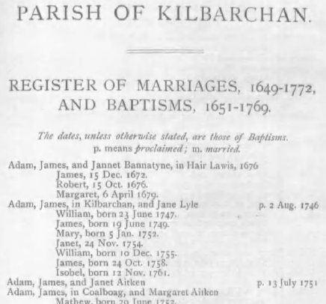
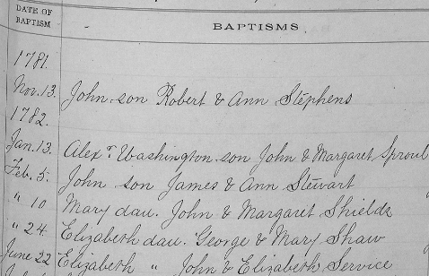
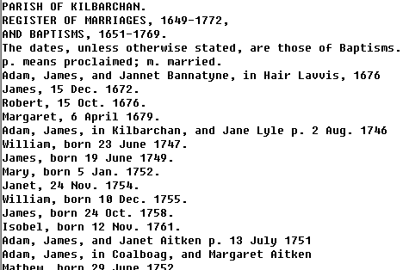
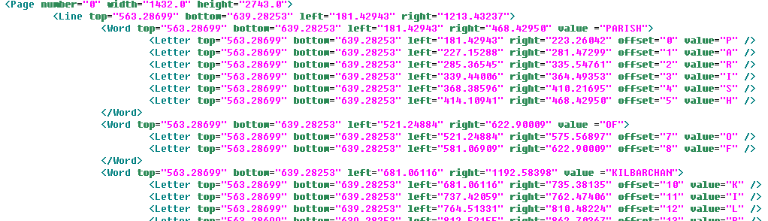
Demo (input doc’s)
Notes:
Probably not for FHTW presentation (too little time). May be useful for DAS – to show the evolution of the documents we use as input.

Slide 23
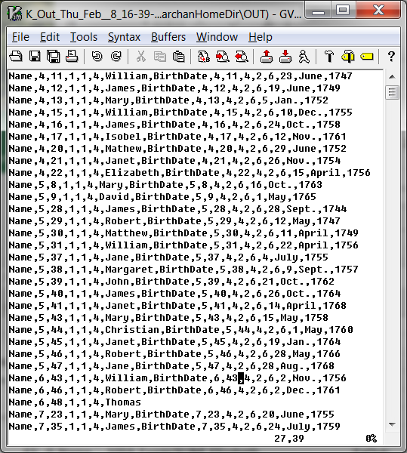
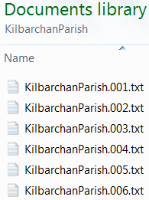
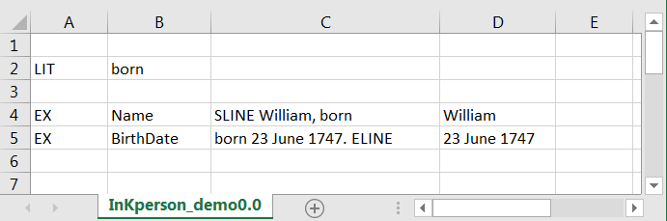



Demo (I/O)
Input
…
Output
Notes:
The Thomas example here is interesting: It locates another record pattern where we can potentially extract more information. It illustrates the general need for postprocessing generated records. I record here, for example, may include two BirthDates, indicating that something is wrong.

Slide 24
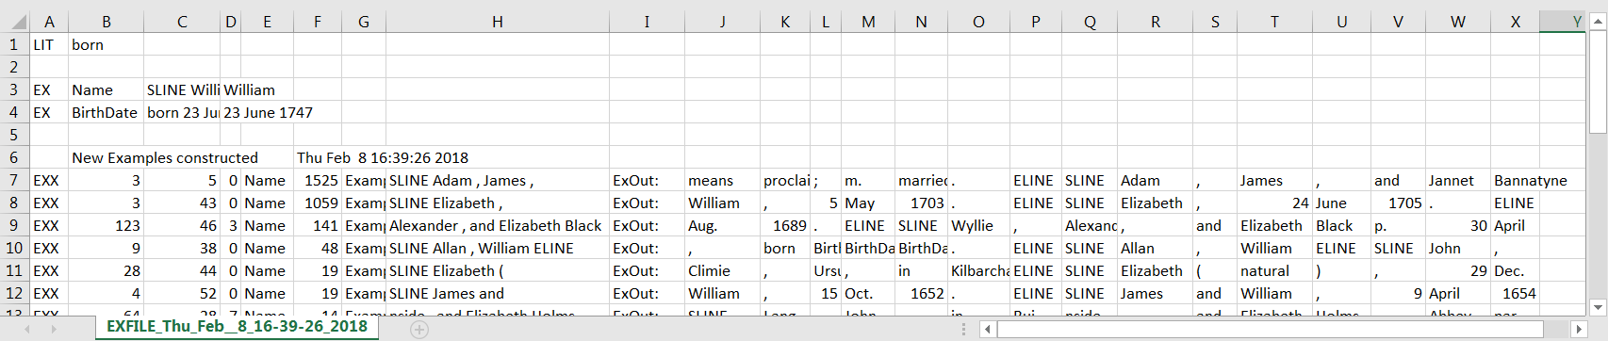
Demo (candidate rule generation)
SLINE Elizabeth , 24 June 1705 . ELINE
ChristeningDate
Name
SLINE Elizabeth , 24 June 1705 . ELINE
SLINE Elizabeth ( natural ) , 29
Name

Slide 25
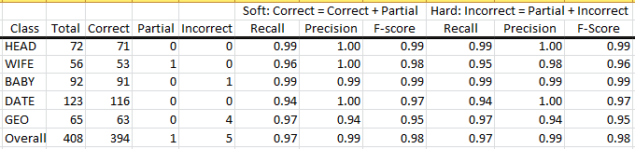
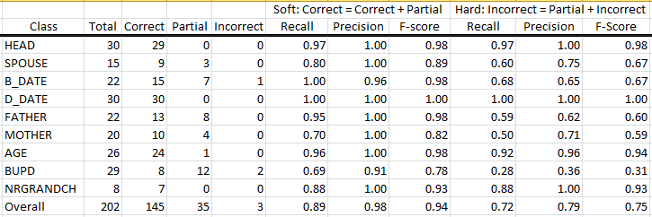
Initial Experimintal Results
Quick
Quality
Notes:
I’d like to do some new experiments, but if we can’t, we at least have something to show.

Slide 26
“Gotchas” (Issues to grapple with and resolve)
Document applicability (appropriately semi-structured)
Record identifiers (affects of precision and recall on grouping)
Overlapping records (rule partitioning)
OCR errors (substitution generalization)
Ambiguity (recognition and suggested resolution)
Boundary-crossing patterns (for both lines and pages)
Application tailoring (name-, date-, place-specific enhancements)
Notes:
Document applicability: a document must have “structured” record patterns for the data to be extracted.
Record identifiers: If we miss a HEAD, we’ll get precision errors; record postprocessing may be able to detect and even fix the precision error, but can do nothing with recall except pinpoint where there may be additional good data. If we mistakenly declare a HEAD, we may get recall errors by not grouping all the data that belongs to a record; record postprocessing may be able to heuristically/statistically detect that something may be wrong.
Overlapping records, such as twins in Kilbarchan and couples in Ely need rule partitioning; rule sets for each partition are to be run separately, but can we automatically detect overlaps and partition rules without user intervention?
OCR errors: we should be able to generalize the same-error/same-substitution within the same context so that “jonet -> Jonet” is sufficient to also catch and fix “janet -> Janet”, ‘jane -> Jane”, … . Are there other generalizations?
Ambiguity: two rules are ambiguous if they classify the same text differently; e.g. one rule declares text to be a ChristeningDate while another declares the same text to be a BirthDate; we should be able to test rules for ambiguity. A common error is to use too little context: “SLINE CAP ,” in Kilbarchan extracts both father surnames and child given names.
Boundary-crossing patterns: templates that cross line boundaries may be already coded, but I suspect that end-of-line hyphens have not yet been worked on. Succeeding for page-boundary crossings would be great; and may have already been worked on.
Application tailoring: you already have something for months – it appears that both non-abbreviated and abbreviated month names are recognized by a pattern for either one. I’ve seen some mention of special tags for name variations. What else is possible? (a gazetteer for place names?, day ranges by month?, reasonable years for documents?, …?)

Slide 27
Future Work (in progress)
Build Interface
Adjust Code to Resolve “Gotchas”
Seize Opportunities
  Improve candidate pattern identification
  Extend to directly extract relationships
  Assess and adjust for increased usability
    Synergistic form-filling paradigm
    Combine with other synergistic form-filling extraction tools
Notes:
Instead of the proposed interface, we make GreenQQ “green” by only having users fill in forms (no rule specification or candidate rule editing). GreenQQ operates in the background. When a user fills in a record field f, we generate an extraction rule and execute it on the the page which creates additional records (as needed) and fills them in for field f. The “as needed” is because in filling-in previous fields, partially filled in records may have already been generated. When the user moves to a new page, the system generates and fills in all the records it can. The user checks records and adds data as needed. If the user U is satisfied that GreenQQ is extracting information well enough, U can let it run to the completion of the book on its own.

Slide 28
Conclusion
Rule creation by text snippet examples
(Hopefully) objectives will be achieved
  Usable by non-experts (examples only; user-friendly interface)
  Rapid development (faster than writing regex rules, comparable to annotating data)
  High quality results (good precision and recall in initial experimentation)
Notes:
Usable by non-experts (example-based with no further assumption of user abilities; careful interface design; awaits field tests).
Rapid development (initial use by us indicates that we can develop rules faster than we can develop regex rules, furthermore, it finds examples not yet covered – a real boon to rule writing; it’s comparable to annotating data for that’s what we can also do with COMET, but we may not need to “annotate” as much data).
High quality results (initial experimentation yields good precision and recall, but I think it’s artificially high for Kilbarchan based on the luck of the draw of pages that had almost no exceptional cases.)

Slide 29

Conclusion
Rule creation by text snippet examples
(Hopefully) objectives will be achieved
  Usable by non-experts (examples only; user-friendly interface)
  Rapid development (faster than writing regex rules, comparable to annotating data)
  High quality results (good precision and recall in initial experimentation)
Notes:
Usable by non-experts (example-based with no further assumption of user abilities; careful interface design; awaits field tests).
Rapid development (initial use by us indicates that we can develop rules faster than we can develop regex rules, furthermore, it finds examples not yet covered; it’s comparable to annotating data for that’s what we can also do with COMET, but we may not need to “annotate” as much data).
High quality results (initial experimentation yields good precision and recall)

