Slide 1
Tree Builder
(Scenarios and Scenario Unification)

Slide 2
Scenarios: Pipeline and Unification
Scenarios (Pipeline)
Extraction-tool testing
Auto-indexing
Scan-to-submit
Add-to-tree
Scenarios (Unification)

Slide 3
Workflow Pipeline
1.pages
2.tools
<toolName>
PMCFI: extracted (osmx)
2.1.tool-ontology-extracted
2.2.ontology-extracted
2.3.extracted-text-cleaned
3.json-from-osmx
3.1.ontology-merged
3.2.value-cleaned
3.3.date-value-parsed
3.4.relationships-added
3.5.constraint-checked
PMCFI: osmx
4.json-working
PMCFI: json
5.json-final
PMCFI: json & osmx
6.osmx-checked
6.1.ontology-merged
6.2.value-cleaned
6.3.date-value-parsed
6.4.relationships-added
6.5.constraint-checked
PMCFI: osmx
7.osmx-enhanced
7.1.target-ontology-generated
7.2.value-standardized (& authority-checked)
7.3.information-inferred
Personas-json
8.gedcomx
8.1.results-generated
8.2.FS-imports-generated (CDS & FamilyTree)
Personas-txt
Personas-pdf
PersonasTreeReady-json
8.3.tree-generated (LLS & FamilyTree)
FamilyTree-gedcomx
MergedPersonas-pdf
MergedPersonas-json
MergedPersonasTreeReady-json
COMET Bypass
COMET Loop
Notes:
The pipeline, [1 2 3 (4 5 6)* 7 8], produces results for FamilySearch with user intervention (for FamilyTree) or without user intervention (for CDS or LLS). It supports four scenarios:
Extraction-tool testing: [1 (2 3 4)+] lets users run extraction tools and observe the results in COMET. The GN-like hints are displayed in COMET; the first page displayed is the one that, in active-learning terms, gives the biggest bang for the buck. (If desired by experimenters and a GroundTruth exists, a PRF (PrecisionRecallFscore) report can be generated; experimenters can also create GroundTruth while in COMET.)
Auto-Indexing: [1 2 3 7 8] is for automatic indexing. If the target is CDS (Canonical Data Store), results in Personas-txt plus documentation in Personas-pdf are sent to CDS. If the target is LLS (Linked Lineage Store), results in FamilyTree-gedcomx plus documentation in MergedPersonas-pdf are sent to LLS.
Scan-to-submit: [1 (2 3)? (4 5 6)+ 7 8] lets a patron P find an ancestor in a document; and with or without extraction-tool help, fill in a form (Individual). Then, using COMET, P can iterate, (4 5 6)+, until the form is filled-out satisfactorily. (In the background, we collect information and begin or update the auto-indexing of the document.) When P is satisfied that the form is filled-out correctly, the results in the Individual form go through 5, 6, and 7 to Personas-json. P then checks and, if necessary, corrects the inferred and standardized information. When P is done, the results in PersonasTreeReady-json are sent to the FamilyTree. (Continuation to the tree and to temple ordinances is beyond the pipeline; the continuation makes use of FamilySearch software for adding to the tree.)
Add-to-tree: [8] lets patrons add merged persona records to the tree. Guided by a family tree FT in FamilyTree-gedcomx, each merged persona in MergedPersonas-json belonging to FT is check and, if necessary, edited to produce a final filled-out tree-ready record in MergedPersonasTreeReady-json. The Gedcomx is correspondingly updated. (Continuation to the tree is by submission of a tree-ready gedcomx from which FamilySearch software semi-automatically adds persons to the tree. Here, semi-automatically means with a human in the loop to resolve merges with current individuals on the tree, as needed.) Alternatively, indeed, primarily, the Gedcomx for individuals in FT is updated if and as MergedPersonas-json are edited. This Gedcomx

Slide 4
Scenario Unification
Transitions between scenarios
Extraction-tool testing -> Auto-indexing (one and the same)
Auto-indexing -> (Scan-to-)Submit (option to submit a selected Persona record)
Auto-indexing -> Add-to-tree (option to submit a family tree of related individuals)
Scan-to-submit -> Extraction-tool testing (option to become an auto-indexer)
Scan-to-submit -> Auto-indexing (automatic background update of GreenQQ templates)
Add-to-tree -> (Scan-to-)Submit (option to submit a selected MergedPersona record)
COMET usage in scenarios
Extraction-tool testing (Individual form)
No extraction; no editing
page browsing over “biggest-bang-for-buck” ordered list (in addition to regular browsing)
Auto-indexing: no COMET usage
Scan-to-submit (TreeReady form)
Extraction-only mode in (4 5 6)+ loop
Edit-only mode for selected Personas-json
Browsing over page-ranked list from search (in addition to regular browsing)
Add-to-tree (TreeReady form)
Edit-only mode for MergedPersonas-json
Browsing over most-to-least-content ordered list of pages (in addition to regular browsing)
Notes:
Extraction only in Scan-to-submit, because we want to be able to generate GreenQQ templates in the background.
Most-to-least-content ordered list of pages: This is the list of pages from which the persona records were taken in order to create the merged persona. The ordering of pages is most-to-least depending on the content contribution of a page.

Slide 5
Extraction-tool testing: Developer Notes
Establish Designator Keys (these are book dependent designators associated with a class):
Ely: (b, BirthDate), (d, DeathDate), (m, MarriageDate), (died, DeathPlace), (died, DeathDate), (born, BirthDate), (bapt, ChristeningDate), …(?)
Kilbarchan: (m, MarriagePlace), (m, MarriageDate), (p, MarriagePlace), (p, MarriageDate), (born, BirthDate), (bom, BirthDate)
Miller: (d, DeathDate), (d, DeathPlace), (BD, BurialDate), (BD, BurialPlace), (b, BirthPlace), (b, BirthPlace), (f, PARENT1), (m, PARENT2), (sp, SPOUSE), (daughter, CHILD), (daughters, CHILD), (son, CHILD), (sons, CHILD)
We can preset these for a book, but users should be able to add to the list. These are also LITs,; the user should also be able to set other LITs that are not necessarily designators, e.g. and, son of, dau. of, … .
Default search phrases (two types):
In the presence of a designator LIT: search to the left for the first designator (if any); if its Class matches the name of the Form Field, generate the rule: “X … E” where X is the designator LIT and E is the Extract, the filled in value.
No designator or a mismatch of Class: as before
EXTRA: a class that stops the look-ahead search for an Extract. (When a user sees that GreenQQ has gone beyond a list of sons, daughters, children, or spouses, the user can designate a LIT which when seen will stop the run-away list.)

Slide 6
Instructions for Auto-indexers
Give the first and last page of the section of the book to be processed.
Determine the major grouping layout (individual, family, nested family).
Click on the name of the primary person in any one of the major groups. (Make sure that the displayed rectangles bound the major groups throughout the book: Click on any primary person incorrectly included in a bounding rectangle.) If the layout is “nested family”, repeat this step within a group for every level of nesting.
Click on the name of a child of any primary person and continue clicking on children of primary persons until all are highlighted.
Click on the name of a spouse of any person and then also on any marriage event date and marriage event place. Continue clicking until all spouses and their marriage event date and place are all highlighted.
Click on the properties of any person, spouse, or child. Continue clicking until all properties of every person, spouse, or child are all highlighted. (Properties: BirthDate, BirthPlace, ChristeningDate, ChristeningPlace, DeathDate, DeathPlace, BurialDate, BurialPlace, and also Parent1 and Parent2.)
For, nested families, repeat the process at each level of nesting. (Children of the next higher level will be automatically relabeled as primary persons. Spouses along with their properties and all other properties are likely to be already labeled.)
Notes:
Nested families are those in which there are children who also have children.
In 4, it’s important to deal only with children of primary persons.
5 and 6 could be done as one step – here, we are only interested in recognizing entities.
Adding the rectangles so that that they cross over page boundaries and don’t cross-over “extraneous stuff” that should not be included might be tricky. (We probably don’t need to worry about “extraneous stuff” being included, as the only instructions at in this step are to click on primary persons incorrectly included in bounding boxes.)
Also note that we can often provide a list of places to look for possibly missing primary persons (as already built into GreenQQ, i.e. where the SearchPhrase applies but there is no extract).
We must also give them an option to click on text that is highlighted that should not be highlighted. And, then we need to fix the extraction templates. ?? How? I’m not sure.

Slide 7
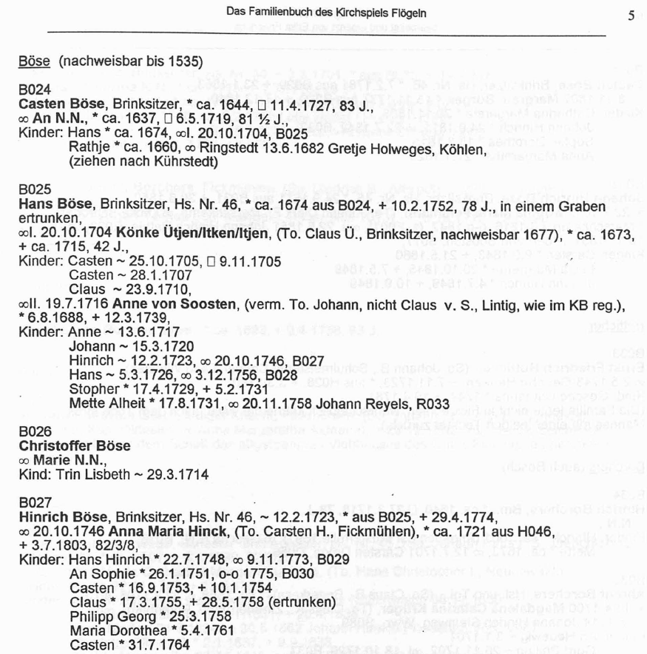
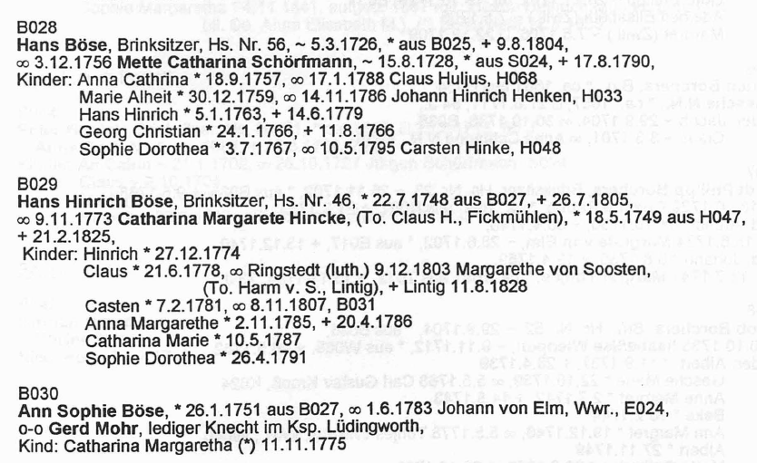
Extract Entities
8024
Casten Böse
Aggregate Grouping Identifier
Reference ID
Head Name
Casten Böse
Gender Designator
Vital Information Record
An N.N.
Name
ca. 1644
Birth Place
Christening Date
Christening Place
17.4.1729
Birth Date
Death Date
Death Place
Burial Date
Burial Place
Casten Böse
8024
Parent 2
Parent Record
Name
H046
Parent 1
Casten Böse
Spouse Name
Marriage Event Date
Marriage Event Place
Name
Marriage Record
Casten Böse
Child
Name
Parent-Child Record

Slide 8
Extract Entities
8024
Casten Böse
Aggregate Grouping Identifier
Reference ID
Head Name
Casten Böse
Gender Designator
Vital Information Record
An N.N.
Name
ca. 1644
Birth Place
Christening Date
Christening Place
17.4.1729
Birth Date
Death Date
Death Place
Burial Date
Burial Place
Casten Böse
8024
Parent 2
Parent Record
Name
H046
Parent 1
Casten Böse
Spouse Name
Marriage Event Date
Marriage Event Place
Name
Marriage Record
Casten Böse
Child
Name
Parent-Child Record
aus
8024

Slide 9
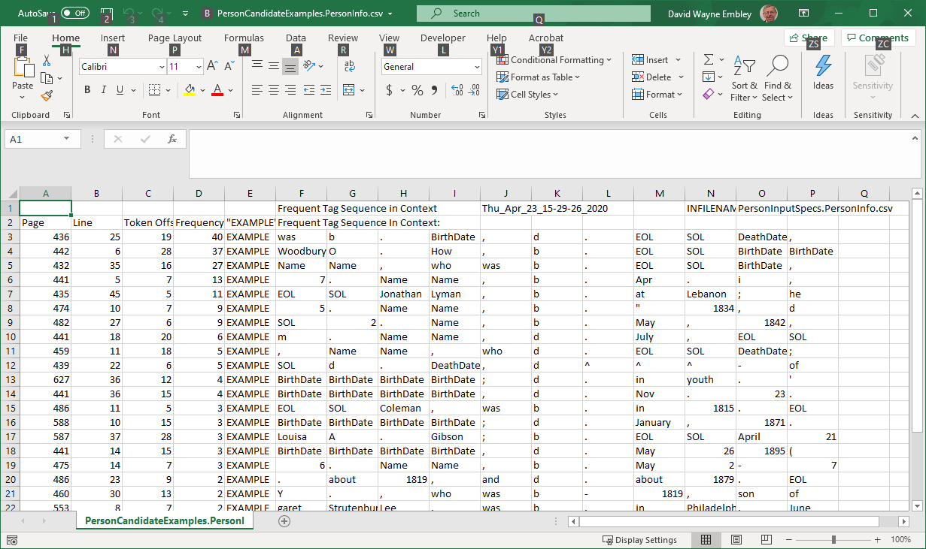
Candidate Examples: the “active learning” component of the GreenQQ UI
Redesign “Candidate Examples” for finding:
Missing Group Heads on Page (too few found on full text page)
Missing ReferenceIDs on Page (too few found on full text page)
Missing Record Heads (run-away Person records)
Missing Extracts (Search Phrase found but no matching Extract)
Missing Search Phrases (Format Variant found, but not labeled)
A Candidate Example is the first of n phrases with identical tag sequences. The importance of a Candidate Example its frequency n and its category as ordered above.
Notes:
The missing SearchPhrase is “b-”

Slide 10
Candidate Examples: the “active learning” component of the GreenQQ UI
Redesign “Candidate Examples” for finding:
Missing Group Heads on Page (too few found on full text page)
Missing ReferenceIDs on Page (too few found on full text page)
Missing Record Heads (run-away Person records)
Missing Extracts (Search Phrase found but no matching Extract)
Missing Search Phrases (Format Variant found, but not labeled)
A Candidate Example is the first of n phrases with identical tag sequences. The importance of a Candidate Example its frequency n and its category as ordered above.
OCR’d text
…
1. George Benjamin, b. 1818, d. 1875, m. 1857 Theresa Dwight.
2. NicoU Fosdick, b. 1821, d. 1851, m. 1844 Frances Elizabeth Smith.
…
FD violation: Name → BirthDate
The missing record head is on page 437 between line 22 / token offset 13 and line 23 / token offset 9
Generated record
…
Name,437,22,4,2,George,Benjamin,BirthDate,437,22,9,1,1818,DeathDate,437,22,13,1,1875,BirthDate,437,23,9,1,1821,DeathDate,437,23,13,1,1851
…

Slide 11
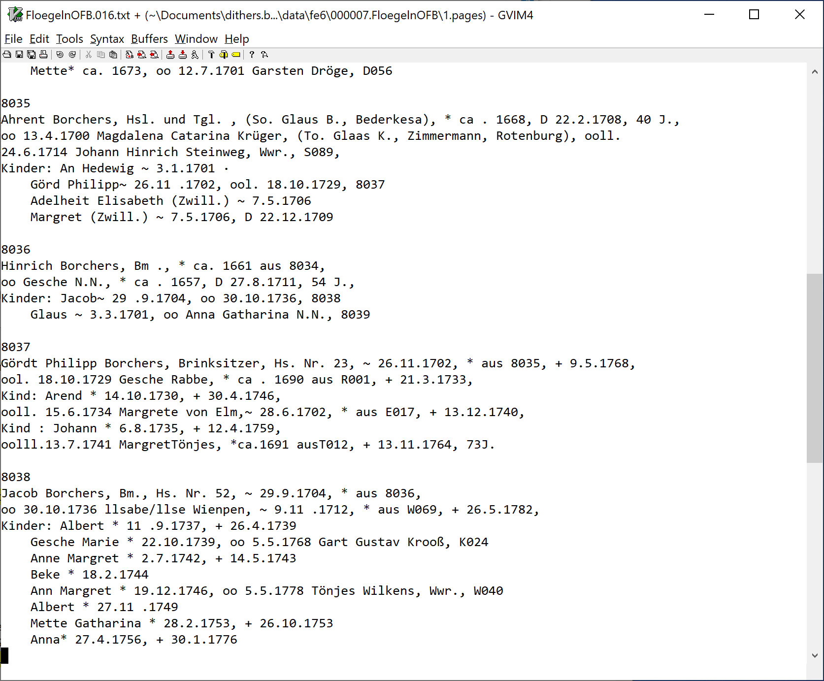
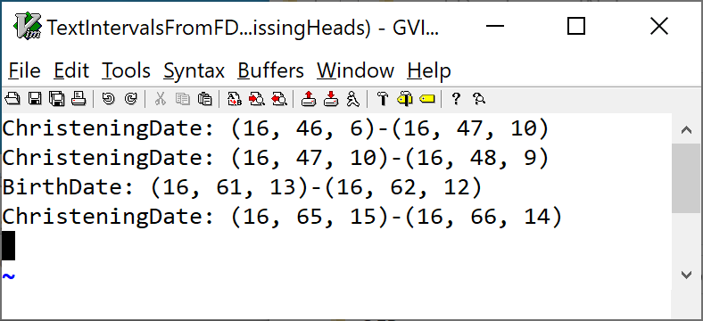
Candidate Examples: the “active learning” component of the GreenQQ UI
Missing Record Heads
A run over pages 15 & 16 found the following four missing Person record heads.
A run over the full book found 471 missing Person record heads.
Notes:
The label goes with the second of the interval pair; the first is just the previous Extract (whatever it happened to be).
I can convert the triples to pairs (page, characterOffset); I can make the bounds tighter by skipping over the characters of the previous Extract and going up to but not including the first character of the current Extract.

Slide 12
Candidate Examples: the “active learning” component of the GreenQQ UI
Missing Record Heads (run-away Family records)
Redesign “Candidate Examples” for finding:
Missing Group Heads on Page (too few found on full text page)
Missing ReferenceIDs on Page (too few found on full text page)
Missing Record Heads (run-away Person records)
Missing Extracts (Search Phrase found but no matching Extract)
Missing Search Phrases (Format Variant found, but not labeled)
A Candidate Example is the first of n phrases with identical tag sequences. The importance of a Candidate Example its frequency n and its category as ordered above.
133552. Mary Peck, b. 1811, dau. of Peter Peck and Sarah Lewis
Colgrove; m. 1838, Daniel Campbell, Columbus Grove, Putnam Co., O.,
b. 1812, son of Richard Campbell and Susannah Lautz. Their children:
1. Chauncey, b. 1839.
2. Lewis, b. 1841, d. 1843.
3. Isaac, b. 1843.
4. Richard, b. 1844.
5. Sarah Ann, b. 1847.
6. Susan Maria, b. 1849, d. i860.
133553- Esther Peck, Winterset, Madison Co., Iowa, b. 1813, dau. of
Peter Peck and Sarah Lewis Colgrove; m. 1833, John Kitchell, Palmy-
ra, la., b. 1809, d. i860, son of Joseph Kitchell and Nancy Kitchell.
Their children :
1. Lucy Ann, b. 1834.
2. Sarah Ellen, b. 1836, d. 1839.
3. Nancy Jane, b. 1838.
4. Charles Wesley, b. 1840.
5. Aaron, b. 1842.
6. Harriet, b. 1844.
7. James, b. 1846.
8. Mary Elizabeth, b. 1848.
g. Esther Eliza, b. 1849.
10. John Whitney, b. 1851, d. 1853.
133556. Sarah Ann Peck, b. 1823, d. 1881, dau. of Peter Peck and
12. Zebulon DeForest b. 1852, m., ist, 1874, Clara Vanola Major; m., 2nd,
1878, Mamie Anne Souder.
Appleton's Cyclopaedia of American Biography has the following
notice of Ezra S. Ely, which is sufficiently interesting to be quoted in full :
…
Omitted
THE ELY ANCESTRY. 301
SIXTH GENERATION.
Washington College, Tenn., gave him the degree of D. D. He was the
author of many valuable and well-known religious works and works of instruction
and explanation in regard to the Scriptures.
24^^2- Elislia Mills Ely, Paris, France, b. 1787, d. 1832, son of
Zebulon Ely and Sarah Apame Mills; m. 1818, Catherine Elizabeth
Boode, Paris, France, who was b. 1800, d. 1876, dau. of Edward Gustave
Parent1,510,18,4,2,Mary,Peck,Child,510,21,4,1,Chauncey,Child,510,22,4,1,Lewis,Child,510,23,4,1,Isaac,Child,510,24,4,1,Richard,Child,510,25,4,2,Sarah,Ann,Child,510,26,4,2,Susan,Maria,Child,510,31,4,2,Lucy,Ann,Child,510,32,4,2,Sarah,Ellen,Child,510,33,4,2,Nancy,Jane,Child,510,34,4,2,Charles,Wesley,Child,510,35,4,1,Aaron,Child,510,36,4,1,Harriet,Child,510,37,4,1,James,Child,510,38,4,2,Mary,Elizabeth,Child,510,40,4,2,John,Whitney
Name,434,29,4,2,Zebulon,DeForest,MarriageEventDate,434,29,15,1,1874,SpouseName,434,29,17,3,Clara,Vanola,Major,MarriageEventDate,434,30,2,5,1878,SpouseName,434,30,6,3,Mamie,Anne,Souder,MarriageEventDate,435,7,11,1,1818,SpouseName,435,7,13,3,Catherine,Elizabeth,Boode
Notes:
Line 26 to line 31 is a bigger gap than 1 -- the typical gap when there is no page break in between children.
The gap between the 2nd and 3rd SpouseName is huge (22 lines) and there is also a page break whereas the gap between the first two SpouseNames is just 1 line. More typically the gap between two legitimate SpouseNames is a couple of lines, whereas the gap between a correct and incorrect SpouseName is a half dozen lines or so when there are no children for the in the first family and a half dozen or so plus n lines when there are n listed children. (Note that this is for Ely’s household; Flögeln is different.)

Slide 13
Candidate Examples: the “active learning” component of the GreenQQ UI
8024
Casten Böse, Brinksitzer, * ca. 1644, □ 11.4.1727, 83 J.,
oo An N.N., * ca. 1637, □ 6.5.1719, 81 ½ J.,
Kinder: Hans* ca. 1674, ool. 20.10.1704, 8025
Rathje * ca. 1660, oo Ringstedt 13.6.1682 Gretje Holweges Köhlen
(ziehen nach Kührstedt) ' '
8025
Hans Böse, Brinksitzer, Hs. Nr. 46, * ca. 1674 aus 8024, + 10.2.1752, 78 J., in einem Graben
ertrunken,
ool. 20.10.1704 Könke Ütjen/ltken/ltjen, (To. Claus 0., Brinksitzer, nachweisbar 1677), * ca. 1673,
+ ca . 1715, 42 J.,
Kinder: Casten ~ 25.10.1705, □ 9.11 .1705 ‘
Gasten ~ 28.1 .1707
Claus ~ 23.9.1710,
ooll. 19.7.1716 Anne von Soosten, (verm. To. Johann, nicht Claus v. S., Lintig, wie im KB reg.),
* 6.8.1688, + 12.3.1739,
Kinder: Anne ~ 13.6.1717
Johann ~ 15.3.1720
Hinrich ~ 12.2.1723, oo 20.10.1746, 8027
Hans~ 5.3.1726, oo 3.12.1756, 8028
Stopher* 17.4.1729, + 5.2.1731
Mette Alheit * 17.8.1731, oo 20.11.1758 Johann Reyels, R033
8026
Christoffer Böse
oo Marie N.N.,
Kind: Trin Lisbeth ~ 29.3.1714
8027
Hinrich Böse, Brinksitzer, Hs. Nr. 46, ~ 12.2.1723, * aus 8025, + 29.4.1774,
oo 20.10.1746 Anna Maria Hinck, (To. Carsten H., Fickmühlen),* ca. 1721 aus H046,
+ 3.7.1803, 82/3/8,
Kinder: Hans Hinrich * 22.7.1748, oo 9.11.1773, 8029
An Sophie * 26.1.1751, o-o 1775, 8030
Gasten* 16.9.1753, + 10.1.1754
Glaus * 17.3.1755, + 28.5.1758 (ertrunken)
Philipp Georg * 25.3.1758
Maria Dorothea * 5.4.1761
Gasten* 31.7.1764
8028
Hans Böse, Brinksitzer, Hs. Nr. 56, ~ 5.3.1726, * aus 8025, + 9.8.1804,
oo 3.12.1756 Mette Catharina Schörfmann, ~ 15.8.1728, * aus S024, + 17.8.1790,
Kinder: Anna Cathrina * 18.9.1757, oo 17.1.1788 Claus Huljus, H068
Marie Alheit * 30.12.1759, oo 14.11 .1786 Johann Hinrich Henken, H033
Hans Hinrich * 5.1.1763, + 14.6.1779
Georg Christian * 24.1.1766, + 11.8.1766
Sophie Dorothea * 3.7.1767, oo 10.5.1795 Garsten Hinke, H048
8029
Hans Hinrich Böse, Brinksitzer, Hs. Nr. 46, * 22.7.1748 aus 8027, + 26.7.1805,
oo 9.11.1773 Catharina Margarete Hincke, (To. Claus H., Fickmühlen),* 18.5.1749 aus H047,
+ 21.2.1825,
Kinder: Hinrich * 27.12.1774
Claus * 21 .6.1778, oo Ringstedt (luth.) 9.12.1803 Margarethe von Soosten,
(To. Harm v. S., Lintig), + Lintig 11.8.1828
Casten * 7.2.1781, oo 8.11.1807, 8031
Anna Margarethe * 2.11.1785, + 20.4.1786
Catharina Marie * 10.5.1787
Sophie Dorothea * 26.4.1791
8030
Ann Sophie Böse, * 26.1.1751 aus 8027, oo 1.6.1783 Johann von Elm, Wwr., E024,
o-o Gerd Mohr, lediger Knecht im Ksp. Lüdingworth,
Kind: Catharina Margaretha (*) 11.11.1775
Redesign “Candidate Examples” for finding:
Missing Group Heads on Page (too few found on full text page)
Missing ReferenceIDs on Page (too few found on full text page)
Missing Record Heads (run-away Person records)
Missing Extracts (Search Phrase found but no matching Extract)
Missing Search Phrases (Format Variant found, but not labeled)
A Candidate Example is the first of n phrases with identical tag sequences. The importance of a Candidate Example its frequency n and its category as ordered above.
The Extract token for HouseholdId based on the example “A001” is AlphaNum, which matches six on the A001 page and none of a possible seven on the 8024 page (page 15).
Abel
A001
Michel Abel, Müller, Fickmühlen,
oo Ann Dorthe N.N.,
Kind: Jochen Michel* 17.12.1730, + 5.10.1731
Ahrens
A002
Johann Ahrens, Brinksitzer, Hs. Nr. 1, * ca. 1669, + 3.4.1729, 60 J.,
Notes:
OCR errors: 8 for B, 0 for D, 0 for O and suspected 5 for S.
In Ely, the SearchPhrase “NUM .” doesn’t match “NUM –” which comes up quite often.

Slide 14
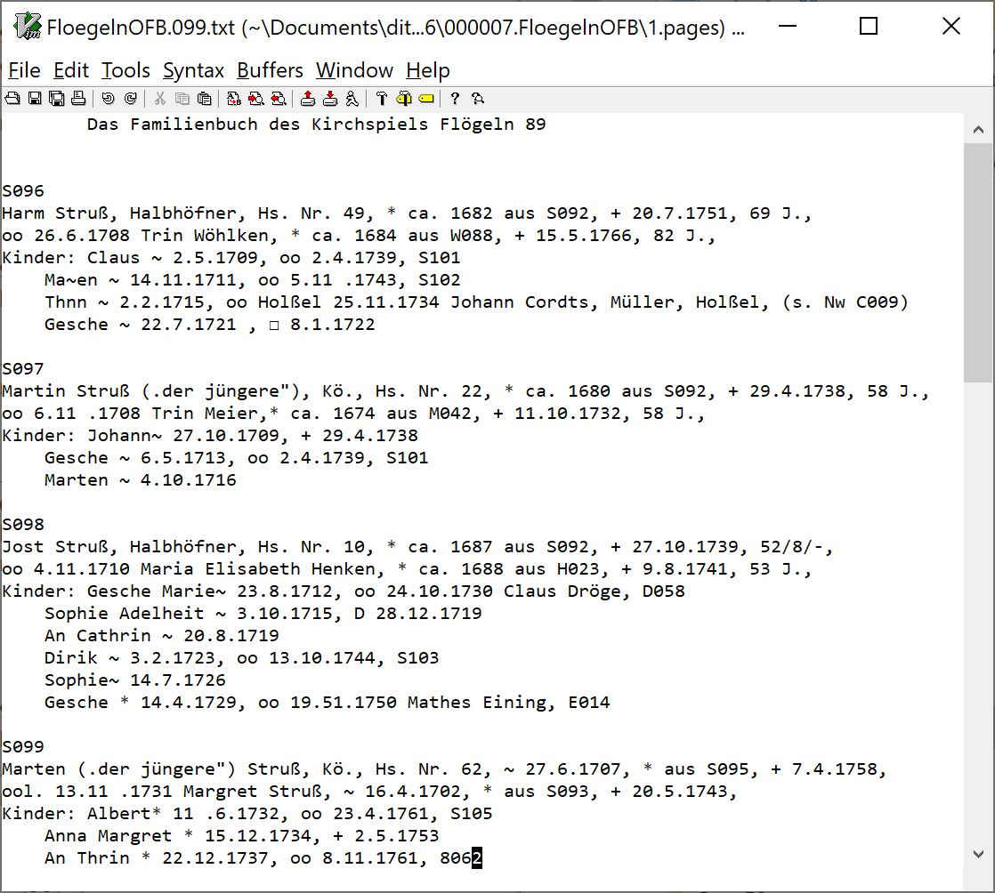
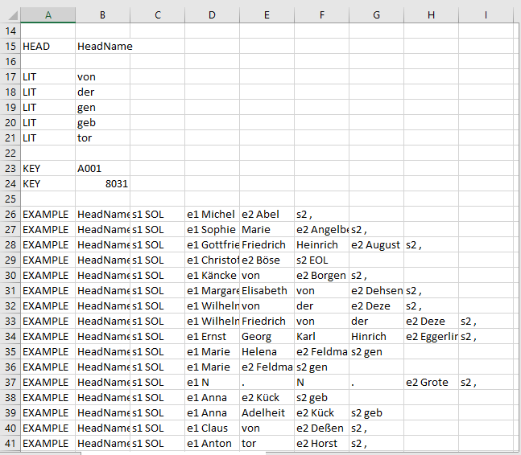
Candidate Examples: the “active learning” component of the GreenQQ UI
Redesign “Candidate Examples” for finding:
Missing Group Heads on Page (too few found on full text page)
Missing ReferenceIDs on Page (too few found on full text page)
Missing Record Heads (run-away Person records)
Missing Extracts (Search Phrase found but no matching Extract)
Missing Search Phrases (Format Variant found, but not labeled)
A Candidate Example is the first of n phrases with identical tag sequences. The importance of a Candidate Example its frequency n and its category as ordered above.

Slide 15
Candidate Examples: the “active learning” component of the GreenQQ UI
Missing Group Heads and Missing Reference IDs
19
79
Threshold: Mean + 2*StandardDeviation

Slide 16
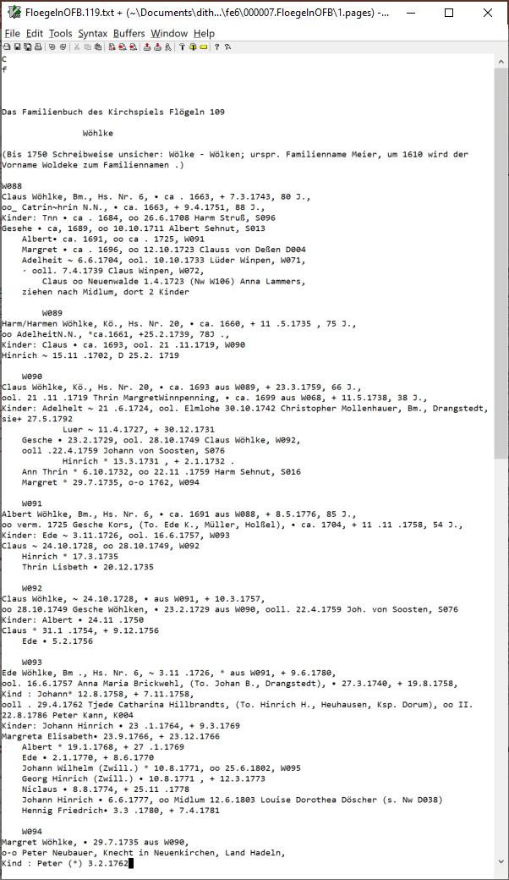
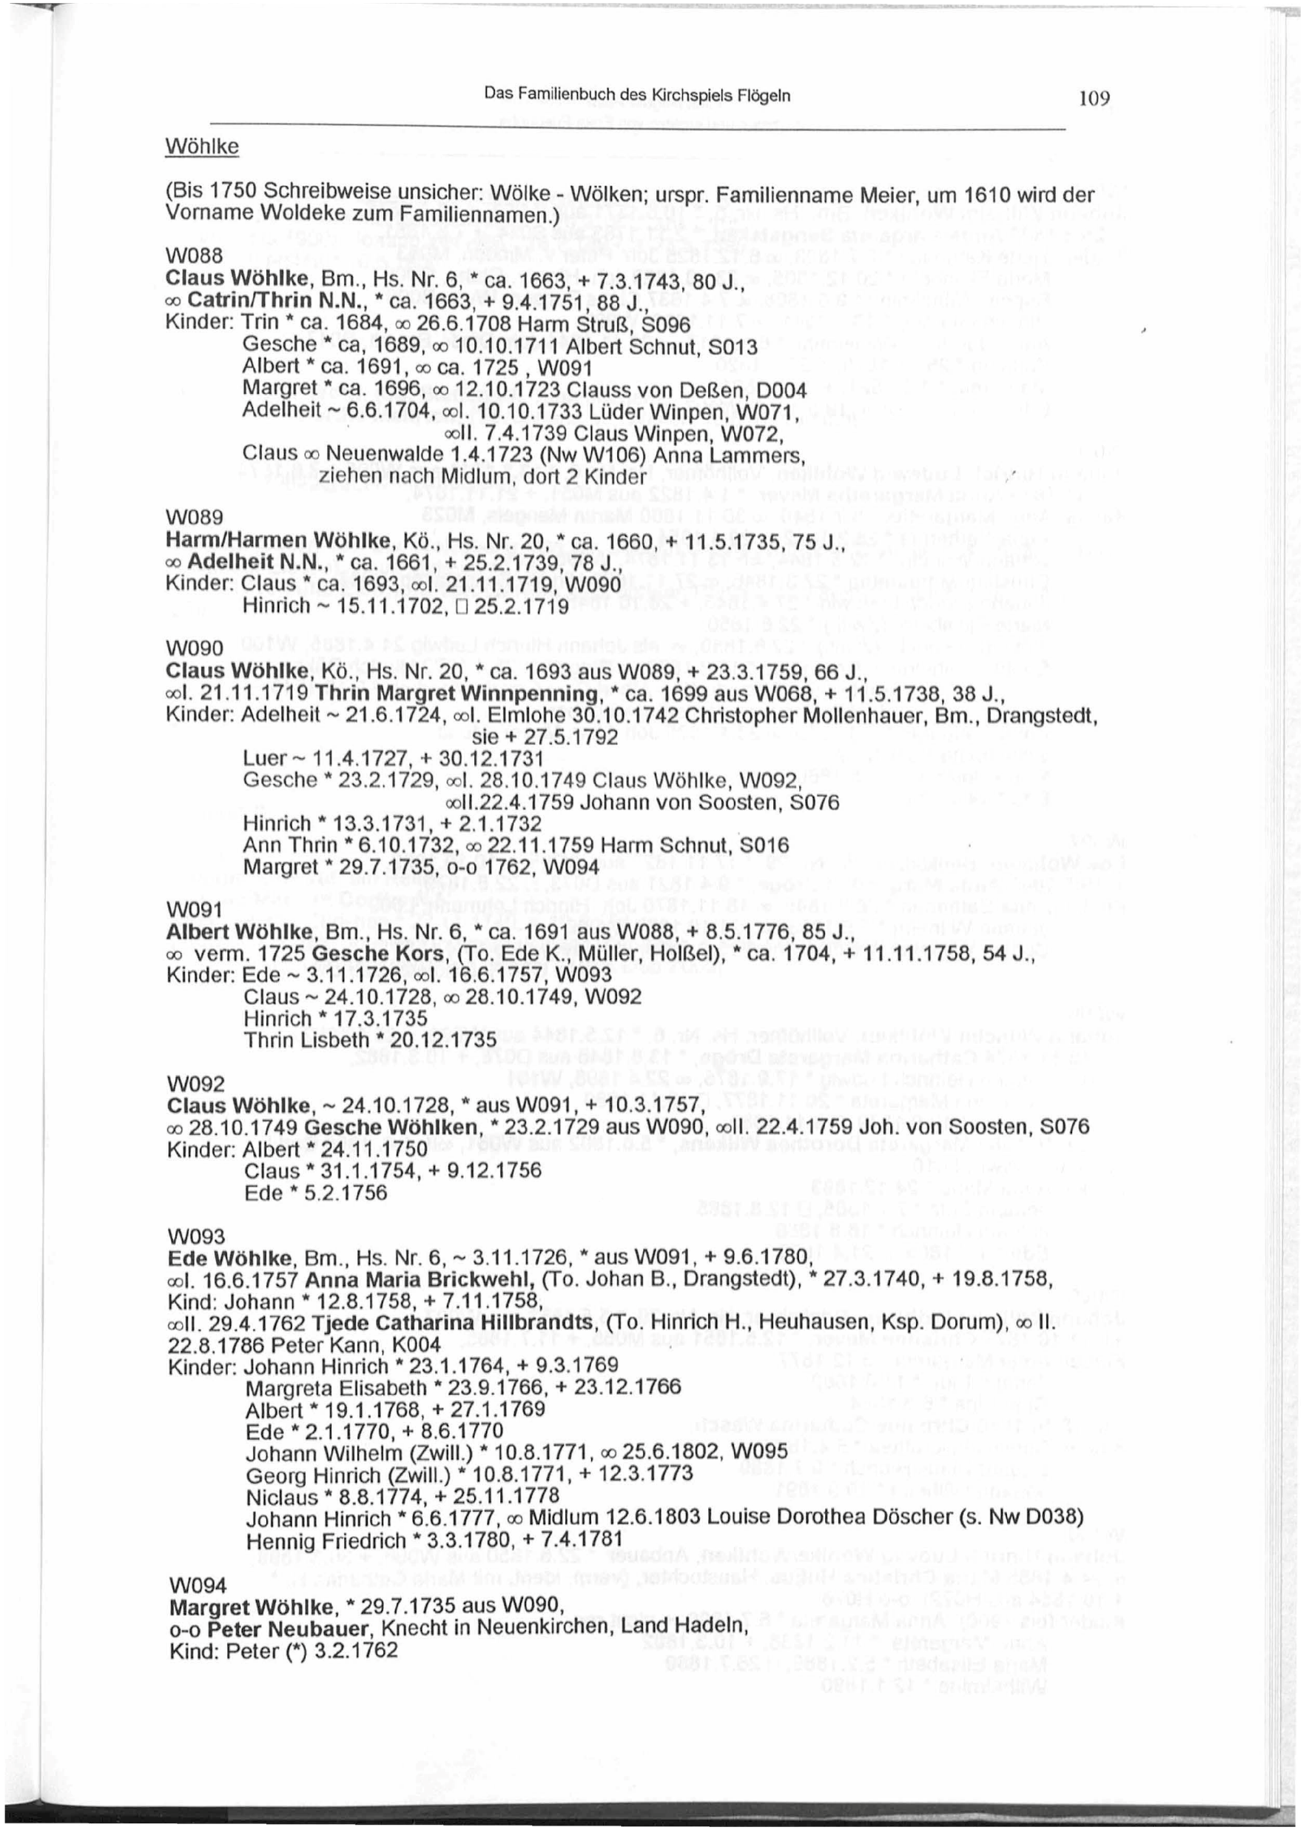
Candidate Examples: the “active learning” component of the GreenQQ UI

Slide 17
Candidate Examples: the “active learning” component of the GreenQQ UI
Notes:
OCR problems.
PDFIndexer issues?

Slide 18
Candidate Examples: the “active learning” component of the GreenQQ UI
4IO THE ELY ANCESTRY.
SEVENTH GENERATION.
157548. Jabez Ely, Dimock, Susq. Co., Pa., b. 1844, son of John
Russell Ely and Lucinda Morgan Giles; m. 1870, Sarah Elizabeth
Gavitt, Dimock, Pa., who was b. 1853, dau. of Prentice Avery Gavitt
and Enimeline Scott Parks. Their children:
1. Arthur Marvin, b. 1872.
2. Bertie Leroy, b. 1875.
3. Edith May, b. 1878.
157549- John Russell Ely, Brooklyn, Pa., b. 1848, son of John
Russell Ely and Lucinda Morgan Giles ; m. 1876, Helen Bissell, Brook-
lyn, Pa., who was b. 1856, dau, of Charles Bissell and Fannie Smith.
Their children :
1. Blanche Gertrude, b. 1877.
2. Martin Augustus, b. 1878.
157551- Isaac Zelophehad Babcock, Montrose, Susq. Co., Pa., who
was b. 1825, son of Parnal Ely and Francis Mitchell Babcock ; m. 1853,
Sarah Ann Allen, who was b. 1825. No children.
157552. Priscilla Walker Babcock, Poultney, Rutland Co., Vt., b.
1831, dau. of Parnal Ely and Francis Mitchell Babcock; m. Joseph Fox
Crosby, Rockford, 111., who was b. 1828, d. 1861 ; m, 2nd, George L.
Bliss, M.D., Poultney, Vt.
157553- Noyes EHab Babcock, Rockford, 111., b. 1833, son of Par-
nal Ely and Frances Mitchell Babcock; m. 1865, Harriet Eloise Crosby,
Rockford, 111., who was b. 1836, dau. of Asa Crosby and Mary Wood
Howe. Their children :
1. Herbert Mitchell, b. 1867.
2. Mary Caroline, b. 1869.
3. Cora Alice, b. 1871.
157554. Amy Elizabeth Babcock, Rockford, III, b. 1835, d. 1875,
dau. of Parnal Ely and Francis Mitchell Babcock; m. 1852, George
Duryea Goodsell, Box 256, DeKalb, 111., who was b. 1830, son of William
liisington Goodsell and Julia Ann Knox. Their children :
1. Albert Mortimer, b. 1854 ; m. 1880.
2. Carrie Louisa, b. 1856; m. 1881.
3. Stella May, b. 1858 ; d. 1866.
4. Minnie Mary, b. 1864.
157555- Lyman Francis Babcock, M.D., Deadwood, South Dakota,
b. 1838, son of Parnal Ely and Francis Mitchell Babcock; m. 1865,
Page | Frequency | Example
 |  | Missing Major Group Header Names:
562 |  | Others expected on page besides those found
510 |  | , b. 1849 … Their children: 1.
434-5 |  | . Appleton’s Cyclopaedia … m. 1818,
 |  | Missing Record Header Names:
437 |  | , m. 1857 Theresa Dwight. \ 2. NicoU Fosdick, b.
 |  | Missing Data Values:
440 | 32 | m. i860
467 | 13 | William. \
482 | 9 | b. May, 1842,
441 | 6 | d. July, \
 |  | Missing Type Designators
442 | 2 | d- 1839
460 | 2 | b- 1819
Notes:
The tokenized search phrase of all those pointed to is “SOL NUM5+ -”, not the standard “SOL NUM5+ .) because of an OCR error (dash for period)

Slide 19
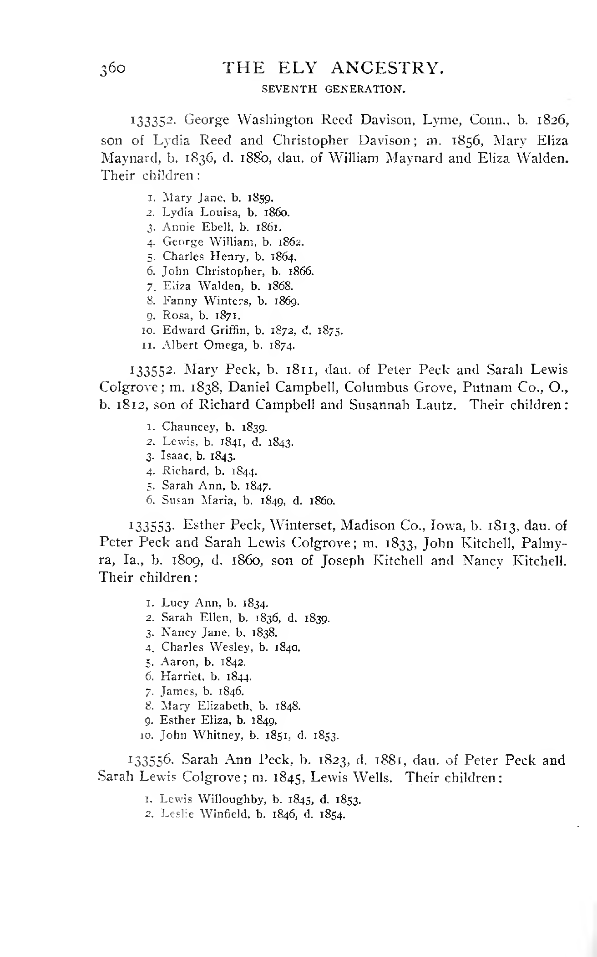
Candidate Examples: the “active learning” component of the GreenQQ UI
Page | Frequency | Example
 |  | Missing Major Group Header Names:
562 |  | Note: additional header names expected on page
510 |  | , b. 1849 … Their children: 1.
434-5 |  | . Appleton’s Cyclopaedia … m. 1818,
 |  | Missing Record Header Names:
437 |  | , m. 1857 Theresa Dwight. \ 2. NicoU Fosdick, b.
 |  | Missing Data Values:
440 | 32 | m. i860
467 | 13 | William. \
482 | 9 | b. May, 1842,
441 | 6 | d. July, \
 |  | Missing Type Designators
442 | 2 | d- 1839
460 | 2 | b- 1819
Notes:
Here’s a possible layout, but …
The example page and highlighting is for a click on 510

Slide 20
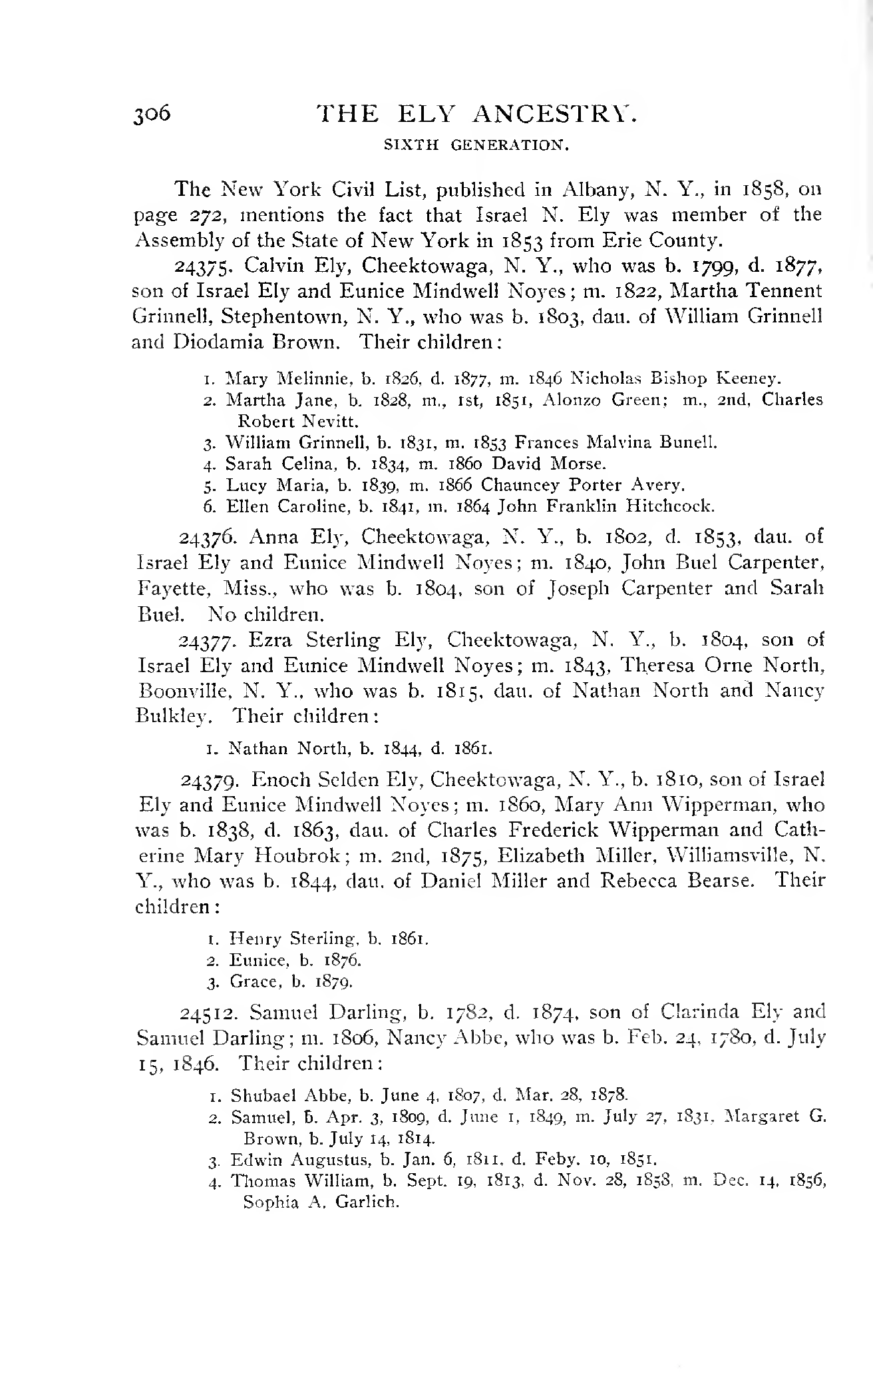
Candidate Examples: the “active learning” component of the GreenQQ UI
Page | Frequency | Example
 |  | Missing Major Group Header Names:
562 |  | Note: additional header names expected on page
510 |  | , b. 1849 … Their children: 1.
434-5 |  | . Appleton’s Cyclopaedia … m. 1818,
 |  | Missing Record Header Names:
437 |  | , m. 1857 Theresa Dwight. \ 2. NicoU Fosdick, b.
 |  | Missing Data Values:
440 | 32 | m. i860
467 | 13 | William. \
482 | 9 | b. May, 1842,
441 | 6 | d. July, \
 |  | Missing Type Designators
442 | 2 | d- 1839
460 | 2 | b- 1819
Notes:
Here’s a possible layout, but …
The example page and highlighting is for a click on 440

Slide 21
Click on the name of the primary person in any one of the major groups. Repeat for nested groups, if any.
Notes:
Initially, the patron record template has the focus on Name (rename?: PersonName or PrimaryPersonName) with the rest of the record template greyed out.
The SearchPhrase (in yellow and outlined with blue) is associated with the one PrimaryPersonName clicked on. (If the SearchPhrase yields incorrect results, it can be adjusted by the patron.)
The patron could have also included the title “Rev.” – because we can include titles (or not) in our external-representation specifications, this should work either way.
“Aitken (Akin)” would likely not be in our ext-rep specs. The user should add it. The pattern then becomes part of the book-specific ext-rep specs for a primary person name.
Note that we have a really ugly problem with Kilbarchan “W. Richard Allasone”. The book author has not been consistent: the last-name-comma pattern has been violated, and the line is formatted as a wrap-around line with one tab of indentation. If these problems are recognized, they can likely be remedied by adding yet another SearchPhrase and ext-rep pattern – “likely” because this kind of thing may upset the apple cart. Also, we’re not likely to be able to help the user find these kinds of issues. Not finding and resolving these issues can cause problems – here, the spouse, Ninian Aitkine, would become a second spouse of Thomas Aitkine.

Slide 22

Click on the name of the primary person in any one of the major groups. Repeat for nested groups, if any.
Notes:
For nested family groups, the user should check that the declared nesting for the group also holds for other groups in the book. (If not, fix the nesting and keep checking.)
The system should keep track of the level being worked on. In the following for Mullinix, we’re working only on the outer layer until we explicitly shift to an inner level. As we work on an outer label, the inner rectangles and the labeling of inner PrimaryPersons are removed until the explicit shift. (?? We may not want to remove the inner bounding boxes.)

Slide 23
Click on the name of a child of any primary person and continue clicking on children of primary persons until all are highlighted.
Notes:
Note that with one click we get all the Ely children and all but one of the Kilbarchan children – the missing twin.
Clicking on the twin gets it. The SearchPhrase for William, the second twin, is “and <Name> , NUM1or2” – here and elsewhere “and” should be a literal. The rule I’m thinking of for declaring a SearchPhrase here is go both left and right until one non-punctuation token is encountered and also include the next tokens on the left back to StartOfLine if the token preceding the left non-punctuation token is a tab or SOL; in the latter case, we then drop the right context if the Extract is for a non-lexical object, i.e. the Name of a Person, Spouse, or Child. This rule is superseded when we can find a declared SearchPhrase on the left (e.g. “b” or “d” or “sp” or …) An immediate tab on the left for primary persons and children should also supersede, and all tabs should be included in the SearchPhrase – the number of tabs matters.

Slide 24
Click on the name of a child of any primary person and continue clicking on children of primary persons until all are highlighted.
Notes:
Among many others, “daughter” and “sons” are predeclared SearchPhrases.
Also in this example, “grandchildren” is a predeclared EXTRA SearchPhrase. EXTRA SearchPhrases should not be marked for the user. They preempt run-away lists. Here “sons” preempts a “daughter” run-away list, but there is nothing to prevent the “sons” list from also picking up “ARTHUR MORRIS”, “SAM MORRIS”, “Miss ELLA MORRIS”, and “Mrs ADA HARP”.
A subtle point here is that the “Mrs.” is sometimes important. Otherwise “HENRY RANCH” will be designated as ESTER’s child.
In Mullinix, note that the number of tabs distinguishes children from grandchildren and great-grandchildren.

Slide 25
Click on the name of a spouse of any person and then also on any marriage event date and marriage event place. Continue clicking until all spouses and their marriage event date and place are all highlighted.
Notes:
In Kilbarchan, note that many SearchPhrase patterns are necessary. It’s interesting, however, that none violates the rule for generating contextual SearchPhrases – except perhaps the one that ends with an end of line. That one may need to be adjusted by the patron because the default would be the CAP following it on the next line. (Normally, end of lines on the right may cause problems, but not in this case; how can the patron tell the difference?)

Slide 26
Click on the properties of any person, spouse, or child. Continue clicking until all properties of every person, spouse, or child are all highlighted.
Notes:
Here, again, we get properties in inner nesting levels, but we ignore all except the children in the next-most level of nesting.
“m” is ambiguous among forms; it may not matter since in Miller the “m” data will be filled into the Parent2 field whereas in Ely the “m” data will be filled into the SpouseName and MarriageEventDate fields and in Kilbarchan the “m” data will be filled into the MarriageEventPlace and MarriageEventDate fields.
I didn’t try to get patterns for Places; we need to depend as much as we can on data-frame external representations, but that might be difficult. (Thought: I may be able to get a list of places, perhaps just for English- and German-speaking places; then we can tokenize the list and pick out the patterns.) Alternatively, in Miller where we have descriptive place names, we could just pick them up, i.e. get all text between recognized Extracts and recognized SearchPhrases.
“ca.” means something and we should probably process it downstream.
Point-size differences in Mullinix may need some special attention.
Died, with the pattern “1862-1866” is something we don’t handle but could.

Slide 27

Repeat process with next nested group.
Notes:
Within a group, recursively do the same thing. Initially, the highlight on top-level PrimaryPersons is removed and the next inner PrimaryPersons are reset as PrimaryPersons (they are the children of the upper-level PrimaryPerson). The outer bounding boxes are turned black to indicate the content outside the outer-most red bounding boxes is to be ignored when post-processing. Other highlights remain in place and need not be redone.
When post-processing, both outer and inner labels need to be properly handled (ignored or included as appropriate).

Slide 28
… after adding children … spouses and attributes are already in place … and we’re done
Notes:
For post-processing, we need to pay attention to groups. It’s probably not good enough to use functional dependency rules to stop accumulating properties (i.e. a property could be missing and we might end up with the property of a child in the next level of nesting). Sorting out multiple spouses is even more difficult to detect and prevent. In the example above, without boundaries Child Mildred Morgan Mullinix would not only have spouse George O. Shipley but also spouse Walker A. Schwyhart who is acutaly her child’s spouse.

Slide 29
Repeat process with next nested group. … and after one click to label a child, we’re done
Notes:
Note that we do not have the spouse ambiguity for Mildred Morgan Mullinix because Lydia Ann Shipley is recognized as a child at this level of nesting and her spouse is Walker A. Schwyhart.

Slide 30
Extraction-tool testing: checking relationships
Finding recall errors
Missing heads
Discover by observing FD violations
For non-FD relationships, discover by finding statistical outliers in the distribution of the text distance between list elements (e.g. the text distance from one child to the next should be far less than the distance from the last child in a family to first child in next family)
If possible, also assess the frequency of patterns in the text space identified as containing the missing heads (perhaps by identifying potential Names and search-phrase variations within the text space)
Other missing extracts (ala GN’s ideas)
Find search phrases without extracts (order token patterns by frequency of occurrence)
Find potential extracts (Names & Dates &? Places) not identified as Extracts (order token patterns by frequency of left context tokens, e.g. “bom” as an OCR error for “born” in Kilbarchan)
Finding precision errors
Display red- and yellow-flag indicators, including new indicators with warning messages when the following can be detected
Relationship violations
Caused by missing heads or by missing extracts (see above)
Other causes (?) as indicated by red and yellow flags
Entity violations (incorrect classification)
Caused by missing search phrases and extracts (see above)
Other causes (?) as indicated by red and yellow flags
Notes:
Need mock-ups showing examples (including highlighting and frequency counts, where possible);
Pages to display should be ordered by “biggest bang for the buck” – meaning that making corrections on top pages in the ordering would do the greatest amount of good.
Precision errors: Except for violations of assumptions about documents, I can’t think of any. Red and Yellow flags may indicate some.
Example of a missing search phrase and extract causing an entity violation: … b. i875, a. 1897 … (here 1897 could be declared as a birth date by cause of the OCR errors). Resolutions for common OCR errors can be accounted for, but not all of them. OCR errors in other extracts may not matter since we don’t usually require template matching to include the Extract.

Slide 31
Missing Head & Missing Extract
?
?
Missing Head: ? Male married male
Missing Head: Suppose the head “Charles Christopher Lathrop” were missed, causing a Family-form run to associate not only William Gerard Lathrop’s five children with him but also all Charles Christopher Lathrop’s children beginning with Charles Halstead.
Missing Extracts: The identified place names and dates are recognized as such, but not picked up as extracts.
Notes:
Green Extracts book-end the text where missing Heads are expected; yellow highlights the area in which missing Heads were expected. Similarly, green Extracts book-end the text where Extracts (highlighted in yellow) are found.

Slide 32
Auto-indexing
Can we automatically determine form combinations to run?
We can always run the four forms: Person, ChildOf, Marriage, Family; but only if we can automatically determine Heads. (In Kilbarchan, for example, the father in a family is the Head for Marriage and Family; each Child is a Head for Person; and there is no Head for ChildOf and it need not be run. In Ely, the Heads for Person are the family head, the spous(es), and the children – all three are needed.)
We can reduce the runs if we can determine the right form combinations or that Individual alone will work. (In Kilbarchan, only two runs are necessary because (1) the Heads for Family and Marriage are the same while (2) the Head for Person is not the same.) Also, for Miller, we can combine them all and make one run.
How do we decide which books to Auto-index?
FamilySearch priorities
Can we automatically determine whether a document has the needed semi-structured properties? And, can we automatically classify them?
Record-separable wrt combinations of forms: Person, Child-of, Marriage, Family.
Classification for the auto-indexer requires us to differentiate between nested and non-nested groups as well as form combinations.
Ultimately, we probably need to involve other extraction tools: OntoES and OntoSoar; and then automatically decide which tool to use.
How do we decide whether the target should be CDS or LLS?
Is predetermine by inspection necessary, or can we determine this automatically?
User directed transition to (Scan-to-)submit or Add-to-tree should also be possible.
Notes:
George Nagy has a different way of post-processing to form relationships. His method post-processes linearly but must consider each extract in all its roles. (In Kilbarchan, for example, the children have two roles: Child for Parent-Child relationships and Person for Person-BirthDate and Person-ChristeningDate relationships. It’s not immediately clear which way to go, but the relation-processing code downstream is geared toward the four forms.

Slide 33
Scan-to-submit
Patron submitter finds a person to submit by filling in FamilySearch provided form.
Assuming the search points them to a semi-structured text document, a patron then selects a person to submit and:
Within the [(4 5 6)+] cycle, completes the extraction of information from the document,
Checks and edits (if necessary) the generated and filled-in tree-ready form, and
Submits it to the FamilySearch Tree using standard FamilySearch procedures.
Notes:
Tailoring to FamilySearch procedures makes the process semi-automatic: API calls let the system handle the work of filling in forms, navigating through merge procedures (if needed), and attaching documentation.

Slide 34
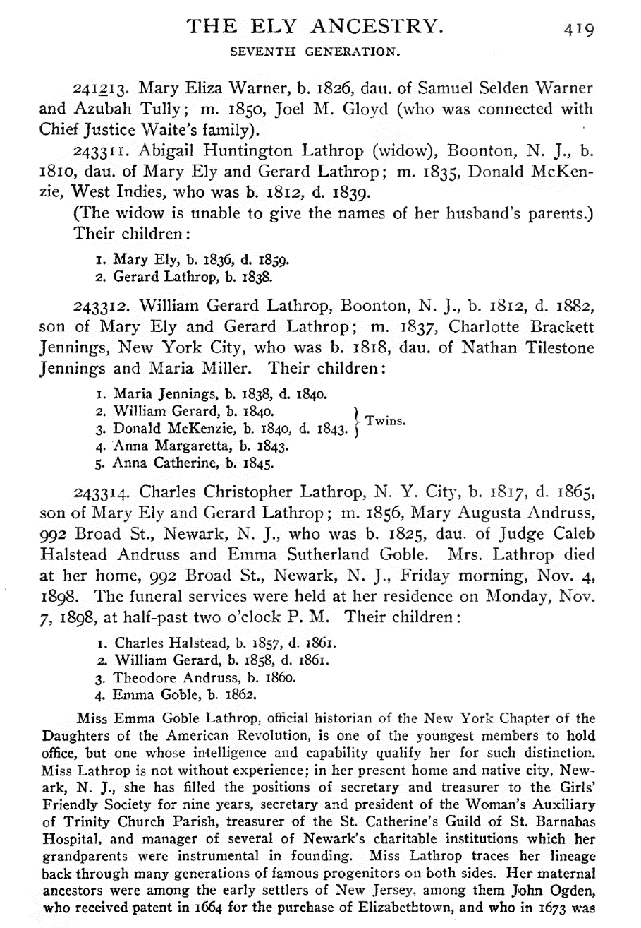
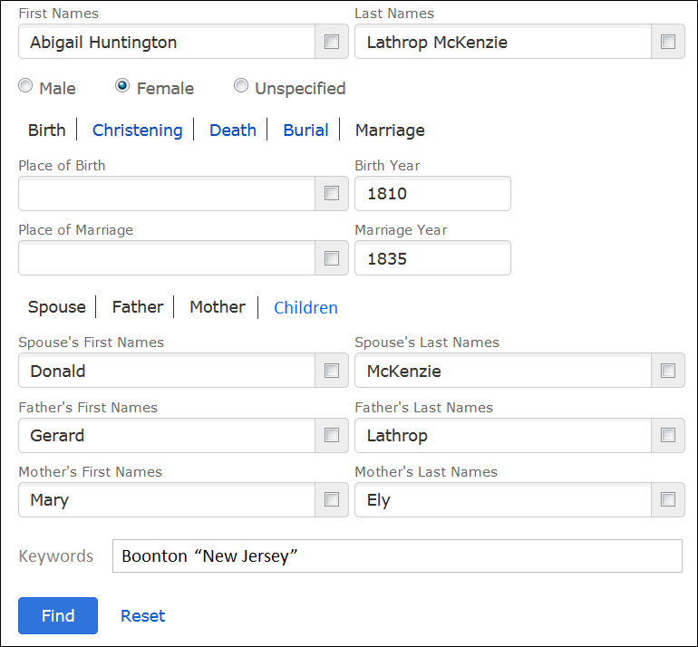
Keyword & Semantic Search
Notes:
HyKSS
Keyword Search: standard for specified keywords (also? standard for fielded words, except when semantically superseded (i.e. there is a semantic hit anywhere in the document that involves the entity in a relationship) or when qualified, where qualified, for example, could be “before 1810” or “1805 – 1815” or “within 10 miles of Newark, New Jersey”)
Semantic Search: entities – fuzzy search given that the entity is a name, date, or place (e.g. within alternate name expectations, within a date range, within a longitude/latitude range for a historical place).

Slide 35
Persona Record (no editing needed before submission)

Slide 36
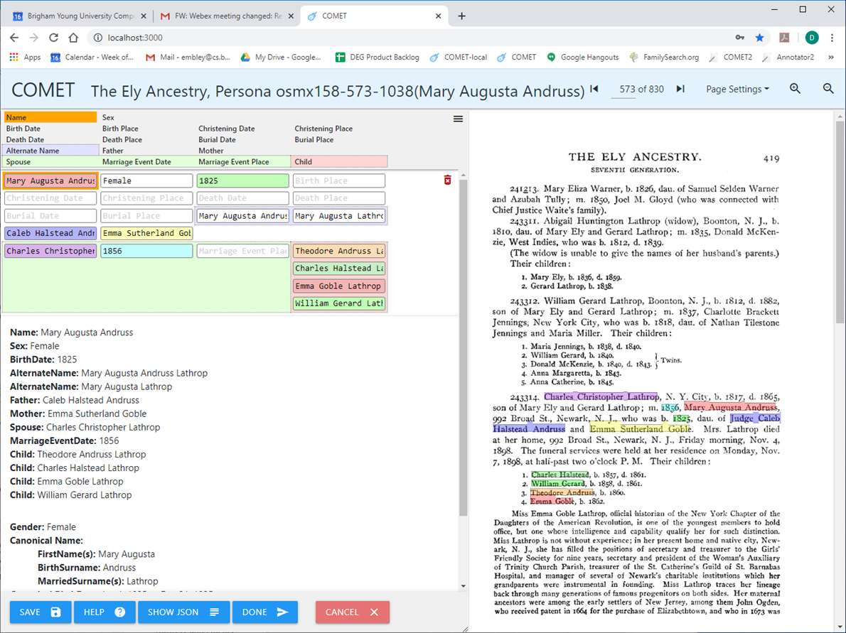
Persona Record (editing needed before submission)
Notes:
Standardized dates and place names should be requested, suggested, and checked.
Can names be checked and standardized?

Slide 37
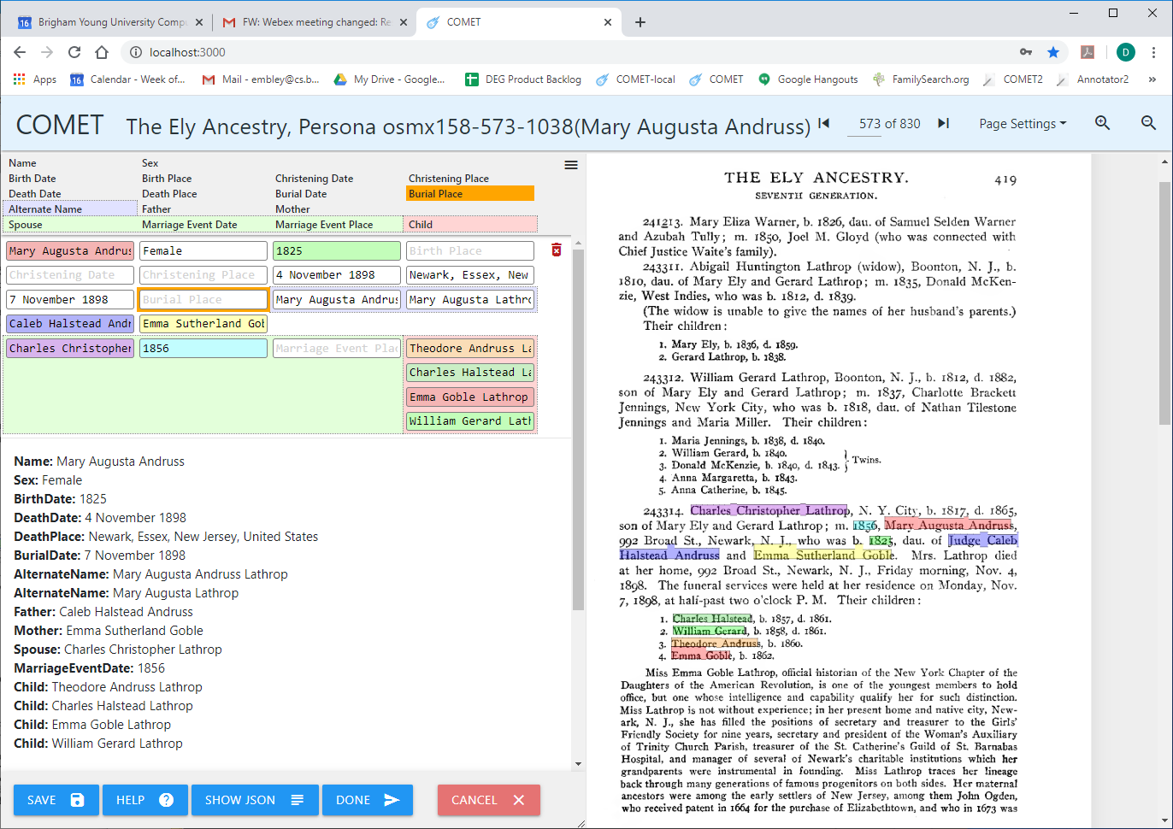
Persona Record (editing needed before submission)
Notes:
Standardized dates and place names should be requested, suggested, and checked.
Can names be checked and standardized?

Slide 38
Add Verified Gedcomx to Tree
Verify: For each Automatically Extracted and Curated Tree, T:
Add T-generated Gedcomx to LLS (for immediate patron search).
While in LLS, check, correct, and update each T-generated filled-in form (as above)
Patron modifies T’s Gedcomx in LLS to reflect the updates (no fear of patron ruining tree).
Submit verified Gedcomx to the FamilySearch Tree, FST:
Automatically assess value of contribution (separately or integrated with the next step).
Automatically determine potential overlap between T and FST.
For each person record in T, ask FamilySearch to return all potential duplicates in FST.
Add any connected subtrees of T with no potential overlap to the FST.
Integrate each connected overlapping subtree S of T into FST.
For each person record P of S, add P and all returned potential duplicate records of P to a set Q.
With guidance from the deep checker and with a human in the loop, determine the duplicates of P in Q.
With a human in the loop merge P with its duplicates in Q.
Notes:
It’s likely best if the list is ordered by the order in which the MergedPersonas were added to the tree. (This will provide a bit of running context, which would not be the case if the list elements were selected randomly.)

Slide 39
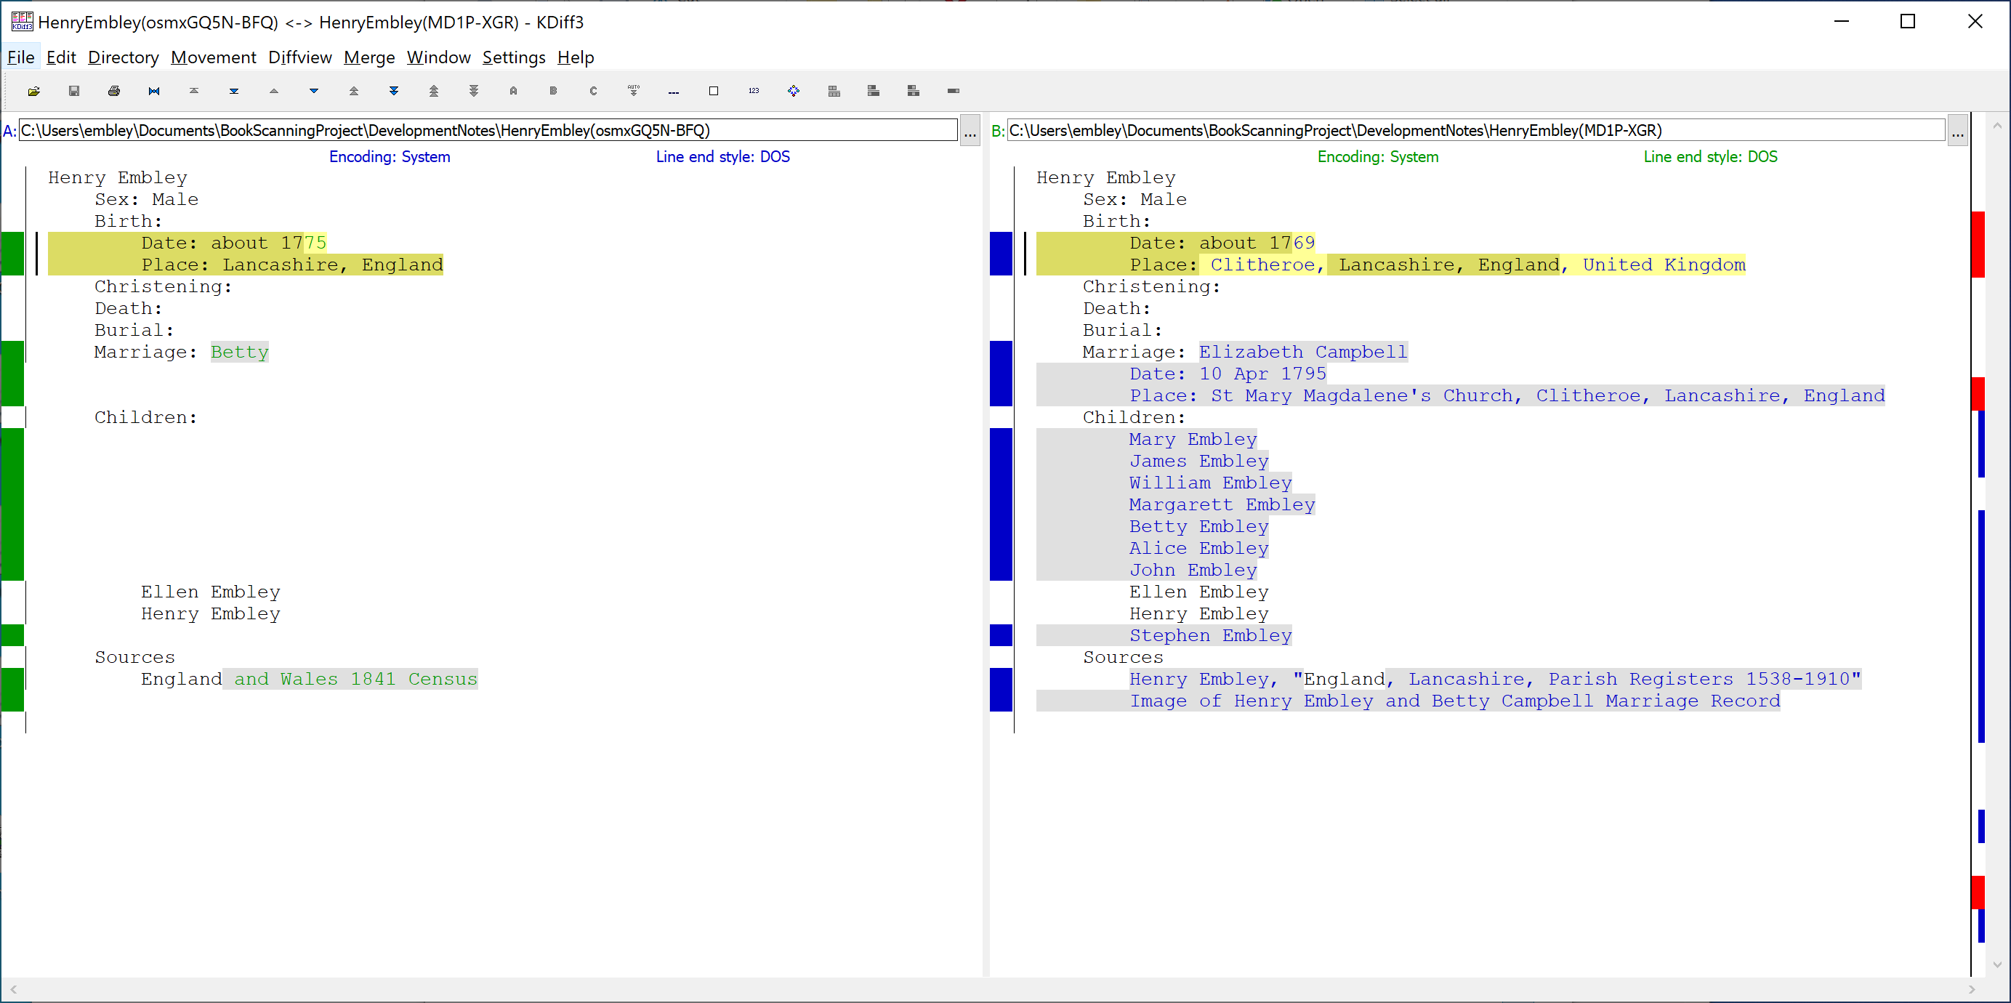
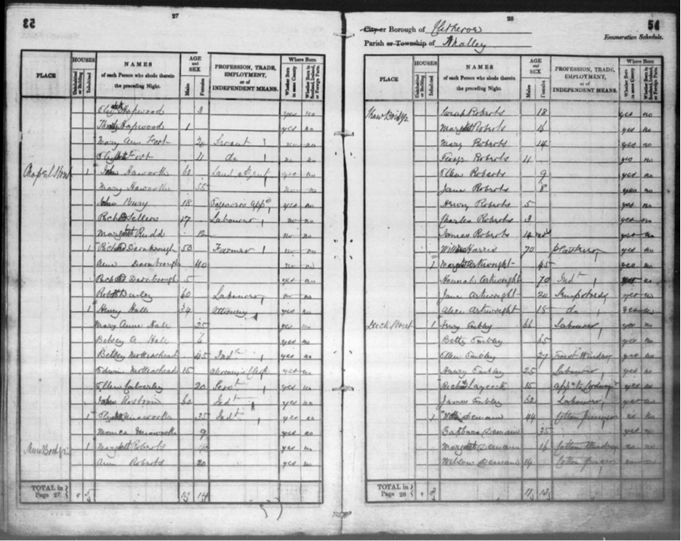
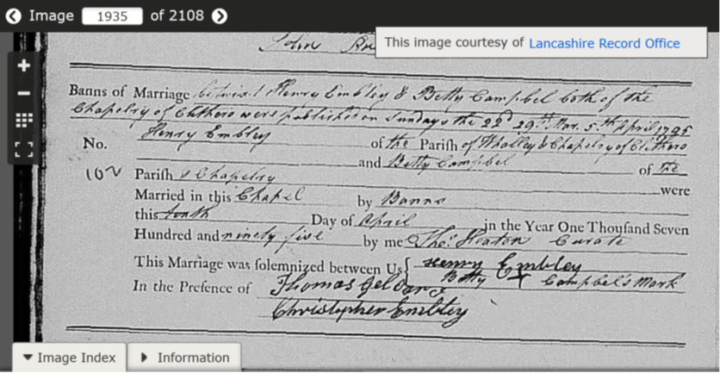
Duplicate Determination Mockup
Estimated dates 6 years apart
being the same has probability 0.5
“Betty” is a common
Nickname for “Elizabeth”
Notes:
Two possible merges on FamilySearch: MD1P-XGR and KLLT-TMK; like our equivalence-class deep checks: check all against all and kick out any that shouldn’t be merged.
Messages can be red (giving a reason to reject a merge, if correct), yellow/orange (warning regarding a merge), and green (reasonable to merge although possibly in conflict). These messages also constitute the basis for providing merge guidance.

Slide 40
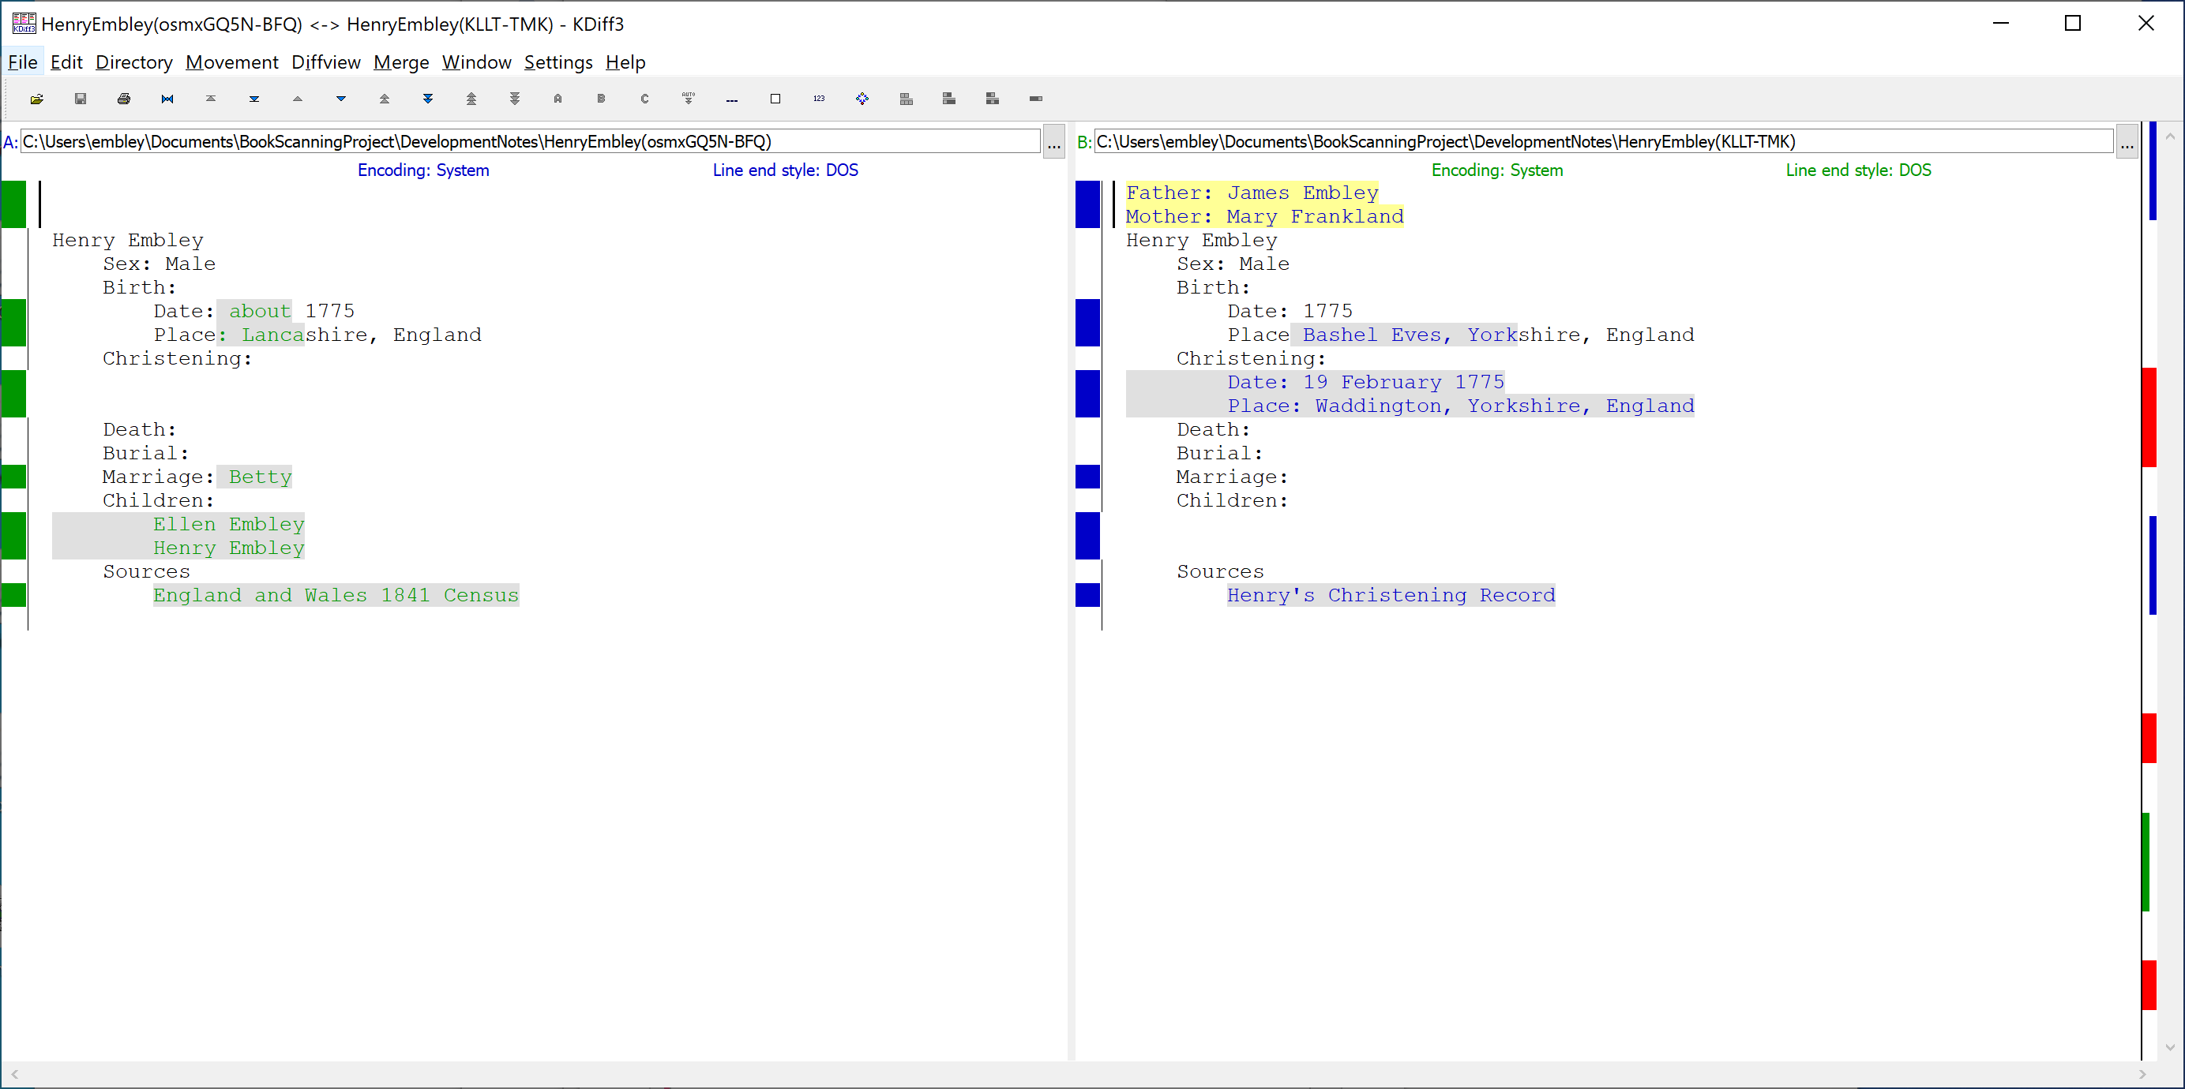
Duplicate Determination Mockup2
Specific dates are usually more reliable than estimated dates
Counties differ but
are adjacent

Slide 41
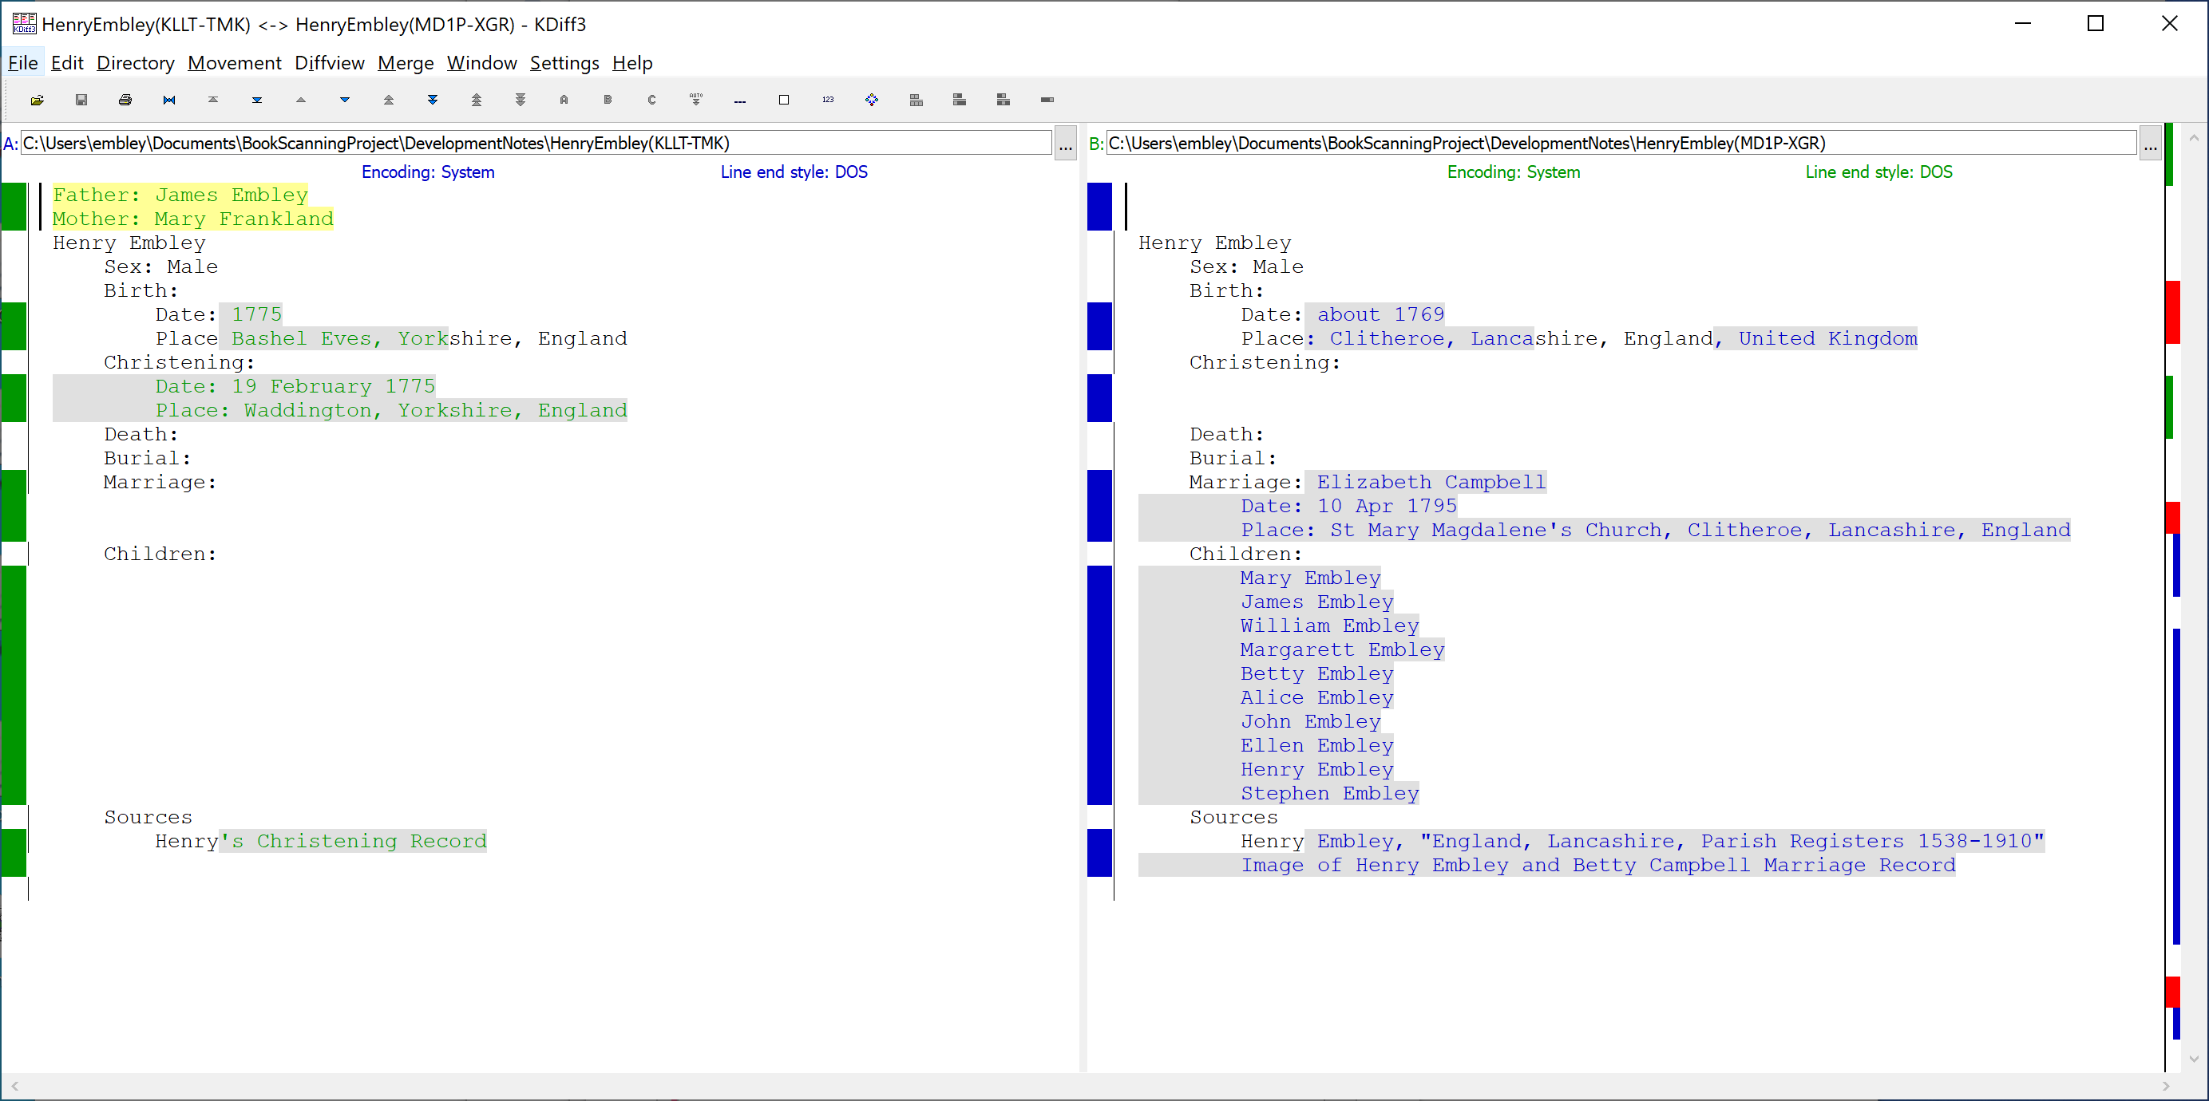
Duplicate Determination Mockup3
Specific dates are usually more reliable than estimated dates
Bashel Eves: 53.8852 N 2.4702 W
Clitheroe: 53.8711 N 2.3931 W
Distance apart: 3 miles
Notes:
Waddington: 53.8887 N 2.4142 W, 2 miles from Bashel Eves and 1 mile from Clitheroe

Slide 42
(Possible) Automatically Generated Merge Guidance Report
Resolve Birth conflicts:
Resolve Date conflict: Using available sources, determine the accuracy of estimated dates. Select the more accurate estimated date.
Resolve Place conflict: Using available sources, verify place names. Select the most specific documented place name.
If selected Date and Place are from different persons, then in the merge interface, choose REPLACE or not, and in either case, edit the Surviving Person’s Birth information post merge.
Eventually, resolve potential wife and children merges:
Do not UNDO.
They are either new, additional information for the Surviving Person, or they are not.
If not, leaving them in place stacks them for later resolution.
If they are duplicates, the system will provide a guide for their resolution.
Notes:
We have enough information to automatically generate a Merge Guidance Report.

Slide 43
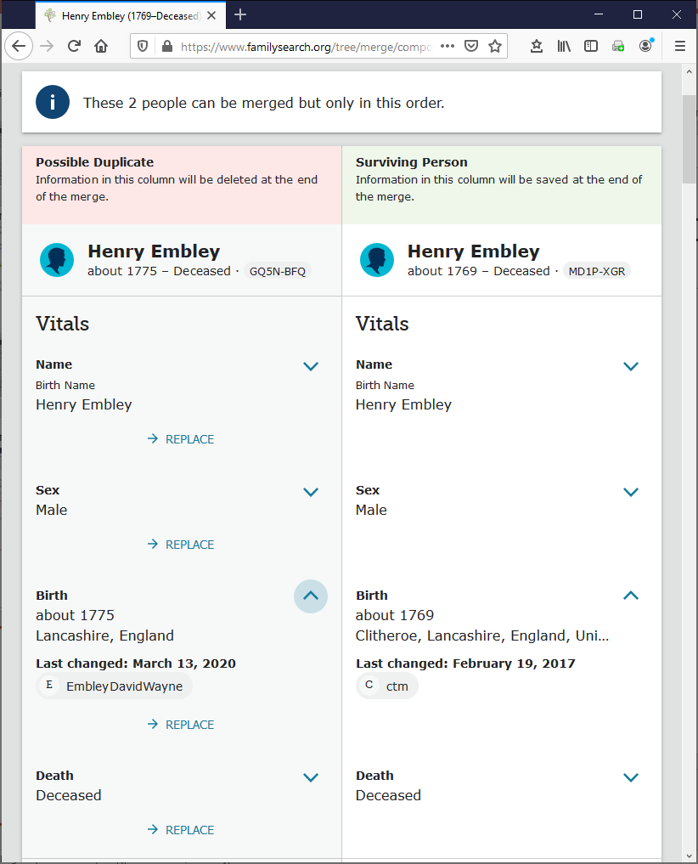
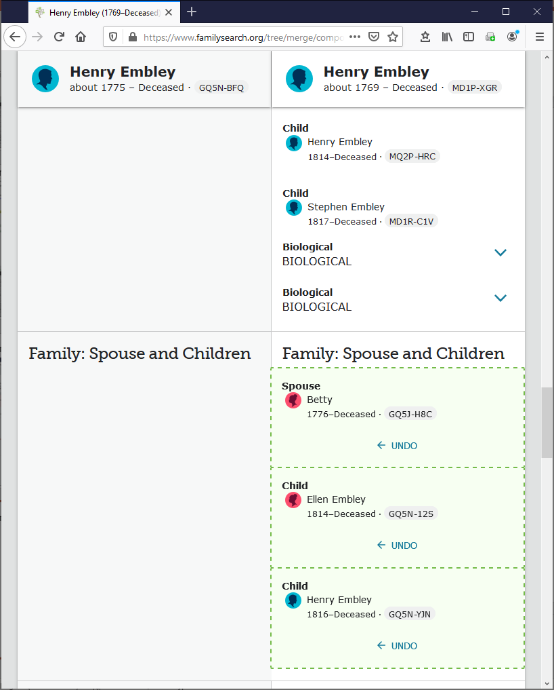
Merge with Merge-Guide Mockup
To do a date-only or place-only merge, edit the Surviving Person after the merge.
Do not UNDO; the system keeps track of potential duplicates and will guide you in their resolution.
Notes:
The merged is left to right (better than the previous right to left), but still has its problems:
* Date and place are bound together (in Birth here, one would like to keep “Clitheroe, Lanc …” and replace “about 1769” with “about 1775” but that doesn’t appear to be possible.
* Family: Spouse and Children begs the user into accepting Betty as another wife, which she is not, and to add Ellen and Henry as additional children of this second spouse; instead, they should be merged.

