Slide 1
Add Verified Gedcomx to Tree
Verify: For each Automatically Extracted and Curated Tree, T
Add T-generated Gedcomx to LLS (for immediate patron search & individual submit)
Check, correct, and update each T-generated filled-in form
Patron modifies T’s Gedcomx to reflect the updates (no fear of patron ruining tree)
Submit verified Gedcomx to the FamilySearch Tree
Automatically assess value of contribution
For each Gedcomx person record, do auto-deep-check for duplicates
If none, auto-add to tree
Else, human expert semi-auto-add to tree
Notes:
It’s likely best if the list is ordered by the order in which the MergedPersonas were added to the tree. (This will provide a bit of running context, which would not be the case if the list elements were selected randomly.)

Slide 2
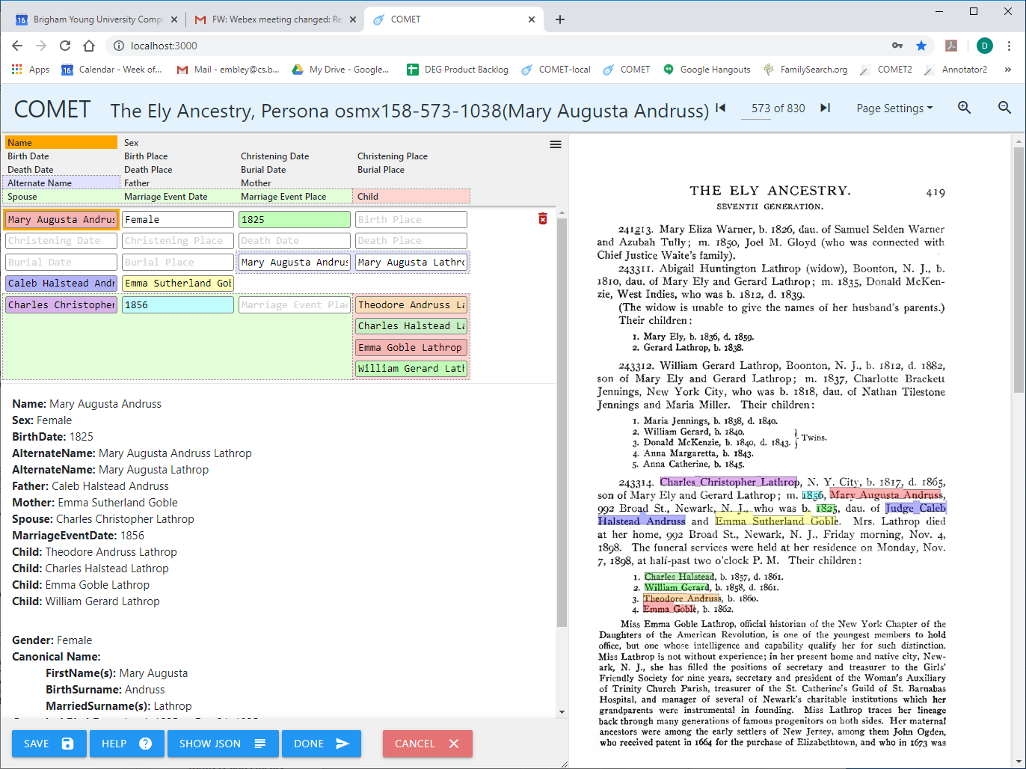
T-Generated Filled-in Form with Source

Slide 3
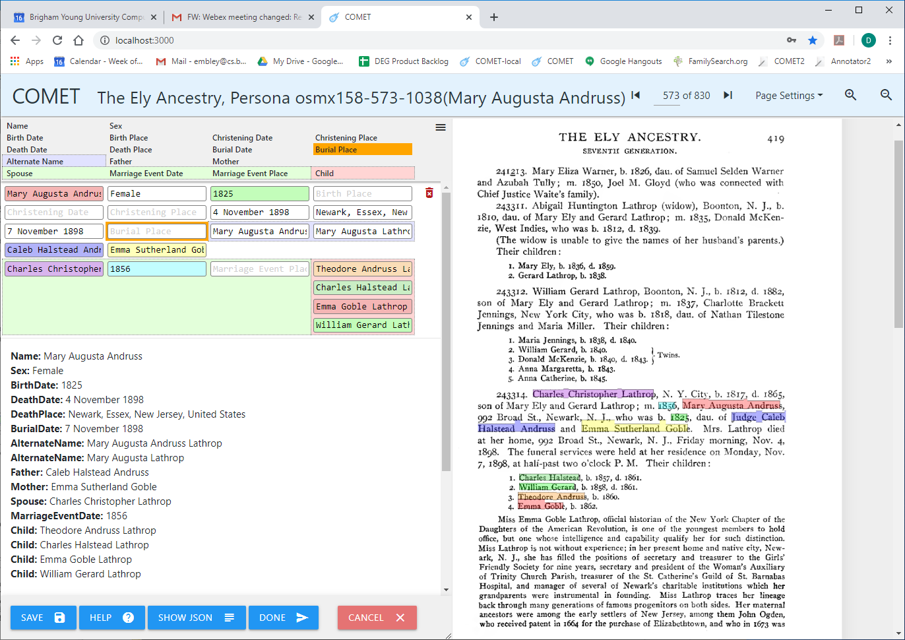
Updated T-Generated Filled-in Form with Source
Notes:
Standardized dates and place names should be requested, suggested, and checked.
Can names be checked and standardized?

Slide 4
Submit Verified Gedcomx to FamilySearch Tree
Gedcomx correctness guaranteed
Prior verification work has been certified by patron
No prior verification work has modified the FamilySearch Tree
Submit verified Gedcomx
Possible match determination
If no match, auto-attach
If potential match (as determined by deep-match criteria), resolve
Match resolvers are to be expert adjudicators (e.g. trained missionaries)

Slide 5
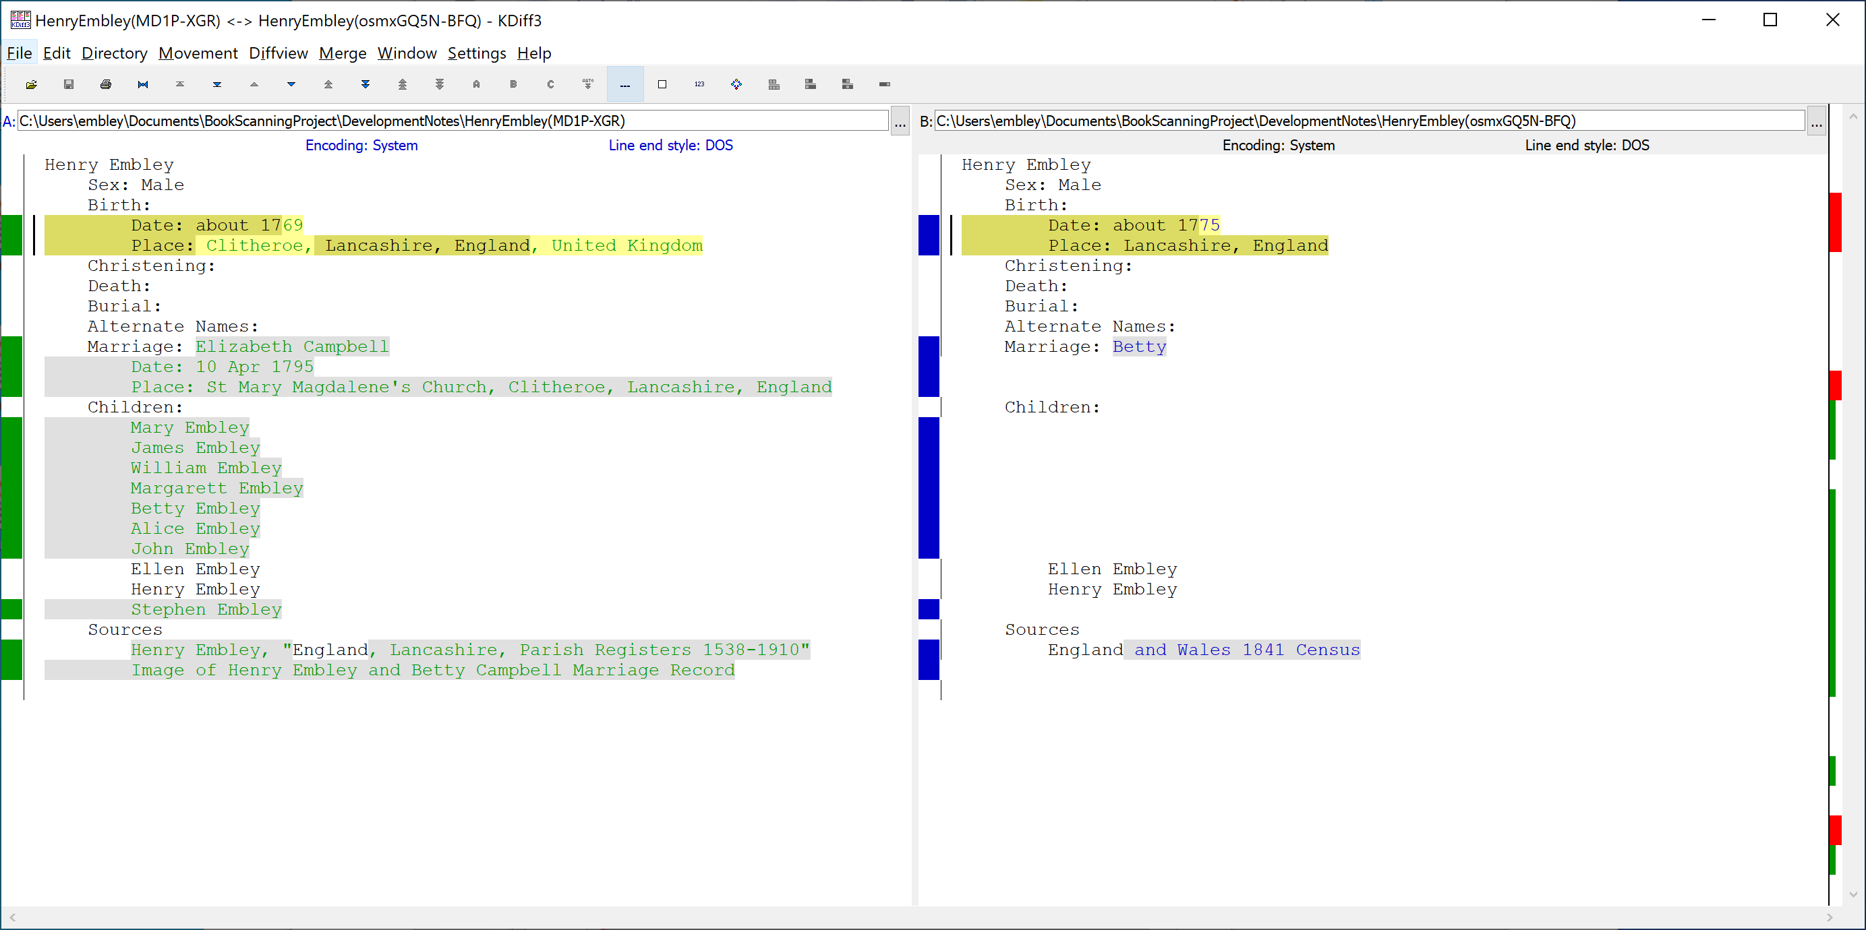
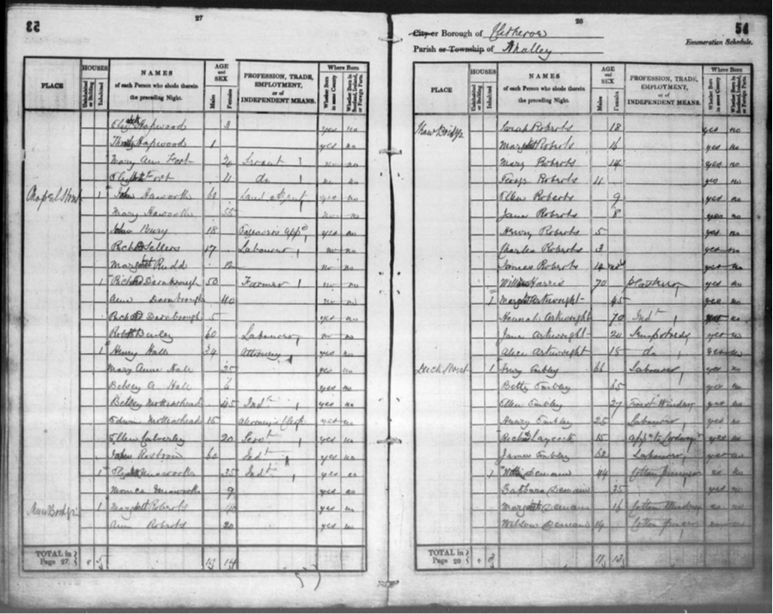
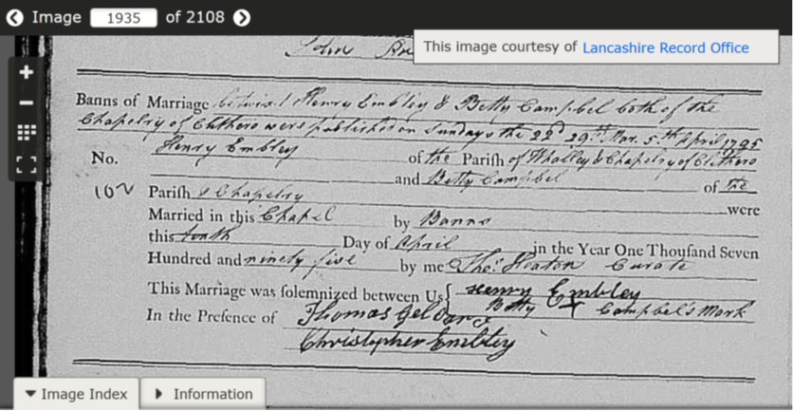
Interface Mockup for Match Evaluation
Check Dates
Estimated dates 6 years apart being the same has probability 0.5
?
?
?
?
“Betty” is a common nickname for “Elizabeth”
Notes:
Warning flags are red, yellow (orange), and green: any red should disallow a merge (unless first rectified); where possible yellows should have probabilities (based on distributions determined from family search); greens are comments about possibilities the user may not have considered.
Source names should not be compared and highlighted (here this is an artifact of using KDiff3 to do the mark-up).
Upon user decision to merge, (1) any data that appears only on the right is accepted as is, or as edited by the user with standardization hints in play; (2) identical data on both sides remains unaltered (standardization hints can be displayed and accepted); (3) for non-identical data on both sides that is not contradictory, the standardized value is suggested and the user can accept it or selected which one to keep (possibly edited and standardized); (4) for data in conflict, the user can choose which to keep (possibly edited and standardized); also for names, users can choose to keep either or both as alternate names.
For a merge in this Henry Embley example, the user should check the rest of the sources to see if there is a better birth date. If not 1775 is likely better because the estimate from the age in the census record is likely more accurate than an estimate based on the average age at a marriage date. “Betty” should be added as an Alternate Name. Sources should always be added unless they are redundant.
For standardized place names given at the city/town level, we can give longitude and latitude information and distance apart.

Slide 6
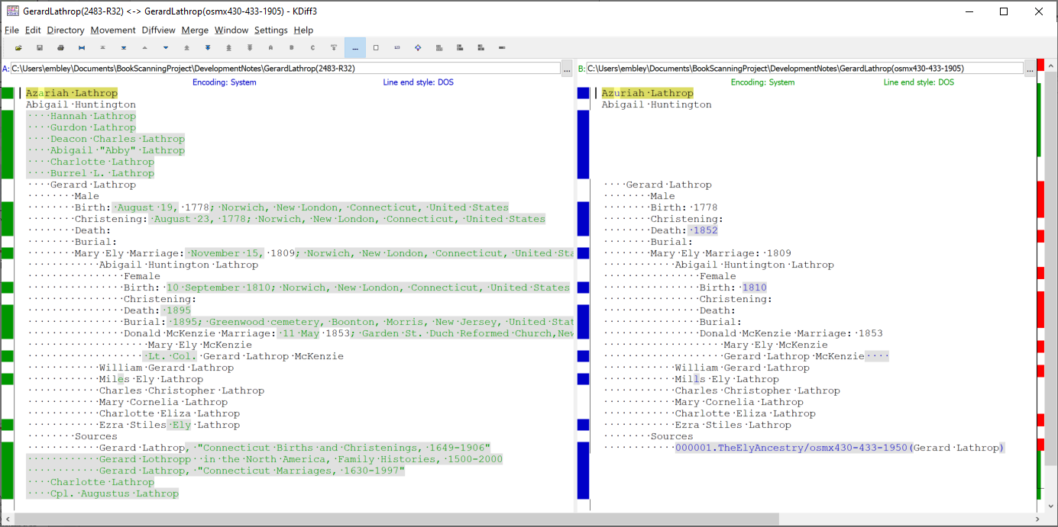

Interface Mockup for Match Evaluation
Check Name
(Names are spelled differently)
Notes:
The information on both sides is what appeared when I created this mock-up on FamilySearch and what was extracted in a run of our pipeline.
I’m assuming I started with Gerard Lathrop and expanded to his family and then expanded Abigail Huntington Lathrop. Any person can be expanded in the view so long as the information is available.
I also hid information: all the data for Gerard’s parents’ family members (this should probably be the default, upon parent-family expansion). Any information can be hidden in the view (and, of course, dynamically recovered).
Clicking on a highlight brings up additional information, if available. All red and yellow (orange) warning messages obtained in deep match are kept for this purpose. Clicking on a warning icon pops up a message.
Sources are clickable; the Henry example below shows an example.
Sources should not be highlighted or compared, just displayed.
It’s possible to add Alternate Names.

Slide 7
Directly Use Improved FamilySearch Interface
For expediency, use the new interface, as is:
We cannot expeditiously build one or expect adaptation of any of our ideas.
Nevertheless, we can better support user decisions about duplicates and about merges.
Provide a guide to determining duplicates with our deep checker.
Let FamilySearch find duplicates as usual, returning their FamilySearch IDs.
Import information from FamilySearch to an osmx ontology for analysis.
Deep-check each individual’s information for self consistency (report warnings).
Do a deep-match check on the set of proposed duplicates (report warnings and a match confidence).
Provide a KDiff-like view of the information with pop-up warnings and pop-up access to all documentation.
Use FamilySearch merge to do the actual merge.
Add the new person as a single individual to the tree and immediately open the merge view.
For now we probably can’t alter the interface itself, but hopefully we can provide a merge guide.
Notes:
For the Henry Embley example, MD1P-XGA and KLLT-TMK are duplicates.

Slide 8
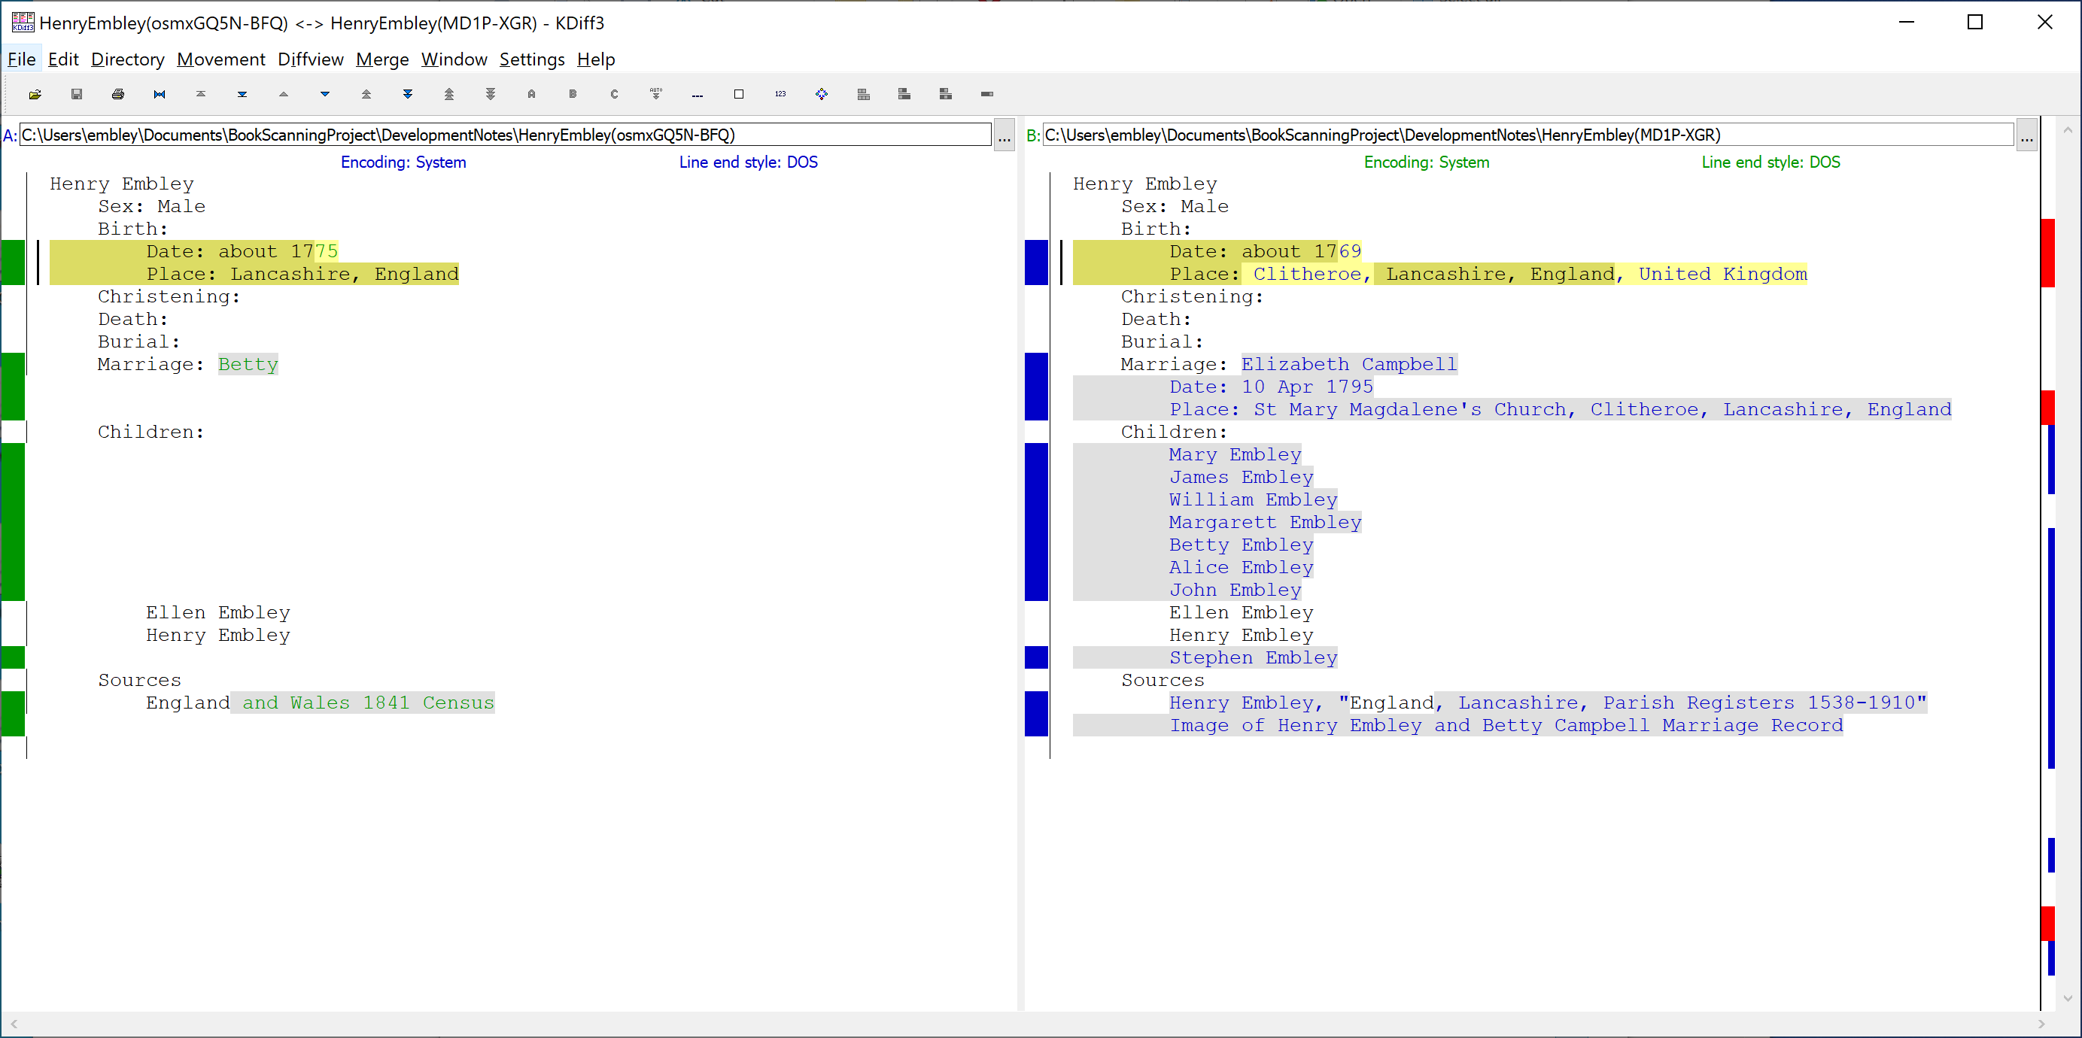
Duplicate Determination Mockup
Estimated dates 6 years apart
being the same has probability 0.5
“Betty” is a common
Nickname for “Elizabeth”
Notes:
Two possible merges on FamilySearch: MD1P-XGR and KLLT-TMK; like our equivalence-class deep checks: check all against all and kick out any that shouldn’t be merged.
Messages can be red (giving a reason to reject a merge, if correct), yellow/orange (warning regarding a merge), and green (reasonable to merge although possibly in conflict). These messages also constitute the basis for providing merge guidance.

Slide 9
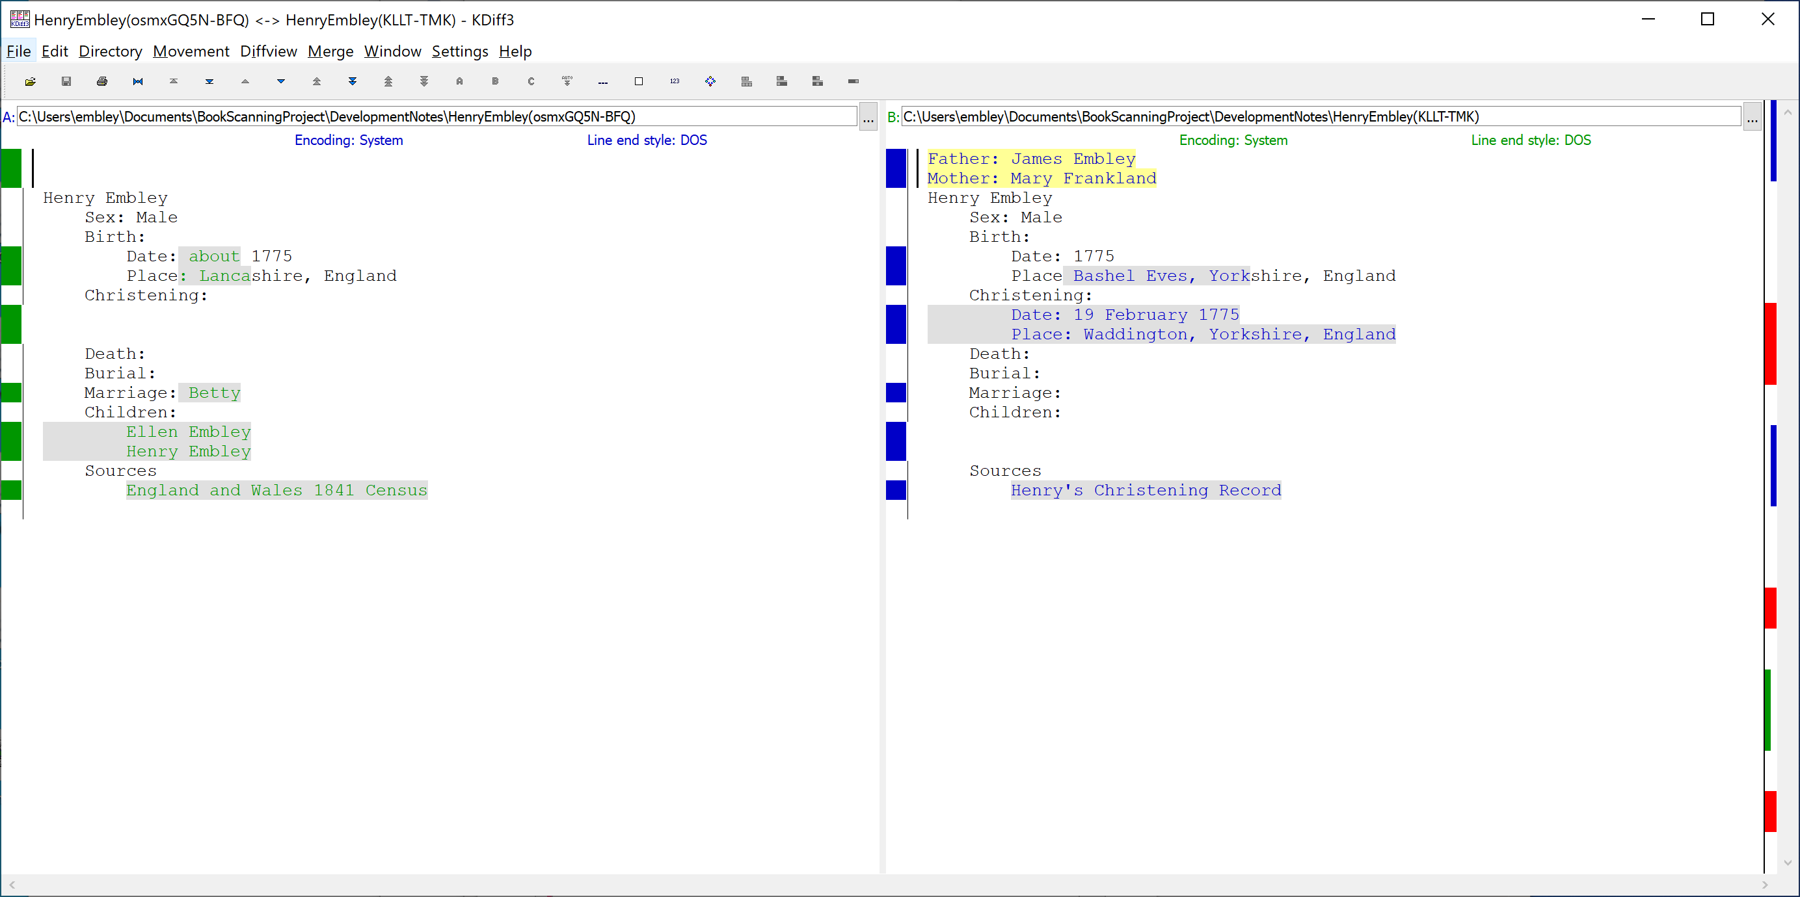
Duplicate Determination Mockup2
Specific dates are usually more reliable than estimated dates
Counties differ but
are adjacent

Slide 10
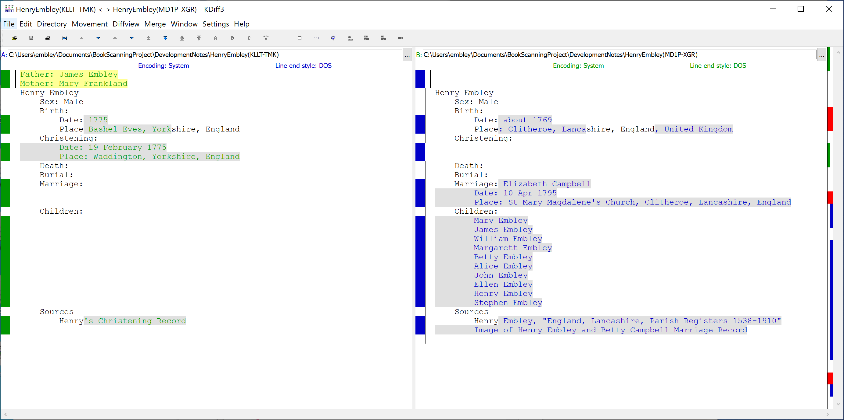
Duplicate Determination Mockup3
Specific dates are usually more reliable than estimated dates
Bashel Eves: 53.8852 N 2.4702 W
Clitheroe: 53.8711 N 2.3931 W
Distance apart: 3 miles
Notes:
Waddington: 53.8887 N 2.4142 W, 2 miles from Bashel Eves and 1 mile from Clitheroe

Slide 11
(Possible) Automatically Generated Merge Guidance Report
Resolve Birth conflicts:
Resolve Date conflict: Using available sources, determine the accuracy of estimated dates. Select the more accurate estimated date.
Resolve Place conflict: Using available sources, verify place names. Select the most specific documented place name.
If selected Date and Place are from different persons, then in the merge interface, choose REPLACE or not, and in either case, edit the Surviving Person’s Birth information post merge.
Eventually, resolve potential wife and children merges:
Do not UNDO.
They are either new, additional information for the Surviving Person, or they are not.
If not, leaving them in place stacks them for later resolution.
If they are duplicates, the system will provide a guide for their resolution.
Notes:
We have enough information to automatically generate a Merge Guidance Report.

Slide 12
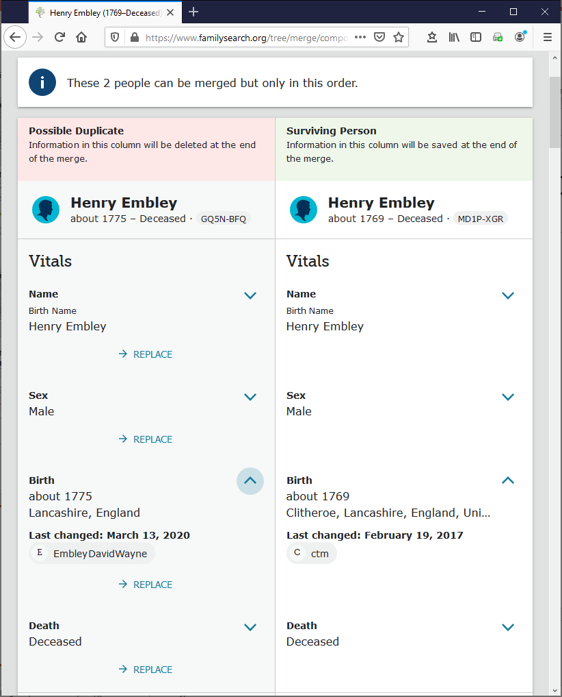
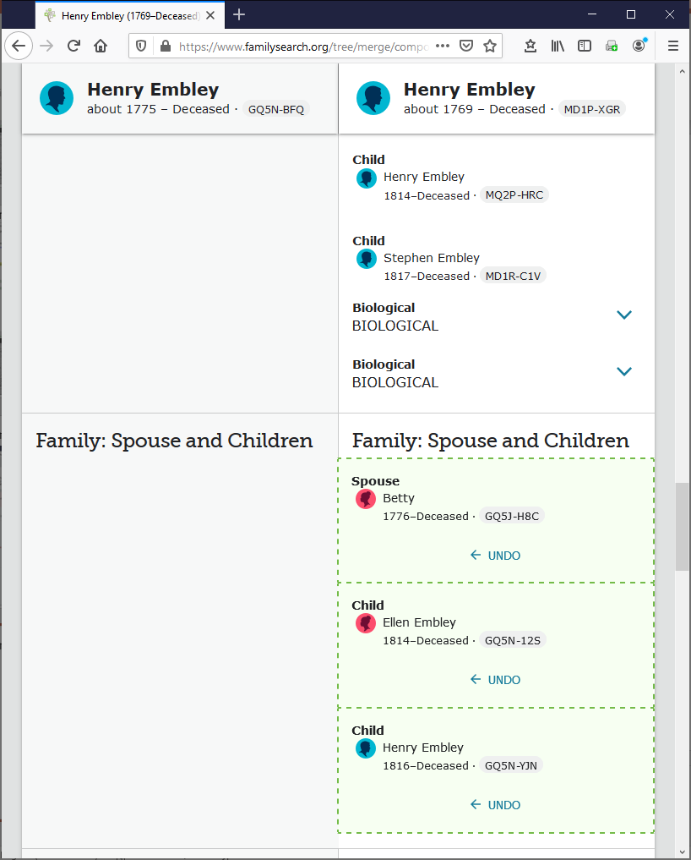
Merge with Merge-Guide Mockup
To do a date-only or place-only merge, edit the Surviving Person after the merge.
Do not UNDO; the system keeps track of potential duplicates and will guide you in their resolution.
Notes:
The merged is left to right (better than the previous right to left), but still has its problems:
* Date and place are bound together (in Birth here, one would like to keep “Clitheroe, Lanc …” and replace “about 1769” with “about 1775” but that doesn’t appear to be possible.
* Family: Spouse and Children begs the user into accepting Betty as another wife, which she is not, and to add Ellen and Henry as additional children of this second spouse; instead, they should be merged.

