Slide 1
Tree Builder
(Scenarios and Scenario Unification)

Slide 2
Workflow Pipeline
1.pages
2.tools
<toolName>
PMCFI: extracted (osmx)
2.1.tool-ontology-extracted
2.2.ontology-extracted
2.3.extracted-text-cleaned
3.json-from-osmx
3.1.ontology-merged
3.2.value-cleaned
3.3.date-value-parsed
3.4.constraint-checked
PMCFI: osmx
4.json-working
PMCFI: json
5.json-final
PMCFI: json & osmx
osmx (from PMCFI)
6.osmx-checked
6.1.ontology-merged
6.2.value-cleaned
6.3.date-value-parsed
6.4.constraint-checked
PMCFI: osmx
7.osmx-enhanced
7.1.target-ontology-generated
7.2.value-standardized (& authority-checked)
7.3.information-inferred
Personas-json
8.gedcomx
8.1.results-generated
8.2.FS-imports-generated (CDS & FamilyTree)
Personas-txt
Personas-pdf
PersonasTreeReady-json
8.3.tree-generated (LLS & FamilyTree)
FamilyTree-gedcomx
MergedPersonas-pdf
MergedPersonas-json
MergedPersonasTreeReady-json
COMET Bypass
COMET Loop
Notes:
The pipeline, [1 2 3 (4 5 6)* 7 8], produces results for FamilySearch with user intervention (for FamilyTree) or without user intervention (for CDS or LLS). It supports four scenarios:
Extraction-tool testing: [1 (2 3 4)+] lets users run extraction tools and observe the results in COMET. The GN-like hints are displayed in COMET; the first page displayed is the one that, in active-learning terms, gives the biggest bang for the buck. (If desired by experimenters and a GroundTruth exists, a PRF (PrecisionRecallFscore) report can be generated; experimenters can also create GroundTruth while in COMET.)
Auto-Indexing: [1 2 3 7 8] is for automatic indexing. If the target is CDS (Canonical Data Store), results in Personas-txt plus documentation in Personas-pdf are sent to CDS. If the target is LLS (Linked Lineage Store), results in FamilyTree-gedcomx plus documentation in MergedPersonas-pdf are sent to LLS.
Scan-to-submit: [1 (2 3)? (4 5 6)+ 7 8] lets a patron P find an ancestor in a document; and with or without extraction-tool help, fill in a form (Individual). Then, using COMET, P can iterate, (4 5 6)+, until the form is filled-out satisfactorily. (In the background, we collect information and begin or update the auto-indexing of the document.) When P is satisfied that the form is filled-out correctly, the results in the Individual form go through 5, 6, and 7 to Personas-json. P then checks and, if necessary, corrects the inferred and standardized information. When P is done, the results in PersonasTreeReady-json are sent to the FamilyTree. (Continuation to the tree and to temple ordinances is beyond the pipeline; the continuation makes use of FamilySearch software for adding to the tree.)
Add-to-tree: [8] lets patrons add merged persona records to the tree. Guided by a family tree FT in FamilyTree-gedcomx, each merged persona in MergedPersonas-json belonging to FT is check and, if necessary, edited to produce a final filled-out tree-ready record in MergedPersonasTreeReady-json. The Gedcomx is correspondingly updated. (Continuation to the tree is by submission of a tree-ready gedcomx from which FamilySearch software semi-automatically adds persons to the tree. Here, semi-automatically means with a human in the loop to resolve merges with current individuals on the tree, as needed.) Alternatively, indeed, primarily, the Gedcomx for individuals in FT is updated if and as MergedPersonas-json are edited. This Gedcomx

Slide 3
Workflow Pipeline
1.pages
2.tools
<toolName>
PMCFI: extracted (osmx)
2.1.tool-ontology-extracted
2.2.ontology-extracted
2.3.extracted-text-cleaned
3.json-from-osmx
3.1.ontology-merged
3.2.value-cleaned
3.3.date-value-parsed
3.4.constraint-checked
PMCFI: osmx
4.json-working
PMCFI: json
5.json-final
PMCFI: json & osmx
osmx (from PMCFI)
6.osmx-checked
6.1.ontology-merged
6.2.value-cleaned
6.3.date-value-parsed
6.4.constraint-checked
PMCFI: osmx
7.osmx-enhanced
7.1.target-ontology-generated
7.2.value-standardized (& authority-checked)
7.3.information-inferred
Personas-json
8.gedcomx
8.1.results-generated
8.2.FS-imports-generated (CDS & FamilyTree)
Personas-txt
Personas-pdf
PersonasTreeReady-json
8.3.tree-generated (LLS & FamilyTree)
MergedPersonas-pdf
MergedPersonas-json
MergedPersonasTreeReady-json
FamilyTree-gedcomx
COMET Bypass
COMET Loop
Notes:
The green arrows denote points of user interaction:
Fix OCR errors
Develop templates
COMET – fix extraction errors
COMET – check and, if necessary, edit persona records
COMET – check and, if necessary, edit merged persona records
In conjunction with FamilySearch, add generated trees to the FamilyTree

Slide 4
Document Preprocessing
Clean-up Scan – Deryle’s script
Clean-up OCR – benefits (template reduction, enhanced search)
OCR-engine suggestions
Missing record heads (person names) and missing search phrases
COMET check
Interaction with PDFindexer
Iterative rerun after OCR-error corrections
COMET updates
Must(?) postpone “final” COMET updates until no more desired reruns
Update even when no more desired reruns

Slide 5


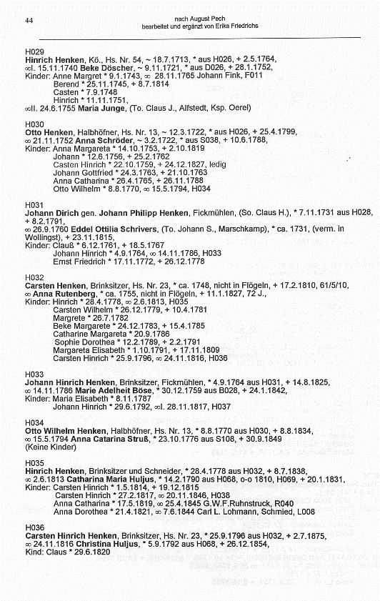
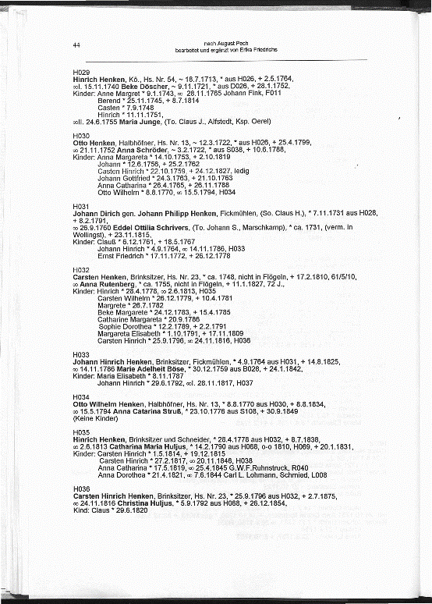
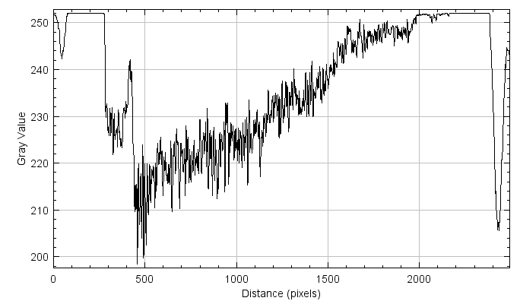
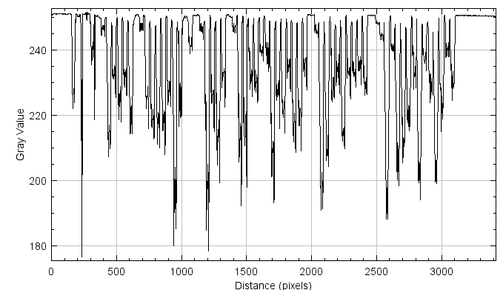
Perl scripts
plot profiles
find margins
crop image

Slide 6



Perl scripts
generate PNG
convert to PNG
consolidate to PDF
split pages
plot profiles
find margins
crop image

Slide 7
Caveats
Seems like unpaper has issues with color images.
Occasional memory/heap error on Win/Cygwin can result in bad margins.
Processing is calibrated for less-than-high density pages.
Can probably script away the IrfanView GUI step post-unpaper.
Most scripting is in Perl.

Slide 8
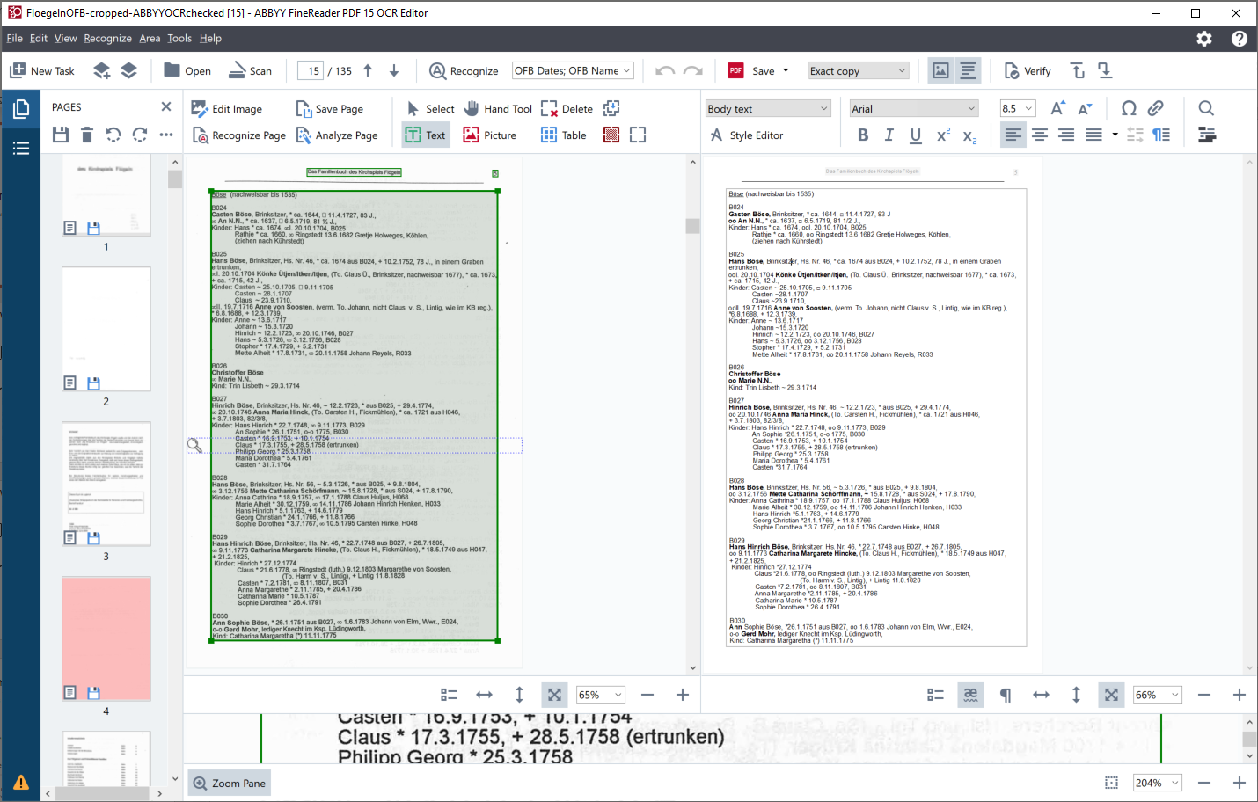
OCR Error Correction
Notes:
The PDF indexer space between “Cl” and “aus” disappeared with the Abby OCR.

Slide 9
Steps to OCR Flögeln Book in ABBYY
Set the Language to German, select OFB User Dictionaries
Set Image Resolution to 700 dpi for all pages
Recognize All Pages
OCR areas missed a couple of Reference IDs. They were adjusted and re-OCRd.
Find/Replace
% ½
„ ., There are a few legitimate „ at the beginning of quotes, so look at each one
‘ *
- ~ There are some legitimate dashes in the book, so after Find/Replace do:
/~ /-
o~o o-o
lls(a,e) Ils(a,e) lowercase l looks like uppercase I
oo1 ool 1 (one) should be l (lowercase L)
ooI(II) ool(ll) These should be lowercase L
col ool There are several legitimate col as in Nicolas, so do this carefully or not at all.
52A/27 52/-/27
rnögl mögl
vernn. verm.
Brn. Bm.
000(1,..,9) O00(1,..,9) Reference IDs for names that start with uppercase O
Search for missing periods in dates – between month-year, search for (0,..,9)(space)1; between day-month, search for (0,..,9)(space) (2,..,9) – search for (0,..,9)(space) 1 was already done in first step
A few of the □ and * symbols that were against the left-hand margin didn’t get exported in the PDF. Add an extra space to move those symbols away from the margin. (R005, R007, S119, S121)
S087 was incorrectly OCRd because the text lines weren’t straight. OCR region was straightened and re-OCRd.

Slide 10
Typos and Author errors in the Flögeln book
Should these be fixed in the book during OCR error correction?
PDF page | Ref. ID | Line | Error | Comment
Missing Delimiters, Extra Delimiters
13 | B010 | 2 | Missing oo in front of 16.11.1860
22 | B076 | 5 | Missing oo in front of 7.11.1862
110 | W024 | 3 | Missing oo; it says aufgeb. 1862
110 | W024 | 7 | Missing oo; it says aufgeb. Okt. 1869
113 | W048 | 9 | Missing oo; it says aufgeb. 1864
114 | W057 | 1 | Missing oo; it says aufgeb. 1853
67 | L016 | 6 | Missing * before 9.3.1885
83 | R019 | 3 | Missing * before 7.3.1811
91 | S040 | 10 | Missing + before 4.6.1743
93 | S054 | 5 | Missing * before 3.9.1772
101 | S111 | 3 | Missing * before 1.1.1785
34 | D062 | 2 | There are 2 birth symbols Gesche Windpen, * 23.2.1734, * aus W070, | This is OK, but unusual
Typos, punctuation
13 | B012 | 4 | Date is 1.1.8.1897. Should be 11.8.1897 ? | FamilySearch, LTK6-VQ6, has 1 Aug 1897
113 | W049 | 4 | Two dots in the date - 13..9.1827
118 | W082 | 2 | Date has an error 9.3.18145 | FamilySearch, GSS2-XN3, has 9 Mar 1846 – With this book as a source (it was changed from 1814)
46 | F018 | 1 | , , There are 2 commas with a space between them.
90 | S109 | 1 | Sengstaken,. Instead of .,
116 | W068 | 1 | missing . after ca
119 | W088 | 4 | missing . after ca
37 | D078 | 3 | Missing : after Kinder
52 | H019 | 4 | Kinder bis 1900: All other instances are Kinder (bis1900):
Extra spaces
38 | D088 | 3 | Extra space in B 308 | I removed the space during OCR correction
47 | G002 | 4 | Extra space in oo ll. | I removed the space during OCR correction
119 | W093 | 4 | Extra space in oo ll. | I removed the space during OCR correction
58 | H059 | 4 | sie + 28.11.1783. | Wife's date is not in the usual place. It was added at the end.
Misspelled words
67 | L009 | 6 | Stove, Vermont
71 | M021 | 9 | Jacksonville, Staat Florida, USA
99 | S102 | 5 | Johannn

Slide 11
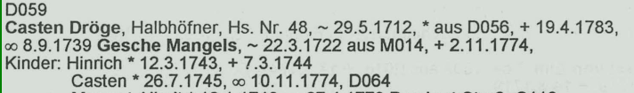
Will adding Missing delimiters cause misalignment of PDF view in COMET?
B010
Gerdt Hinrich Bensen, Gastwirt, Hs. Nr. 1, *29.11.1832 aus B009, + 6.5.1906,
oo 16.11.1860 Adelheid Heins, * 5.2.1837 aus H014,
Some of the spacing was changed during OCR
D059
Casten Dröge, Halbhöfner, Hs. Nr. 48, ~ 29.5.1712, * aus D056, + 19.4.1783,
oo 8.9.1739 Gesche Mangels, ~ 22.3.1722 aus M014, + 2.11.1774,
Kinder: Hinrich * 12.3.1743, + 7.3.1744
Casten *26.7.1745, oo 10.11.1774, D064

Slide 12
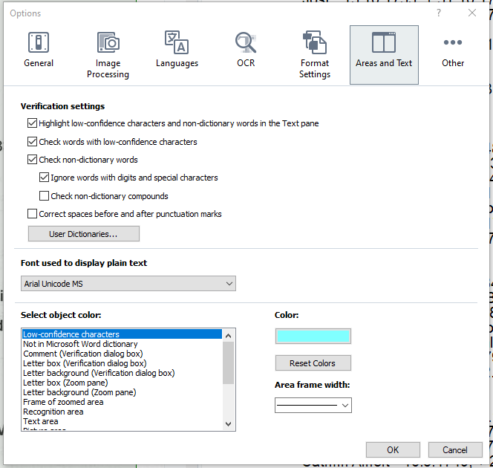
During OCR, there’s an ABBYY option to “Correct spaces before and after punctuation marks”, (and others)
I used the defaults, but some of these options may help?

Slide 13
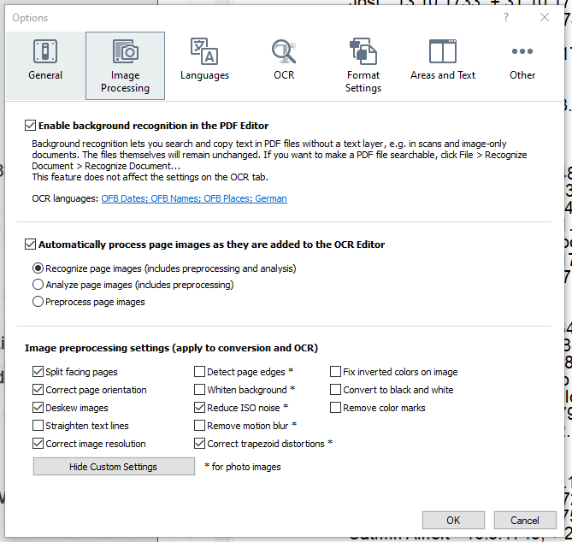
ABBYY Image Processing Options Before OCR
I used the defaults, but some of these options may help?
I did “Straighten Text Lines” in 1 OCR area.
There are options to: Split Facing Pages
Detect Page Edges
Do these duplicate Deryl’s cropping process?

Slide 14
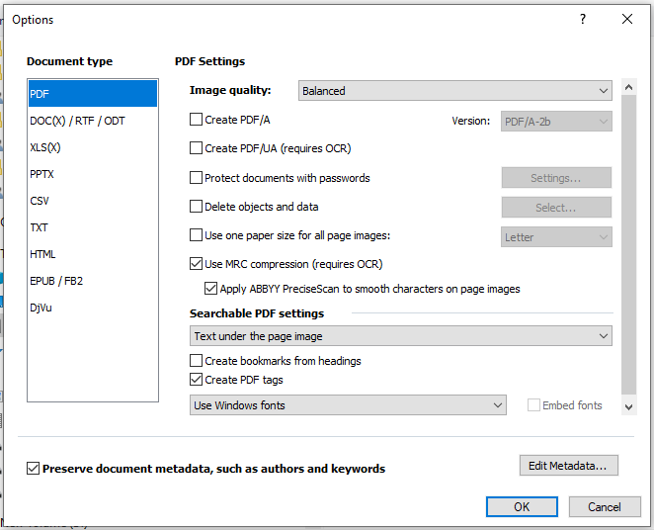
Output PDF Formats from ABBYY Does the choice affect the PDF Display in COMET?
File>Save As>Searchable PDF Document
Options
Input File Size of FloegelnOFB-cropped: 44,214 KB
Output File Size from ABBYY:
With No Compression: 46,980 KB
With MRC Compression: 5,579 KB
With ABBYY PreciseScan: 6,307 KB

Slide 15
Document Semi-Structured Requirement
Fundamental consideration for determining whether a document can be processed by our pipeline: For record-head persons, all data of interest for that person (1) must follow the head person’s name and appear before the next head person’s name; (2) must not include data not belonging to the head person; and (3) only one-hop relationships.
H059
Henrich Holweg, Bm., Hs. Nr. 9, * ca. 1675 aus H058, + 16.12.1728, 53 J.,
oo 10.10.1702 An Rademacher, (To. Hans R., Fickmühlen), * ca. 1681, + 25.5.1741,60 J.,
Kinder: Engel ~ 25.10.1703, oo Ringstedt (luth.) 21.10.1727 Johann Holwegs, Alfstedt, * ca. 1693,
+ Alfstedt 2.11.1776, sie + 28.11.1783
Carsten ~ 30.10.1706, oo 5.7.1735, H063
Fabian ~ 24.11.1709, + 21.5.1741
Harm ~ 7.4.1713, □ 12.7.1713
An Catrin ~ 10.8.1714, oo 24.10.1737 Johann Struß, S100
Hinrich ~28.1.1718, + 14.5.1741
Margret ~8.12.1722
ALBRIGHT, ESTHER R. d 1 Jan 1946 113 Sherman St Dayton OH BD Abbottsville Cem
Dke Co OH 3 Jan 1946 b 22 July 1863 Butler Co OH age 82-6-9 f THOMAS
BENTON MORRIS Butler Co OH m ANGELINE HARROD Hamilton Co OH housekeeper
widow sp WINFIELD S. ALBRIGHT 1 daughter Mrs HENRY RANCH 4 sons HENDER-
SON of Greenville WILBUR of Greenville GEO of Dayton ELBERT of Dayton
12 grandchildren 2 brothers ARTHUR MORRIS Venice OH & SAM MORRIS Harrison
OH 2 sisters Miss ELLA MORRIS Greenvi lle OH & Mrs ADA HARP Tulsa OK
Notes:
Record Head Persons: household members for Flögeln, Ely, Kilbarchan, …; person who died for Miller, …
Violation of 1 & 2 discovered by Jim while doing OCR correction and by a missing-heads run. Violation of 3 encountered by George, who added EXTRA for templates (named for extra persons beyond one-hop relationships. Both points should be understood by our indexers.
Do not generate templates to pick up data in violation of this fundamental consideration.

Slide 16
Guidelines for OCR Error Correction
Set up
Set the Language to German, select OFB User Dictionaries
Set Image Resolution to 700 dpi for all pages
Straighten text lines (applied to all pages)
Recognize All Pages
Correct OCR errors
Sometimes it’s best to accept the OCR error (e.g. ooI, with a lowercase “L”)
Sometimes it’s best to make replace-all changes and then correct the few that were already correct (e.g. change – to ~ and then change o~o back to o-o)
Replacing one symbol by two (a miss-OCRd German open quote by .,) or two symbols by one (“rn” by “m”)
Small symbols such as a period may be missed and can be added (e.g. “21.2.1800”).
?? Sometimes left-margin symbols are dropped in exporting to PDF; inserting a space in front rectifies this problem.
Do not correct typesetting and author errors

Slide 17
PDF Indexer Issues

Slide 18
PDFIndexer Errors in PersonOutput
page 26 line 9 first SeqNo 13947
"SOL C007Martin Hinrich Conradi , K
C007
Martin Hinrich Conradi, Kgl. dänischer Amtsverwalter im Land Wührden, oo 6.10.1730 Margaretha
Felicia von Budden, (To. Kgl. schwedischen Capitains v. B., in
Pommern)
page 29 line 43 first SeqNo 17322
"SOL ooll . 9 . 5 . 1702 Hellwig Ellerhorstgeb . N . N . ,
_{C007}
ooll. 9.5.1702 Hellwig Ellerhorst geb. N.N., (Wwe. aus E015), *ca. 1652, □ 13.11.1719, 67 J.
page 113 line 59 first SeqNo 94600
"SOL oo 10 . 12 . 1819 Anna Margareta Rademachergeb . Dröge ,
W050
Matthias Wilkens, Halbhöfner, Interimswirt, Hs. Nr. 8, * 22.8.1794 aus W046, + 4.8.1857,
oo 10.12.1819 Anna Margareta Rademacher geb. Dröge, (Wwe. aus R016), *20.1.1792 aus D064, + 30.1.1868,

Slide 19
PDF Indexer Errors in ChildOfOutput
Reference ID wasn’t extracted because of missing space after aus
D070
ooll. 3.11.1815 Anna Margareta Struß, * 27.10.1791 aus S112, + 14.7.1856,
_{D072}
Claus Dröge, Halbhöfner, Hs. Nr. 35, * 30.10.1785 aus D066, + 3.7.1857,
oo 1.6.1813 Anna Catharina Sengstaken, * 10.3.1790 aus S054,
_{R011}
ooll. 24.11.1797 Anna Maria Teute, * 18.5.1760 aus T002, ooll. 4.2.1802 Joachim Mohrmann, Hb.,
_{Marschkamp, Wwr.}
_{S056}
oo 24.5.1811 Ilsabe/Ilsabeth Cordes, *24.7.1791 aus C008, + 19.5.1828,
S066
Claus Sengstaken, Halbhöfner, Hs. Nr. 10, * 20.10.1851 aus S061,
_{S095}
Albert Struß, Halbhöfner, Hs. Nr. 57, * ca. 1672 aus S092, + 12.12.1739, 67 J., oo 4.10.1701 Margret Schröder, * ca. 1682 aus S037, + 1.11.1750, 68 J.

Slide 20
PDF Indexer Errors in ChildOfOutput (Cont’d)
Reference ID wasn’t extracted because of missing space after aus (Cont’d)
_{S106}
Harm Struß, Kö., Hs. Nr. 22, * 20.11.1751 aus S101,
_{S118}
Claus Hinrich Struß, Großkö., Hs. Nr. 26, * 15.11.1797 aus S107, + 11.5.1875,
_{S121}
Johann Struß, Anbauer und Fischer, Hs. Nr. 65, *7.1.1803 aus S113, □21.3.1878,
_{W043}
Anna Margareta Wilkens, *5.9.1754 aus W038, oo 22.11.1781 Harm Jacob Butt, Wwr., B093,
o-o Borchert Struß, *25.1.1751 aus S100,
_{W076}
Claus Winpen, Halbhöfner, Hs. Nr. 3, * 31.5.1770 aus W074, + 5.12.1849,
oo 30.11.1797 Margareta Struß, *31.12.1778 aus S107, + 17.2.1852,

Slide 21
PDF Indexer Errors in Marriage-Head-Spouse
None that have not already been noted

Slide 22
PDF Indexer Errors in Marriage-Child-Spouse
Marriage Date wasn’t extracted because of missing space after oo
H073 Johannes * 17.11.1853, oo 9.11.1877, H075
_{L009}
Kinder: Anna Dorothea *21.12.1870, oo 21.5.1895 Klaus Hinrich von Deßen, D019
_{M004}
Kinder: Heinrich *27.12.1833, oo 21.11.1862, M005
_{S009}
Kinder: Albert *ca. 1678, oo 4.11.1710, S012
_{S058}
Kinder: Margaretha Catharina * 10.8.1831, oo 22.11.1855 Peter Hinr. v. Deßen, D016

Slide 23
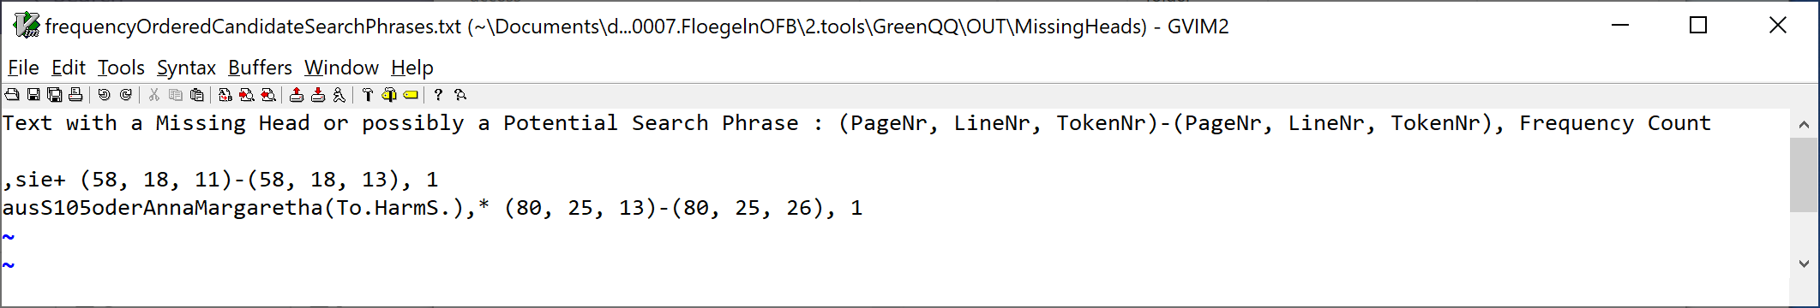
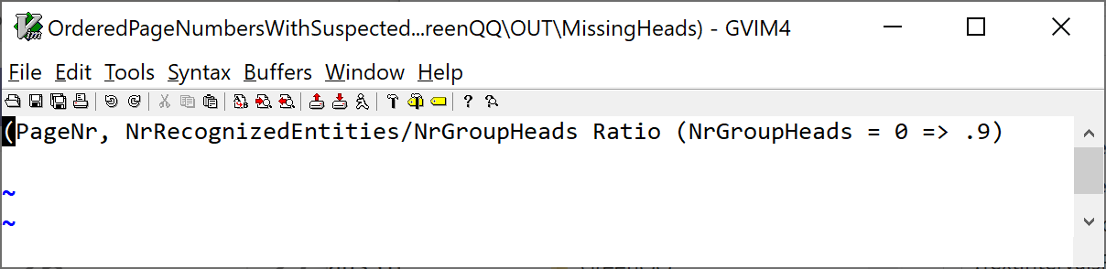
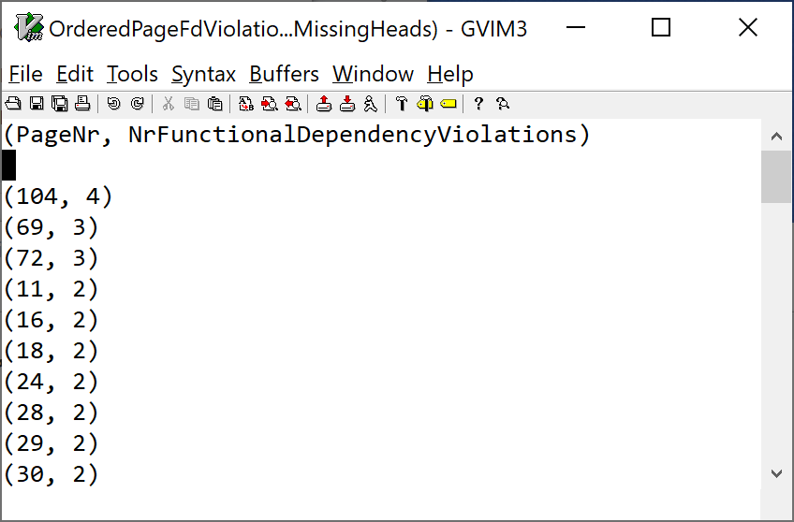
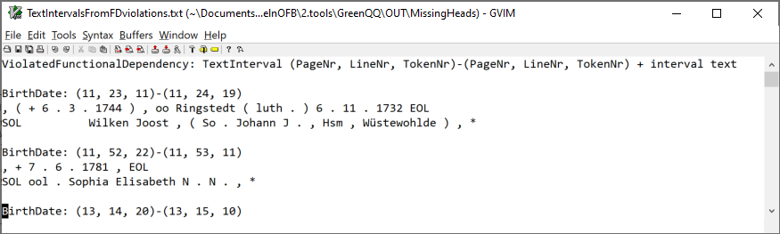
Developing GreenQQ Templates

Slide 24
BirthDate: (69, 48, 9)-(69, 49, 6)
, oo 28 . 6 . 1707 , M013 EOL
SOL verm . An *
BirthDate: (69, 50, 8)-(69, 51, 6)
, oo ca . 1705 , M012 EOL
SOL verm . Hinrich *
page 69 line 49 first SeqNo 54165
"SOL verm . An * ca . 1677 , oo 14 . 10 . 1704 Jacob Dröge , D057 EOL"
SOL NONE NONE NONE NONE NONE BirthDate BirthDate BirthDate NONE NONE NONE NONE NONE NONE NONE NONE NONE NONE NONE EOL
"SOL verm . An * T41 T41 T41 , oo 14 . 10 . 1704 Jacob Dröge , D057 EOL"
page 69 line 50 first SeqNo 54186
"SOL Johann * ca . 1683 , oo ca . 1705 , M012 EOL"
SOL NONE Name NONE BirthDate BirthDate BirthDate NONE NONE NONE NONE NONE NONE NONE EOL
"SOL T36 * T41 T41 T41 , oo ca . 1705 , M012 EOL"
page 69 line 51 first SeqNo 54201
"SOL verm . Hinrich * ca . 1686 , oo 6 . 7 . 1710 , M014 EOL"
SOL NONE NONE NONE NONE NONE BirthDate BirthDate BirthDate NONE NONE NONE NONE NONE NONE NONE NONE NONE EOL
"SOL verm . Hinrich * T41 T41 T41 , oo 6 . 7 . 1710 , M014 EOL"
Notes:
Add to template file if expected

Slide 25
ChristeningDate: (103, 70, 11)-(104, 6, 22)
, + 2 . 3 . 1736 EOL
SOL 94 nach August Pech EOL
SOL bearbeitet und ergänzt von Erika Friedrichs EOL
SOL EOL
SOL EOL
SOL S133 EOL
SOL Gerdt / Goerdt Julius Stürke / Stürken , Fickmühlen , ( So . Johann S . , Fickmühlen ) , ~
page 104 line 6 first SeqNo 85816
"SOL Gerdt / Goerdt Julius Stürke / Stürken , Fickmühlen , ( So . Johann S . , Fickmühlen ) , ~ 4 . 3 . 1712 , EOL"
SOL NONE NONE NONE NONE NONE NONE NONE NONE NONE NONE NONE NONE NONE NONE NONE NONE NONE NONE NONE NONE NONE ChristeningDate ChristeningDate ChristeningDate ChristeningDate ChristeningDate NONE EOL
"SOL Gerdt / Goerdt Julius Stürke / Stürken , Fickmühlen , ( So . Johann S . , Fickmühlen ) , ~ T43 T43 T43 T43 T43 , EOL"
Notes:
… when to include slashes and when not to include slashes?

Slide 26
BirthDate: (98, 46, 8)-(98, 49, 20)
, oo 24 . 10 . 1713 Johann Schröder , S038 EOL
SOL EOL
SOL S093 EOL
SOL Marten (  der ältere  ) Struß , Kö . , Hs . Nr . 62 , *
page 98 line 46 first SeqNo 79998
"SOL Gesche * ca . 1690 , oo 24 . 10 . 1713 Johann Schröder , S038 EOL"
SOL NONE Name NONE BirthDate BirthDate BirthDate NONE NONE NONE NONE NONE NONE NONE NONE NONE NONE NONE EOL
"SOL T36 * T41 T41 T41 , oo 24 . 10 . 1713 Johann Schröder , S038 EOL"
page 98 line 47 first SeqNo 80017
SOL EOL
SOL EOL
SOL EOL
page 98 line 48 first SeqNo 80019
SOL S093 EOL
SOL NONE EOL
SOL S093 EOL
page 98 line 49 first SeqNo 80022
"SOL Marten ( „ der ältere “ ) Struß , Kö . , Hs . Nr . 62 , * ca . 1671 , + 22 . 5 . 1741 , 70 J . , EOL"
SOL NONE NONE NONE NONE NONE NONE NONE NONE NONE NONE NONE NONE NONE NONE NONE NONE NONE NONE NONE BirthDate BirthDate BirthDate NONE NONE DeathDate DeathDate DeathDate DeathDate DeathDate NONE NONE NONE NONE NONE EOL
"SOL Marten ( „ der ältere “ ) Struß , Kö . , Hs . Nr . 62 , * T41 T41 T41 , + T44 T44 T44 T44 T44 , 70 J . , EOL"

Slide 27
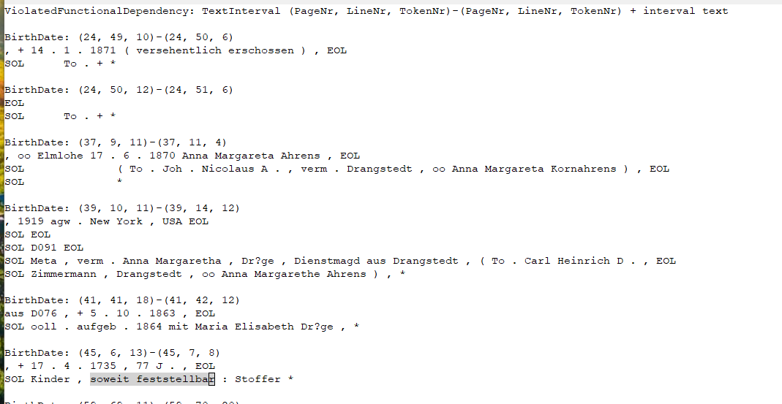
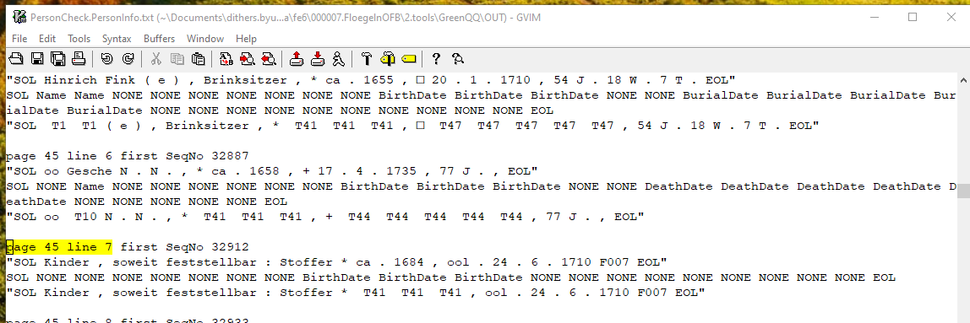
One-of-a kind format is not added to template

Slide 28
Problem: the GenderDesignator in “To. Harm v. S.” belongs to Margarethe von Soosten, Claus’s spouse, not to Claus. This pattern violates our semi-structuredness invariant constraint and suggests that we had better not pick up GenderDesignators at all.

Slide 29
Page 33: “Martin Gottfried * 24.3.1732, + 12.15.1740” : yellow-? message: Unrecognizable date or date with a missing or unrecognizable year.
Page 55: “Margaretha Elisabeth * 26.7.1849, oo 10.10.1873 Christoph Henken, Wwr., H039” : Extracted GenderDesignator “Wwr.” for Margaretha
Johann Hinrich Mohrmann, Kö., * 4.5.1867 aus M067,
oo 6.11.1891 Anna Margareta Katharina Reiß, * 23.4.1869 aus R027,
Kinder: Johann Hinrich (*) 25.5.1890, führt mit amtl. Genehmigung vom 31.10.1892 den
Namen Mohrmann
Notes:
führt mit amtl. Genehmigung vom 31.10.1892 Den Namen Mohrmann = took with official approval the name Mohrmann as of 31.10.1892

Slide 30
Name,18,8,2,2,Hinrich,Brandt
Name,18,9,2,2,Adelheid,Jungen,MarriageEventDate,18,10,3,5,22,.,4,.,1814,SpouseName,18,10,8,3,Anna,Rebecca,Fink
Resolution: for HouseholdId books, always extend the left context for household heads to include the ReferenceID.
Name,18,8,2,2,Hinrich,Brandt,MarriageEventDate,18,10,3,5,22,.,4,.,1814,SpouseName,18,10,8,3,Anna,Rebecca,Fink,EXTRA,18,14,2,1,B047
Notes:
Head template problems circled in red. Resolve by including ReferenceID in the left context of the head spouse.
Also, BTW, we added EXTRA to prevent run-away spouse lists.

Slide 31
Notes:
Resolution: right context – extend as little as possible but to at least the first token that doesn’t belong to the class.

Slide 32
Notes:
Resolution: right context – extend as little as possible but to at least the first token that doesn’t belong to the class.

Slide 33
Automatic Generation of Name Templates
Full Name Base Set Examples (cross product of Given Names with Surnames):
Casten Meier
Casten von Dehsen
Casten von der Desen
Casten tor Horst
Sophie Marie Meier
Sophie Marie von Dehsen
Sophie Marie von der Desen
Sophie Marie tor Horst
Anne Margarete Trin Meier
Anne Margarete Trin von Dehsen
Anne Margarete Trin von der Desen
Anne Margarete Trin tor Horst
Ernst Georg Karl Wilhelm Meier
Ernst Georg Karl Wilhelm von Dehsen
Ernst Georg Karl Wilhelm von der Desen
Ernst Georg Karl Wilhelm tor Horst
Given Name Base Set Examples:
Casten
Sophie Marie
Anne Margarete Trin
Ernst Georg Karl Wilhelm
Surname Base Set Examples:
Meier
von Dehsen
von der Desen
tor Horst
…
Notes:
Automatic generation of templates is a needed extension to version 1 of GN’s GreenQQ template processor. One click (COMET annotation) is all that’s required to generate all the Name templates. A bunch are required for the SpouseName templates, one for each variation of <Marriage Symbol> MarriageEventPlace? MarriageEventDate? SpouseName.

Slide 34
Notes:
Three template variations for Child; thus, three clicks (COMET annotations) are required.

Slide 35
Issues found in PersonOutput
Birth, Death information for Spouse of child is used for Child
There are > 37 of instances of this.
A002
From PersonOutputRecords
Name,11,23,5,2,Anna,Catharina,BirthDate,11,23,8,3,ca,.,1700,DeathDate,11,23,14,5,6,.,3,.,1744,BirthDate,11,24,20,3,ca,.,1695,DeathDate,11,24,25,5,5,.,3,.,1752
_{From the Book}
verm. Anna Catharina * ca. 1700, (+6.3.1744), oo Ringstedt (luth.) 6.11.1732
Wilken Joost, (So. Johann J., Hsm, Wüstewohlde), * ca. 1695, + 5.3.1752
B043
Name,17,46,3,2,Sophie,Margaretha,BirthDate,17,46,6,5,4,.,11,.,1841,BirthPlace,17,47,18,1,Bederkesa,BirthDate,17,47,19,5,12,.,8,.,1835
Sophie Margaretha * 4.11.1841, aufgeb. 1867 mit Johann Heinrich Munter, gen. Oest, (ill. So. Anna Elisabeth M.), (*) Bederkesa 12.8.1835

Slide 36
Issues solved by the addition of new-person markers (CHILD, SPOUSE, PARENT), along with removing parenthetical remarks.
A002
Johann Ahrens, Brinksitzer, Hs. Nr. 1, * ca. 1669, + 3.4.1729, 60 J.,
oo Gretje N.N., * ca. 1667, + 18.5.1741,73 1/2 J.,
Kinder: Gesche ~ 12.5.1701, oo 21.11.1730 Johann von Soosten, S075
Johann ~ 30.12.1705, □ 8.12.1706
verm. Anna Catharina * ca. 1700, (+6.3.1744), oo Ringstedt (luth.) 6.11.1732
Wilken Joost, (So. Johann J., Hsm, Wüstewohlde), * ca. 1695, + 5.3.1752
Name,11,23,5,2,Anna,Catharina,BirthDate,11,23,8,3,ca,.,1700,LPAREN,11,23,12,1,(,DeathDate,11,23,14,5,6,.,3,.,1744,RPAREN,11,23,19,1,),LPAREN,11,23,23,1,(,RPAREN,11,23,26,1,),SPOUSE,11,24,4,2,Wilken,Joost,LPAREN,11,24,7,1,(,RPAREN,11,24,17,1,),BirthDate,11,24,20,3,ca,.,1695,DeathDate,11,24,25,5,5,.,3,.,1752
B043
Peter Hinrich Borwege, Schuster und Anbauer, Hs. Nr. 45, (So. Johann Hinrich B., Gerichtsbote,
Altenbruch), * ca. 1807, + 3.4.1899, 92/3/28,
oo 23.1.1831 Maria Catharina Margaretha Itjen, (To. Hans Christopher I., Neuenwalde),
* Neuenwalde 22.11.1799, + 13.8.1855,
Kinder: Johann Hinrich (*) Neuenwalde 2.11.1830, + Neuenwalde 30.11.1830
Catharina Elisabeth * 22.11.1831, + 20.4.1834
Anna Maria *21.8.1834, oo 30.5.1862 Johann Hinrich Friederich Voß, V007
Charlotte Elisabeth * 2.1.1837, + 9.9.1838
Sophie Margaretha * 4.11.1841, aufgeb. 1867 mit Johann Heinrich Munter, gen. Oest,
(ill. So. Anna Elisabeth M.), (*) Bederkesa 12.8.1835
Name,17,46,3,2,Sophie,Margaretha,BirthDate,17,46,6,5,4,.,11,.,1841,SPOUSE,17,46,16,3,Johann,Heinrich,Munter,LPAREN,17,47,4,1,(,RPAREN,17,47,13,1,),LPAREN,17,47,15,1,(,RPAREN,17,47,17,1,),BirthPlace,17,47,18,1,Bederkesa,BirthDate,17,47,19,5,12,.,8,.,1835,LPAREN,17,50,3,1,(,RPAREN,17,50,6,1,)
Notes:
When a non-primary person is introduced in the record area of a primary person and has birth and death information, we can add a new-person marker (one of CHILD, SPOUSE, PARENT) to tell the record post-processor to ignore birth and death information beyond the marker.
Note that in the Anna Catharina record, the DeathDate is properly extracted but then thrown away because we discard parenthetical remarks for Person. (Unfortunate: why did the author put it in parens?)

Slide 37
B049
Johann Hinrich Bröckelmann, Mietsmann, Fickmühlen, vorher Neuenwalde,
oo Neuenwalde 19.4.1885 (Nw B112) Marie Rebecka Catherina Schlichting, (ill. To. Elisabeth
Sch., Hymendorf, o-o N.N., Kind: Carl August (*) 13.2.1881, s. Nw S016),
Kinder: Anna Dorothea Gesina * Nw 13.2.1886
Becke Catharine + 18.2.1889,1/4/7
Greta Dorothea Maria * 31.1.1890
Heinrich Friedrich August * Nw 21.6.1904
Name,18,33,13,4,Marie,Rebecka,Catherina,Schlichting,LPAREN,18,33,18,1,(
Name,18,34,17,2,Carl,August,LPAREN,18,34,19,1,(,RPAREN,18,34,21,1,),BirthDate,18,34,22,5,13,.,2,.,1881,RPAREN,18,34,31,1,)
B074
Otto Brokmann, englischer Soldat, später Pensionär und Häusler, * 27.5.1787 aus B065,
+ 7.1.1857,
oo 27.6.1830 Catharina Sophia Dorothea Magdalena Titan , (To. Luis Niclaus T., gewes.
französ. Soldat), * ca. 1802, □ 10.1.1878, 75/9/-,
Kinder: Johann Diederich *21.3.1831, + 23.3.1832
Anna Margaretha * 14.7.1832, oo 26.5.1859 Hinrich Jürgen Stüben, S128
Peter Wilhelm Ludewig * 7.10.1835
Helene Maria * 16.5.1841, oo Ringstedt 18.12.1863 Claus Glandorf, Hainmühlen,
(So. Hinr. G. oo Adelheit Rademaker), * Estorf, Gem. Oldendorf, 29.8.1829
Hinrich Otto *2.9.1844
Name,21,63,8,5,Catharina,Sophia,Dorothea,Magdalena,Titan,LPAREN,21,63,14,1,(,RPAREN,21,64,5,1,),BirthDate,21,64,8,3,ca,.,1802,BurialDate,21,64,13,5,10,.,1,.,1878
Name,21,68,3,2,Helene,Maria,BirthDate,21,68,6,5,16,.,5,.,1841,SPOUSE,21,68,19,2,Claus,Glandorf,LPAREN,21,69,4,1,(,RPAREN,21,69,14,1,),BirthPlace,21,69,17,1,Estorf,BirthDate,21,69,23,5,29,.,8,.,1829
Notes:
Note that both the Marie Rebecka Catherina Schlichting record and the Carl August record are discarded -- Marie because she has no birth or death info and Carl because he is not a primary person.

Slide 38
B076
Carl Hinrich Brokmann, Halbhöfner, Hs. Nr. 16, * 9.1.1802 aus B069, + 23.4.1868,
oo 30.10.1835 Anne Margarethe Döscher, (To. Johann Hinrich D., Frelsdorf), * ca. 1801, ,
□ 12.5.1884, 73/-/12,
Kinder: Anna Catherina * 5.7.1836, oo 15.7.1859 Johann Hinrich Meyer, Wwr., M055
Johann Hinrich *26.11.1837, 7.11.1862, B079
Anna Margareta * 19.9.1839, + 10.5.1856
Martin * 26.1.1842, oo Ringstedt luth. 23.11.1869 Gesche Katharina Schröder,
(To. Johann S., Schmied, Alfstedt, Ksp. Ringstedt, oo Dorothea Margareta
von der Lieth), * Alfstedt 7.10.1847
(Als künftiger Wohnort wird Alfstedt angegeben.)
Gesche * 10.3.1844, oo 14.11.1873 Hermann Steffens, S086
Anna *6.11.1851
Name,22,18,8,3,Anne,Margarethe,Döscher,LPAREN,22,18,12,1,(,RPAREN,22,18,21,1,),BirthDate,22,18,24,3,ca,.,1801,BurialDate,22,19,3,5,12,.,5,.,1884
Name,22,23,3,1,Martin,BirthDate,22,23,5,5,26,.,1,.,1842,SPOUSE,22,23,20,3,Gesche,Katharina,Schröder,LPAREN,22,24,4,1,(,RPAREN,22,25,7,1,),BirthPlace,22,25,10,1,Alfstedt,BirthDate,22,25,11,5,7,.,10,.,1847,LPAREN,22,26,4,1,(,RPAREN,22,26,12,1,)

Slide 39
Adding new-person markers, along with NOT removing parenthetical remarks allows ChildOf to work.
A002
Johann Ahrens, Brinksitzer, Hs. Nr. 1, * ca. 1669, + 3.4.1729, 60 J.,
oo Gretje N.N., * ca. 1667, + 18.5.1741,73 1/2 J.,
Kinder: Gesche ~ 12.5.1701, oo 21.11.1730 Johann von Soosten, S075
Johann ~ 30.12.1705, □ 8.12.1706
verm. Anna Catharina * ca. 1700, (+6.3.1744), oo Ringstedt (luth.) 6.11.1732
Wilken Joost, (So. Johann J., Hsm, Wüstewohlde), * ca. 1695, + 5.3.1752
Child,11,23,5,2,Anna,Catharina,LPAREN,11,23,12,1,(,RPAREN,11,23,19,1,),LPAREN,11,23,23,1,(,RPAREN,11,23,26,1,),SPOUSE,11,24,4,2,Wilken,Joost,LPAREN,11,24,7,1,(,Parent1,11,24,10,3,Johann,J,.,RPAREN,11,24,17,1,)
B043
Peter Hinrich Borwege, Schuster und Anbauer, Hs. Nr. 45, (So. Johann Hinrich B., Gerichtsbote,
Altenbruch), * ca. 1807, + 3.4.1899, 92/3/28,
oo 23.1.1831 Maria Catharina Margaretha Itjen, (To. Hans Christopher I., Neuenwalde),
* Neuenwalde 22.11.1799, + 13.8.1855,
Kinder: Johann Hinrich (*) Neuenwalde 2.11.1830, + Neuenwalde 30.11.1830
Catharina Elisabeth * 22.11.1831, + 20.4.1834
Anna Maria *21.8.1834, oo 30.5.1862 Johann Hinrich Friederich Voß, V007
Charlotte Elisabeth * 2.1.1837, + 9.9.1838
Sophie Margaretha * 4.11.1841, aufgeb. 1867 mit Johann Heinrich Munter, gen. Oest,
(ill. So. Anna Elisabeth M.), (*) Bederkesa 12.8.1835
Child,17,40,8,4,Maria,Catharina,Margaretha,Itjen,LPAREN,17,40,13,1,(,Parent1,17,40,16,4,Hans,Christopher,I,.,RPAREN,17,40,22,1,)
Child,17,46,3,2,Sophie,Margaretha,SPOUSE,17,46,16,3,Johann,Heinrich,Munter,LPAREN,17,47,4,1,(,Parent1,17,47,9,4,Anna,Elisabeth,M,.,RPAREN,17,47,13,1,),LPAREN,17,47,15,1,(,RPAREN,17,47,17,1,),LPAREN,17,50,3,1,(,RPAREN,17,50,6,1,)
Notes:
Note that we do remove the parens, just not the recognized fields between them. It’s SPOUSE that prevents Anna Catharina from being a ChildOf Johann J.

Slide 40
B049
Johann Hinrich Bröckelmann, Mietsmann, Fickmühlen, vorher Neuenwalde,
oo Neuenwalde 19.4.1885 (Nw B112) Marie Rebecka Catherina Schlichting, (ill. To. Elisabeth
Sch., Hymendorf, o-o N.N., Kind: Carl August (*) 13.2.1881, s. Nw S016),
Kinder: Anna Dorothea Gesina * Nw 13.2.1886
Becke Catharine + 18.2.1889,1/4/7
Greta Dorothea Maria * 31.1.1890
Heinrich Friedrich August * Nw 21.6.1904
Child,18,33,13,4,Marie,Rebecka,Catherina,Schlichting,LPAREN,18,33,18,1,(,Parent1,18,33,23,3,Elisabeth,Sch,.
Child,18,34,17,2,Carl,August,LPAREN,18,34,19,1,(,RPAREN,18,34,21,1,),RPAREN,18,34,31,1,)
B074
Otto Brokmann, englischer Soldat, später Pensionär und Häusler, * 27.5.1787 aus B065,
+ 7.1.1857,
oo 27.6.1830 Catharina Sophia Dorothea Magdalena Titan , (To. Luis Niclaus T., gewes.
französ. Soldat), * ca. 1802, □ 10.1.1878, 75/9/-,
Kinder: Johann Diederich *21.3.1831, + 23.3.1832
Anna Margaretha * 14.7.1832, oo 26.5.1859 Hinrich Jürgen Stüben, S128
Peter Wilhelm Ludewig * 7.10.1835
Helene Maria * 16.5.1841, oo Ringstedt 18.12.1863 Claus Glandorf, Hainmühlen,
(So. Hinr. G. oo Adelheit Rademaker), * Estorf, Gem. Oldendorf, 29.8.1829
Hinrich Otto *2.9.1844
Child,21,61,2,2,Otto,Brokmann
Child,21,61,11,1,Häusler,Parent1,21,61,20,1,B065
Child,21,63,8,5,Catharina,Sophia,Dorothea,Magdalena,Titan,LPAREN,21,63,14,1,(,Parent1,21,63,17,4,Luis,Niclaus,T,.,RPAREN,21,64,5,1,)
Child,21,68,3,2,Helene,Maria,SPOUSE,21,68,19,2,Claus,Glandorf,LPAREN,21,69,4,1,(,Parent1,21,69,7,4,Hinr,.,G,.,Parent2,21,69,12,2,Adelheit,Rademaker,RPAREN,21,69,14,1,)
Notes:
Note that the Carl August record will be discarded. (As currently coded downstream, I won’t recognize “Sch.” as an abbreviated surname and expand it to “Schlichting”.)
There appears to be a bug in GreenQQ: Häusler should not have been recognized as a Child. (No template matches Häusler – the one selected by GreenQQ is T78, which makes no sense because it begins with “|s1 SOL |ooll | …”.)
The Child record for Helene Maria will be discarded because there is no remaining information beyond the record head (true for all records in all record types).

Slide 41
B076
Carl Hinrich Brokmann, Halbhöfner, Hs. Nr. 16, * 9.1.1802 aus B069, + 23.4.1868,
oo 30.10.1835 Anne Margarethe Döscher, (To. Johann Hinrich D., Frelsdorf), * ca. 1801, ,
□ 12.5.1884, 73/-/12,
Kinder: Anna Catherina * 5.7.1836, oo 15.7.1859 Johann Hinrich Meyer, Wwr., M055
Johann Hinrich *26.11.1837, 7.11.1862, B079
Anna Margareta * 19.9.1839, + 10.5.1856
Martin * 26.1.1842, oo Ringstedt luth. 23.11.1869 Gesche Katharina Schröder,
(To. Johann S., Schmied, Alfstedt, Ksp. Ringstedt, oo Dorothea Margareta
von der Lieth), * Alfstedt 7.10.1847
(Als künftiger Wohnort wird Alfstedt angegeben.)
Gesche * 10.3.1844, oo 14.11.1873 Hermann Steffens, S086
Anna *6.11.1851
Child,22,17,2,3,Carl,Hinrich,Brokmann,Parent1,22,17,21,1,B069
Child,22,18,8,3,Anne,Margarethe,Döscher,LPAREN,22,18,12,1,(,Parent1,22,18,15,4,Johann,Hinrich,D,.,RPAREN,22,18,21,1,)
Child,22,23,3,1,Martin,SPOUSE,22,23,20,3,Gesche,Katharina,Schröder,LPAREN,22,24,4,1,(,Parent1,22,24,7,3,Johann,S,.,Parent2,22,24,20,2,Dorothea,Margareta,RPAREN,22,25,7,1,),LPAREN,22,26,4,1,(
Notes:
GreenQQ bug on line wrap of Dorothea Margareta von der Lieth.

Slide 42
Issues found in PersonOutput
Father was dead at time of marriage. This is extracted as the DeathPlace
There are several instances of these (5 – So.; 6 – To.)
C001
From PersonOutputRecords
Name,25,30,14,3,Ann,Margret,Winnepen,DeathPlace,25,30,22,1,Joh,BirthPlace,25,30,31,1,Lintig,BirthDate,25,30,32,5,2,.,4,.,1729
From the Book
Harm Carstens, Brinksitzer, Flögeln, aus Lintig, (So. Joh. Castens, oo Adelheid N.N.) * Lintig 13.12.1723,+ 5.8.1790, 76 J.,
ool. Ringstedt (luth.) 29.11.1757 Ann Margret Winnepen, (To. + Joh. W., Lintig), * Lintig 2.4.1729, + vor 1767,
I added “Parent1” to Person Template to block this
Name,25,30,14,3,Ann,Margret,Winnepen,LPAREN,25,30,18,1,(,RPAREN,25,30,28,1,),BirthPlace,25,30,31,1,Lintig,BirthDate,25,30,32,5,2,.,4,.,1729
Notes:
Note: I did not have a template for picking up “Joh.”, but if I had the parenthetical remark would have been removed in any case.

Slide 43
Issues with PersonOutput
Month is sometimes written out as a word rather than a number
B016
Name,13,65,9,3,Eleonore,Catharine,Breden,BirthPlace,13,65,24,1,Juni,BirthDate,13,65,25,1,1721,DeathPlace,13,66,3,1,Elmlohe,DeathDate,13,66,4,5,4,.,3,.,1763
ool. 11.4.1752 Eleonore Catharine Breden, (To. Hinrich B., Hambergen), * Juni 1721,
W024
Marie Mathilde, * 13.3.1841, aufgeb. Okt. 1869 mit Wilhelm Hinrich Rüdel, Tischlermeister, Bederkesa, (So. Gerd Jacob R., Tischlermeister, oo Margareta Katherina Krooß), * Bederkesa 19.5.1835
I added templates to Person to include these as Dates,
but the rest of the pipeline probably doesn’t handle them.
Notes:
I haven’t yet, but will code the date parser to recognize these dates – just pick them up as they are.

Slide 44
Issues with PersonOutput
Headings are picked up as Person Names
_{Bischoff - Before B018}
_{Caulier - Before C003}
Unique symbols – These symbols can be defined in the Templates, but each word in the book can only have one attribute, so the same date can’t be BirthDate and DeathDate?
*+
*~
Notes:
Picking up a name heading as a name is not a problem so long as there is no birth or death info associated with it. (We discard records that only have a Head.)
No solution here. It’s probably best to pick them up as BirthDates: |s1 * |+ | … and |s1 * |~ | …

Slide 45
Issues with PersonOutput
Missing Spaces in OCR output ? These are PDFIndexer problems.
page 26 line 9 first SeqNo 13947
"SOL C007Martin Hinrich Conradi , K
page 29 line 43 first SeqNo 17322
"SOL ooll . 9 . 5 . 1702 Hellwig Ellerhorstgeb . N . N . ,
page 113 line 59 first SeqNo 94600
"SOL oo 10 . 12 . 1819 Anna Margareta Rademachergeb . Dröge ,

Slide 46
Issues with PersonOutput
Misc. These are a few examples. There are more.
Is this her 2nd marriage?
_{B035}
Ahrent Borchers, Hsl. und Tgl., (So. Claus B., Bederkesa), * ca. 1668, □ 22.2.1708, 40 J., oo 13.4.1700 Magdalena Catarina Krüger, (To. Claas K., Zimmermann, Rotenburg), ooll.
24.6.1714 Johann Hinrich Steinweg, Wwr., S089,
Carl August is the son of Marie Rebecka Catherina Schlichting
_{B049}
Johann Hinrich Bröckelmann, Mietsmann, Fickmühlen, vorher Neuenwalde,
oo Neuenwalde 19.4.1885 (Nw B112) Marie Rebecka Catherina Schlichting, (ill. To. Elisabeth Sch., Hymendorf, o-o N.N., Kind: Carl August (*) 13.2.1881, s. Nw S016),
Döse was extracted as Birth Place, but it’s author commentary. This is a place.
Kinder: Mangels (*) Döse vorehelich, führt und vererbt den Namen Brokmann, oo 3.10.1791, B068
Notes:
B049: is in a parenthetical remark, as explained above

Slide 47
Without processing parentheses:
D011
Anna von Deßen, (ill. To. Gerhard v. D., Dienstknecht, Otterndorf, ident. Gerd v. D.,
*21.11.1773 aus D005),
o-o Hinrich Holge, (So. Hinrich H., Bederkesa),
Kind: Hinrich (*) 26.12.1819, + 24.3.1820
Person: Name,28,14,2,3,Anna,von,Deßen,BirthDate,28,15,3,5,21,.,11,.,1773
ChildOf: Child,28,14,2,3,Anna,von,Deßen,Parent1,28,14,11,5,Gerhard,v,.,D,.,Parent1,28,15,9,1,D005
With processing parentheses (remove parenthetical remarks for Person, Marriage, and Family, but not ChildOf):
D011
Anna von Deßen, (ill. To. Gerhard v. D., Dienstknecht, Otterndorf, ident. Gerd v. D.,
*21.11.1773 aus D005),
o-o Hinrich Holge, (So. Hinrich H., Bederkesa),
Kind: Hinrich (*) 26.12.1819, + 24.3.1820
Person: Name,28,14,2,3,Anna,von,Deßen,LPAREN,28,14,6,1,(,BirthDate,28,15,3,5,21,.,11,.,1773,RPAREN,28,15,10,1,)
ChildOf: Child,28,14,2,3,Anna,von,Deßen,LPAREN,28,14,6,1,(,Parent1,28,14,11,5,Gerhard,v,.,D,.,Parent1,28,15,9,1,D005,RPAREN,28,15,10,1,)
Notes:
ident. = identish mit
The second Parent1 is removed because of the FD Child -> Parent1.

Slide 48
D013
Claus von Dehsen, Fickmühlen, * 8.3.1791 aus D007, (o-o Anna Margaretha Stürcken, Alfstedt:
Kind: Gesche Maria (*) Alfstedt 13.6.1812), + 6.5.1857,
ool. Ringstedt (luth.) 1.3.1818 Christina Rebecca Petersen, (To. Albert P., Westerende-
Otterndorf), * ca. 1791, + 26.1.1842, auf dem Weg von Bederkesa tot aufgefunden,
ooll. 20.12.1842 Gesche Joost, (To. Martin J., Brinksitzer, Köhlen, oo Thrine Margarethe
Hollwegs), * Köhlen 10.12.1810, ooll. 5.8.1859 Niclaus Butt, Fickmühlen, B096
Kind: Claus Hinrich * 15.9.1851
Person:
Name,28,32,2,3,Claus,von,Dehsen,BirthDate,28,32,9,5,8,.,3,.,1791,LPAREN,28,32,17,1,(
Name,28,33,4,2,Gesche,Maria,LPAREN,28,33,6,1,(,RPAREN,28,33,8,1,),BirthPlace,28,33,9,1,Alfstedt,BirthDate,28,33,10,5,13,.,6,.,1812,RPAREN,28,33,15,1,),DeathDate,28,33,18,5,6,.,5,.,1857,LPAREN,28,34,5,1,(,RPAREN,28,34,8,1,)
Name,28,34,14,3,Christina,Rebecca,Petersen,LPAREN,28,34,18,1,(,RPAREN,28,35,3,1,),BirthDate,28,35,6,3,ca,.,1791,DeathDate,28,35,11,5,26,.,1,.,1842
Name,28,36,9,2,Gesche,Joost,LPAREN,28,36,12,1,(,RPAREN,28,37,3,1,),BirthPlace,28,37,6,1,Köhlen,BirthDate,28,37,7,5,10,.,12,.,1810
Name,28,38,4,2,Claus,Hinrich,BirthDate,28,38,7,5,15,.,9,.,1851
ChildOf:
Child,28,32,2,3,Claus,von,Dehsen,Parent1,28,32,15,1,D007,LPAREN,28,32,17,1,(
Child,28,33,2,1,Kind
Child,28,33,4,2,Gesche,Maria,LPAREN,28,33,6,1,(,RPAREN,28,33,8,1,),RPAREN,28,33,15,1,),LPAREN,28,34,5,1,(,RPAREN,28,34,8,1,)
Child,28,34,14,3,Christina,Rebecca,Petersen,LPAREN,28,34,18,1,(,Parent1,28,34,21,3,Albert,P,.
Child,28,35,2,1,Otterndorf,RPAREN,28,35,3,1,)
Child,28,36,9,2,Gesche,Joost,LPAREN,28,36,12,1,(,Parent1,28,36,15,3,Martin,J,.,RPAREN,28,37,3,1,)
Child,28,38,4,2,Claus,Hinrich
Family:
Parent1,28,32,2,3,Claus,von,Dehsen,LPAREN,28,32,17,1,(,Child,28,33,4,2,Gesche,Maria,LPAREN,28,33,6,1,(,RPAREN,28,33,8,1,),RPAREN,28,33,15,1,),LPAREN,28,34,5,1,(,RPAREN,28,34,8,1,),LPAREN,28,34,18,1,(,RPAREN,28,35,3,1,),LPAREN,28,36,12,1,(,RPAREN,28,37,3,1,),Child,28,38,4,2,Claus,Hinrich,EXTRA,28,40,2,1,D014
Notes:
Note that “Kind:” just happened to be at the beginning of the line, and the extraction of Gesche Maria just happens to be correct (i.e. Gesche is the illegitimate child of Claus von Dehsen). But Gesche is inside the parenthetical remark, which we are supposed to delete when processing Person. A consequence is that Clause von Dehsen’s DeathDate is not extracted for him, but instead for Gesche. In postprocessing, the full record of Gesche Maria is discarded (as it should be).
In ChildOf, we remove left and right parens, but not the information between them.
Note the properly nested parens.

Slide 49
D013
Claus von Dehsen, Fickmühlen, * 8.3.1791 aus D007, (o-o Anna Margaretha Stürcken, Alfstedt:
Kind: Gesche Maria (*) Alfstedt 13.6.1812), + 6.5.1857,
ool. Ringstedt (luth.) 1.3.1818 Christina Rebecca Petersen, (To. Albert P., Westerende-
Otterndorf), * ca. 1791, + 26.1.1842, auf dem Weg von Bederkesa tot aufgefunden,
ooll. 20.12.1842 Gesche Joost, (To. Martin J., Brinksitzer, Köhlen, oo Thrine Margarethe
Hollwegs), * Köhlen 10.12.1810, ooll. 5.8.1859 Niclaus Butt, Fickmühlen, B096
Kind: Claus Hinrich * 15.9.1851
Marriage(ofHead):
Name,28,32,2,3,Claus,von,Dehsen,LPAREN,28,32,17,1,(,LPAREN,28,33,6,1,(,RPAREN,28,33,8,1,),RPAREN,28,33,15,1,),MarriageEventPlace,28,34,4,1,Ringstedt,LPAREN,28,34,5,1,(,RPAREN,28,34,8,1,),MarriageEventDate,28,34,9,5,1,.,3,.,1818,SpouseName,28,34,14,3,Christina,Rebecca,Petersen,LPAREN,28,34,18,1,(,RPAREN,28,35,3,1,),MarriageEventDate,28,36,4,5,20,.,12,.,1842,SpouseName,28,36,9,2,Gesche,Joost,LPAREN,28,36,12,1,(,RPAREN,28,37,3,1,),EXTRA,28,40,2,1,D014
Marriage(ofChild):
Name,28,29,3,1,Hinrich,EXTRA,28,31,2,1,D013,LPAREN,28,32,17,1,(
Name,28,33,4,2,Gesche,Maria,LPAREN,28,33,6,1,(,RPAREN,28,33,8,1,),RPAREN,28,33,15,1,),EXTRA,28,34,2,1,ool,LPAREN,28,34,5,1,(,RPAREN,28,34,8,1,),LPAREN,28,34,18,1,(,RPAREN,28,35,3,1,),EXTRA,28,36,2,1,ooll,LPAREN,28,36,12,1,(,SpouseName,28,36,24,2,Thrine,Margarethe,RPAREN,28,37,3,1,)
Name,28,38,4,2,Claus,Hinrich,EXTRA,28,40,2,1,D014,EXTRA,28,42,2,1,oo,MarriageEventDate,28,42,3,5,4,.,4,.,1845,SpouseName,28,42,8,2,Gesche,Kohrs,LPAREN,28,42,13,1,(,RPAREN,28,42,22,1,),LPAREN,28,43,2,1,(,RPAREN,28,43,6,1,),EXTRA,28,45,2,1,D015,EXTRA,28,47,2,1,ooll,EXTRA,28,49,2,1,D016,EXTRA,28,51,2,1,oo,MarriageEventDate,28,51,3,5,22,.,11,.,1855,SpouseName,28,51,8,3,Margaretha,Catharina,Sengstaken
Notes:
Here we have a recall error – we should have picked up the common-law marriage of Anna Margaretha Stürcken.

Slide 50
B074
Otto Brokmann, englischer Soldat, später Pensionär und Häusler, * 27.5.1787 aus B065,
+ 7.1.1857,
oo 27.6.1830 Catharina Sophia Dorothea Magdalena Titan , (To. Luis Niclaus T., gewes.
französ. Soldat), * ca. 1802, □ 10.1.1878, 75/9/-,
Kinder: Johann Diederich *21.3.1831, + 23.3.1832
Anna Margaretha * 14.7.1832, oo 26.5.1859 Hinrich Jürgen Stüben, S128
Peter Wilhelm Ludewig * 7.10.1835
Helene Maria * 16.5.1841, oo Ringstedt 18.12.1863 Claus Glandorf, Hainmühlen,
(So. Hinr. G. oo Adelheit Rademaker), * Estorf, Gem. Oldendorf, 29.8.1829
Hinrich Otto *2.9.1844
Person: Name,21,63,8,5,Catharina,Sophia,Dorothea,Magdalena,Titan,LPAREN,21,63,14,1,(,RPAREN,21,64,5,1,),BirthDate,21,64,8,3,ca,.,1802,BurialDate,21,64,13,5,10,.,1,.,1878
ChildOf: Child,21,63,8,5,Catharina,Sophia,Dorothea,Magdalena,Titan,LPAREN,21,63,14,1,(,Parent1,21,63,17,4,, Luis,Niclaus,T,.RPAREN,21,64,5,1,)
Person: Name,21,68,3,2,Helene,Maria,BirthDate,21,68,6,5,16,.,5,.,1841,LPAREN,21,69,4,1,(,RPAREN,21,69,14,1,),BirthPlace,21,69,17,1,Estorf,BirthDate,21,69,23,5,29,.,8,.,1829
ChildOf: Child,21,68,3,2,Helene,Maria,LPAREN,21,69,4,1,(,Parent1,21,69,7,4,Hinr,.,G,.,Parent2,21,69,12,2,Adelheit,Rademaker,RPAREN,21,69,14,1,)
Marriage(of Child) with right context “,” following Claus Glandorf: Name,21,68,3,2,Helene,Maria,MarriageEventPlace,21,68,13,1,Ringstedt,MarriageEventDate,21,68,14,5,18,.,12,.,1863,SpouseName,21,68,19,2,Claus,Glandorf,LPAREN,21,69,4,1,(,RPAREN,21,69,14,1,)
Marriage(of Child) without right context: Name,21,68,3,2,Helene,Maria,MarriageEventPlace,21,68,13,1,Ringstedt,MarriageEventDate,21,68,14,5,18,.,12,.,1863,SpouseName,21,68,19,2,Claus,Glandorf,LPAREN,21,69,4,1,(,SpouseName,21,69,12,2,Adelheit,Rademaker,RPAREN,21,69,14,1,)
Family: Parent1,21,61,2,2,Otto,Brokmann,LPAREN,21,63,14,1,(,RPAREN,21,64,5,1,),Child,21,65,4,2,Johann,Diederich,Child,21,66,3,2,Anna,Margaretha,Child,21,67,3,3,Peter,Wilhelm,Ludewig,Child,21,68,3,2,Helene,Maria,LPAREN,21,69,4,1,(,RPAREN,21,69,14,1,),Child,21,70,3,2,Hinrich,Otto,EXTRA,22,5,2,1,B075
Notes:
“gewes.” = “gewesener” (an adjective taken from “gewesen” (past participle of “sein”) = “ist gewesen” (has been) or “ist gewesen worden” (had been)), i.e. Luis had been a French Soldier.
All kinds of problems when the parenthetical remark is not about a primary person:
If we could recognize that the parenthetical remark is not about Helene Maria, we could drop it. (We’re already overfitting(?) with the first heuristic for removing parenthetical remarks, so I’m hesitant to even think about this case.)
Tricky to remember to add right context (especially for a person name), and the pattern doesn’t come up often enough that we’re likely to see the issue. But we can remove parenthetical remarks when post-processing Marriage.
For FloegelnOFB, parenthetical remarks can be dropped for Family.
Overfitting??

Slide 51
Discovered Bug in GreenQQ python
B076 -- page 22 (note that we must use the paren context to differentiate Spouses from Parent2s; also note that to get the Parent2, we must write a very long template if we use the left paren, but shorter if we use the right paren)
Carl Hinrich Brokmann, Halbhöfner, Hs. Nr. 16, * 9.1.1802 aus B069, + 23.4.1868,
oo 30.10.1835 Anne Margarethe Döscher, (To. Johann Hinrich D., Frelsdorf), * ca. 1801, ,
□ 12.5.1884, 73/-/12,
Kinder: Anna Catherina * 5.7.1836, oo 15.7.1859 Johann Hinrich Meyer, Wwr., M055
Johann Hinrich *26.11.1837, 7.11.1862, B079
Anna Margareta * 19.9.1839, + 10.5.1856
Martin * 26.1.1842, oo Ringstedt luth. 23.11.1869 Gesche Katharina Schröder,
(To. Johann S., Schmied, Alfstedt, Ksp. Ringstedt, oo Dorothea Margareta
von der Lieth), * Alfstedt 7.10.1847
(Als künftiger Wohnort wird Alfstedt angegeben.)
Gesche * 10.3.1844, oo 14.11.1873 Hermann Steffens, S086
Anna *6.11.1851
ChildOf:
Child,22,23,3,1,Martin,LPAREN,22,24,4,1,(,Parent1,22,24,7,3,Johann,S,.,Parent2,22,24,20,2,Dorothea,Margareta,RPAREN,22,25,7,1,),LPAREN,22,26,4,1,(
Child,22,26,7,1,Wohnort
Child,22,26,9,1,Alfstedt,RPAREN,22,26,12,1,)
Child,22,27,3,1,Gesche
Marriage(Child):
Name,22,23,3,1,Martin,LPAREN,22,24,4,1,(,SpouseName,22,24,20,2,Dorothea,Margareta,RPAREN,22,25,7,1,),LPAREN,22,26,4,1,(,RPAREN,22,26,12,1,)
Name,22,27,3,1,Gesche,MarriageEventDate,22,27,12,5,14,.,11,.,1873,SpouseName,22,27,17,2,Hermann,Steffens
Notes:
Here again, the parenthetical remarks following Martin don’t pertain to him, but rather to his spouse, Gesche. And what’s the last remark telling us? Translated it says, “As a future residence Alfstedt is specified.” Which Alfstedt? Neither make sense to me.
The last part of Dorothea Margareta von der Lieth’s name is missing. (GN handles cross-line names, but he I didn’t give him any books where TABs were set.)
We should leave the python code as it is and start working with the JavaScript.

Slide 52
Non-Remark Parentheses?
In SearchPhrases they cause no problems.
B080
Anna Maria Brockmann, (*) vorehelich 25.6.1859 aus B077,
o-o N.N.,
Kind: Arend (*) 18.4.1881, □ 27.5.1881
In Extracts, they can cause problems. For example, what should be done with parentheses in names?:
S093
Marten („der ältere“) Struß, Kö., Hs. Nr. 62, * ca. 1671, + 22.5.1741, 70 J.,
oo 19.10.1700 Könke Prage, * ca. 1675 aus P006, + 12.2.1743, 68 J.,
Kinder: Margret ~ 16.4.1702, oo 13.11.1731 Marten Struß, den jüngeren, S099
An Catrin ~ 1.5.1706, □ 8.7.1706
Albert ~ 19.1.1708
Marten ~ 31.7.1712, □ 24.5.1729
T003
Claus Teute, Brinksitzer, (So. Gerd Jürgen T., Fickmühlen), *20.12.1745 aus T002, + 25.8.1815,
oo 25.5.1777 Froke/Veronica (?) Margreta Töns, verm. aus T015, o-o 1774, T017, und o-o 1791, T004
Kind: Johann *2.6.1778
D088
Hinrich Dröge, Häusler und Arbeitsmann, * 9.10.1841 aus D077,
oo Debstedt 11.1.1870 (Deb D159) Dorothea Brockmann, (To. Claus B., Halbhöfner, Sievern, oo Anna Margareta Fink), * 20.6.1853 aus Deb B308, + 24.10.1875,
Kinder: Carl Hinrich * Sievern 31.1.1870, (s. Deb 159)
Claus *12.8.1872
Johann * 15.4.1875, + 25.9.1875
I suppose somewhere along the line we'll see "Dorothea (Deb) Brockmann"

Slide 53
Guidelines for Developing GreenQQ Templates
… getting every last bit of genealogically relevant data is generally not possible …
… strive to get all that pertain to the principal persons
… for others, remember that it can be added at the end at add-to-tree
… add expected templates even if not seen ?? (if ool., then also ooll. and oolll.
… always add EXTRA to stop run-away child lists and run-away spouse lists
… omit GenderDesignator unless can guarantee correctly associated with the right person
… for HouseholdId book types, always include the reference ID as part of the left context for the household head
… sometimes right context is needed to avoid ambiguity among templates
… where a full name is expected, and the author only puts a given name
… to make sure place names and person names don’t get mixed, it might be best to use right context. (Proposal for automatic template creation: extend to the first non name-form symbol, always for Place and for Name when a full name is expected and only a given name appears.)
… determine the author’s general pattern for presenting data and work from the general pattern to create templates for variations
Notes:
Important adjustment to COMET’s Merged Persona’s Annotations: allow additional persona records to be added!

Slide 54
COMET Corrections

Slide 55
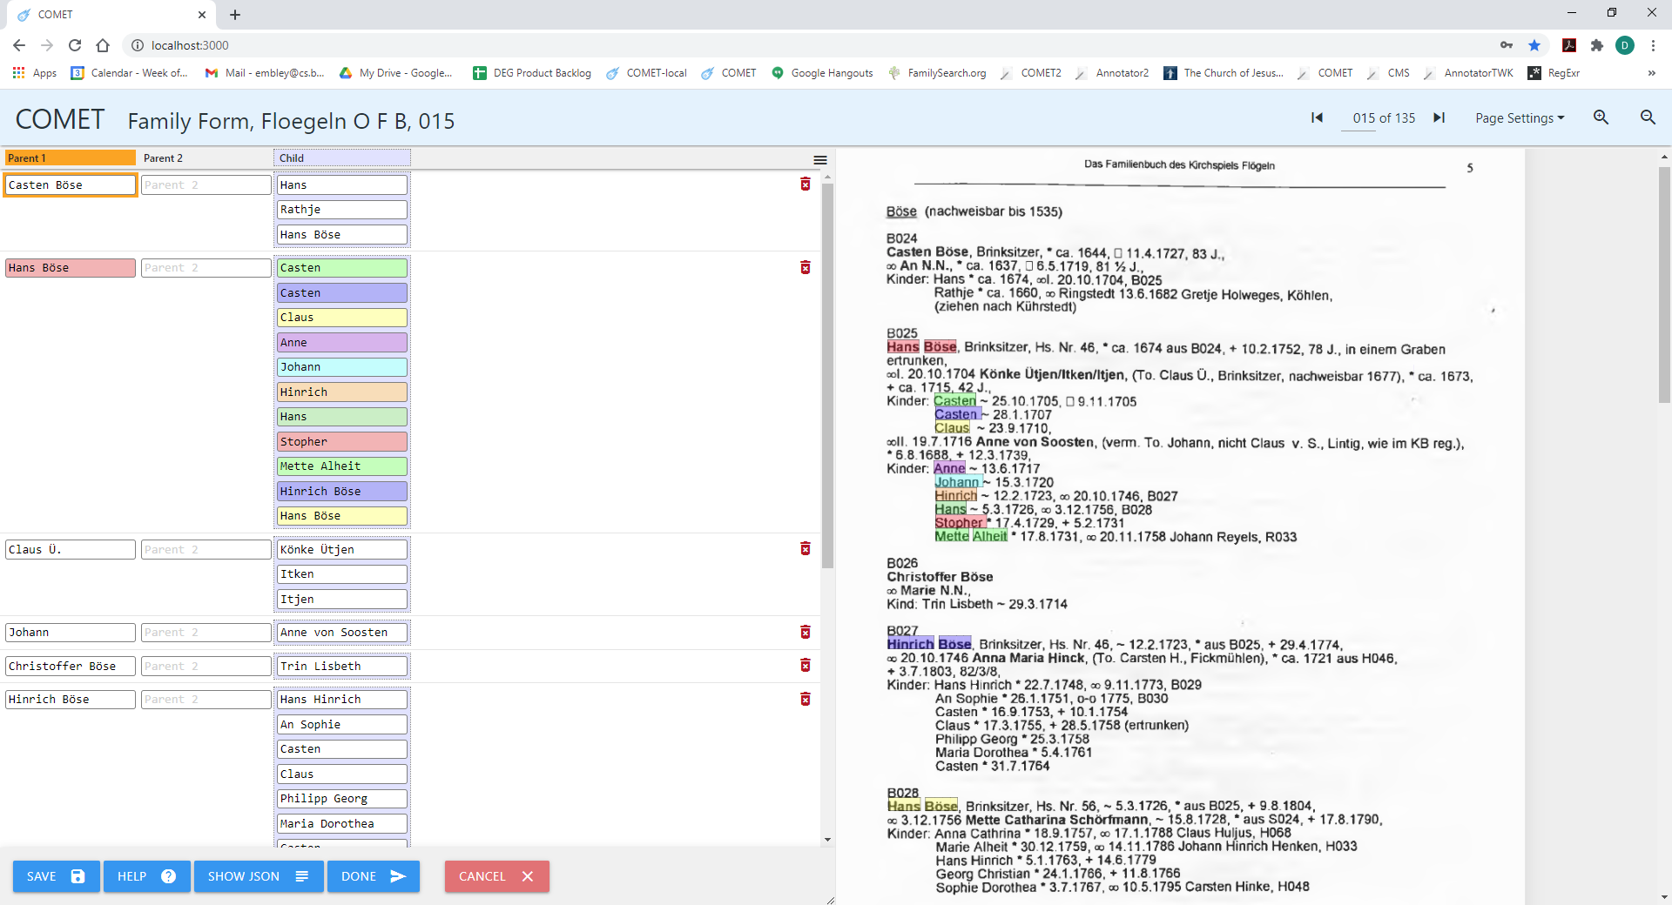
Notes:
Note what chasing the reference IDs does – Hinrich and Hans Böse are added twice to the list of children. This shouldn’t hurt us downstream when we merge … or does it? (Scott) Is it awkward for COMET users trying to do final clean-up? (Jim) What about Ground Truthing? (Deryle)

Slide 56
1st record:
2nd record:
Two problems here:
In the 1st record Claus appears to be missing as a child; but he isn’t missed as seen in the 2nd.
In the 2nd record, Harm v. S. is not Claus’s parent. This is a fundamental problem: the author nests one record inside another.
Notes:
Resolution of the 1st problem: ??
Extracted Records:
Family: Parent1,15,57,2,3,Hans,Hinrich,Böse,Child,15,60,4,1,Hinrich,Child,15,61,3,1,Claus,Child,15,63,3,1,Casten,Child,15,64,3,2,Anna,Margarethe,Child,15,65,3,2,Catharina,Marie,Child,15,66,3,2,Sophie,Dorothea,EXTRA,15,68,2,1,B030 -- which more visually rendered is Family(Parent1:Hans Hinrich Böse, (Child:Hinrich, Child:Claus, Child:Casten, Child:Anna Margarethe, Child:Catharina Marie, Child:Sophie Dorothea)*).
Person: Name,15,61,3,1,Claus,BirthDate,15,61,5,5,21,.,6,.,1778,DeathPlace,15,62,17,1,Lintig,DeathDate,15,62,18,5,11,.,8,.,1828 -- which more visually rendered is Person(Name:Claus, BirthDate:21.6.1778, DeathPlace:Lintig, DeathDate11.8.1828).
Marriage: Name,15,61,3,1,Claus,MarriageEventPlace,15,61,12,1,Ringstedt,MarriageEventDate,15,61,17,5,9,.,12,.,1803,SpouseName,15,61,22,3,Margarethe,von,Soosten -- which more visually rendered is Marriage(Name:Claus, MarriageEventPlace:Ringstedt, MarriageEventDate, 9.12.1803, SpouseName:Margarethe von Soosten.
ChildOf (an incorrect extraction): Child,15,61,3,1,Claus,Parent1,15,62,7,5,Harm,v,.,S,. -- which more visually rendered is ChildOf(Child:Claus, Parent1:Harm v. S.)
Merged Records: (taken from the results in COMET after Split2Forms following the merge on Claus (ordered Person, ChildOf, Family, Marriage); but written in terms of the target extraction ontology)
Family view (for Claus, as seen above): Person(PersonName:Harm v. S., PersonName:Hans Hinrich Böse, ChildName:Claus):
Person view (for Claus): Person(PersonName:Claus, BirthDate:21.6.1778, DeathDate:11.8.1828, DeathPlace:Lintig)
Marriage view (for Claus): Person(PersonName:Claus, SpouseName:Margarethe von Soosten, MarriageEventDate:9.12.1803, MarriageEventPlace:Ringstedt)
ChildOf view (for Claus): Person(ChildName:Claus, PersonName:Harm v. S., PersonName:Hans Hinrich Böse) – the order of the parents is arbitrary – which ever one is encountered first in the unordered merge is first
Resolution of the 2nd problem: ?? Note that Catharina Margarete Hincke is the daughter of Claus H. – a correct extraction and one we have all along been expected to get. (Our rule of thumb: get parents of household parents and get spouses of household children.) But Harm v. S. is the parent of a spouse of a child. More problematic from a technical point of view is that we have a nested record (as we’ve defined records – i.e. PCMFI), but ChildOf(Margarethe von Soosten, Parent1:Ham v. S.) is nested inside the record Person(Name:Claus, GenderDesignator:?, BirthDate:21.6.1778, BirthPlace:?, ChristeningDate:?, ChristeningPlace:?, DeathDate:11.8.1828, DeathPlace:Lintig, BurialDate:?, BurialPlace:?) in the text as Person(Name:Claus, BirthDate:21.6.1778, (ChildOf(Margarethe von Soosten, Parent1:Ham v. S.)), DeathPlace:Lintig, DeathDate:11.8.1828). To further compound the problem, the syntax for both is the same – (To. <Name> – and even extending the identifying SearchPhrase, “(To.”, farther to the left doesn’t help. This reminds me of the problem of trying to parse context sensitive programming languages – an idea thought of back in the 1960’s and gave up on. Our parser is merely an entity recognizer (a simple lexical analyzer) followed by a relationship recognizer that assumes that record attribute values are those recognized entities between one record head and another.
Resolution of both problems with COMET: ?? Delete the 2nd and add Claus to the 1st.

Slide 57
Check file:
page 15 line 16 first SeqNo 3529
"SOL ool . 20 . 10 . 1704 Könke Ütjen / Itken / Itjen , ( To . Claus Ü . , Brinksitzer , nachweisbar 1677 ) , * ca . 1673 , EOL"
SOL NONE NONE NONE NONE NONE NONE NONE Child Child NONE Child NONE Child NONE NONE NONE NONE Parent1 Parent1 Parent1 NONE NONE NONE NONE NONE NONE NONE NONE NONE NONE NONE NONE EOL
"SOL ool . 20 . 10 . 1704 T19 T19 / T28 / T28 , ( To . T41 T41 T41 , Brinksitzer , nachweisbar 1677 ) , * ca . 1673 , EOL"
T19:
T28:
GreenQQ output records file:
Child,15,16,9,2,Könke,Ütjen
Child,15,16,12,1,Itken
Child,15,16,14,1,Itjen,Parent1,15,16,19,3,Claus,Ü,.
Notes:
The previous “Kind:” is one page back and up some 30 lines. Hard to explain: GN’s alg. must turn these search phrases on and scan for a match without turning them off ??? (In any case, I think there will be a fair amount of work to clean up the version of GN’s alg. that we implement in JavaScript. BTW, tags are another item to look at …)
Because of Kilbarchan twins (e.g. “Mary and James, born 10 Mar. 1693”) to pick up both pre-names of the date (i.e. the Kilbarchan output record for this line has the form:
Name,…,Mary
Name,…,James,…10,Mar,.,1693
where the page-line-offset values tell me that the two names are within just a few characters of each other.

Slide 58
PRF Summary Report for Entities (pages:015 & forms:P)
Precision (106/(106+0)): 1.00
Recall (106/106): 1.00
Fscore ((2*Precision*Recall)/(Precision+Recall)): 1.00
PRF Summary Report for Entities (pages:015 & forms:M)
Precision (58/(58+0)): 1.00
Recall (58/58): 1.00
Fscore ((2*Precision*Recall)/(Precision+Recall)): 1.00
PRF Summary Report for Relationships (pages:015 & forms:P)
Precision (106/(106+0)): 1.00
Recall (106/106): 1.00
Fscore ((2*Precision*Recall)/(Precision+Recall)): 1.00
PRF Summary Report for Relationships (pages:015 & forms:M)
Precision (39/(39+0)): 1.00
Recall (39/39): 1.00
Fscore ((2*Precision*Recall)/(Precision+Recall)): 1.00
PRF Summary Report for Entities (pages:015 & forms:C)
Precision (81/(81+4)): 0.95
Recall (81/80): 1.01
Fscore ((2*Precision*Recall)/(Precision+Recall)): 0.98
PRF Summary Report for Entities (pages:015 & forms:F)
Precision (51/(51+4)): 0.93
Recall (51/51): 1.00
Fscore ((2*Precision*Recall)/(Precision+Recall)): 0.96
PRF Summary Report for Relationships (pages:015 & forms:C)
Precision (80/(80+5)): 0.94
Recall (80/80): 1.00
Fscore ((2*Precision*Recall)/(Precision+Recall)): 0.97
PRF Summary Report for Relationships (pages:015 & forms:F)
Precision (50/(50+5)): 0.91
Recall (50/51): 0.98
Fscore ((2*Precision*Recall)/(Precision+Recall)): 0.94
PRF Summary Report for Entities (pages:015 & forms:PCMF)
Precision (296/(296+8)): 0.97
Recall (296/295): 1.00
Fscore ((2*Precision*Recall)/(Precision+Recall)): 0.99
PRF Summary Report for Relationships (pages:015 & forms:PCMF)
Precision (275/(275+10)): 0.96
Recall (275/276): 1.00
Fscore ((2*Precision*Recall)/(Precision+Recall)): 0.98
Notes:
The PRF reports for Entities have two issues: (1) a correct Entity extraction can be counted more than once (as a true positive) because of a relationship being incorrectly generated (e.g. on page 15, Claus Ü was extracted once for the correct relationship (Könke Ütjen, Claus Ü) and twice for the incorrect extracted relationships (Itken, Claus Ü) and (Itjen, Claus Ü)); and (2) a correct Entity extraction can be missed and NOT counted (as a true positive) because of a relationship being missed (e.g. on page 15, the relationship (Hans Hinrich Böse, Claus) was missed and thus one Hans Hinrich Böse was not counted as a correctly extracted Entity. Thus, it’s best not to consider them, or if considered, realize that they are only a rough approximation and are skewed one way or another by incorrect relationship extractions.
The PRF reports for Relationships have no issues of concern about the results but must be understood for what they really are – an accurate assessment of the populated relationships in the various ontologies. Thus, for example, for the Family ontology the relationship sets are Family—Parent1, Family—Parent2, and Family—Child. In page 15, the GroundTruth for Family has 51 relationships records (11, 0, 40 respectively) and are COMET-displayed in 11 Family records. Only one of the 51 relationships was not found: Family<of Hans Hinrich Böse> --- Child:Claus. Five generated relationships were incorrect: Family<of Harm v. S.>--Parent1:Harm v. S. (i.e. there is no family of Harm v. S. in the GroundTruth), Family<Harm v. S.>--Parent2:Hans Hinrich Böse, Family<Harm v. S.>--Child:Claus, Family<of Claus Ü>--Child:Itjen, and Family<of Claus Ü>--Child:Itken. And for the ChildOf ontology, the relationship sets are Parents—Child, Parents—Parent1, Parents—Parent2. In page 15, the GroundTruth for ChildOf has 80 relationships (40, 40, 0 respectively) in 40 ChildOf records. (Note that there are no Parents-Parent2 relationships – Flögeln never specifies any (i.e., no phrases like “To. Carsten H. und …”). Also note that because when we split out ChildOf records from the merger of the four record types, every Parent-Child relationship gets recorded twice – once for Parents—Child and once for Parent1—Parents. For the split out of Family, on the other hand, we only record Parent-Child relationships of the children of the household head (i.e. of the Family) and the Parent-Child relationships for the parent of the household head and the household-head spouses.) The five incorrect relationships are Parent1:Claus Ü—Child:Itken, Parent1:Claus Ü—Child:Itjen, Parent1:Harm v. S.—Child:Claus, Parents<Harm v. S.>--Parent1:Harm v. S., and Parents<Harm v. S.>--Parent2:HansHinrich Böse. The last three here come from the incorrect record ChildOf(Child:Claus, Parent1:Harm v. S., Parent2:Hans Hinrich Böse) where Parents<Harm v. S.> denotes the Parents object in the nonlexical object set, which uses Parent1 for ontological commitment.
Since our interest is in correctly identifying correct relationships in the ontology’s relationship sets, we have exactly the PRF measures we want. (That is, we seek to correctly establish the relationships: Person—BirthDate, Person—BirthPlace, …, Person—BurialPlace, Person—Spouse—MarriageEventDate—MarriageEventPlace, Person—Child.)

Slide 59
Discovered by considering “was rejected” in the Defective Personas report:
“aus” does not always denote the household of parents.
B040
Diedrich Hinrich Borchers, Fickmühlen, (So. Diedrich B., Alfstedt), ~ 29.5.1733 (luth.), + 10.3.1799,
oo 15.3.1755 Alheit Tönjes geb. Mangels, (Wwe. aus T013), ~ 15.10.1713, * aus M013, + 10.3.1795
Keine Kinder
T013
Johann Töns, Fickmühlen, ~ 27.5.1700, * aus T012, + 22.4.1754,
ool. 28.11.1730 Beata Elisabeth Wichmann, ~ 28.8.1710, * aus W016, o-o 1732, T014
Kind: Borchert Johann Gustaff *26.11.1731, + 13.2.1732,
ooll. 23.4.1743 Alheit Mangels, ~ 15.10.1713, * aus M013, ooll. 15.3.1755 Diedrich Hinr. Borchers,
B040,
Kinder: Lüer * 12.6.1745, + 27.6.1745
Johann * 17.9.1746, + 17.5.1747
Johann * 17.3.1748, + 8.10.1748
Dirich Hinrich * 19.7.1749, + 9.5.1775
Margret Alheit * 28.7.1751, + 26.3.1752
Gesche Alheit * 11.10.1754, + 22.7.1779
No counter examples on 015: must replace “aus”-parent template with templates that only denote parents by extending search-phrase context to the left for all cases where “aus” denotes parents (i.e. “1890 aus”, “1890 , aus”, and “* aus” at least and maybe more).

Slide 60
Guidelines for COMET Corrections

Slide 61
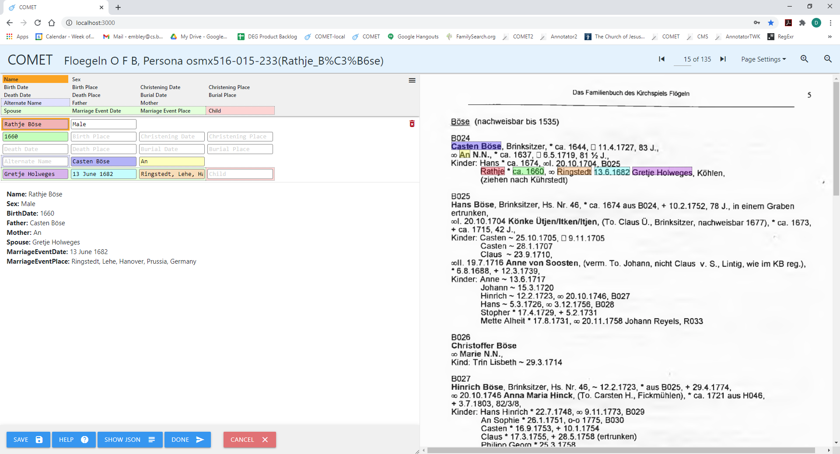
Persona Record Corrections
Inferred and standardized
What should we do with uncertain dates and names?

Slide 62
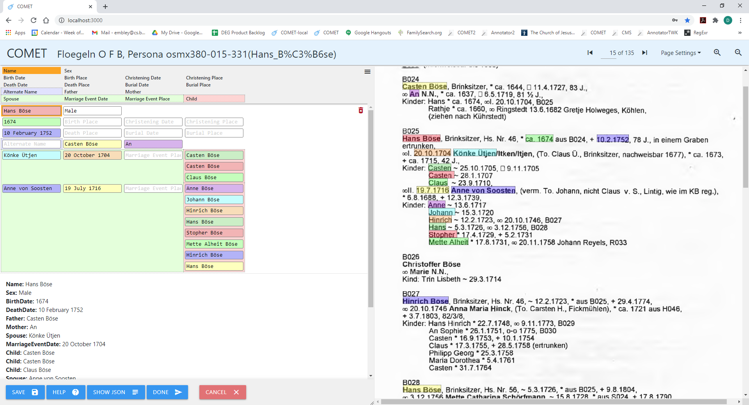
Notes:
Because we chase ReferenceIDs, we get duplicates (which are actually just different instances). How will the deep checker handle this?

Slide 63
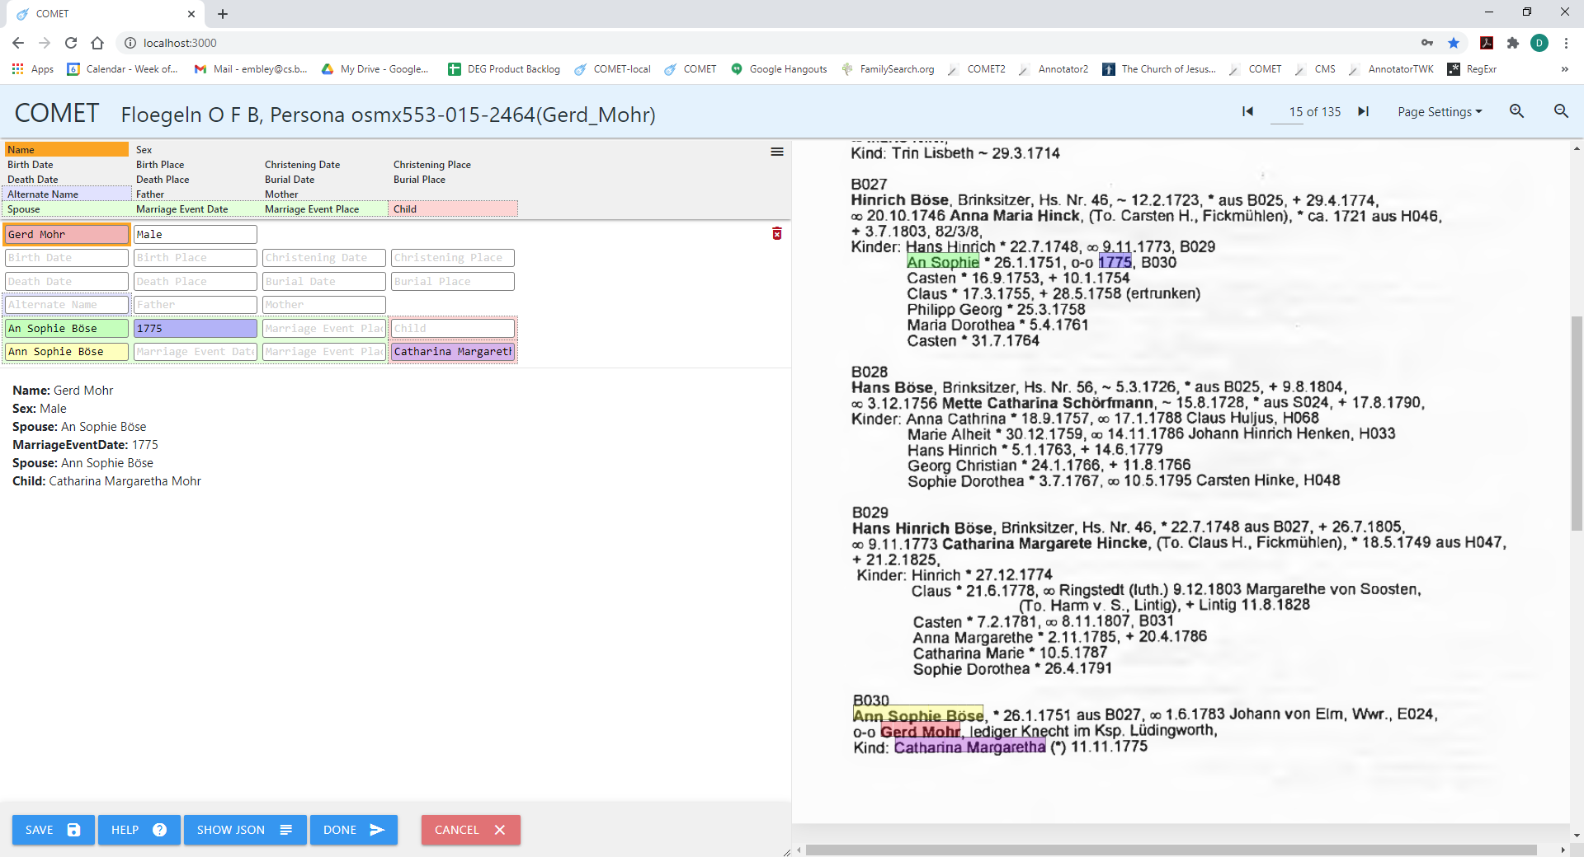
Notes:
Here we have different names (An & Ann) and some info from each not in the other.

Slide 64
Guidelines for Persona Record Corrections

Slide 65
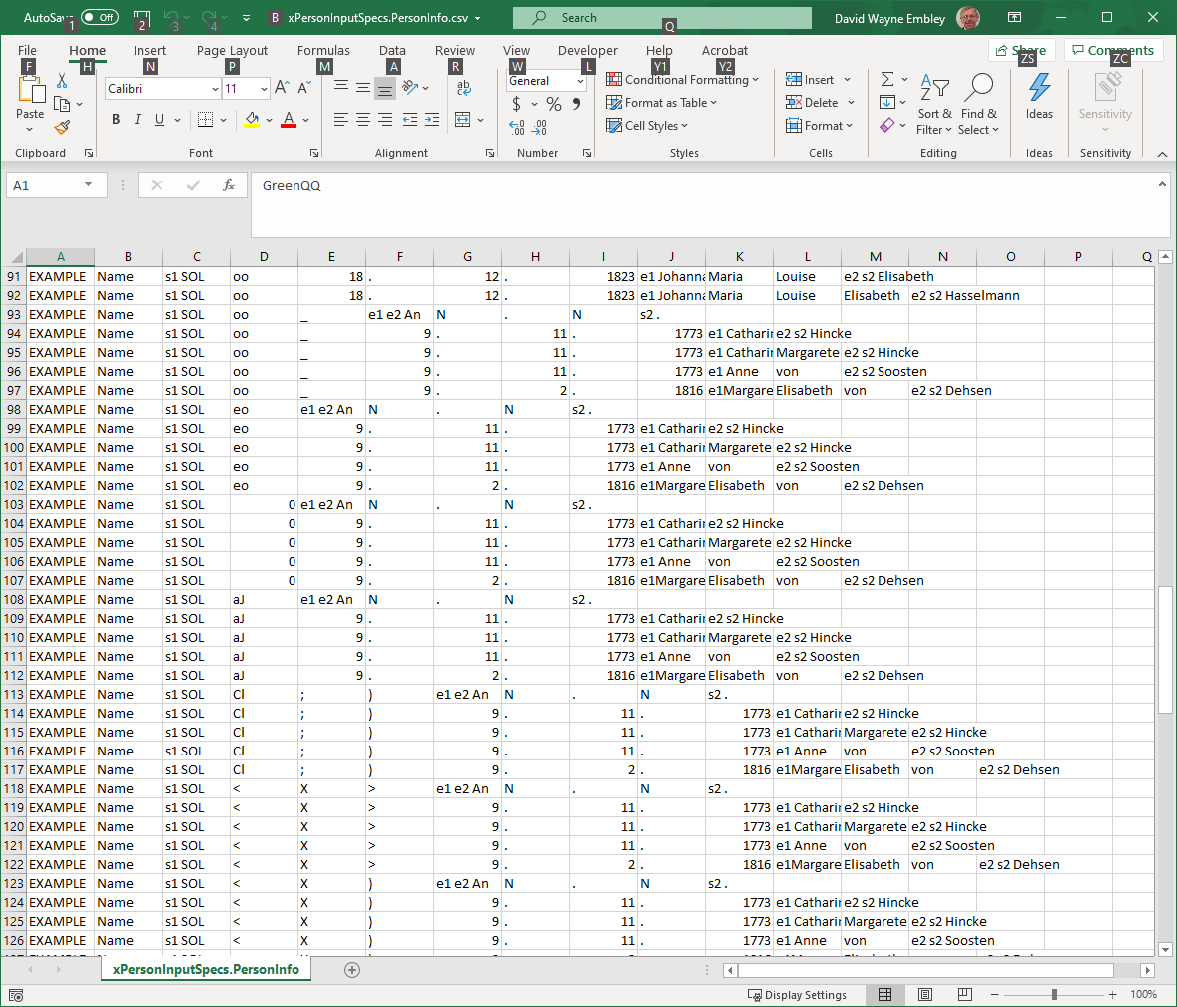
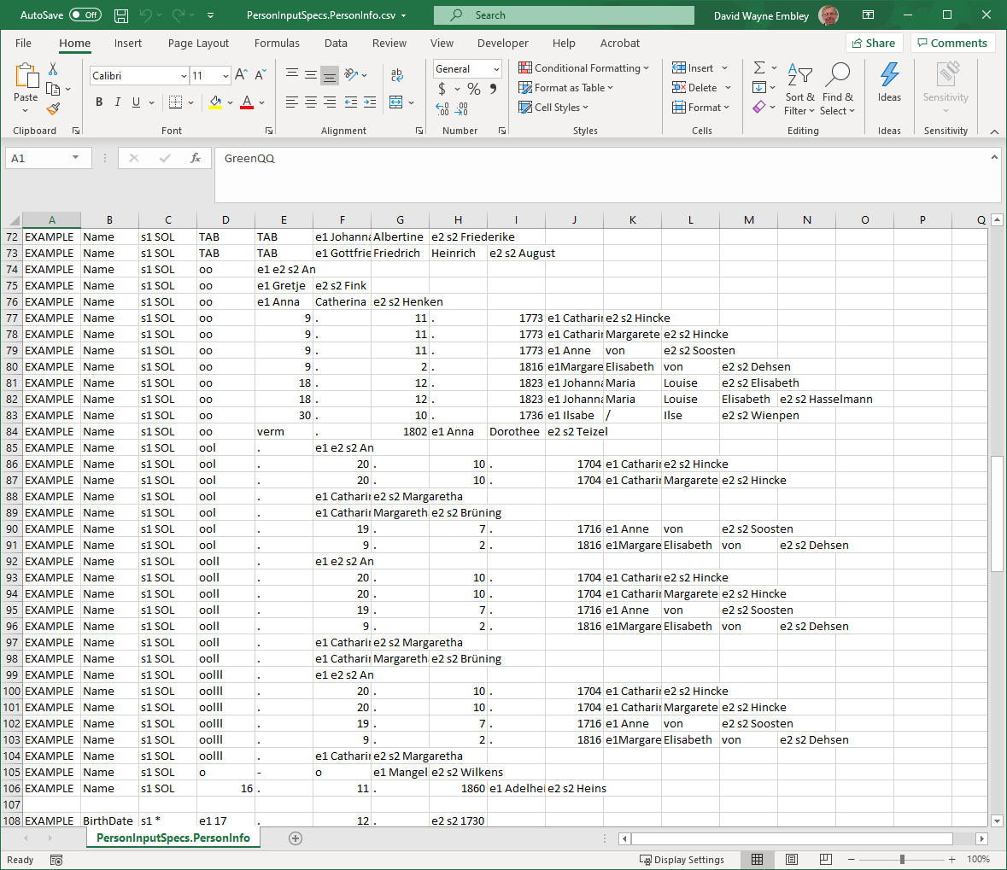
Benefits of OCR-error Clean-up
Reduction of number of templates & potential reuse of templates across books
Enhanced fielded and keyword search of CDS records
Name Templates: 124 (with OCR variations), 68 (with corrected OCR), 10 (with generated name types)
Marriage Symbol Search Phrases: 90 (with OCR variations), 33 (with corrected OCR), 6 (with generated name types)

Slide 66
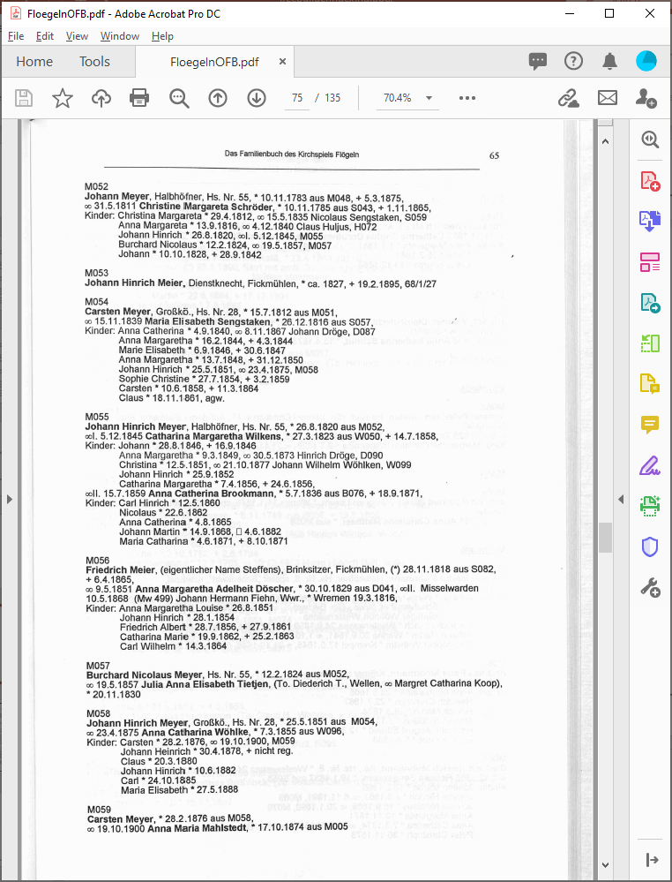
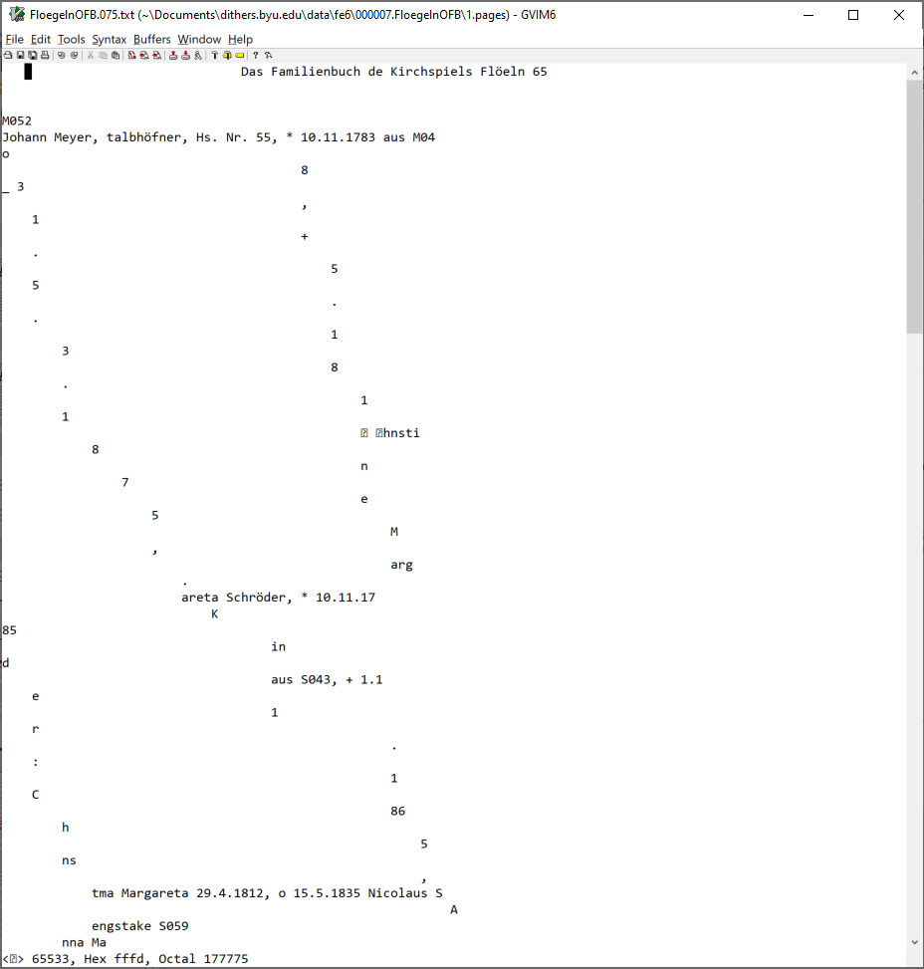
Issues Encountered
Notes:
Noise on page (bottom left); I cheated – removed an extra TAB on all standard lines.

Slide 67
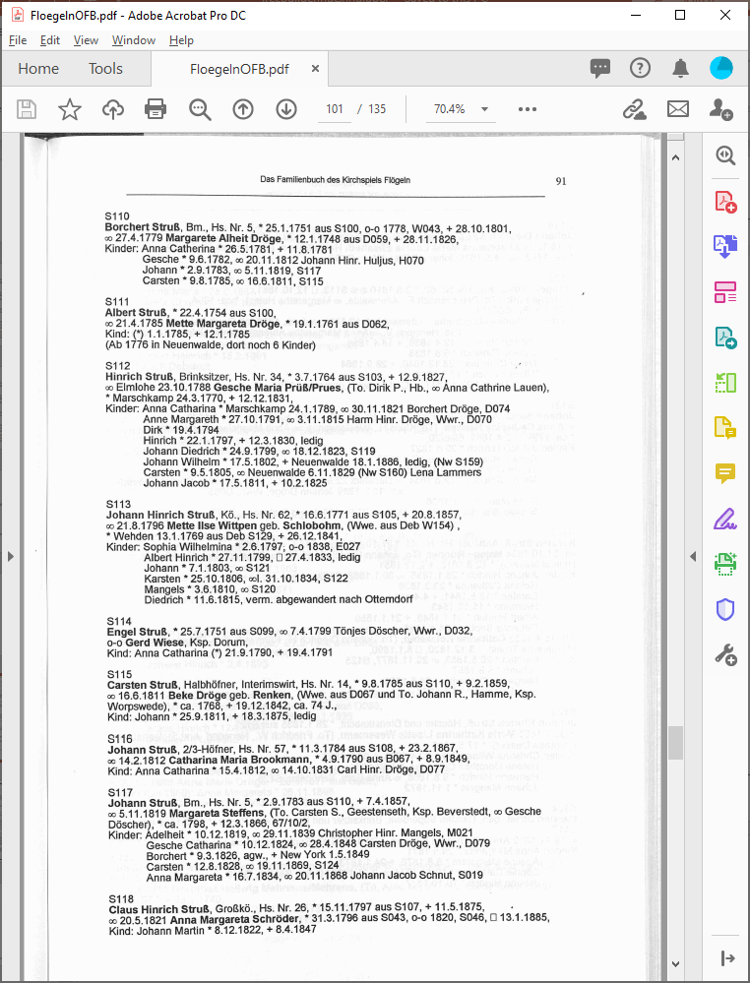
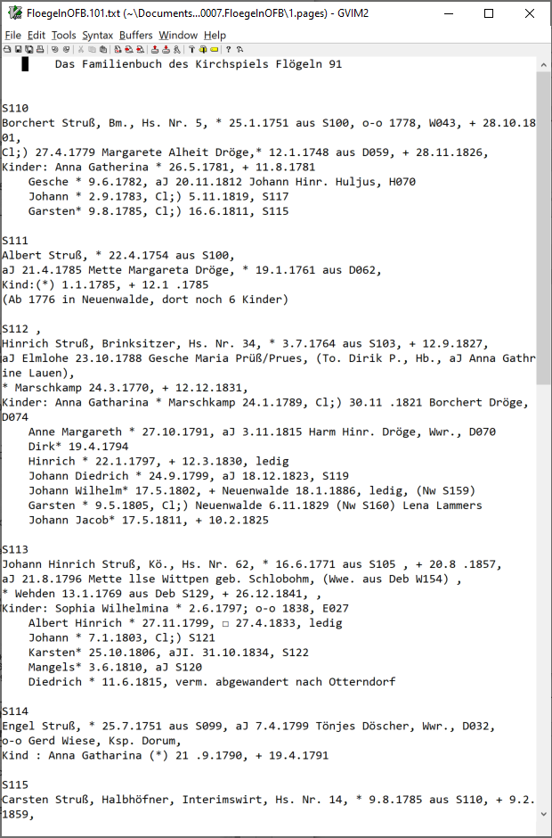
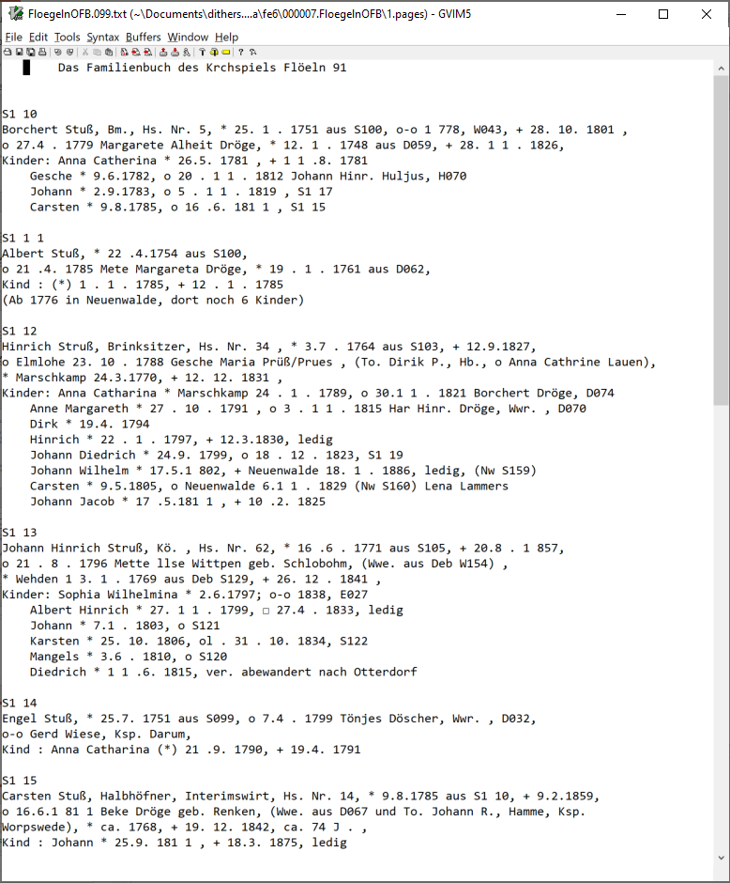
Issues Encountered
Notes:
Leftmost – OCRed from original; whereas the one OCR’d from Deryle is in the middle.

Slide 68
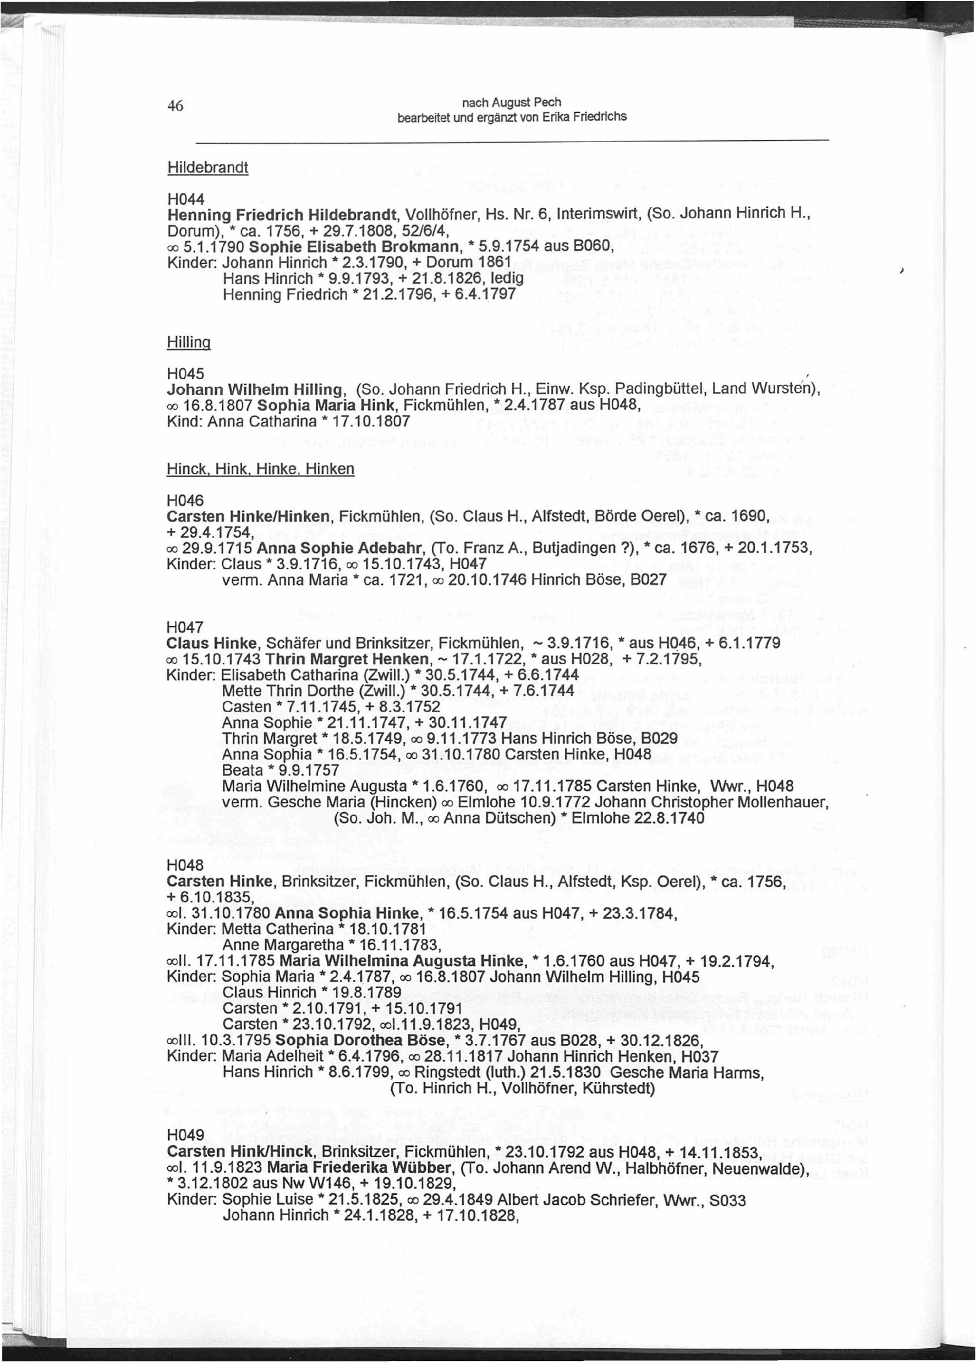
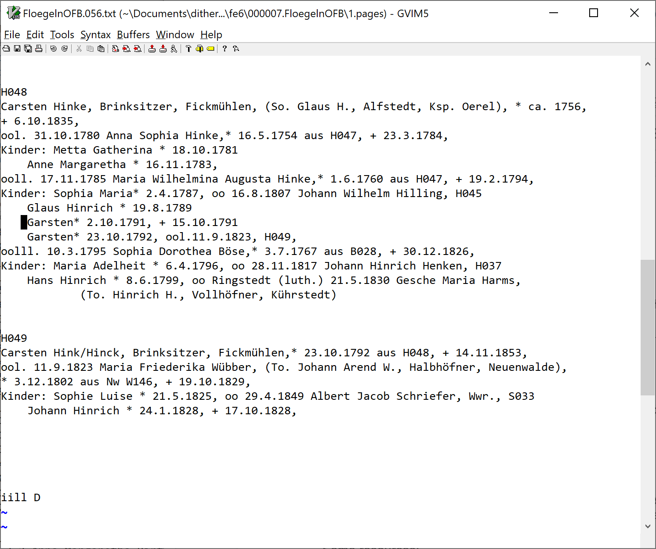
Issues Encountered
Fixed
Notes:
Noise on page (bottom left); I cheated – removed an extra TAB on all standard lines.

Slide 69
Issues Encountered
Chasing long tail of missing heads – starting with 3,966
(26, 5)
(43, 5)
(42, 4)
(54, 4)
(81, 4)
(87, 4)
(88, 4)
(112, 4)
(64, 3)
(66, 3)
(94, 3)
(101, 3)
(104, 3)
(16, 2)
(21, 2)
(24, 2)
(27, 2)
(37, 2)
(41, 2)
(46, 2)
(60, 2)
(69, 2)
(71, 2)
(85, 2)
(89, 2)
(91, 2)
(93, 2)
(97, 2)
(111, 2)
(113, 2)
(116, 2)
(119, 2)
(13, 1)
(17, 1)
(18, 1)
(19, 1)
(20, 1)
(22, 1)
(23, 1)
(28, 1)
(30, 1)
(33, 1)
(34, 1)
(38, 1)
(39, 1)
(44, 1)
(45, 1)
(48, 1)
(50, 1)
(52, 1)
(53, 1)
(55, 1)
(56, 1)
(58, 1)
(63, 1)
(65, 1)
(70, 1)
(72, 1)
(74, 1)
(75, 1)
(80, 1)
(92, 1)
(95, 1)
(98, 1)
(99, 1)
(103, 1)
(105, 1)
(107, 1)
marriage symbol issues (usually OCR’d as oo): Cl; aJ <X> <X) eo 00 oo_
“vermutlich” issues: 7 occurrences of various types preventing Person heads from being recognized
Chasing long tail – now with 4,154
SOL Kind : Peter ( ' ) 3 . 2 . 1762 EOL
SOL NONE NONE Name NONE NONE NONE NONE NONE NONE NONE NONE EOL
ool. 4.2.1779 llsabe von Elm geb. Wilkens, r,Nwe. aus E023), * 26.7.1752 aus W038, + 1.3.1798,
llsabeth * 24.7.1791, oo 24.5.1811 Johann Jacob Sengstaken, S056,
ooll. 8.2.1798 Margaretha Dorothea Meyer,* 18.9.1769 aus M048, + 24.1.1850,
Johann* 14.9.1862, + 15.4.1865
Kinder (bis 1900): Sophie Elisabeth* 24.12.1898
8althasar Hinrich * 18.7.1758, + 6.3.1771
Kinder: Sophia Maria* 22.12.1777, oo Ringstedt (luth.) 8.11.1796 Garsten Hildebrand,
(So. Joh. Christopher H., Kührstedt), * 7.3.1769
Albert (Zwill.) *+14.4.1781
Chasing long tail – now with 4,211 – remaining long tail from OrderedPageViolationCountList has 68 entries.
Notes:
3,966 is the number of lines in the Person file after the missing heads on page reports no pages. Starting point uncertain, but probably about right.
The various marriage symbols are all potentially compounded by a first, second, and third spouse denoted by l, ll, and lll.
( ‘ ) : Excel strange behavior when typed in (i.e. disappears); \’ doesn’t work; copy paste works but visible only in header & when executed GreenQQ chokes (exit code 1).
llsabe : OCR error; given name starts with lower-case letter.
llsabeth : ditto
TAB TAB : initial tabs, not sure why, but this is the messed-up page 26; perhaps we should run this page through unpaper. (see slide below)
On left margin : this is a child and should be indented by a TAB; again, messed-up page 26. (Perhaps we should create a script to process all Floegeln pages with unpaper.)
(bis 1900) : legitimate author exception; I added a template for this case
8althasar : OCR error
Garsten Hildebrand : missing head is the spouse of a child (a pattern we should probably ignore); we’re also likely to extract “So.” as being for Sophia and thus get the wrong gender; note also *+ (GreenQQ can only assign a single class to an Extract.
At 4,211, the long tail is as shown. (I drove the count to <=5 by adding templates.)
PersonCandidateExamples.PersonInfo.csv provided no help in finding missing SearchPhrases and missing Extracts.

Slide 70
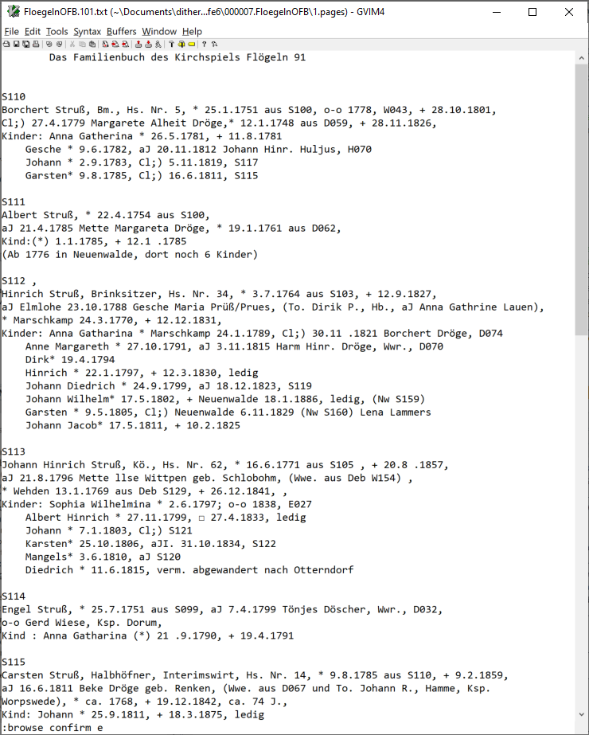
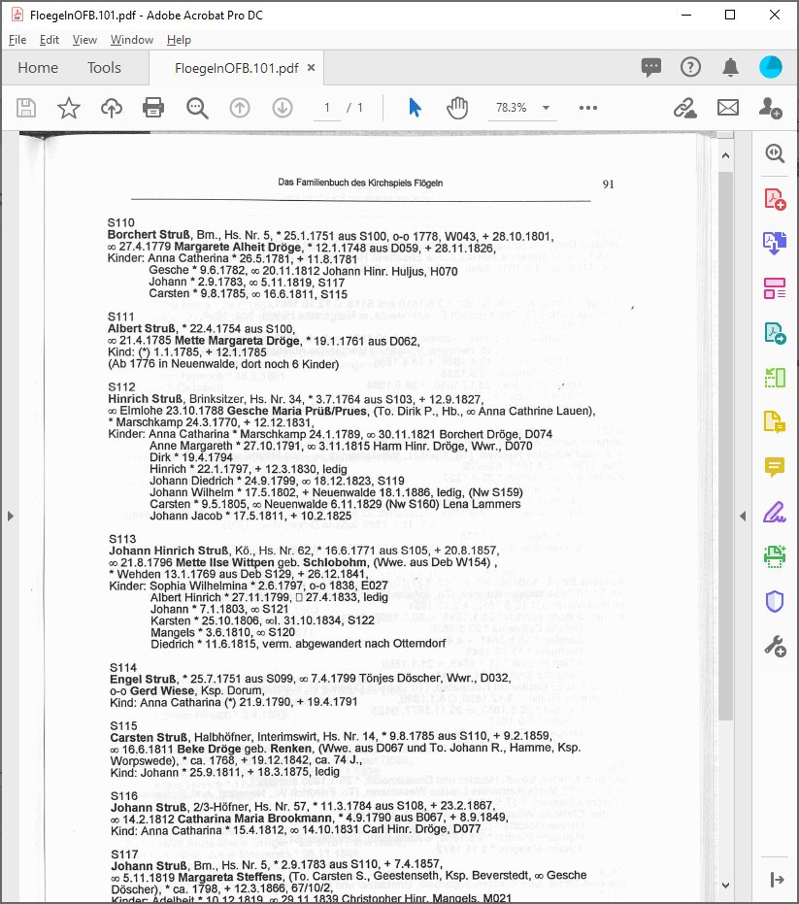
Issues Encountered
OCR variations of the marriage symbol:
Cl;
aJ
<X>
<X)
eo
00 (?? Excel 00 as text fails as does 00 = 0 as a number; GreenQQ tag = NUM?; LIT 00 as text)
oo_ found 7, enough to justify templates

Slide 71
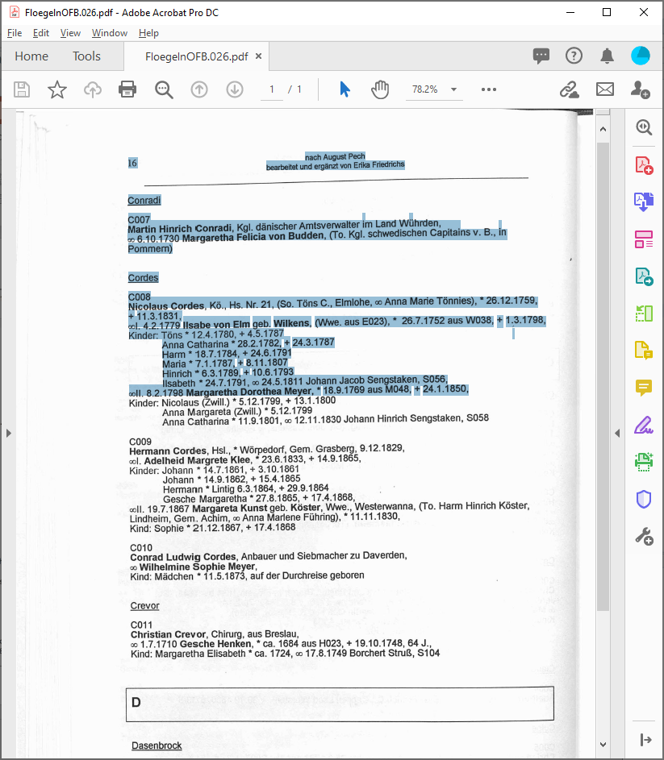
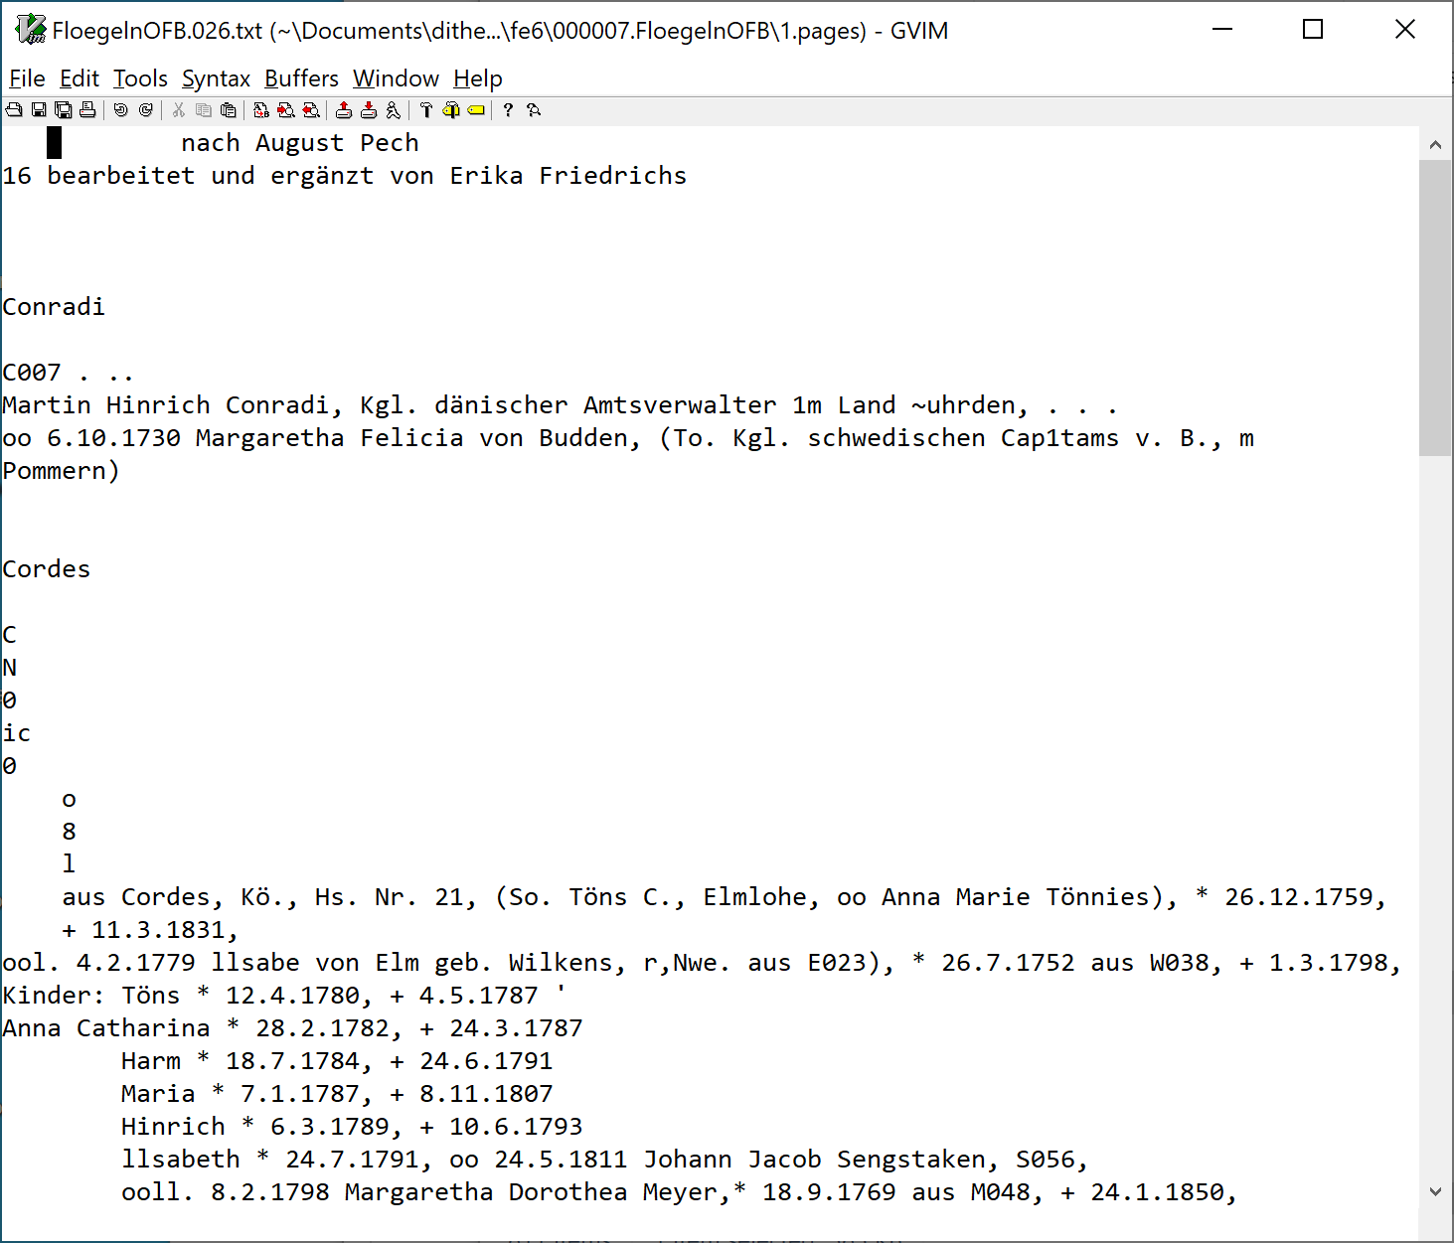
Issues Encountered
Notes:
Skew picks up the dot above the “i” and the umlauts above the “ü”.
Characters between “Cordes” and “aus” (the last letters of Nicolaus) ??

Slide 72
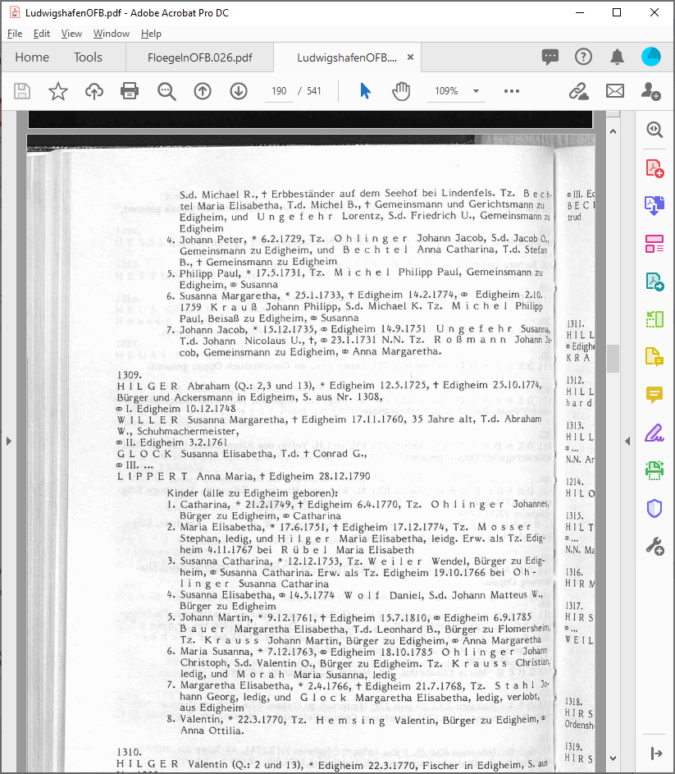
Issues Encountered
Notes:
Crud around the info of interest; gutter skew.

Slide 73
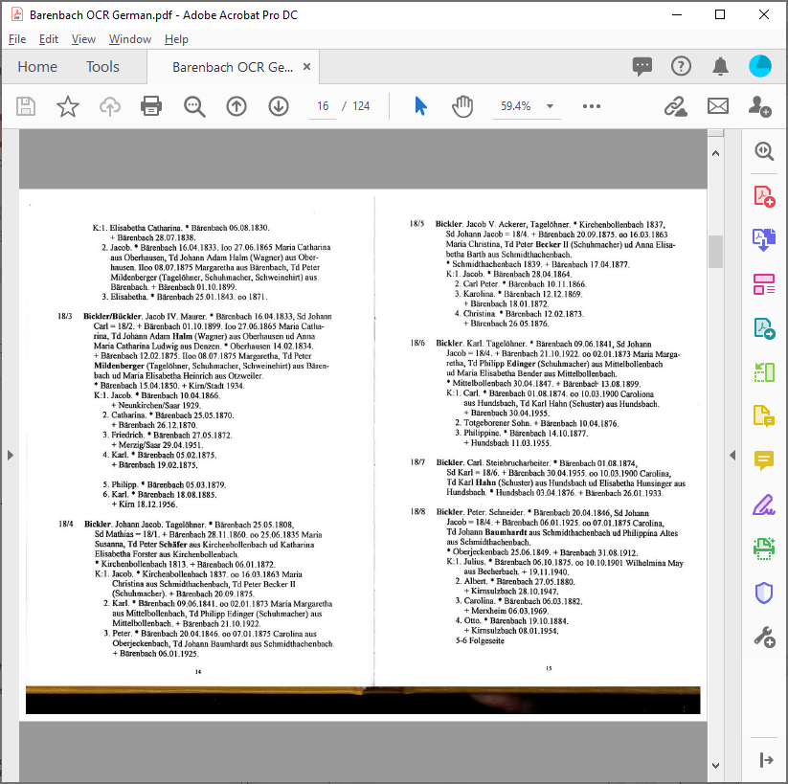
Issues Encountered
Notes:
Double pages

Slide 74
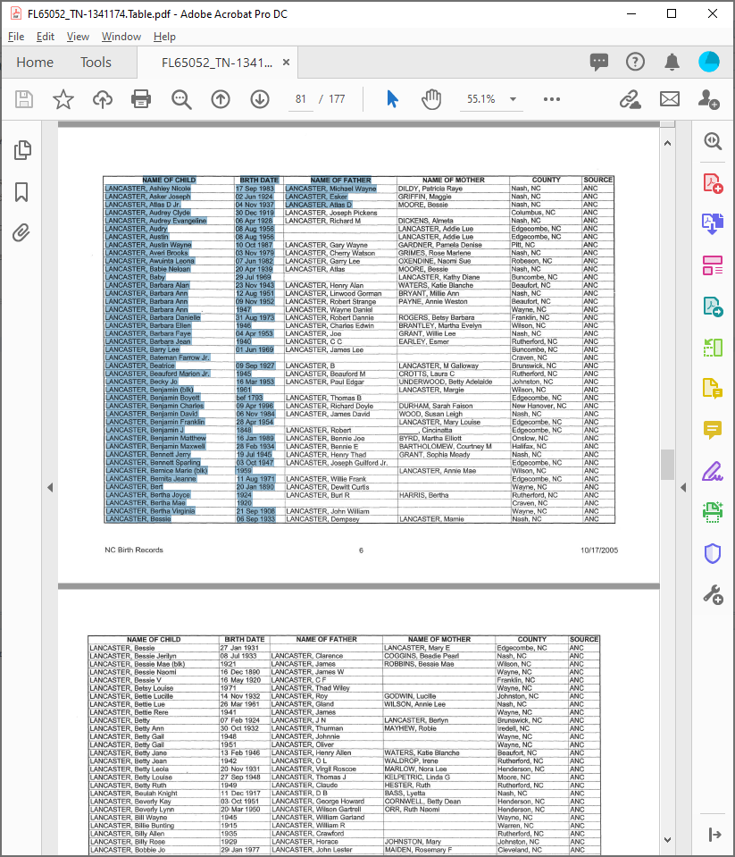
Issues Encountered
Notes:
OCR is by column; if we could get it by row, we could do the processing we proposed at ER02 in Tampere where we distributed the table headers across the rows and extract with OntoES.
OR we could leave the OCR as it is; and write a specialized extractor to piece the records together and load them into an ontology.

Slide 75
Ideas for Quick-Starting the UI
Use GN’s v1 instead of v2 (eventually upgrade with v2 issues)
SL has already coded v1 in JavaScript. Put it in the pipeline.
DE test and do previously suggested v1 upgrades (Tags, LITs and …)
Create a basic UI (minimal but useable; upgrade later, as we go)
json layout specification (SL/DE)
COMET annotation actions (SL)
Generate csv from COMET annotation actions (DE).
Add format variants directly to csv (DE) (eventually do format variants in code as in v2)
Let users can directly edit the generated csv (e.g. add LITs, modify templates); UI actions to edit the csv can be added piecemeal.
Make use of the facilities for finding missing Heads and SearchPhrases as currently provided (again, to be added piecemeal to the UI).

Slide 76
Guidelines for Auto-indexers
Give the first and last page of the section of the book to be processed.
Determine the major grouping type (individual, family, nested family, households with IDs).
Choose a typical page and work on it as follows:
Check for and fix OCR errors.
For each field in the Aggregate Grouping Identifier (often only one field), click on a field example for any one of the major groups. Every field instance should be highlighted and displayed rectangles should correctly bound every major group. If not (1) for recall errors (R), click on an unhighlighted field instance and (2) for precision errors (P), adjust the templates or OCR so as not to identify non-field instances.
Click on the name of a child of any primary person and continue until R&P errors are fixed.
Click on the name of a spouse of any person and then also on MarriageEventDates and MarriageEventPlaces. Continue until all R&P errors are fixed.
Click on the parents of any person and continue until R&P errors are fixed.
Click on the properties of any person, spouse, or child. Continue until all R&P errors are fixed. Continue clicking until all properties of every person, spouse, or child are all highlighted. (Properties: BirthDate, BirthPlace, ChristeningDate, ChristeningPlace, DeathDate, DeathPlace, BurialDate, BurialPlace, Parent1, and Parent2.)
Ask the system to find missed person names and properties on other pages. Click on the returned page number of highest priority and repeat steps a – e.
Ask the system to check semantics and open COMET on a page with semantic warnings.
Resolve warnings that should be resolved with steps a – f.
Once semantic warnings have been resolved, check and make any final corrections with COMET. (OCR errors can still be corrected, but if templates are corrected and rerun, any non-OCR-error corrections with COMET will be lost and will need to be redone.)
For, nested families, repeat the process at each level of nesting.
Notes:
Nested families are those in which there are children who also have children.
In 4, it’s important to deal only with children of primary persons.
5 and 6 could be done as one step – here, we are only interested in recognizing entities.
Adding the rectangles so that that they cross over page boundaries and don’t cross-over “extraneous stuff” that should not be included might be tricky. (We probably don’t need to worry about “extraneous stuff” being included, as the only instructions at in this step are to click on primary persons incorrectly included in bounding boxes.)
Also note that we can often provide a list of places to look for possibly missing primary persons (as already built into GreenQQ, i.e. where the SearchPhrase applies but there is no extract).
We must also give them an option to click on text that is highlighted that should not be highlighted. And, then we need to fix the extraction templates. ?? How? I’m not sure.

Slide 77
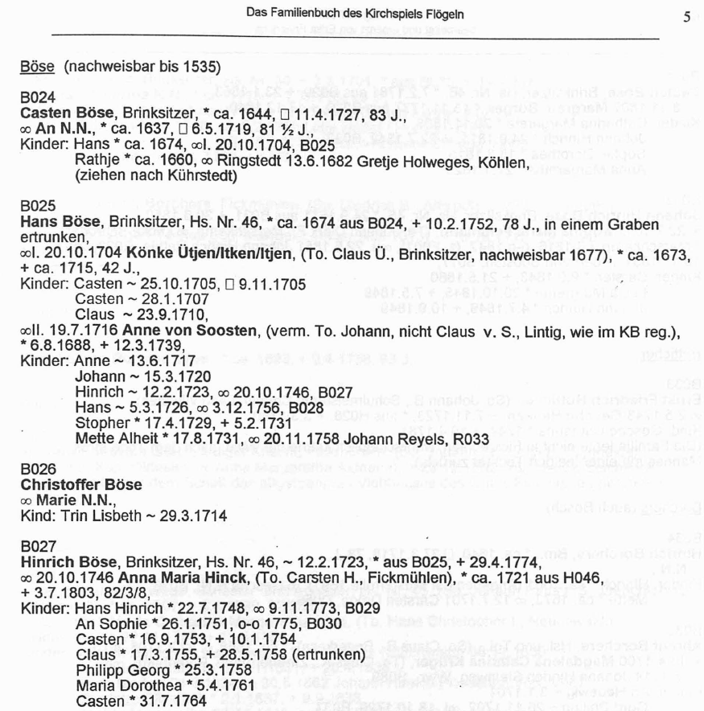
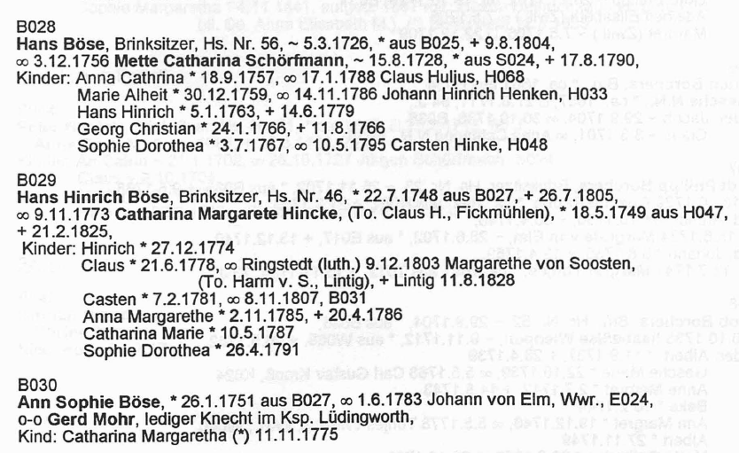
GreenQQ UI: Quick Start Mockup
B024
Casten Böse
Aggregate Grouping Identifier
Reference ID
Head Name
Casten Böse
Child
FamilyHousehold Record
Casten Böse
Spouse Name
Marriage Event Date
Marriage Event Place
Marriage Record
Casten Böse
Parent 1
Parent 2
ChildOf Record
Casten Böse
Gender Designator
Person Record
Birth Date
Birth Place
Christening Date
Christening Place
Death Date
Death Place
Burial Date
Burial Place
Notes:
Entity Recognizer (We must postprocess to form records. But the information for each record is grouped here together. AND the order is significant in the sense that templates for person names automatically trickle down to the next record.)
Results after click on B024 and on Casten Böse.
Note that each HeadName also fills a Name field in every other record type.
Instead of red outline boxes it may be easier and just as effective to just add a dividing line immediately preceding recognized Reference IDs.
?? Behind the scenes, EXTRA should be added on Reference ID as a record field stopper for run-away searches for every record type ??

Slide 78
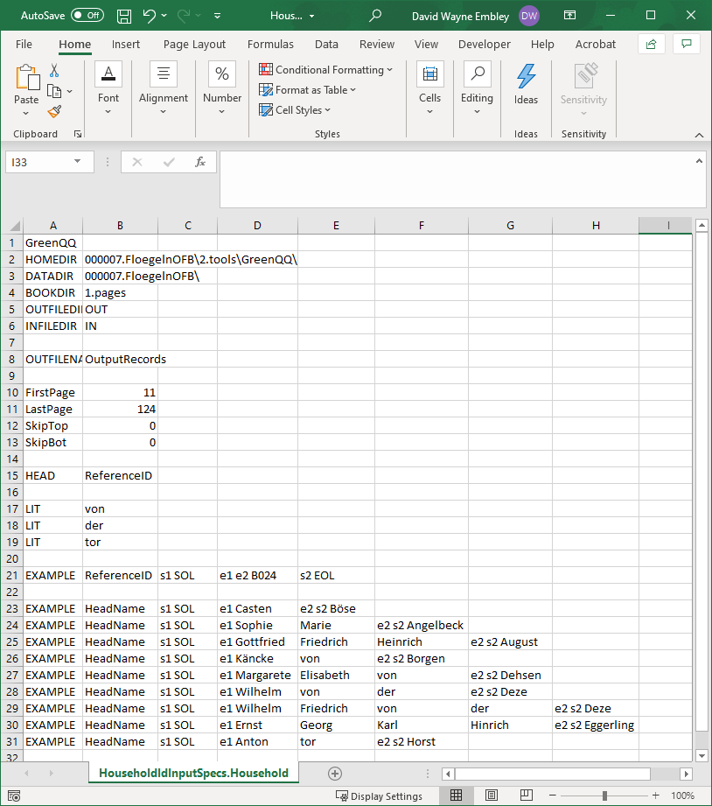
GreenQQ UI: Quick Start Mockup
Notes:
generated csv; only the EXAMPLES were generated. Book set-up should be able to provide lines 1-15. The LITs here are also automatic because they come with the format variants (they’re all surname prefixes).
Note the format variants for HeadName.

Slide 79
GreenQQ UI: Quick Start Mockup
B024
Casten Böse
Aggregate Grouping Identifier
Reference ID
Head Name
Casten Böse
Hans
FamilyHousehold Record
Rathje
Trin Lisbeth
Child
Casten Böse
Spouse Name
Marriage Event Date
Marriage Event Place
Hans
Rathje
Marriage Record
Trin Lisbeth
Casten Böse
Parent 1
Parent 2
ChildOf Record
Hans
Rathje
Trin Lisbeth
Casten Böse
Gender Designator
Person Record
Hans
Rathje
Trin Lisbeth
Birth Date
Birth Place
Christening Date
Christening Place
Death Date
Death Place
Burial Date
Burial Place
Notes:
Results after clicks on Hans for the “Kinder” pattern, on Rathje for the “TAB” pattern, and on Trin Lisbeth for the “Kind” pattern.
To prevent runaway child lists, ReferenceIDs and/or household head names should be marked with the EXTRA stopper.
There is one error; can you spot it? (“Cl” instead of “Claus” because the PDFindexer’s heuristic for a space was violated(?) and hence it’s rendered as “Cl aus”. How should this type of error be corrected by the user? (In COMET during the final phase – the template is not wrong, neither is the OCR.))
Note that every child is potentially also someone who has a spouse, has parents, or has vital information. Even when they don’t, recognizing them helps prevent run-away search.
Note also that we only recognize one-hop relationships (i.e. we do not recognize children of children with respect to the household head)

Slide 80
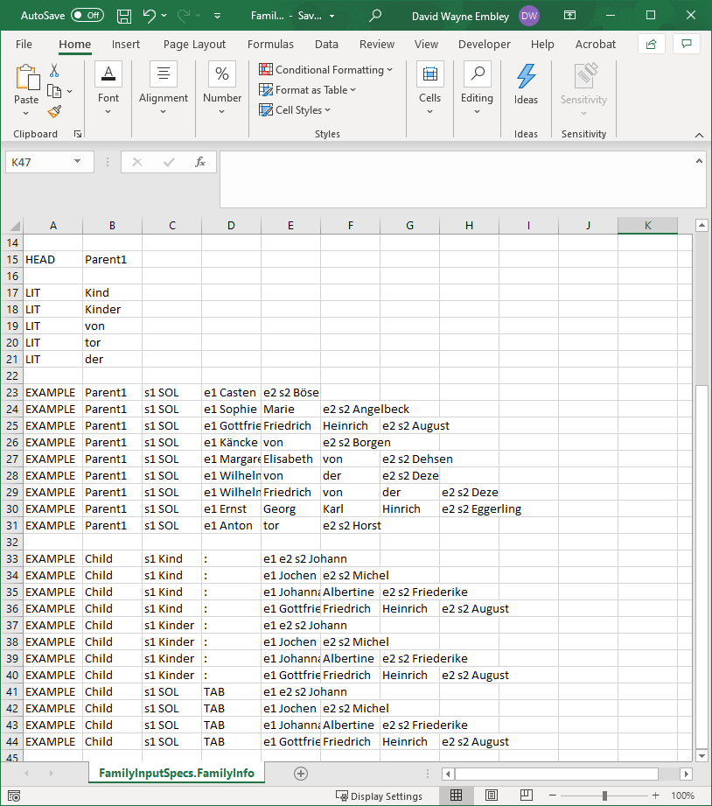
GreenQQ UI: Quick Start Mockup
Notes:
generated csv; only the EXAMPLES were generated. Book set-up should be able to provide lines 1-15. The LITs here are also automatic because they come with the format variants (they’re all surname prefixes).
Note the format variants for HeadName and all other names throughout. (The name variations here are likely incomplete, but are what I found in the book so far.)

Slide 81
GreenQQ UI: Quick Start Mockup (superseded – see below)
…
Casten Böse
Anna Maria Hink
20.10.1704
Ringstedt
Hans
Könke Ütjen
13.6.1682
Marriage Event Place
Rathje
Anne von Soosten
19.7.1716
Trin Lisbeth
Gerd Mohr
1775
B025
Marriage Event Date
Marriage Record
Spouse Name
Casten Böse
Parent 1
Parent 2
ChildOf Record
Hans
Rathje
Trin Lisbeth
Anna Maria Hink
Könke Ütjen
Anne von Soosten
Gerd Mohr
Casten Böse
Gender Designator
Person Record
Hans
Rathje
Trin Lisbeth
Anna Maria Hink
Könke Ütjen
Anne von Soosten
Gerd Mohr
Birth Date
Birth Place
Christening Date
Christening Place
Death Date
Death Place
Burial Date
Burial Place
Notes:
Technical issue when recognizing spouses: The pattern for spouses for household heads can overlap the pattern for spouses for children of household heads. Hence, we need to run these patterns separately. Note, for example, the in B025 there are two spouses for Hans Böse; now, if one of the children of the first spouse has a spouse, we have overlap and cannot pick up the spouses of Hans Böse by sequentially grabbing all persons labeled as spouses until we hit the next household head. Luckily, the pattern for household head spouses (preceding SOL) is different from the pattern for children spouses (no immediately preceding SOL even for wrap-around lines for then they are indented and have a white-space TAB preceding them). We therefore must keep track of which record heads are for children and which are for head spouses.
Note, however, that because the interface is only an entity recognizer, the user doesn’t need to distinguish them. Because, we care, however, we must prevent a user from directly adding to the Name field in the Marriage Record. Instead, Child person names can only be added in the FamilyHousehold Record and household heads can only be added in the grouping record (and thus we must also prevent their addition in a FamilyHousehold Record. This last principle holds throughout – hence there are no empty Name fields – and thus the user cannot make this mistake.
Runaway spouses for the household and for children in the household are also different. Runaway household spouses should be prevented by marking ReferenceIDs and/or household head names with EXTRA whereas Runaway child spouses should be marked by household marriage identifiers as well as by Reference IDs and/or household head names.
I’m thinking, however, that spouses of children should not propagate to ChildOf and Person records.
I’m not certain about the following user actions (and in the mock-up, I only do 4 markups for SpouseNames (+3 for RefId SpouseNames), one for each different marriage symbol in which SpouseNames occur, and similarly for MarriageEventDate & MarriageEventPlace):
Results here are (1) after clicking on SpouseNames An (no MarriageEventDate patterns; note that I choose not to include “N.N.” as part of the name), Könke Ütjen (standard ool patterns; note that generated templates with a slash (/) in them are not generated automatically – when the name with slashes is last, I choose not to extract them; and when not last, a new special case Name format variant is established on the fly), Anne von Soosten (standard ooll patterns), Anna Maria Hinck (standard patterns with MarriageEventDate), and Gerd Mohr (o-o patterns); (2) after clicking on MarriageEventDates, any one for oo patterns, for ool patterns, and ooll patterns; (3) after clicking on MarriageEventPlace Ringstedt (either one).
For GN’s v1 I may also have to do some more work to extend the pattern backward; ideally, we program it so that the search phrase carries as it extends until the next search phrase indicator is hit. It appears that v1 works this way already.?? I needed EXTRA as a stop marker. It’s not clear to me how we deal with this, in general. For this book, it required that I declare every marriage indicator in MarriageInputSpecs.HeadSpouse(s).csv as an EXTRA in MarriageInputSpecsChildSpouses(s).csv (and BTW, NOT conversely). It seems to me that this will work generally (here, again, this is a consequence of self-overlapping template records.

Slide 82
GreenQQ UI: Quick Start Mockup
How do we separate household spouses from child spouses?
…
Casten Böse
Anna Maria Hink
20.10.1704
Ringstedt
Hans
Könke Ütjen
13.6.1682
Marriage Event Place
Rathje
Anne von Soosten
19.7.1716
Trin Lisbeth
Gerd Mohr
1775
Spouse Name
Marriage Event Date
Marriage Record
B025 +
Gretje Holweges +
B027 +
Johann Reyels +
B030 +
Margarethe von Soo
Child: Spouse Name
Notes:
Important question!!: Can we automatically separate the set of household Marriage templates from the set of child Marriage templates? (I’m not so sure … Possibly we could look left until we hit a child or household spouse, but then we would have to make sure household spouses are identified first. It may be better to revise the Marriage template as shown here, which makes the user responsible.)
Also, I see that in the original, I didn’t add click examples for all the child spouses on 015, and I didn’t also note that the default pick-up of left context would be insufficient so that a user should extend it – indeed extend it back to the marriage symbol. Thus I need a click+extension on B025 (as before), but also a click+extension on Gretje Holweges, on B027, on Johann Reyels, on B030, and on Margarethe von Soosten. And BTW, I also see that I likely need extensions on others too – also added here.

Slide 83
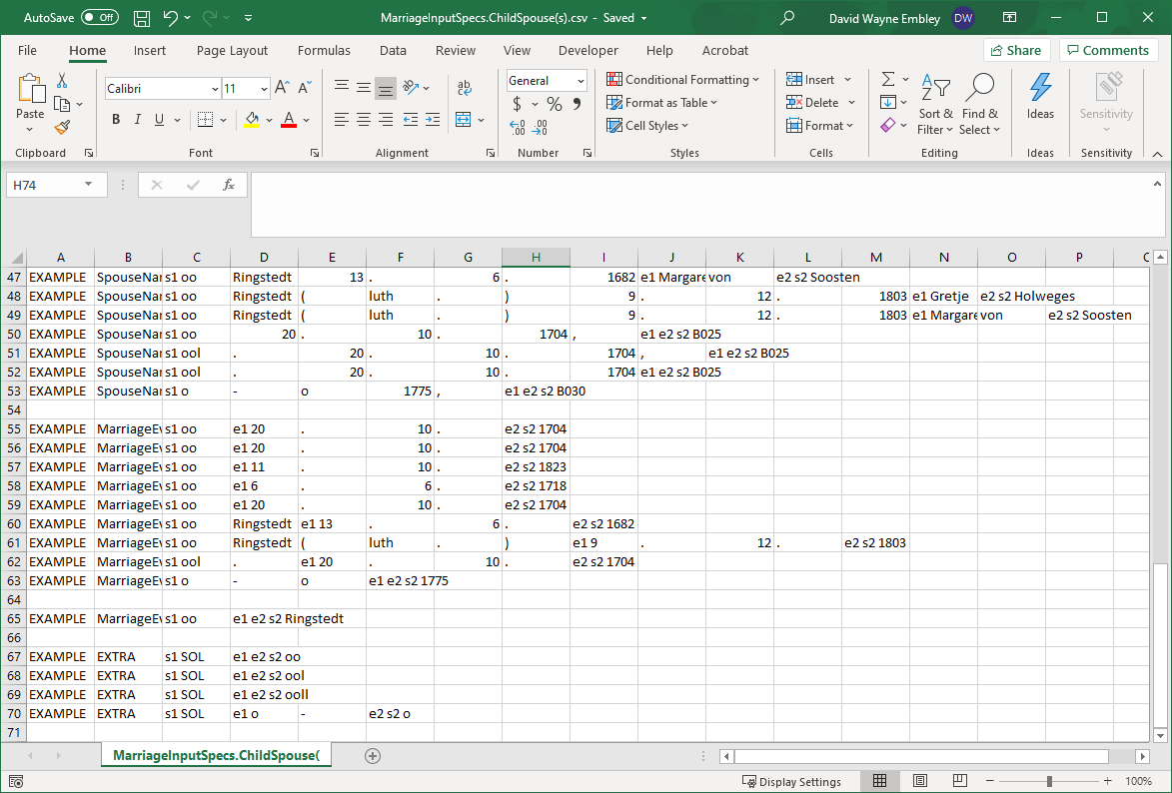
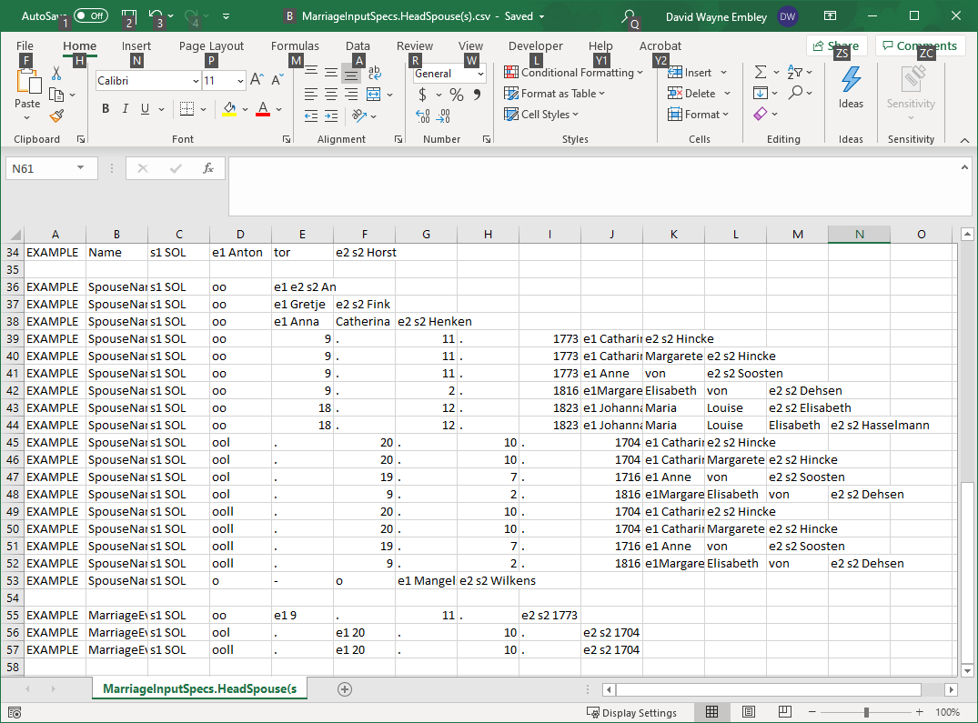
GreenQQ UI: Quick Start Mockup
Notes:
Since we have overlap, we have two template sets: one for household head spouses and one for household child spouses.
Because we are trying to incorporate some of the features of GN’s v2, I have tried to avoid having right context, which could be used at the end of every child template to say that all field info must be on one and only one line. However, there are a lot of different endings and we would have to replicate every SpouseName, MarraigeEventDate, and MarriageEventPlace template n times for n different endings. Rather than do so, we choose to add a stopper, EXTRA, as GN did in v2 – EXTRA because all extra field after EXTRA in a GreenQQ record are to be ignored. (I’ll need to adjust my postprocessing, but I would have had to do this anyway if we were to directly use v2.)
Important question!!: Can we automatically separate the set of household Marriage templates from the set of child Marriage templates?

Slide 84
GreenQQ UI: Quick Start Mockup
…
Casten Böse
Claus Ü
Parent 2
ChildOf Record
Hans
B025
Rathje
Parent 1
Trin Lisbeth
Anna Maria Hink
Könke Ütjen
Anne von Soosten
Gerd Mohr
Casten Böse
Gender Designator
Person Record
Hans
Rathje
Trin Lisbeth
Anna Maria Hink
Könke Ütjen
Anne von Soosten
Gerd Mohr
Birth Date
Birth Place
Christening Date
Christening Place
Death Date
Death Place
Burial Date
Burial Place
Notes:
Child spouses do not carry down (they are not household persons, i.e. not primary persons for which for which ChildOf parents and Person vitals are to be obtained).
We do not pick up parents of spouses nor do we pick up vital information. Similarly, below we do not carry down Parent1 and Parent2 and we don’t pick up additional information for them.
Note that the OCR error, ü instead of Ü, prevents us from getting all of “Claus Ü.”.
Note that “Kirchspiels Flögeln is labeled as a Child. I can’t see how this could have happened. The Check file reports that this was recognized by template T29: | EXAMPLE | Child | s1 Kind | : | e1 Jochen | e2 s2 Michel |
Notes about apparent GreenQQ coding errors (otherwise unexplainable)
T29: “EXAMPLE Child s1 Kind : e1 Jochen e2 s2 Michel” recognizes “Kirchspiels Flögeln” as a child in ChildOf
And some more: Itken, Itjen, Ksp, all T28:
We can and probably should take care of the Itken and Itjen by properly adding book-specific name forms.
Currently, the other two won’t hurt us because we’ll discard them when we postprocess records.
These errors will likely carry over to Person, but likewise shouldn’t hurt us on this page but could if vital properties follow them.

Slide 85
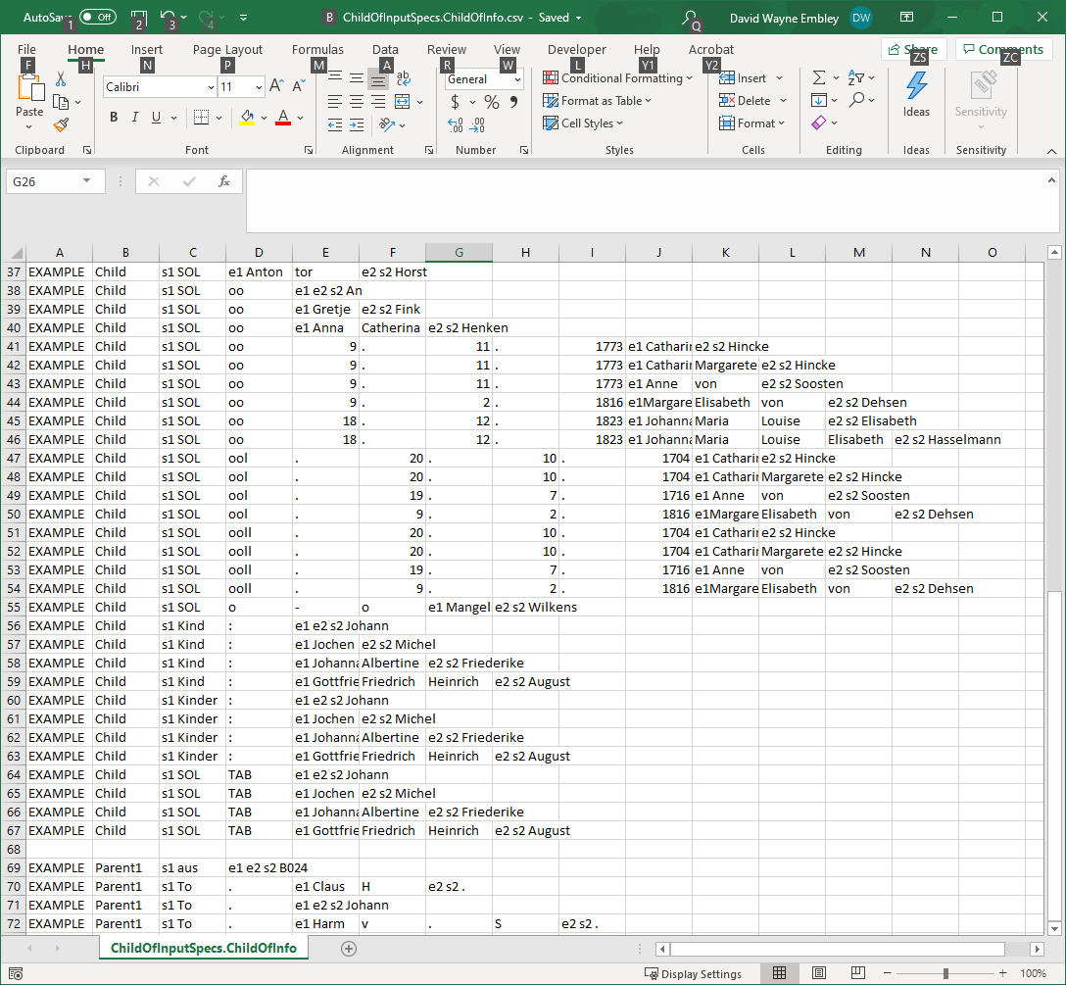
GreenQQ UI: Quick Start Mockup
T28
T29
Notes:
Here are T28 and T29 for the notes above (copied here):
Note that “Kirchspiels Flögeln is labeled as a Child. I can’t see how this could have happened. The Check file reports that this was recognized by template T29: | EXAMPLE | Child | s1 Kind | : | e1 Jochen | e2 s2 Michel |
Notes about apparent GreenQQ coding errors (otherwise unexplainable)
T29: “EXAMPLE Child s1 Kind : e1 Jochen e2 s2 Michel” recognizes “Kirchspiels Flögeln” as a child in ChildOf
And some more: Itken, Itjen, Ksp, all T28:
We can and probably should take care of the Itken and Itjen by properly adding book-specific name forms.
Currently, the other two won’t hurt us because we’ll discard them when we postprocess records.
These errors will likely carry over to Person, but likewise shouldn’t hurt us on this page but could if vital properties follow them.

Slide 86
GreenQQ UI: Quick Start Mockup
…
Casten Böse
Claus Ü
Parent 2
ChildOf Record
Hans
B025
Rathje
Parent 1
Trin Lisbeth
Anna Maria Hink
Könke Ütjen
Anne von Soosten
Gerd Mohr
Casten Böse
To.
Person Record
Hans
Wwr.
Rathje
Gender Designator
Trin Lisbeth
Anna Maria Hink
Könke Ütjen
Anne von Soosten
Gerd Mohr
ca. 1644
Birth Place
25.10.1705
Christening Place
6.8.1688
Christening Date
11.11.1775
Birth Date
10.2.1752
Death Place
11.4.1727
Burial Place
ca. 1715
Burial Date
Death Date
Notes:
Click on BirthDates “ca 1644”, “11.11.1775”, and the date in “(*) 11.11.1775” (this last one may need adjustment after the first heuristic guess about the left context); on ChristeningDate 25.10.1705; on DeathDates “10.2.1752”, “ca. 1715” and 11.8.1828 (for “Lintig 11.8.1828); on BurialDate “11.4.1727”; and on GenderDesignators “To.” and “Wwr.”
Note that we are missing a couple of BurialDates: An on 6.5.1719 and Casten on 9.11.1705. These were OCR’d incorrectly and an attempt to fix them as a box failed (and so they were set to D). We should be able to fix this OCR error with ABBYY.

Slide 87
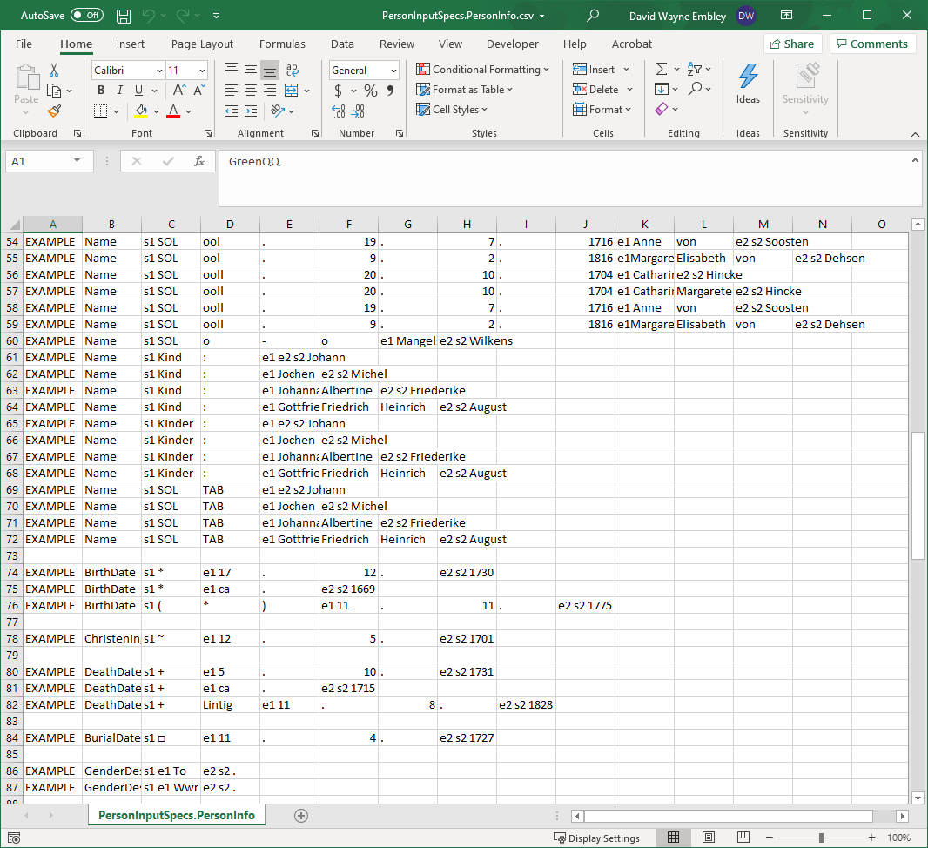
GreenQQ UI: Quick Start Mockup

Slide 88
GreenQQ UI: Quick Start Mockup
Notes
OCR errors that probably shouldn’t be corrected
The letter “l” for “I” in “oll” (small letter “l” is almost indistinguishable from capital letter “I”)
The actual big centered dot in place of * (perhaps the dot should be changed to *)
Further corrections of OCR errors discovered at this stage of work:
ü instead of Ü
Some □’s were OCR’d incorrectly; we were unable to correct them as □’s and made them “D” instead.
PDFindexer errors
Cl aus (shouldn’t be corrected as an OCR error (which it isn’t), nor as an extraction error (which it isn’t)
The “1” on a line by itself should be corrected as an OCR error of the comma following 1704.
Author and typesetting errors, inconsistencies, or potentially confusing nomenclature
The author’s use of “* aus B025”, for example, could confuse GreenQQ because of the unnecessary *.
Inconsistencies will cause us to create otherwise unnecessary templates.
Typos can possibly be corrected like OCR error corrections.
Apparent GreenQQ coding errors (otherwise unexplainable)
T29: “|EXAMPLE|Child|s1 Kind|:|e1 Jochen|e2 s2 Michel|” recognizes “Kirchspiels Flögeln” as a child in ChildOf. And T28 recognizes: Itken, Itjen, and Ksp.
We can and probably should take care of the Itken and Itjen by properly adding book-specific name forms. Currently, the other two won’t hurt us because we’ll discard them when we postprocess records; but if they are coding errors, they should be corrected.
Notes:
The “1” on a line by itself is positioned there by the PDFindexer (see FloegelnOFG.015.txt). But note that on the line above, the comma following “20.10.1704” is missing. Presumable it was OCR’d as a “1” and because in the image it protrudes below the baseline a little farther than the other commas in the line, presumably the PDFindexer made it a line unto itself.

Slide 89
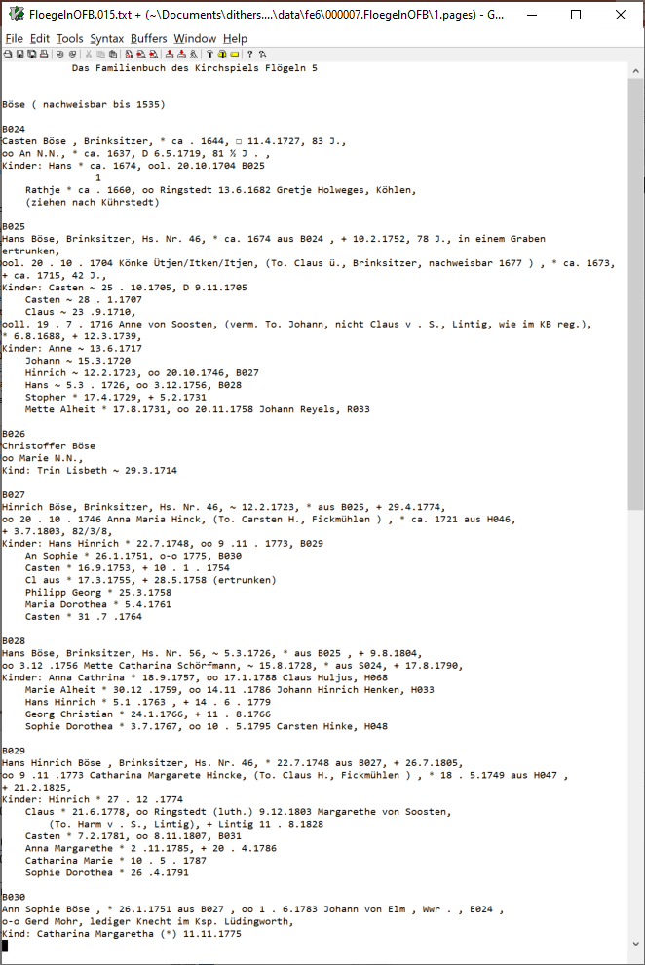
GreenQQ UI: Quick Start Mockup

Slide 90
Extract Entities
8024
Casten Böse
Aggregate Grouping Identifier
Reference ID
Head Name
Casten Böse
Gender Designator
Person Record
An N.N.
Name
ca. 1644
Birth Place
Christening Date
Christening Place
17.4.1729
Birth Date
Death Date
Death Place
Burial Date
Burial Place
Casten Böse
8024
Parent 2
ChildOf Record
Name
H046
Parent 1
Casten Böse
Spouse Name
Marriage Event Date
Marriage Event Place
Name
Marriage Record
Casten Böse
Child
Name
FamilyHousehold Record

Slide 91
Extract Entities
8024
Casten Böse
Aggregate Grouping Identifier
Reference ID
Head Name
Casten Böse
Gender Designator
Vital Information Record
An N.N.
Name
ca. 1644
Birth Place
Christening Date
Christening Place
17.4.1729
Birth Date
Death Date
Death Place
Burial Date
Burial Place
Casten Böse
8024
Parent 2
Parent Record
Name
H046
Parent 1
Casten Böse
Spouse Name
Marriage Event Date
Marriage Event Place
Name
Marriage Record
Casten Böse
Child
Name
Parent-Child Record
aus
8024

Slide 92
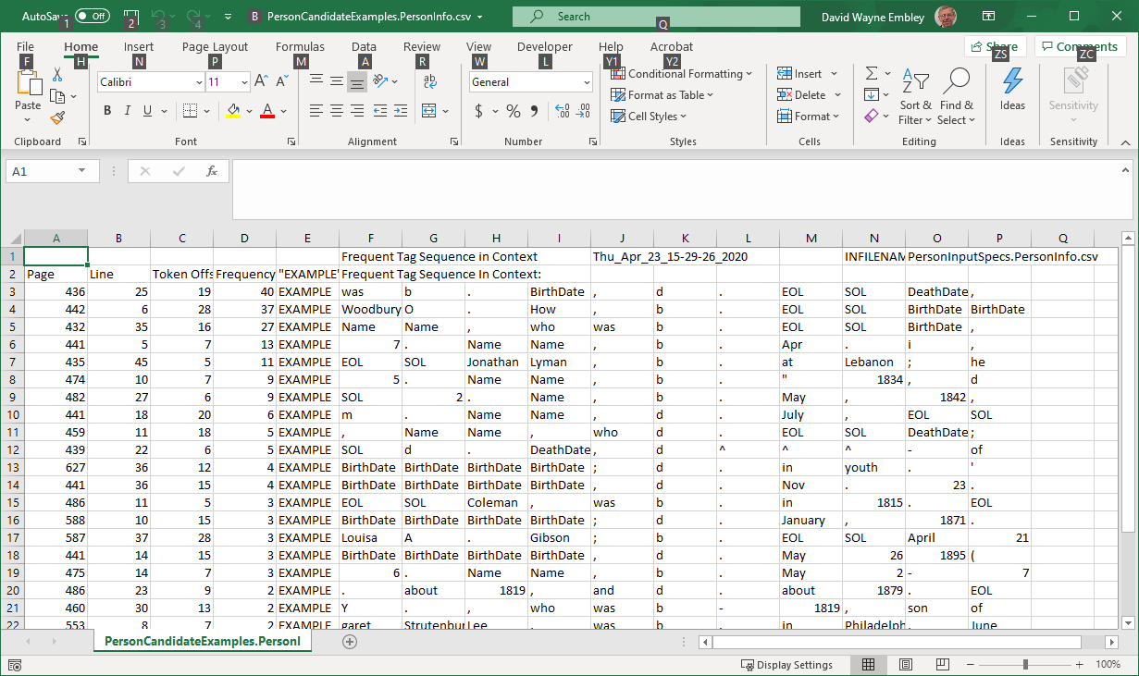
Candidate Examples: the “active learning” component of the GreenQQ UI
Redesign “Candidate Examples” for finding:
Missing Group Heads on Page (too few found on full text page)
Missing ReferenceIDs on Page (too few found on full text page)
Missing Record Heads (run-away Person records)
Missing Extracts (Search Phrase found but no matching Extract)
Missing Search Phrases (Format Variant found, but not labeled)
A Candidate Example is the first of n phrases with identical tag sequences. The importance of a Candidate Example its frequency n and its category as ordered above.
Notes:
The missing SearchPhrase is “b-”

Slide 93
Candidate Examples: the “active learning” component of the GreenQQ UI
Redesign “Candidate Examples” for finding:
Missing Group Heads on Page (too few found on full text page)
Missing ReferenceIDs on Page (too few found on full text page)
Missing Record Heads (run-away Person records)
Missing Extracts (Search Phrase found but no matching Extract)
Missing Search Phrases (Format Variant found, but not labeled)
A Candidate Example is the first of n phrases with identical tag sequences. The importance of a Candidate Example its frequency n and its category as ordered above.
OCR’d text
…
1. George Benjamin, b. 1818, d. 1875, m. 1857 Theresa Dwight.
2. NicoU Fosdick, b. 1821, d. 1851, m. 1844 Frances Elizabeth Smith.
…
FD violation: Name → BirthDate
The missing record head is on page 437 between line 22 / token offset 13 and line 23 / token offset 9
Generated record
…
Name,437,22,4,2,George,Benjamin,BirthDate,437,22,9,1,1818,DeathDate,437,22,13,1,1875,BirthDate,437,23,9,1,1821,DeathDate,437,23,13,1,1851
…

Slide 94
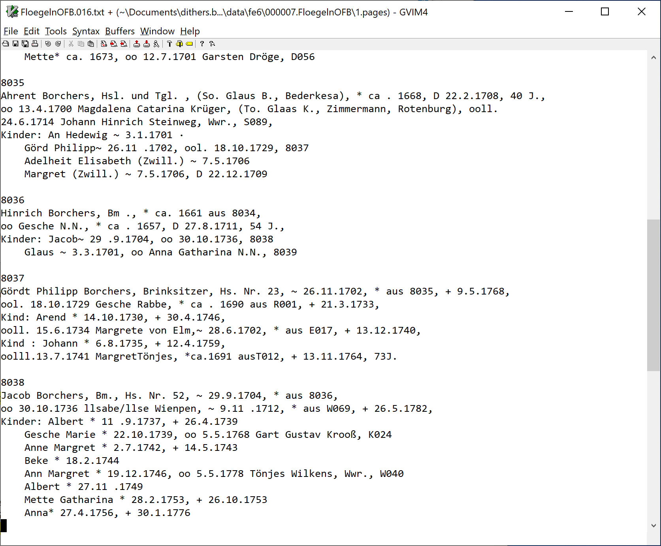
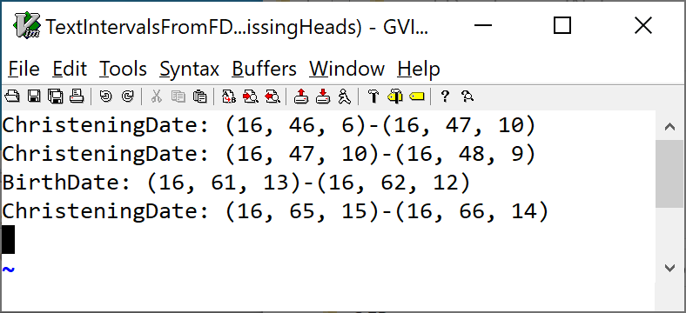
Candidate Examples: the “active learning” component of the GreenQQ UI
Missing Record Heads
A run over pages 15 & 16 found the following four missing Person record heads.
A run over the full book found 471 missing Person record heads.
Notes:
The label goes with the second of the interval pair; the first is just the previous Extract (whatever it happened to be).
I can convert the triples to pairs (page, characterOffset); I can make the bounds tighter by skipping over the characters of the previous Extract and going up to but not including the first character of the current Extract.

Slide 95
Candidate Examples: the “active learning” component of the GreenQQ UI
Missing Record Heads (run-away Family records)
Redesign “Candidate Examples” for finding:
Missing Group Heads on Page (too few found on full text page)
Missing ReferenceIDs on Page (too few found on full text page)
Missing Record Heads (run-away Person records)
Missing Extracts (Search Phrase found but no matching Extract)
Missing Search Phrases (Format Variant found, but not labeled)
A Candidate Example is the first of n phrases with identical tag sequences. The importance of a Candidate Example its frequency n and its category as ordered above.
133552. Mary Peck, b. 1811, dau. of Peter Peck and Sarah Lewis
Colgrove; m. 1838, Daniel Campbell, Columbus Grove, Putnam Co., O.,
b. 1812, son of Richard Campbell and Susannah Lautz. Their children:
1. Chauncey, b. 1839.
2. Lewis, b. 1841, d. 1843.
3. Isaac, b. 1843.
4. Richard, b. 1844.
5. Sarah Ann, b. 1847.
6. Susan Maria, b. 1849, d. i860.
133553- Esther Peck, Winterset, Madison Co., Iowa, b. 1813, dau. of
Peter Peck and Sarah Lewis Colgrove; m. 1833, John Kitchell, Palmy-
ra, la., b. 1809, d. i860, son of Joseph Kitchell and Nancy Kitchell.
Their children :
1. Lucy Ann, b. 1834.
2. Sarah Ellen, b. 1836, d. 1839.
3. Nancy Jane, b. 1838.
4. Charles Wesley, b. 1840.
5. Aaron, b. 1842.
6. Harriet, b. 1844.
7. James, b. 1846.
8. Mary Elizabeth, b. 1848.
g. Esther Eliza, b. 1849.
10. John Whitney, b. 1851, d. 1853.
133556. Sarah Ann Peck, b. 1823, d. 1881, dau. of Peter Peck and
12. Zebulon DeForest b. 1852, m., ist, 1874, Clara Vanola Major; m., 2nd,
1878, Mamie Anne Souder.
Appleton's Cyclopaedia of American Biography has the following
notice of Ezra S. Ely, which is sufficiently interesting to be quoted in full :
…
Omitted
THE ELY ANCESTRY. 301
SIXTH GENERATION.
Washington College, Tenn., gave him the degree of D. D. He was the
author of many valuable and well-known religious works and works of instruction
and explanation in regard to the Scriptures.
24^^2- Elislia Mills Ely, Paris, France, b. 1787, d. 1832, son of
Zebulon Ely and Sarah Apame Mills; m. 1818, Catherine Elizabeth
Boode, Paris, France, who was b. 1800, d. 1876, dau. of Edward Gustave
Parent1,510,18,4,2,Mary,Peck,Child,510,21,4,1,Chauncey,Child,510,22,4,1,Lewis,Child,510,23,4,1,Isaac,Child,510,24,4,1,Richard,Child,510,25,4,2,Sarah,Ann,Child,510,26,4,2,Susan,Maria,Child,510,31,4,2,Lucy,Ann,Child,510,32,4,2,Sarah,Ellen,Child,510,33,4,2,Nancy,Jane,Child,510,34,4,2,Charles,Wesley,Child,510,35,4,1,Aaron,Child,510,36,4,1,Harriet,Child,510,37,4,1,James,Child,510,38,4,2,Mary,Elizabeth,Child,510,40,4,2,John,Whitney
Name,434,29,4,2,Zebulon,DeForest,MarriageEventDate,434,29,15,1,1874,SpouseName,434,29,17,3,Clara,Vanola,Major,MarriageEventDate,434,30,2,5,1878,SpouseName,434,30,6,3,Mamie,Anne,Souder,MarriageEventDate,435,7,11,1,1818,SpouseName,435,7,13,3,Catherine,Elizabeth,Boode
Notes:
Line 26 to line 31 is a bigger gap than 1 -- the typical gap when there is no page break in between children.
The gap between the 2nd and 3rd SpouseName is huge (22 lines) and there is also a page break whereas the gap between the first two SpouseNames is just 1 line. More typically the gap between two legitimate SpouseNames is a couple of lines, whereas the gap between a correct and incorrect SpouseName is a half dozen lines or so when there are no children for the in the first family and a half dozen or so plus n lines when there are n listed children. (Note that this is for Ely’s household; Flögeln is different.)

Slide 96
Candidate Examples: the “active learning” component of the GreenQQ UI
8024
Casten Böse, Brinksitzer, * ca. 1644, □ 11.4.1727, 83 J.,
oo An N.N., * ca. 1637, □ 6.5.1719, 81 ½ J.,
Kinder: Hans* ca. 1674, ool. 20.10.1704, 8025
Rathje * ca. 1660, oo Ringstedt 13.6.1682 Gretje Holweges Köhlen
(ziehen nach Kührstedt) ' '
8025
Hans Böse, Brinksitzer, Hs. Nr. 46, * ca. 1674 aus 8024, + 10.2.1752, 78 J., in einem Graben
ertrunken,
ool. 20.10.1704 Könke Ütjen/ltken/ltjen, (To. Claus 0., Brinksitzer, nachweisbar 1677), * ca. 1673,
+ ca . 1715, 42 J.,
Kinder: Casten ~ 25.10.1705, □ 9.11 .1705 ‘
Gasten ~ 28.1 .1707
Claus ~ 23.9.1710,
ooll. 19.7.1716 Anne von Soosten, (verm. To. Johann, nicht Claus v. S., Lintig, wie im KB reg.),
* 6.8.1688, + 12.3.1739,
Kinder: Anne ~ 13.6.1717
Johann ~ 15.3.1720
Hinrich ~ 12.2.1723, oo 20.10.1746, 8027
Hans~ 5.3.1726, oo 3.12.1756, 8028
Stopher* 17.4.1729, + 5.2.1731
Mette Alheit * 17.8.1731, oo 20.11.1758 Johann Reyels, R033
8026
Christoffer Böse
oo Marie N.N.,
Kind: Trin Lisbeth ~ 29.3.1714
8027
Hinrich Böse, Brinksitzer, Hs. Nr. 46, ~ 12.2.1723, * aus 8025, + 29.4.1774,
oo 20.10.1746 Anna Maria Hinck, (To. Carsten H., Fickmühlen),* ca. 1721 aus H046,
+ 3.7.1803, 82/3/8,
Kinder: Hans Hinrich * 22.7.1748, oo 9.11.1773, 8029
An Sophie * 26.1.1751, o-o 1775, 8030
Gasten* 16.9.1753, + 10.1.1754
Glaus * 17.3.1755, + 28.5.1758 (ertrunken)
Philipp Georg * 25.3.1758
Maria Dorothea * 5.4.1761
Gasten* 31.7.1764
8028
Hans Böse, Brinksitzer, Hs. Nr. 56, ~ 5.3.1726, * aus 8025, + 9.8.1804,
oo 3.12.1756 Mette Catharina Schörfmann, ~ 15.8.1728, * aus S024, + 17.8.1790,
Kinder: Anna Cathrina * 18.9.1757, oo 17.1.1788 Claus Huljus, H068
Marie Alheit * 30.12.1759, oo 14.11 .1786 Johann Hinrich Henken, H033
Hans Hinrich * 5.1.1763, + 14.6.1779
Georg Christian * 24.1.1766, + 11.8.1766
Sophie Dorothea * 3.7.1767, oo 10.5.1795 Garsten Hinke, H048
8029
Hans Hinrich Böse, Brinksitzer, Hs. Nr. 46, * 22.7.1748 aus 8027, + 26.7.1805,
oo 9.11.1773 Catharina Margarete Hincke, (To. Claus H., Fickmühlen),* 18.5.1749 aus H047,
+ 21.2.1825,
Kinder: Hinrich * 27.12.1774
Claus * 21 .6.1778, oo Ringstedt (luth.) 9.12.1803 Margarethe von Soosten,
(To. Harm v. S., Lintig), + Lintig 11.8.1828
Casten * 7.2.1781, oo 8.11.1807, 8031
Anna Margarethe * 2.11.1785, + 20.4.1786
Catharina Marie * 10.5.1787
Sophie Dorothea * 26.4.1791
8030
Ann Sophie Böse, * 26.1.1751 aus 8027, oo 1.6.1783 Johann von Elm, Wwr., E024,
o-o Gerd Mohr, lediger Knecht im Ksp. Lüdingworth,
Kind: Catharina Margaretha (*) 11.11.1775
Redesign “Candidate Examples” for finding:
Missing Group Heads on Page (too few found on full text page)
Missing ReferenceIDs on Page (too few found on full text page)
Missing Record Heads (run-away Person records)
Missing Extracts (Search Phrase found but no matching Extract)
Missing Search Phrases (Format Variant found, but not labeled)
A Candidate Example is the first of n phrases with identical tag sequences. The importance of a Candidate Example its frequency n and its category as ordered above.
The Extract token for HouseholdId based on the example “A001” is AlphaNum, which matches six on the A001 page and none of a possible seven on the 8024 page (page 15).
Abel
A001
Michel Abel, Müller, Fickmühlen,
oo Ann Dorthe N.N.,
Kind: Jochen Michel* 17.12.1730, + 5.10.1731
Ahrens
A002
Johann Ahrens, Brinksitzer, Hs. Nr. 1, * ca. 1669, + 3.4.1729, 60 J.,
Notes:
OCR errors: 8 for B, 0 for D, 0 for O and suspected 5 for S.
In Ely, the SearchPhrase “NUM .” doesn’t match “NUM –” which comes up quite often.

Slide 97
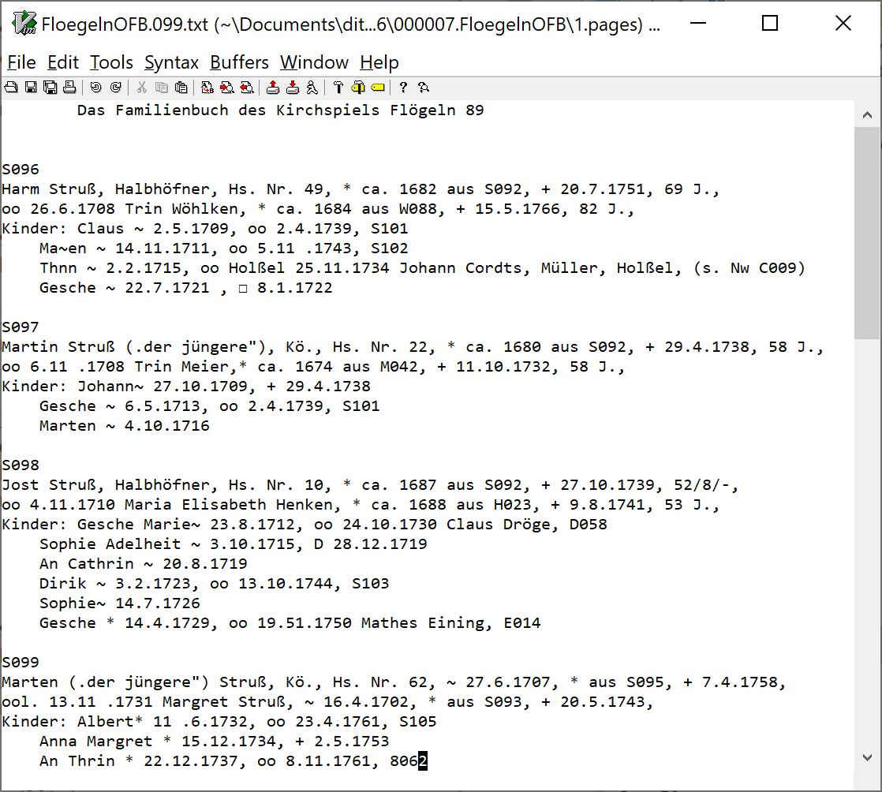
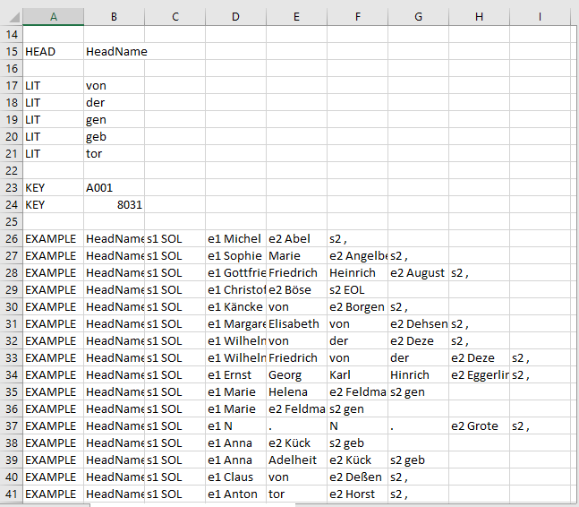
Candidate Examples: the “active learning” component of the GreenQQ UI
Redesign “Candidate Examples” for finding:
Missing Group Heads on Page (too few found on full text page)
Missing ReferenceIDs on Page (too few found on full text page)
Missing Record Heads (run-away Person records)
Missing Extracts (Search Phrase found but no matching Extract)
Missing Search Phrases (Format Variant found, but not labeled)
A Candidate Example is the first of n phrases with identical tag sequences. The importance of a Candidate Example its frequency n and its category as ordered above.

Slide 98
Candidate Examples: the “active learning” component of the GreenQQ UI
Missing Group Heads and Missing Reference IDs
19
79
Threshold: Mean + 2*StandardDeviation

Slide 99
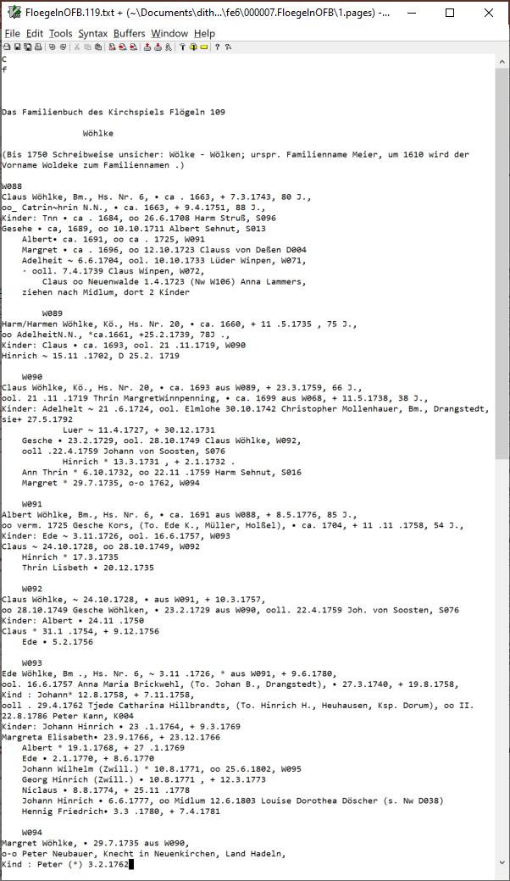

Candidate Examples: the “active learning” component of the GreenQQ UI

Slide 100
Candidate Examples: the “active learning” component of the GreenQQ UI
Notes:
OCR problems.
PDFIndexer issues?

Slide 101
Candidate Examples: the “active learning” component of the GreenQQ UI
4IO THE ELY ANCESTRY.
SEVENTH GENERATION.
157548. Jabez Ely, Dimock, Susq. Co., Pa., b. 1844, son of John
Russell Ely and Lucinda Morgan Giles; m. 1870, Sarah Elizabeth
Gavitt, Dimock, Pa., who was b. 1853, dau. of Prentice Avery Gavitt
and Enimeline Scott Parks. Their children:
1. Arthur Marvin, b. 1872.
2. Bertie Leroy, b. 1875.
3. Edith May, b. 1878.
157549- John Russell Ely, Brooklyn, Pa., b. 1848, son of John
Russell Ely and Lucinda Morgan Giles ; m. 1876, Helen Bissell, Brook-
lyn, Pa., who was b. 1856, dau, of Charles Bissell and Fannie Smith.
Their children :
1. Blanche Gertrude, b. 1877.
2. Martin Augustus, b. 1878.
157551- Isaac Zelophehad Babcock, Montrose, Susq. Co., Pa., who
was b. 1825, son of Parnal Ely and Francis Mitchell Babcock ; m. 1853,
Sarah Ann Allen, who was b. 1825. No children.
157552. Priscilla Walker Babcock, Poultney, Rutland Co., Vt., b.
1831, dau. of Parnal Ely and Francis Mitchell Babcock; m. Joseph Fox
Crosby, Rockford, 111., who was b. 1828, d. 1861 ; m, 2nd, George L.
Bliss, M.D., Poultney, Vt.
157553- Noyes EHab Babcock, Rockford, 111., b. 1833, son of Par-
nal Ely and Frances Mitchell Babcock; m. 1865, Harriet Eloise Crosby,
Rockford, 111., who was b. 1836, dau. of Asa Crosby and Mary Wood
Howe. Their children :
1. Herbert Mitchell, b. 1867.
2. Mary Caroline, b. 1869.
3. Cora Alice, b. 1871.
157554. Amy Elizabeth Babcock, Rockford, III, b. 1835, d. 1875,
dau. of Parnal Ely and Francis Mitchell Babcock; m. 1852, George
Duryea Goodsell, Box 256, DeKalb, 111., who was b. 1830, son of William
liisington Goodsell and Julia Ann Knox. Their children :
1. Albert Mortimer, b. 1854 ; m. 1880.
2. Carrie Louisa, b. 1856; m. 1881.
3. Stella May, b. 1858 ; d. 1866.
4. Minnie Mary, b. 1864.
157555- Lyman Francis Babcock, M.D., Deadwood, South Dakota,
b. 1838, son of Parnal Ely and Francis Mitchell Babcock; m. 1865,
Page | Frequency | Example
 |  | Missing Major Group Header Names:
562 |  | Others expected on page besides those found
510 |  | , b. 1849 … Their children: 1.
434-5 |  | . Appleton’s Cyclopaedia … m. 1818,
 |  | Missing Record Header Names:
437 |  | , m. 1857 Theresa Dwight. \ 2. NicoU Fosdick, b.
 |  | Missing Data Values:
440 | 32 | m. i860
467 | 13 | William. \
482 | 9 | b. May, 1842,
441 | 6 | d. July, \
 |  | Missing Type Designators
442 | 2 | d- 1839
460 | 2 | b- 1819
Notes:
The tokenized search phrase of all those pointed to is “SOL NUM5+ -”, not the standard “SOL NUM5+ .) because of an OCR error (dash for period)

Slide 102

Candidate Examples: the “active learning” component of the GreenQQ UI
Page | Frequency | Example
 |  | Missing Major Group Header Names:
562 |  | Note: additional header names expected on page
510 |  | , b. 1849 … Their children: 1.
434-5 |  | . Appleton’s Cyclopaedia … m. 1818,
 |  | Missing Record Header Names:
437 |  | , m. 1857 Theresa Dwight. \ 2. NicoU Fosdick, b.
 |  | Missing Data Values:
440 | 32 | m. i860
467 | 13 | William. \
482 | 9 | b. May, 1842,
441 | 6 | d. July, \
 |  | Missing Type Designators
442 | 2 | d- 1839
460 | 2 | b- 1819
Notes:
Here’s a possible layout, but …
The example page and highlighting is for a click on 510

Slide 103

Candidate Examples: the “active learning” component of the GreenQQ UI
Page | Frequency | Example
 |  | Missing Major Group Header Names:
562 |  | Note: additional header names expected on page
510 |  | , b. 1849 … Their children: 1.
434-5 |  | . Appleton’s Cyclopaedia … m. 1818,
 |  | Missing Record Header Names:
437 |  | , m. 1857 Theresa Dwight. \ 2. NicoU Fosdick, b.
 |  | Missing Data Values:
440 | 32 | m. i860
467 | 13 | William. \
482 | 9 | b. May, 1842,
441 | 6 | d. July, \
 |  | Missing Type Designators
442 | 2 | d- 1839
460 | 2 | b- 1819
Notes:
Here’s a possible layout, but …
The example page and highlighting is for a click on 440

Slide 104
Determination of birth surnames
Wöhlken
Notes:
“Sophia Catharina” -- Resolvable (with effort): cross-page personas with cross-page father-child relationships (unknown father in second persona record, but known father when combined with first persona record)
“Wöhlke/Wöhlken”-- Unresolvable (author-inconsistencies): spelling – which is correct? (as a consequence, Sophie Wilhelmine’s birth name becomes “Sophie Wilhelmine Wöhlke Wöhlken” because when I get the birth surname from the father, I then check to see if it is the same as the last name of the child, if not, I add it as I do here)
“geb. Dröge” -- Unresolvable? (extraction and reasoning limitations): lots of work both extraction and reasoning to resolve.
“H.”-> “”Hildebrandt” -- Resolvable (ignoring author assumptions about the reader): don’t extract father; but then we miss an important link to the father, which is evidently not mentioned elsewhere in the book (not clear to me what to do … recommendations? Ideally, we would extract the father and resolve the father’s surname by unabbreviation)

Slide 105
Names rendered differently by author
Notes:
“Thrin” is by itself a given name that appears several times in Flögeln; here it appears to be a shortened form of “Catharina” (perhaps it always is).
Compound surnames are difficult to deal with; in all culturals over all variations, I suspect there are numerous variations. I can probably get Flögeln names with just “von” and “von der” and “tor” and ??; should I?
So, presumably, Anne is the daughter of Johann, not Claus as stated in the KB register. Not something we are likely to be able to extract

Slide 106
Click on the name of the primary person in any one of the major groups. Repeat for nested groups, if any.
Notes:
Initially, the patron record template has the focus on Name (rename?: PersonName or PrimaryPersonName) with the rest of the record template greyed out.
The SearchPhrase (in yellow and outlined with blue) is associated with the one PrimaryPersonName clicked on. (If the SearchPhrase yields incorrect results, it can be adjusted by the patron.)
The patron could have also included the title “Rev.” – because we can include titles (or not) in our external-representation specifications, this should work either way.
“Aitken (Akin)” would likely not be in our ext-rep specs. The user should add it. The pattern then becomes part of the book-specific ext-rep specs for a primary person name.
Note that we have a really ugly problem with Kilbarchan “W. Richard Allasone”. The book author has not been consistent: the last-name-comma pattern has been violated, and the line is formatted as a wrap-around line with one tab of indentation. If these problems are recognized, they can likely be remedied by adding yet another SearchPhrase and ext-rep pattern – “likely” because this kind of thing may upset the apple cart. Also, we’re not likely to be able to help the user find these kinds of issues. Not finding and resolving these issues can cause problems – here, the spouse, Ninian Aitkine, would become a second spouse of Thomas Aitkine.

Slide 107

Click on the name of the primary person in any one of the major groups. Repeat for nested groups, if any.
Notes:
For nested family groups, the user should check that the declared nesting for the group also holds for other groups in the book. (If not, fix the nesting and keep checking.)
The system should keep track of the level being worked on. In the following for Mullinix, we’re working only on the outer layer until we explicitly shift to an inner level. As we work on an outer label, the inner rectangles and the labeling of inner PrimaryPersons are removed until the explicit shift. (?? We may not want to remove the inner bounding boxes.)

Slide 108
Click on the name of a child of any primary person and continue clicking on children of primary persons until all are highlighted.
Notes:
Note that with one click we get all the Ely children and all but one of the Kilbarchan children – the missing twin.
Clicking on the twin gets it. The SearchPhrase for William, the second twin, is “and <Name> , NUM1or2” – here and elsewhere “and” should be a literal. The rule I’m thinking of for declaring a SearchPhrase here is go both left and right until one non-punctuation token is encountered and also include the next tokens on the left back to StartOfLine if the token preceding the left non-punctuation token is a tab or SOL; in the latter case, we then drop the right context if the Extract is for a non-lexical object, i.e. the Name of a Person, Spouse, or Child. This rule is superseded when we can find a declared SearchPhrase on the left (e.g. “b” or “d” or “sp” or …) An immediate tab on the left for primary persons and children should also supersede, and all tabs should be included in the SearchPhrase – the number of tabs matters.

Slide 109
Click on the name of a child of any primary person and continue clicking on children of primary persons until all are highlighted.
Notes:
Among many others, “daughter” and “sons” are predeclared SearchPhrases.
Also in this example, “grandchildren” is a predeclared EXTRA SearchPhrase. EXTRA SearchPhrases should not be marked for the user. They preempt run-away lists. Here “sons” preempts a “daughter” run-away list, but there is nothing to prevent the “sons” list from also picking up “ARTHUR MORRIS”, “SAM MORRIS”, “Miss ELLA MORRIS”, and “Mrs ADA HARP”.
A subtle point here is that the “Mrs.” is sometimes important. Otherwise “HENRY RANCH” will be designated as ESTER’s child.
In Mullinix, note that the number of tabs distinguishes children from grandchildren and great-grandchildren.

Slide 110
Click on the name of a spouse of any person and then also on any marriage event date and marriage event place. Continue clicking until all spouses and their marriage event date and place are all highlighted.
Notes:
In Kilbarchan, note that many SearchPhrase patterns are necessary. It’s interesting, however, that none violates the rule for generating contextual SearchPhrases – except perhaps the one that ends with an end of line. That one may need to be adjusted by the patron because the default would be the CAP following it on the next line. (Normally, end of lines on the right may cause problems, but not in this case; how can the patron tell the difference?)

Slide 111
Click on the properties of any person, spouse, or child. Continue clicking until all properties of every person, spouse, or child are all highlighted.
Notes:
Here, again, we get properties in inner nesting levels, but we ignore all except the children in the next-most level of nesting.
“m” is ambiguous among forms; it may not matter since in Miller the “m” data will be filled into the Parent2 field whereas in Ely the “m” data will be filled into the SpouseName and MarriageEventDate fields and in Kilbarchan the “m” data will be filled into the MarriageEventPlace and MarriageEventDate fields.
I didn’t try to get patterns for Places; we need to depend as much as we can on data-frame external representations, but that might be difficult. (Thought: I may be able to get a list of places, perhaps just for English- and German-speaking places; then we can tokenize the list and pick out the patterns.) Alternatively, in Miller where we have descriptive place names, we could just pick them up, i.e. get all text between recognized Extracts and recognized SearchPhrases.
“ca.” means something and we should probably process it downstream.
Point-size differences in Mullinix may need some special attention.
Died, with the pattern “1862-1866” is something we don’t handle but could.

Slide 112

Repeat process with next nested group.
Notes:
Within a group, recursively do the same thing. Initially, the highlight on top-level PrimaryPersons is removed and the next inner PrimaryPersons are reset as PrimaryPersons (they are the children of the upper-level PrimaryPerson). The outer bounding boxes are turned black to indicate the content outside the outer-most red bounding boxes is to be ignored when post-processing. Other highlights remain in place and need not be redone.
When post-processing, both outer and inner labels need to be properly handled (ignored or included as appropriate).

Slide 113
… after adding children … spouses and attributes are already in place … and we’re done
Notes:
For post-processing, we need to pay attention to groups. It’s probably not good enough to use functional dependency rules to stop accumulating properties (i.e. a property could be missing and we might end up with the property of a child in the next level of nesting). Sorting out multiple spouses is even more difficult to detect and prevent. In the example above, without boundaries Child Mildred Morgan Mullinix would not only have spouse George O. Shipley but also spouse Walker A. Schwyhart who is acutaly her child’s spouse.

Slide 114
Repeat process with next nested group. … and after one click to label a child, we’re done
Notes:
Note that we do not have the spouse ambiguity for Mildred Morgan Mullinix because Lydia Ann Shipley is recognized as a child at this level of nesting and her spouse is Walker A. Schwyhart.

Slide 115
Extraction-tool testing: Finding Precision Errors
Display red- and yellow-flag indicators, including new indicators with warning messages when the following can be detected
Relationship violations: ??
Entity violations (incorrect classification): ??
Notes:
At the moment I know of none. Once we have the ConstraintEnforcer reconfigured, we’ll look at error reports and see if anything pops up.

Slide 116
Auto-indexing
Can we automatically determine form combinations to run?
We can always run the four forms: Person, ChildOf, Marriage, Family; but only if we can automatically determine Heads. (In Kilbarchan, for example, the father in a family is the Head for Marriage and Family; each Child is a Head for Person; and there is no Head for ChildOf and it need not be run. In Ely, the Heads for Person are the family head, the spous(es), and the children – all three are needed.)
We can reduce the runs if we can determine the right form combinations or that Individual alone will work. (In Kilbarchan, only two runs are necessary because (1) the Heads for Family and Marriage are the same while (2) the Head for Person is not the same.) Also, for Miller, we can combine them all and make one run.
How do we decide which books to Auto-index?
FamilySearch priorities
Can we automatically determine whether a document has the needed semi-structured properties? And, can we automatically classify them?
Record-separable wrt combinations of forms: Person, Child-of, Marriage, Family.
Classification for the auto-indexer requires us to differentiate between nested and non-nested groups as well as form combinations.
Ultimately, we probably need to involve other extraction tools: OntoES and OntoSoar; and then automatically decide which tool to use.
How do we decide whether the target should be CDS or LLS?
Is predetermine by inspection necessary, or can we determine this automatically?
User directed transition to (Scan-to-)submit or Add-to-tree should also be possible.
Notes:
George Nagy has a different way of post-processing to form relationships. His method post-processes linearly but must consider each extract in all its roles. (In Kilbarchan, for example, the children have two roles: Child for Parent-Child relationships and Person for Person-BirthDate and Person-ChristeningDate relationships. It’s not immediately clear which way to go, but the relation-processing code downstream is geared toward the four forms.

Slide 117
Scan-to-submit
Patron submitter finds a person to submit by filling in FamilySearch provided form.
Assuming the search points them to a semi-structured text document, a patron then selects a person to submit and:
Within the [(4 5 6)+] cycle, completes the extraction of information from the document,
Checks and edits (if necessary) the generated and filled-in tree-ready form, and
Submits it to the FamilySearch Tree using standard FamilySearch procedures.
Notes:
Tailoring to FamilySearch procedures makes the process semi-automatic: API calls let the system handle the work of filling in forms, navigating through merge procedures (if needed), and attaching documentation.

Slide 118


Keyword & Semantic Search
Notes:
HyKSS
Keyword Search: standard for specified keywords (also? standard for fielded words, except when semantically superseded (i.e. there is a semantic hit anywhere in the document that involves the entity in a relationship) or when qualified, where qualified, for example, could be “before 1810” or “1805 – 1815” or “within 10 miles of Newark, New Jersey”)
Semantic Search: entities – fuzzy search given that the entity is a name, date, or place (e.g. within alternate name expectations, within a date range, within a longitude/latitude range for a historical place).

Slide 119
Persona Record (no editing needed before submission)

Slide 120

Persona Record (editing needed before submission)
Notes:
Standardized dates and place names should be requested, suggested, and checked.
Can names be checked and standardized?

Slide 121

Persona Record (editing needed before submission)
Notes:
Standardized dates and place names should be requested, suggested, and checked.
Can names be checked and standardized?

